Slide 1
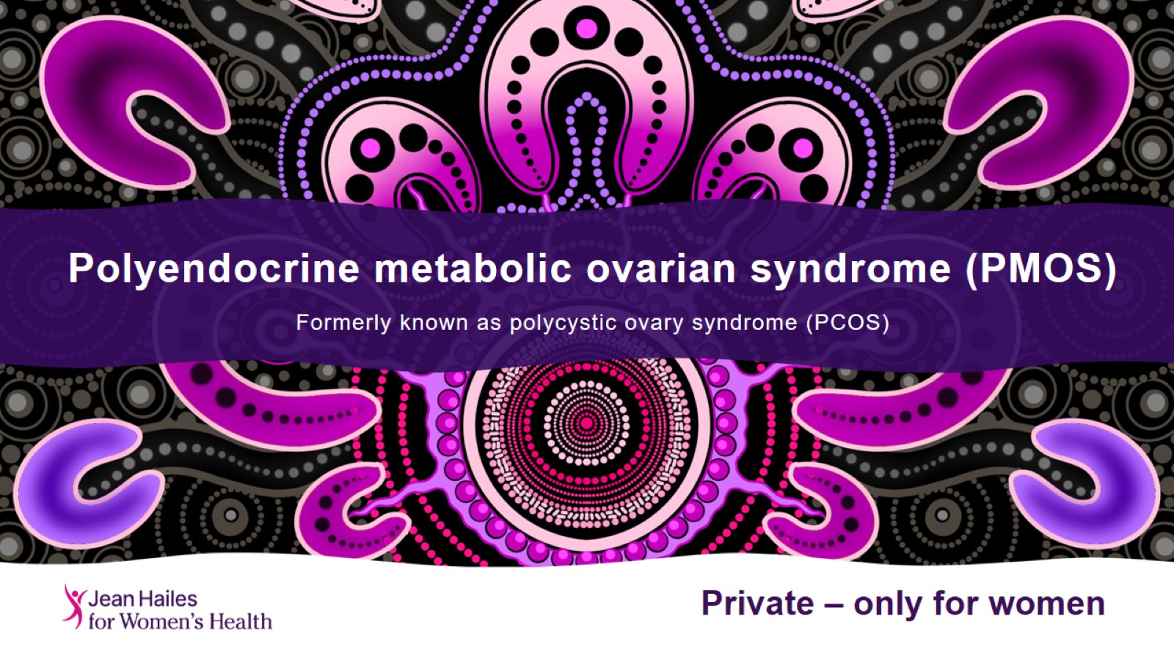
Polyendocrine metabolic ovarian syndrome (PMOS)
Formerly known as polycystic ovary syndrome (PCOS)

Slide 2
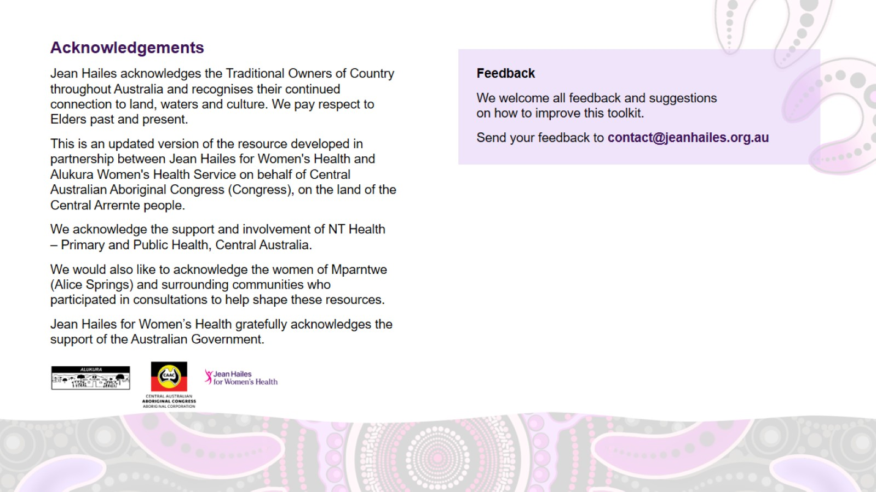
Acknowledgements

Slide 3
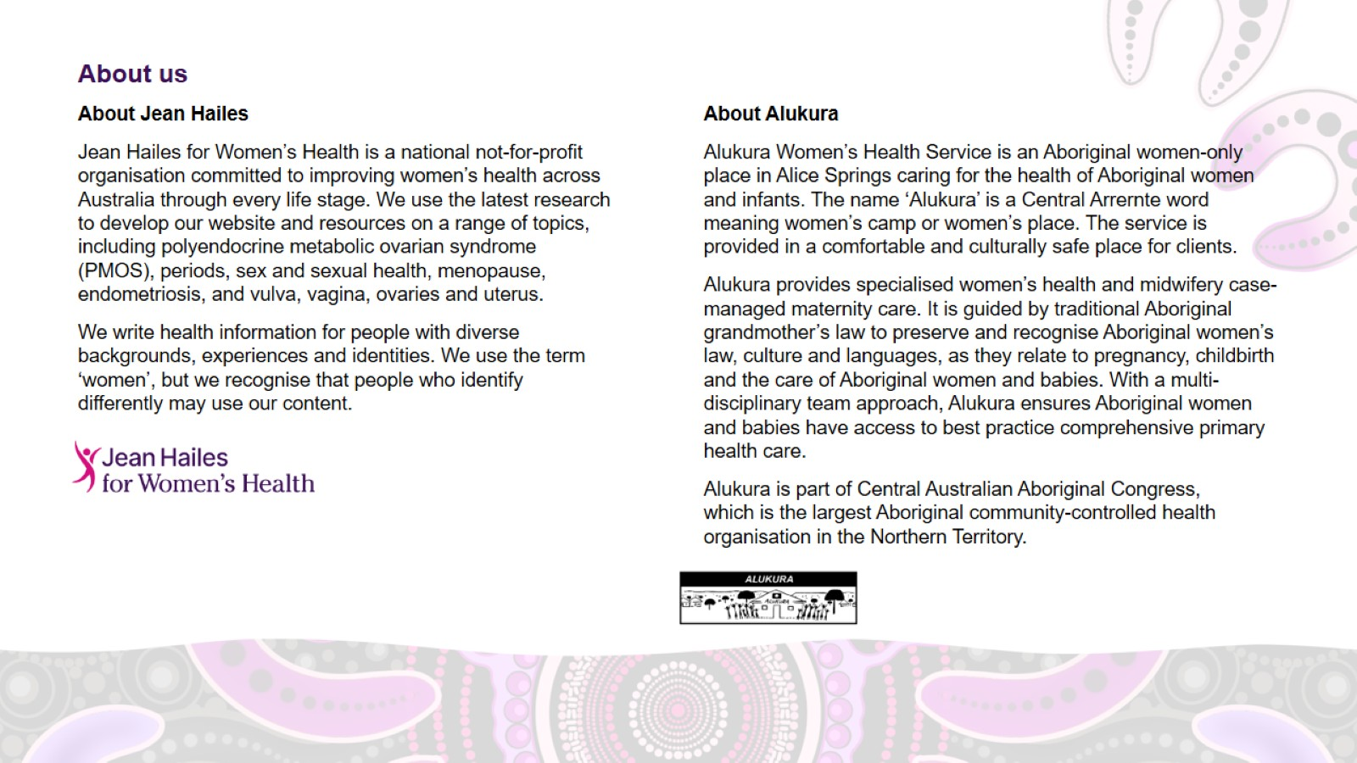
About us

Slide 4
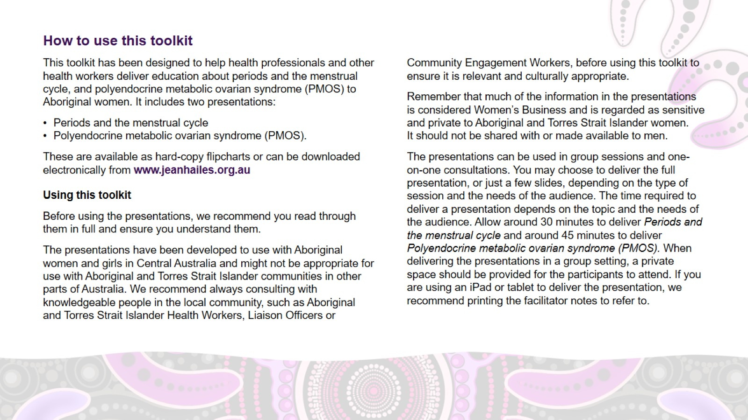
How to use this toolkit

Slide 5
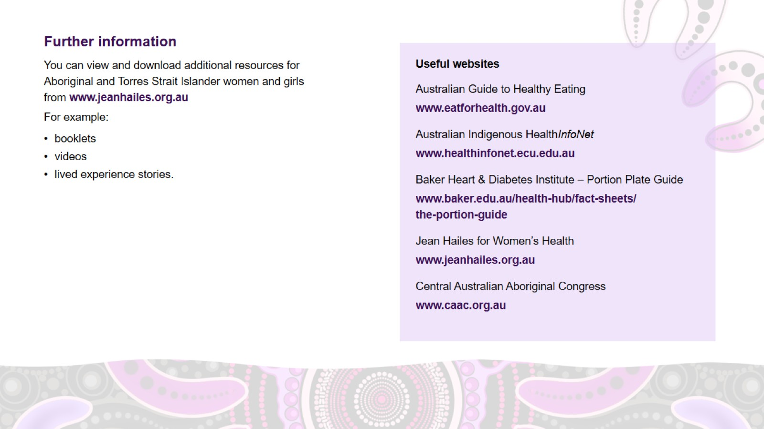
Further information

Slide 6
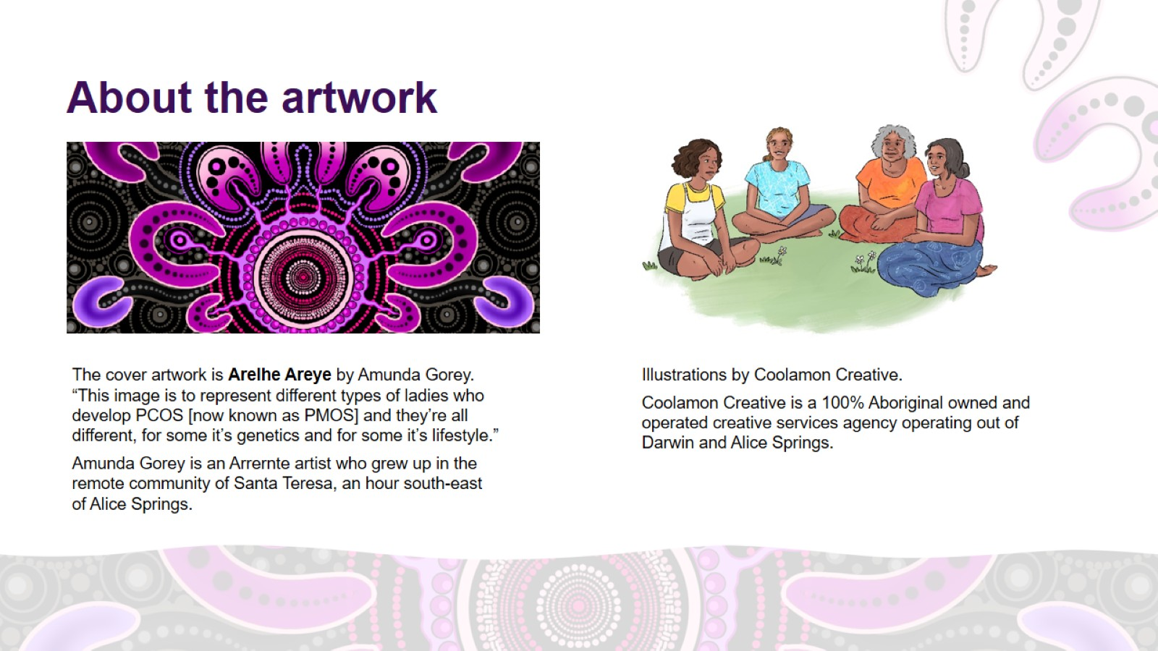
About the artwork

Slide 7
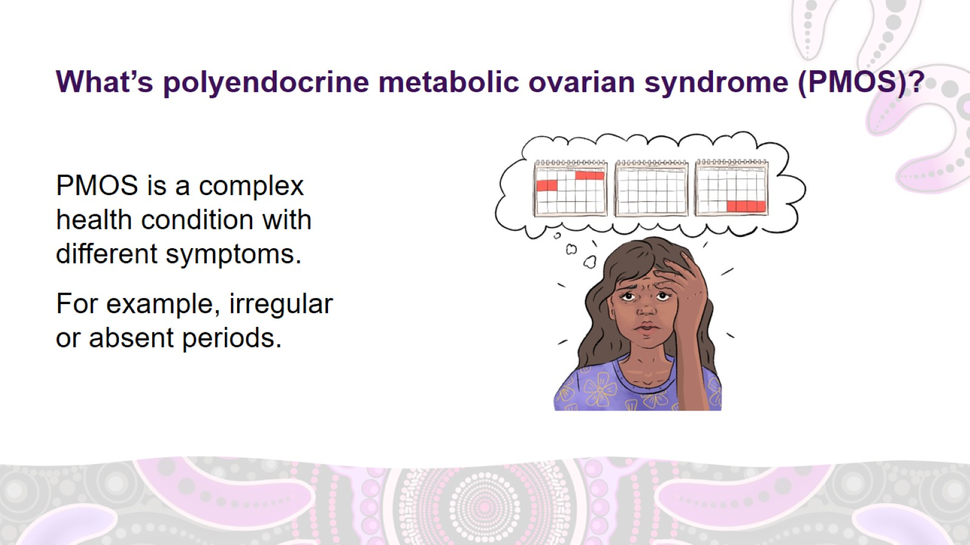
What’s polyendocrine metabolic ovarian syndrome (PMOS)?
Notes:
What’s polyendocrine metabolic ovarian syndrome (PMOS)?
Polyendocrine metabolic ovarian syndrome (PMOS) used to be called polycystic ovary syndrome (PCOS). The new name shows that the condition affects the whole body.
PMOS is a complex health condition with different symptoms, including irregular or absent periods.

Slide 8
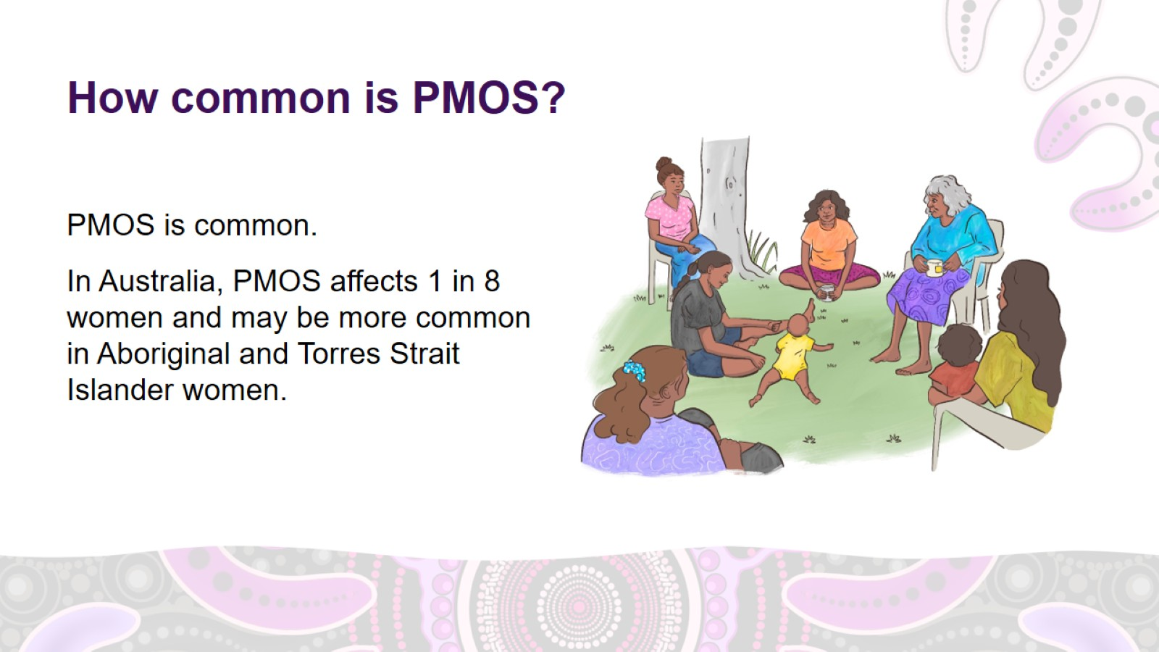
How common is PMOS?
Notes:
How common is PMOS?
PMOS is common.
In Australia, PMOS affects 1 in 8 women and may be more common in Aboriginal and Torres Strait Islander women.

Slide 9
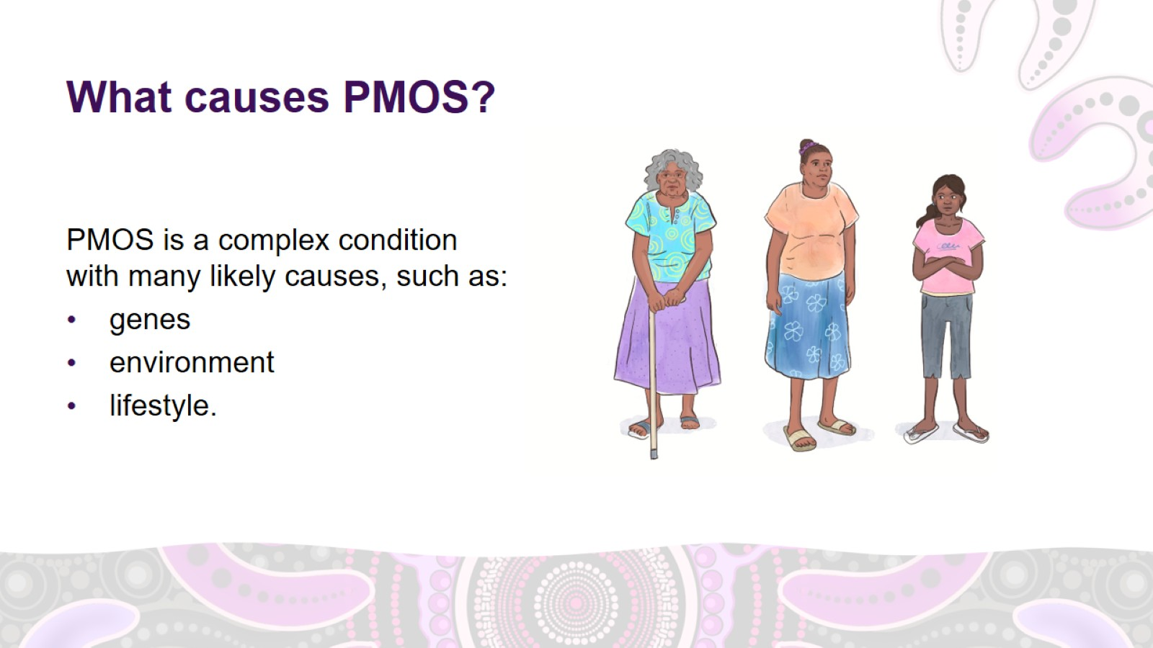
What causes PMOS?
Notes:
What causes PMOS?
PMOS is a complex condition with many likely causes involving women’s:
genes
environment
lifestyle.
Hormonal changes and ovarian changes influence each other, and it’s not clear which one comes first.
Risk factors for PMOS
Some risk factors for PMOS can’t be changed, such as genetics. Risk factors that can be changed include:
smoking
exposure to pollution
an unhealthy diet
not exercising enough
obesity.
But having these risk factors doesn’t mean you will develop PMOS.

Slide 10
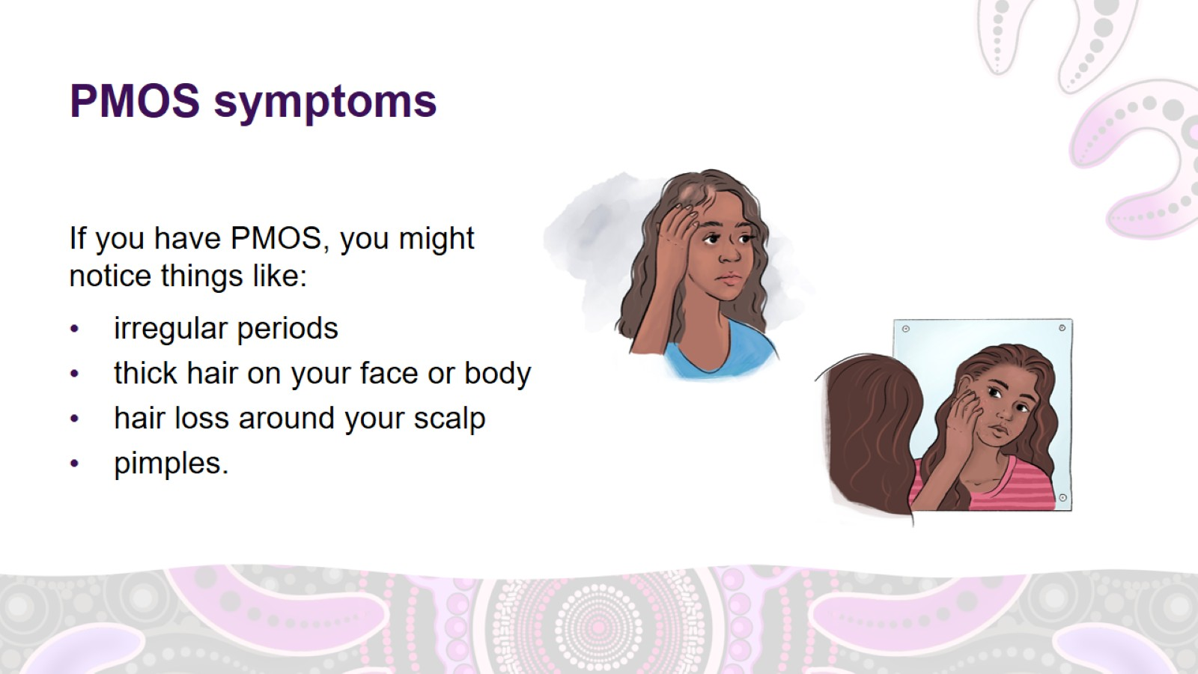
PMOS symptoms
Notes:
PMOS symptoms
If you have PMOS, you might notice symptoms such as:
irregular or no periods
thick hair on your face and body
hair loss around your scalp
pimples.

Slide 11
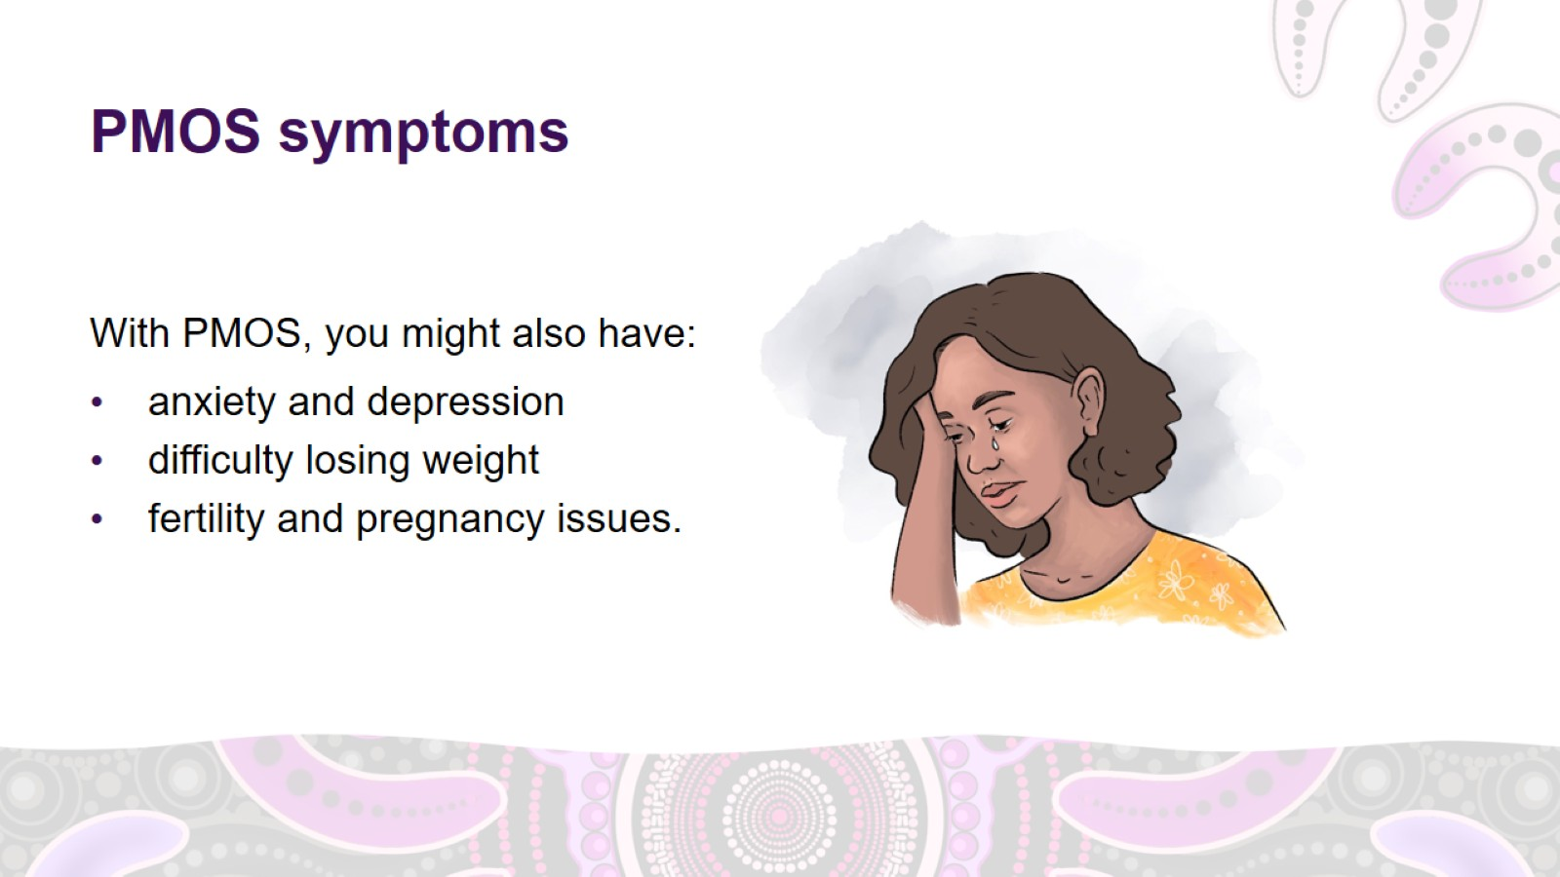
PMOS symptoms
Notes:
PMOS symptoms (continued)
With PMOS, you might also have:
anxiety and depression
difficulty losing weight
fertility and pregnancy issues.

Slide 12
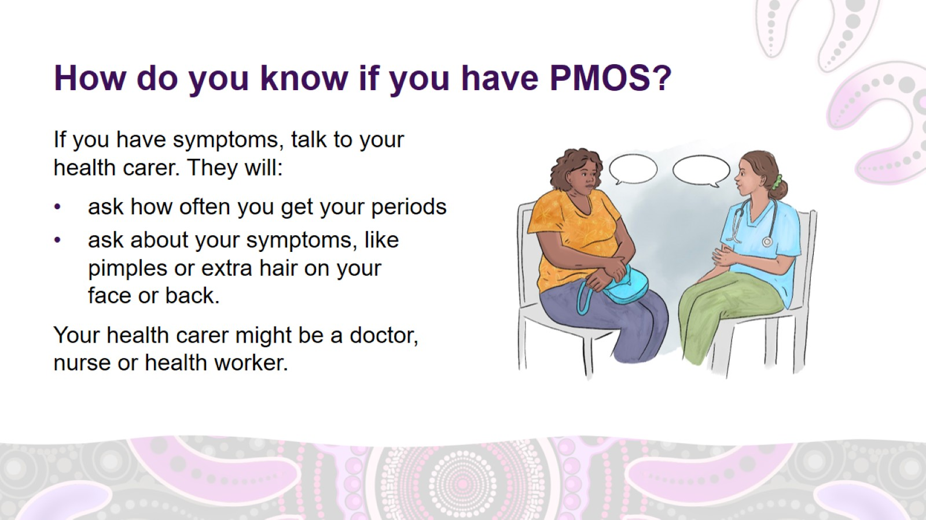
How do you know if you have PMOS?
Notes:
How do you know if you have PMOS?
If you have symptoms, talk to your health carer. They will:
ask how often you get your periods. It is a good idea to keep track of your periods using a diary, calendar or smartphone app so that you have this information ready for your health carer
ask about your symptoms, like pimples or extra hair on your face or back.
Your health carer might be a doctor, nurse or health worker.

Slide 13
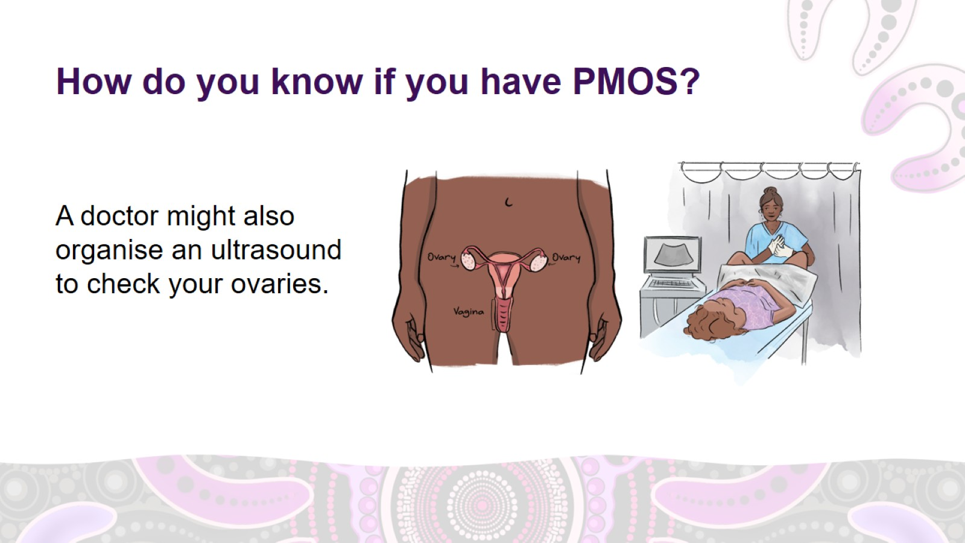
How do you know if you have PMOS?
Notes:
How do you know if you have PMOS? (continued)
A doctor might also organise an ultrasound to check the number of little sacs of fluid (follicles) in the ovaries. Having 20 or more follicles in each ovary is a sign of PMOS.
Ultrasounds are not usually recommended for women aged under 20.

Slide 14
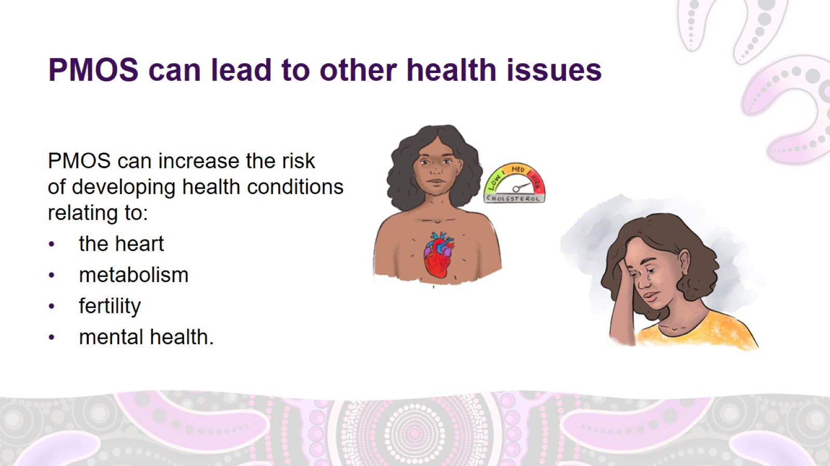
PMOS can lead to other health issues
Notes:
PMOS can lead to other health issues
PMOS can affect different systems in the body.
Women with PMOS have a higher risk of developing conditions relating to:
the heart
metabolism (how the body converts food and drink into energy)
fertility
mental health.

Slide 15
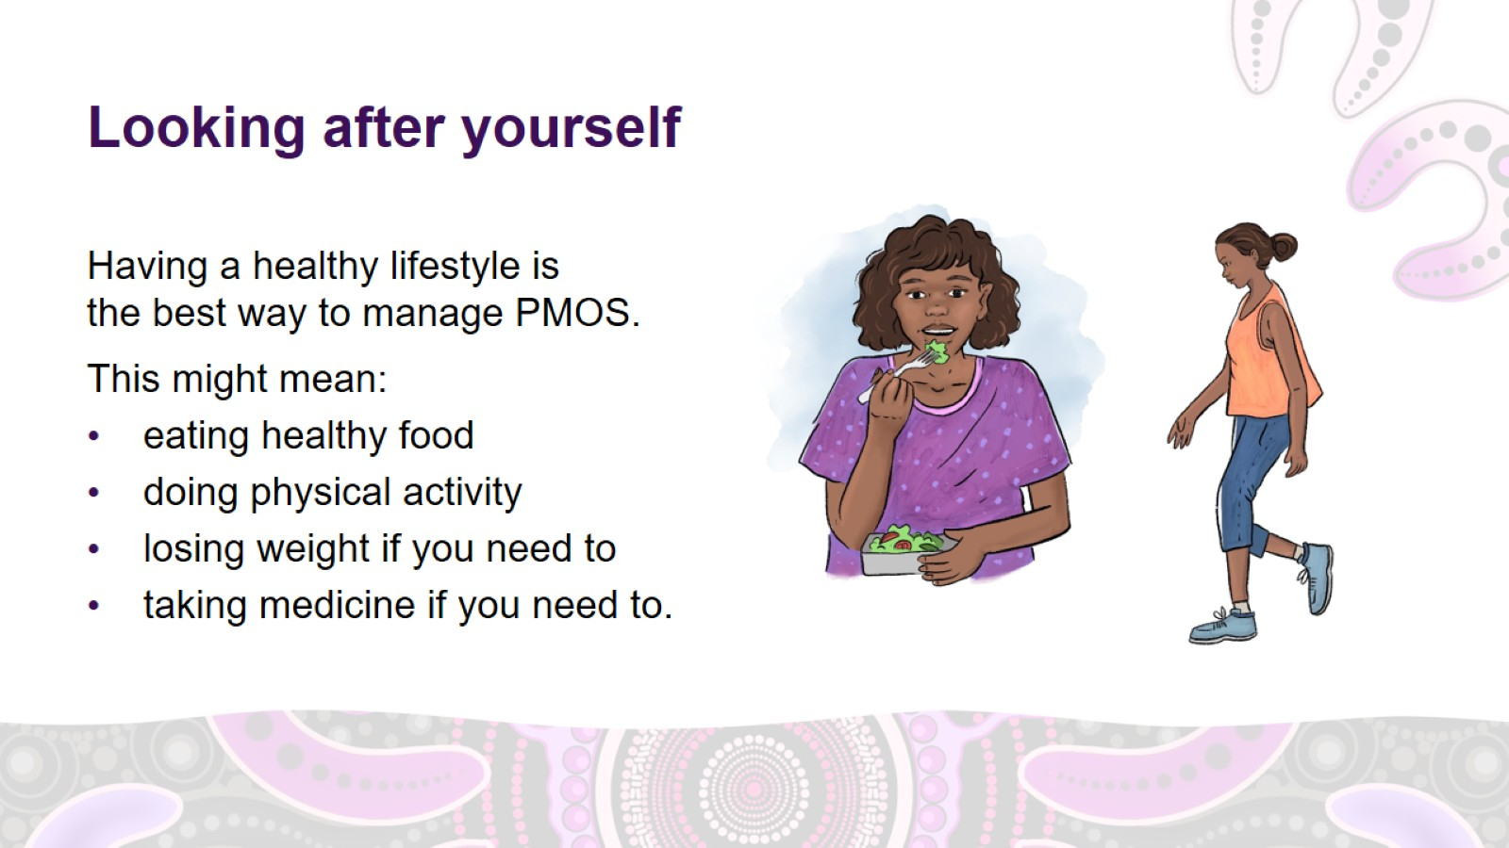
Looking after yourself
Notes:
Looking after yourself
Having a healthy lifestyle is the best way to manage PMOS.
A healthy lifestyle means:
a healthy diet
regular physical activity
losing some weight if you need to
taking medicine if you need to.
Possible questions for discussion:
What does a healthy diet mean to you?
How do we find balance in the way we eat?
What are some nutritious foods you know of?
How can we build more physical activity into our lives?

Slide 16
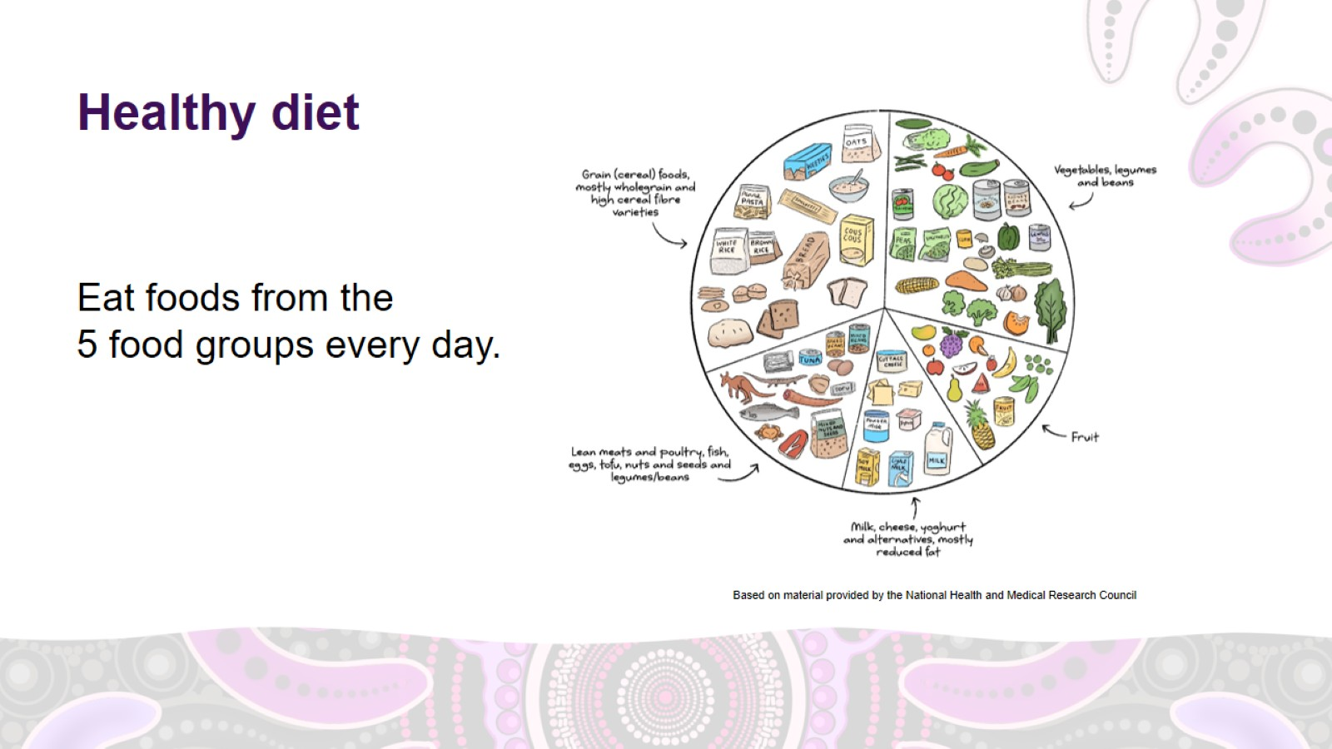
Healthy diet
Notes:
Managing PMOS – healthy diet
Eating a healthy diet is important if you have PMOS.
To eat a healthy diet, eat foods from the 5 food groups every day. The diagram shows foods from each of the 5 food groups.
Food group 1: Grains
4 to 6 serves every day
1 serve of grains is equal to 1 slice of bread or half a cup of cooked rice, pasta, noodles or quinoa.
Choose whole grains. For example, wholemeal bread instead of white bread.
Food group 2: Vegetables
5 serves every day
1 serve of vegetables is equal to half a cup of cooked vegetables or 1 cup of salad.
Frozen or tinned vegetables are also cheap and nutritious options.
Food group 3: Fruit
2 serves every day
1 serve of fruit is equal to 1 medium apple, banana, orange or pear, or 1 cup of tinned fruit with no added sugar.
Dried fruit, frozen fruit and tinned fruits are all good options.
Food group 4: Dairy and dairy alternatives
3 serves a day
1 serve of dairy is equal to 1 cup of milk, 2 slices of hard cheese, or 1 small tub of yoghurt.
Food group 5: Meat and other protein
2 to 3 serves every day
1 serve of protein is equal to 65g of cooked lean red meat, such as beef, lamb, or kangaroo (about the size of the palm of your hand), one small can of fish, or 2 large eggs.
For more information about serving sizes, go to www.eatforhealth.gov.au/food-essentials/five-food-groups

Slide 17
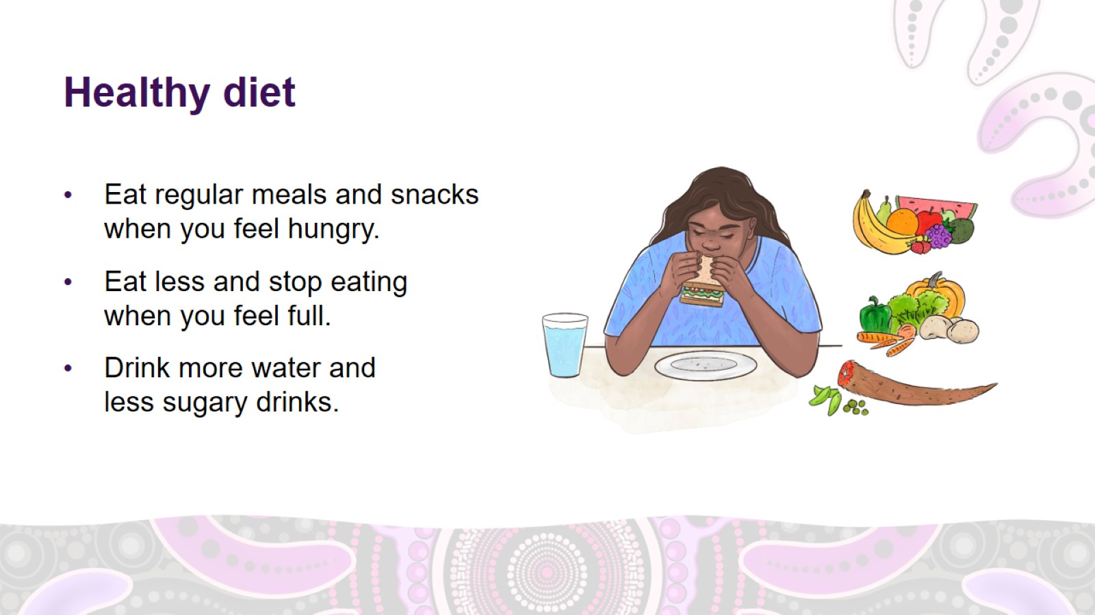
Healthy diet
Notes:
Managing PMOS – healthy diet (continued)
Eat regular meals and snacks when you feel hungry.
Eat less and stop eating when you feel full.
Healthy foods are better at making you feel full as they have protein and fibre.
Drink mostly water, or other low-sugar or sugar-free drinks like:
diet soft drink
kombucha
flavoured sparkling water
diet cordial.
Avoid sugary drinks like soft drinks and flavoured milk.

Slide 18
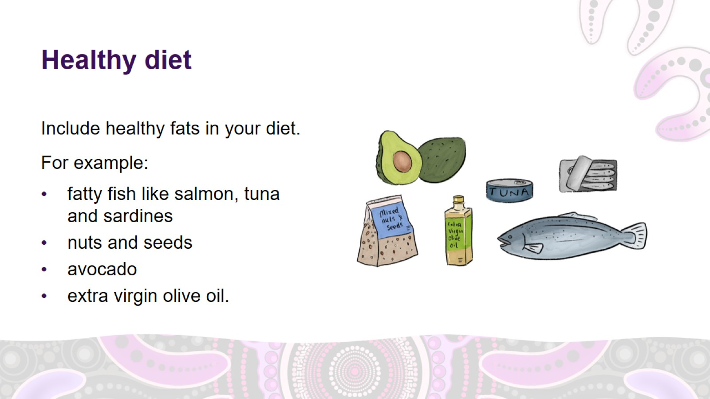
Healthy diet
Notes:
Managing PMOS – healthy diet (continued)
Include healthy fats in your diet.
Healthy fats are important for lots of things like maintaining good cholesterol and heart health.
Healthy fats include:
fatty fish like salmon, tuna and sardines
nuts and seeds
avocado
extra virgin olive oil.

Slide 19
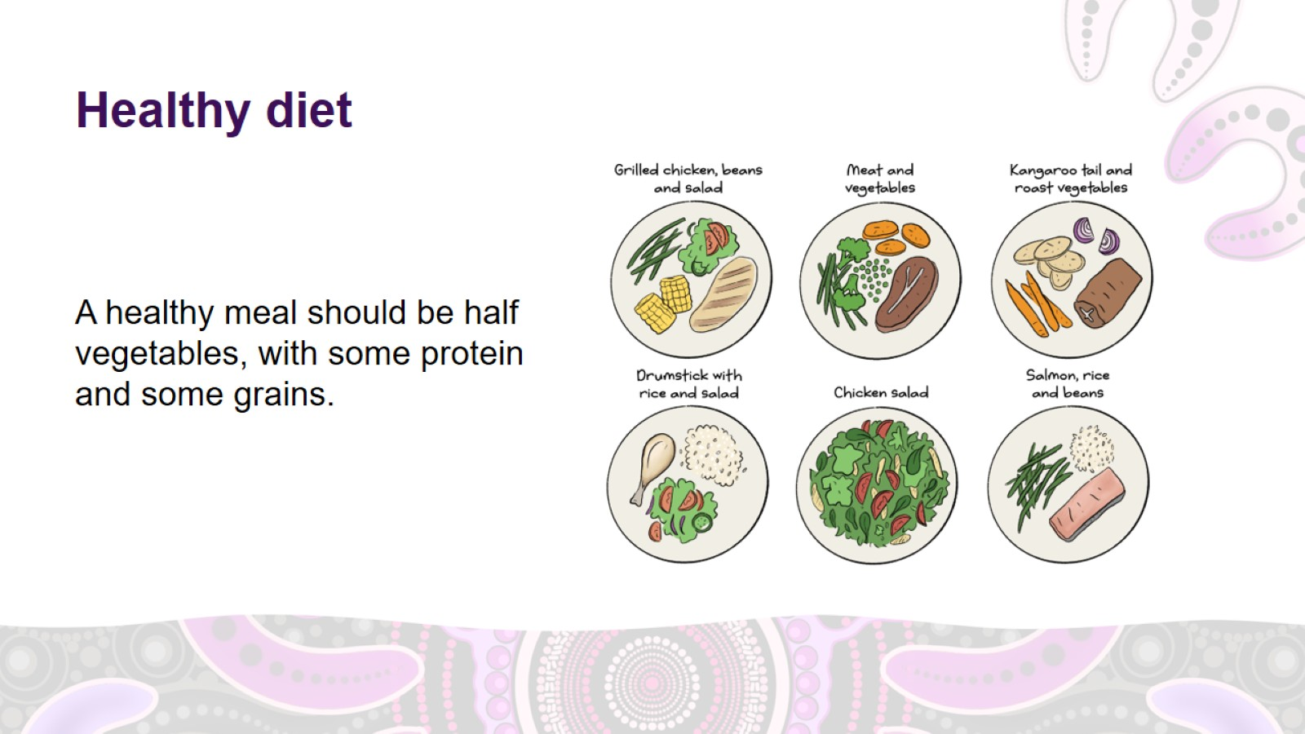
Healthy diet
Notes:
Managing PMOS – healthy diet (continued)
A healthy meal should be half vegetables, with some protein and some grains or other starchy foods (carbohydrates) like pasta or sweet potato.
To make a healthy meal:
1. fill half your plate with vegetables
2. add some protein – for example, meat, eggs, fish, tofu or legumes like chickpeas or lentils
3. add some grains or other starchy foods – for example, rice, noodles, quinoa, pasta, potato, sweet potato or bread
4. eat fruit or dairy as a snack or for dessert.

Slide 20
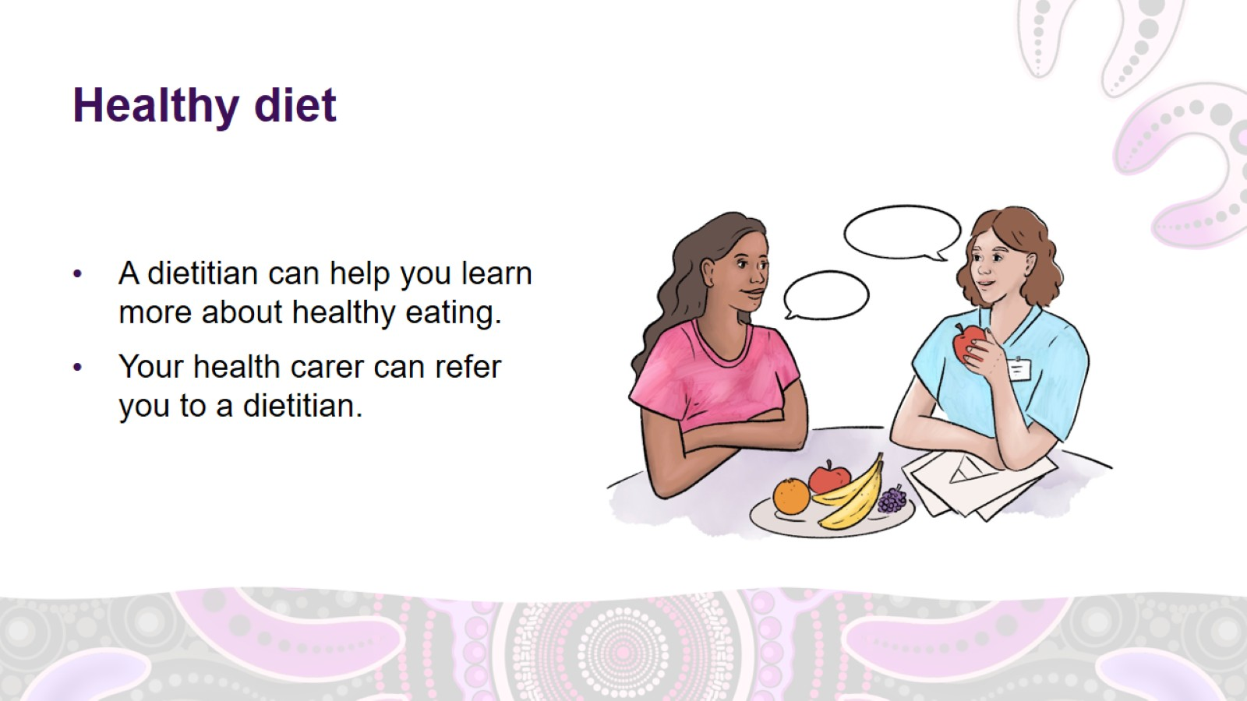
Healthy diet
Notes:
Managing PMOS – healthy diet (continued)
A dietitian is a health professional who can help you learn more about healthy eating.
Your health carer can refer you to a dietitian.

Slide 21
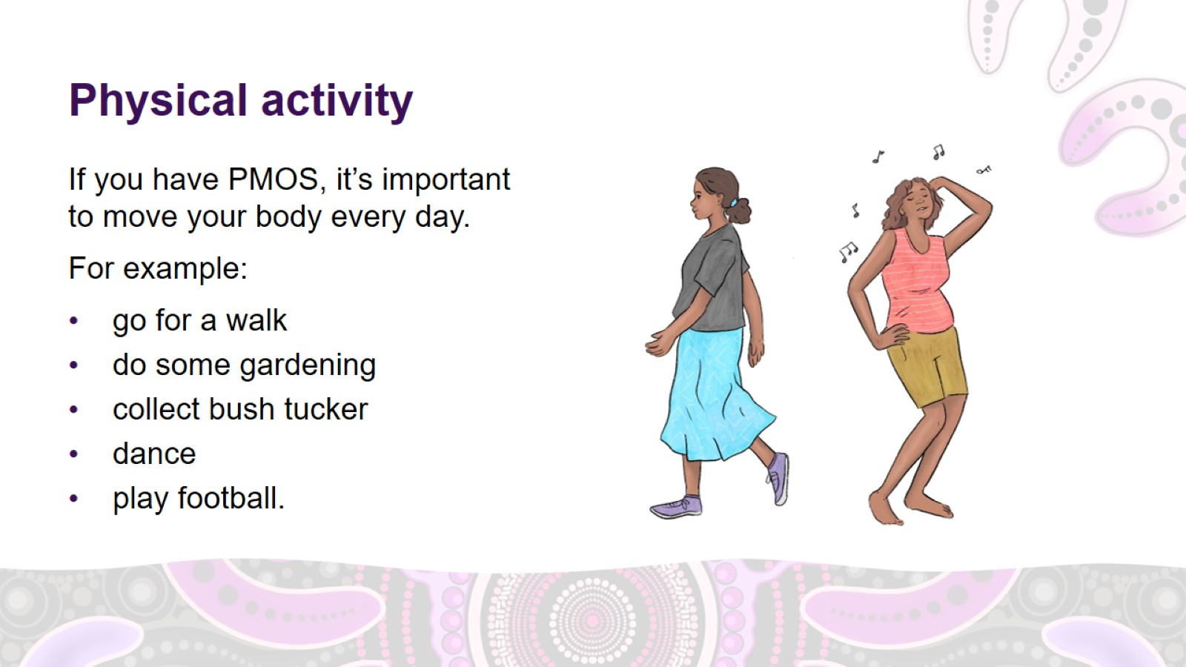
Physical activity
Notes:
Managing PMOS – physical activity
Physical activity means moving your body.
Regular physical activity can help to reduce your PMOS symptoms. It can also reduce your risk of having other health issues.
Find ways to build movement and exercise into your daily life.
Physical activity includes moving at home. For example:
gardening
housework
playing with your children if you have them
walking to the shops instead of driving.
It also includes moving out bush. For example:
hunting
collecting bush tucker.
Physical activity also includes moving at work. For example:
walking to work instead of driving
lifting or walking as a part of your job.
It also includes moving through sport and exercise. For example:
football
netball
basketball
yoga
jogging
dancing
hiking.

Slide 22
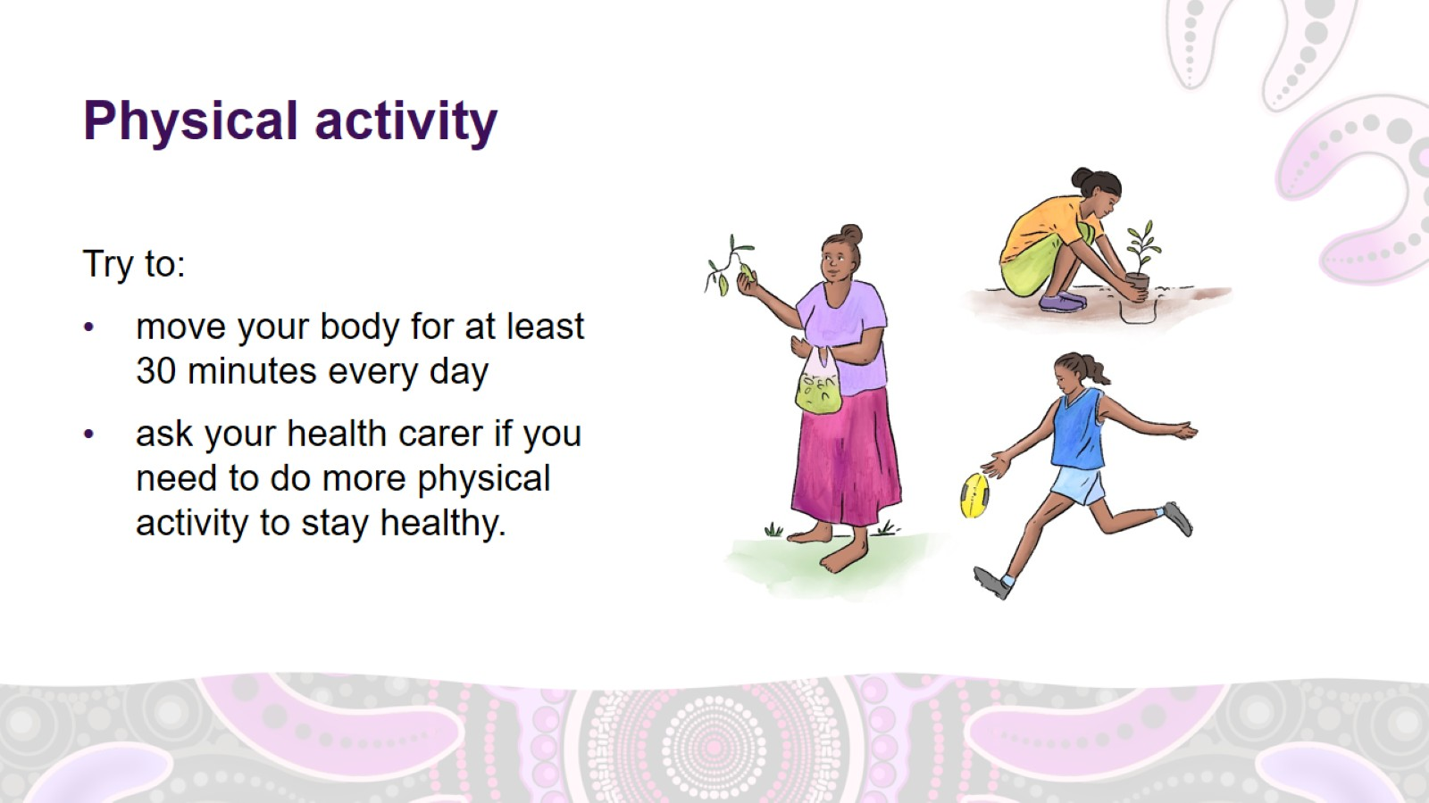
Physical activity
Notes:
Managing PMOS – physical activity (continued)
Try to:
move your body for at least 30 minutes every day – you can break this up into 3 blocks of ten minutes
ask your health carer if you need to do more physical activity to stay healthy.
Exercise recommendations
Facilitator note: you may wish to present the relevant information only.
What activity should you do?
Try to do a mixture of moderate activity where you feel puffed but can still have a conversation, and vigorous activity where you feel puffed and can’t have a conversation.
To stay a healthy weight
Adults should do:
150 minutes (2.5 hours) of moderate physical activity or 75 minutes of vigorous physical activity per week
muscle-strengthening activities on 2 non-consecutive days.
Adolescents should do:
1 hour of moderate-to-vigorous physical activity per day
muscle- and bone-strengthening activities at least 3 times per week.

Slide 23
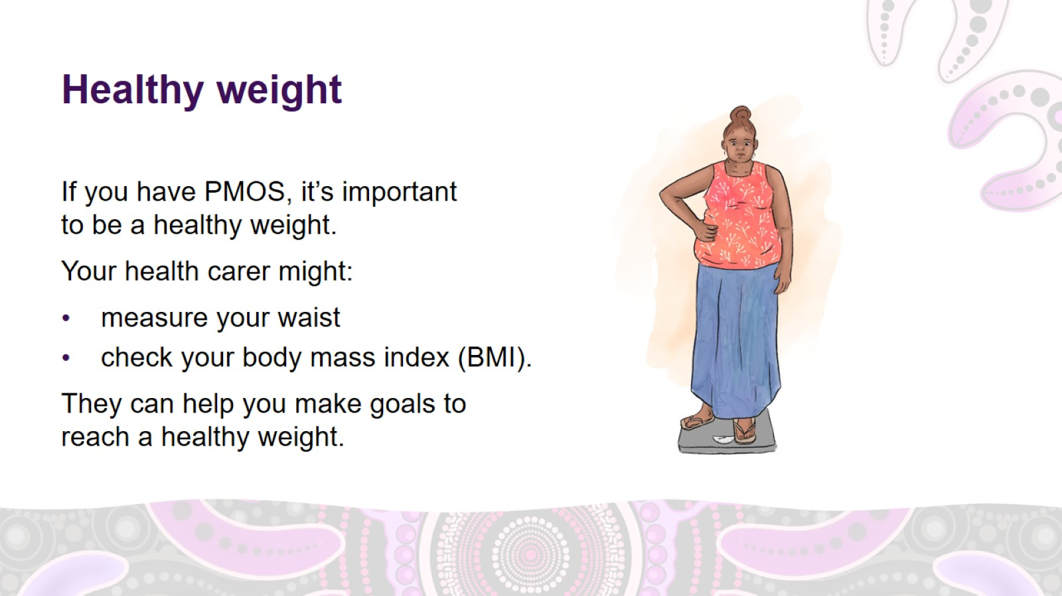
Healthy weight
Notes:
Managing PMOS – healthy weight
If you have PMOS, it’s important to be a healthy weight.
Your health carer might measure your waist and check your body mass index (BMI) to see if you are a healthy weight.
They can help you make goals to reach a healthy weight.

Slide 24
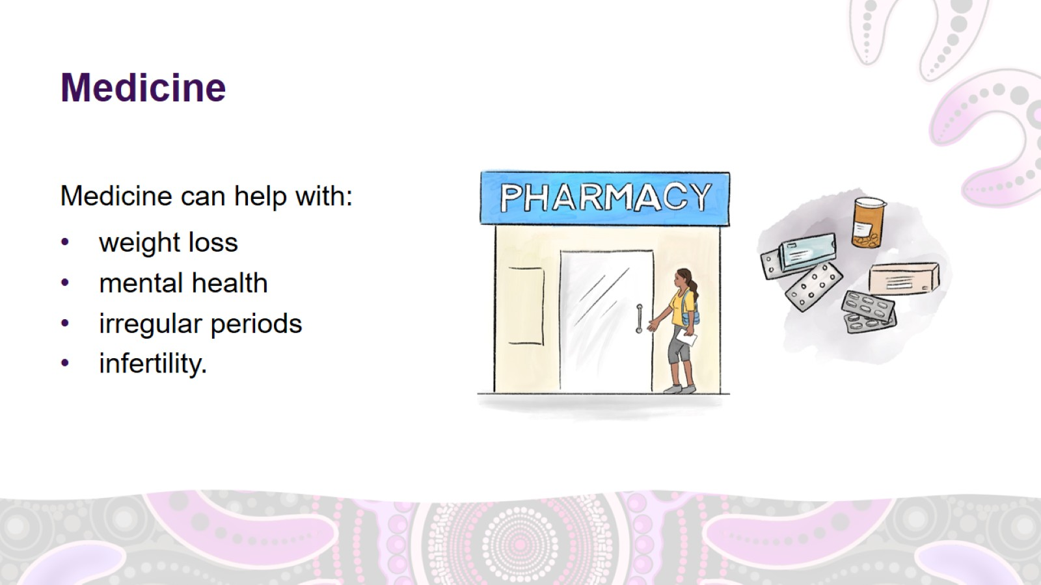
Medicine
Notes:
Managing PMOS – medicine
Some people with PMOS will also need medicine to help manage symptoms.
Medicine can help with:
weight loss
mental health
irregular periods
infertility.

Slide 25
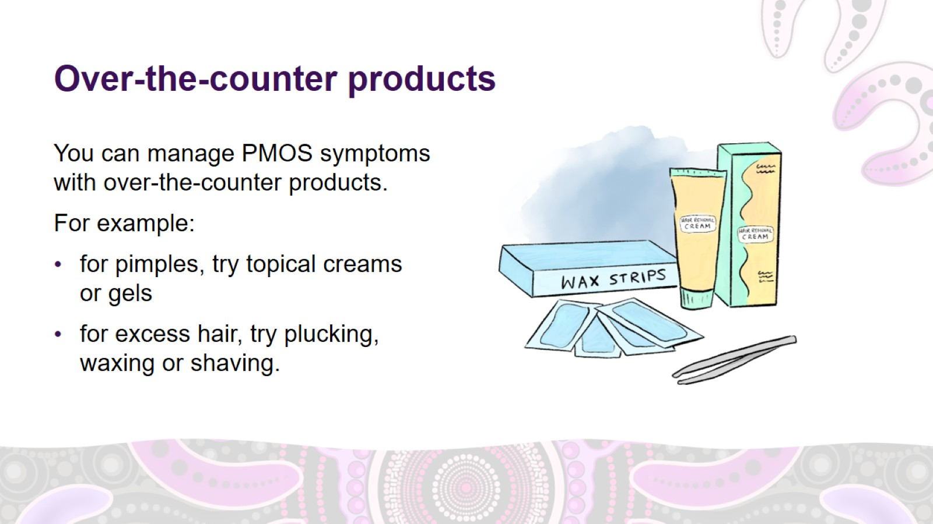
Over-the-counter products
Notes:
Managing PMOS – over-the-counter products
You can manage your PMOS symptoms with over-the-counter products.
For pimples, try topical creams or gels.
For excess hair growth, try plucking, waxing or shaving.
For hair loss, try minoxidil (foam or tablets).
Ask your health carer about the best treatment for you.

Slide 26
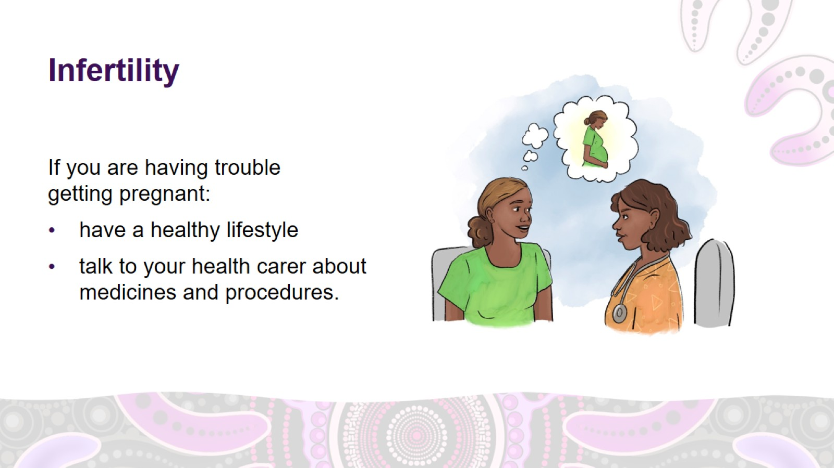
Infertility
Notes:
Managing PMOS – infertility
If you are having trouble getting pregnant, your health carer might recommend:
a healthy lifestyle to improve fertility and lower health risks
medicine, for example, letrozole
medical procedures, like in vitro fertilisation (IVF).

Slide 27
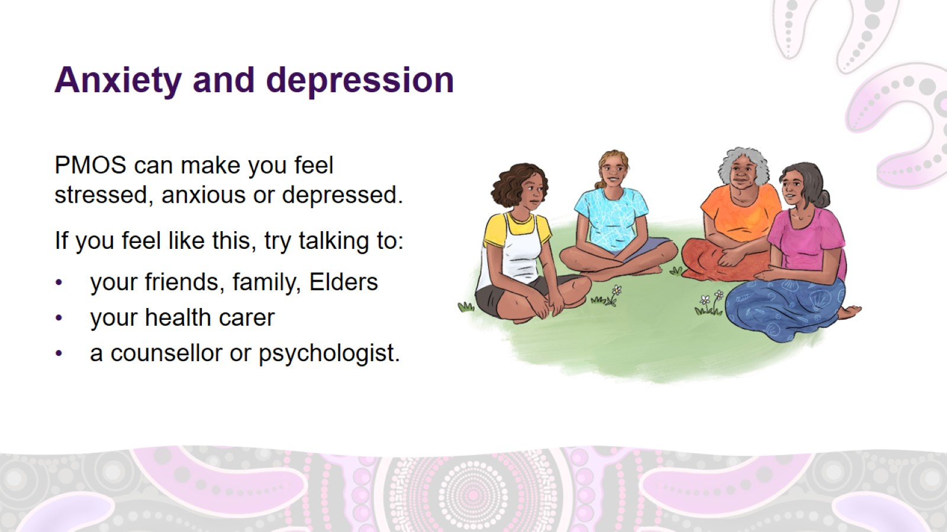
Anxiety and depression
Notes:
Managing PMOS – anxiety and depression
PMOS can make you feel stressed, anxious or depressed.
If you often feel like this, talking about your feelings can help.
There are lots of people you can talk to. For example:
your friends, family, people in your community, Elders
your health carer
people with special training in social and emotional wellbeing, such as a counsellor, social worker or psychologist.
Your health carer can refer you to a counsellor.

Slide 28
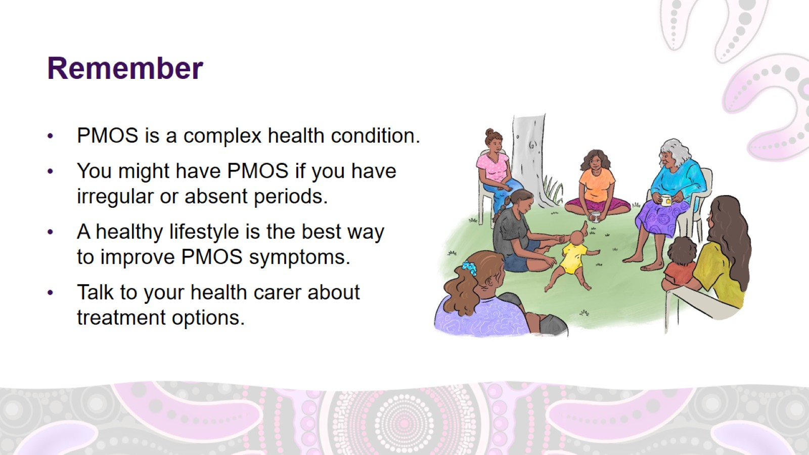
Remember

Slide 29

Thank you

Slide 30


