Slide 1





GP Turner syndrome update
November 2025
Overview of Turner syndrome:
What GPs need to know
Adj Clin Prof Amanda Vincent, MBBS, BMed Sci, PhD, FRACP
Endocrinologist, Menopause Clinics, Monash Health
Head, Early menopause Research, MCHRI, Monash University
Better Care, Better Equity, Better Health
Notes:
Thank-you for that introduction.
Today I am going to provide you with an overview of Turner syndrome, a condition which although rare represents a diagnostic and management challenge and where GPs have an important role. I will highlight key aspects form the updated 2024 Turner syndrome guideline

Slide 2
Disclosures
  Travel and speaker honorarium from Amgen, Merck and Besins, Australasian Menopause Society, Health Ed
  Consulting fees from Theramex, Besins
  Research funding from Amgen
  Research funding from Australian government: NHMRC, MRFF, CRE-WHiRL

Slide 3

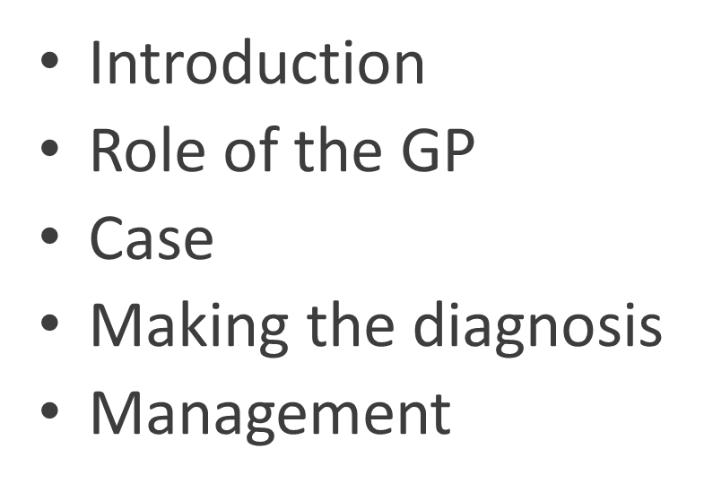
Outline

Slide 4
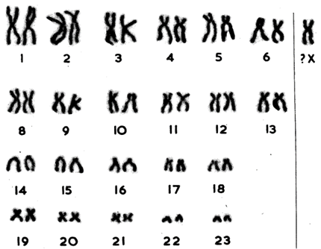
Introduction
  Affects ~ 1/2000 live female births
  Complete or partial X chromosome monosomy
  Characterized by short stature and hypergonadotrophic hypogonadism
  Multi-morbidity and decreased survival
Notes:
Turner syndrome or TS was first described in the 1930’s by Henry Turner in USA and Otto Ulrich in Europe
The X chromosome abnormality shown here was identified in 1959 by Ford and co workers
TS affects ~ 1/2000 live female births

Slide 5
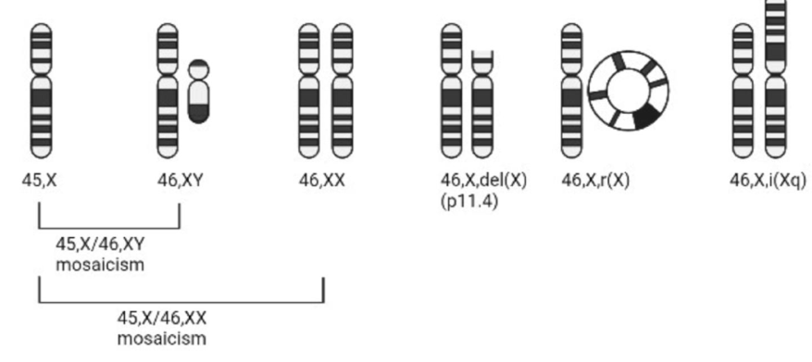
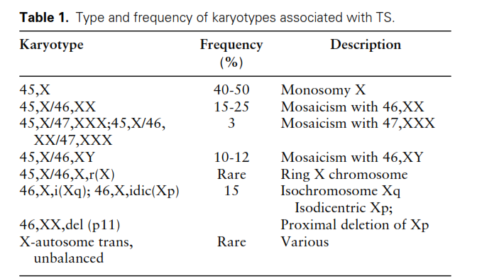
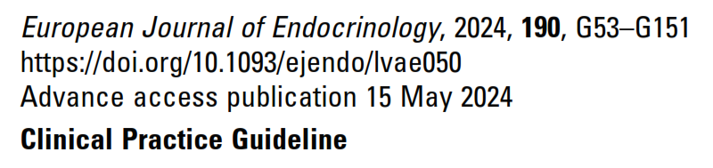
Variable genotype
Notes:
TS is defined as …
Variable karyotypes are associated with the TS phenotype with 45X being the most common.
There are a variety of mosaic forms of TS including that with the Y chromosome.

Slide 6
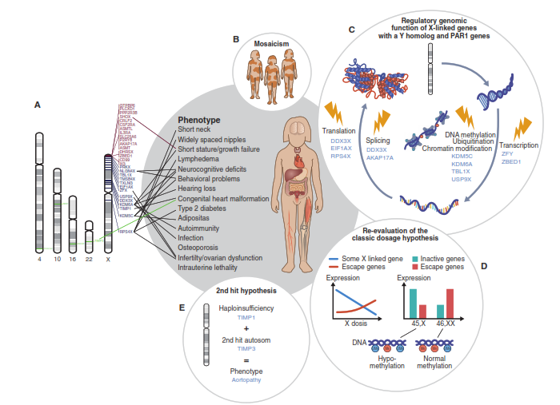
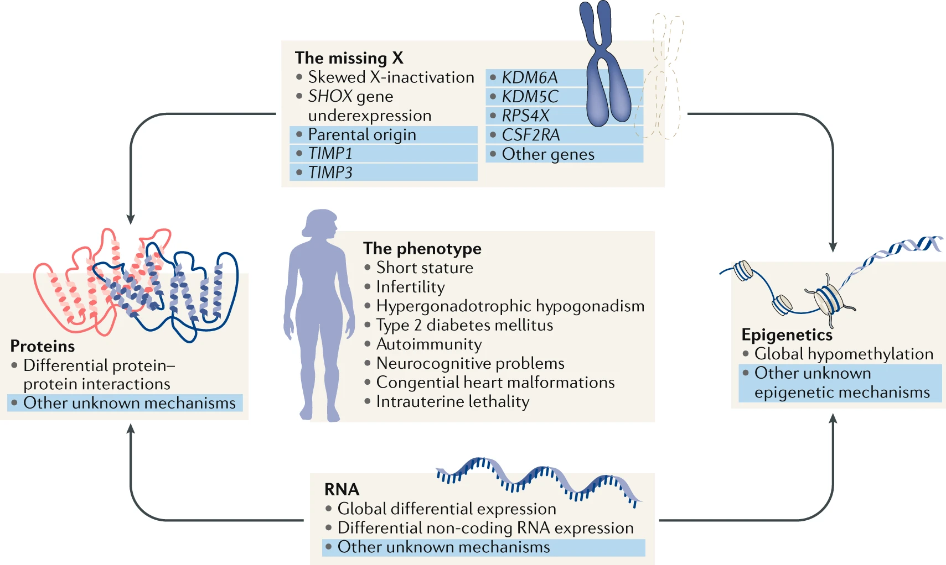
Genotype- Phenotype: It’s complicated!
Other factors influencing health effects of TS:
Estrogen therapy
Lifestyle
Gut microbiome?
Environment?
Other health issues
Ageing
X chromosome
+
Chromosome 22
=
Dilated aorta
Notes:
This picture shows just how complicated the genotype- phenotype relationship is and why the effects of TS can vary between individuals

Slide 7
Clinical Features
  Phenotype varies with genotype
    Highest prevalence of co-morbidity with 45X
    Milder phenotype with mosaic TS
    Higher risk of intellectual disability with ring X chromosome
    Lower prevalence of BAV with isochrome Xq and ring X
Shah et al., Climacteric 2018
Cameron-Pimblatt et al. Clin Endocrinol. 2017
Notes:
From the previous slide you can see how TS affects multiple organ systems. These are shown in this figure. Short stature and hypogonadism are the most prevalent.
There is some variation in phenotype with genotype. The 45 X karyotype is associated with the highest prevalence of comorbidities and highest mortality

Slide 8
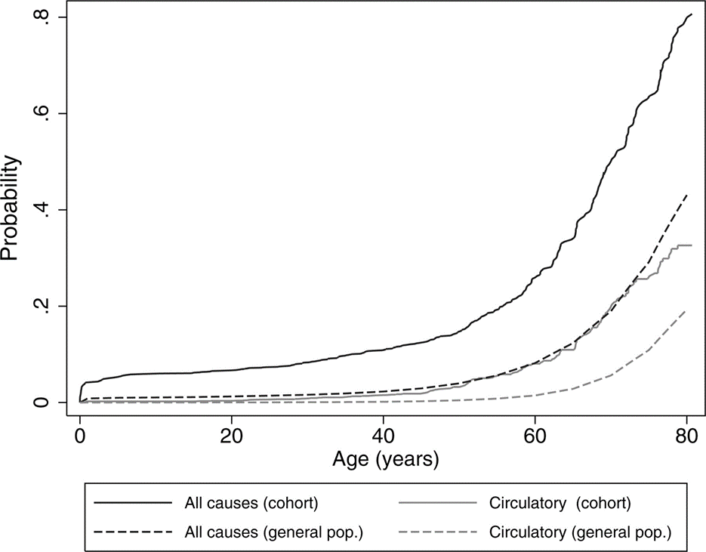
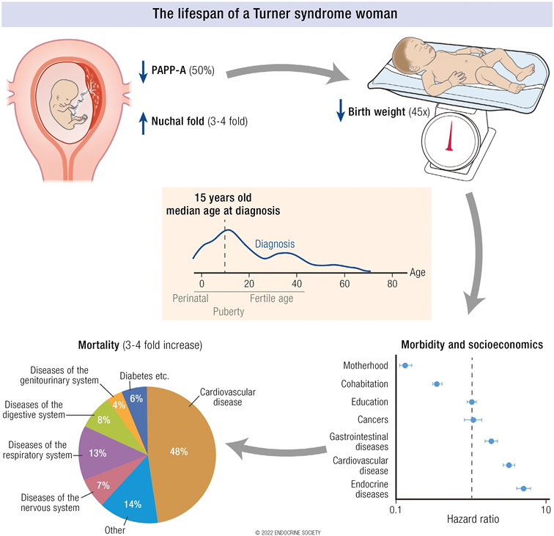
Increased mortality and morbidity
Less likely
More likely
Cumulative risk of death from all causes and from circulatory disease observed in the cohort of patients with TS
Notes:
TS is associated with an 3 fold increased mortality predominately due to CVD
Increased all causes and CVD mortality is seen in the TS cohort shown by the sold lines compared to the general population showed by the dotted lines.
This translates to a apparent loss of lifespan of approximately 13-15 years
Apart from congenital heart disease, the absolute excess mortality increases with advancing age with cardiovascular disease the main contributor.
The third panel shows the hazard ratios for health and social . Women with TS are more likely to haveGIT, CVD and endocrine dosorers and less likely to achieve motherhood or co-habitation with a romantic partner

Slide 9
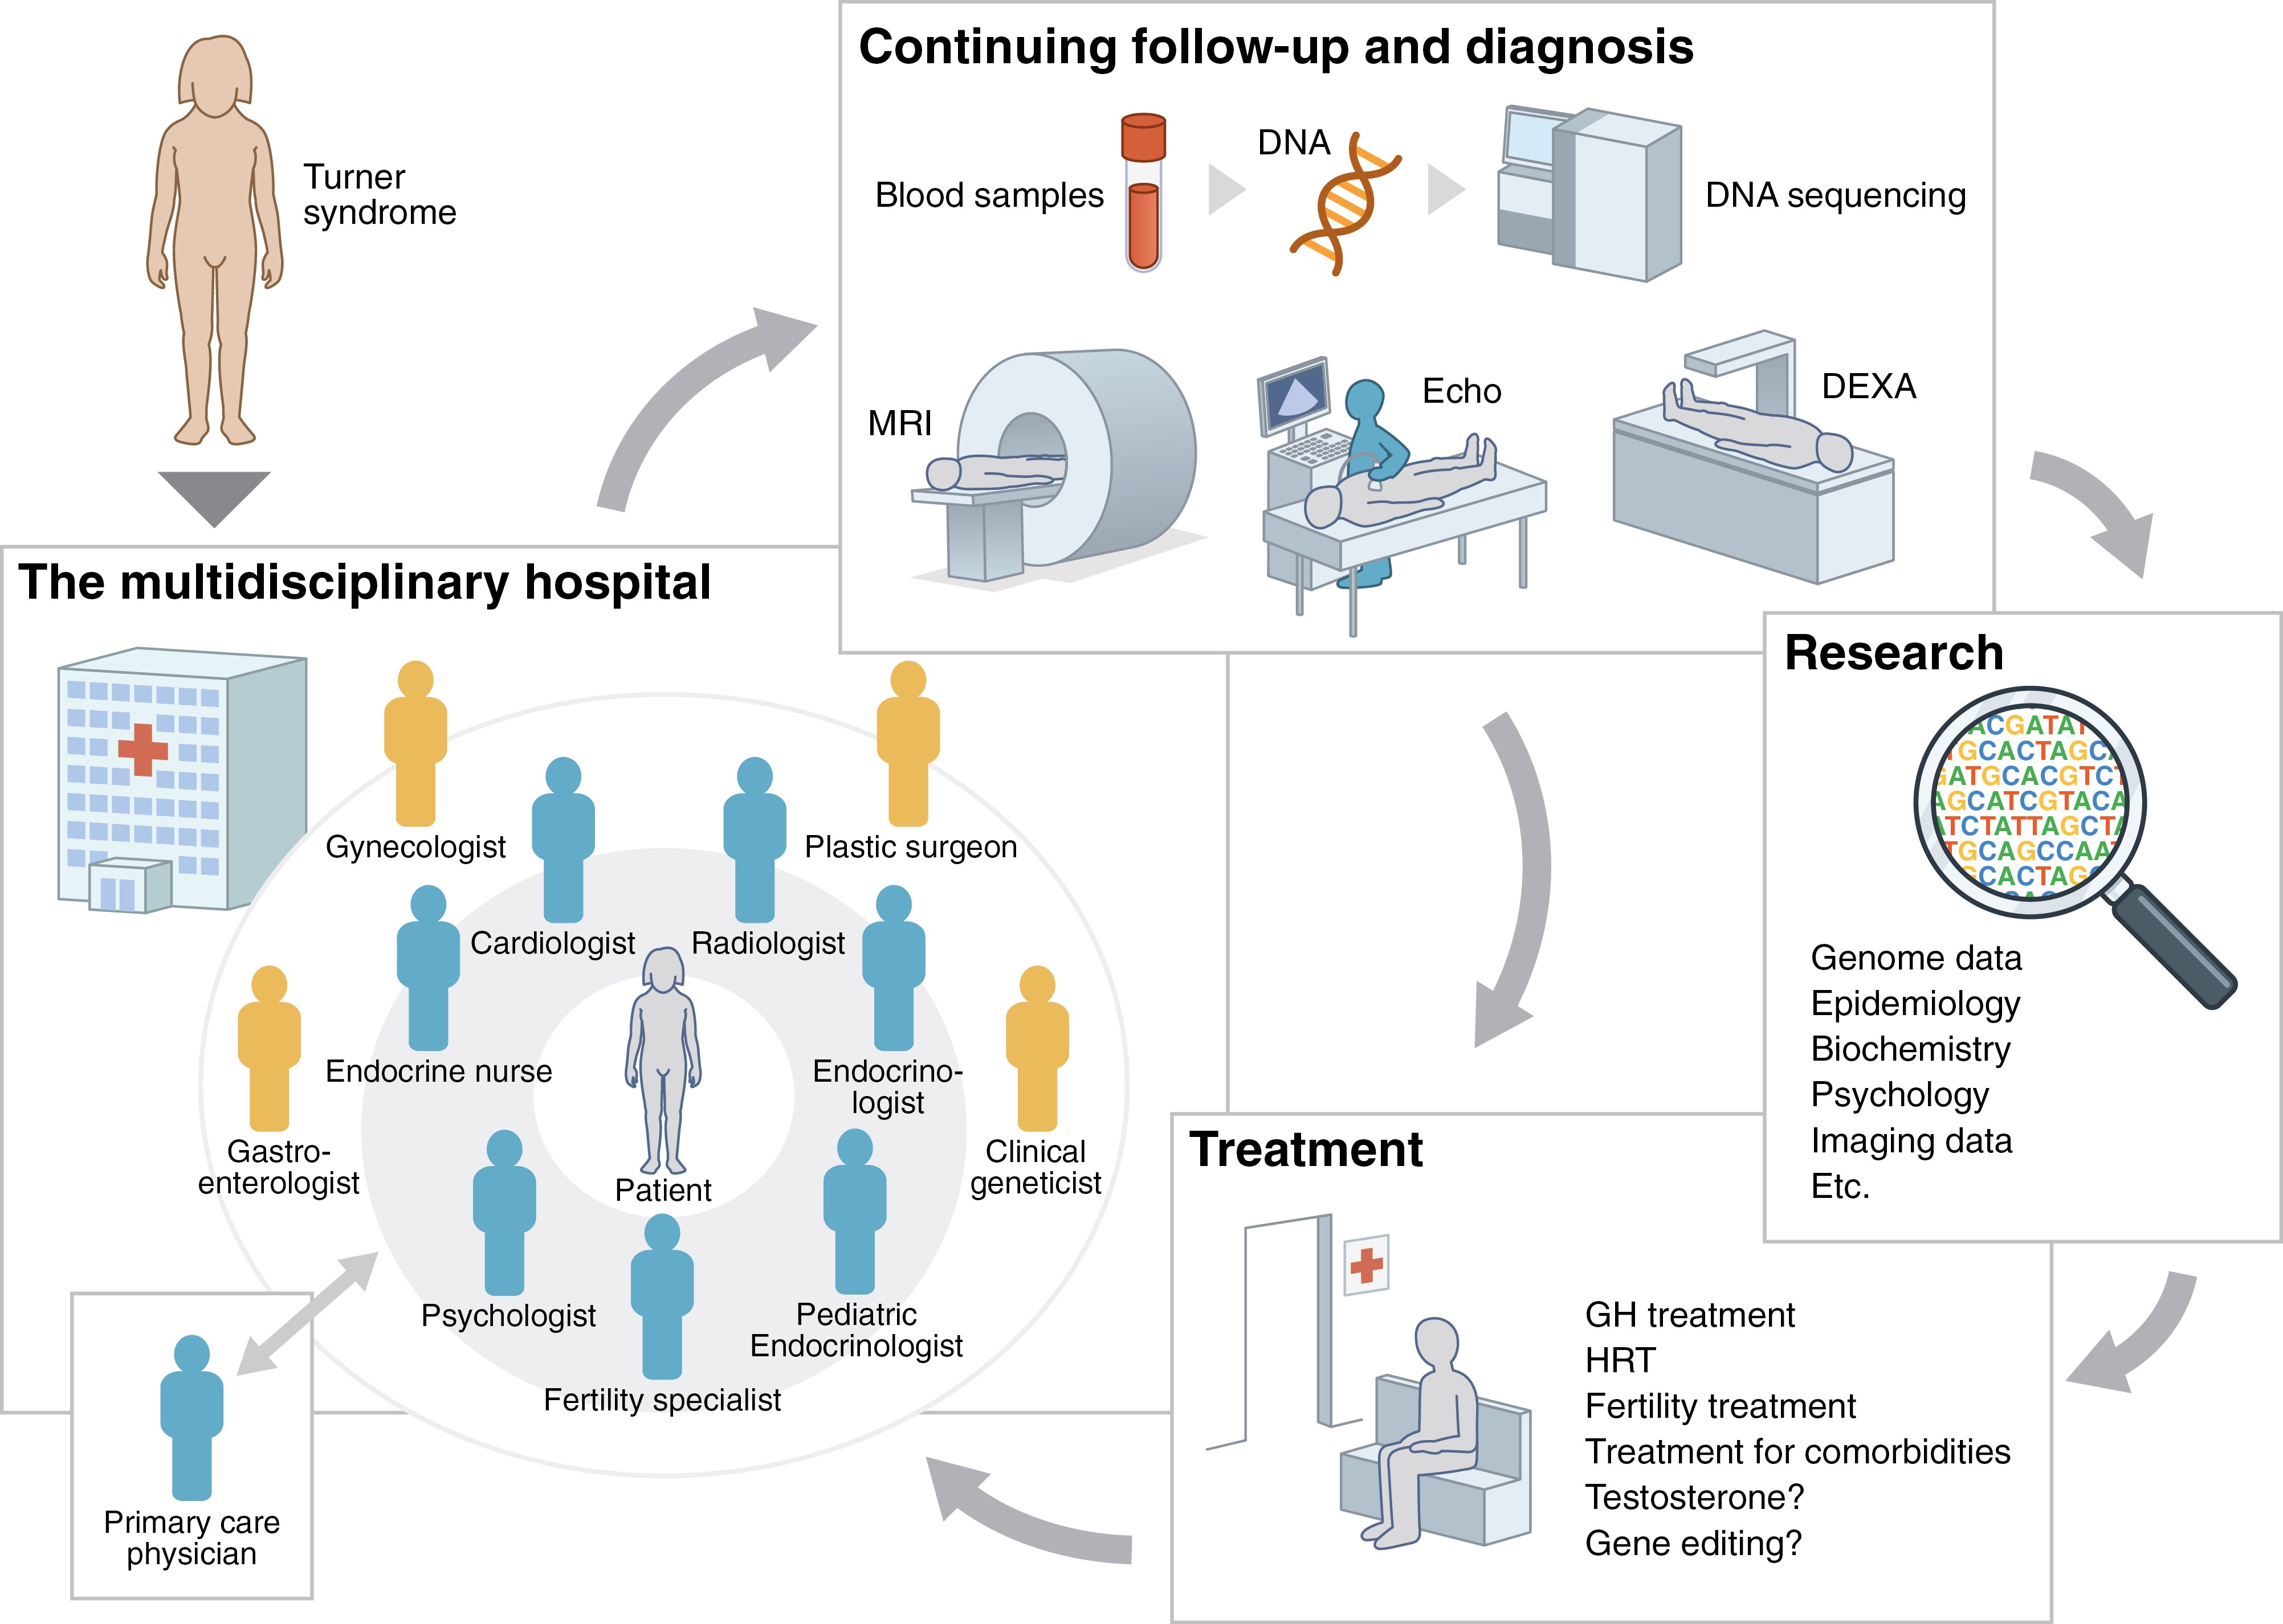
Role of the GP
Early Identification
Recognise symptoms and signs
Initiate investigations
Diagnosis
Confirm with karyotype
Convey diagnosis in a sensitive manner
Initial management
Screen for co-morbidities
Assess fertility, psychosocial, sexual health needs
Assess and support healthy lifestyle
Assess and initiate personalised hormone therapy if no contraindications
Referral
Long term follow-up
Genetic counselling, gynaecology, endocrinology, psychology, fertility, allied health, sexual counselling support group
Monitor and support healthy lifestyle
Monitor co-morbidities especially CVD and bone health risk factors
Review hormone therapy and promote adherence
Monitor and address psychological and sexual health needs
Specialist multidisciplinary clinic
Medicare Item 695
Notes:
The GP has key roles in the diagnosis and management of TS which are summarised here.
Individuals with TS, particularly in childhood are involved in specialist care but transition to adult care can be fragmented and many are lost to follow up. Adult specialist multidisciplinary care clinics such as at Monash Health can assist in the management of these patients.

Slide 10

Case: AB age 36y with 2º amenorrhea
  Married teacher
  8 months of amenorrhoea following cessation of OCP
  Mild vasomotor symptoms
  Medication: Vitamin D supplement
  O&G history
    menarche aged 13
    G2P2- spontaneous conception. No pregnancy complications. Two children aged 8 and 6 years
    commenced OCP 10 years ago
  Past history
    low Vitamin D
  Family history: Dyslipidemia. Nil early menopause
  Examination:
    Height 138.5cm, weight 46kg. BMI 23
    Normotensive
    Examination unremarkable
Notes:
Let us use a case to illustrate these roles.

Slide 11
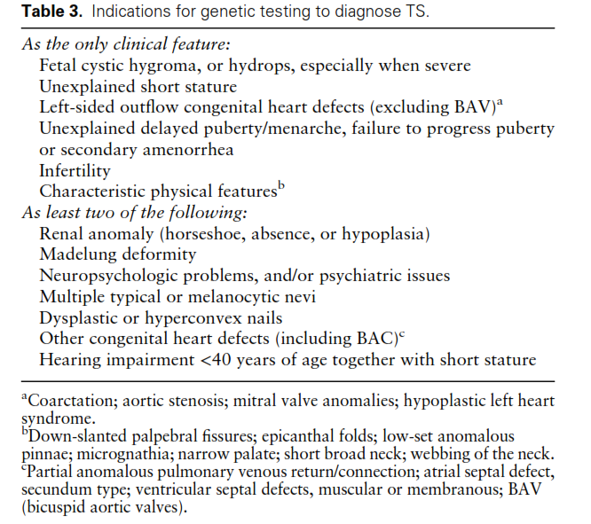
Consider the diagnosis
Notes:
It is important to consider a diagnosis of TS in a female presenting with primary amenorrhoea, POI, infertility or the typical features of TS
The recommendations shown throughout this presentation are from the 2024 updated Turner syndrome clinical guideline or 2024 POI guideline.

Slide 12
Consider the Diagnosis:
Premature ovarian insufficiency (POI)
Clinical presentation: <40 years of age
≥4months oligo/amenorrhea
+/- symptoms of estrogen deficiency
Investigations
Pregnancy test
Check Follicle Stimulating Hormone (FSH) concentration
If diagnosis not confirmed on first FSH test
Repeat FSH after 4-6 weeks
Check Anti-Mullerian hormone level
Symptoms or signs of potential cause
Infertility
Serum estradiol not needed for diagnosis but if low indicates hypoestrogenism
Pelvic Ultrasound not needed for diagnosis but may show small ovaries and low antral follicle count
FSH>25IU/L + oligo/amenorrhoea for at least 4 months = DIAGNOSIS of POI
Notes:
The diagnosis of POI should be considered in any woman under the age of 40 years presenting with either 1. primary amenorrhoea or more than 4 months of secondary amenorrhoea or oligo/amenorrhoea or 2. symptoms of estrogen deficiency or 3. infertility. They may also have signs or symptoms of a potential cause of POI
As in the previous ESHRE POI guideline the diagnosis of POI should be considered where there is oligo/amenorrhoea occurring for at least 4 months and an elevated FSH level>25IU.
Where the new guideline differs is that a second FSH level is only required where there is diagnostic uncertainty.
Anti-Mullerian hormone is not recommended as a primary test to diagnose POI but can be useful if the diagnosis is uncertain.
Hopefully this change should facilitate more timely diagnosis.

Slide 13

POI diagnosed according to the following diagnostic criteria:
disordered menses (spontaneous amenorrhea or irregular menstrual cycles) for at least 4 months, and
an elevated FSH concentration >25 IU/l.
Bilateral oophorectomy before age 40 years
Diagnosis: Assessing cause
Yes
Previous chemotherapy, pelvic radiotherapy, pelvic/ovarian surgery?
Yes
Diagnosis of
iatrogenic POI
No
Genetic tests:
After counselling
and informed consent
Chromosomal analysis
FMR1 premutation testing*
Additional testing (e.g. NGS) may be offered, if available
Abnormal
Diagnosis of
POI with genetic cause
Refer for genetic counselling and follow up
Consider effect
on relatives
Normal
Autoimmune tests:
Screening for adrenal antibodies (21OH-Abs)
TSH screening
Additional autoimmune antibody tests depending on history and examination
Abnormal
Diagnosis of
POI with autoimmune cause
Refer for follow up testing
Normal TSH and antibodies
No other cause identified
Diagnosis of idiopathic POI
Notes:
Once the diagnosis is made than a cause of POI should be sought. Genetic testing with chromosomal analysis and Fragile X gene premutation testing is recommended regardless of age.
Further gene testing can be performed but is expensive
Adrenal antibody testing and TSH with additional autoimmune testing depending on the clinical picture
Most often spontaneous POI is found to be idiopathic. This may change with more advanced genetic testing in future.
The panel has 84 “diagnostic/green” genes. It has a further 40 amber (moderate confidence) and 31 red (low confidence) genes that would be reported on only if sufficient evidence emerged.

Slide 14
Case: AB age 36y with 2º amenorrhea
  Investigations:
    FSH 129 IU/L, E2 73 pmol/L
    Vaginal US: Normal size uterus, R ovary not seen, L ovary 2 follicles. Horseshoe kidney
    Karyotype: 45,X/47XXX
    POI due to Mosaic Turner syndrome
  Sensitively informed of the diagnosis of Turner syndrome
  Referred for genetic counselling
  Referred to Turner syndrome clinic at Monash Health

Slide 15
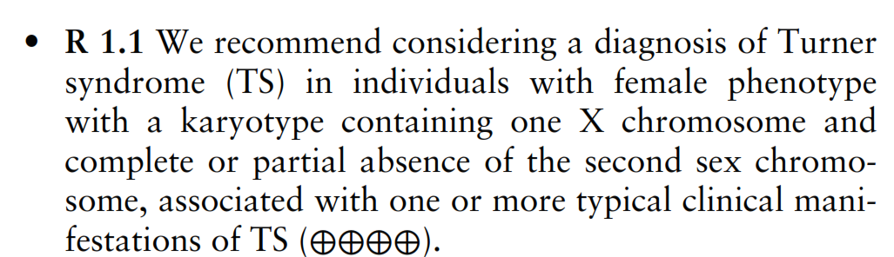
Turner Syndrome Diagnosis
Most patients diagnosed at birth or childhood but 38% diagnosed in adulthood
45X karyotype associated with earlier diagnosis
Up to 50% unrecognized
Increased detection with non-invasive pre-natal testing, new genomic techniques (Artificial intelligence and facial analysis?)
Monash Health TS clinic audit:
  median age at diagnosis was 12 years (range 0-65)
  12% diagnosed after age 18years
Gravholt et al., 2023 Endocrine Reviews; TS guideline 2024
Notes:
Although most patients are diagnosed at birth or childhood, approximately one third are diagnosed as adults as indicated in this frequency distribution of a UK clinic cohort.
Previously it was calculated that up to 50% of TS cases may be unrecognised but …..
Triple test identifies~40% of expected cases
NIPT PPV 26% so needs to be confirmed

Slide 16
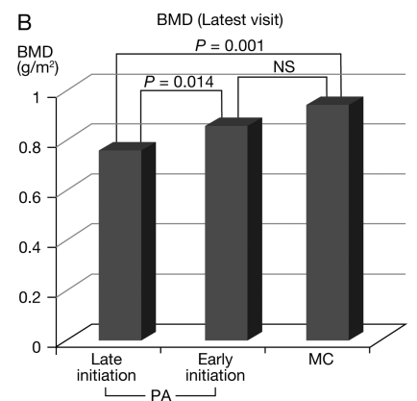
Challenges of Late Diagnosis
Reduced final height
Reduced bone density
Adverse effects on
  Psycho-sexual development
  Psycho-social development
Unrecognised deafness and other co-morbidities
Decreased quality of life
Lee and Conway, Lancet Diabetes Endocrinol. 2014; Nakamura et al., Endocrine Journal 2015
Notes:
Delayed or late diagnosis can have negative effects on health outcomes and psychosocial development with decreased quality of life.
This graph shows lower bone density in adolescents who started HRT late compared to similar bone density between early HRT onset and menstruating controls

Slide 17

Management
Screening for co-morbidities
Psychological health
Lifestyle management
Hormone Therapy
Fertility
Education and counselling
https://www.turnersyndrome.org/support-groups
Notes:
Management is directed at screening for and managing co-morbidities associated with TS,
optimising psychological wellbeing,
supporting healthy lifestyle behaviours which are particularly important due to the elevated risk of CVD and osteoporosis,
prompt commencement of personalised hormone therapy if hypogonadal,
attention to fertility concerns and
providing education and counselling.

Slide 18
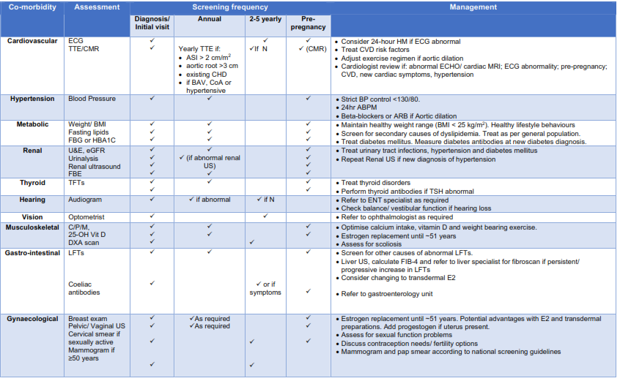
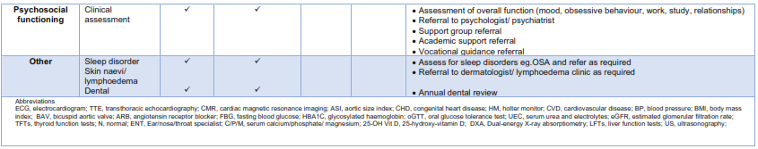

Slide 19

Case: AB age 36y with mosaic TS
Biochemistry
  TSH 5.5mU/L ; FT4 14 pmol/L
  Positive TPO and TG Abs
  25 OH Vit D 40 nmol/L
  Normal lipid profile/ FBG/ HBA1C
  Normal U&E, LFTs, CPM
  Negative coeliac antibodies
DXA: Normal BMD
Audiometry
  ↓ high frequency loss
Echocardiogram: Normal
ECG-Normal
Mosaic TS
POI
Subclinical hypothyroidism
Low Vitamin D
Hearing impairment

Slide 20
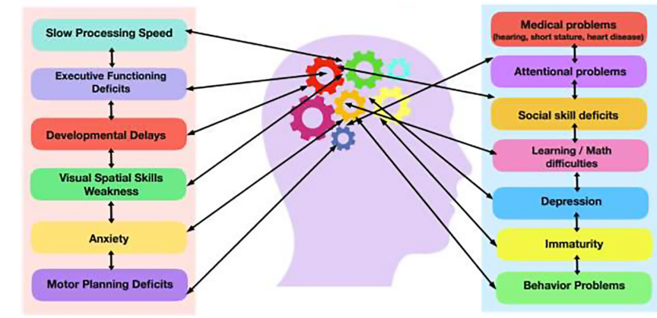
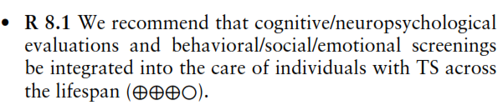
Neurocognitive and Psychological Impacts
Hutaff-Lee C, Bennett E, Howell S, Tartaglia N.. Am J Med Genet Part C. 2019; 181C: 42–50.
Notes:
TS is associated with specific neurocognitive changes and psychological disorders such as anxiety and depression which can affect emotional and social wellbeing in addition to education and work. We do not understand the mechanisms underlying how the genetic changes with TS affect brain function although estrogen deficiency does play a role.

Slide 21
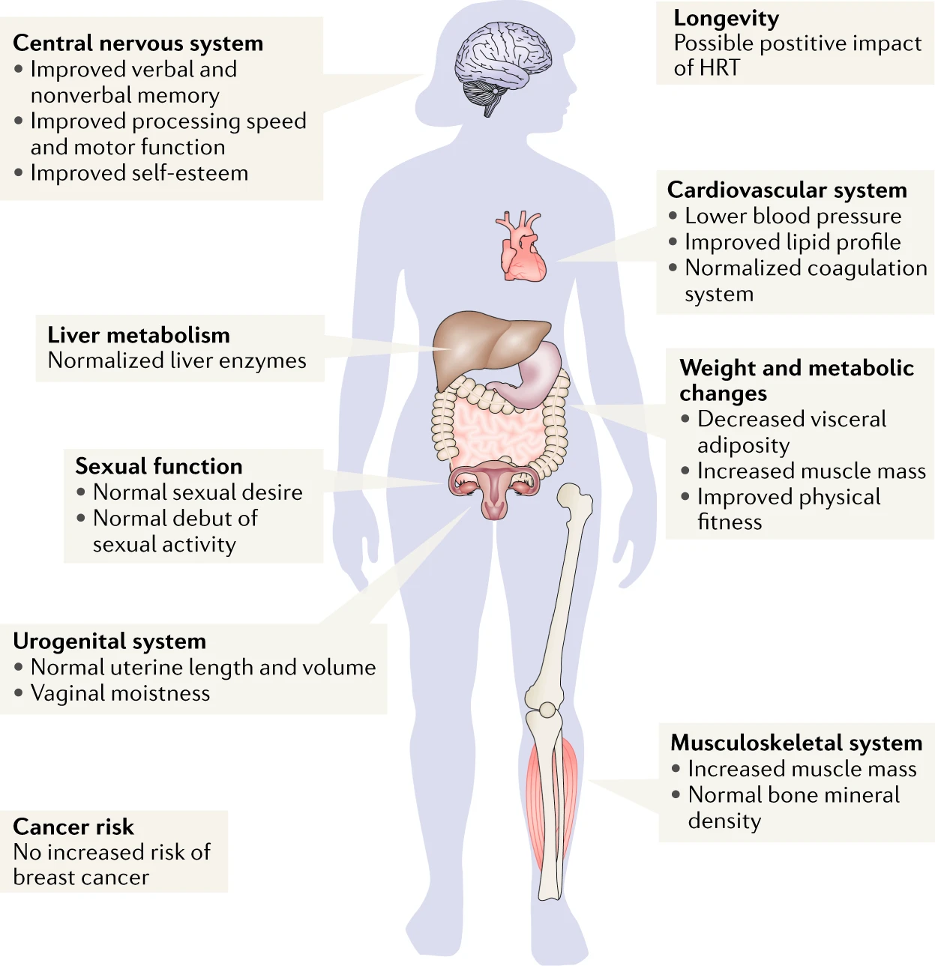
Beneficial Effects of HRT
  Primary amenorrhea or
  Premature ovarian insufficiency
  Prompt institution
  Continued adherence
    Non-adherence associated with bone loss
  Continue until at least the usual age of menopause
Gravholt, C.H., Viuff, M.H., Brun, S. et al.. Nat Rev Endocrinol 15, 601–614 (2019)
Notes:
Hormone therapy is indicated for those with primary amenorrhoea or premature ovarian insufficiency. The beneficial effects of HRT are summarised in this figure.

Slide 22

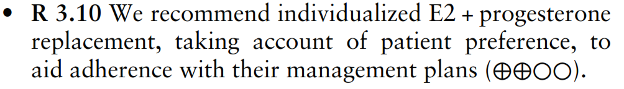
Choice of HRT
  Age
  Need for pubertal induction
  Need for GH
  Symptoms
  Contraindications to HRT
  Uterus present
  Need for Contraception
  HRT preparation and dose
  Co-morbidities
    VTE risk
    Malabsorption
    Liver disease
    Hypertension
  Patient preference
Individualise
Shared Decision Making
Notes:
The choice of hormone therapy depends on a number of factors including…
Shared decision making is important and the need to personalise therapy.

Slide 23
Management algorithm for POI
Systemic Hormone Therapy
Discuss benefits/risks
Individualize according to patient preferences and comorbidities
Non-hormonal treatments for VMS
CBT
Hypnosis
SSRIs
SNRIs
Gabapentin/Pregabalin
Clonidine
Oxybutynin
Fezolinetant
(Evidence for older women only)
Contraindicated?
(e.g. estrogen dependent cancers)*
Yes
No
Hysterectomy?
Yes
Estrogen-only HT
No
Contraception required?
No
Yes
Insufficient evidence to recommend herbal therapies or complementary medicine.
Continuous combined HRT
Sequential combined HRT
Combined COC (continuous use)
52mcg LNG IUS + Estradiol (transdermal or oral)
Notes:
This algorithm summarises the steps when considering choice of systemic hormone therapy for those with POI

Slide 24


Hormone Therapy and Co-morbidities
HT in women with POI with potential higher risks linked to co-morbidities
Avoid or personalize choice of HT
  Breast cancer survivor (NH)
  Known CVD (NH)
Malabsorption (TD)
BRCA1/2 mutations after RRBSO, without a personal history of breast cancer
Migraine (with Aura) (TD)
Hypertension (TD)
Diabetes mellitus
Obesity (TD)
Endometriosis (E+P)
Prior VTE (TD)
Abnormal liver function (TD)
TD: Transdermal
E+P: combined HRT even if hysterectomy
NH: Non-hormonal therapy
Notes:
The guideline has recommendations for HT use in the setting of different co-morbidities and are summarised here. Specialist advice may be helpful here
Tick means can be used but transdermal is suggested in view or malabsorption of oral HT
Orange indicates shared decision making with discussion of personalised risk/ benefits and in certain settings transdermal therapy is preferred.
For endometrioisis combned estrogen+ progestogen therapy is preferred even if hysterectomy to avoid reactivation or malignant transformation
The red symbol indicates that HT is generally contraindicated.

Slide 25
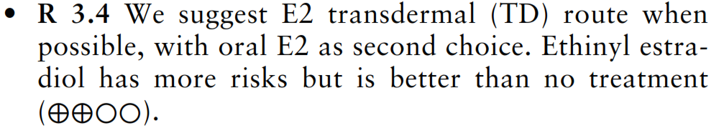
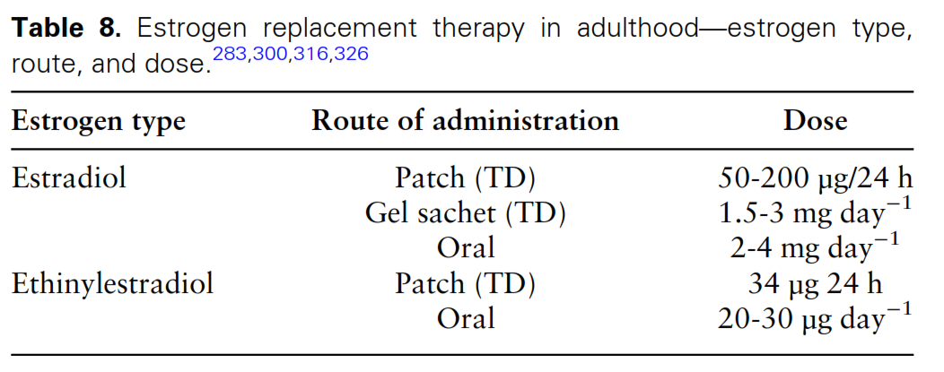
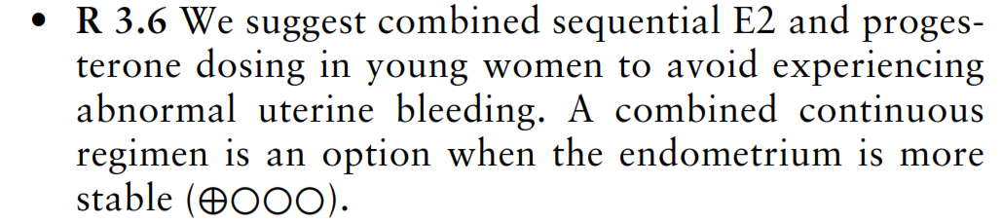
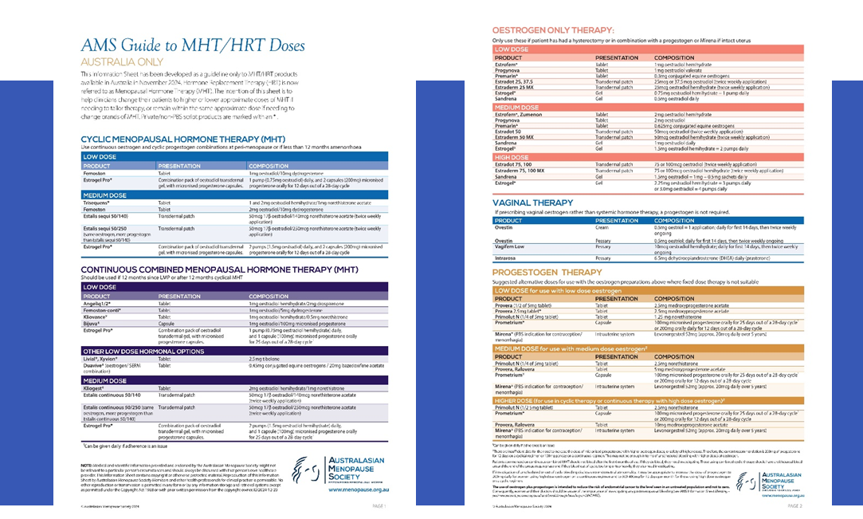
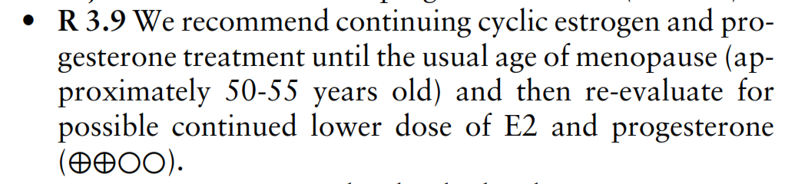
Hormone Therapy In Adulthood: Estrogen
Notes:
Recommendations regarding estrogen replacement therapy are shown here.
It is important to note that generally higher doses of estradiol are preferred and transdermal estradiol is suggested as the preferred route
The OCP with ethinyl estradiol may be required in those women with spontaneous menstrual function.
There is no data regarding the use of the estradiol containing OCPs but Qlaira would be an potential choice for oral contraception.

Slide 26
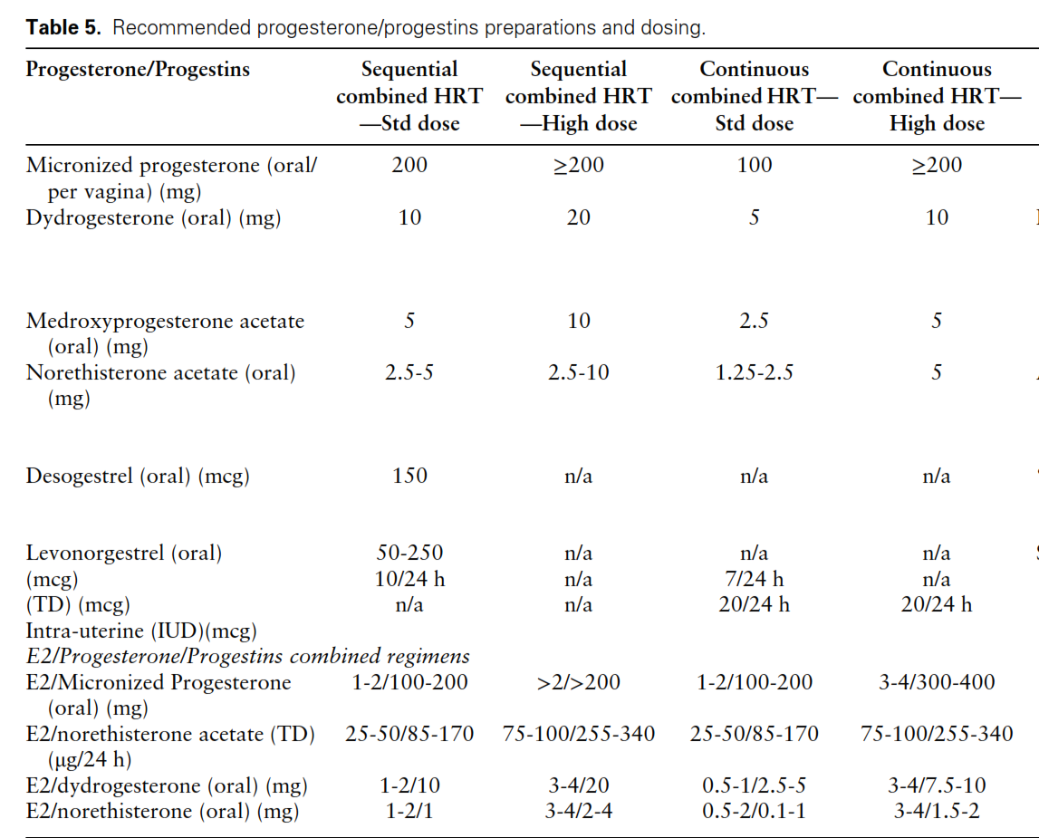
Hormone Therapy In Adulthood:
Progestogen
Need for higher progestogen dose with higher estrogen dose

Slide 27
Case: AB age 36y with mosaic TS
Discussed HRT options
  Elected to recommence COCP as was sexually active
  Prescribed 20mg Ethinyl estradiol COCP- to take continuously
Increased Vitamin D supplement dose
Provided lifestyle advice for CVD risk reduction, managing weight and bone health
Subclinical hypothyroidism
  Monitoring of TFTs at yearly minimum
Offered referral to psychologist
Referred to TS support group
Yearly clinical review
  Repeat Audiology in one year
  Repeat DXA every two years
  Repeat ECHO in 2-5 years

Slide 28
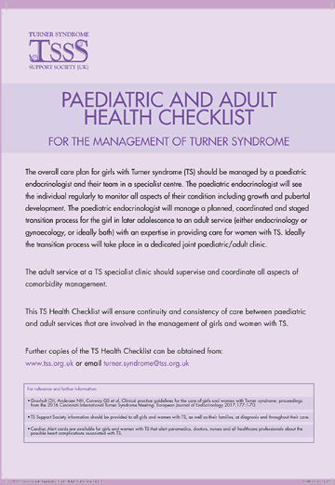
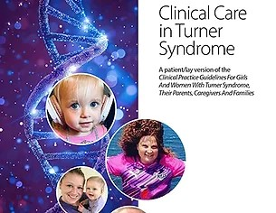
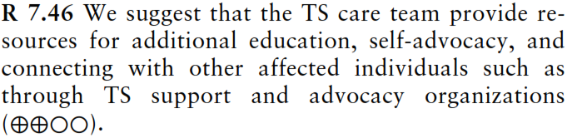
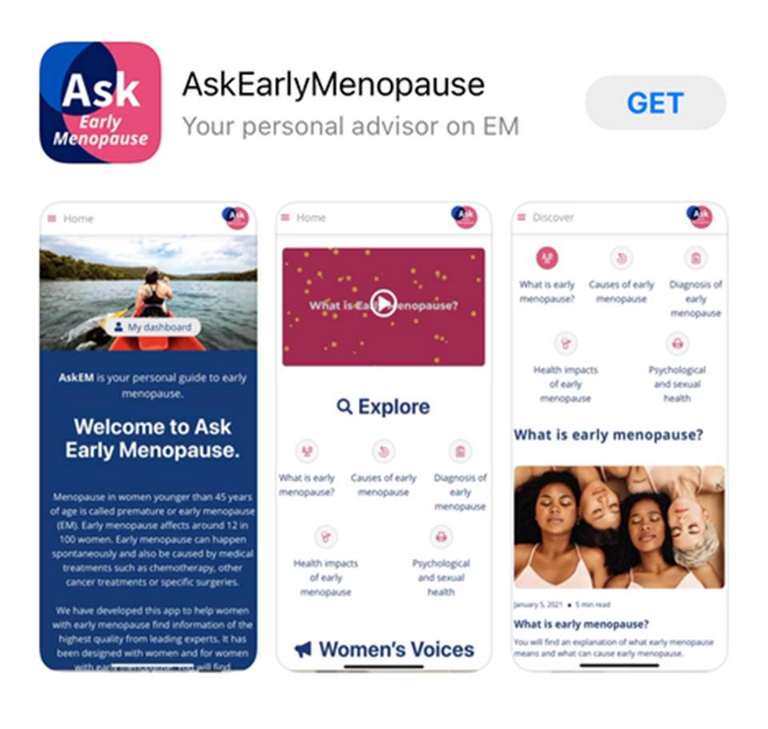
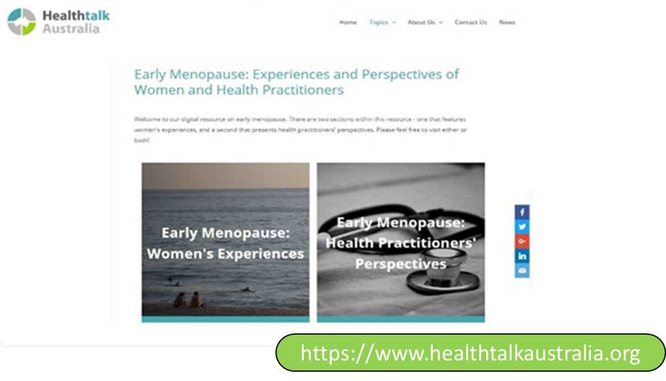

www.turnersyndrome.org/guidelines-and-checklists
Education and Support
https//tss.org.uk
https://www.turnersyndrome.org.au
https://www.earlymenopause.org/

Slide 29
Case: AB age 38y
24 months later at regular review at GP
Weight gain of 3 kg
No menopausal symptoms
Medication:
  EE COCP- taking continuously
  Vitamin D supplement
BP 140/ 90, weight 49kg BMI 25.4
TFTs unchanged
Lipids, FBG, HBA1C, LFTs normal
Cease ethinyl estradiol COCP
HRT Options:
  Needs contraception?
    Mirena+ transdermal estradiol
    Estradiol COCP
    SLINDA+ 50mcg estradiol patch
  Transdermal estrogen + prometrium
Lifestyle advice for BP and weight management
Home BP monitoring or Ambulatory BP monitoring
If BP does not improve then start anti-hypertensive
Consider ECHO
Notes:
Estradiol containing OCP eg Zoely
transdermal estrogen + progestogen

Slide 30
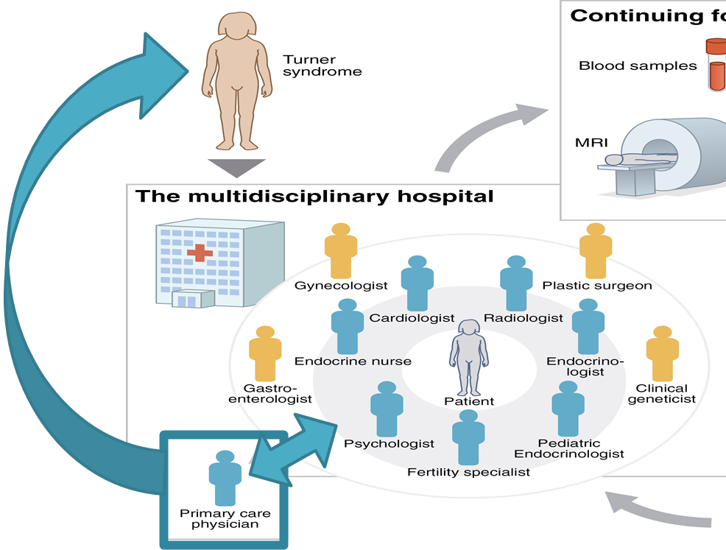
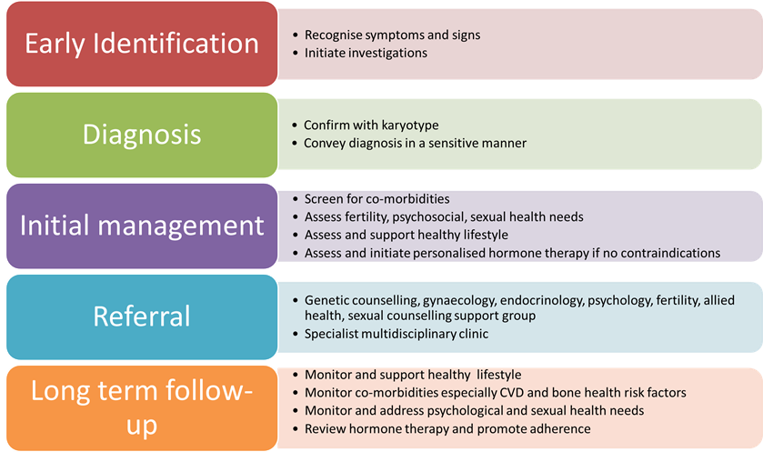
Take Home Messages
Consider the diagnosis of Turner syndrome in the young woman with oligo/amenorrhoea or characteristic clinical features
Diagnosis: karyotype
Inform of diagnosis in a sensitive manner
Provide education and psychological support
Assess, monitor and manage co-morbidities
Individualize HRT and continue until at least age 51 years
GP plays a key role as part of specialist healthcare team

Slide 31
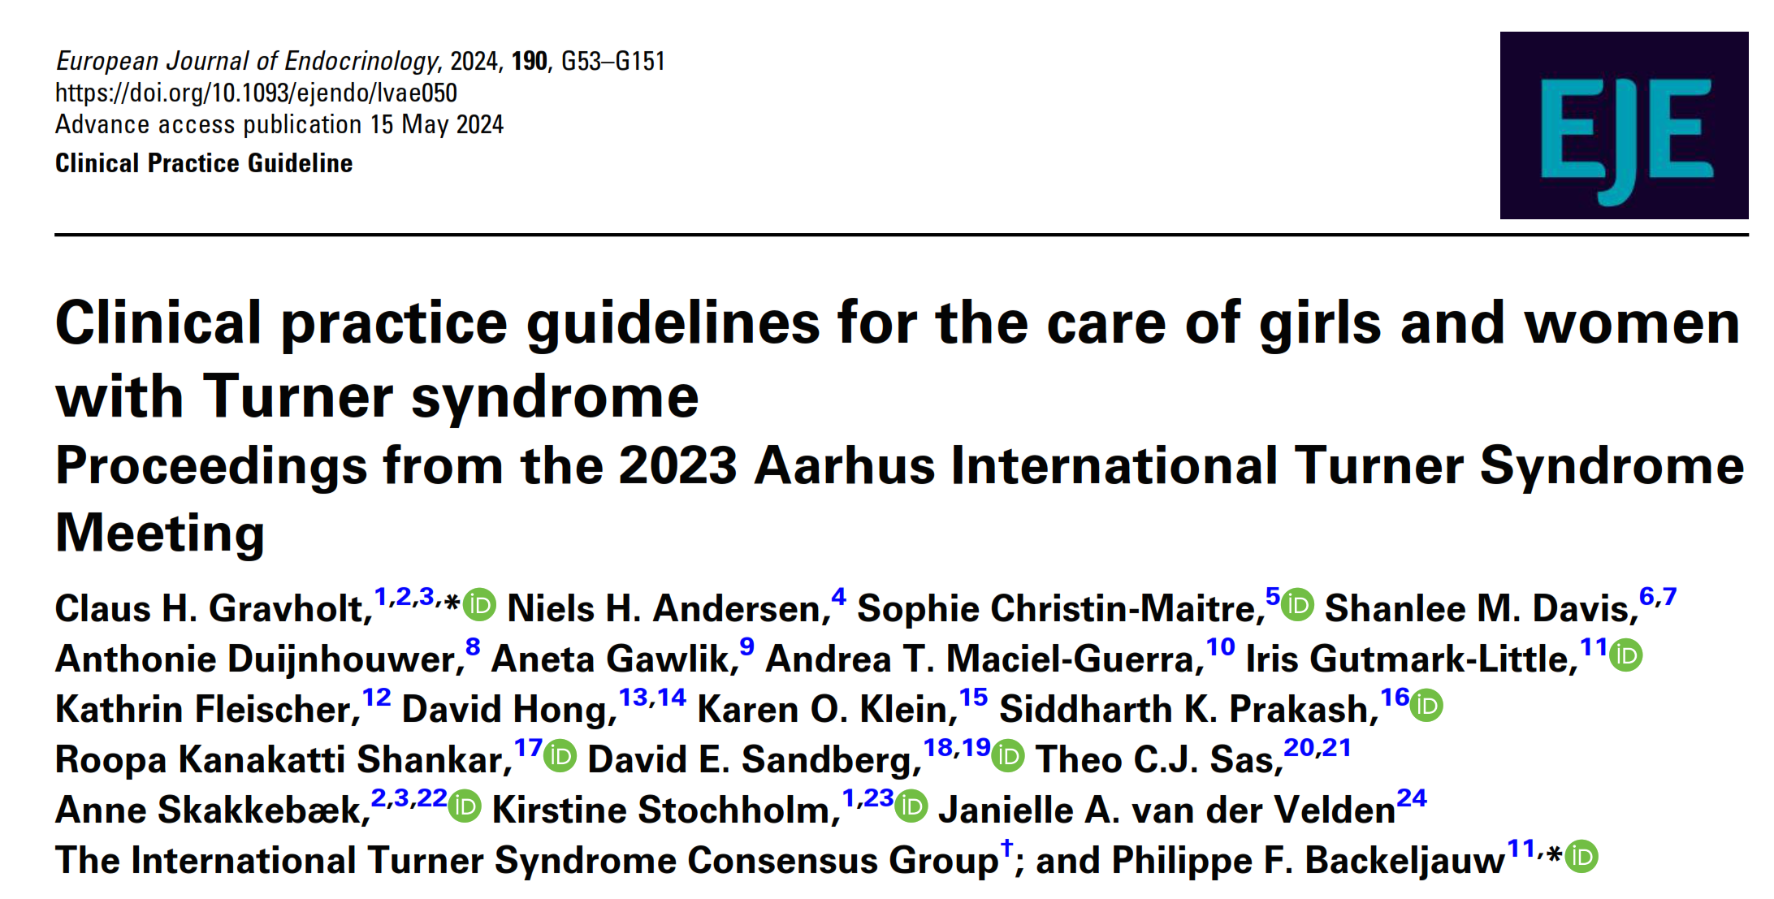
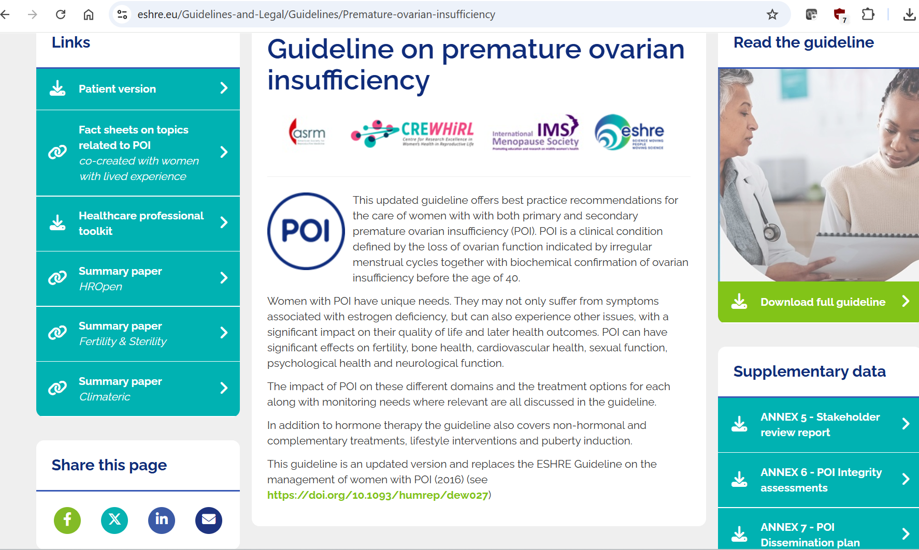
Useful
Resources

Slide 32

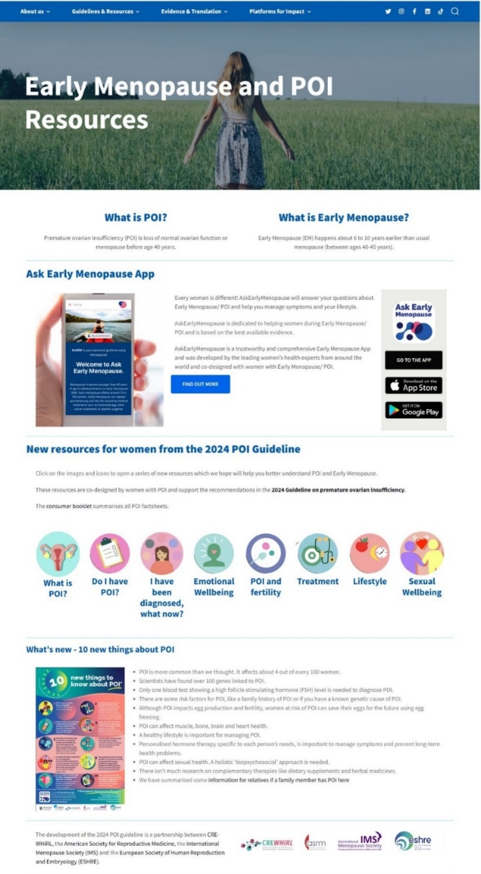

Education and Support
www.turnersyndrome.org/guidelines-and-checklists
https//tss.org.uk
https://www.turnersyndrome.org.au

Slide 33
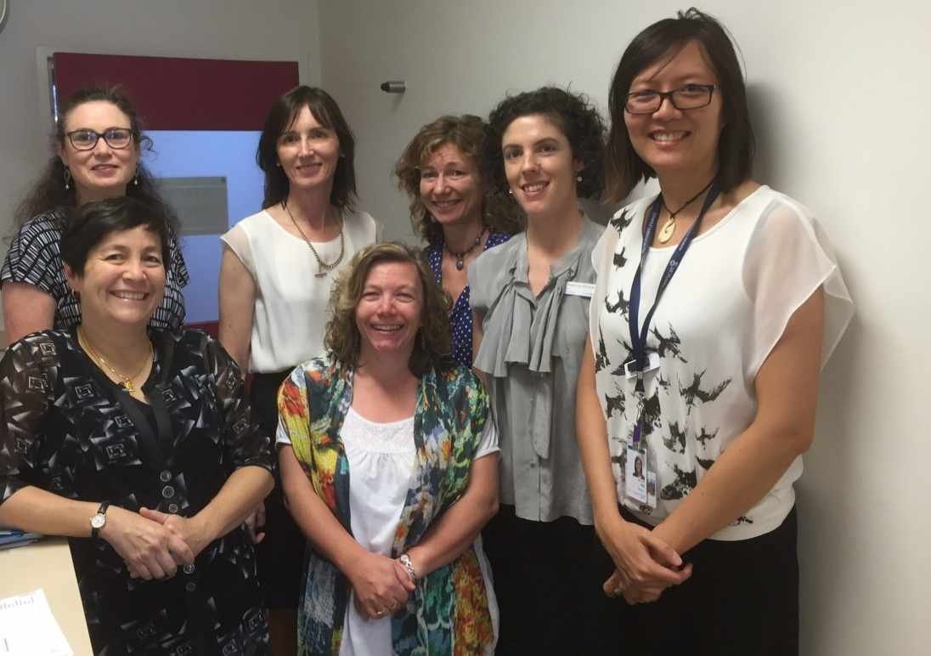

Acknowledgements
Turner Syndrome Long-term Clinic staff and patients
Jean Hailes For Women’s Health
Prof G Conway, University College London

Slide 34
Turner Syndrome and Cardiovascular Health
Dr Esther Davis – Cardiologist and Lead of Women’s Heart Health
Victorian Heart Hospital and Victorian Heart Institute
22nd November 2025

Slide 35
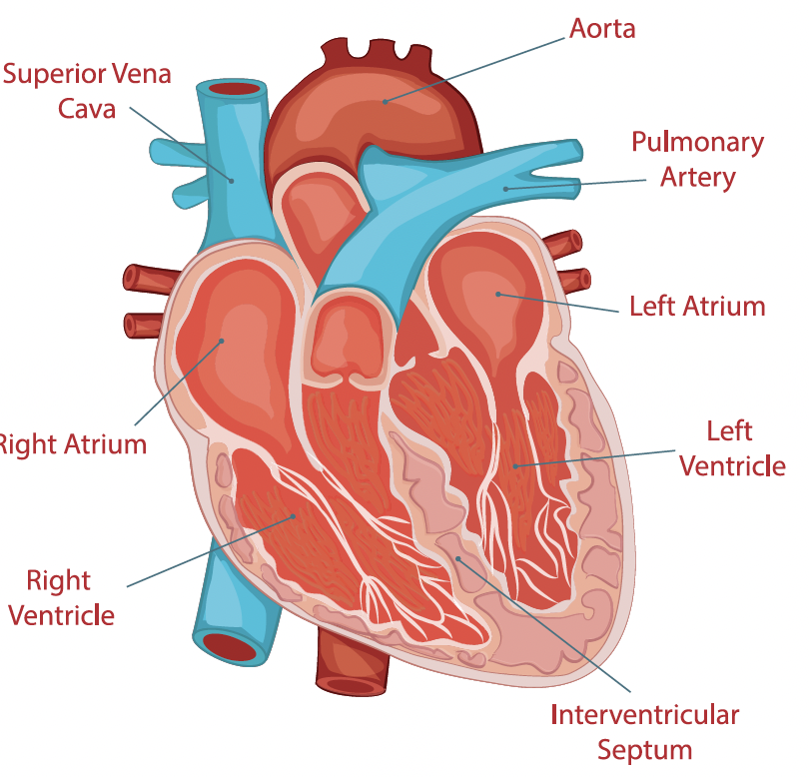
Overview
Overview of Cardiac disease in Turner Syndrome
Recommendations for screening for cardiac disease in Turner Syndrome (Adult and Paediatric)
Congenital Heart disease and Turner Syndrome
Aortic Dilation and Dissection in Turner Syndrome
Hypertension and Turner Syndrome
Hypercholesterolaemia and Turner Syndrome
Cardiac Disease and Pregnancy for patients with Turner Syndrome

Slide 36
Cardiac Issues that need to be considered in Turner Syndrome
Turner Syndrome patients have a significant lifelong burden of both congenital and acquired cardiovascular disease.
Cardiac disease is primarily responsible for the early morbidity and mortality that is seen in adults with Turner Syndrome
The prevalence of congenital heart disease is markedly increased compared to the general population (~50-60%)
  Particularly BAV and Coarctation
Aortopathy is prevalent and the risk of aortic dissection is high at smaller absolute aortic dimensions
Women with Turner Syndrome are also at risk of premature acquired coronary disease – exacerbated by high risk of premature onset hypertension and predisposition to metabolic abnormalities.

Slide 37
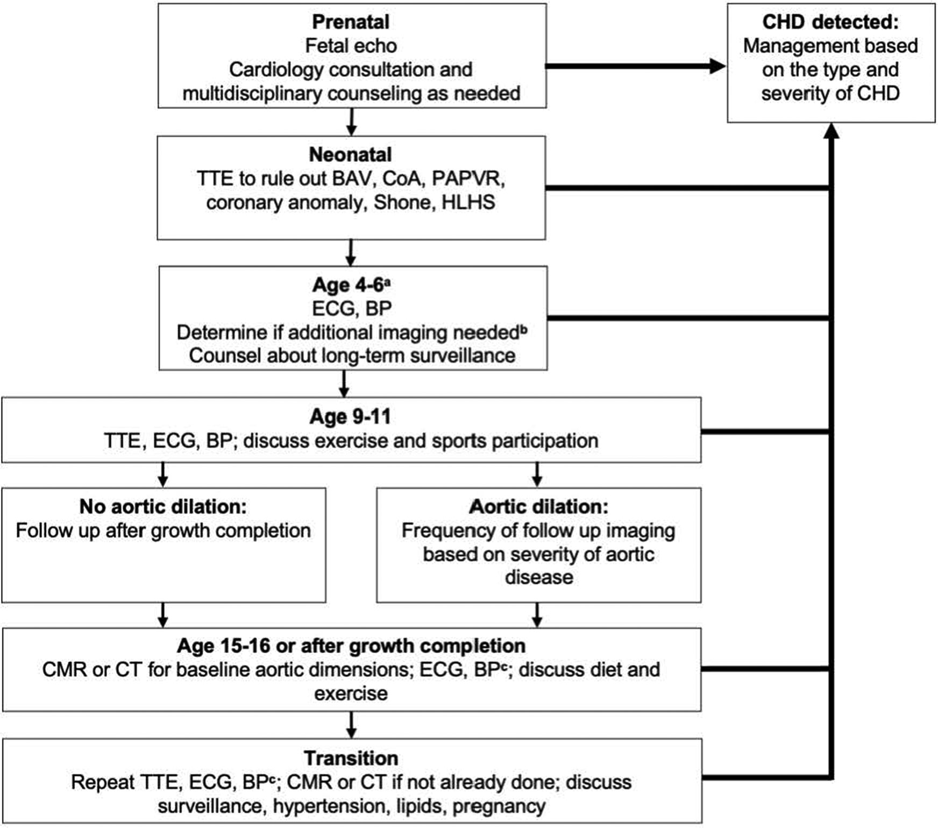
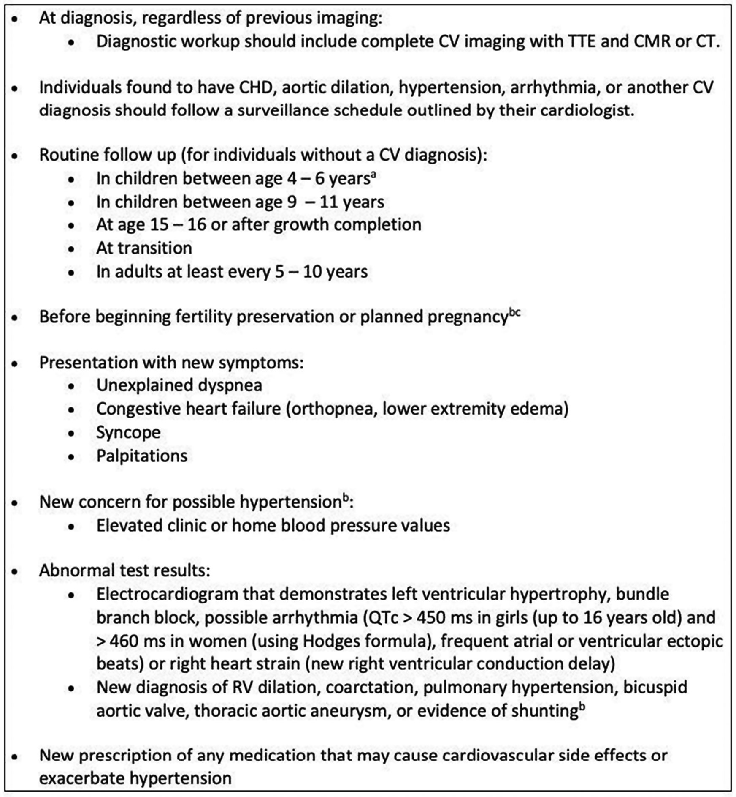
Recommendations for Cardiac Screening and Cardiology Involvement in Women with Turner Syndrome
Notes:
MBS billing number for aoropahthy can be used here

Slide 38
Congenital Heart Disease in Turner Syndrome
Depending on age and imaging technique used congenital heart disease may impact up to 40-60% of patients with Turner Syndrome
Left sided obstructive lesions are the most common.
Rates are highest with 45X karyotype and lower in patients with mosaicism.
Many vascular annomolies (particularly annomolous venous lesions) will not be detected without advanced cardiac imaging.

Slide 39
How Common is Congenital Heart Disease for Patients with Turner Syndrome
 | Turner Syndrome Patients | General Populations
Overall Congenital Heart Disease | 23-50% | 0.8% | 29-62 x more likely
Bicuspid Aortic Valve | 14-40% | 1-2% | Up to 40-50 x more likely
Aortic Coarctation | 4-15% | 0.34% | 12-44 x more likely
Bovine aortic arch | 6-29% | 13% | 2 x more likely
Aberrant right subclavian Artery | 6-8% | 0.5-2.5% | Up to 16 x more likely
Persistent left sided SVC | 2-13% | 0.3-0.5% | Up to 26 x more likely
Partial Anomalous Pulmonary Venous Return | 4-16% | 0.4-0.7% | 11-40 x more likely
Hypoplastic Left Heart | 4-5% | 0.0002-0.003% | More than 1000 x more likely
Notes:
Bovine aortic arch – LCC arises from the brachiocephalic
Abbarent right subclavian - arises as the forth branch of the acrch and tracks back around the oesophagous
Persistent left SVC – a vein that normally regresses persists and often drins into the RA via the coronary sinus.
PAPVR – pulmonary veins drain into the right rather than the left atrium
Hypoplastic left heart – the left ventricle is severely underdeveloped and cannot support the systemic circulation – very complex and requires surgical intervention in infancy

Slide 40
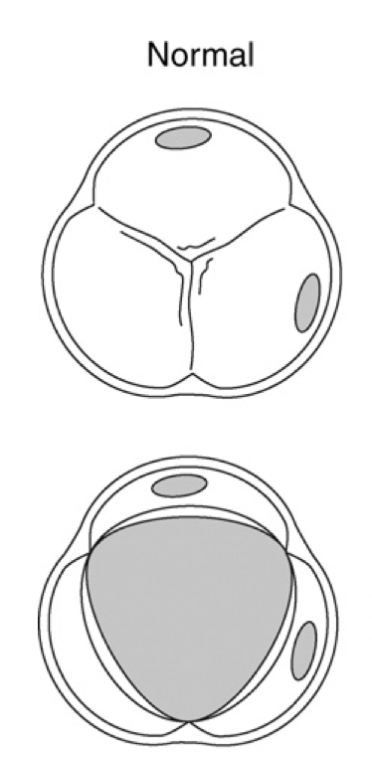
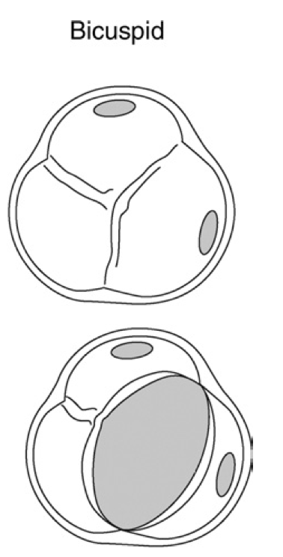
Bicuspid Aortic Valve
Bicuspid Aortic Valve are present in 14-40% of Women with Turner Syndrome.
BAV is frequently associated with thoracic aortic dilation, coronary anomalies, coarctation, and other left-sided congenital lesions.
Although BAV is a common feature of TS, isolated BAV is also common in the general population with a prevalence of 1%-2% - therefore diagnosis does not necessitate genetic evaluation unless other features are present.
Echocardiography should be performed at intervals depending on severity of stenosis, regurgitation and aortic dilation.
  With mild lesions echo should be undertaken every 3-5 years
  With moderate lesions echo should be undertaken every 1-2 years
Referral to cardiology is reasonable for any patient moderate or greater stenosis or regurgitation.

Slide 41
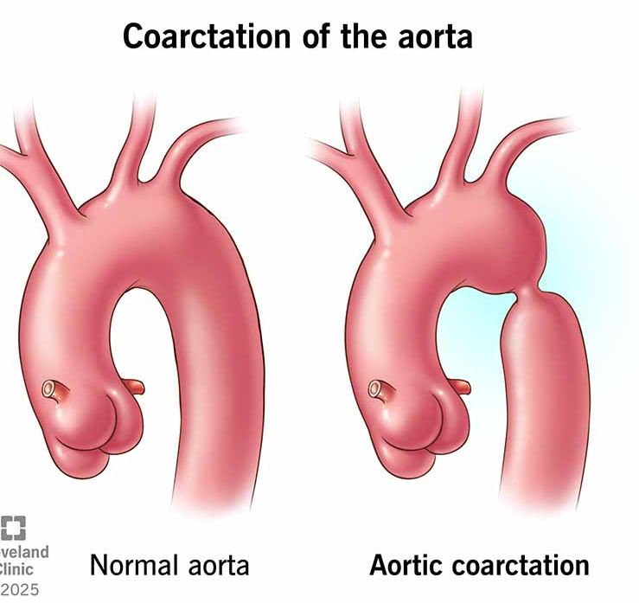
Coarctation of the Aorta
Coarctation of the aorta (CoA) is a narrowing of the descending aorta, which is typically located just distal to the left subclavian artery. Most cases are sporadic.
  Approximately 30% of patients will have another associated congenital abnormality.
Approximately 5 to 15 percent of girls with CoA have Turner syndrome
Genetic testing for Turner syndrome may be considered in patient with Coarctation
Clinical manifestations vary with age – in older children and adulthood hypertension is classic.
Treatment may be percutaneous or surgical depending on age and anatomy.
Hypertension may persist after treatment and recoarctation rates may be as high as 15%
All patients should be under the care of a cardiologist.

Slide 42
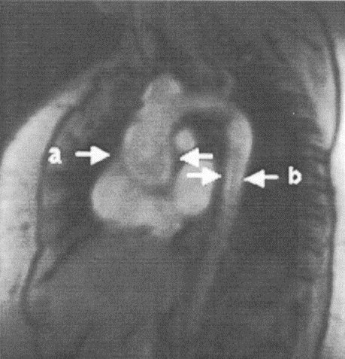
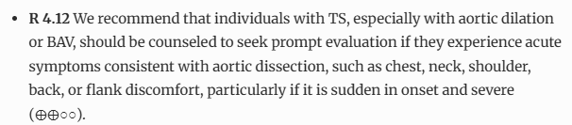
Aortic Dilation and Aortic Dissection
Incidence of aortic dissection is much high in Turner Syndrome
  164/100,000 py versus 6/ 100,000 py
Similar to other genetic aortopathies dissection occurs at a younger age
  Mean 30-35 years
Risk factors for dissection
  Bicuspid Valve
  Coarctation
  Pregnancy
  Hypertension
  Rapid increase in aortic dimension (>3mm/year)
  Absolute aortic size - risk is greatest at AHI > 23mm/m or with a z-score > 3.5
Echocardiography is the mainstay of monitoring – however CT and MRI are more accurate
Gravholt et al, European Journal of Endocrinology, June 2024

Slide 43
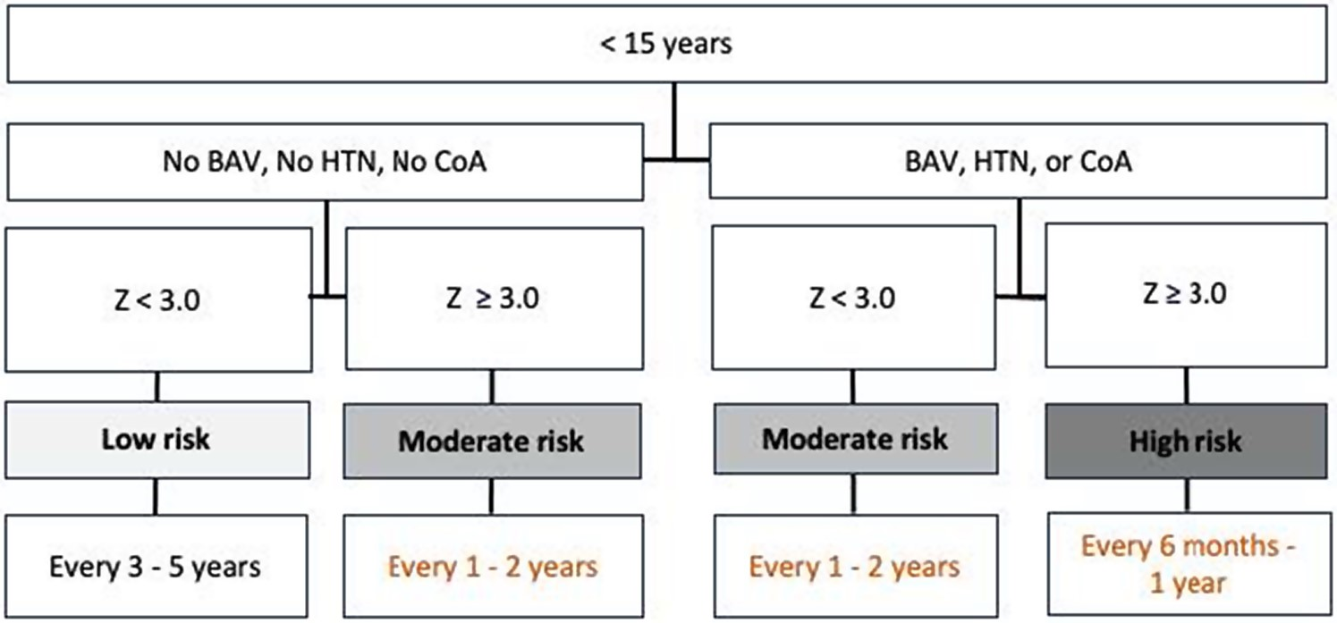
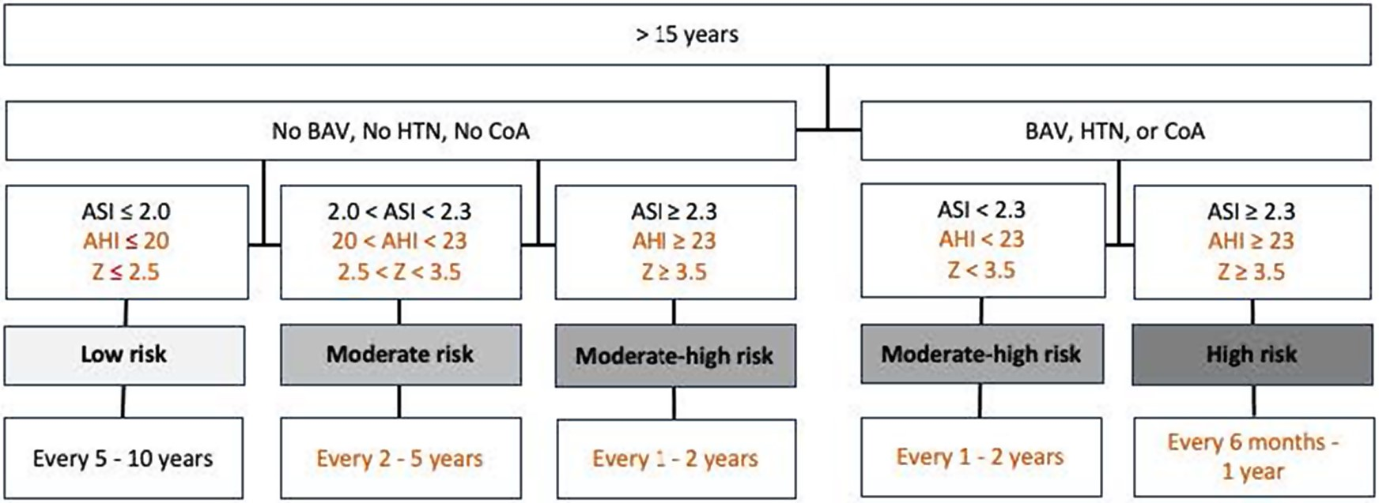
Screening guidelines for aortic dilation in Turner Syndrome

Slide 44
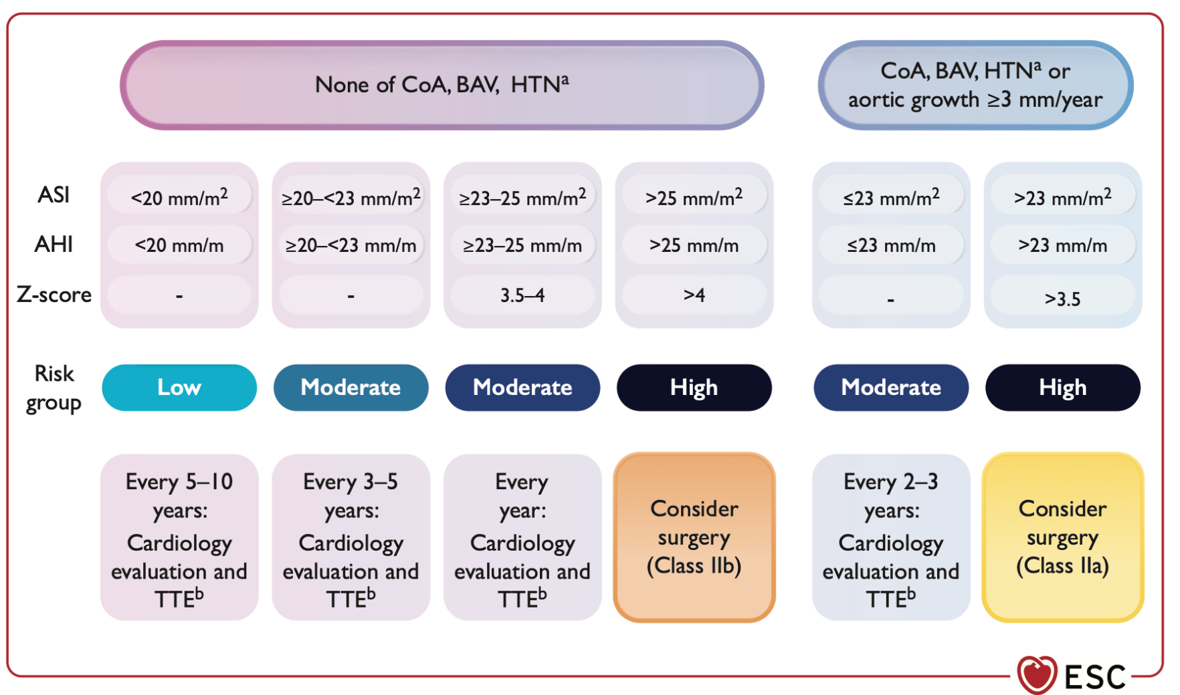
Interventional thresholds for aortic dilation in Turner Syndrome

Slide 45
Exercise and Activity with BAV and Aortic Dilation.
The metabolic and cardiovascular benefit of exercise outweigh the small risk of exercise induced aortic dissection for the vast majority of patients.
Current recommendations include at least 150 min of weekly moderate intensity, primarily aerobic physical activities for adults and at least 60 min of daily moderate to vigorous activities for children.
Before starting an exercise program it is important that the patient be evaluated for aortic dilatation.
Where the aortic size is normal no restrictions are required.
Where the aorta is mild to moderately dilated low and moderate intensity sports are acceptable but intense weight lifting should be avoided.
With a moderate to severely dilated aorta competitive sport, intense weight lifting and activities with risk of contact injury should be avoided.
Gravholt et al, European Journal of Endocrinology, June 2024
Notes:
R 4.29 We suggest that for individuals with normal aortic size (age < 15 years: Z < 2.5; age ≥ 15 years: AHI < 20 mm m⁻¹, ASI < 2.0 cm m⁻², or Z < 2.5), it is reasonable to participate in all sports (⨁○○○).
R 4.30 We suggest that for individuals with a mild to moderately dilated aorta (age < 15 years: Z 2.5-3.5; age ≥ 15 years: AHI 20-23 mm m⁻¹, ASI 2.0-2.3 cm m⁻², or Z 2.5-3.5), participation in low and moderate static and dynamic competitive sports may be acceptable but intense weight-training should be avoided (⨁○○○).
R 4.31 We suggest that individuals with a moderately to severely dilated aorta (age < 15 years: Z > 3.5; age ≥ 15 years: AHI > 23 mm m⁻¹, ASI > 2.3 cm m⁻², or Z > 3.5) should be advised not to participate in any competitive sports, intense weight-training, or physical activities with risk of contact injury to the chest (⨁○○○).

Slide 46
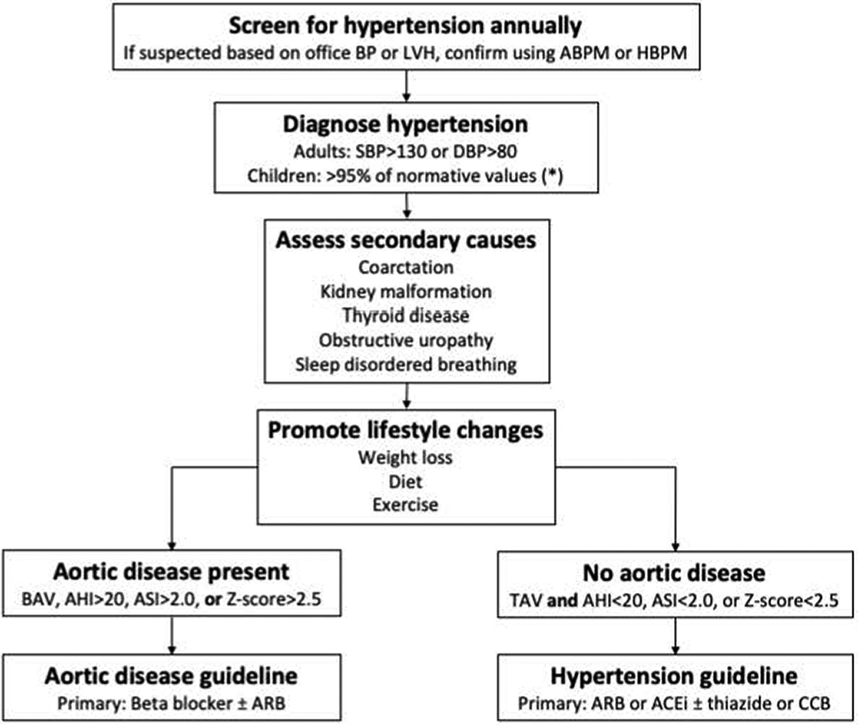
Hypertension and Turner Syndrome
Hypertension is 3-4 times more prevalent in Turner Syndrome compared to baseline population.
Hypertension is seen in 20-40% of children and up to 60% of adults with Turner Syndrome
Presentation is early and severity often progresses throughout life.
May associate with coarctation or renal abnormalities but can also be idiopathic.
Patients should be screened annually – and diagnosis confirmed with home or 24 hour ABP monitoring
  24 hour ABP is only funded if not on medication.
Treatment is with ARB/BB if aortic dilation or as per guidelines if no aortic dilation.
I aim for a BP of 120-129/70-79mmHg with no aortic disease and <120/70 if aortic dilation is present.
Notes:
There is inconclusive evidence about the effect of estrogen supplementation on blood pressure. A recent randomized clinical trial found no difference in the rate of increase in blood pressure over 5 years in young participants with TS (23 ± 2 years) who were assigned to 2 or 4 mg of oral E2 supplementation.³²⁸ A crossover study found that arterial stiffness and central blood pressures decreased in older individuals with TS (29 ± 9 years) after they stopped taking 2 mg oral E2.³⁵⁸ Another study showed that blood pressure decreased during treatment with E2 (either oral or TD) for 6 months compared with no treatment for 4 months.³⁵⁷ There is some evidence that blood pressure may be substantially lower with TD E2 preparations compared to oral ethinyl E2, but this has not been tested specifically in TS.³⁵⁹
We recommend treatment with a beta-blocker, an angiotensin receptor blocker, or both for individuals with TS who have hypertension and have a dilated aorta
Note ESC guuidelines (HTN 135/85 on 24 hour monitoring – however anything over 120/70 is elevated

Slide 47
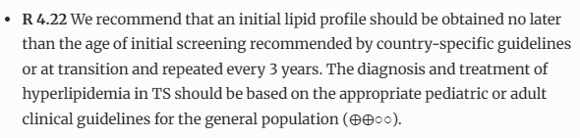
Cholesterol and Turners Syndrome
Hypercholesterolaemia is highly prevalent and influenced by obesity, metabolic syndrome and diabetes.
There is some suggestion that Turner Syndrome patients have higher cholesterol compared to controls impacting all aspects of the lipid panel.
Where cholesterol is elevated, it is important to exclude secondary causes.
Diet and lifestyle changes should be backbone of therapy for all patients with hypercholesterolaemia.
Statin therapy where needed should be to standard primary and secondary prevention guidelines.
Notes:
Individuals with TS and comorbidities often exhibit higher total cholesterol, LDL cholesterol, and triglycerides compared to controls, although severe elevations are infrequently reported.^{331,476}There does not seem to be a specific dyslipidemia associated with TS.

Slide 48
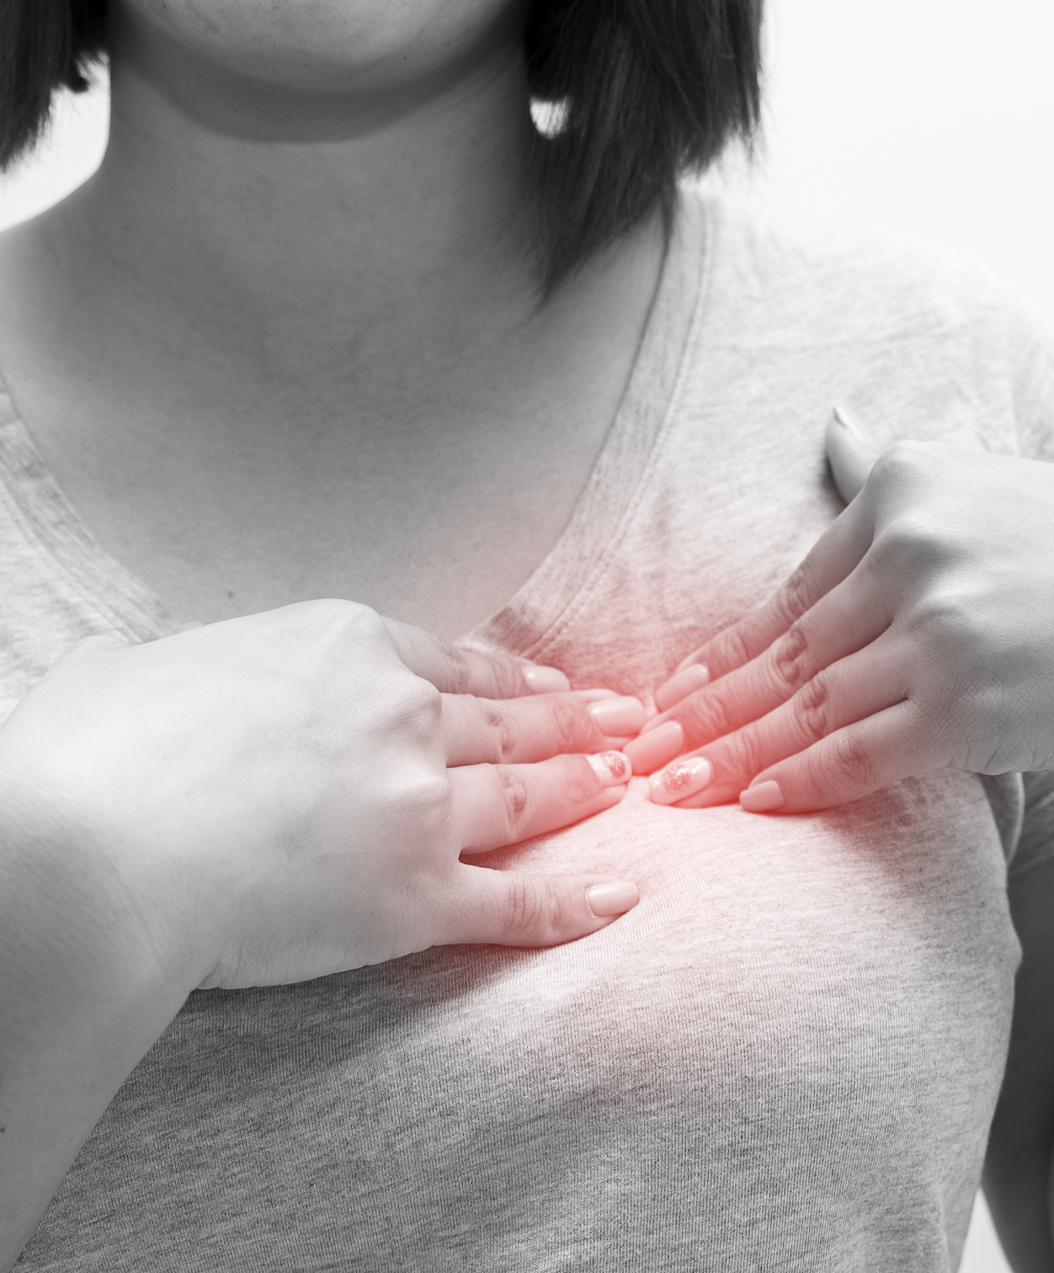

Coronary Artery Disease in Turner Syndrome
Ischaemic heart disease is a major cause of morbidity and mortality in Turner Syndrome.
Women with Turner Syndrome may develop premature CAD due to multiple metabolic risk factors – particularly hypertension, diabetes and metabolic syndrome.
There is no benefit to routine screening for coronary artery disease in Turner Syndrome (outside of standard preventative health screening recommendations).

Slide 49


Turner Syndrome, Cardiovascular Disease and Pregnancy
Pregnancy is a high-risk period for aortic dissection.
Women with Turner Syndrome are also at increased risk of hypertensive disorders of pregnancy
Women need full cardiovascular imaging (ideally CMR) within 2 years of a planned pregnancy.
The majority of women will tolerate pregnancy well from a cardiac POV – but severe valve lesions and significant aortic dilation is a high-risk situation.
A cardiologist with experience in cardio-obstetrics should be involved as part of the treating team when pregnancy is planned.

Slide 50
Thank you

Slide 51


Turner Syndrome and Fertility
Professor Beverley Vollenhoven AM
Reproductive Endocrinologist and Infertility Specialist
Carl Wood Chair of Obstetrics and Gynaecology, Monash University
Head of Gynaecology and Research, Monash Health
Monash IVF

Slide 52
Fertility
90-95% are infertile (1.3-5%)
Causes:
  Ovarian failure due to absent or damaged ovarian follicles
  Accelerated depletion of oocytes
Some mosaic TS (45,X/46,XX) may retain some fertility and even some with 45XO may have pregnancies if XX in ovaries

Slide 53

Ovarian Reserve Decline in Turner Syndrome

Slide 54
Fertility Preservation
Fertility window is narrow
Oocyte cryopreservation: Must have reached puberty and for those with detectable ovarian function. Requires IVF cycle
Embryo Cryopreservation: Requires partner
Ovarian tissue cryopreservation: pros and cons. May retain fertility but may also be at the expense of future ovarian function.

Slide 55
Ovarian Tissue Freezing
Surgical removal of ovarian cortical tissue containing follicles or unilateral oophorectomy
Tissue cryopreserved and transplanted later to restore fertility/endocrine function
Accepted by ASRM (2019) as a standard option for fertility preservation
Counsel about uncertainty: limited evidence of live births after OTC specifically in TS

Slide 56
Ovarian Tissue Cryopreservation Process
Ovary biopsy
Tissue slicing
Cryopreservation
Reimplantation

Slide 57

Outcomes After OTC

Slide 58
Other Fertility Options
Egg donation + IVF: most common and successful option. Pregnancy possible as uterus functional
Surrogacy if high cardiac risk
Adoption
Child free living

Slide 59
Pregnancy Planning
High risk of aortic dissection and maternal mortality
Increased risks: hypertension, diabetes, preeclampsia
Need for comprehensive cardiovascular and endocrine evaluation before conception

Slide 60
Pregnancy Planning
Cardiovascular evaluation:
MRI/CT of aorta before pregnancy
Assess for bicuspid aortic valve, coarctation
Metabolic evaluation:
Glucose tolerance test, thyroid, liver, renal function
Endocrine:
Optimize thyroid/metabolic control
Estrogen/progesterone replacement until conception

Slide 61
Pregnancy
Aortic dissection (1–2%)
Hypertension, preeclampsia
Preterm birth, SGA
LUSCS common
Joint care: maternal-fetal medicine, cardiology, endocrinology
Blood pressure control
Serial cardiac imaging
Delivery at tertiary centre

Slide 62
Post Partum
Cardiovascular reassessment (MRI 6 months postpartum)
Endocrine follow-up
Contraception counseling
Psychological support

Slide 63
Pregnancy Contraindications
ASI ≥2.5 cm/m²
Severe aortic or cardiac disease
Uncontrolled hypertension
Significant renal disease

Slide 64
Monash Health Data
2009 – 2022
 | 45X | Mosaic
Number of pregnancies | 10 | 15
Spontaneous conception | 0 | 10
Pregnancies using ART | 10 | 5
Multiple pregnancy | 0 | 1
Age at first pregnancy (years, mean) | 37 | 27
BMI (kg/m2, mean) | 25 | 31.6
Patients with pre-existing comorbidity* (n) 1 3 | 1 | 3
Existing cardiac condition (n) 0 0 | 0 | 0
Miscarriage Livebirth (n) 5 12 | 5 5 | 3 12

Slide 65
Conclusions
TS often leads to infertility but options exist
Early detection, intervention critical
With proper care, safe and fulfilling paths to parenthood are possible

Slide 66
References
Gravholt CH, Andersen NH, Conway GS, et al. Clinical practice guidelines for the care of girls and women with Turner syndrome: proceedings from the 2016 Cincinnati International Turner Syndrome Meeting. Eur J Endocrinol. 2017; 177(3): G1- G70. doi.org/10.1530/eje-17-0430
Marqui ABT. Turner syndrome and spontaneous pregnancy. J Bras Pathol Med
Lab. 2018; 54: 387- 392. doi.org/10.5935/1676-2444.20180065
Grewal J, Valente AM, Egbe AC, et al. Cardiovascular outcomes of pregnancy in Turner syndrome. Heart. 2021; 107(1): 61- 66. doi.org/10.1136/heartjnl-2020-316719
Whigham CA, Vollenhoven B, Vincent A. Reproductive Health in Turner Syndrome: a narrative review. Prenat Diagn. Nov 2022. doi.org/10.1002/pd.6261
Practice Committee for ASRM. Increased maternal cardiovascular mortality associated with pregnancy in women with Turner Syndrome. Fertil Steril. 2012 Feb;97(2):282-4. doi: 10.1016/j.fertnstert.2011.11.049.

Slide 67
References
ESHRE Guideline: Female fertility preservation. Hum Reprod Open. 2020. (ESHRE Guideline on Female Fertility Preservation)
ASRM Practice Committee Opinion: Fertility preservation in patients undergoing gonadotoxic therapy or gonadectomy. 2019
Cuman et al. 'Exploring the Frontiers of Ovarian Tissue Cryopreservation' J Clin Med. 2024;13(15):4513
Turner Syndrome Foundation: Fertility preservation review and practical guidelines. 2024
Nadesapillai et al. TurnerFertility trial and related Fertility and Sterility commentary. 2023-2024
Anderson et al. Systematic reviews on ovarian tissue transplantation outcomes. Front Endocrinol. 2022; and Hum Reprod Update reviews
Gravholt CH et al. Lancet Diabetes Endocrinol. 2019;7(8):639–652
Donadille B et al. Fertil Steril. 2020;114(6):1282–1293
Bondy CA. J Clin Endocrinol Metab. 2007;92(1):10–25
ASRM Practice Committee. Fertil Steril. 2016;106(8):e56–e62
European Society of Cardiology Guidelines. Eur Heart J. 2018
Notes:
Include DOI/URLs in handout for attendees. Selected recent reviews and guidelines listed.

