Slide 1

Sexual health
Notes:
Insert a text box to add presenter name and position title.

Slide 2
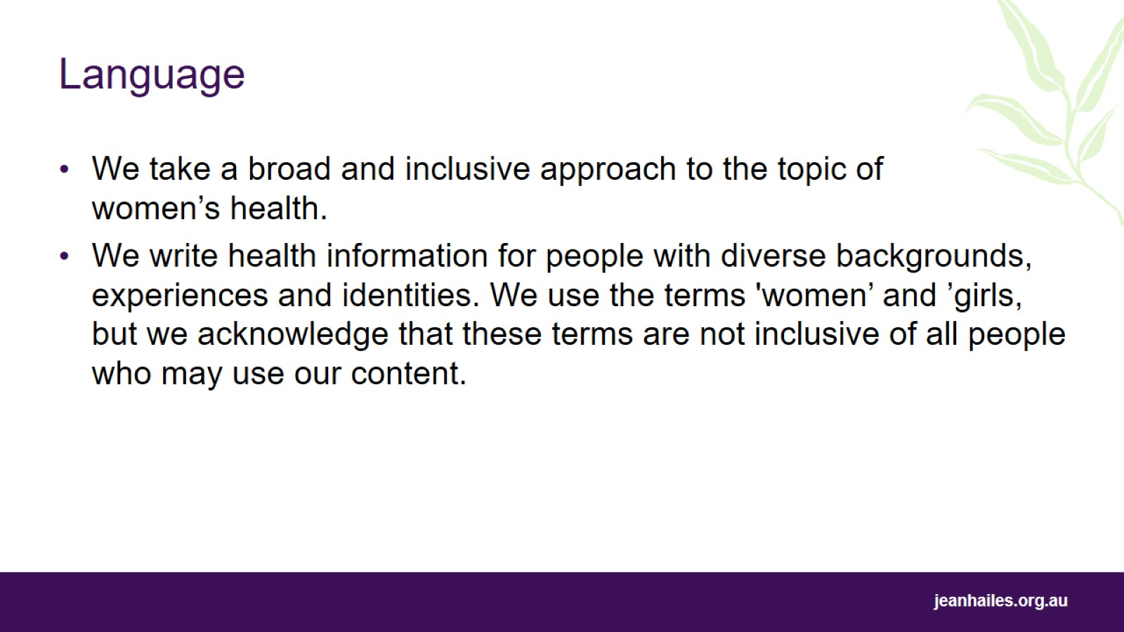
Language

Slide 3
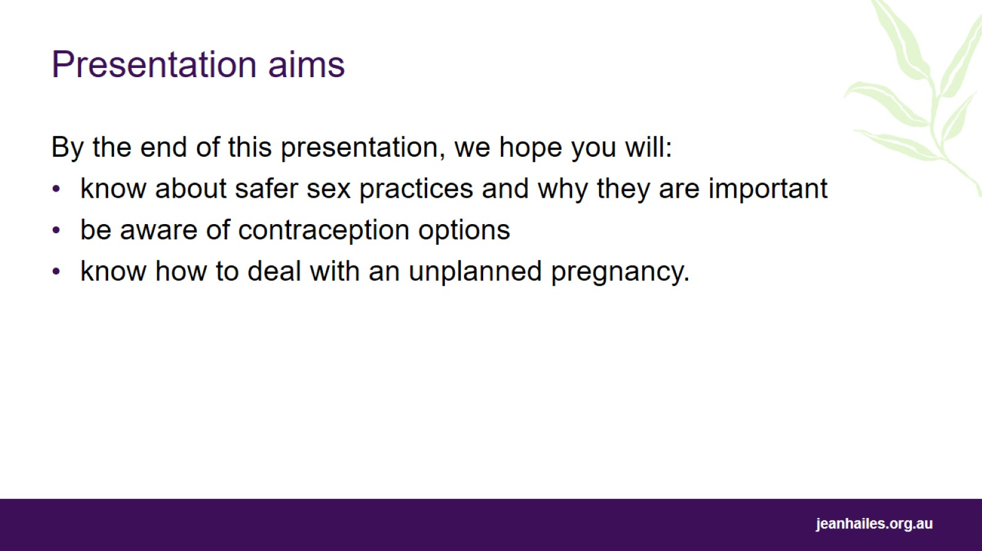
Presentation aims
Notes:
Today we’ll be talking about sexual health.
By the end of this presentation, we hope you will:
know about safer sex practices and why they are important
be aware of contraception options
know options for dealing with unplanned pregnancy.

Slide 4
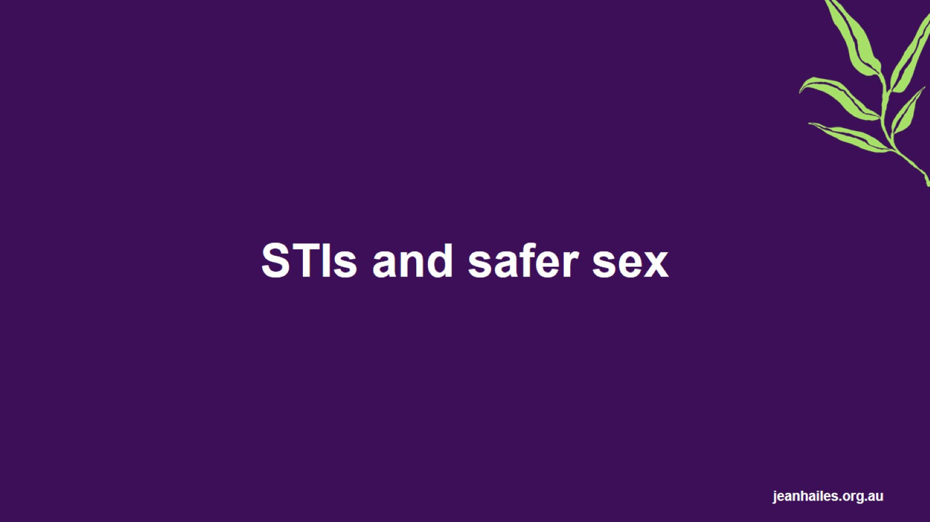
STIs and safer sex

Slide 5
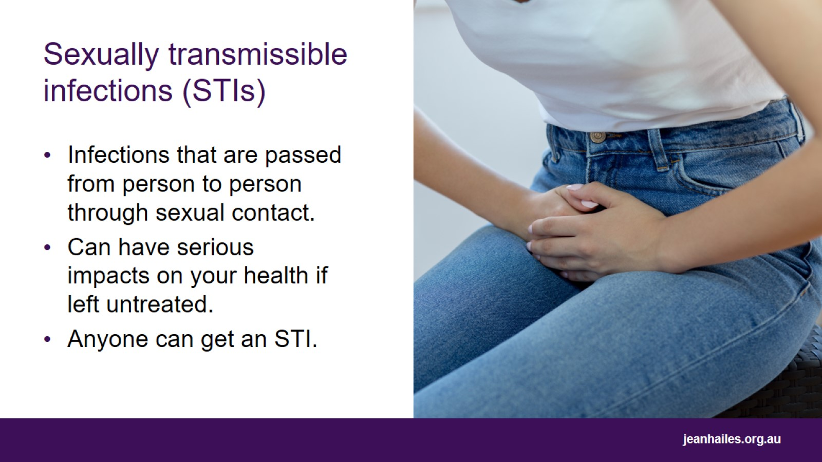
Sexually transmissible infections (STIs)
Notes:
Sexually transmissible infections (STIs) are infections that are passed from person to person through sexual contact. This can be through exchange of bodily fluids such as semen, or through skin-to-skin contact.
Most STIs can be cured and all can be treated with medication. Some infections can be lifelong, such as HIV and herpes.
STIs can have serious impacts on your health and wellbeing if left untreated. For example, if left untreated, chlamydia can lead to issues such as pelvic pain and infertility.
Anyone can catch an STI.
You can catch an STI at any age – rates of STIs among older women are increasing.
You cannot tell if someone has an STI just by looking at them.

Slide 6
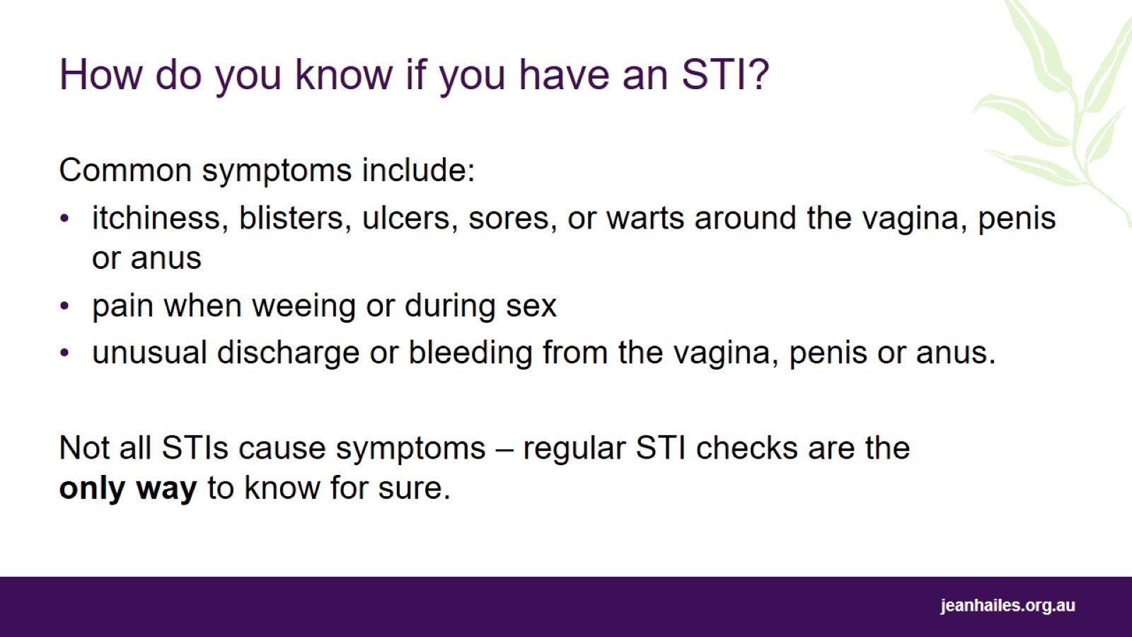
How do you know if you have an STI?
Notes:
How do you know if you have an STI?
Common symptoms of STIs include:
itchiness around the vagina, penis or anus
pain when peeing
unusual discharge from the vagina, penis or anus
painful sex
unusual vaginal bleeding
blisters, ulcers, sores, warts.
However, not all STIs cause symptoms. For example, chlamydia often doesn’t cause symptoms.
Regular STI checks are the only way to know if you have an STI.

Slide 7
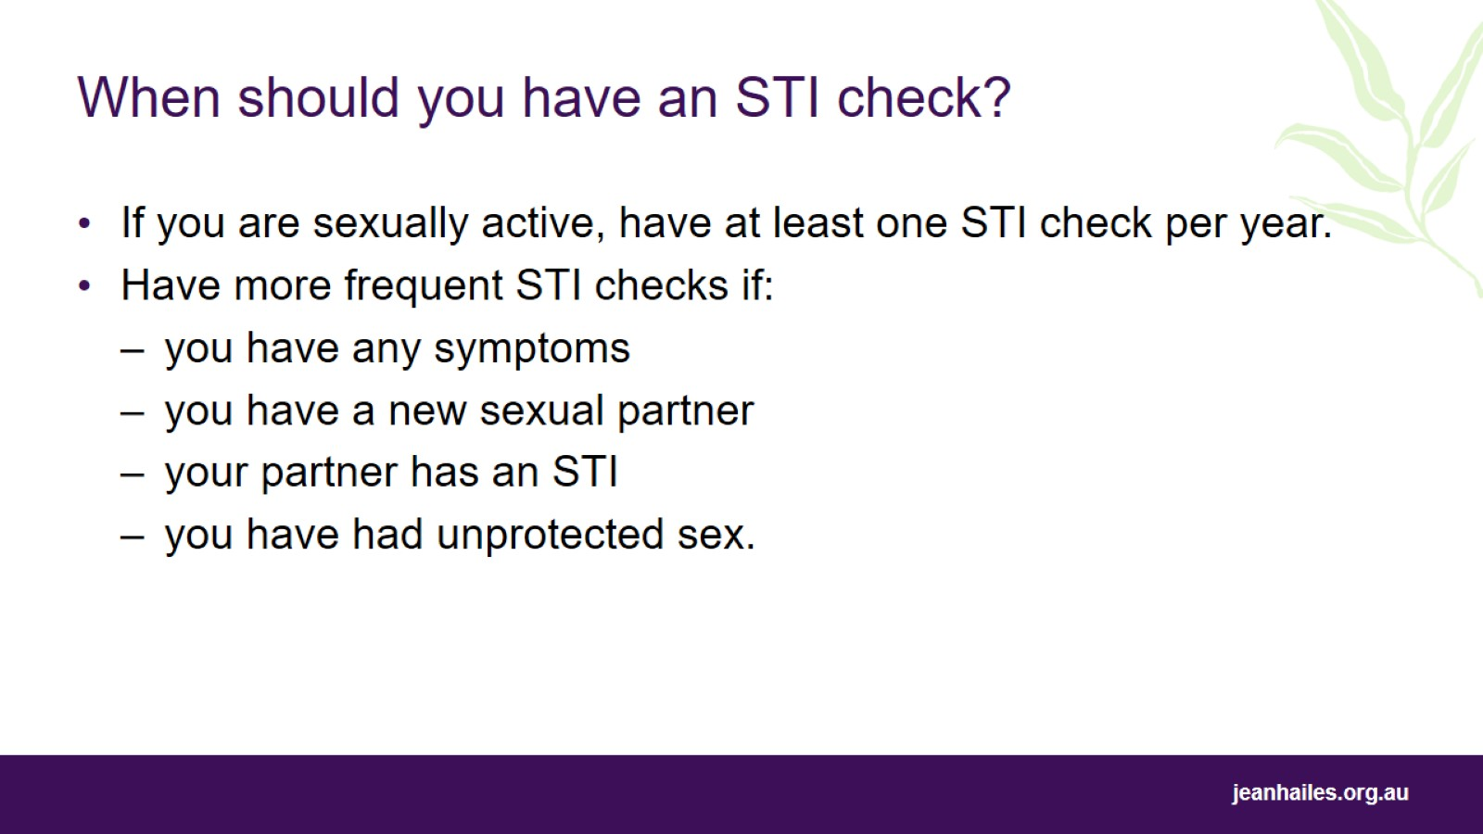
When should you have an STI check?
Notes:
If you are sexually active, it is recommended that you should have a sexual health check at least every year.
You may need to be tested more regularly if:
you have any symptoms
you have a new sexual partner
your partner has an STI
you have had unsafe sex, i.e. you have had sex without using a barrier method of contraception like a condom.
There may be other reasons for you to be tested more regularly than once a year. Talk to your doctor or nurse about your specific circumstances.
Talk to your doctor or nurse about getting an STI test.
You can also go to a women’s health clinic or a sexual health centre. These organisations specialise in sexual health and STI checks and can be a good option, especially if you feel embarrassed or uncomfortable going to your regular doctor.

Slide 8
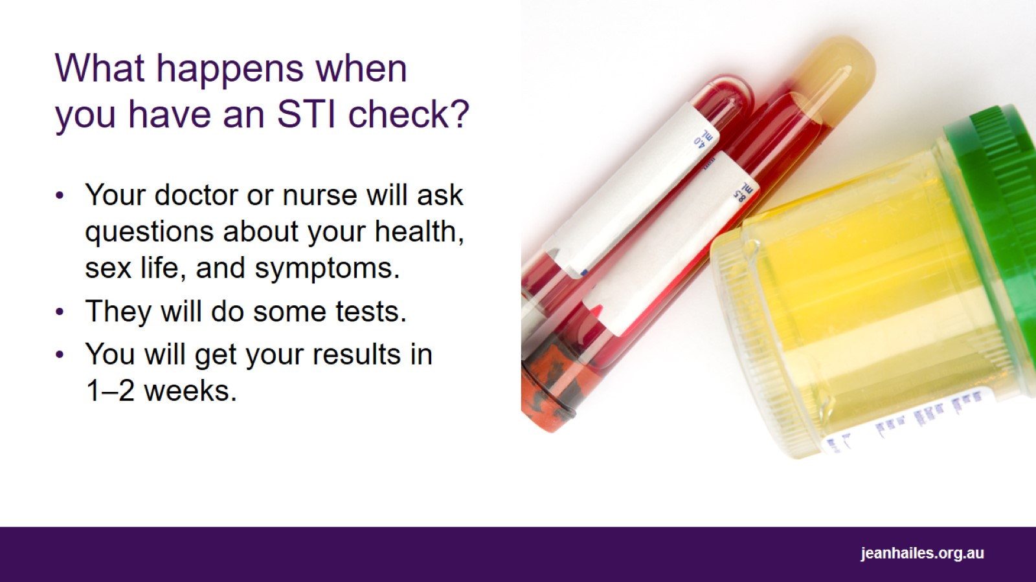
What happens when you have an STI check?
Notes:
Going for an STI check can be a daunting experience, especially if you’ve never had one before. Knowing what will happen when you go for a check can help you to feel more comfortable. Your doctor or nurse won’t tell your friends or family that you’ve had an STI check, what you’ve spoken about or what your results are. It’s between you and your doctor or nurse.
Your doctor or nurse will ask you some questions about your health, sex life and symptoms. It’s important to answer these questions honestly, as your answers will help the doctor or nurse decide which tests to take. This could be questions such as:
Have you had an STI check in the past? When was your last check?
Do you have vaginal sex? Do you have oral sex? Do you have anal sex?
Do you have any tattoos or body piercings?
Do you have any symptoms?
Then, your doctor or nurse will decide what tests need to be done. They might:
take blood or urine (wee) samples
take vaginal, anal or throat swabs
check your vagina for signs of STIs.
Usually, you will get your results back in 1–2 weeks. Depending on the result, your doctor or nurse might notify you by text or phone call, or they may ask you to come in for another appointment.

Slide 9
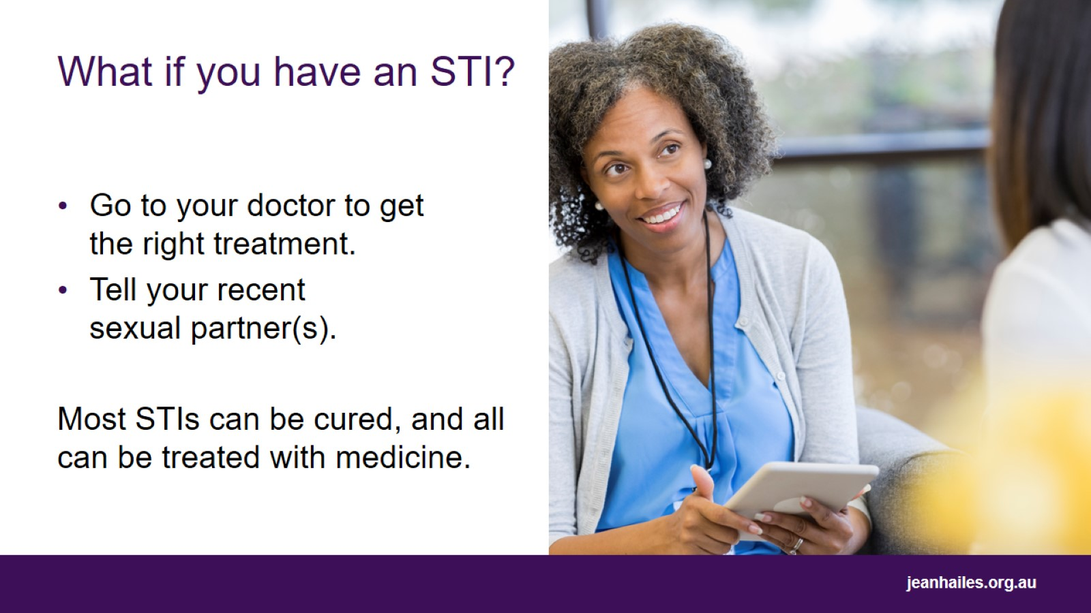
What if you have an STI?
Notes:
If your test result shows that you have an STI, you will need to return to the doctor to discuss treatment.
You will also need to notify your recent sexual partners so that they can be tested, and treated if they have any STIs. You can notify partners anonymously via services such as letthemknow.org.au
Finding out you have an STI can be scary. Remember, most STIs can be cured and all can be treated with medication.

Slide 10
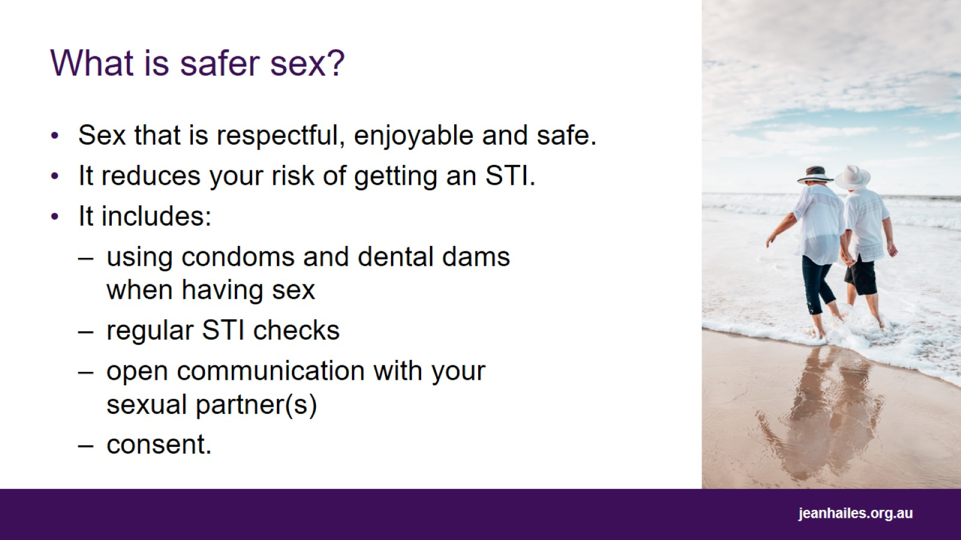
What is safer sex?
Notes:
Safer sex means having sex that is respectful and enjoyable while reducing the risk of getting an STI.
The best way to avoid getting or transmitting an STI is to use condoms and dental dams.
Condoms are plastic or rubber sheaths that are worn on an erect penis or inside the vagina which catch sperm and stop it from reaching the egg.
Dental dams are sheets of thin, stretchy latex that are placed between the mouth and genitals or anus when having oral sex.
Condoms and dental dams prevent the exchange of bodily fluids such as semen and vaginal fluids.
Other safer sex practices include:
having regular STI checks,
open communication with your sexual partner(s) about your sexual needs and preferences, whether you are having sex with other people and whether you have an STI or symptoms of an STI
consent.

Slide 11
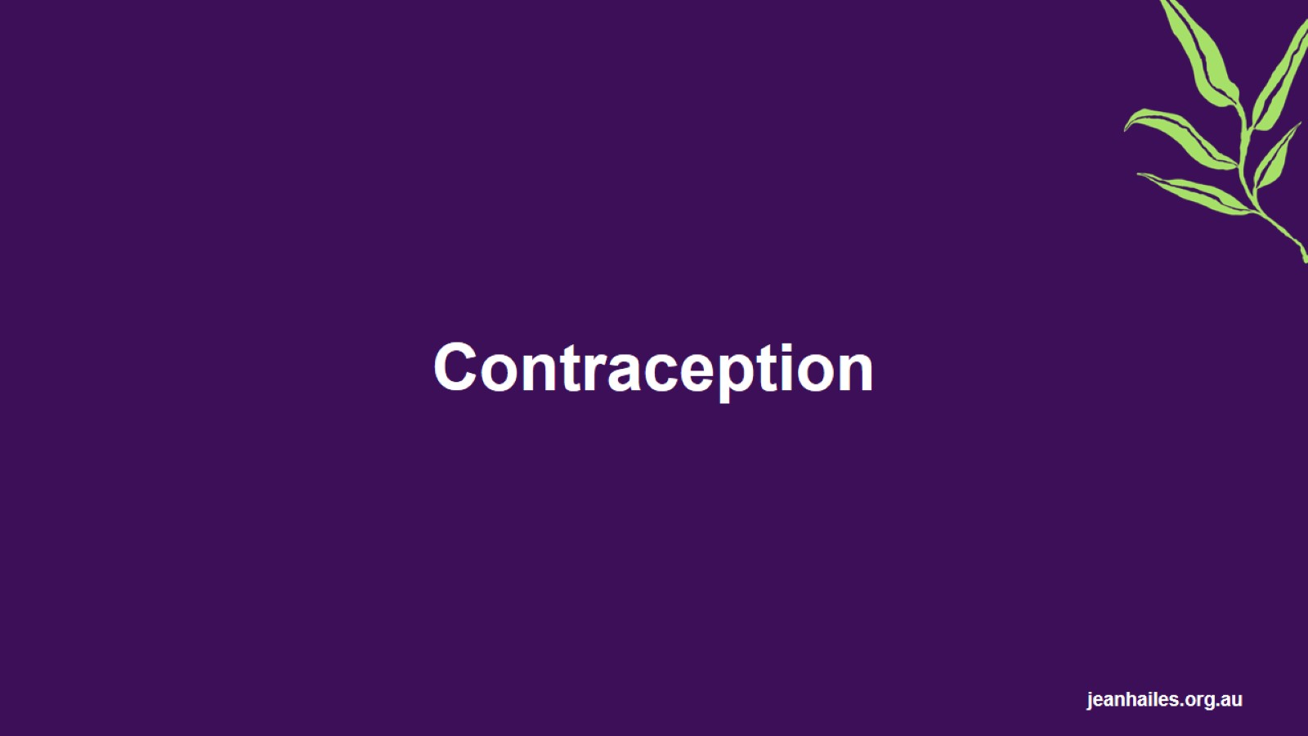
Contraception

Slide 12
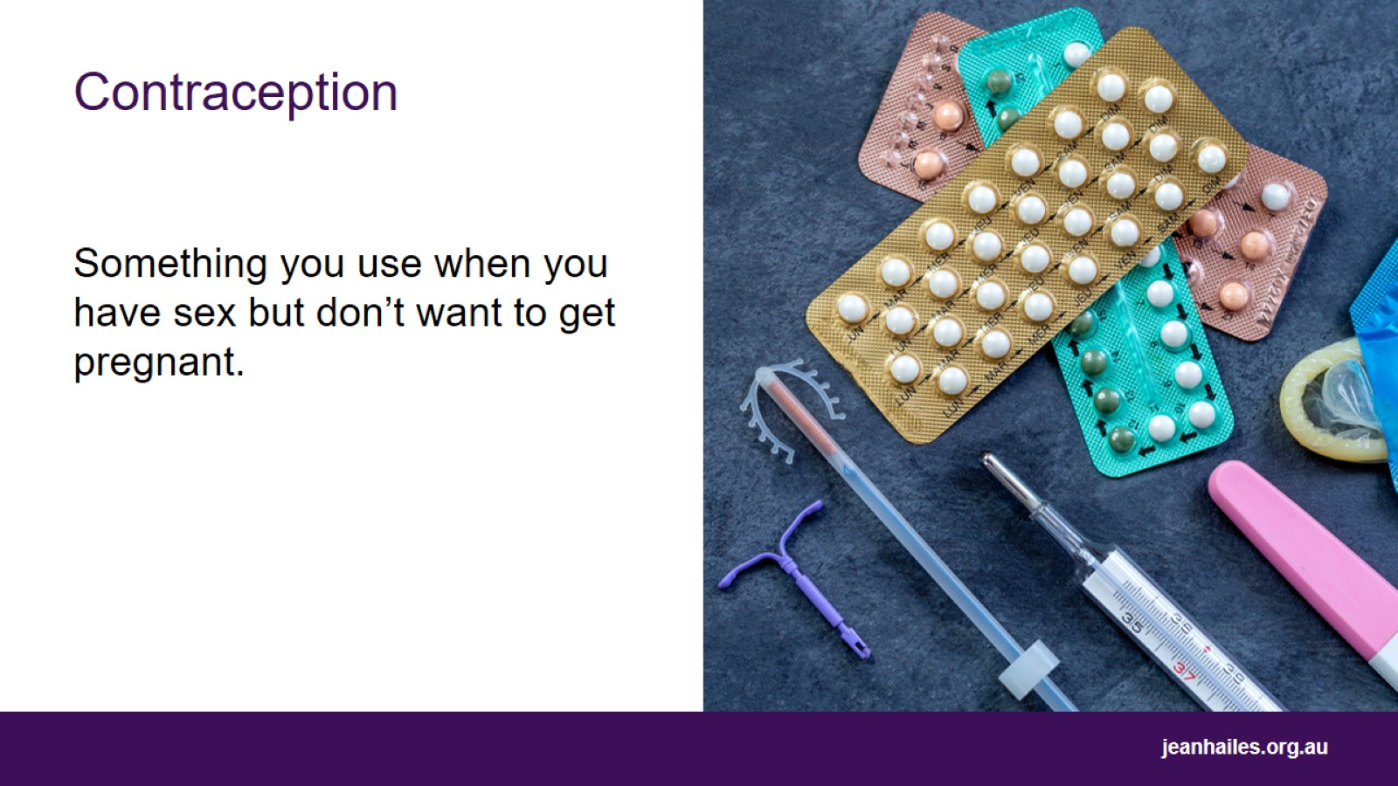
Contraception
Notes:
Contraception is something you do, take, or use when you are having penetrative (penis in vagina) sex, to avoid becoming pregnant.
There are many different methods of contraception.
No contraception is 100% effective at preventing pregnancy – some are more effective than others.
Your doctor or sexual health centre can help you decide which method is right for you.

Slide 13
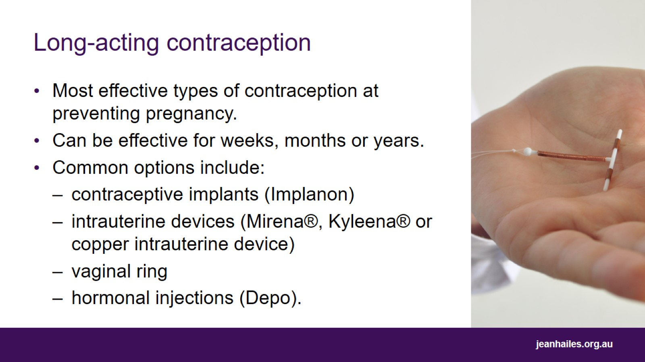
Long-acting contraception
Notes:
Long-acting reversible contraceptives, also called LARCs, are the most effective types of contraception at preventing pregnancy.
They are often described as ‘set and forget’ contraception methods and can provide effective contraception for weeks, months or years.
Different types of LARC include:
Contraceptive implant – small, rod-shaped device inserted under the skin on your arm which releases a hormone into your bloodstream to prevent pregnancy for up to 3 years.
Intrauterine device – small device inserted into the uterus to prevent pregnancy for 5–10 years. They can be hormonal or non-hormonal.
Vaginal ring – a thin plastic ring inserted into the vagina that releases hormones to prevent pregnancy. After three weeks you can remove the ring and either have a period or insert a new one immediately to skip your period.
Hormonal injection – injections given every three months by your doctor.

Slide 14
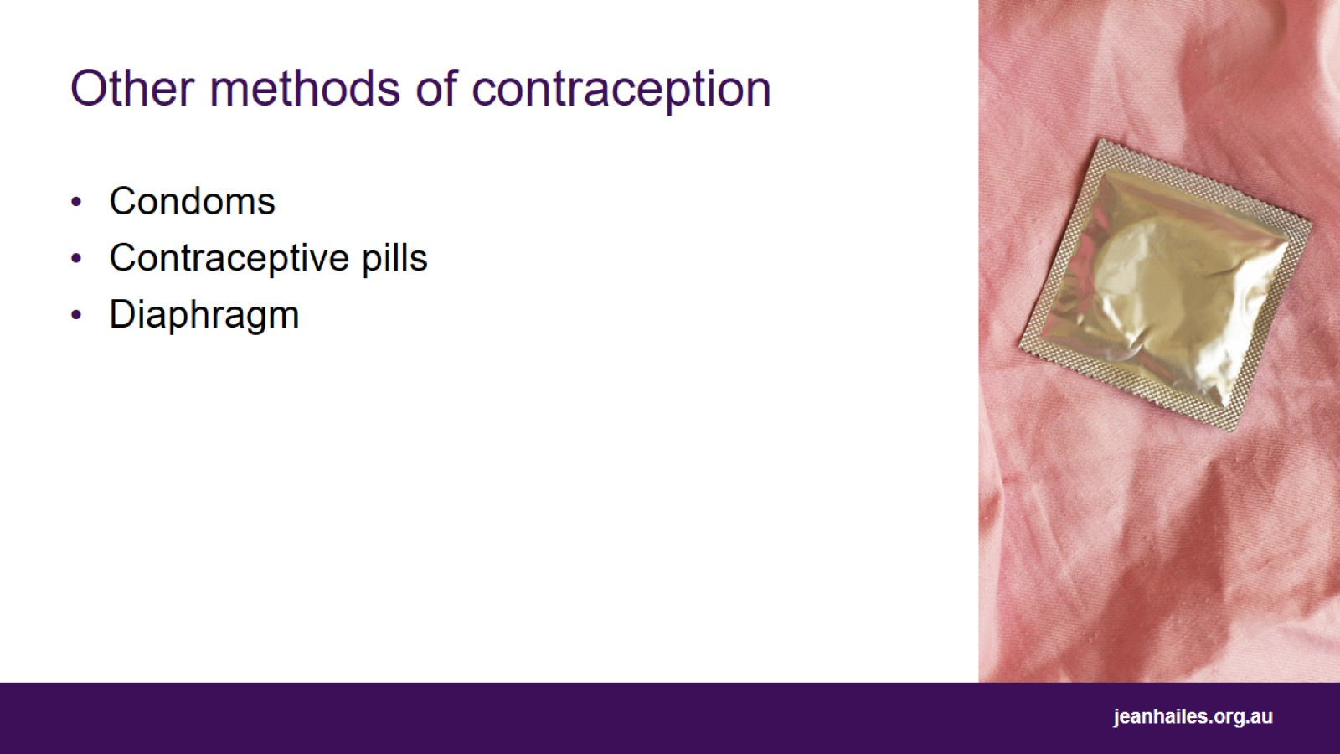
Other methods of contraception
Notes:
Condoms – the only type of contraception that also offers protection against getting or transmitting an STI. There are two types of condoms:
external (male) condom – plastic or rubber sheath worn on an erect penis which catches sperm and stops it from reaching the egg
internal (female) condom – plastic or rubber sheath worn inside the vagina to catch sperm and stop it from reaching the egg.
Contraceptive pills – pills containing hormones which prevent pregnancy that you take daily. There are different types of contraceptive pills available.
Diaphragm – a small cap that sits at the entrance of the cervix and prevents sperm from reaching the egg.

Slide 15
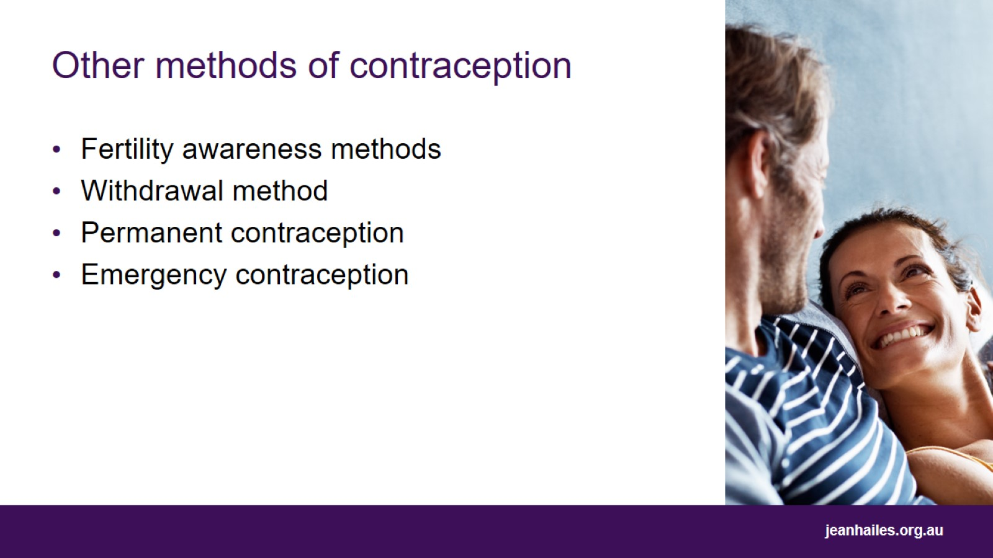
Other methods of contraception
Notes:
Fertility awareness methods – monitoring your ‘fertile window’, i.e., the time during your menstrual cycle that you can become pregnant, and not having sex during that time.
Withdrawal method – removing the penis from the vagina before ejaculating. The withdrawal method is the least effective method of contraception. It is more effective when used in combination with another method.
Permanent contraception – surgical procedures that permanently prevent pregnancy. There are two types of permanent contraception. Tubal ligation or ‘getting your tubes tied’ for women and vasectomy for men.
Emergency contraception:
Emergency contraceptive pill – pills that you take within 3–5 days of unprotected sex to prevent pregnancy. There are 2 types of emergency contraceptive pills on the market. The pharmacist can help you decide which one is right for you.
Non-hormonal (copper) IUD – can be used as emergency contraception when inserted within 5 days of unprotected sex.

Slide 16
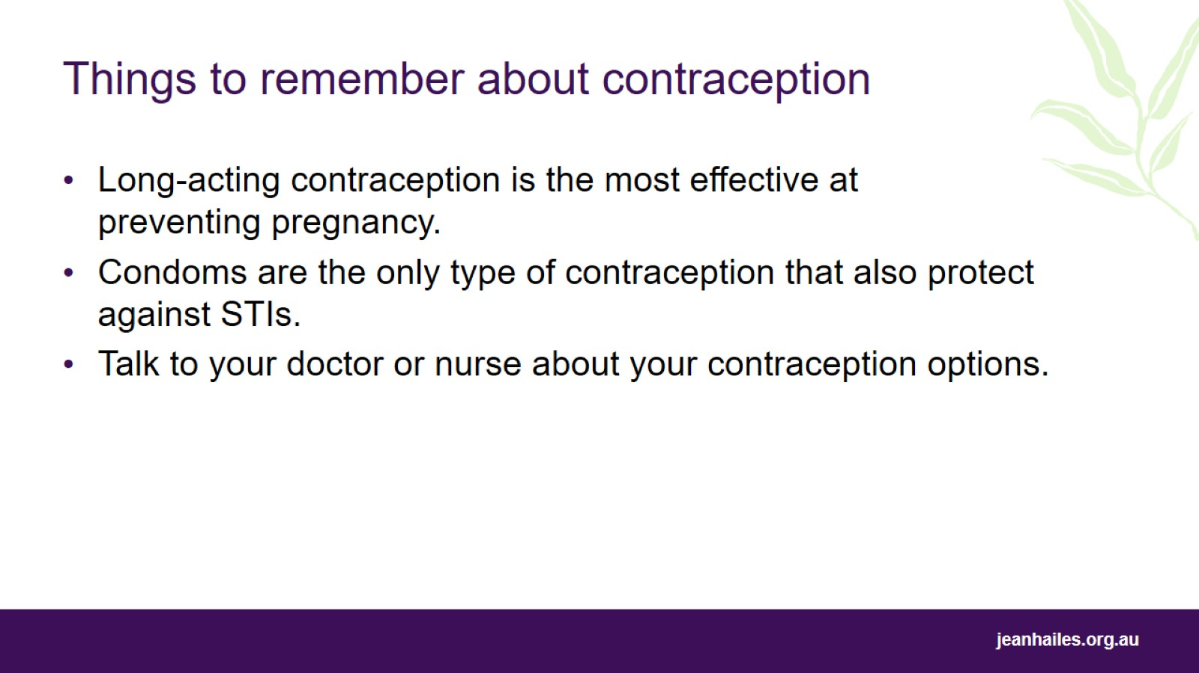
Things to remember about contraception
Notes:
If you have sex and don’t want to get pregnant, use contraception.
No contraception is 100% effective.
Long-acting reversible contraceptives (LARCs) are most effective at preventing pregnancy.
Condoms are the only type of contraception that also protect against STIs.
Speak to your doctor or nurse about your contraception options.

Slide 17
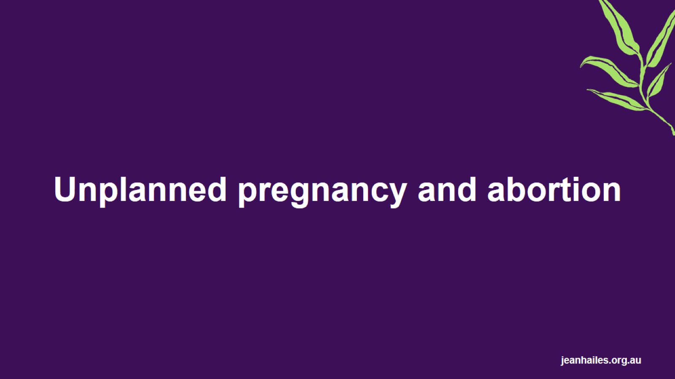
Unplanned pregnancy and abortion

Slide 18
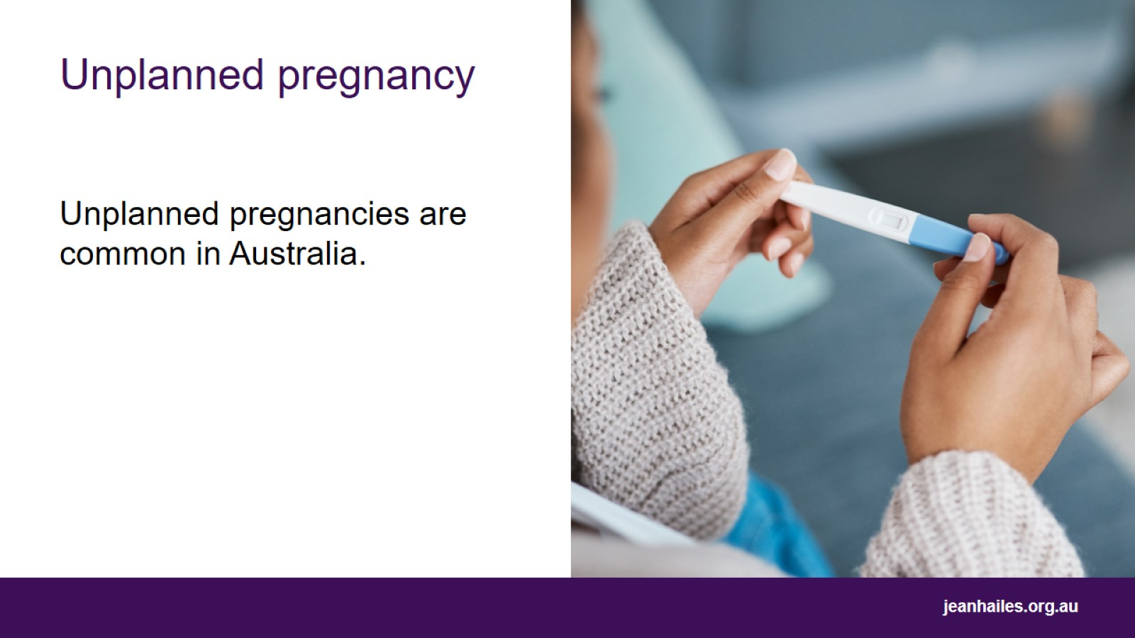
Unplanned pregnancy
Notes:
Unplanned pregnancies are common in Australia.
Why do people have unplanned pregnancies?
No contraception is 100% effective.
Sometimes, people forget to use contraception.
Some people choose not to use contraception.
Unplanned pregnancy can also be a result of rape. Rape is a criminal offence. It can also happen in a relationship. If you have experienced rape or sexual assault and need support, you can call 1800RESPECT (1800 737 732). The line is open 24 hours, 7 days. Counsellors can listen to your story and provide support that is right for you and your circumstances.

Slide 19
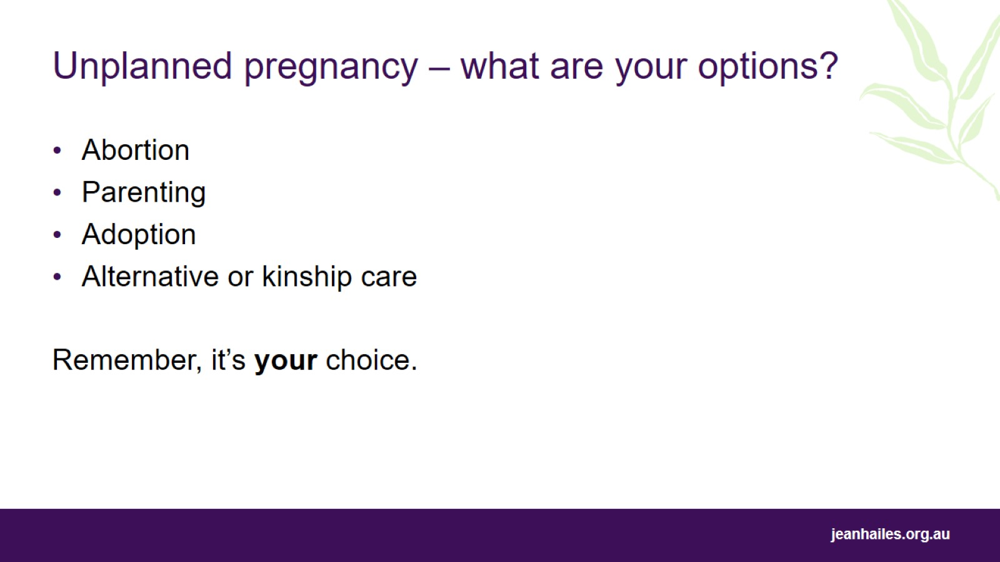
Unplanned pregnancy – what are your options?
Notes:
Unplanned pregnancies may be wanted or unwanted. If you have an unplanned pregnancy, the options are:
Abortion – end the pregnancy with an abortion.
Parenting – continue the pregnancy and raise the child.
Adoption – continue the pregnancy and place the child for adoption.
Alternative or kinship care – continue the pregnancy and place the child in the care of another person, such as a close friend or family member, or a foster carer.
If you have an unplanned pregnancy, it can be difficult to know what option is right for you.
There are services available that offer counselling to help you decide what you want to do. They will help you to understand your options and talk through any concerns you may have. They won’t tell you what to do or try to influence your decision. For more information, contact your local sexual health centre.
Remember, you are the expert in your own life, and if you have an unplanned pregnancy, you get to decide which option is right for you.

Slide 20
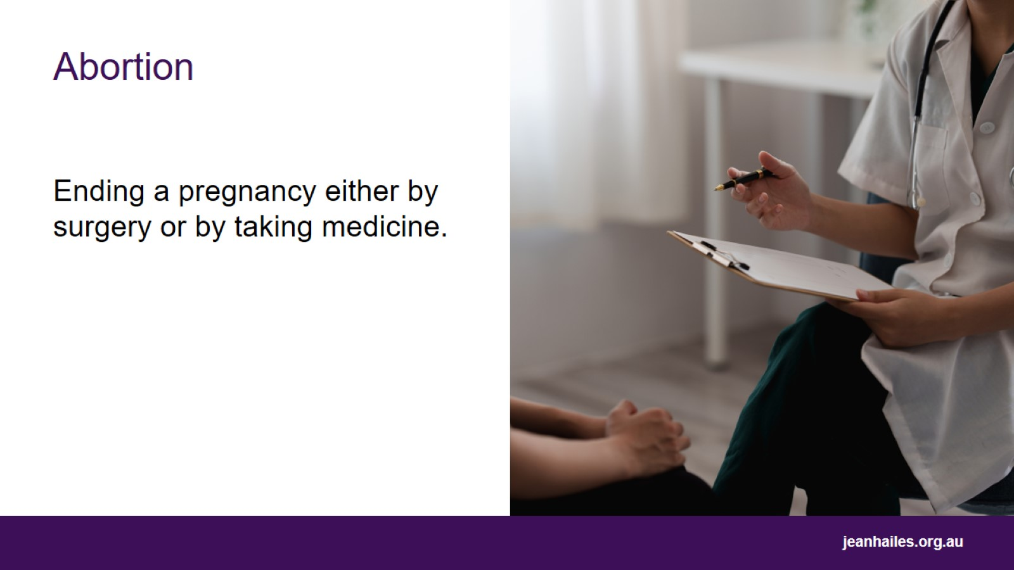
Abortion
Notes:
Ending a pregnancy either by surgery, or by taking medication.
Medical abortion, also called ‘medical termination of pregnancy’, is when you take two different medications that work together to end a pregnancy. In Australia, medical abortion can be performed at up to 9 weeks gestation.
Surgical abortion, also called ‘surgical termination of pregnancy’, is when the pregnancy is ended with a short surgical procedure.
Abortion is common. In Australia, many women have had an abortion.

Slide 21
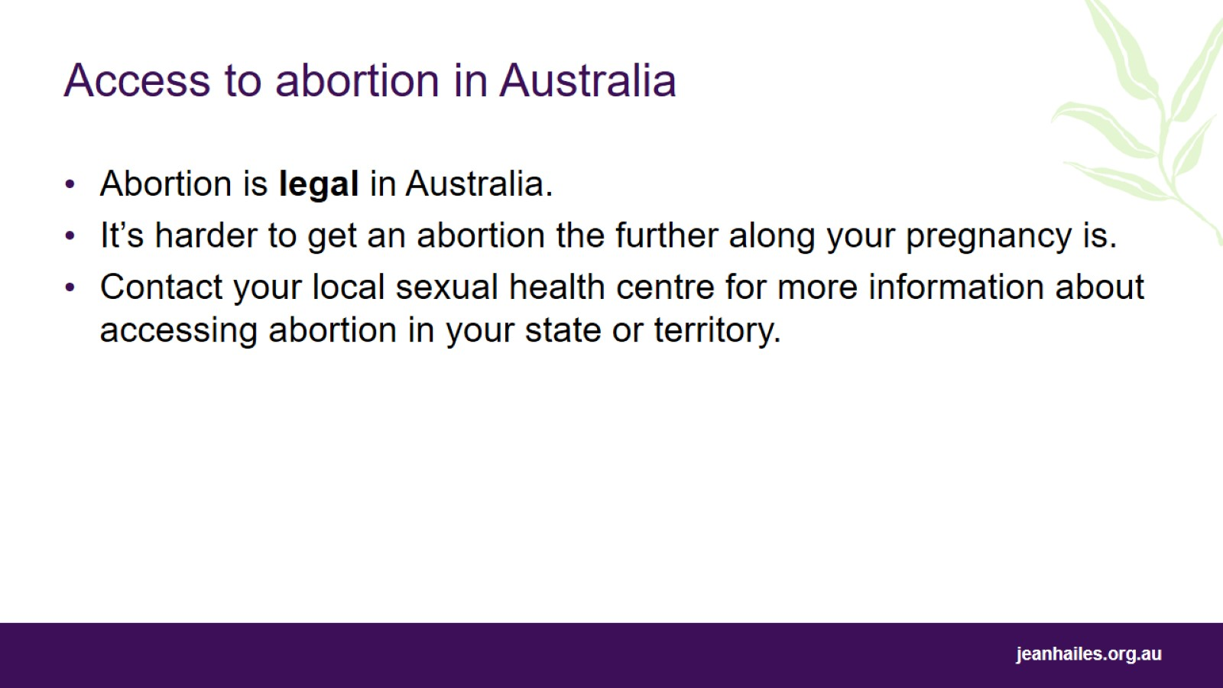
Access to abortion in Australia
Notes:
It is important to know that abortion is legal in Australia, although exact laws vary between states and territories.
Access to abortion becomes more restricted the further along your pregnancy is, and in some cases you may need to travel to another state to have an abortion.
Contact your local sexual health centre for more information about accessing abortion in your state or territory.

Slide 22
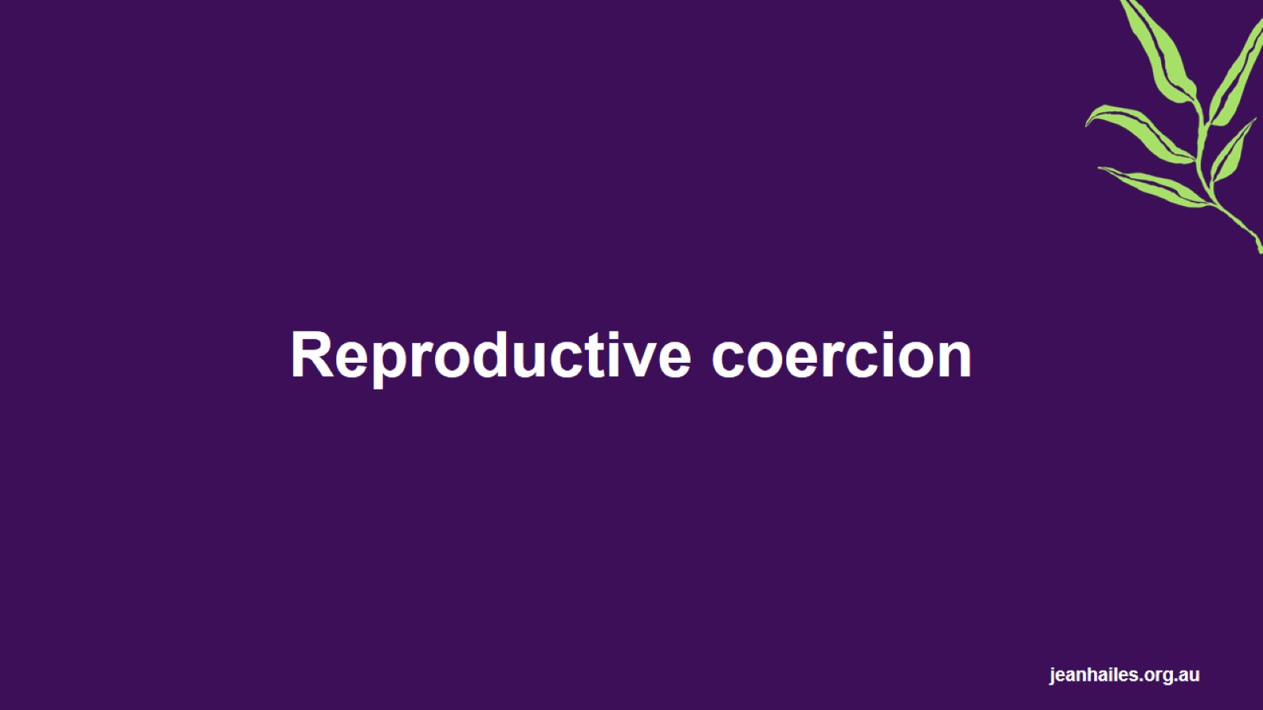
Reproductive coercion

Slide 23
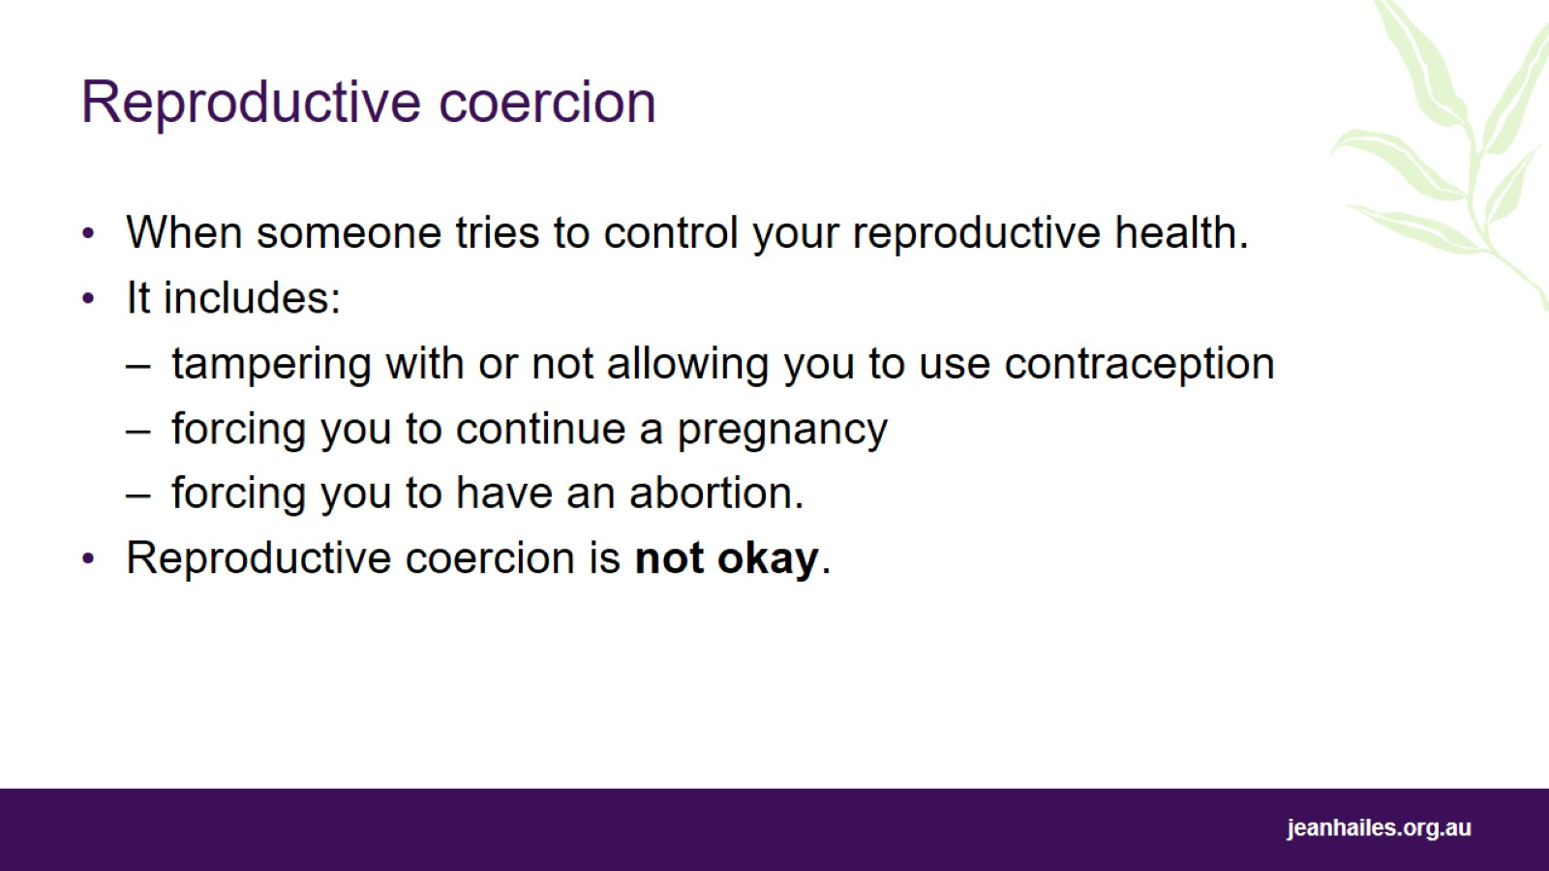
Reproductive coercion
Notes:
Reproductive coercion is when someone interferes with your ability to control your own reproductive health.
It is often done by someone such as a partner, family member or ex partner.
Reproductive coercion involves using financial, social, emotional or behavioural control to influence a reproductive health decision. It includes behaviours such as:
tampering with or not allowing you to use contraception
forcing you to continue a pregnancy
forcing you to have an abortion.
Reproductive coercion is not okay.

Slide 24
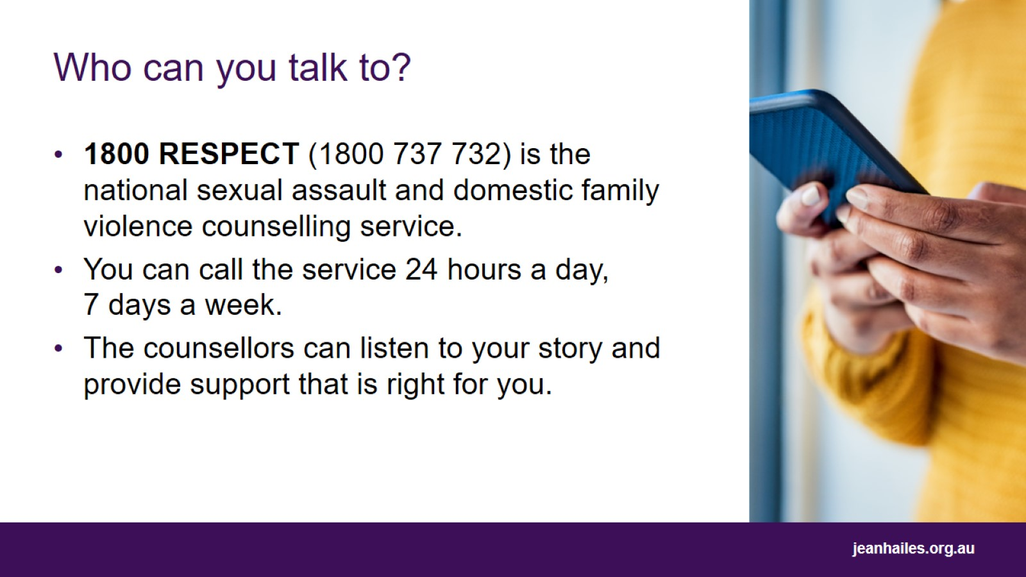
Who can you talk to?
Notes:
You can call 1800 RESPECT (1800 737 732) if you are concerned that:
you might be experiencing reproductive coercion
someone has had sex or done sexual things to you without your consent.
1800 RESPECT is the national sexual assault and domestic family violence counselling service.
You can call the service 24 hours a day, 7 days a week.
The counsellors can listen to your story and provide support that is right for you and your circumstances.

Slide 25
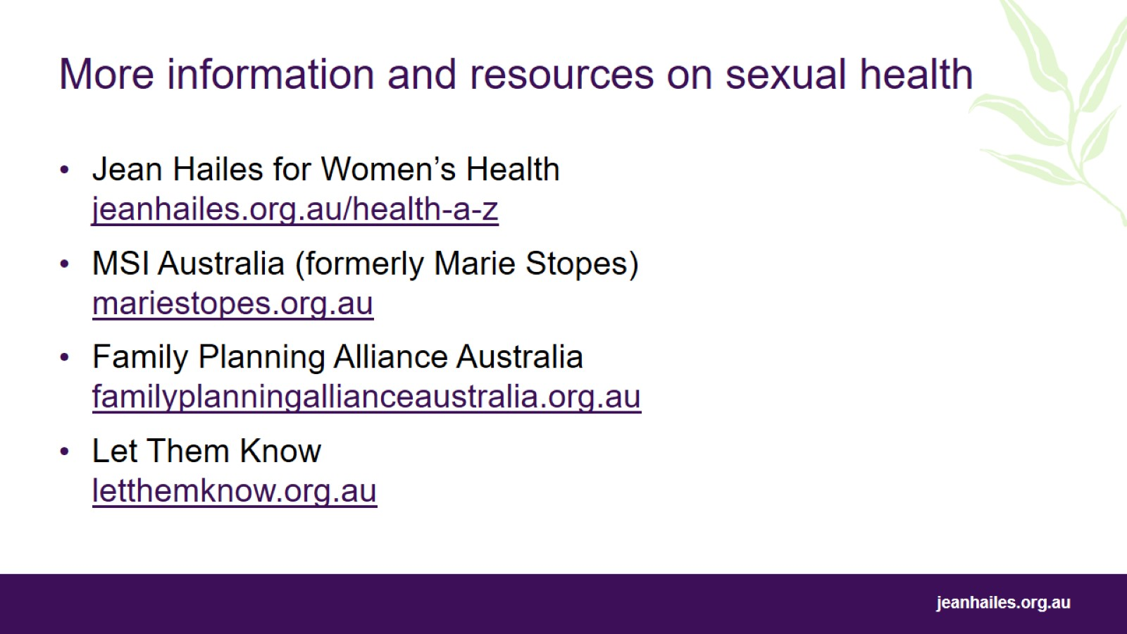
More information and resources on sexual health
Notes:
MSI Australia (formerly Marie Stopes) – mariestopes.org.au – a national organisation providing safe abortion and contraception services and information to people across Australia.
Family Planning Alliance Australia – familyplanningallianceaustralia.org.au
Let Them Know – letthemknow.org.au – resource to help people who have been diagnosed with an STI to let their sexual partners know that they are at risk.

Slide 26

Thank you

Slide 27
