Slide 1

Periods
Notes:
Insert a text box to add presenter name and position title.

Slide 2
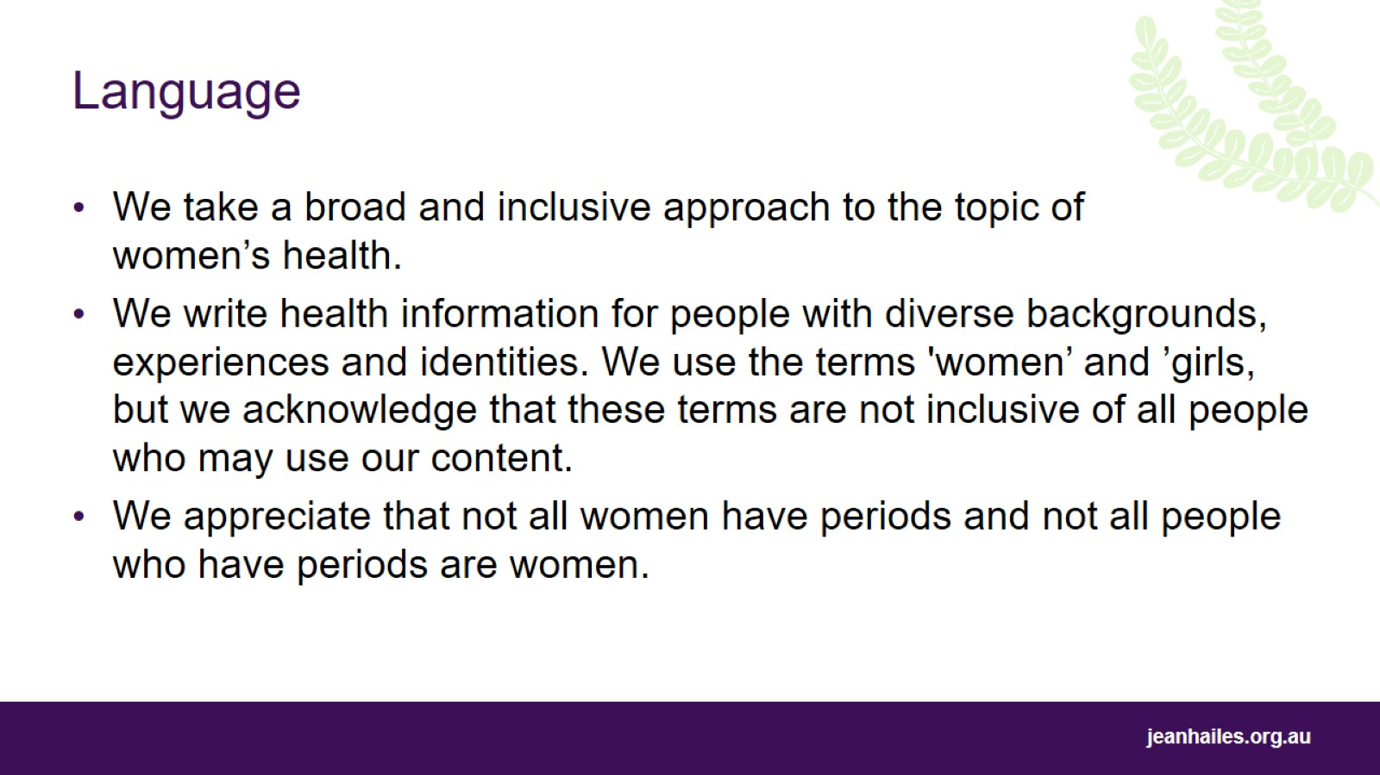
Language

Slide 3
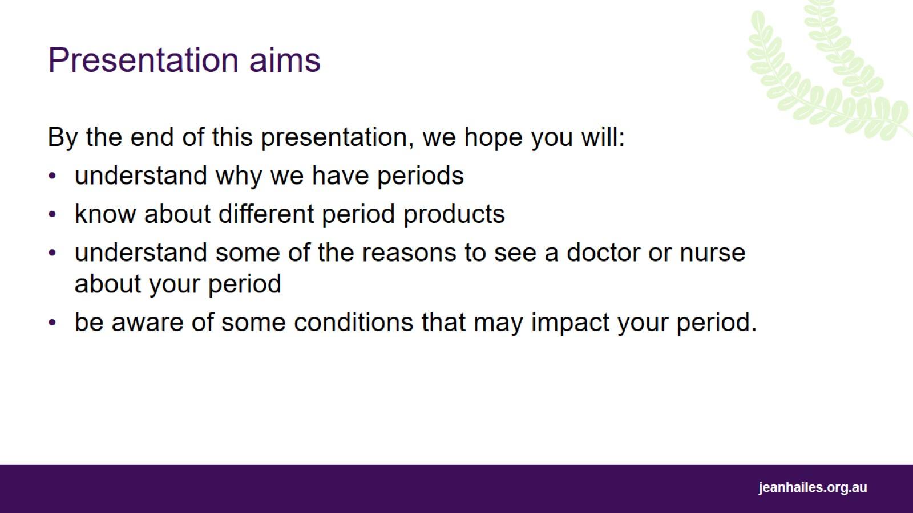
Presentation aims
Notes:
Today we’ll be talking about periods. By the end of this presentation, we hope you will:
understand why we have periods
know about different period products
understand some of the reasons to see a doctor or nurse about your period
be aware of some conditions that may impact your period.

Slide 4
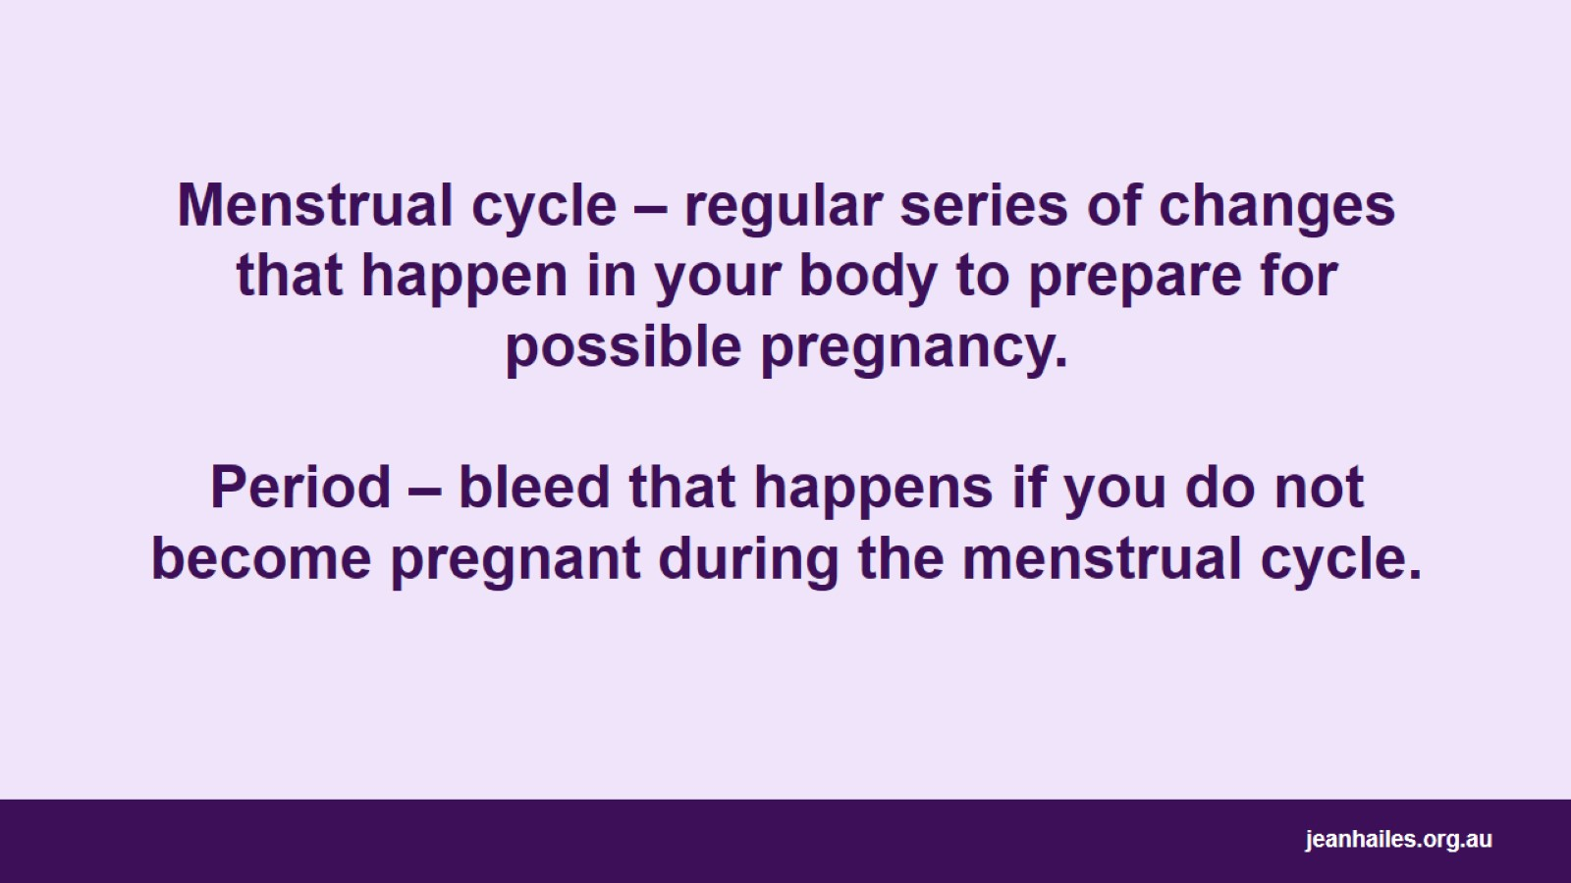
Menstrual cycle – regular series of changes that happen in your body to prepare for possible pregnancy.
Period – bleed that happens if you do not become pregnant during the menstrual cycle.
Notes:
The menstrual cycle is a regular series of changes that happen in your body to prepare you for a possible pregnancy.
A period is a bleed that happens if you do not get pregnant during the menstrual cycle.
Only 13% of women have a ‘regular’ 28-day cycle.
Menstruation begins with ‘menarche’, which is the first period, and ends with ‘menopause’, which is the last period.
The age of menarche can range from 9–16 years; in Australia the average is 12–13 years.
Most women will reach menopause between 45 and 55 years; in Australia, the average age women reach menopause is 51–52 years.
The average woman in Australia will have between 450 and 500 periods in their lifetime.

Slide 5
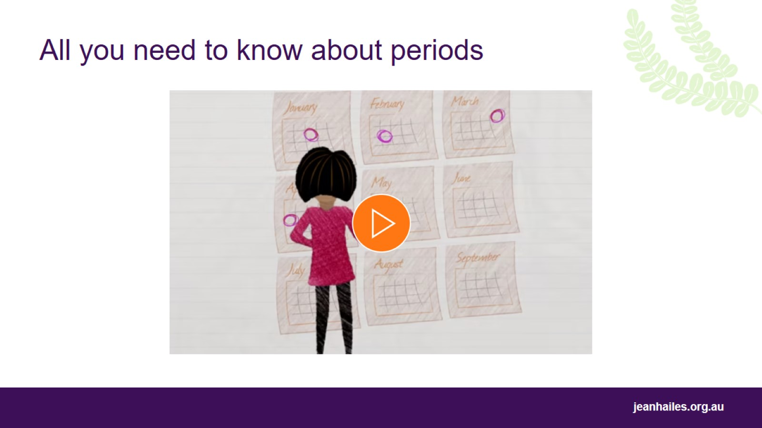
All you need to know about periods
Notes:
To play the animation ‘All you need to know about periods’, copy and paste this link into your browser: https://vimeo.com/129065040
This video covers the following:
Multiple reproductive organs are involved in making a period happen. These are: ovaries, fallopian tubes, uterus.
Reproductive organs are controlled by ‘chemical messengers’ called ‘hormones’. One of the hardest working hormones is oestrogen.
Once a month, an egg is released from one of the ovaries and travels down the fallopian tube into the uterus. The egg can only live for 24 hours. If it does not meet a sperm in this time, the period will begin 10–14 days later.
The period is made up of blood, fluid and lining cells of the uterus leaving the body through the vagina.

Slide 6
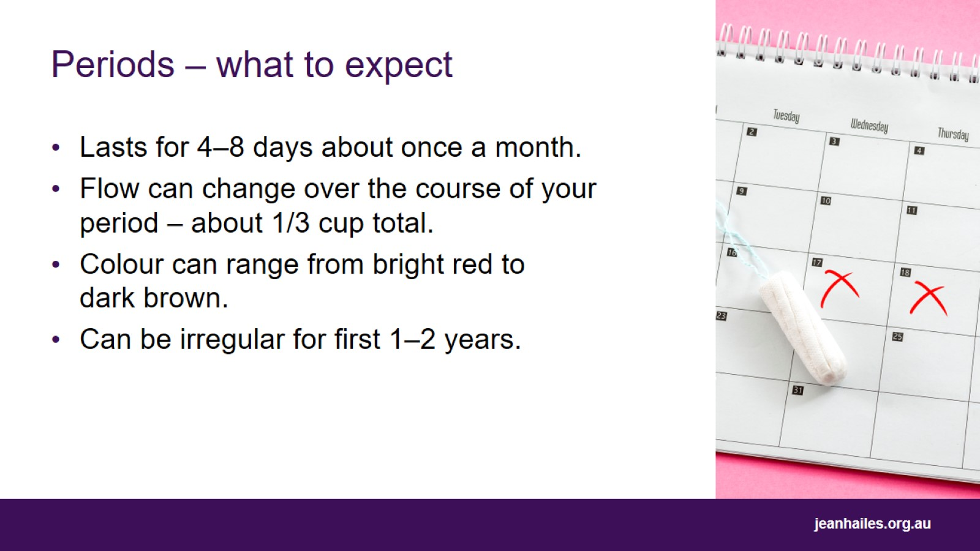
Periods – what to expect
Notes:
All periods are different – however it is important to know what the average period is like.
On average, menstrual cycles last from 21–38 days, with periods lasting four to eight days.
Irregular periods are common during the first 1–2 years of menstruating and in the lead up to menopause.
The blood flow will change over the course of your period, e.g. some days you might have heavy bleeding, other days you might just have spotting.
Most women will lose less than 1/3 cup of blood over the course of their period.
Colour may change over the course of your period, ranging from bright red to dark brown.

Slide 7
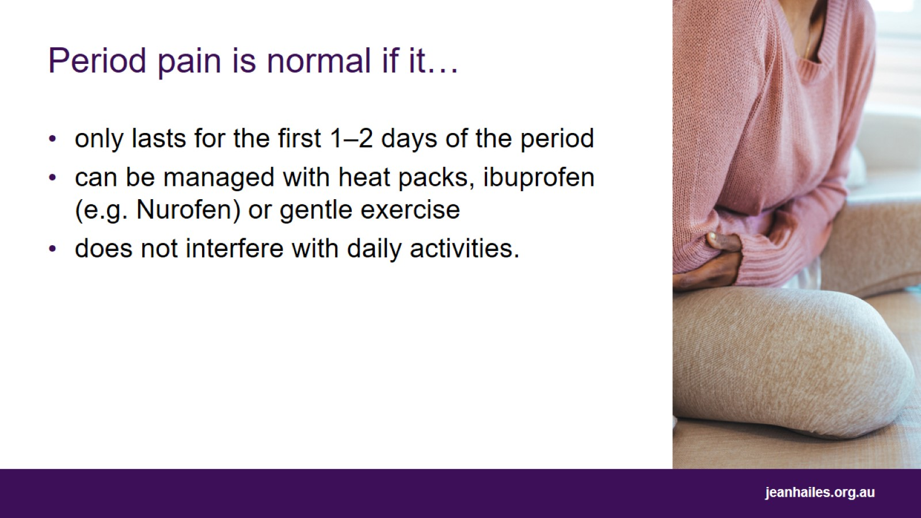
Period pain is normal if it…
Notes:
Between 70% and 90% of women will experience some period pain.
Period pain is considered ‘normal’ if:
the pain is only there for the first 1–2 days of your period
the pain can be managed by applying heat packs, using medication such as ibuprofen (e.g. Nurofen) or other period pain medication, or gentle exercise such as stretching or yoga
the pain does not interfere with your normal activities.

Slide 8
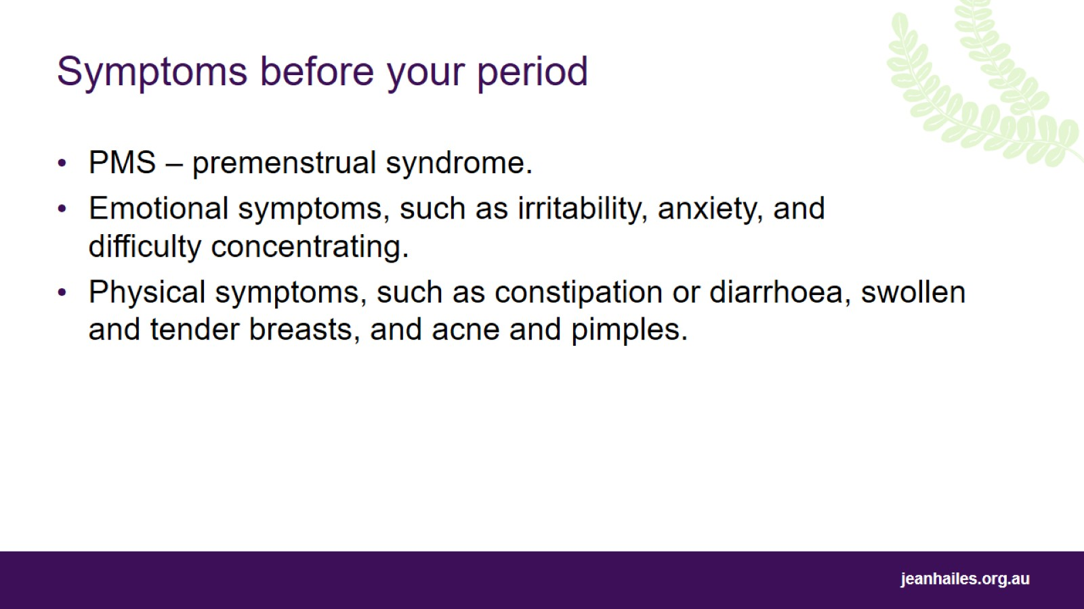
Symptoms before your period
Notes:
Many women will experience at least 1 or 2 symptoms in the 4–10 days before their period – this is known as ‘premenstrual syndrome’, or PMS.
Most women will experience symptoms that they can manage themselves.
If you have premenstrual symptoms that trouble you, speak to a doctor or nurse.

Slide 9
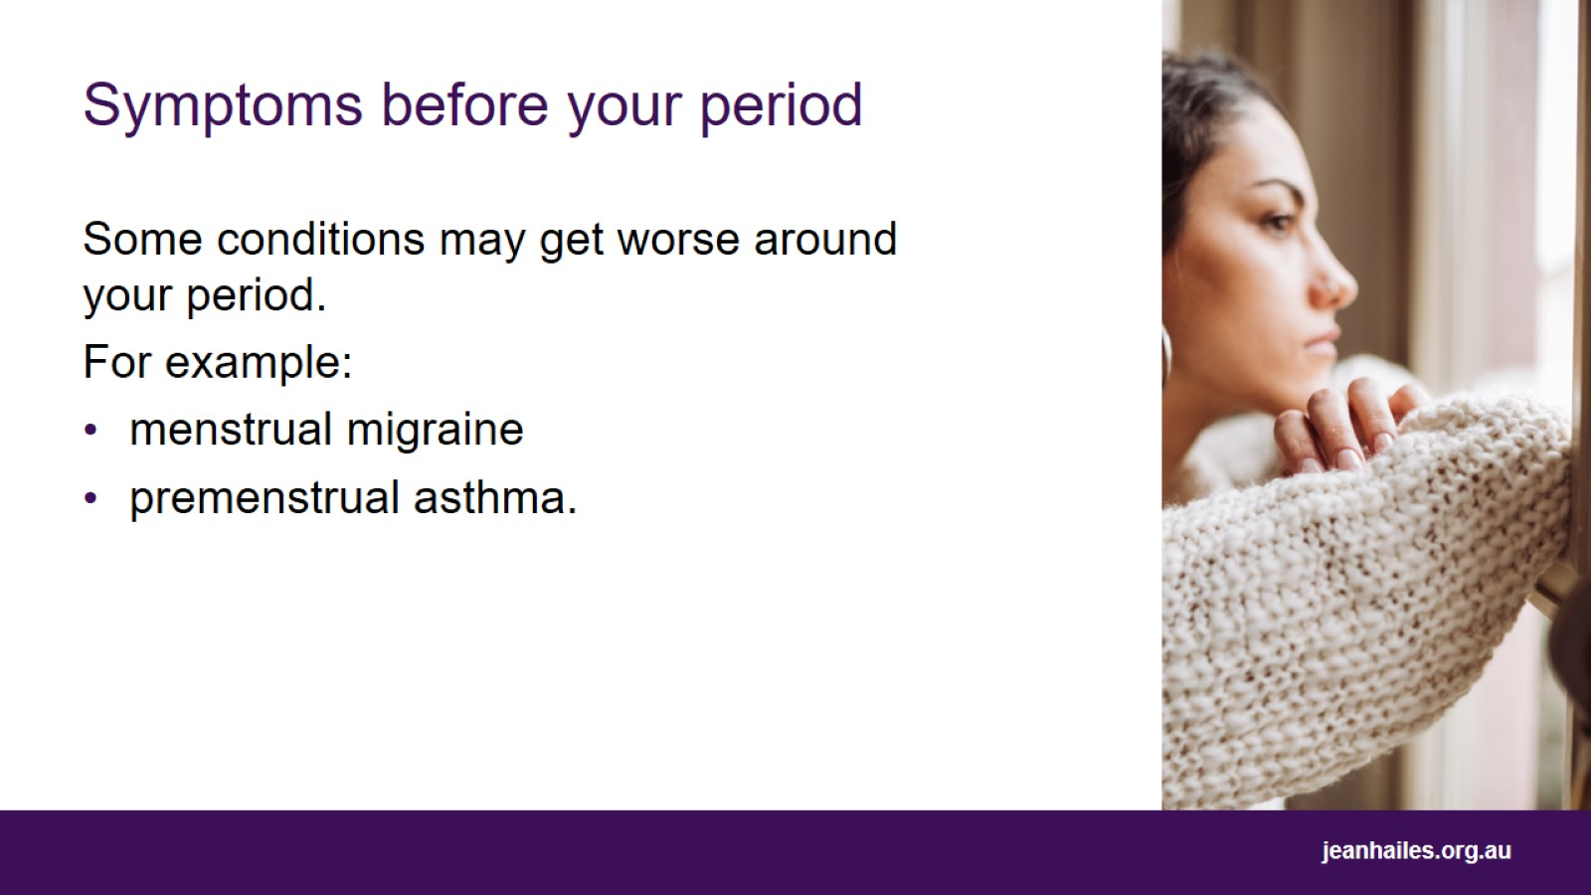
Symptoms before your period
Notes:
If you have conditions such as asthma and migraine, you might find that they get worse in the lead-up to your period.
For example:
Premenstrual asthma can affect 40% of women with asthma and can cause asthma to get worse in the lead-up to the period.
20–25% of women who get migraines will experience ‘menstrual migraine’, which are migraines that happen from 2 days before bleeding until 3 days after bleeding starts.

Slide 10
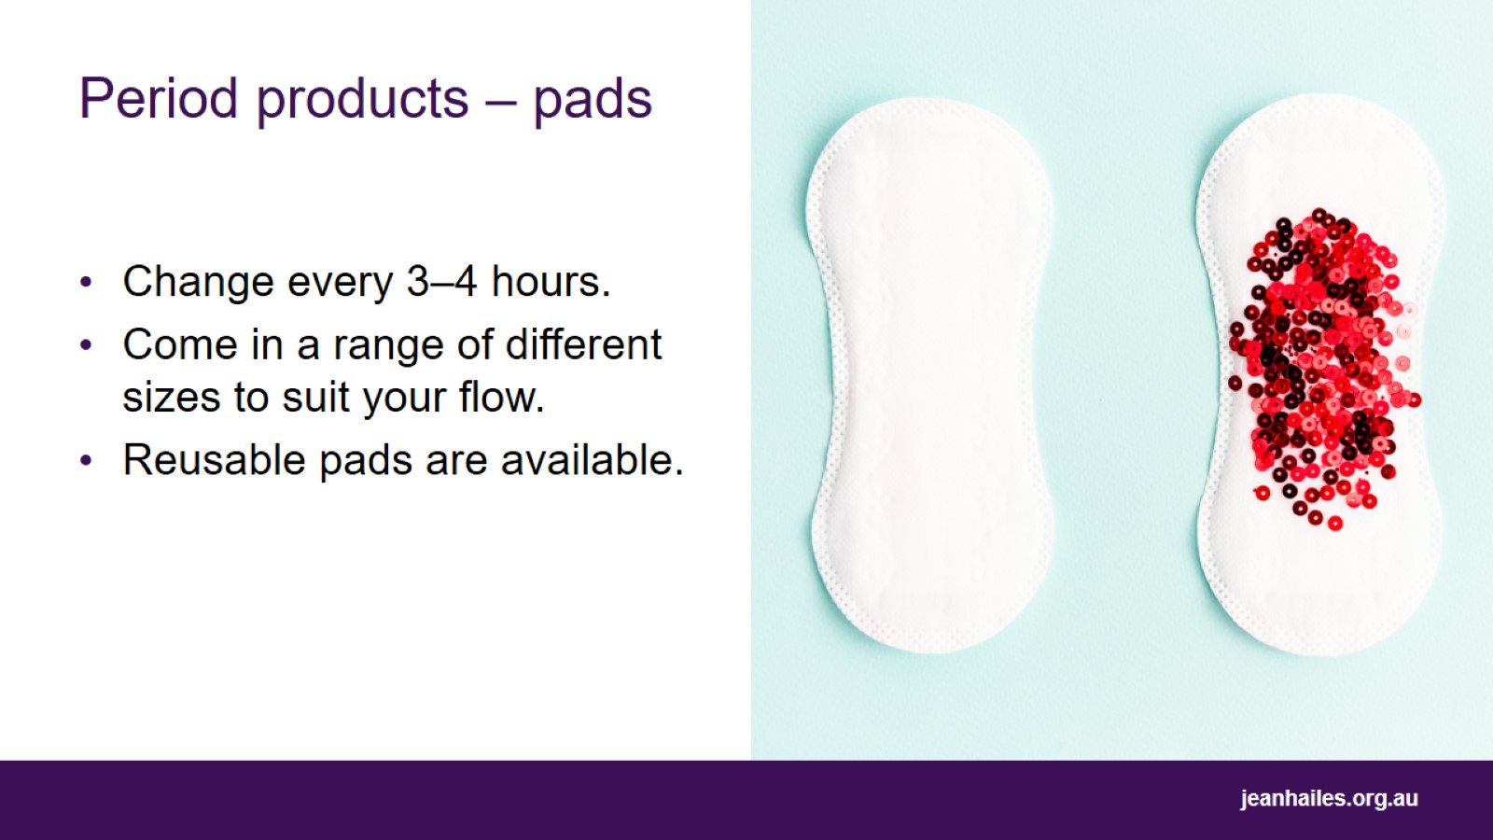
Period products – pads
Notes:
There are a range of period products designed to manage the blood flow during your period.
There are pros and cons to each – it’s a matter of personal preference!
Pads are strips of absorbent material that sit in your underwear and absorb the flow of your period.
Pads come in different sizes such as ‘light’, ‘medium’ or ‘heavy’/’maxi’, so you can choose one to suit your flow. Liners are a small, very thin pad for days with a very light bleed.
You may need to change your pad every 3–4 hours on the heavier days of your period.
Pads may cause irritation if used all the time. If you find your vulva is becoming irritated, try using 100% cotton pads or period underwear.

Slide 11
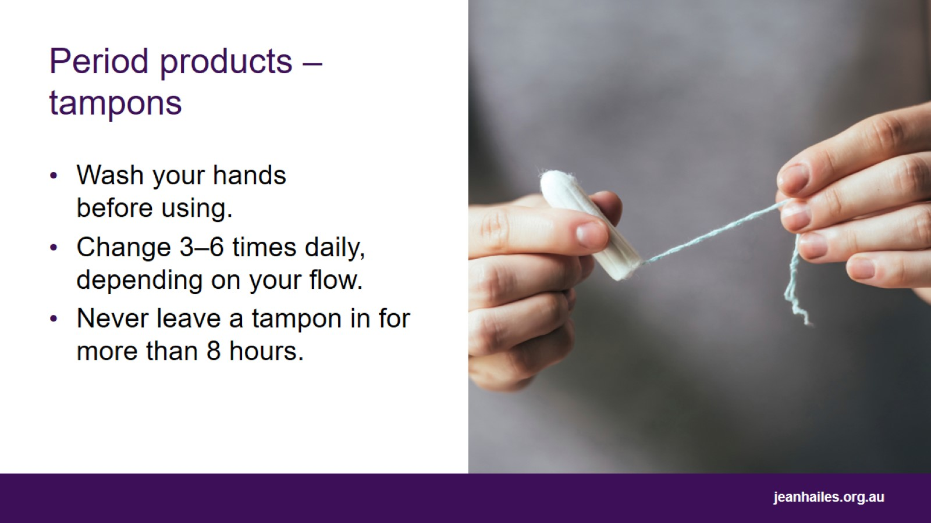
Period products – tampons
Notes:
Tampons work like a cotton plug that you insert in your vagina to absorb the flow of your period.
Tampons come in a range of different sizes to suit your flow.
You can still play sport and go swimming while wearing a tampon.
Always wash your hands before using tampons.
Relax, read the instructions, and make sure to insert far enough. Choosing a brand that comes with an applicator can be useful when you are learning.
Plan to change your tampon between 3 and 6 times daily, depending on how heavy your flow is.
A serious infection called ‘toxic shock syndrome’ is possible when using tampons; however, it is very rare. Make sure you don’t leave a tampon in for more than 8 hours and always wash your hands before use.

Slide 12

Don’t flush!
Notes:
Never flush pads and tampons down the toilet.
Flushing pads and tampons can cause damage to plumbing, sewerage systems, wastewater treatment plants and the environment, by releasing plastics and chemicals into our rivers and oceans.
Instead, wrap used pads and tampons in toilet paper and put in the general waste bin (or sanitary bin if available).
Alternatively, there are a number of reusable period products available that have low environmental impact and are cost effective.

Slide 13
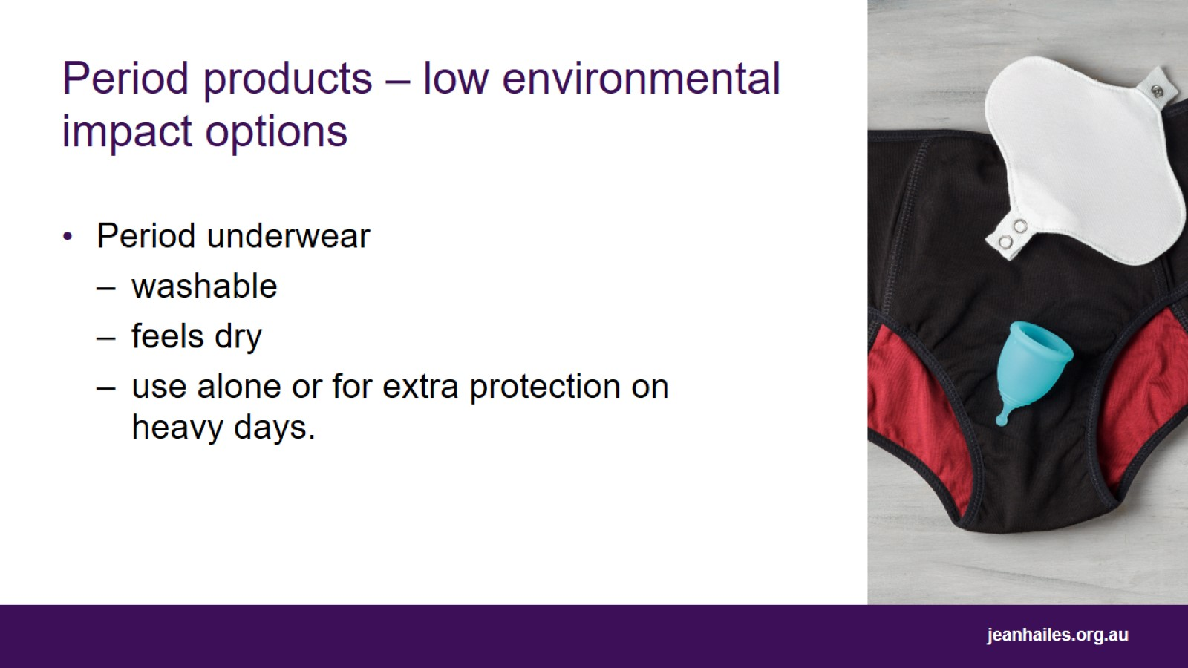
Period products – low environmental impact options
Notes:
Period underwear:
is underwear with built-in absorbency of between 10 and 20 ml, which is around 2-4 tampons’ worth, depending on the brand
can be used on their own, or as a backup to tampons on heavier days.

Slide 14
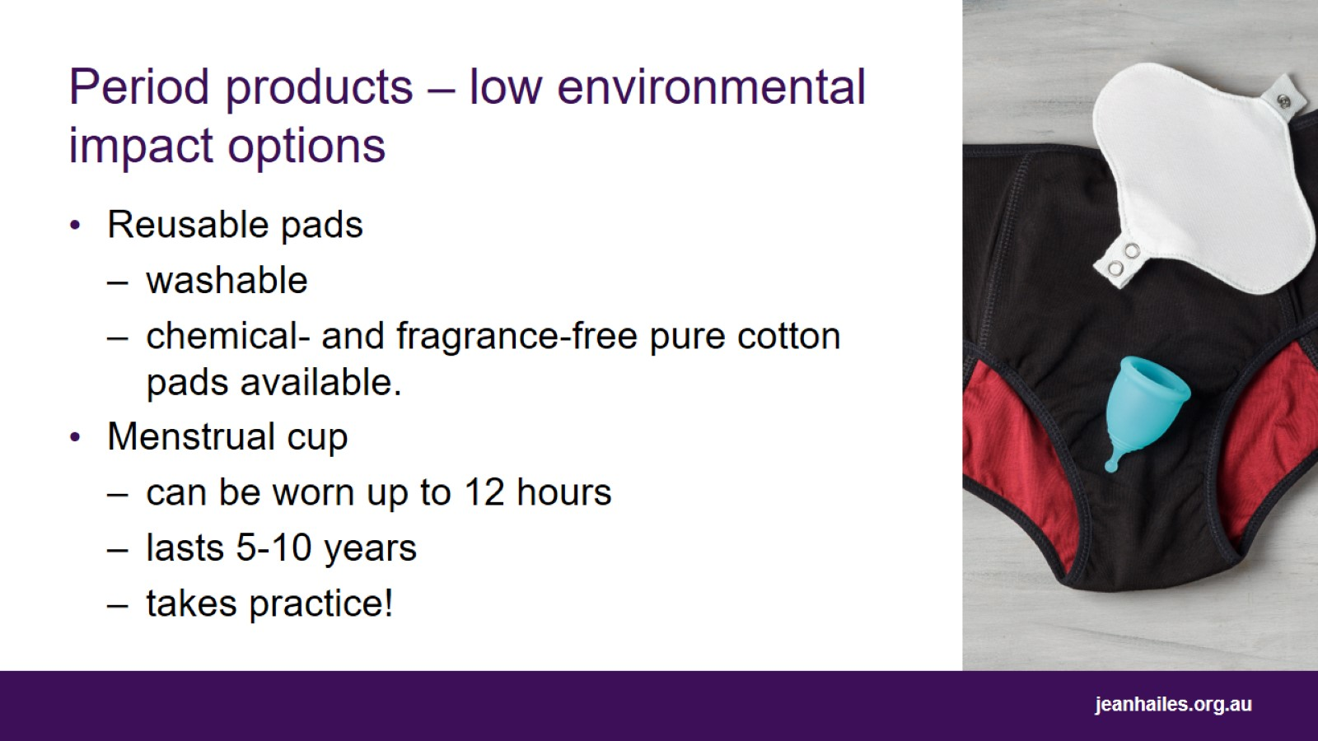
Period products – low environmental impact options
Notes:
Reusable pads
Reusable pads made from fabric that can be washed are also available.
Menstrual cups
Menstrual cups are made of silicone or rubber. They are folded and then inserted into the vagina like a tampon, although sit lower in the vagina. Here they open and create a seal, collecting your menstrual flow until you are ready to remove it, empty, rinse and reinsert.
Menstrual cups can collect 2–3 times the flow of a pad or tampon and are safe to wear overnight.
The cups can last for 5–10 years, which makes them a cost-effective and low environmental impact option.
Menstrual cups come in a few different shapes and sizes.
It might take some practice when you first try using a menstrual cup. Keep trying!

Slide 15
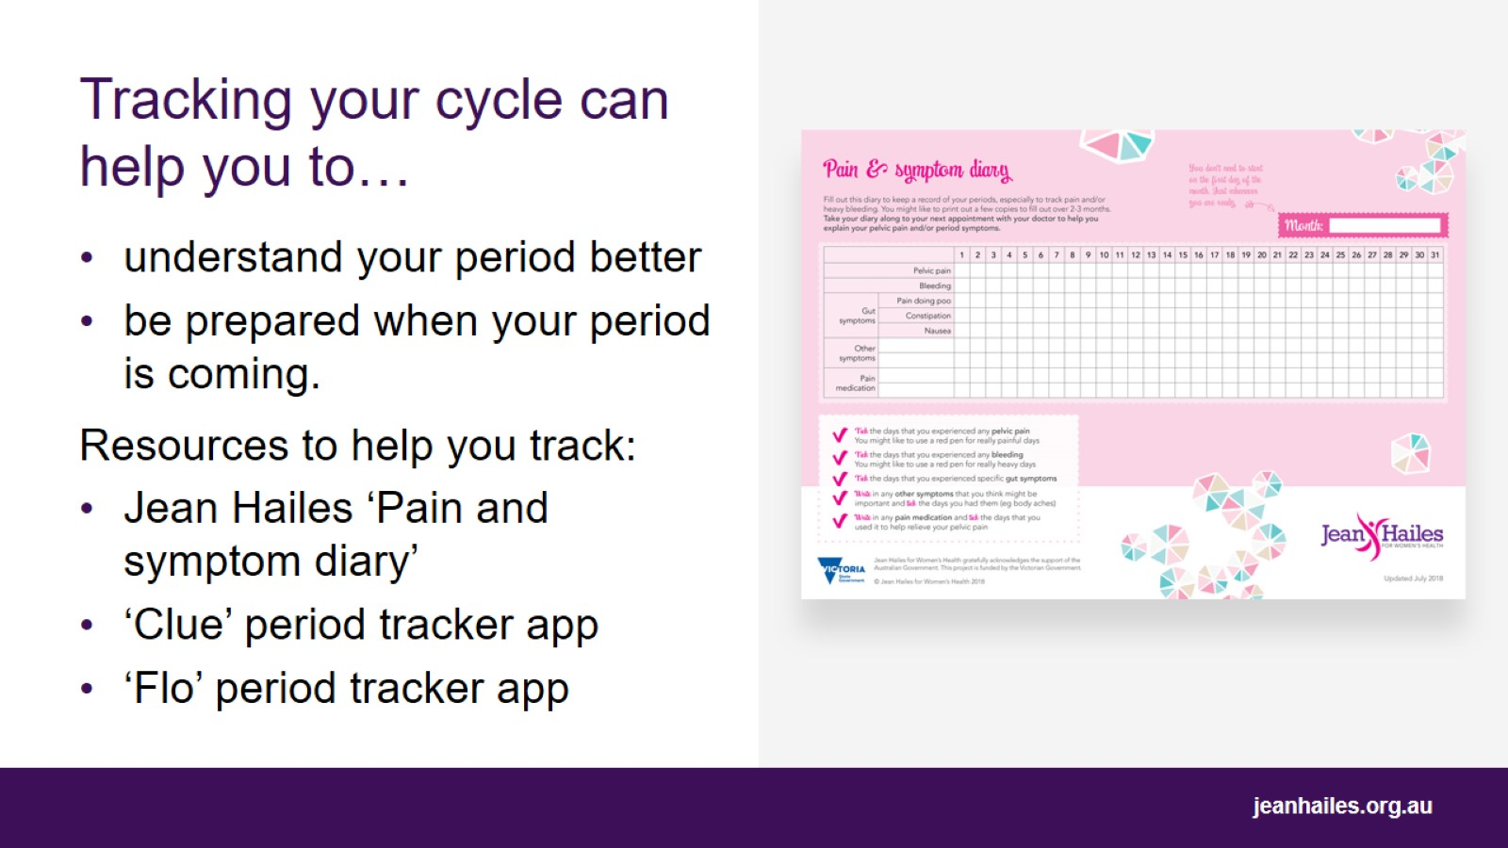
Tracking your cycle can help you to…
Notes:
Tracking your menstrual cycle, including physical and emotional symptoms, can be a good way to
understand your period better
be prepared when your period is due
monitor your symptoms
help you know if/when you might need to see a doctor or nurse.
If you are having tricky periods and need to see a doctor or nurse, they will usually want to know about your symptoms. Tracking your symptoms in a diary or an app can be a useful way to come prepared for appointments with your doctor or nurse.
There are lots of different ways to track your period including the Jean Hailes’ ‘Pain and symptom diary’ and tracking apps such as Flo and Clue.

Slide 16
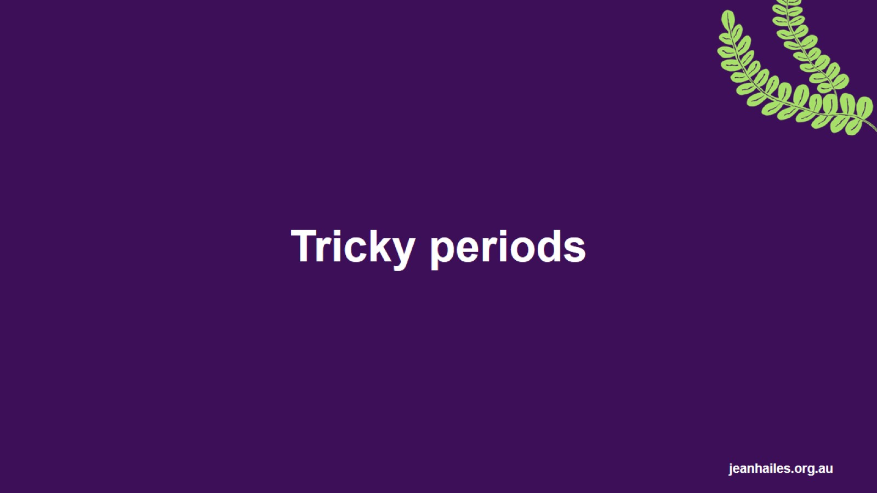
Tricky periods
Notes:
Now that we have covered what an average period looks like, let’s look at some reasons why you might need to see a doctor or nurse about your period.

Slide 17
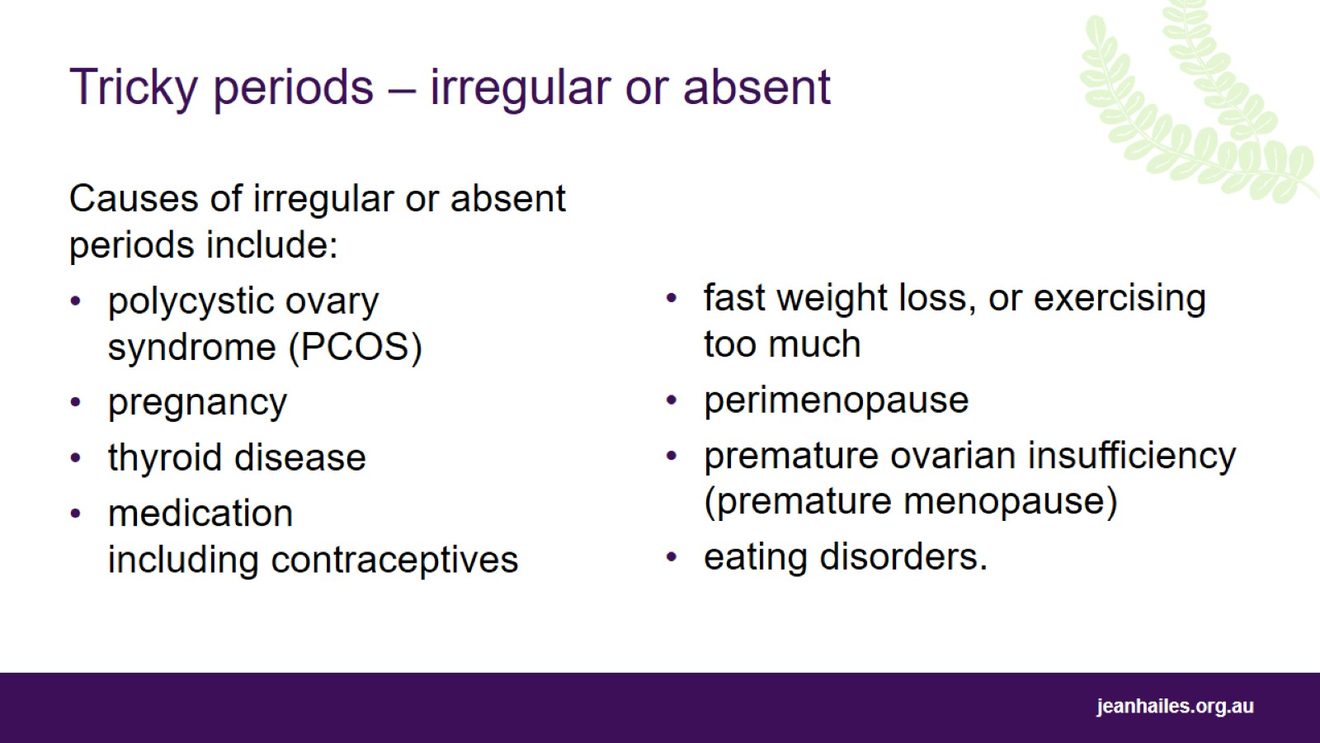
Tricky periods – irregular or absent
Notes:
It is common for periods to be irregular for the first couple of years after your first period, menarche, and in the lead-up to your final period, menopause.
However, very irregular or absent periods can be caused by a number of conditions so it’s important to speak to a doctor or nurse if you notice a change in the pattern of your periods, if they stop coming, or if your periods come more than 2–3 months apart.

Slide 18
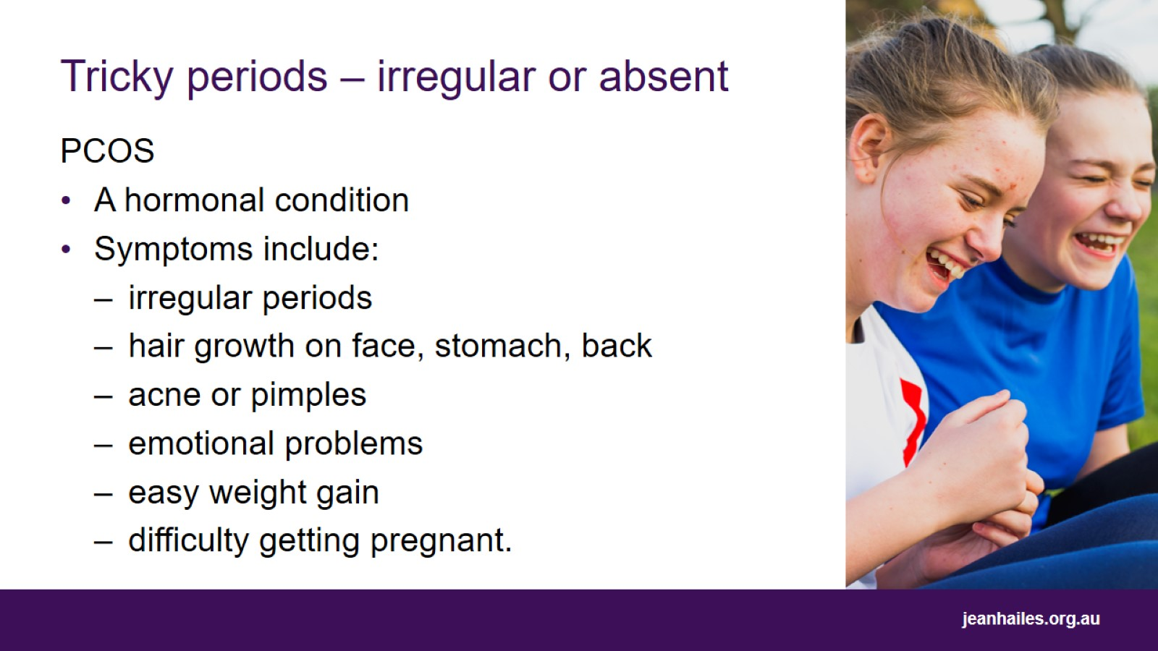
Tricky periods – irregular or absent
Notes:
A common condition that can make your period irregular is polycystic ovary syndrome (PCOS).
PCOS is a hormonal condition that affects 1 in 10 women of child-bearing age.
It can cause symptoms such as:
irregular periods
hair growth on face, stomach, back
acne or pimples
emotional problems including anxiety or depression
easy weight gain
difficulty getting pregnant.
PCOS is a common condition that is best managed with a healthy diet and exercise.

Slide 19
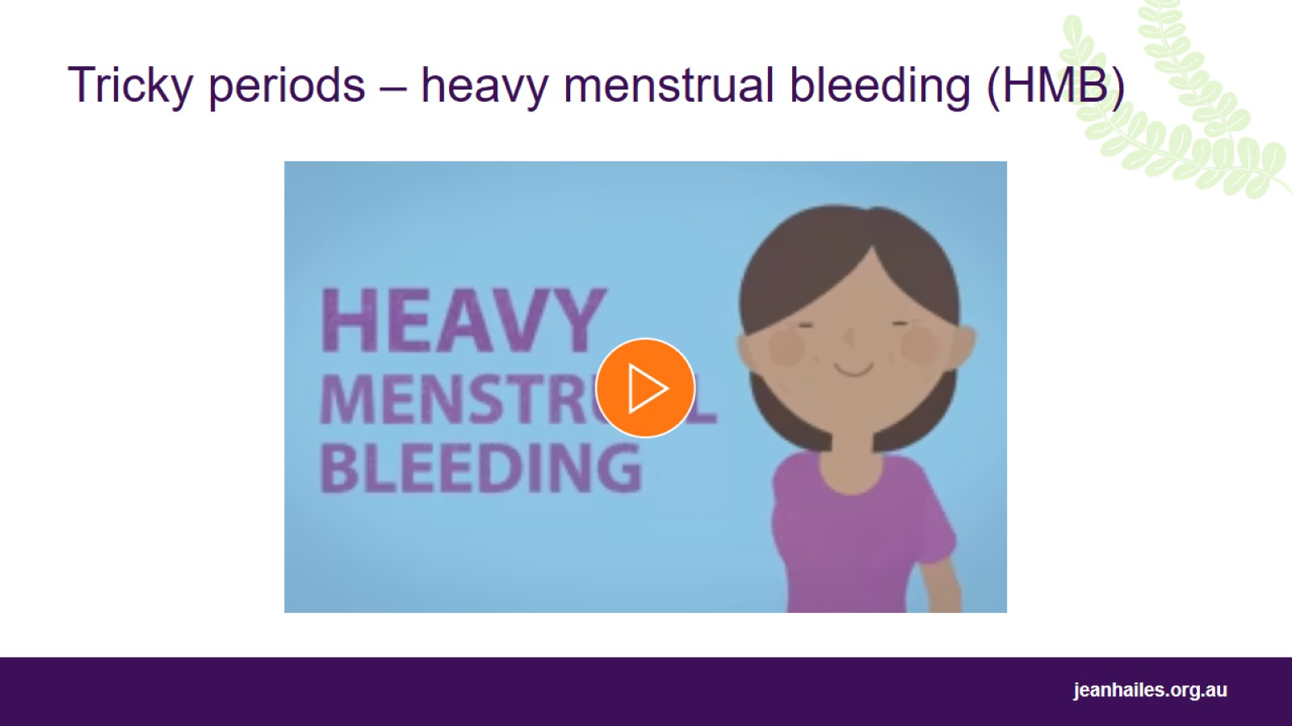
Tricky periods – heavy menstrual bleeding (HMB)
Notes:
To play the animation ‘Heavy menstrual bleeding’, copy and paste this link into your browser: https://vimeo.com/341130042
Symptoms of HMB include:
changing your pad/tampon every hour, or overnight
blood clots larger than a 50-cent piece
bleeding longer than seven to eight days
fear of bleeding through your clothes
change from what is normal for you.
Heavy menstrual bleeding can be caused by a number of conditions including PCOS, endometriosis, endometrial cancer and fibroids. In half of people with heavy menstrual bleeding, there is no clear underlying cause.

Slide 20
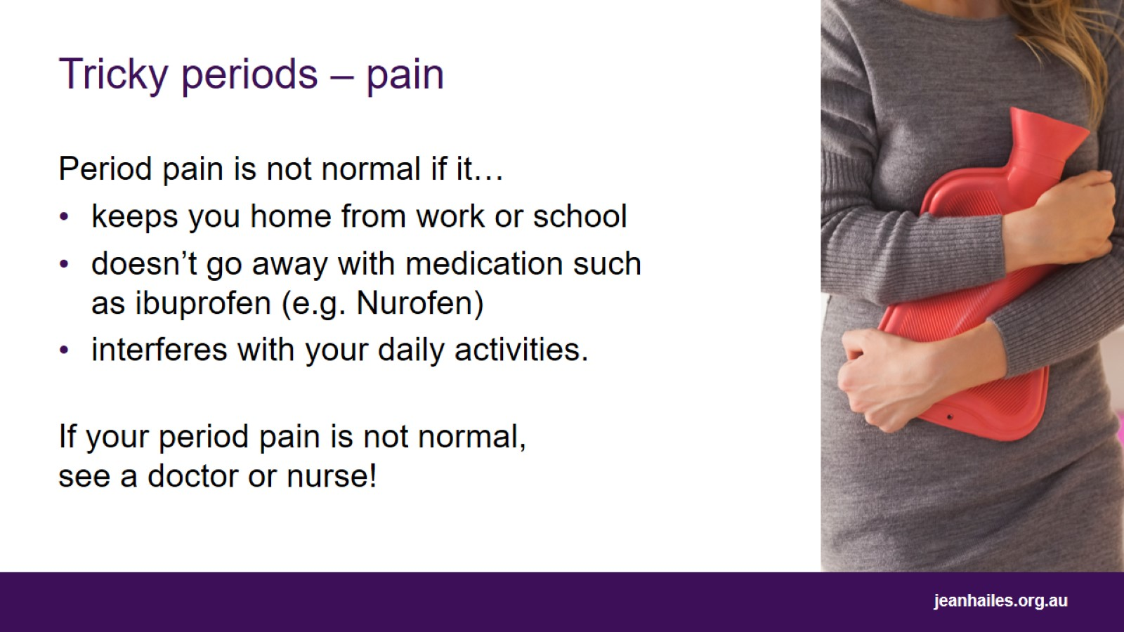
Tricky periods – pain
Notes:
Pain so bad that you are unable to go to work, school or other activities, or that doesn’t go away with medication such as ibuprofen (e.g. Nurofen), is not considered normal.
Possible causes include:
endometriosis
pelvic inflammation
uterine fibroids.
If this is like your experience of period pain, talk to a doctor or nurse.

Slide 21
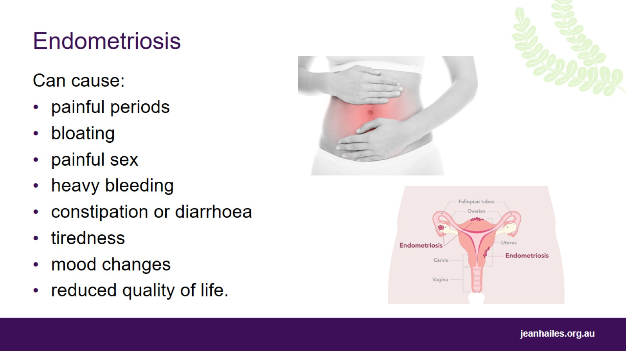
Endometriosis
Notes:
A common cause of severe period pain is endometriosis, a condition that affects around 1 in 10 women in Australia of child-bearing age.
Endometriosis occurs when cells similar to those that line the uterus grow in other parts of the body, most commonly in the pelvis and reproductive organs.
Other signs and symptoms of endometriosis may include:
bloating
painful sex
heavy bleeding
constipation or diarrhoea
tiredness
mood changes
reduced quality of life.
See your doctor or nurse if this sounds like your experience of period pain.

Slide 22
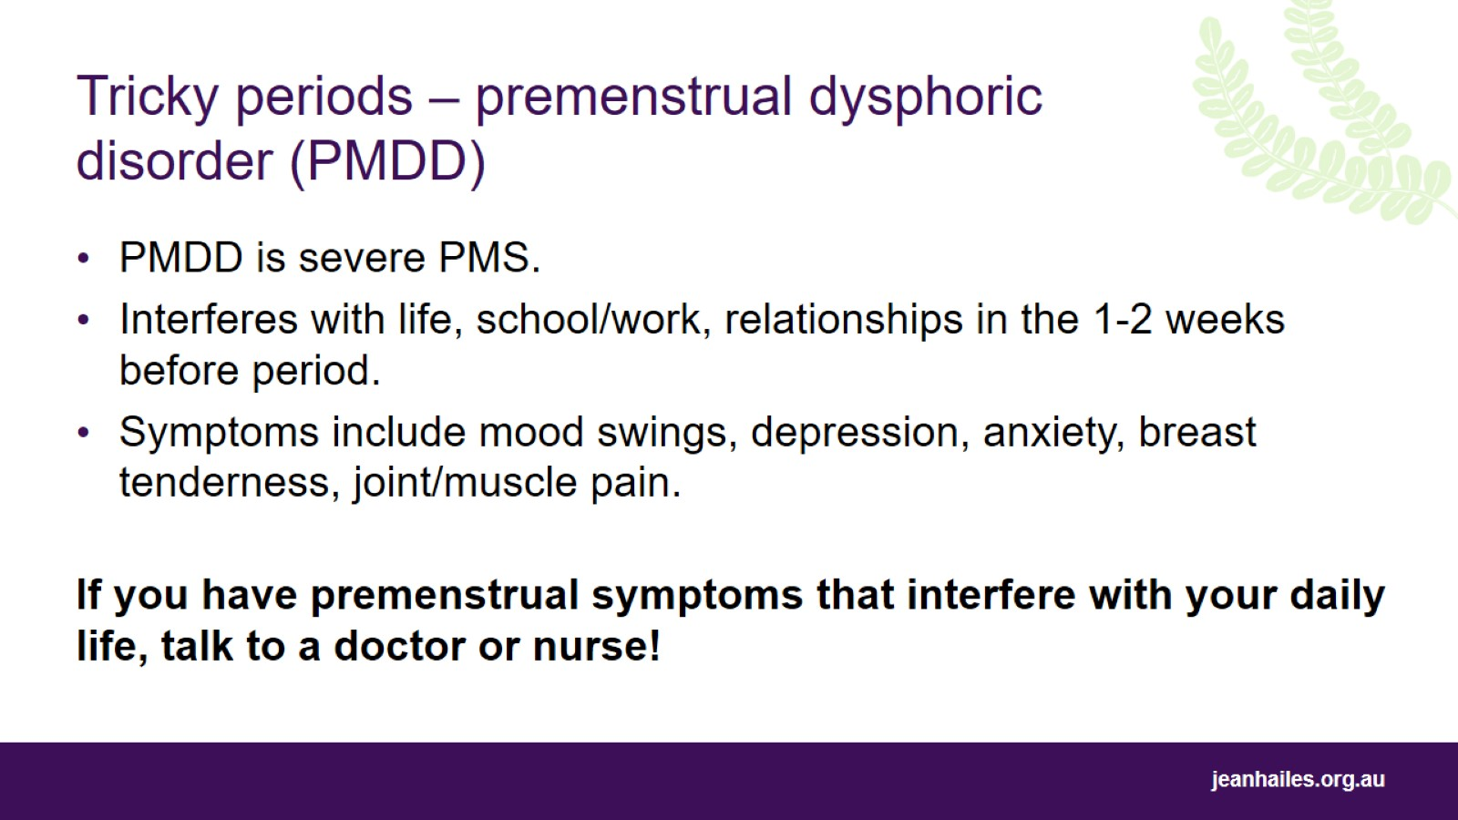
Tricky periods – premenstrual dysphoric disorder (PMDD)
Notes:
Premenstrual dysphoric disorder (PMDD) is a severe form of PMS that affects between 3% and 8% of women of reproductive age.
PMDD is similar to PMS, in that symptoms appear in the lead-up to your period and go away in the first few days of bleeding.
Main feature of PMDD is severity of symptoms compared to PMS, i.e. people with PMDD will have difficulty functioning at home, at work, and in relationships when they are symptomatic.
PMDD is diagnosed by looking at your symptoms over time. Symptoms include emotional symptoms such as mood swings, depression and anxiety, and physical symptoms such as breast tenderness and swelling, joint and/or muscle pain and weight gain.
If you have premenstrual symptoms that concern you, or that interfere with your daily life, talk to your doctor or nurse.
The International Association for Premenstrual Disorders provides a range of information, resources and support groups for people who have, or who think they may have, PMDD https://iapmd.org/i-think-i-have-pmdd

Slide 23
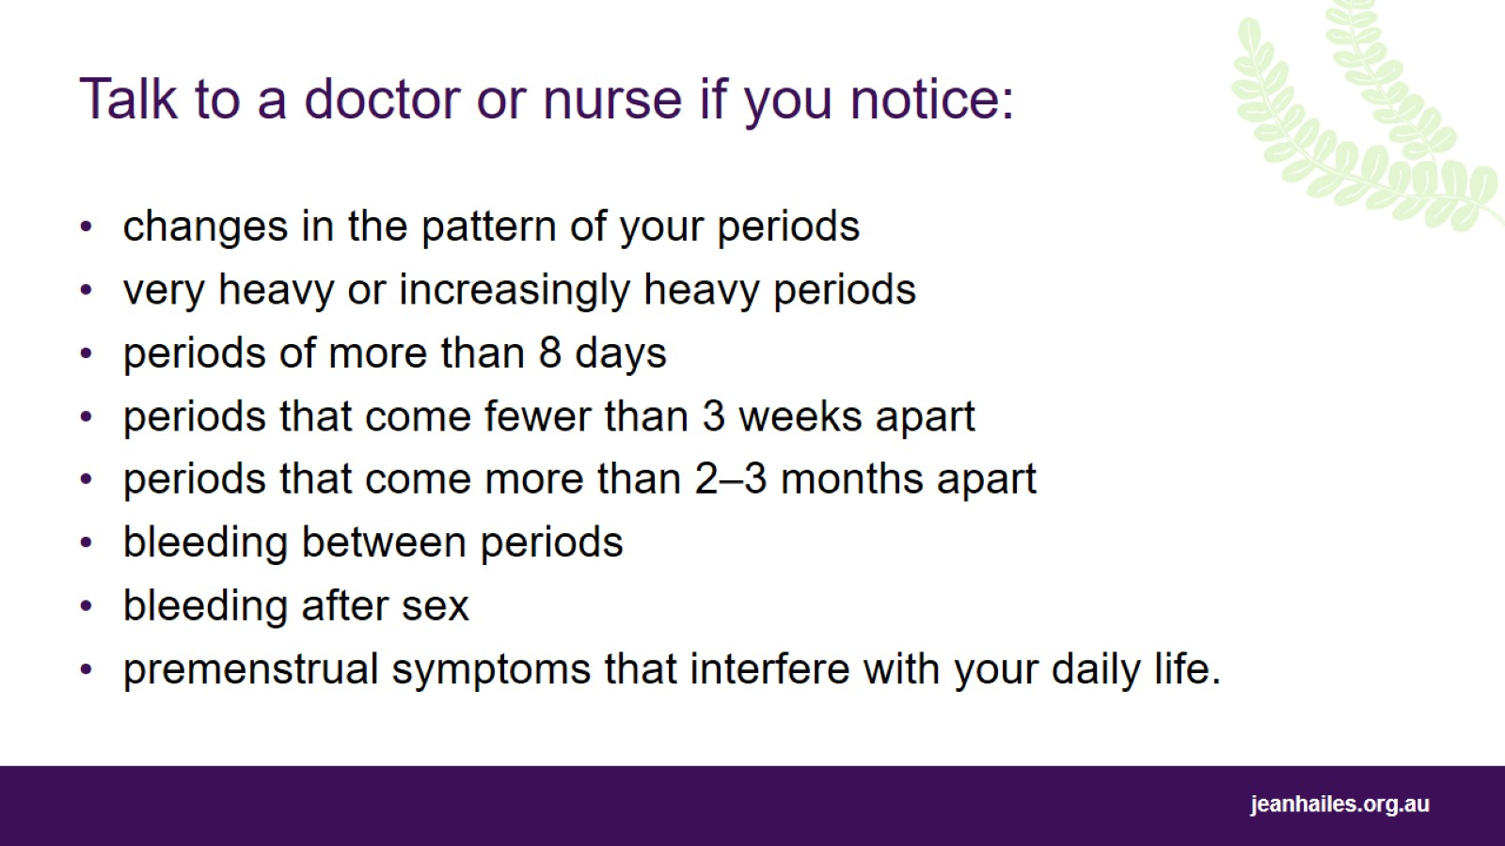
Talk to a doctor or nurse if you notice:
Notes:
Talk to a doctor or nurse if you notice:
changes in the pattern of your periods
very heavy or increasingly heavy periods
periods of more than eight days
periods that come fewer than three weeks apart
periods coming more than 2–3 months apart
painful periods that cause you to stay home
bleeding between periods
bleeding after sex
premenstrual symptoms that interfere with your daily life
anything else that troubles you about your period or menstrual cycle.

Slide 24
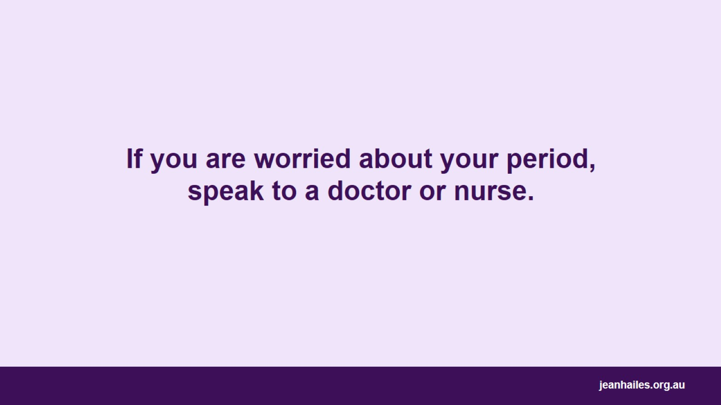
If you are worried about your period, speak to a doctor or nurse.

Slide 25
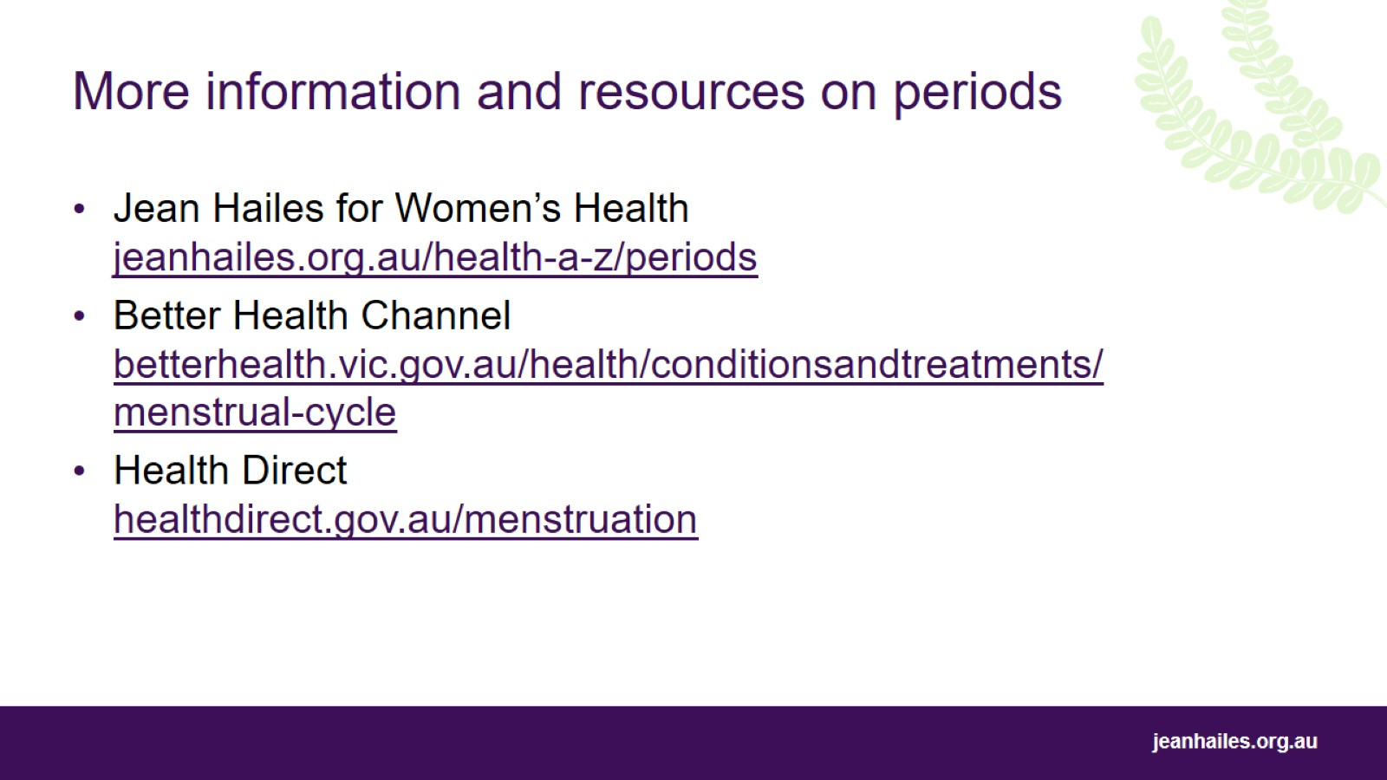
More information and resources on periods

Slide 26
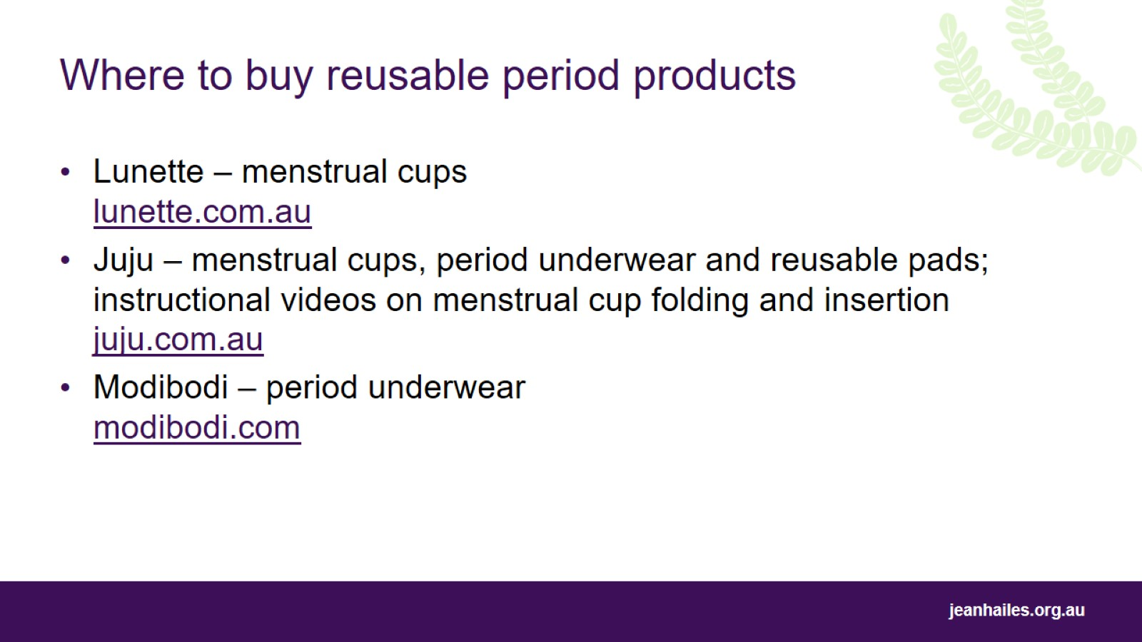
Where to buy reusable period products

Slide 27
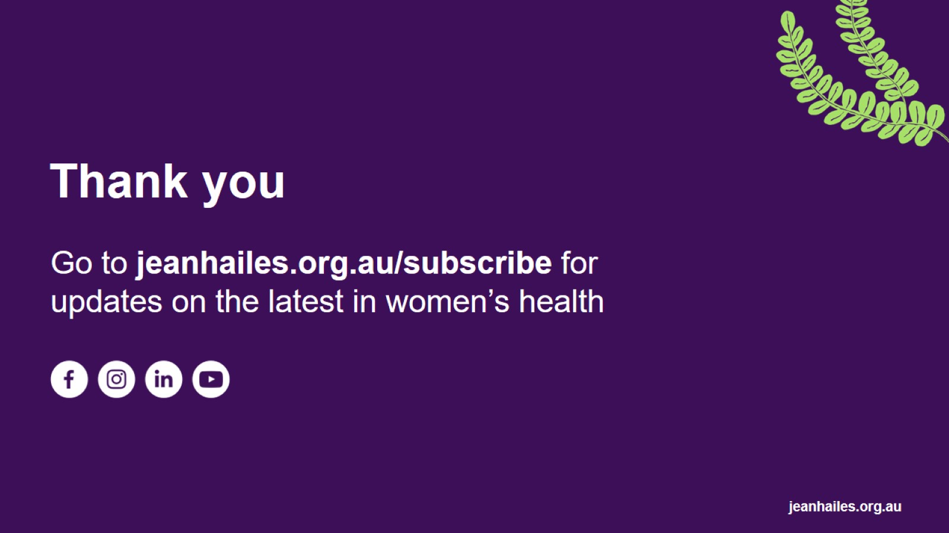
Thank you

Slide 28
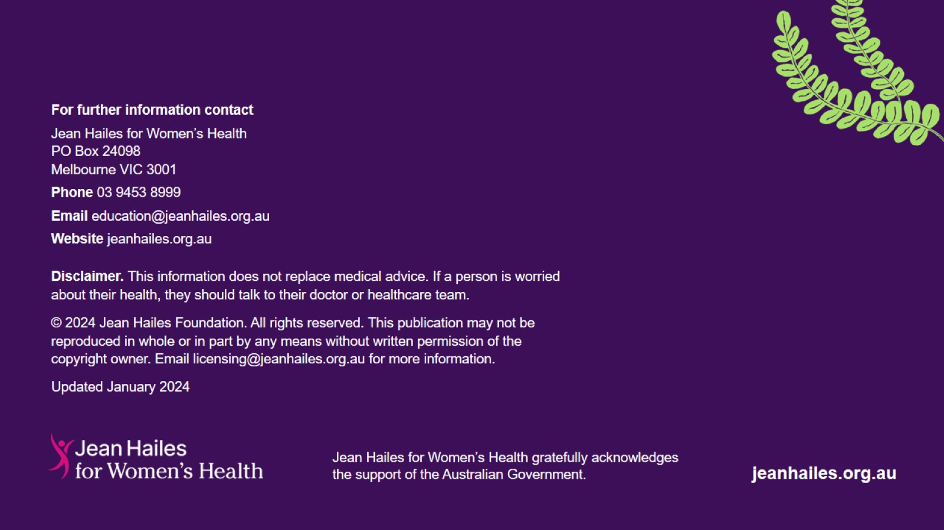

Slide 29
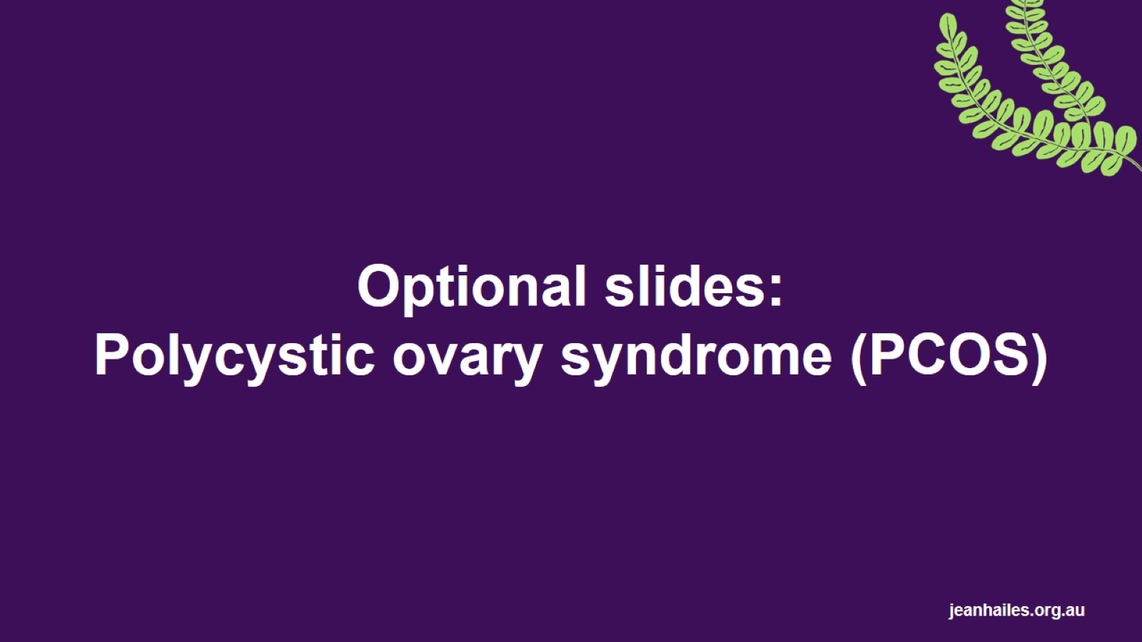
Optional slides:
Polycystic ovary syndrome (PCOS)
Notes:
These are optional slides that can be added to the main presentation.

Slide 30
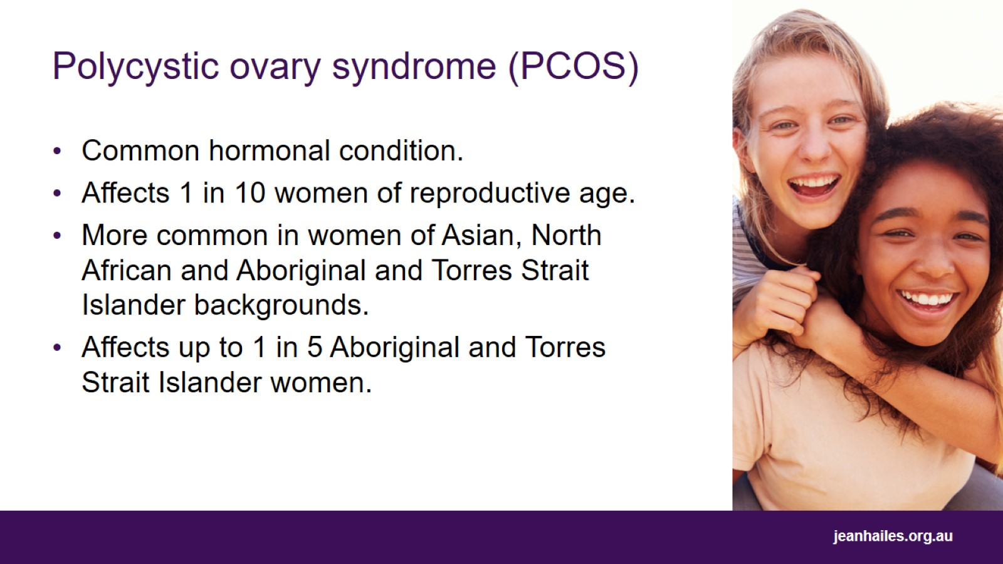
Polycystic ovary syndrome (PCOS)
Notes:
Polycystic ovary syndrome (PCOS) is a common hormonal condition in which two types of hormones, insulin and androgens, are produced in higher-than-normal levels.
Insulin is the hormone that allows your body to use glucose (sugar) from the foods you eat as energy.
Androgens, also known as ‘male-type’ hormones, are the group of hormones that give men their ‘male’ characteristics. However, they are also present in women, but in much lower levels. In women with PCOS, the higher levels of androgens cause some of the symptoms.
PCOS affects between 8% to 13%, or around 1 in 10, women of reproductive age (i.e. between the ages of 12 and 52).
It is more common in some groups, including women of Asian, North African and Aboriginal and Torres Strait Islander backgrounds.

Slide 31
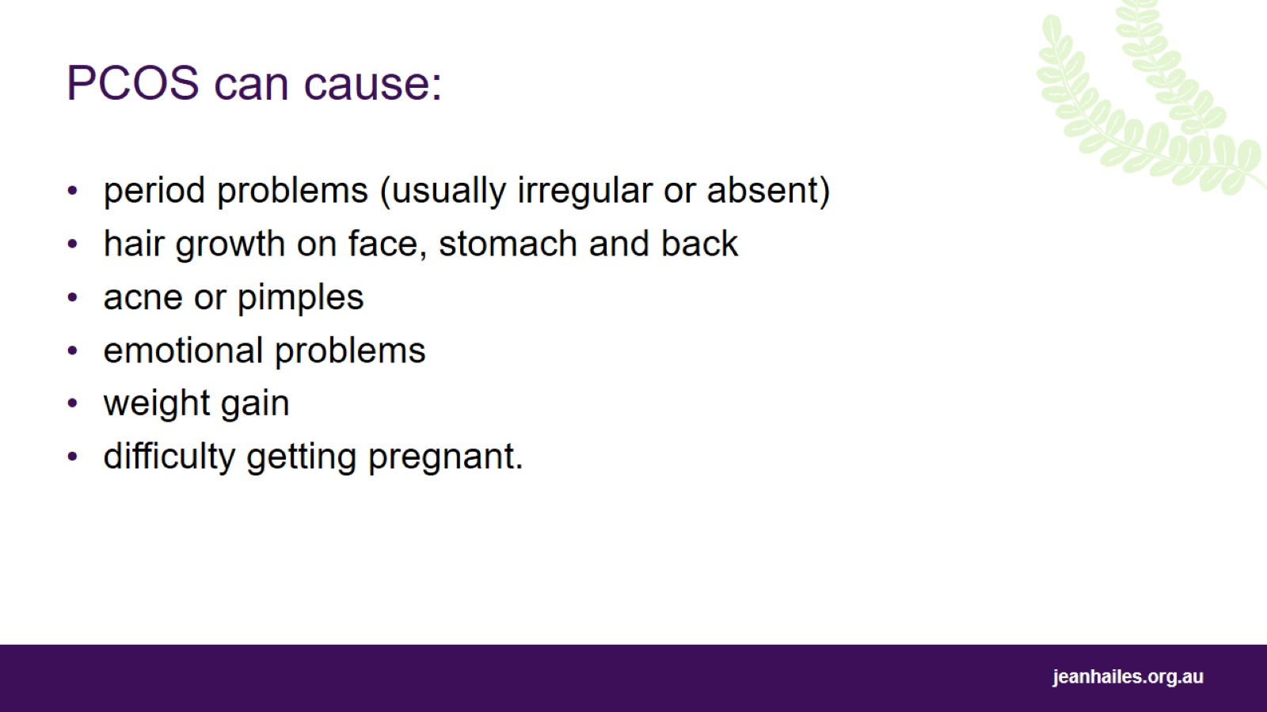
PCOS can cause:
Notes:
PCOS can cause any of the following symptoms:
period problems (usually irregular or absent)
hair growth on face, stomach and back
acne or pimples
emotional problems including anxiety or depression
easy weight gain
difficulty getting pregnant.

Slide 32
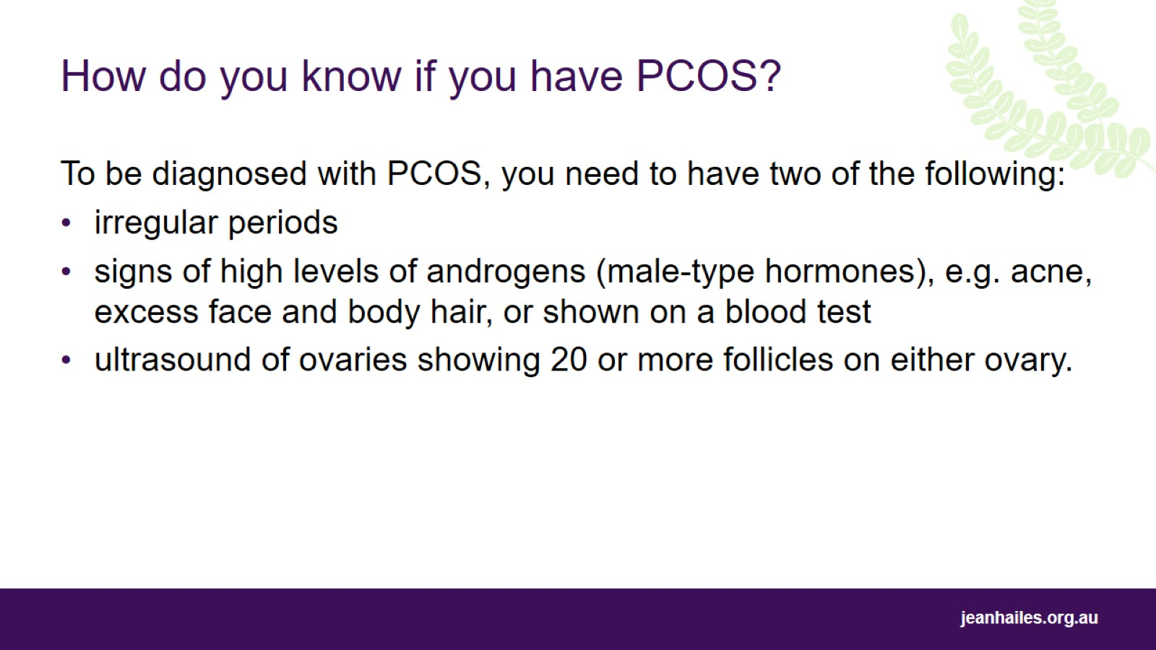
How do you know if you have PCOS?
Notes:
To be diagnosed with PCOS, you need two of the following:
signs of excess ‘androgens’ e.g., acne, excess body hair, or increased blood levels of androgens
irregular periods
ultrasound of ovaries showing 20 or more follicles on either ovary.
Note that ultrasound is only required if one of the first two are not present, and the procedure is not recommended for people under 20 years of age.

Slide 33
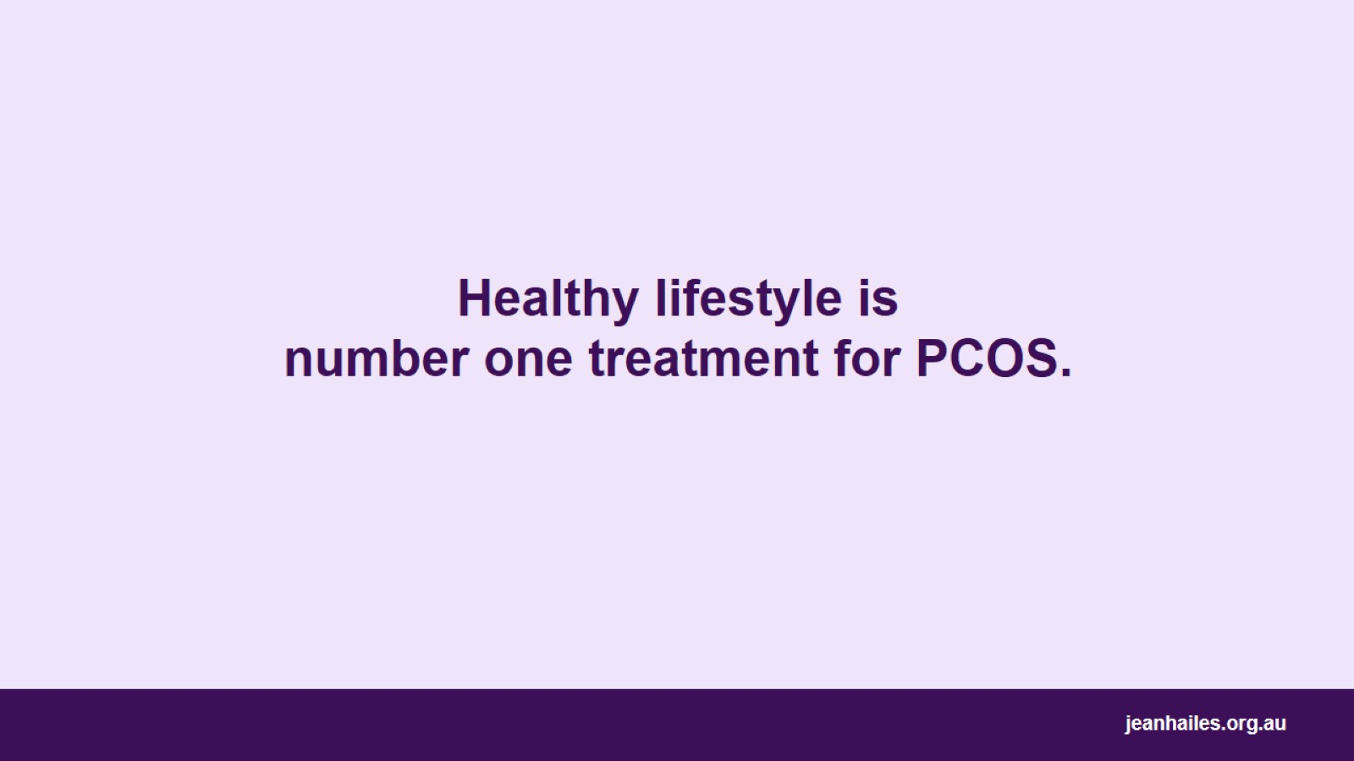
Healthy lifestyle is number one treatment for PCOS.
Notes:
A healthy lifestyle is the most effective way to manage PCOS successfully and to reduce the severity of your symptoms.
This includes eating a balanced and nutritious diet, maintaining a healthy weight, being as active as possible, not smoking, and avoiding excessive drinking.
If you are overweight, losing 5–10% of your body weight can help to improve symptoms of PCOS.
There is also a range of medical and cosmetic treatments that may be used in the management of various PCOS symptoms, depending on your treatment goals.

Slide 34
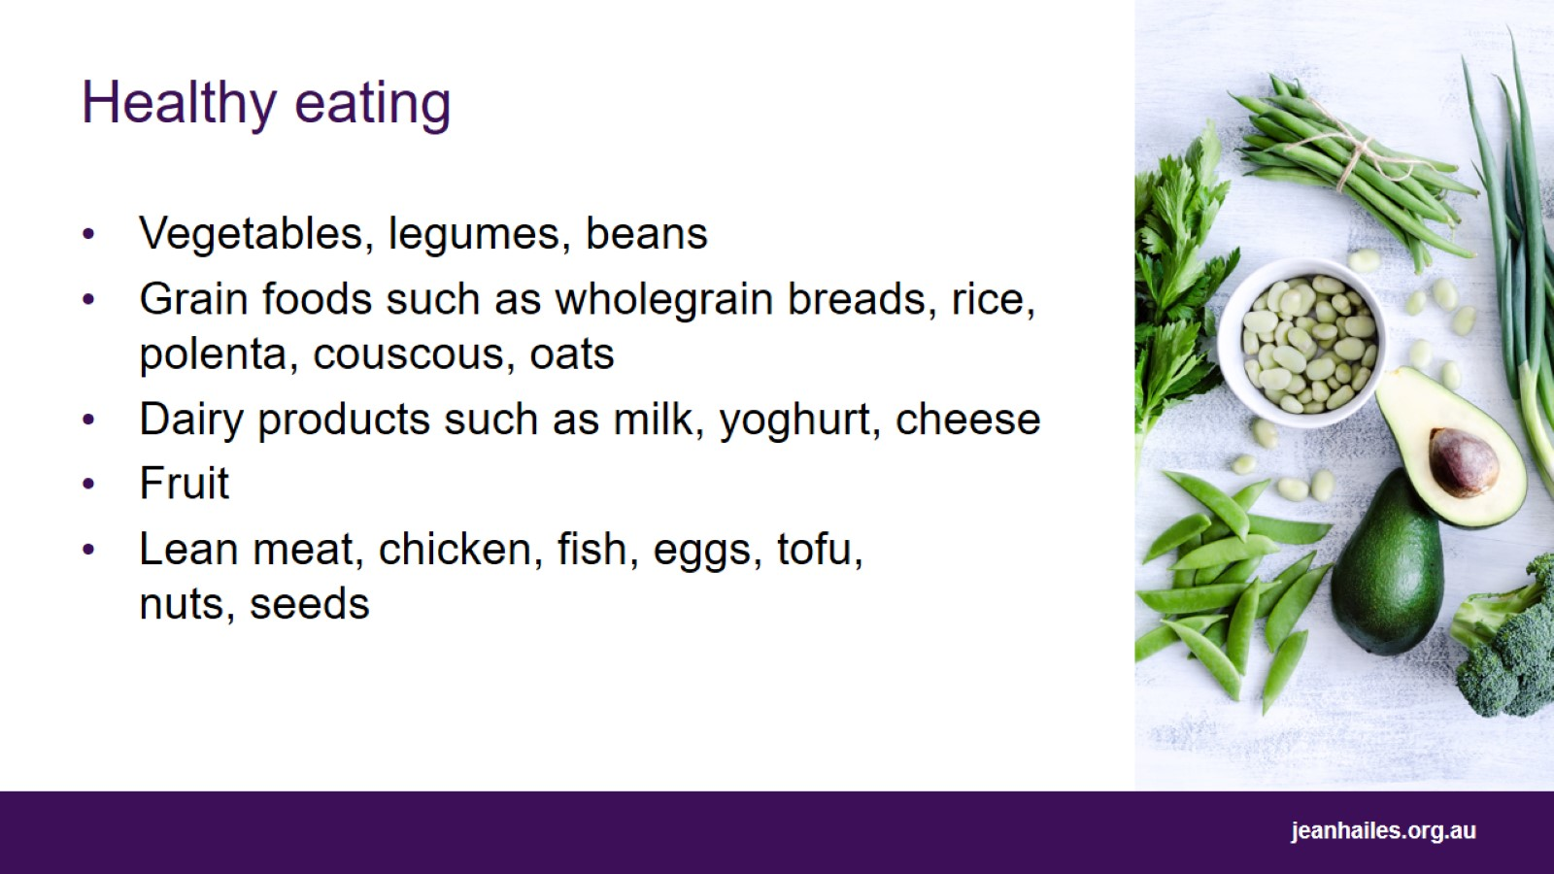
Healthy eating
Notes:
People diagnosed with PCOS should follow general healthy eating principles, as per recommendations for the general population.
This means eating a variety of foods from the five food groups every day:
vegetables and legumes/beans
fruit
grain foods such as wholegrain breads, rice, polenta, couscous, oats
lean meats, chicken, fish, eggs, tofu, nuts and seeds
dairy products such as milk, yoghurt, cheese.

Slide 35
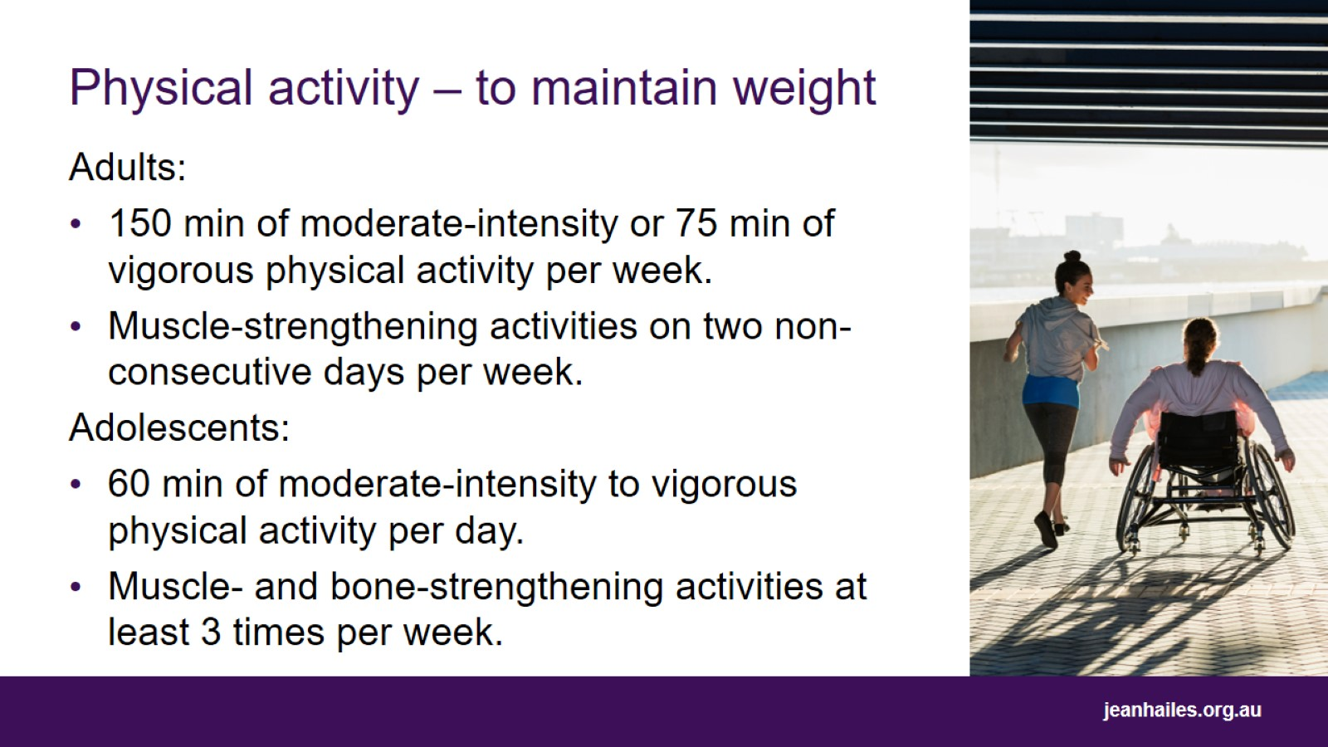
Physical activity – to maintain weight
Notes:
Regular exercise is an effective way to improve PCOS symptoms.
Recommended exercise to maintain weight:
Adults – aim for 150 minutes of moderate-intensity physical activity per week or 75 minutes of vigorous physical activity and muscle-strengthening activities on two non-consecutive days per week.
Adolescents – aim for 60 minutes of moderate to vigorous physical activity per day and muscle- and bone-strengthening activities at least three times per week.

Slide 36
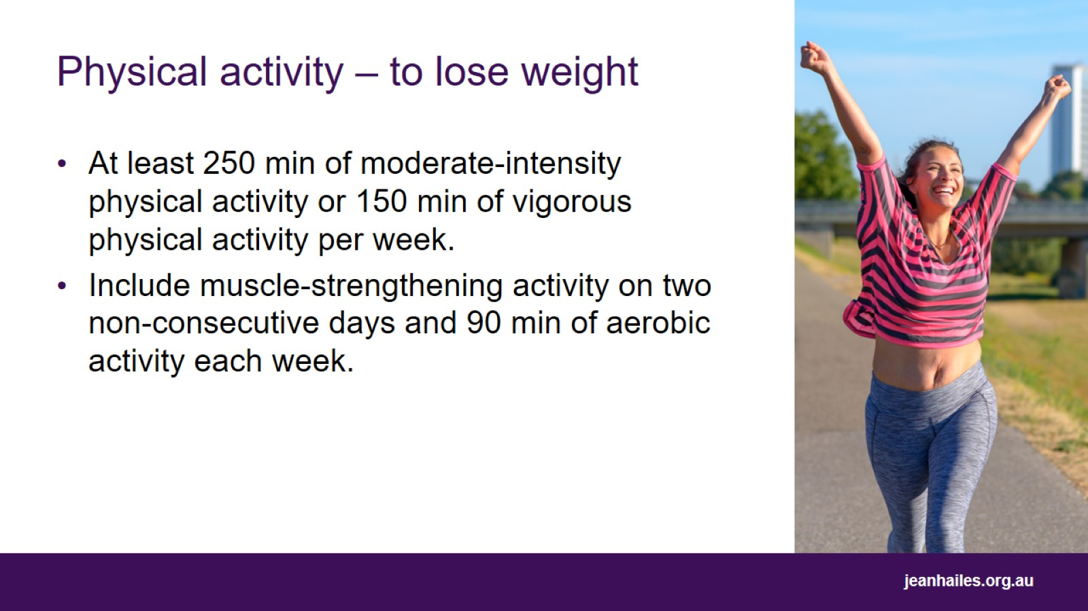
Physical activity – to lose weight
Notes:
If you are overweight, losing between 5% to 10% of your body weight can help to improve PCOS symptoms.
Recommended daily exercise to lose weight:
aim for minimum 250 minutes of moderate-intensity physical activity per week or 150 minutes of vigorous physical activity per week
include muscle-strengthening activity on 2 non-consecutive days and 90 minutes of aerobic activity each week.

Slide 37
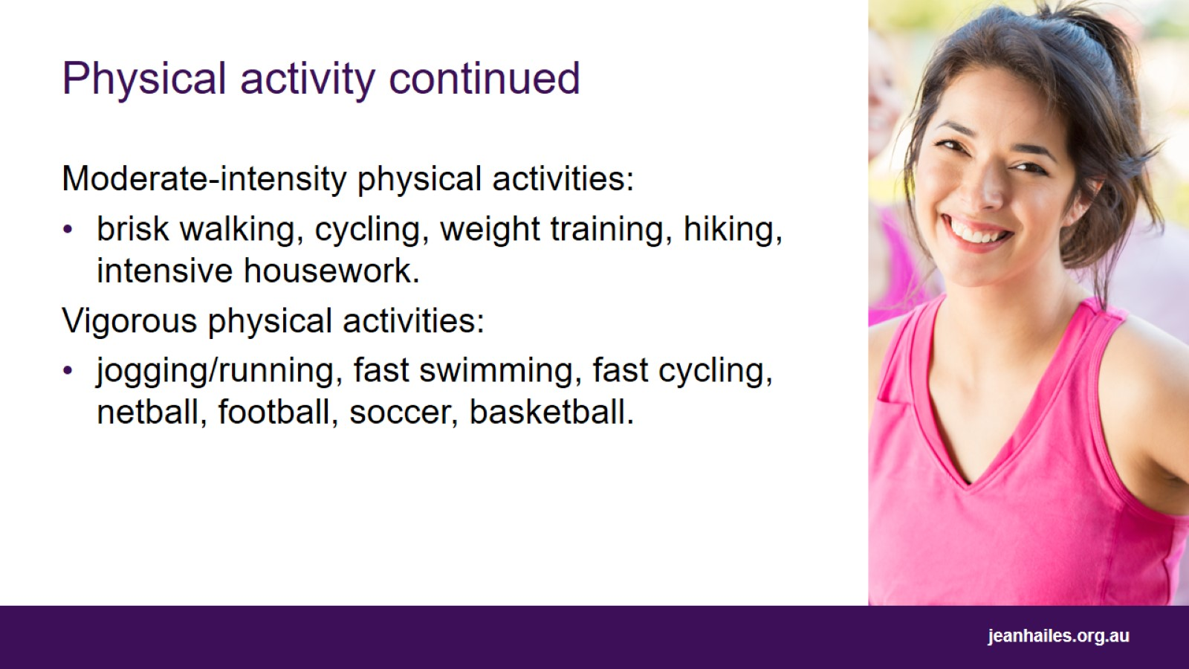
Physical activity continued
Notes:
Moderate-intensity physical activities include brisk walking, cycling, hiking, weight training, intensive housework.
Vigorous physical activities include jogging or running, fast cycling, netball, fast swimming, football, soccer, basketball.
Choose activities that you enjoy.

Slide 38
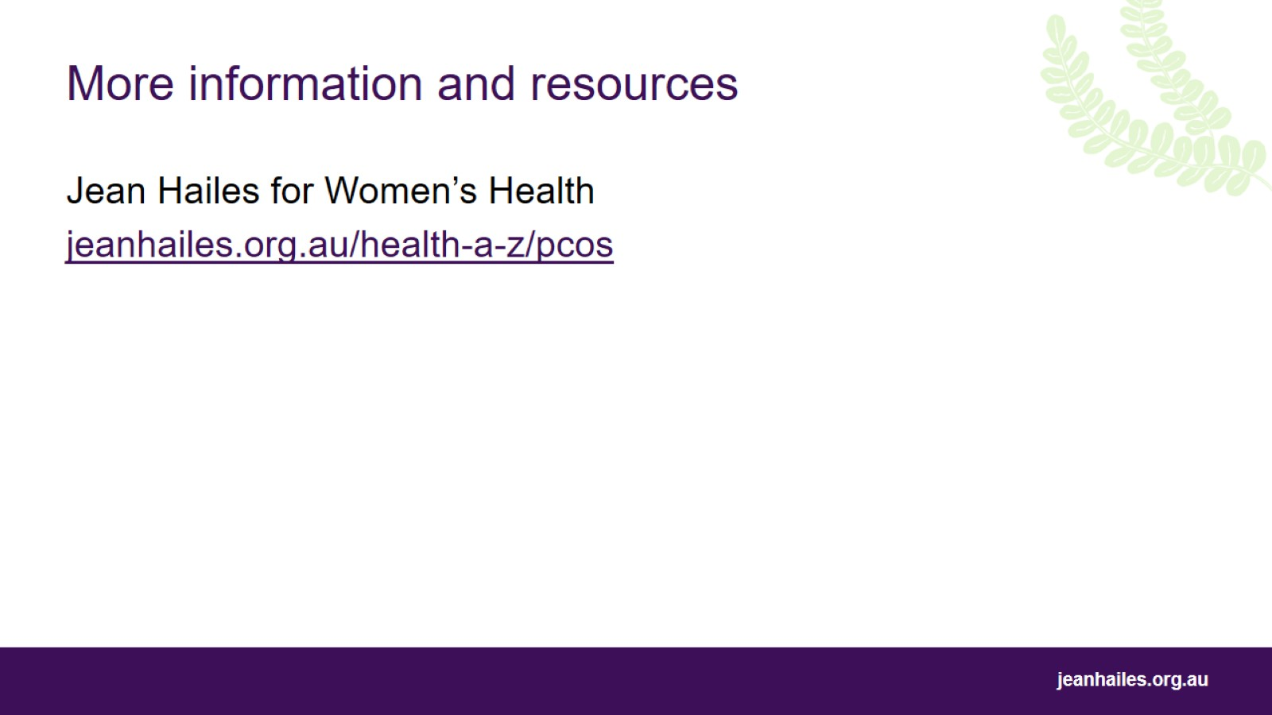
More information and resources

Slide 39
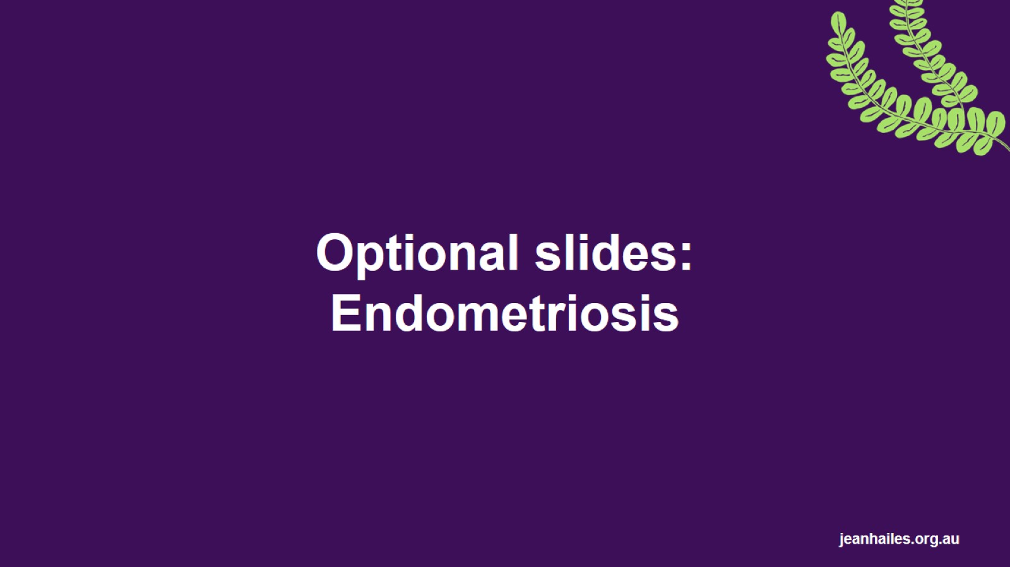
Optional slides:
Endometriosis
Notes:
These are optional slides that can be added to the main presentation.

Slide 40
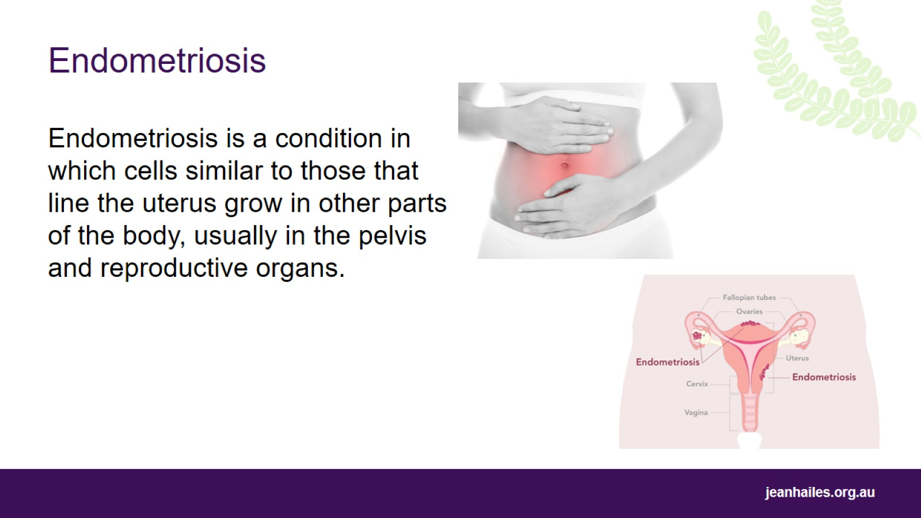
Endometriosis
Notes:
Endometriosis, or ‘endo’, is a condition that occurs when cells similar to those that line the uterus grow in other parts of the body, usually in the pelvis and reproductive organs.
When these cells grow outside the uterus, they form lesions or patches that bleed and leak fluid in response to your hormones at the time of your period. This leads to inflammation and scarring.
Endometriosis is common and affects around 1 in 10 women of reproductive age.
Despite this, the average time taken to diagnose endometriosis is 7-10 years.

Slide 41
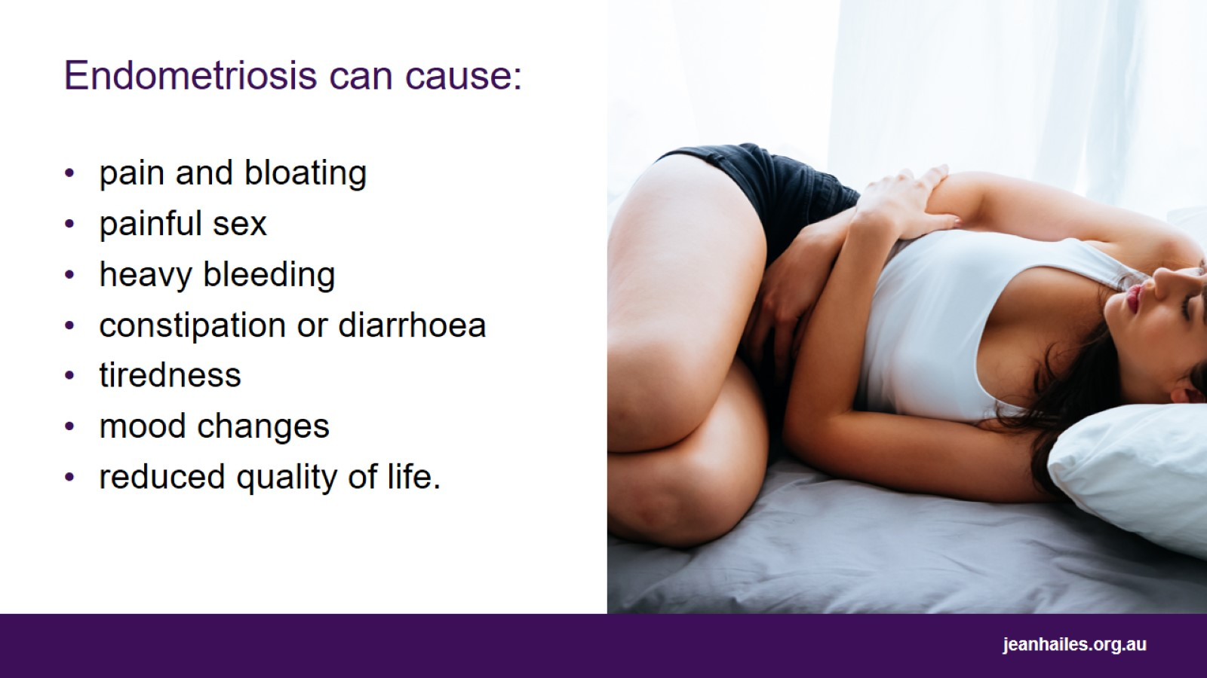
Endometriosis can cause:
Notes:
Endometriosis can cause many signs and symptoms, which may be different from person to person.
Some women have many symptoms, while some women will have none at all.
The severity of the symptoms may not reflect how bad the condition is.

Slide 42
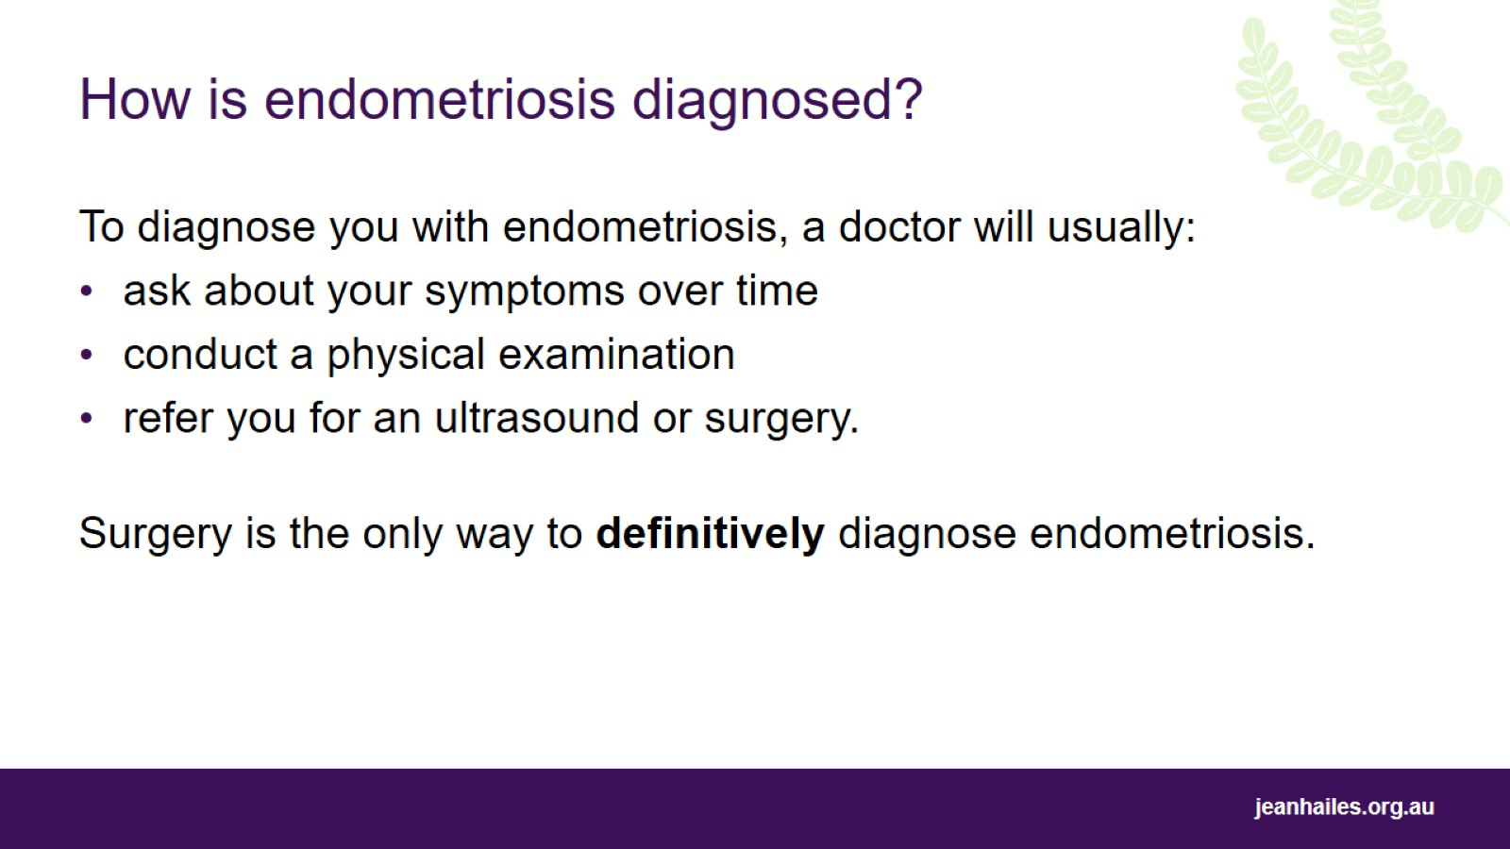
How is endometriosis diagnosed?
Notes:
Diagnosing endometriosis can be tricky and time consuming due to the many different symptoms.
Usually, a doctor will ask you lots of questions about your symptoms over time.
They may also do a physical examination, which can include feeling inside your pelvis and vagina if you are, or have been, sexually active.
Ultrasound can be used to diagnose endometriosis in some, but not all, cases.
Surgery called ‘laparoscopy’ is the only way to definitively diagnose endometriosis. During a laparoscopy, a slender tool with a camera and light on the end is inserted through a small cut in your belly button and is used to look at the inside of your pelvic area for signs of endometriosis.

Slide 43
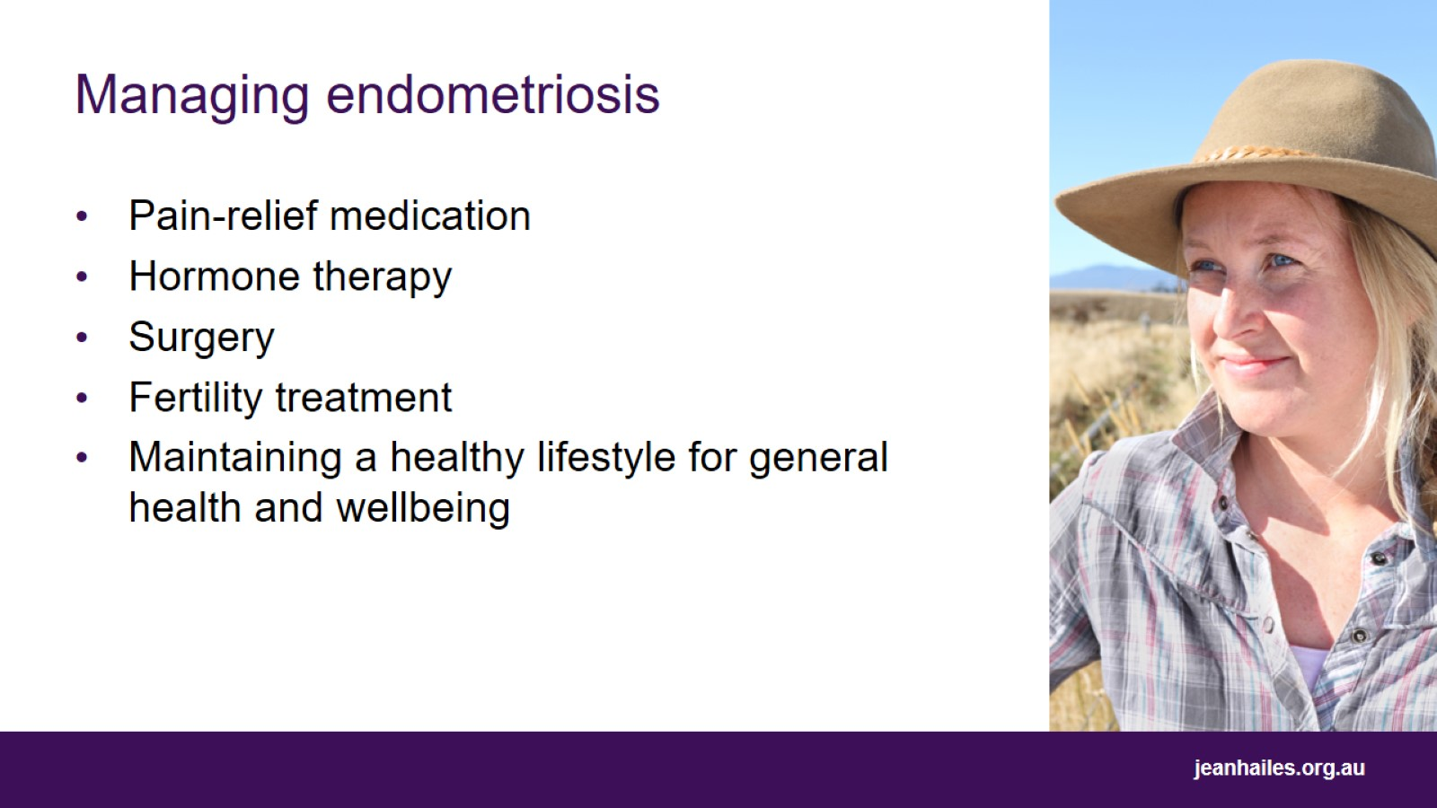
Managing endometriosis
Notes:
There is no cure for endometriosis.
Management depends on your symptoms and treatment goals.
Pain-relief medication – manage pain associated with endometriosis.
Hormone therapy such as the contraceptive pill may help manage pain and slow the growth of endometriosis.
Surgery to remove endometriosis patches.
Fertility treatment if you want to get pregnant but are having trouble doing so.
More research is required to understand whether complementary therapies such as yoga or acupuncture help in managing pain associated with endometriosis.

Slide 44
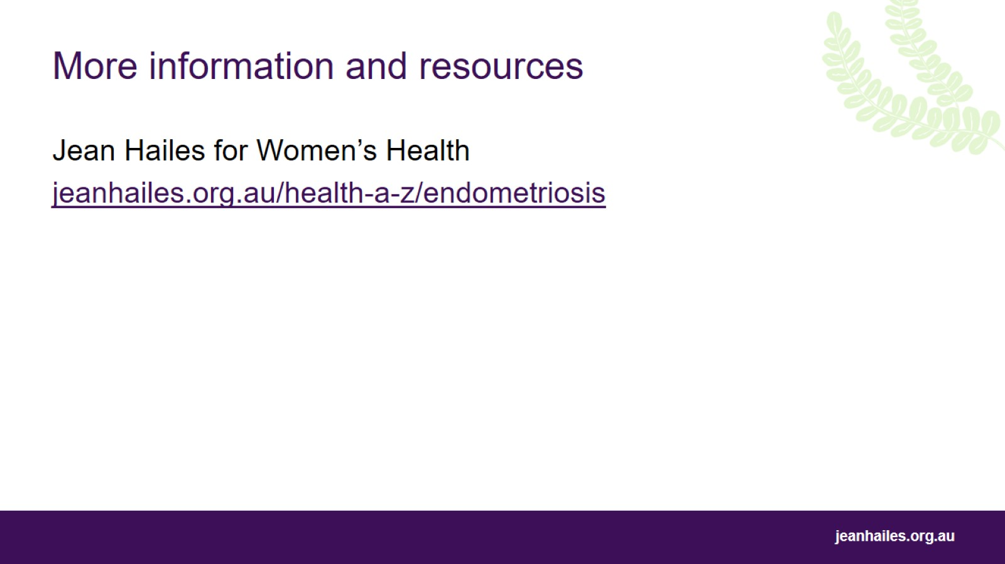
More information and resources

