Slide 1
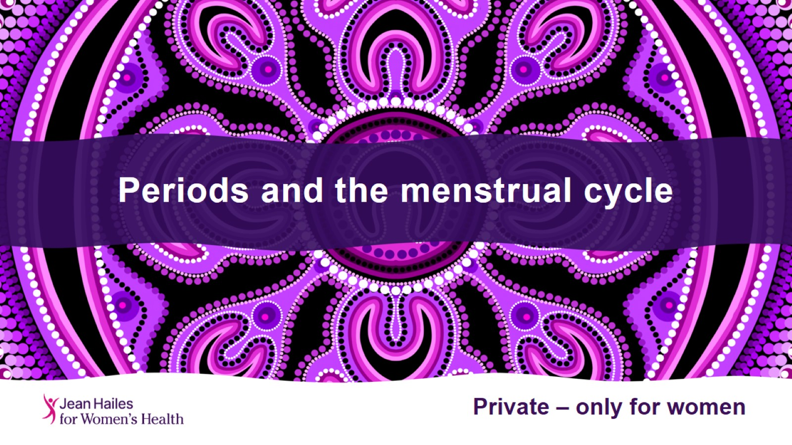
Periods and the menstrual cycle

Slide 2
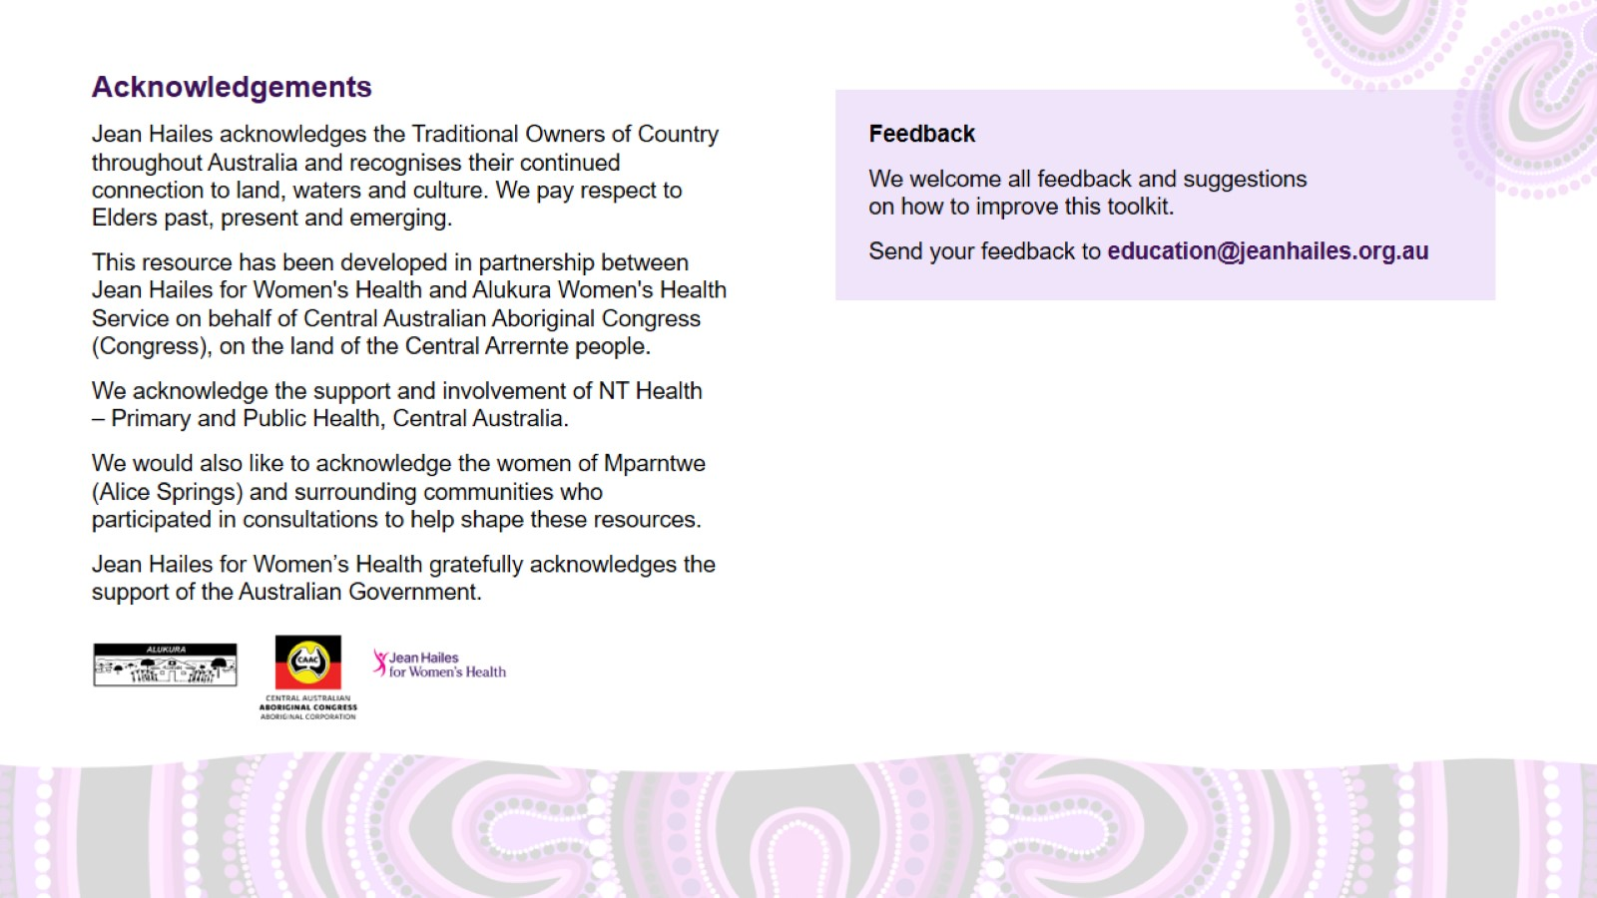
Acknowledgements

Slide 3
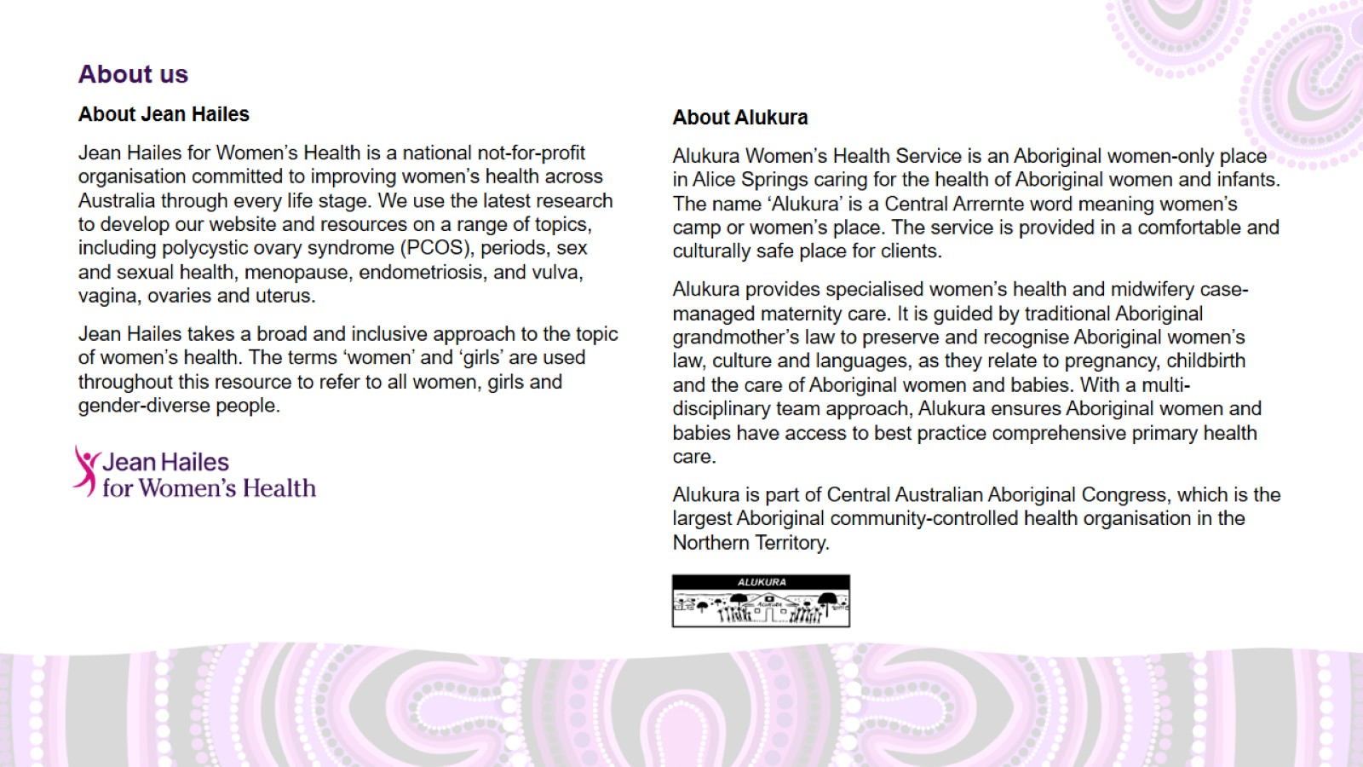
About us

Slide 4
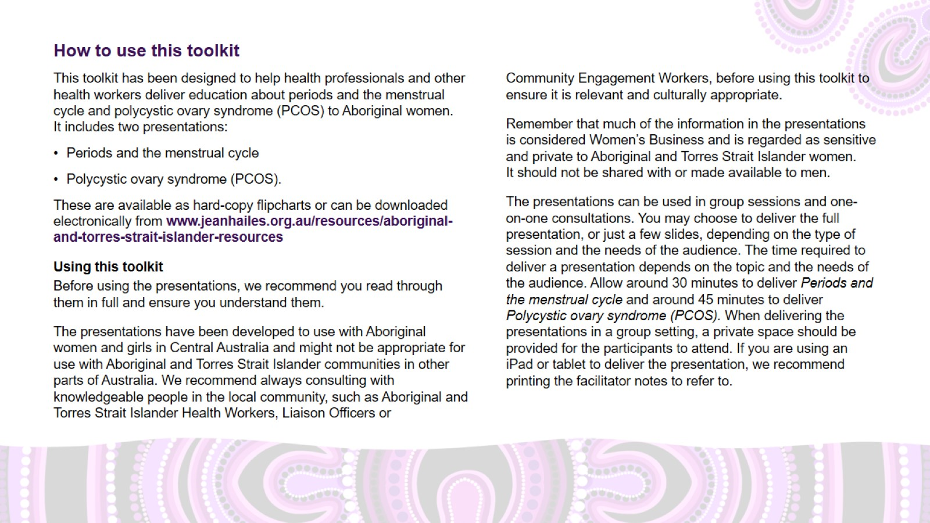
How to use this toolkit

Slide 5
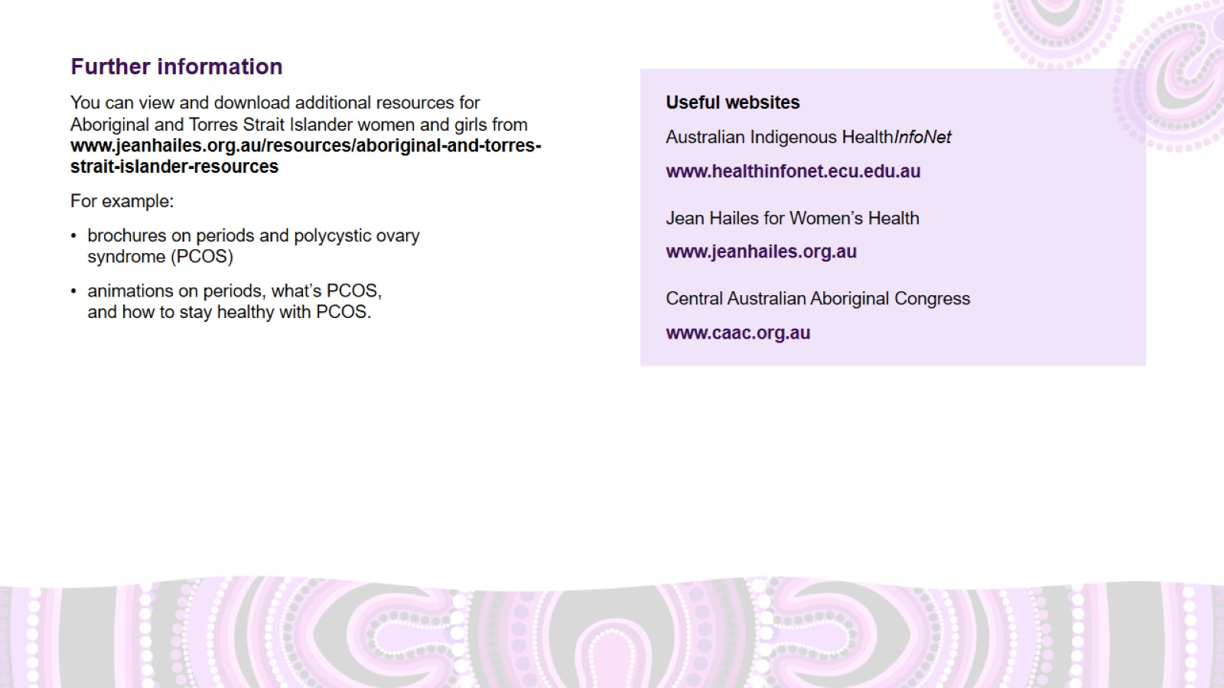
Further information

Slide 6
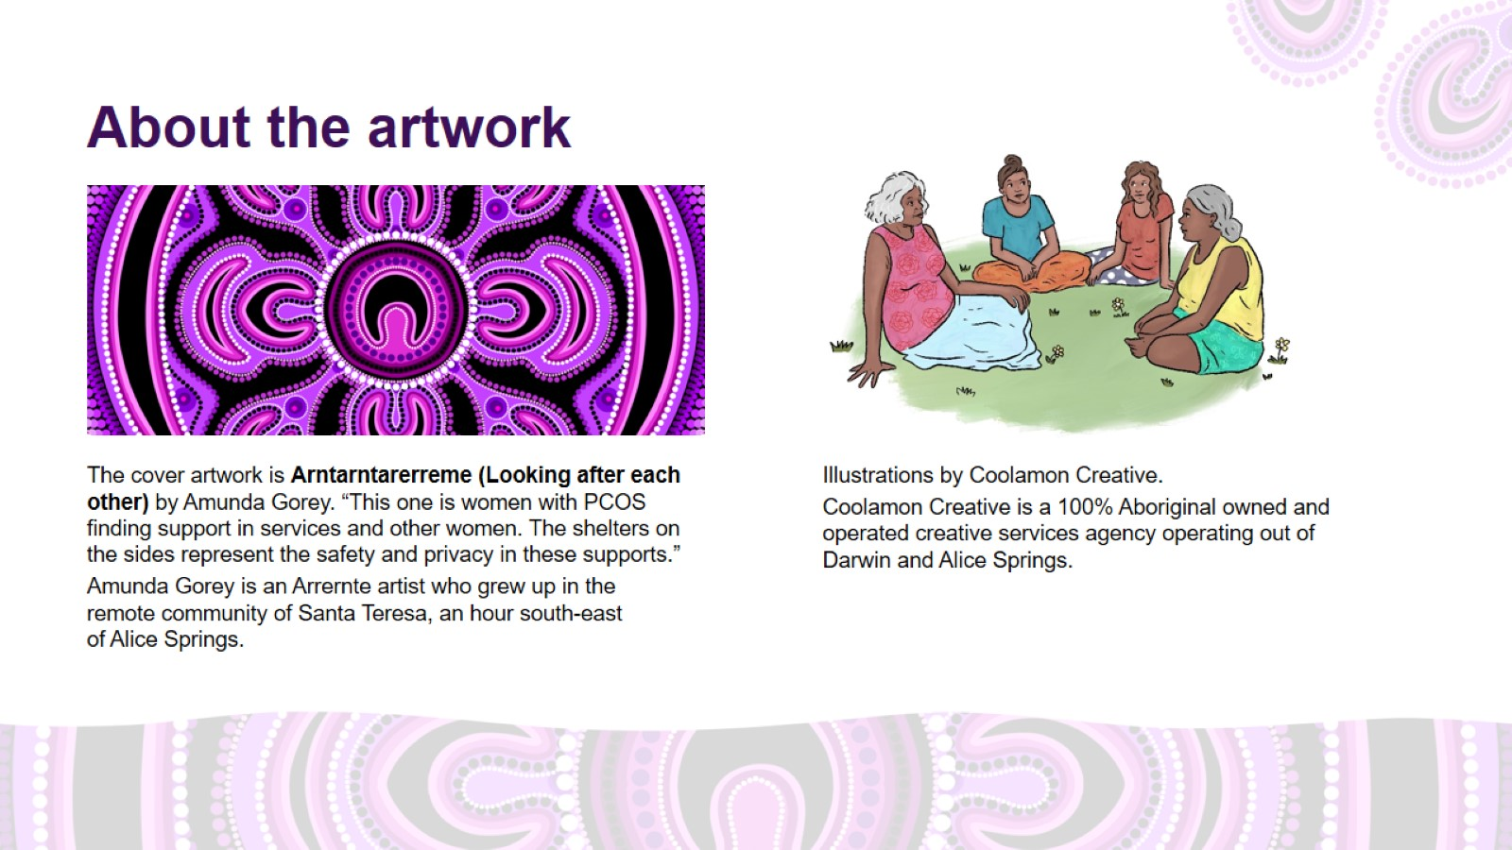
About the artwork

Slide 7
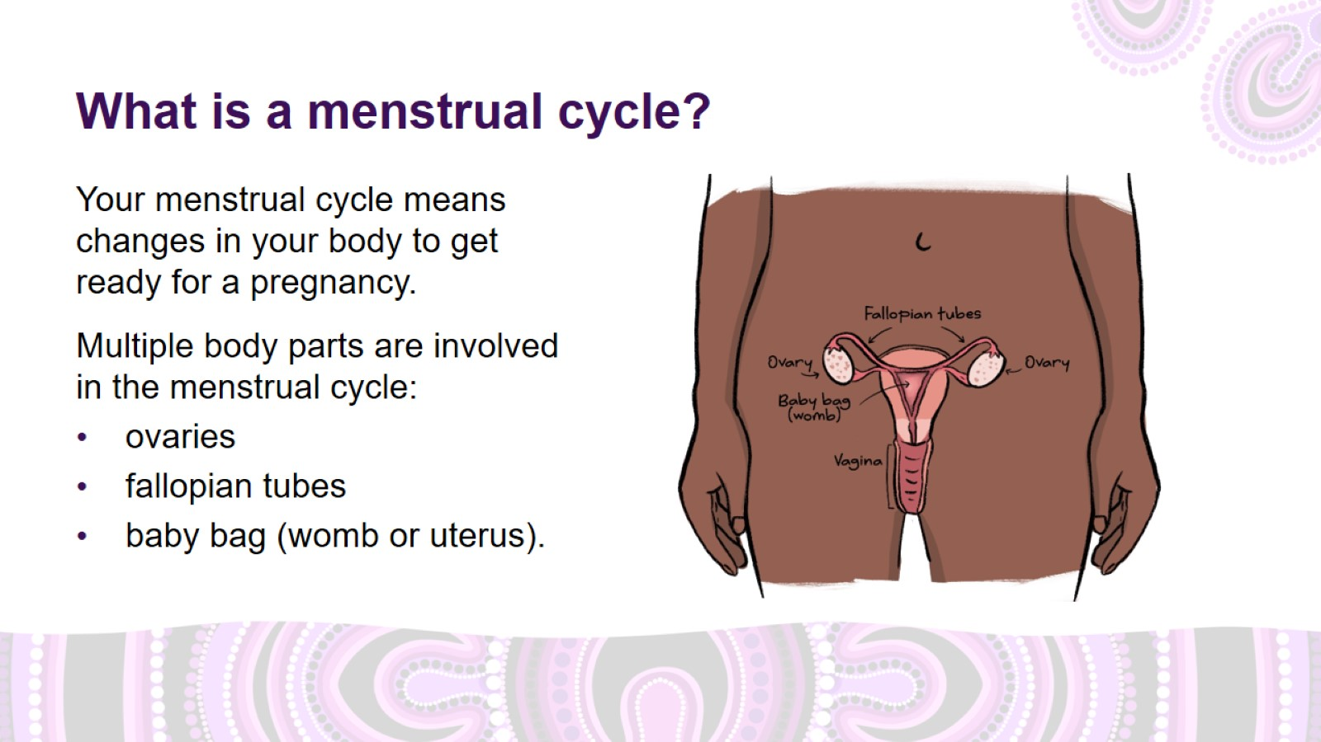
What is a menstrual cycle?
Notes:
What is a menstrual cycle?
Your menstrual cycle means changes in your body to get ready for a pregnancy.
Multiple body parts are involved in your menstrual cycle. These are ovaries, fallopian tubes and the baby bag (womb).
Ovaries are small, round organs in your reproductive system that contain eggs. Women have two ovaries, one on each side.
Fallopian tubes are the tubes that connect the ovaries to the baby bag (womb).
Baby bag (also called womb or uterus) is where the baby grows if you are pregnant.

Slide 8
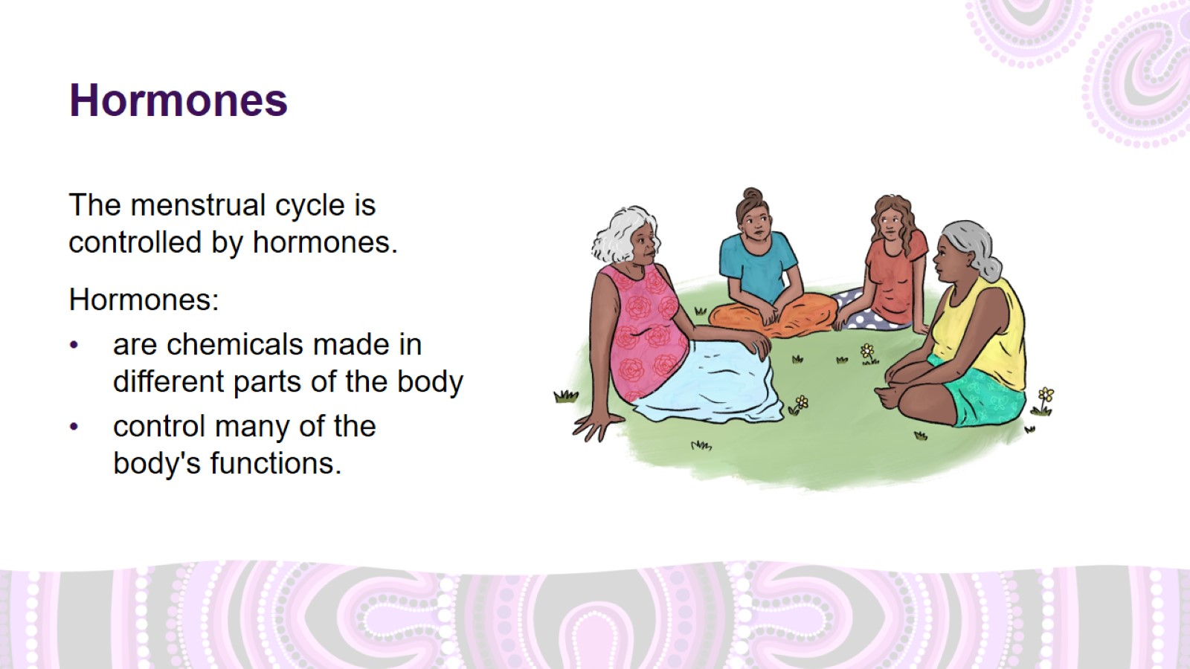
Hormones
Notes:
Hormones
The menstrual cycle is controlled by hormones.
What are hormones?
Hormones are chemicals made in different parts of the body, including the brain and the ovaries. They send messages through the bloodstream to tissues and organs.
They help control many of the body's functions, such as temperature, growth, energy, repair of cells, reproduction, sexual function and digestion.
Hormones tell the body to eat, stop eating, sleep, wake up, grow or stop growing.

Slide 9
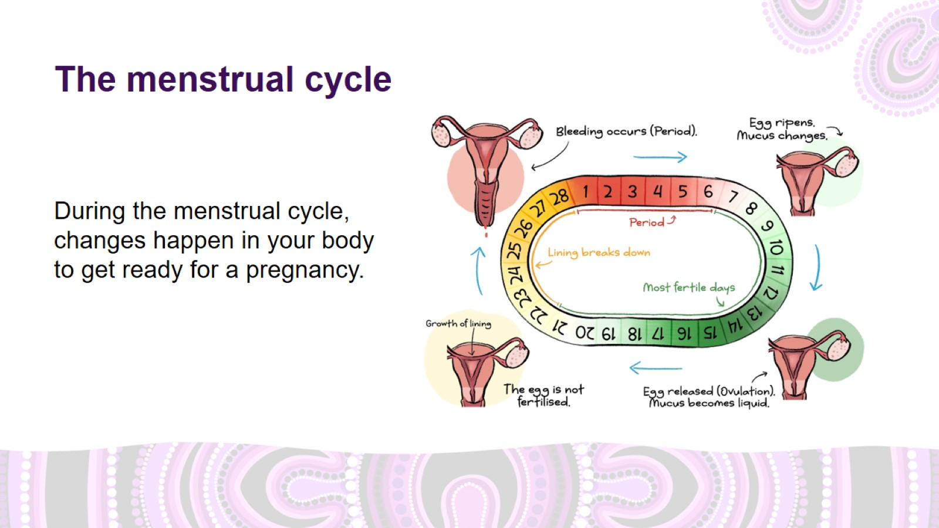
The menstrual cycle
Notes:
The menstrual cycle
The image shows a 28-day menstrual cycle. An average cycle is about 28 days, but they can be shorter or longer.
Day 1 is the first day of the menstrual cycle and the first day of your period if you are not pregnant. During this time, the lining of the baby bag breaks down and leaves the body through your vagina. This is your period or ‘monthly’.
After your period, hormone levels rise, and the lining of the baby bag starts getting thicker to prepare for a possible pregnancy.
Around halfway through your cycle, an egg leaves an ovary and travels down the fallopian tube towards the baby bag. This is when you are most likely to get pregnant.
If you don’t get pregnant, hormone levels drop, the lining of the baby bag breaks down and the menstrual cycle begins again.
Diagram of the menstrual cycle adapted from Remote Primary Health Care Manuals. (2017). Women's Business Manual (6th edition). Alice Springs, NT: Centre for Remote Health.

Slide 10
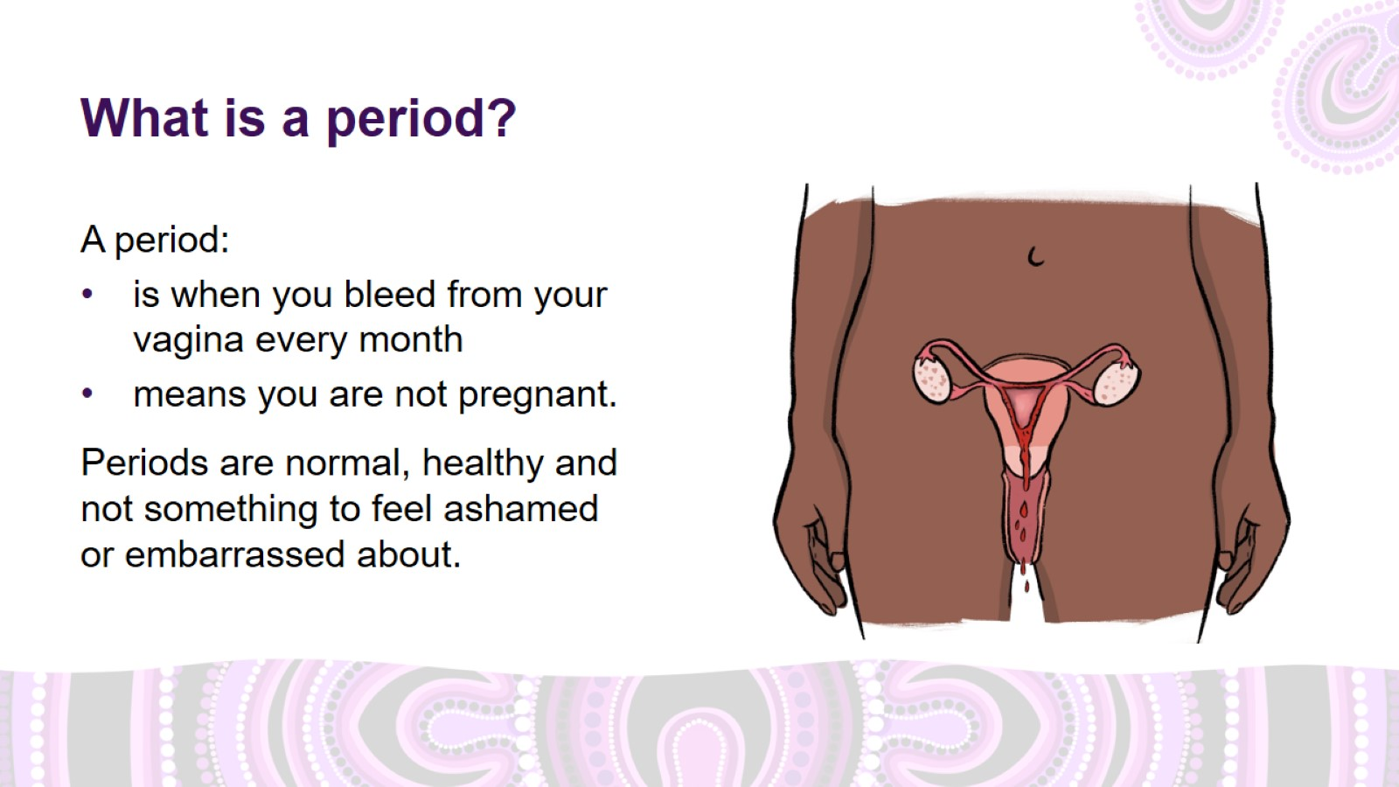
What is a period?
Notes:
What is a period?
A period:
is when you bleed from your vagina every month
means you are not pregnant.
Most girls in Australia have their first period at age 12 or 13, but it can start as early as 9 and as late as 16.
Periods are sometimes called 'monthlies', 'menstruation', 'menses', 'bleeds', 'that thing’.
Periods are normal, healthy and not something to feel ashamed or embarrassed about.

Slide 11
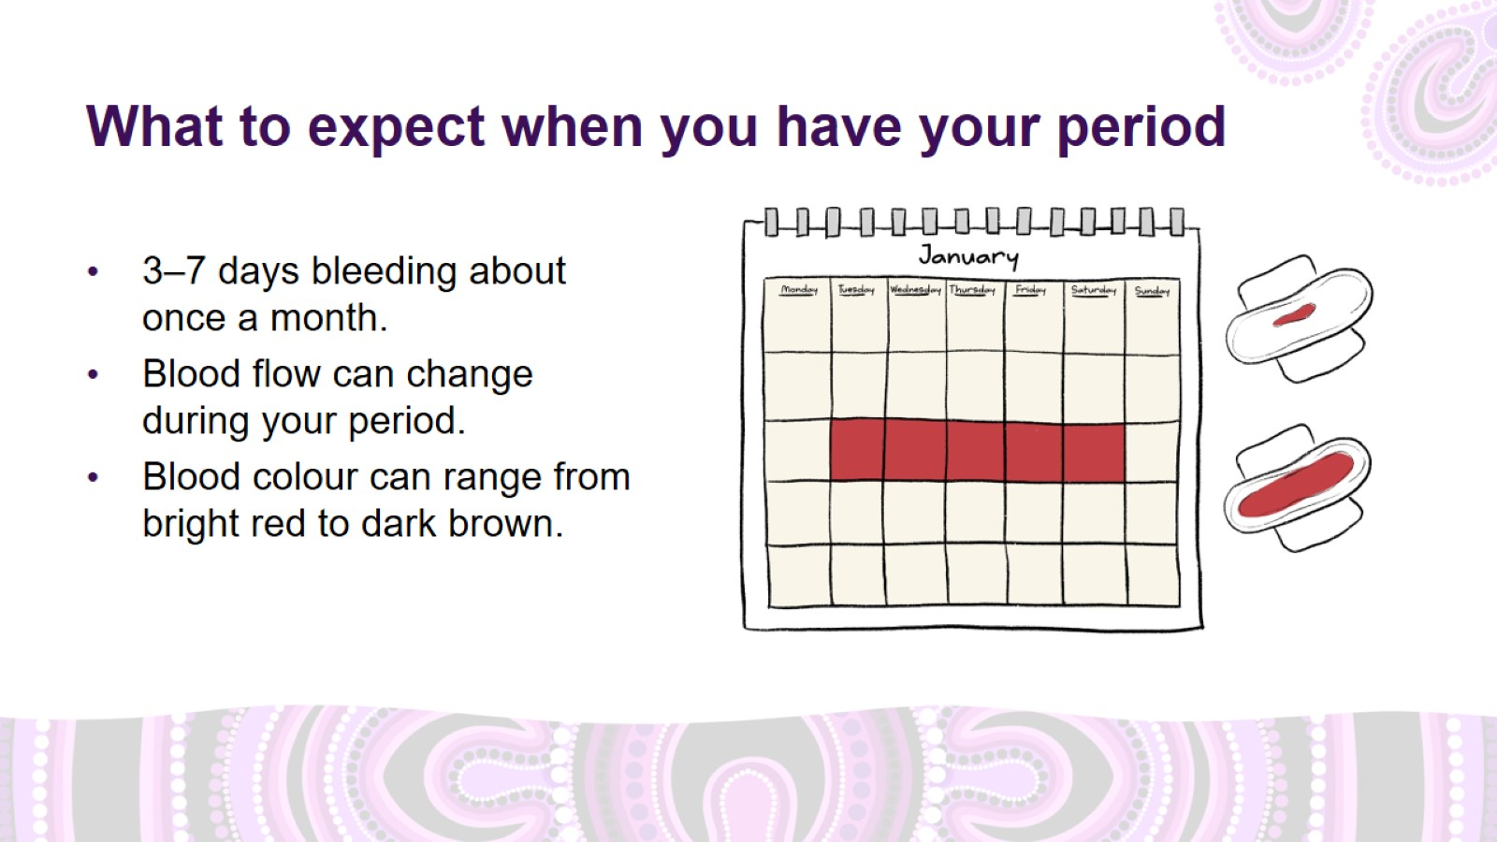
What to expect when you have your period
Notes:
What to expect when you have your period
All periods are different, however it’s important to know what the average period is like.
3–7 days bleeding about once a month
Blood flow can change during your period – for example, heavier at the start and lighter toward the end. It can also change from one period to the next.
Blood colour can range from bright red at the start to dark brown toward the end.
For the first 1–2 years after your period starts, it might not come every month.

Slide 12
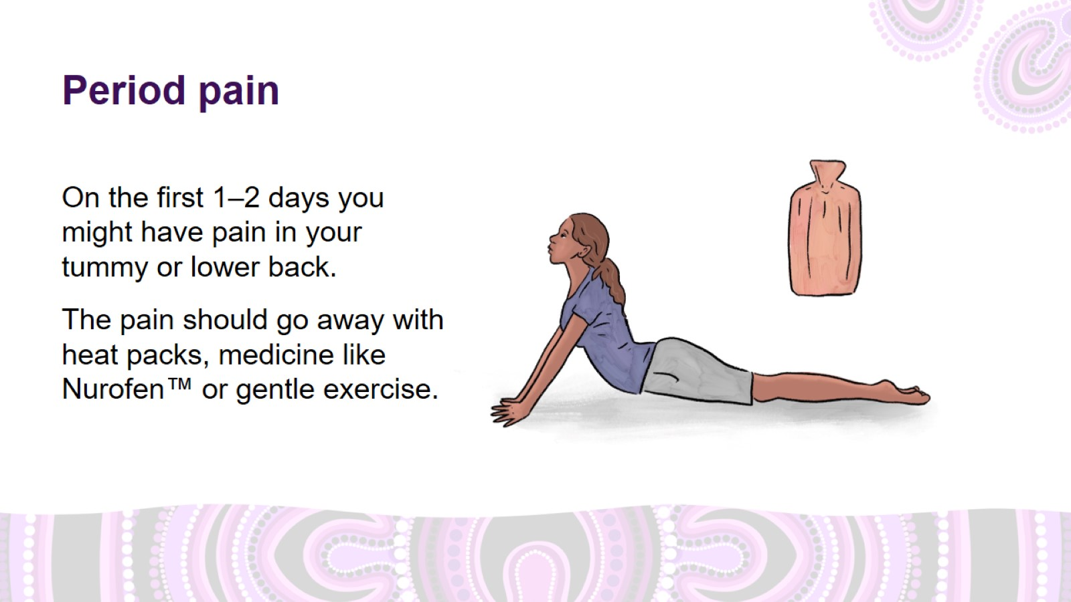
Period pain
Notes:
Period pain
On the first 1–2 days you might have pain in your tummy or lower back.
Period pain is ‘normal’ if:
it is only there for the first one or two days of your period
it can be managed by applying heat packs or hot water bottles, using medication such as ibuprofen (Nurofen™) or other period pain medication, or doing gentle exercise such as stretching or yoga
it does not stop you from doing usual activities, such as going to school or working.

Slide 13
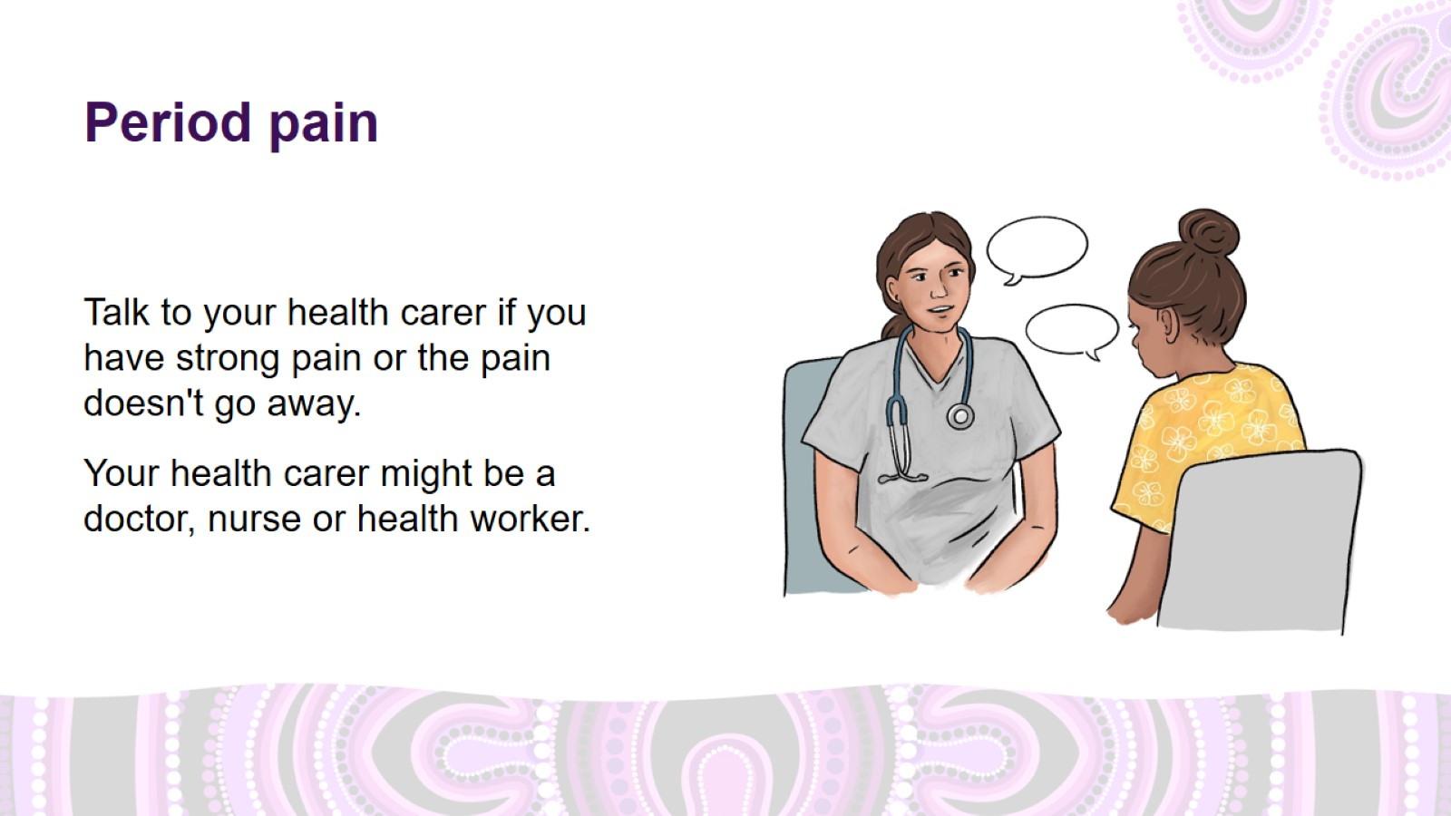
Period pain
Notes:
Period pain (continued)
Talk to your health carer if you have strong pain or the pain doesn't go away.
Your health carer might be a doctor, nurse or health worker.

Slide 14
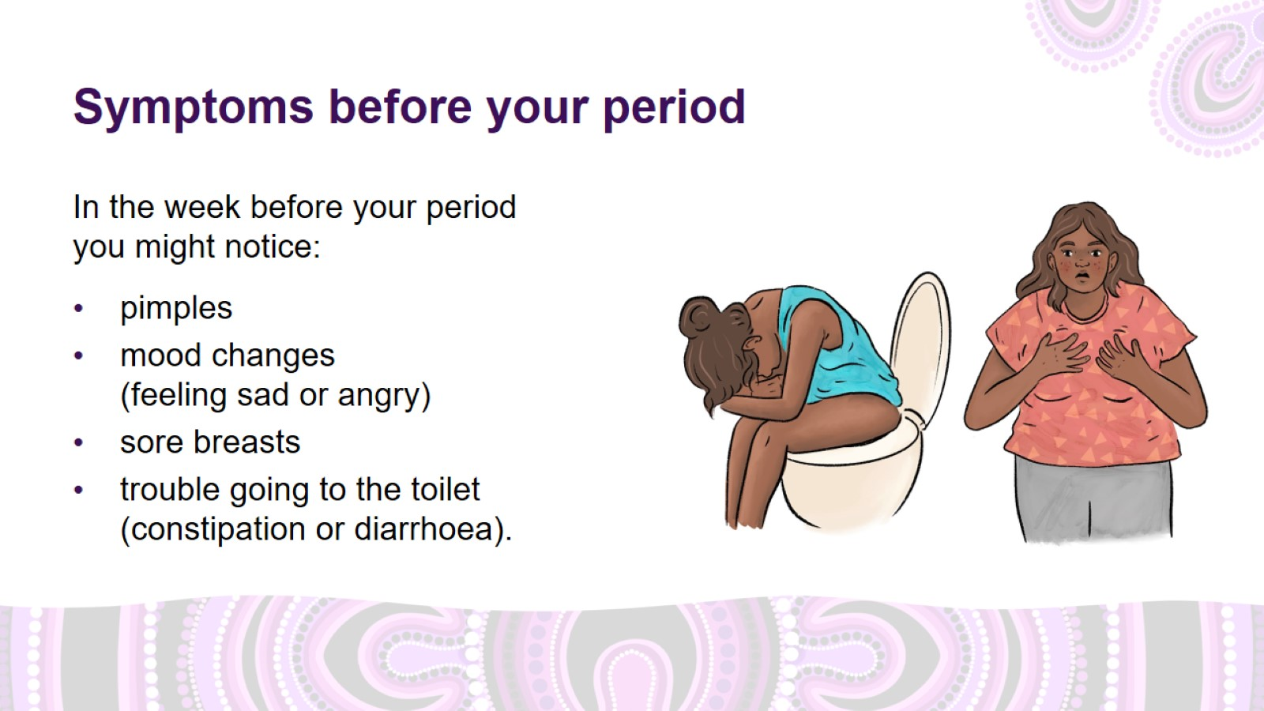
Symptoms before your period
Notes:
Symptoms before your period
Many women will experience at least 1 or 2 symptoms in the week before their period.
Possible symptoms include:
acne and pimples
mood changes (sad or angry)
sore breasts
trouble going to the toilet (constipation or diarrhoea).
Most women will experience symptoms that they can manage themselves.
If you are worried about these symptoms, talk to your health carer.

Slide 15
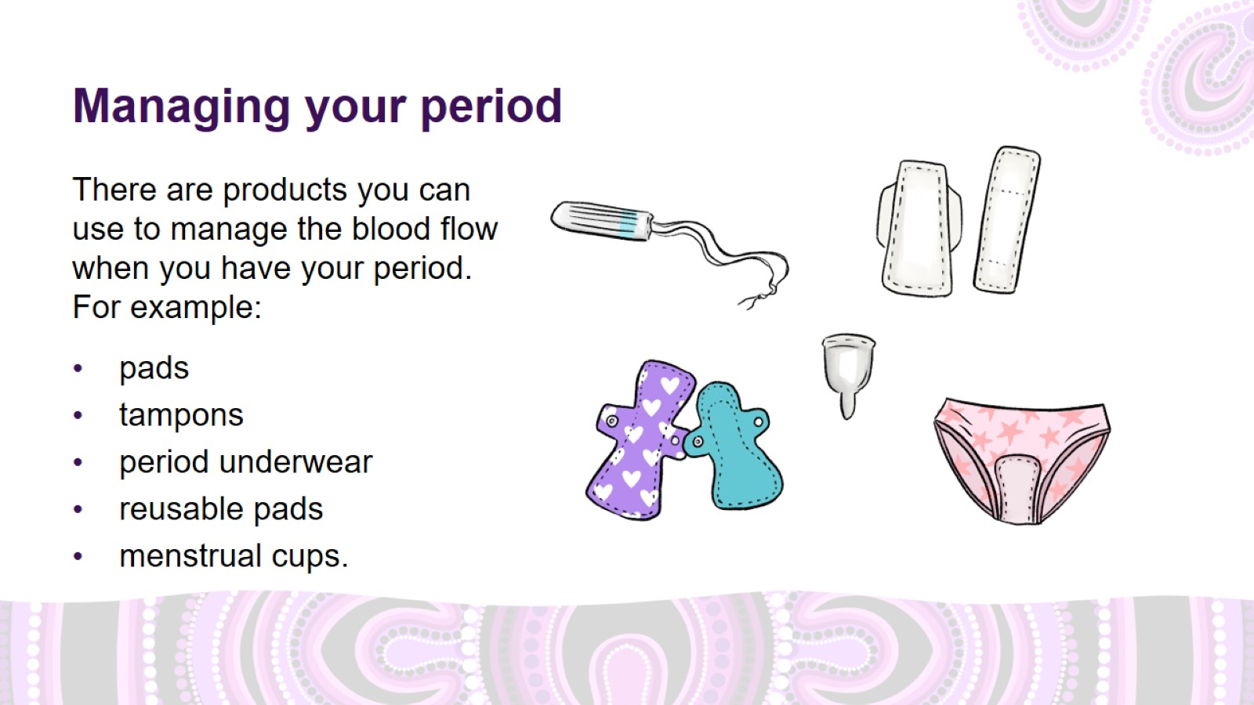
Managing your period
Notes:
Managing your period
Pads
Pads are strips of absorbent material that sit in your underwear and absorb the blood from your period.
Pads come in different sizes such as ‘light’, ‘medium’ or ‘heavy’.
You may need to change your pad every 3–4 hours when your period is heavy.
Tampons
Tampons work like a cotton plug that you insert in your vagina to absorb the blood from your period.
Tampons come in a range of different sizes to suit your flow.
You can still play sport and go swimming while wearing a tampon.
Plan to change your tampon between 3 and 6 times daily, depending on how heavy your period is.
Toxic shock syndrome is a very rare, but very serious infection that is possible when using tampons. Never leave a tampon in for more than 8 hours, always wash your hands before use, and use pads instead of tampons overnight.
Period underwear
Period underwear is underwear designed to absorb the blood from your period.
Period underwear can be used on their own, or as a backup to tampons or a menstrual cup when your period is heavy.
Reusable pads
Reusable pads are made from fabric that can be washed and reused.
Menstrual cups
Menstrual cups are silicone or rubber cups that you fold and insert into your vagina like a tampon. The cup unfolds inside your vagina and collects your period blood until you are ready to remove it, empty it, rinse it with water and reinsert. It might take some practice when you first try using a menstrual cup.
Menstrual cups come in different shapes and sizes and are safe to wear overnight.
Menstrual cups can last for 5–10 years, which makes them a cost-effective and environmentally friendly option.

Slide 16
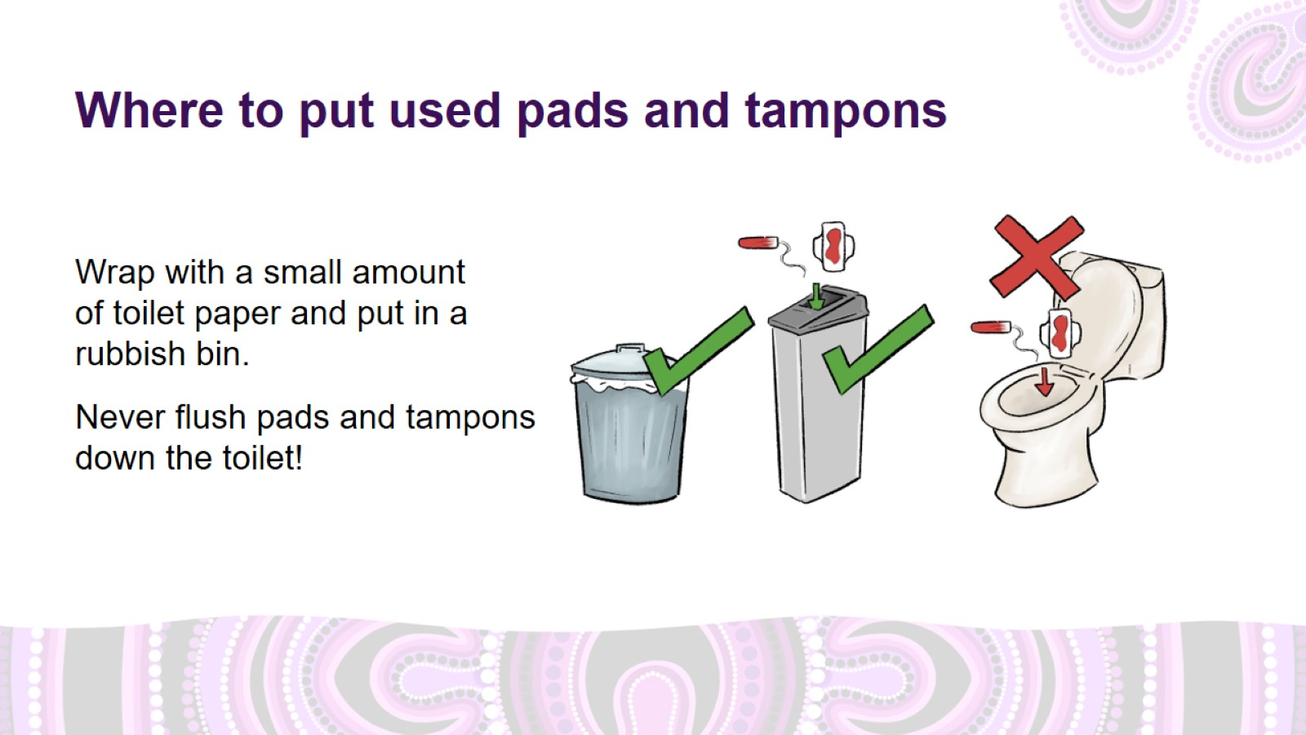
Where to put used pads and tampons
Notes:
Where to put used pads and tampons
Wrap used pads and tampons in toilet paper and put in the rubbish bin.
Never flush pads and tampons down the toilet.
Flushing pads and tampons can block your toilet and cause damage to plumbing, sewerage systems, wastewater treatment plants and the environment, by releasing plastics and chemicals into our rivers and oceans.

Slide 17
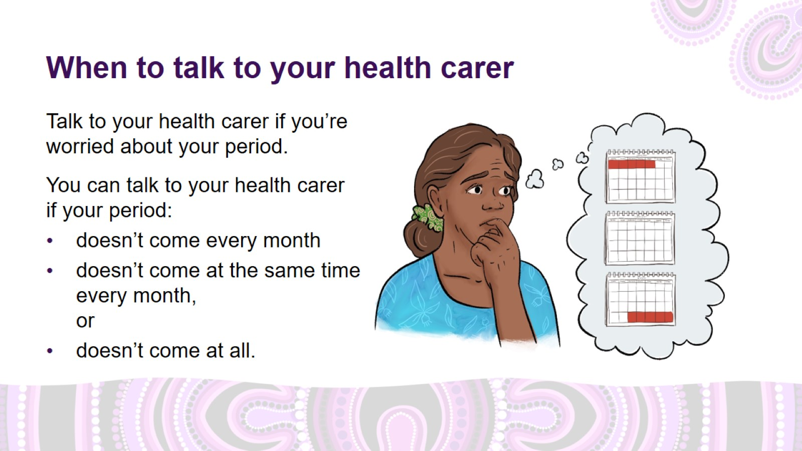
When to talk to your health carer
Notes:
When to talk to your health carer: irregular or absent periods
Talk to your health carer if your period:
doesn’t come every month
doesn’t come at the same time every month, or
doesn’t come at all.
Periods that don’t come every month, don’t come at the same time every month, or don’t come at all can be caused by lots of conditions.
If your period is like this, it's important to talk to your health carer.

Slide 18
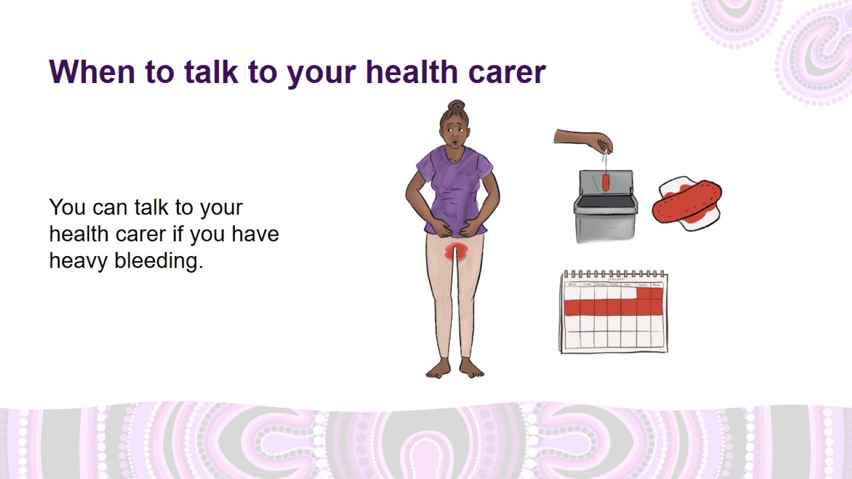
When to talk to your health carer
Notes:
When to talk to your health carer: heavy bleeding
Talk to your health carer if you:
bleed so much that you have to change your pad or tampon every 2 hours or less, or during the night
bleed for longer than 7–8 days
bleed through to your clothes.

Slide 19
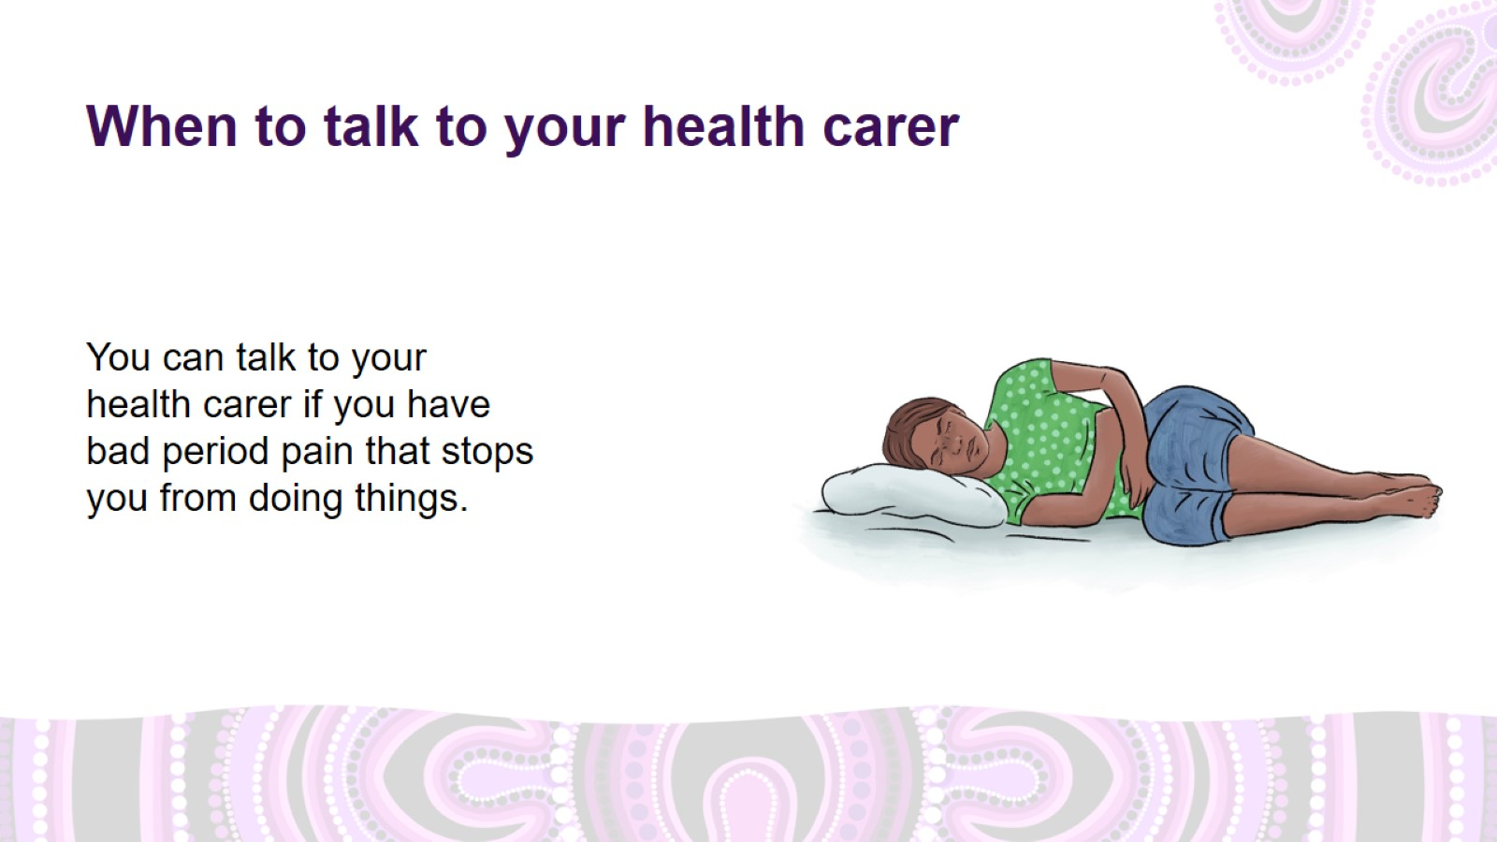
When to talk to your health carer
Notes:
When to talk to your health carer: period pain
Pain so bad that you are unable to go to work, school or other activities, or that doesn’t go away with medication such as ibuprofen (Nurofen™), is not normal.
Really bad pain can be caused by lots of different conditions, so it is important to get it checked out and treated.
Talk to your health carer if you have bad period pain that stops you from doing things.

Slide 20
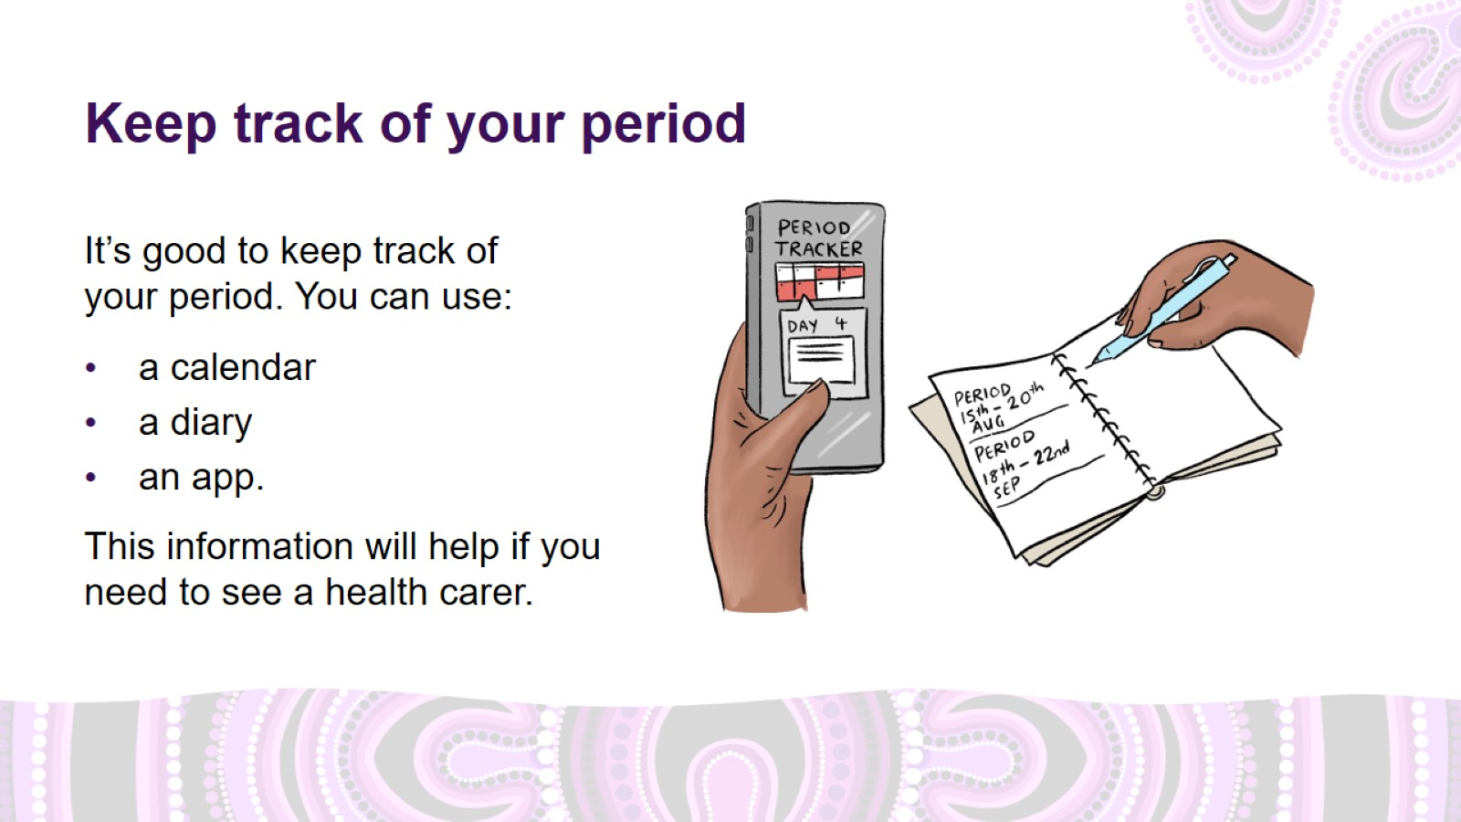
Keep track of your period
Notes:
Keep track of your period
Tracking your menstrual cycle, including physical and emotional symptoms, can help you notice if you need to see a health carer. It is a good way to:
understand your period better
know when your period is due, and be ready for it
help you to notice changes in what’s normal for you, so you know if you need to see a health carer.
How to track your period
Track your period using a calendar, diary, or smartphone app.
Track when your period starts, how long it lasts, and any symptoms like pain or heavy bleeding.
This is all useful information if you need to see a health carer about your period.

Slide 21
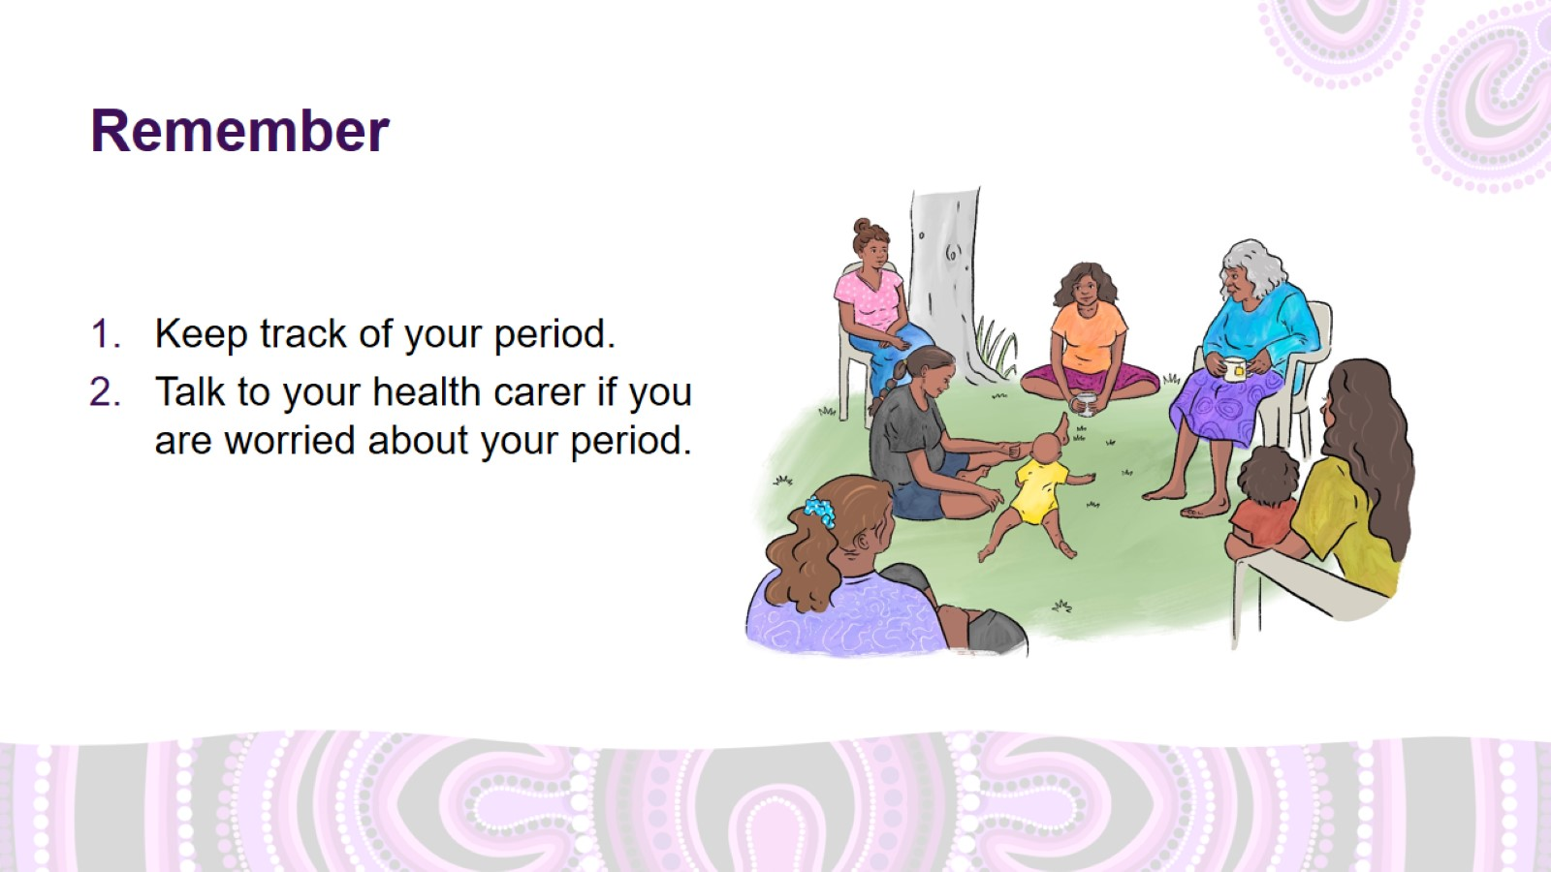
Remember

Slide 22

Thank you

Slide 23
