Slide 1

Polycystic ovary syndrome (PCOS)

Slide 2

Acknowledgements

Slide 3
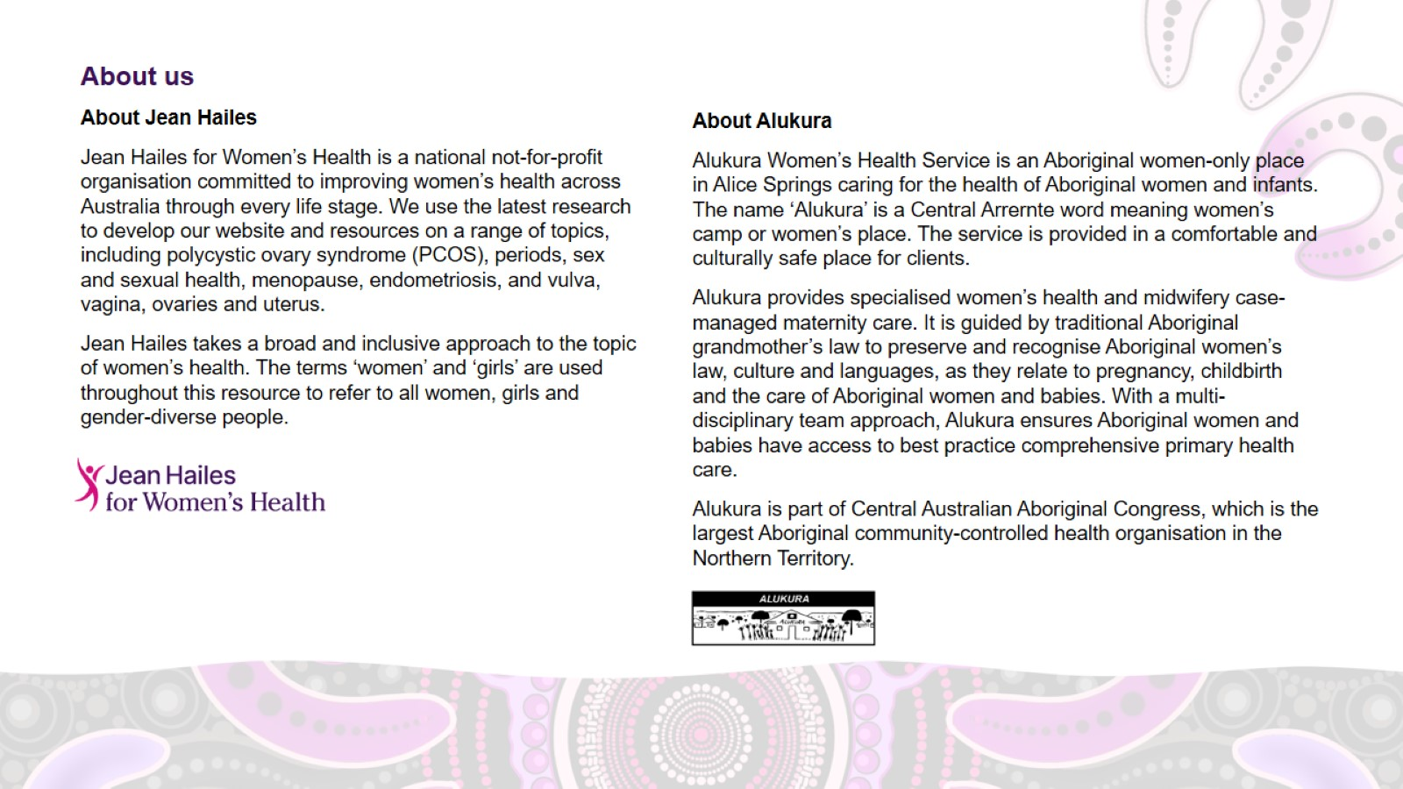
About us

Slide 4
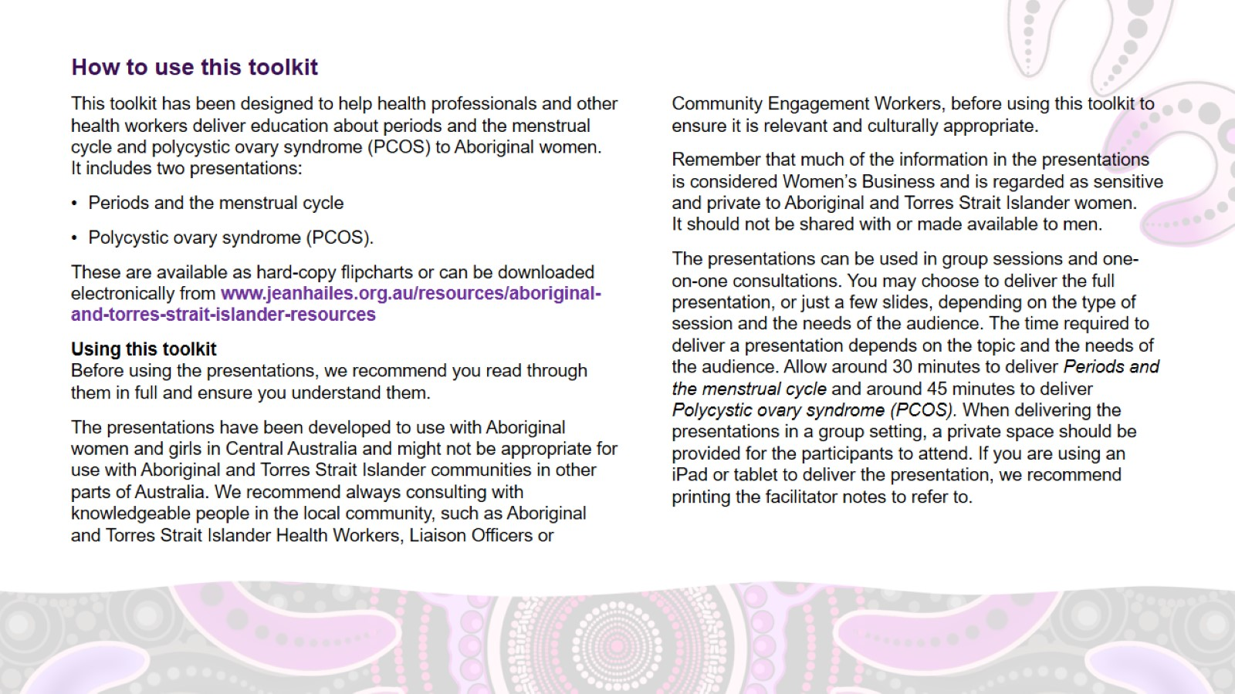
How to use this toolkit

Slide 5
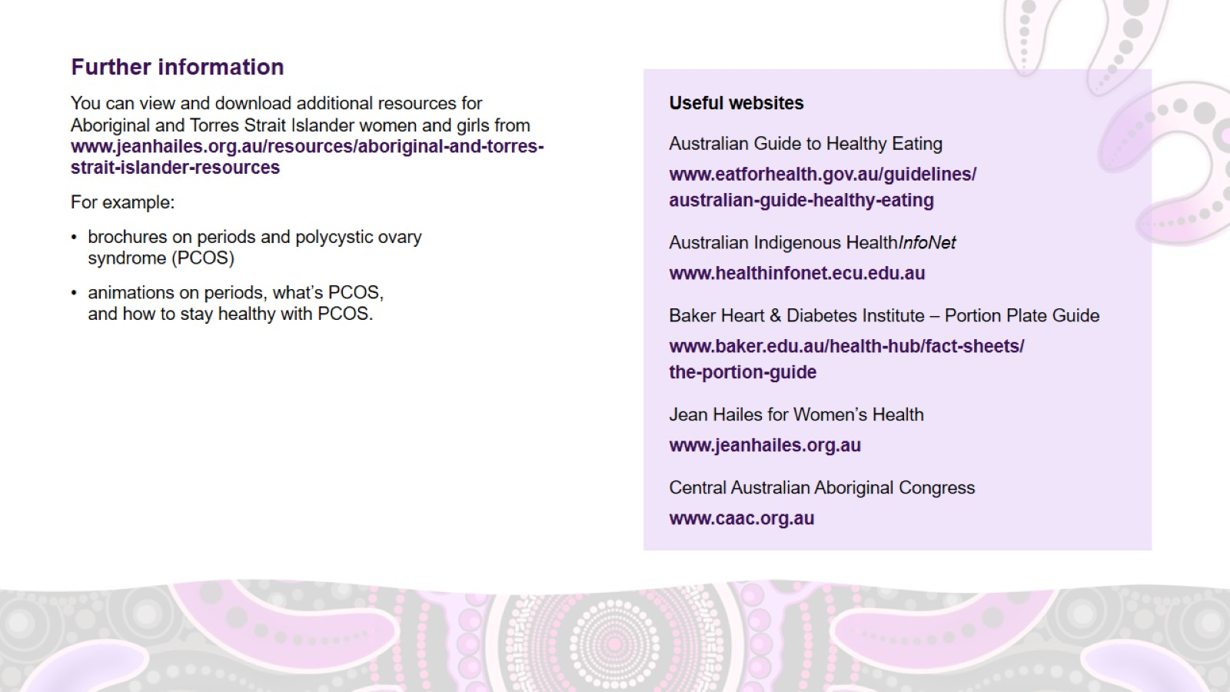
Further information

Slide 6
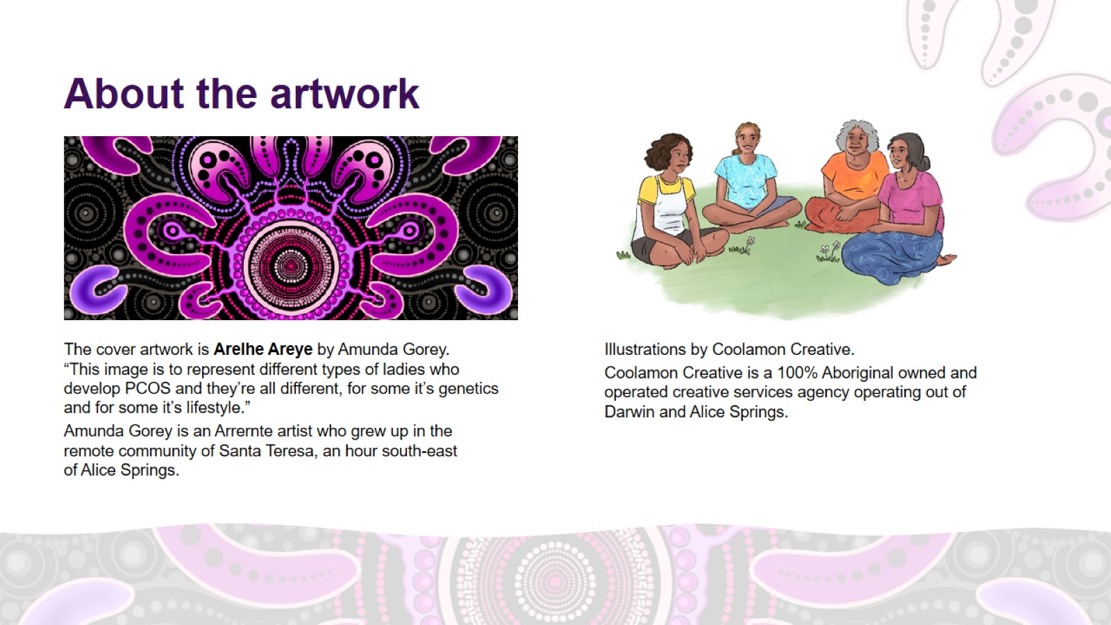
About the artwork

Slide 7
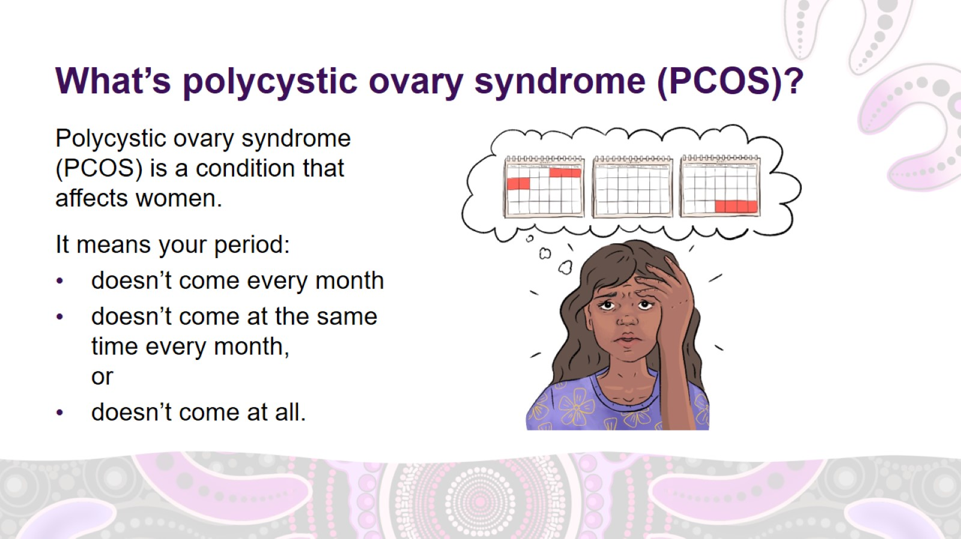
What’s polycystic ovary syndrome (PCOS)?
Notes:
What's polycystic ovary syndrome (PCOS)?
Polycystic ovary syndrome (PCOS) is a condition that affects women.
PCOS means your period:
doesn’t come every month
doesn’t come at the same time every month, or
doesn’t come at all.

Slide 8
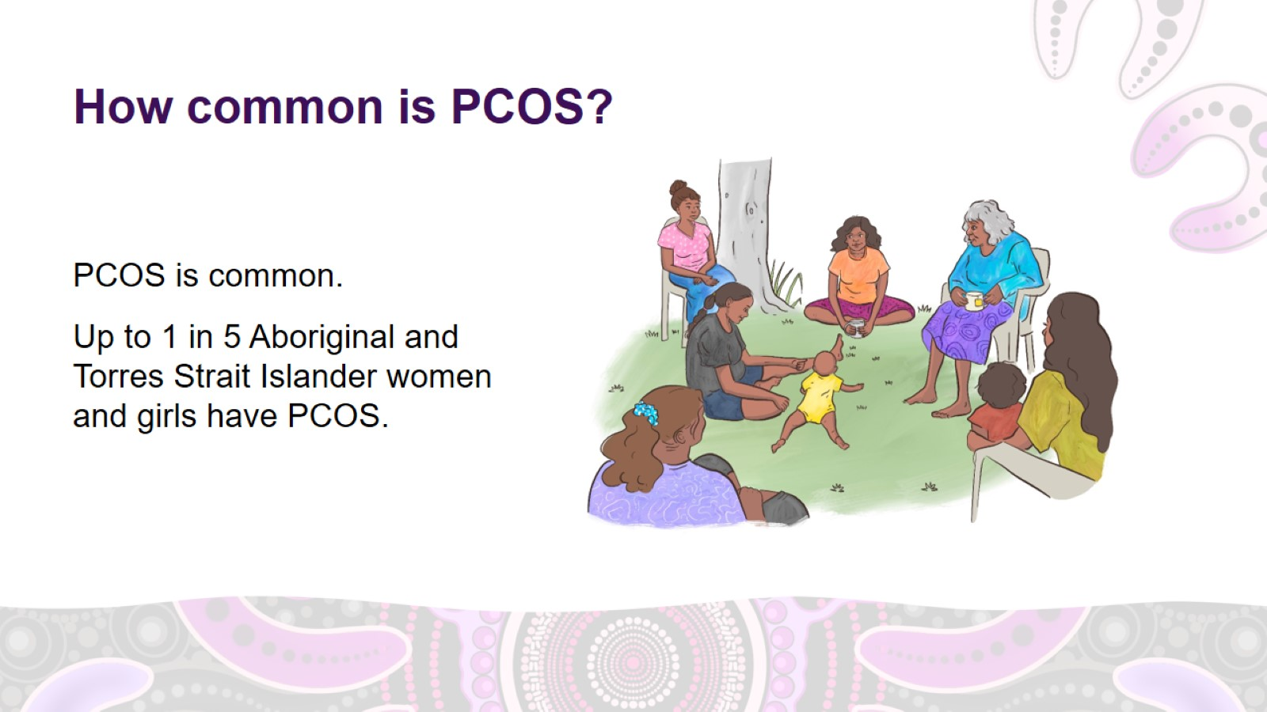
How common is PCOS?
Notes:
How common is PCOS?
PCOS is common.
Up to 1 in 5 Aboriginal and Torres Strait Islander women and girls have PCOS.

Slide 9
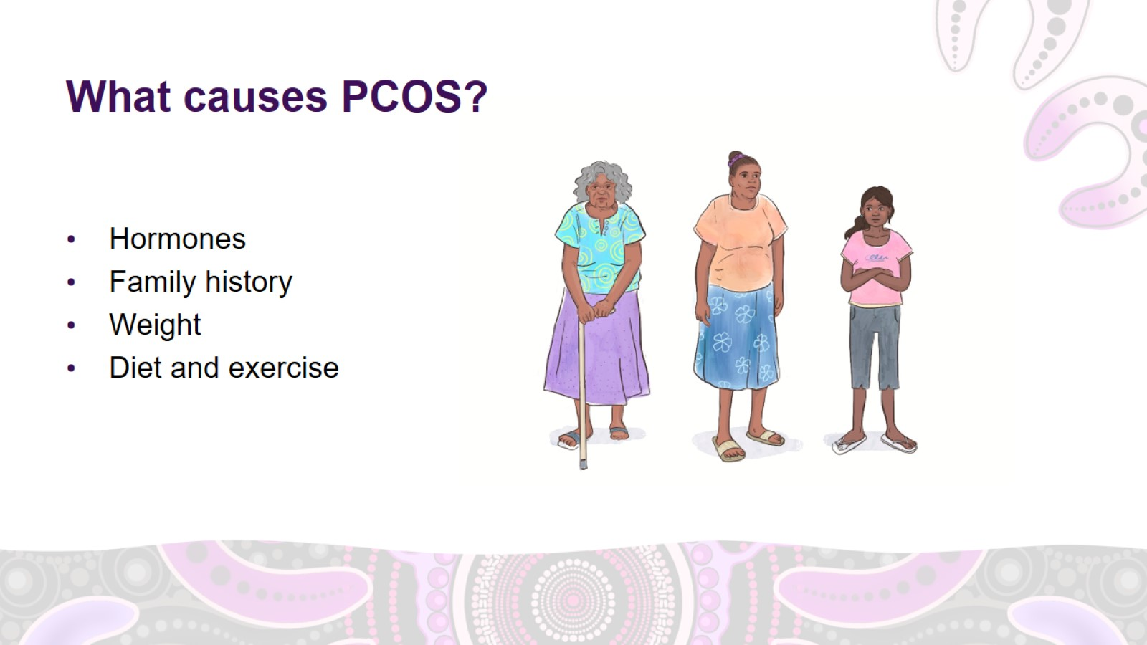
What causes PCOS?
Notes:
What causes PCOS?
PCOS is caused by a combination of hormones, family history, weight, and lifestyle factors such as diet and exercise.
Hormones
Hormones are chemicals made in different parts of the body, including the brain and the ovaries. They send messages through the bloodstream to tissues and organs.
They help control many of the body's functions, such as temperature, growth, energy, repair of cells, reproduction, sexual function and digestion.
Hormones tell the body to eat, stop eating, sleep, wake up, grow or stop growing.
PCOS and hormones
Women with PCOS have higher levels of two types of hormones:
Insulin: the hormone that lets sugar from the food you eat into your body's cells to be used for energy.
Androgens: 'male-type' hormones that are responsible for lots of things, including hair growth and acne.
PCOS and insulin resistance
Insulin resistance means that the insulin in your body doesn't work properly, so to try and help, the body produces more insulin.
Many women with PCOS have insulin resistance.
High levels of insulin in the body cause the ovaries to work differently. The ovaries start to produce higher levels of androgens (male-type hormones). This causes many of the symptoms of PCOS.
Family history
Women with PCOS are more likely to have a mother, aunt, sister or daughter who also has PCOS.
Type 2 diabetes is also common in the families of women with PCOS.
Weight and lifestyle factors such as diet and exercise
Being overweight, eating an unhealthy diet and not exercising enough can make PCOS symptoms worse.

Slide 10
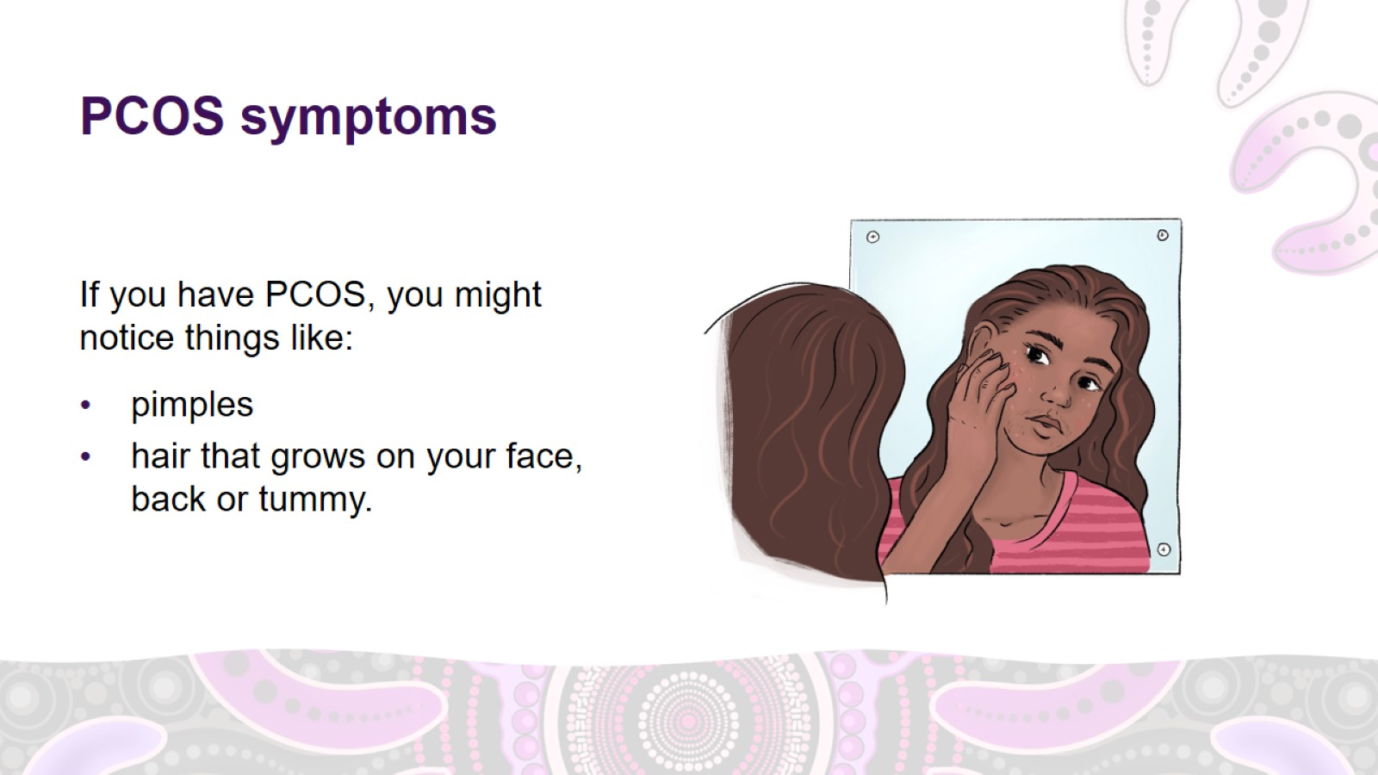
PCOS symptoms
Notes:
PCOS symptoms
If you have PCOS, you might notice things like:
skin problems like pimples
hair that grows on your face, back or tummy.

Slide 11
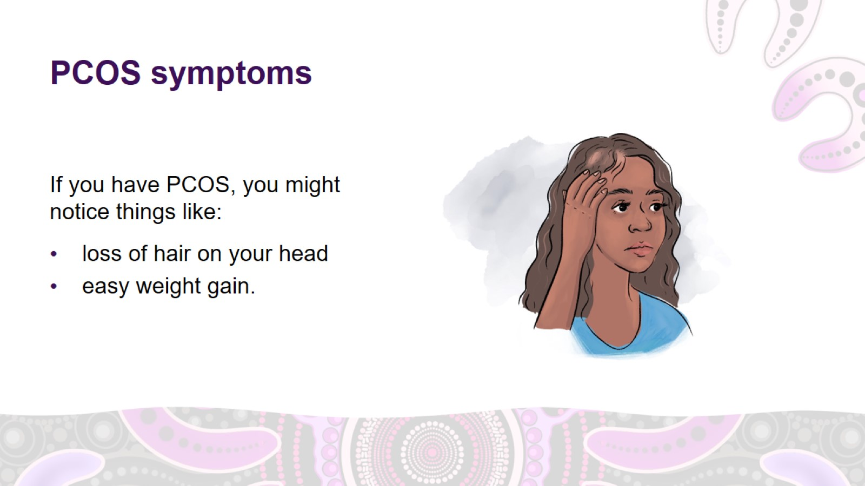
PCOS symptoms
Notes:
PCOS symptoms (continued)
If you have PCOS, you might also notice things like:
loss of hair on your head
weight gain and difficulty losing weight

Slide 12
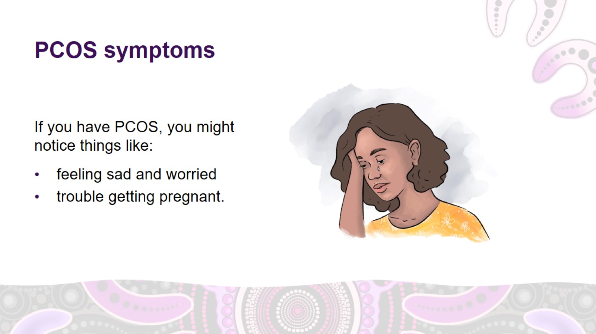
PCOS symptoms
Notes:
PCOS symptoms (continued)
If you have PCOS, you might also notice things like:
feeling sad, unhappy, worried or nervous
trouble getting pregnant.

Slide 13
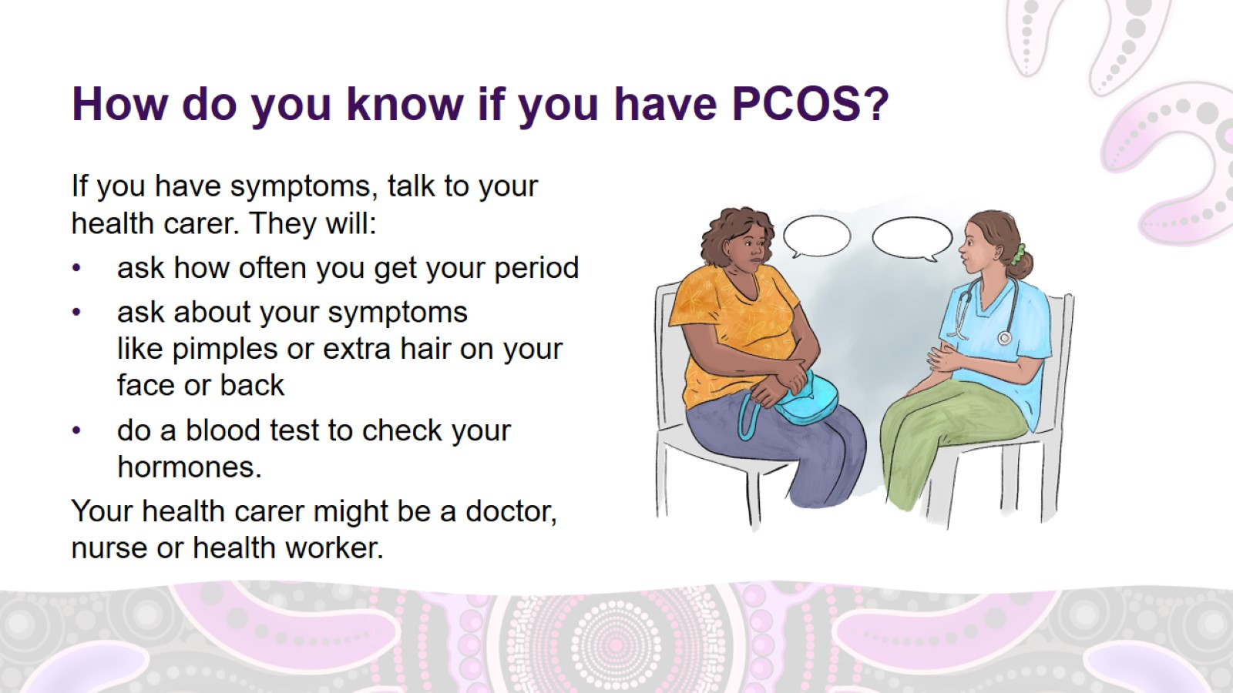
How do you know if you have PCOS?
Notes:
How do you know if you have PCOS?
If you have symptoms, talk to your health carer. They will:
ask how often you get your period. It is a good idea to keep track of your period using a diary, calendar or smartphone app so that you have this information ready for your health carer.
ask about your symptoms like pimples or extra hair on your face or back, or
take a blood test to check your hormones.
Your health carer might be a doctor, nurse or health worker.

Slide 14
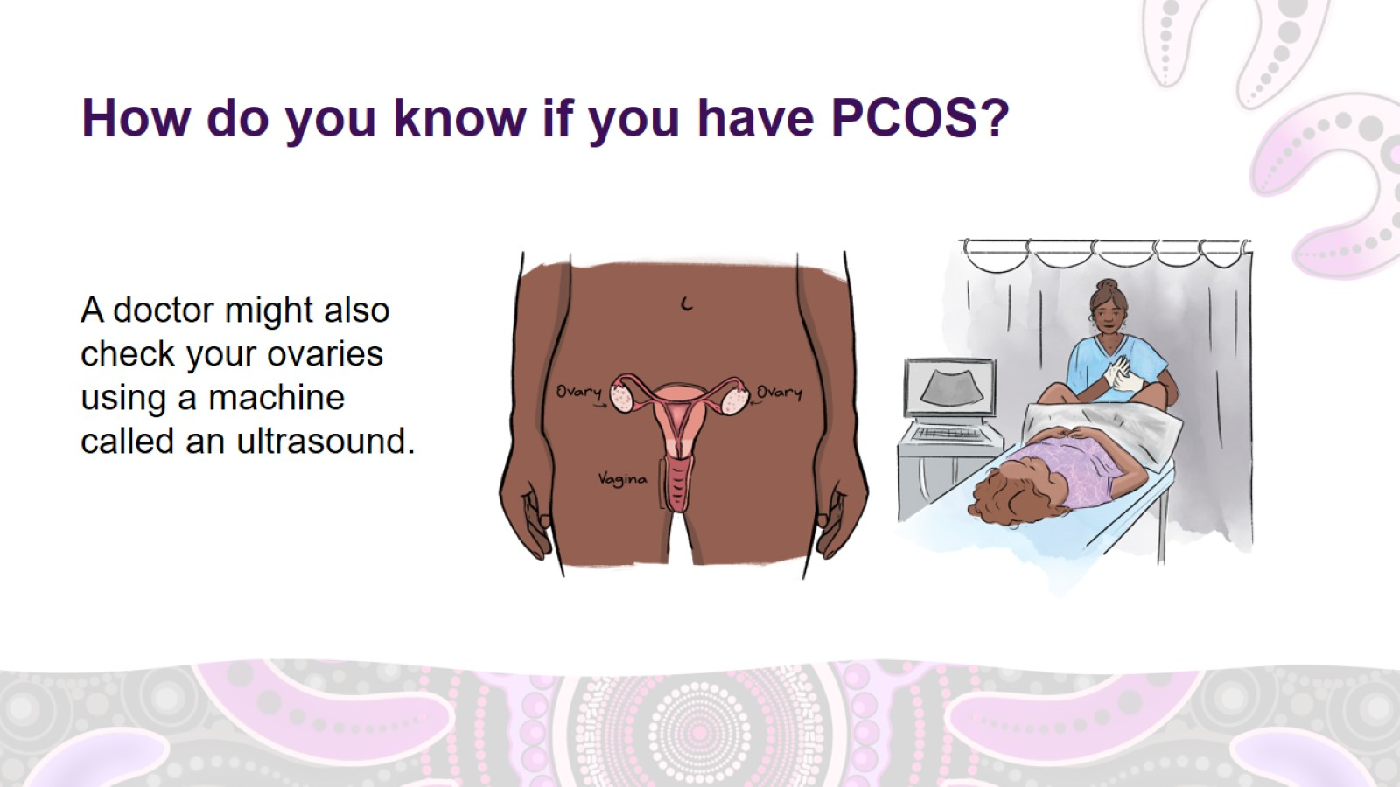
How do you know if you have PCOS?
Notes:
How do you know if you have PCOS? (continued)
A doctor might also check your ovaries using a machine called an ultrasound.
To check for PCOS, it is best to have an internal ultrasound. This means the ultrasound device goes inside your vagina to look at your ovaries. Your doctor can tell you more about this.
Tell your doctor if you don't want to have an internal ultrasound.
If you have PCOS, the ultrasound might show:
more than 25 little sacs of fluid (follicles) containing partly developed eggs on your ovaries
one or both ovaries bigger than they should be (enlarged).

Slide 15
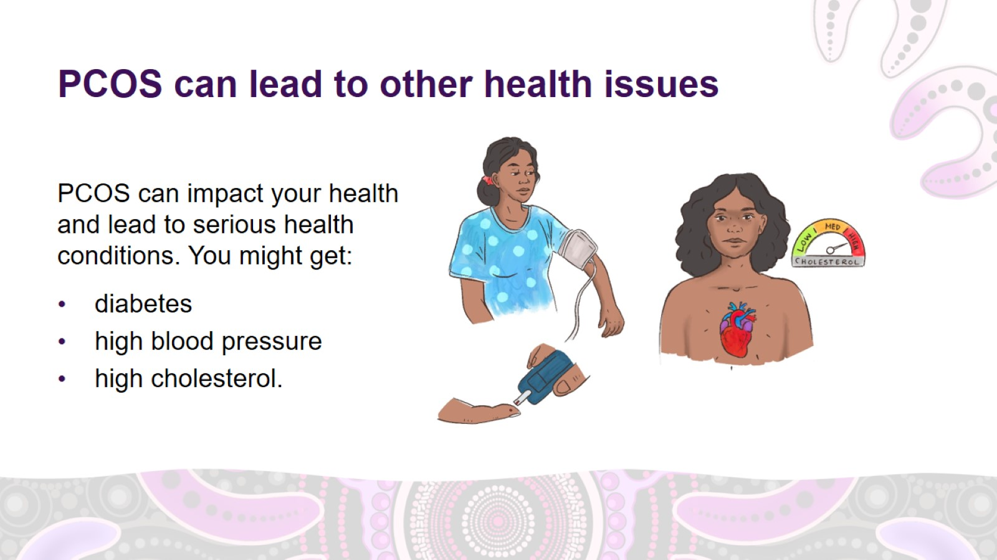
PCOS can lead to other health issues
Notes:
PCOS can lead to other health issues
Diabetes
PCOS can increase your risk of developing type 2 diabetes and diabetes during pregnancy.
Diabetes means you have too much sugar in your blood.
High blood pressure
PCOS can increase your risk of developing high blood pressure.
High blood pressure means that your blood pumps through your body with too much force. High blood pressure is bad for your heart.
High cholesterol
PCOS can increase your risk of developing high cholesterol.
High cholesterol means you have too much fat in your blood. High cholesterol is bad for your heart.

Slide 16
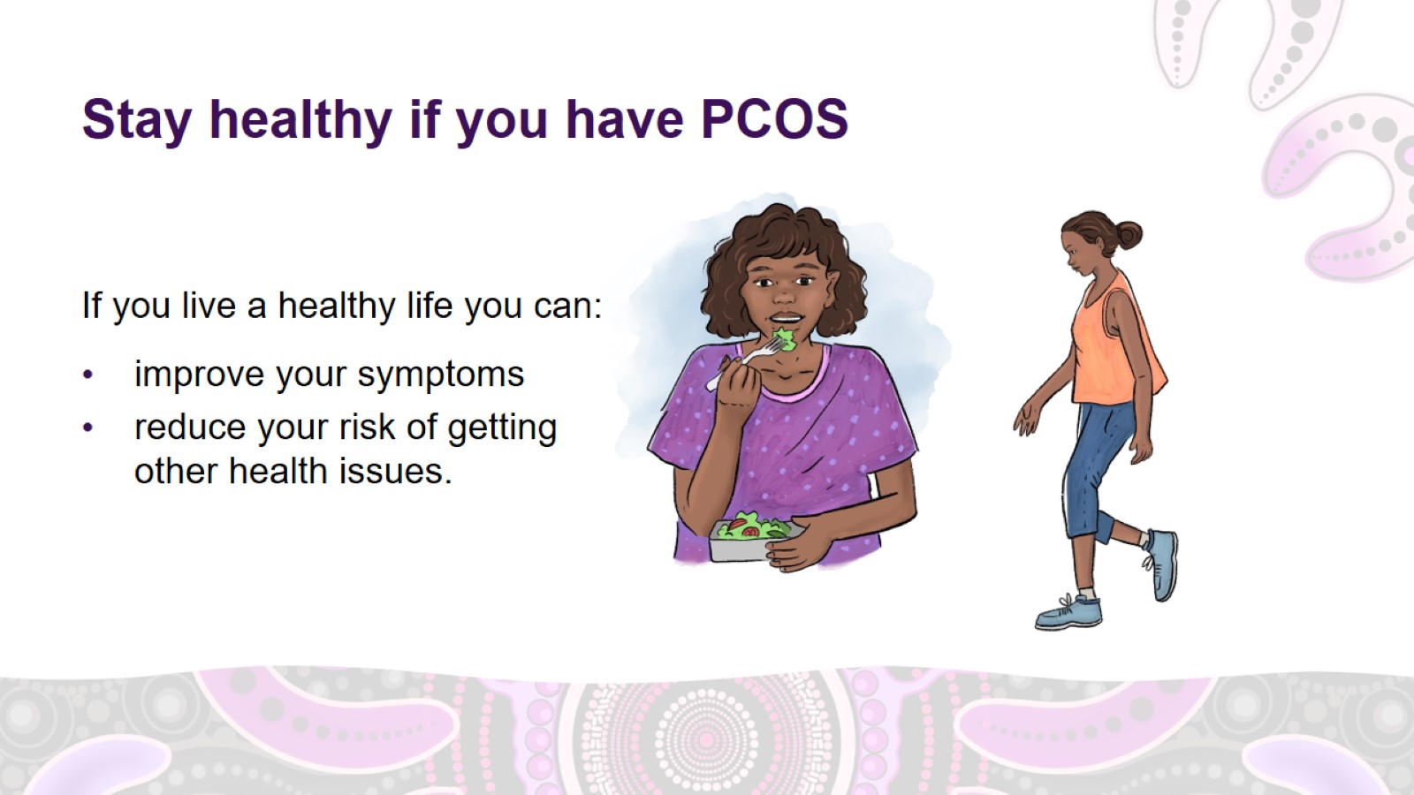
Stay healthy if you have PCOS
Notes:
Stay healthy if you have PCOS
PCOS cannot be cured, but if you live a healthy life you can:
improve your symptoms
reduce your risk of getting other health issues.
Living a healthy life means:
healthy diet
physical activity
losing some weight if you need to
taking medicine if you need to.
Possible questions for discussion:
What does a healthy diet mean to you?
How do we find balance in the way we eat?
What are some nutritious foods you know of?
How can we build more physical activity into our lives?

Slide 17
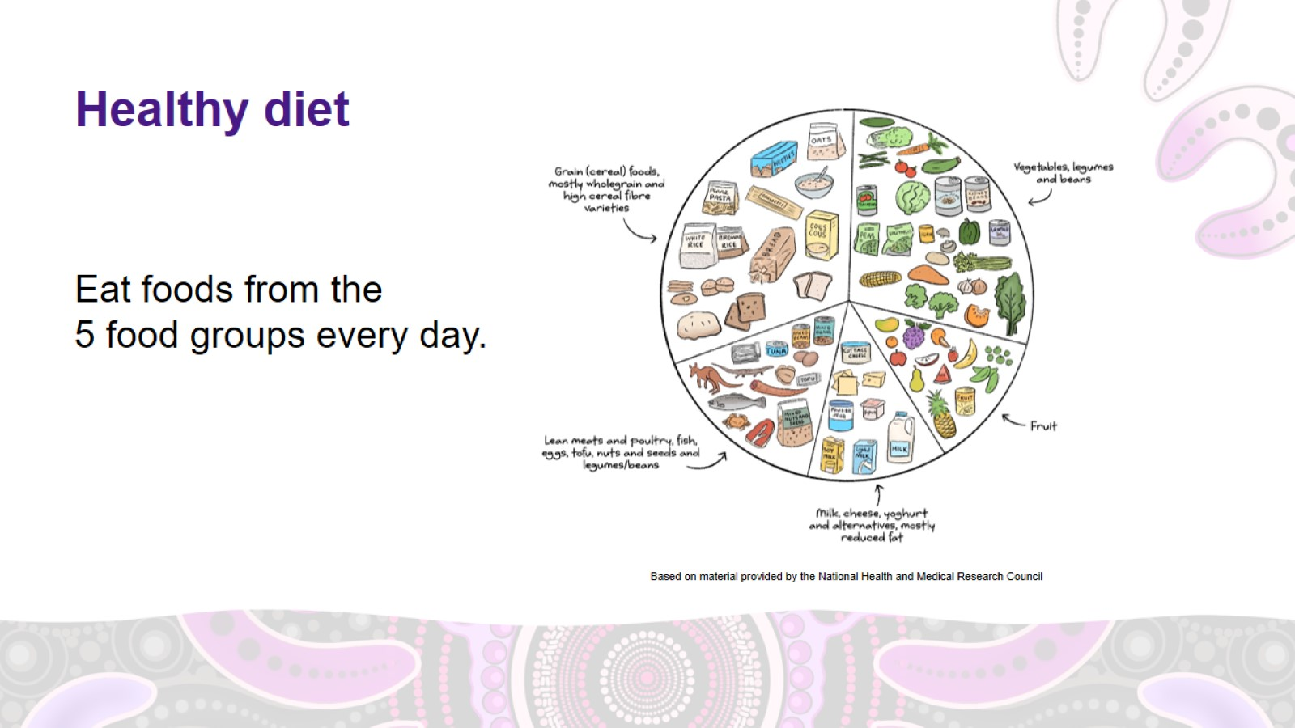
Healthy diet
Notes:
Managing PCOS – healthy diet
Eating a healthy diet is important if you have PCOS.
To eat a healthy diet, eat foods from the five food groups every day. The image on the slide shows foods from each of the five food groups.
Food group 1: Grains
4–6 serves every day
1 serve of grains is equal to 1 slice of bread or half a cup of cooked rice, pasta, noodles or quinoa.
Choose whole grains. For example, wholemeal bread instead of white bread.
Food group 2: Vegetables
5 serves every day
1 serve of vegetables is equal to half a cup of cooked vegetables or 1 cup of salad.
Frozen or tinned vegetables are also cheap and nutritious options.
Food group 3: Fruit
2 serves every day
1 serve of fruit is equal to 1 medium apple, banana, orange or pear, or 1 cup of tinned fruit with no added sugar.
Dried fruit, frozen fruit and tinned fruits are all good options.
Food group 4: Dairy and dairy alternatives
3 serves a day
1 serve of dairy is equal to 1 cup of milk, 2 slices of hard cheese, or 1 small tub of yoghurt.
Food group 5: Meat and other protein
2– 3 serves every day
1 serve of protein is equal to 65g of cooked lean red meat, such as beef, lamb, or kangaroo (about the size of the palm of your hand), one small can of fish, or 2 large eggs.
For more information about serving sizes go to www.eatforhealth.gov.au/food-essentials/five-food-groups

Slide 18
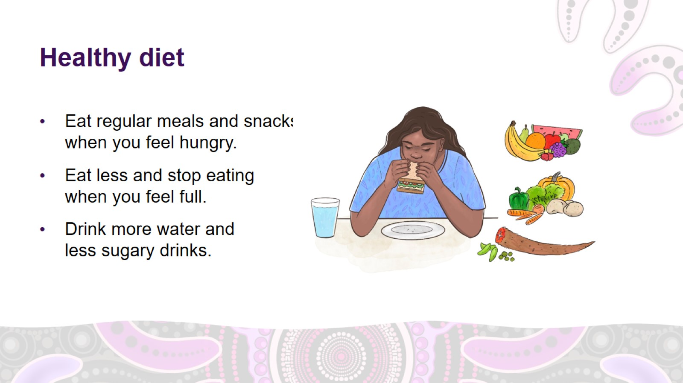
Healthy diet
Notes:
Managing PCOS – healthy diet (continued)
Eat regular meals and snacks when you feel hungry.
Eat less and stop eating when you feel full.
Healthy foods are better at making you feel full as they have protein and fibre.
Drink mostly water, or other low-sugar or sugar-free drinks like:
diet soft drink
kombucha
flavoured sparking water
diet cordial.
Avoid sugary drinks like soft drink and flavoured milk.

Slide 19
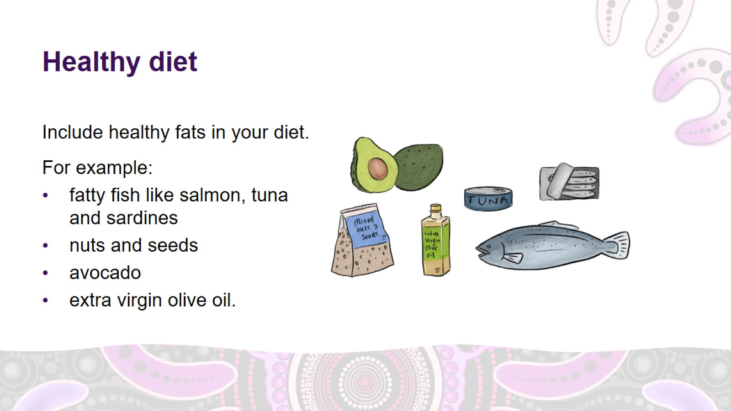
Healthy diet
Notes:
Managing PCOS – healthy diet (continued)
Include healthy fats in your diet.
Healthy fats are important for lots of things like maintaining good cholesterol and heart health.
Healthy fats include:
fatty fish like salmon, tuna and sardines
nuts and seeds
avocado
extra virgin olive oil.

Slide 20
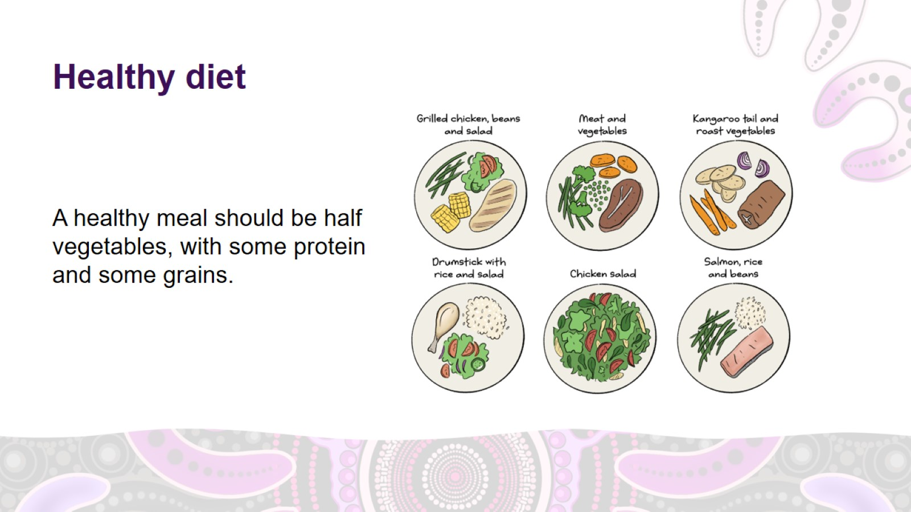
Healthy diet
Notes:
Managing PCOS – healthy diet (continued)
A healthy meal should be half vegetables, with some protein and some grains or other starchy foods (carbohydrates) like pasta or sweet potato. To make a healthy meal:
1. fill half your plate with vegetables
2. add some protein – for example, meat, eggs, fish, tofu or legumes like chickpeas or lentils
3. add some grains or other starchy foods – for example, rice, noodles, quinoa, pasta, potato, sweet potato or bread
4. eat fruit or dairy as a snack or for dessert.

Slide 21
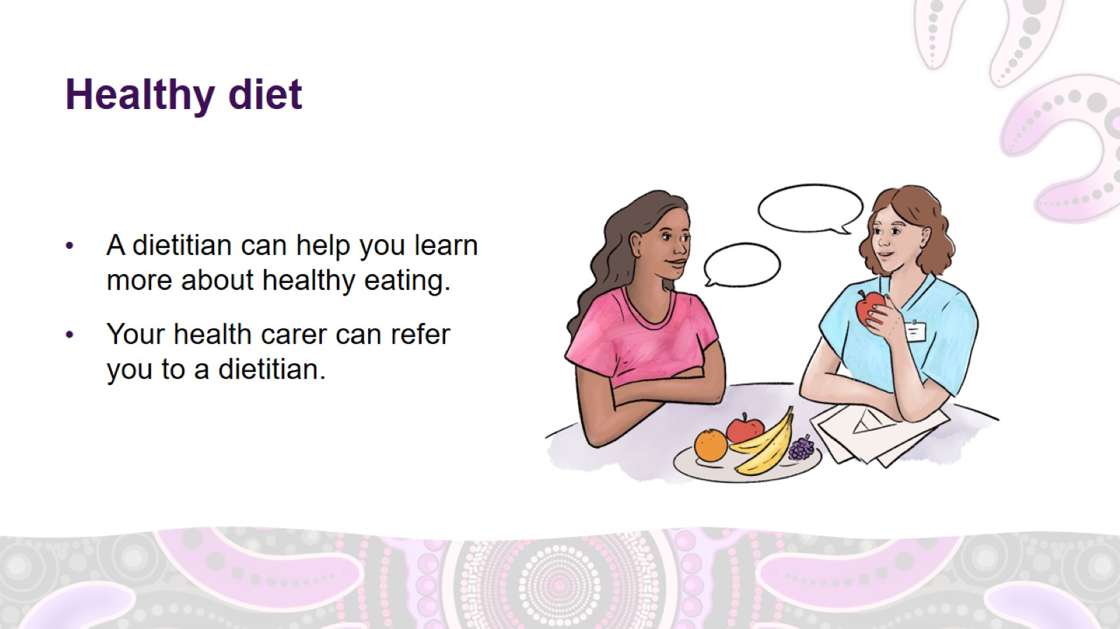
Healthy diet
Notes:
Managing PCOS – healthy diet (continued)
A dietitian is a health professional who can help you learn more about healthy eating.
Your health carer can refer you to a dietitian.

Slide 22
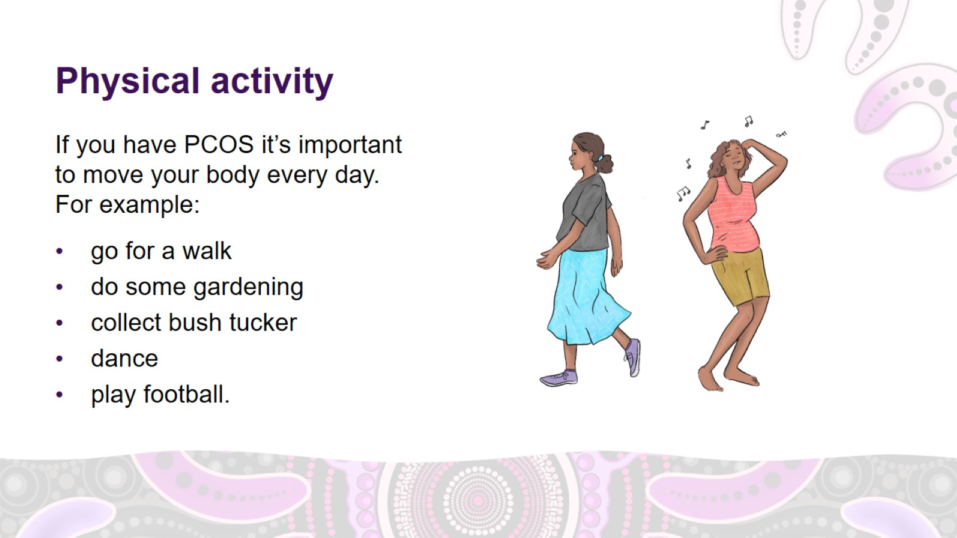
Physical activity
Notes:
Managing PCOS – physical activity
Physical activity means moving your body.
Regular physical activity can help to reduce your PCOS symptoms.
It can also reduce your risk of having other health issues.
Find ways to build movement and exercise into your daily life.
Physical activity includes moving at home. For example:
gardening
housework
playing with your children if you have them
walking to the shops instead of driving.
It also includes moving out bush. For example:
hunting
collecting bush tucker.
Physical activity also includes moving at work. For example:
walking to work instead of driving
lifting or walking as a part of your job.
It also includes moving through sport and exercise. For example:
football
netball
basketball
yoga
jogging
dancing
hiking.

Slide 23
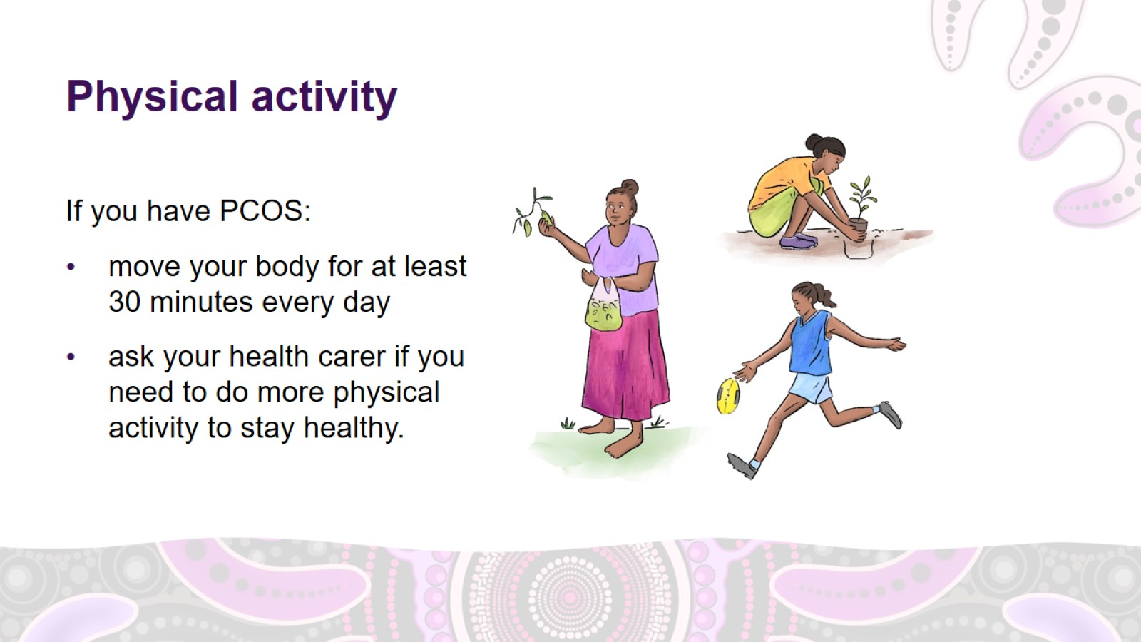
Physical activity
Notes:
Managing PCOS – physical activity (continued)
If you have PCOS:
move your body for at least 30 minutes every day. You can break this up into 3 blocks of ten minutes.
ask your health carer if you need to do more physical activity to stay healthy.
Exercise recommendations
(facilitator note: you may wish to present the relevant information only, if you are delivering this presentation in a one-on-one session)
What activity should you do?
Try to do a mixture of ‘moderate’ activity where you feel puffed but you can still have a conversation, and ‘vigorous’ activity where you feel puffed and can’t have a conversation.
To stay a healthy weight
Adults should do:
150 minutes (2.5 hours) of moderate physical activity OR 75 minutes of vigorous physical activity per week
muscle-strengthening activities on 2 non-consecutive days.
Adolescents should do:
1 hour of moderate-to-vigorous physical activity per day
muscle- and bone-strengthening activities at least 3 times per week.
To lose some weight
Do at least 250 minutes (4 hours) of moderate-intensity physical activity per week OR 150 minutes (2.5 hours) of vigorous physical activity per week.
Include muscle-strengthening activity on 2 non-consecutive days and 90 minutes (1.5 hours) of aerobic activity each week.

Slide 24
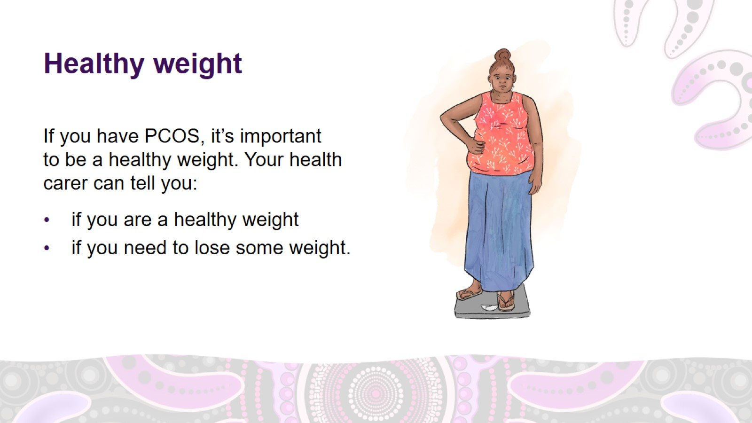
Healthy weight
Notes:
Managing PCOS – healthy weight
If you have PCOS, it’s important to be a healthy weight.
Your health carer can tell you:
if you are a healthy weight
if you need to lose some weight.
If you are overweight, losing 5–10% of your body weight can help to improve symptoms of PCOS. For example, losing weight can help make your period come every month and help reduce pimples and hair on your face and back.
For example, if you weigh 80kg, losing 4–8kg will improve your symptoms.

Slide 25
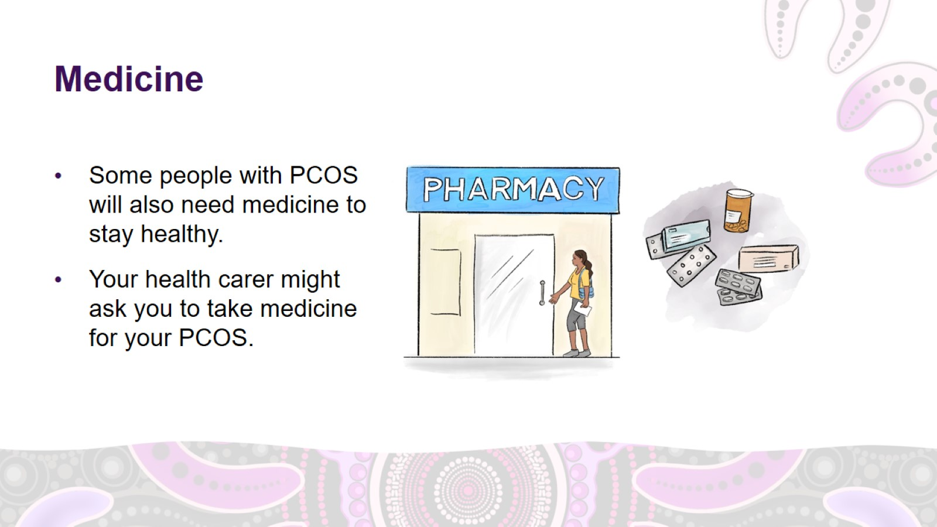
Medicine
Notes:
Managing PCOS – medicine
Some people with PCOS will also need medicine to stay healthy.
Medicine used to treat PCOS can include:
medicine to help balance your hormones
medicine to help you lose weight
medicine to help with your mental and emotional health, such as antidepressants or antianxiety medicine
medicine to help with pimples.
Your health carer might ask you to take medicine for your PCOS.

Slide 26
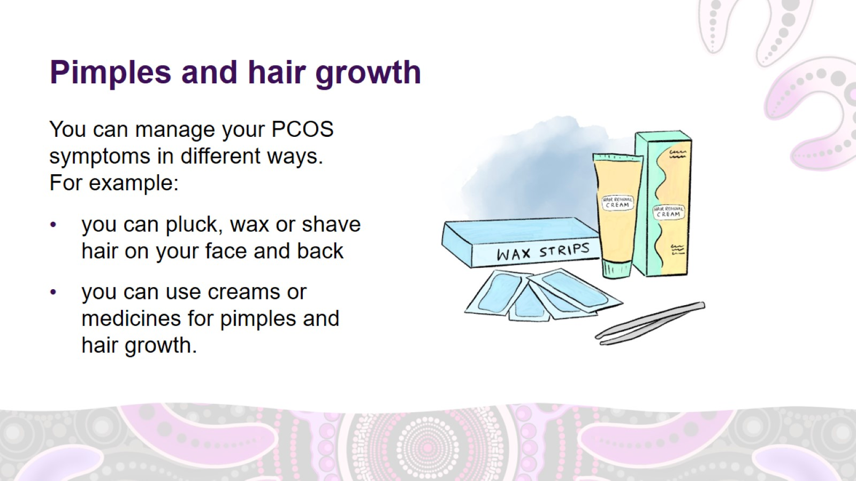
Pimples and hair growth
Notes:
Other ways to manage PCOS: pimples and hair growth
You can manage your PCOS symptoms in different ways. For example:
you can pluck, wax, shave or use creams to get rid of hair on your face and back. Laser therapy and electrolysis can be effective long-term treatments for extra hair growth, however they are more expensive up front.
you can use creams or medicines for pimples and hair growth.
Ask your health carer about medicines that can help with excess hair growth and pimples.

Slide 27
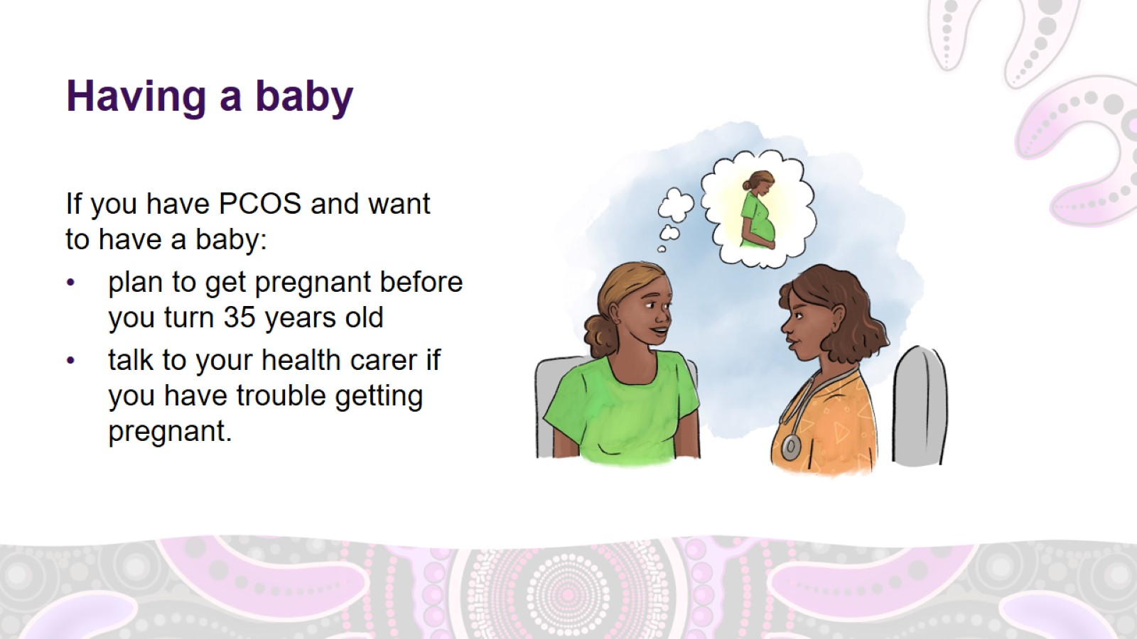
Having a baby
Notes:
Other ways to manage PCOS: having a baby
If you have PCOS and want to have a baby, plan to have a baby before you are 35 years old if possible.
If you are having trouble getting pregnant, talk to your health carer.
Most women with PCOS will be able to have a baby, but it might take longer and you might need help from:
a doctor who specialises in fertility (helping people get pregnant)
medicine
medical procedures.

Slide 28
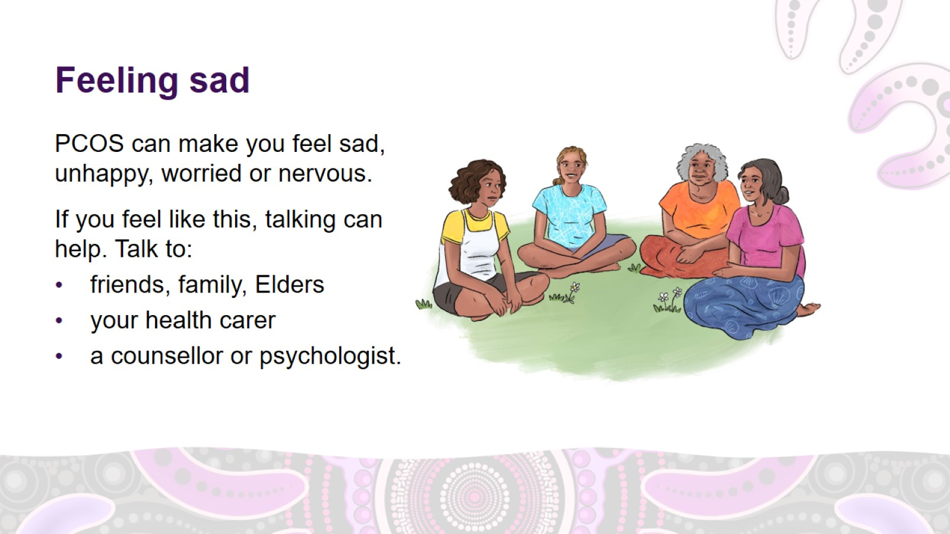
Feeling sad
Notes:
Other ways to manage PCOS: feeling sad
PCOS can make you feel sad, unhappy, worried or nervous.
If you often feel like this, talking about your feelings can help.
There are lots of people you can talk to. For example:
friends, family, people in your community, Elders
your health carer
people with special training in social and emotional wellbeing, such as a counsellor, social worker or psychologist.
Your health carer can refer you to a counsellor.

Slide 29
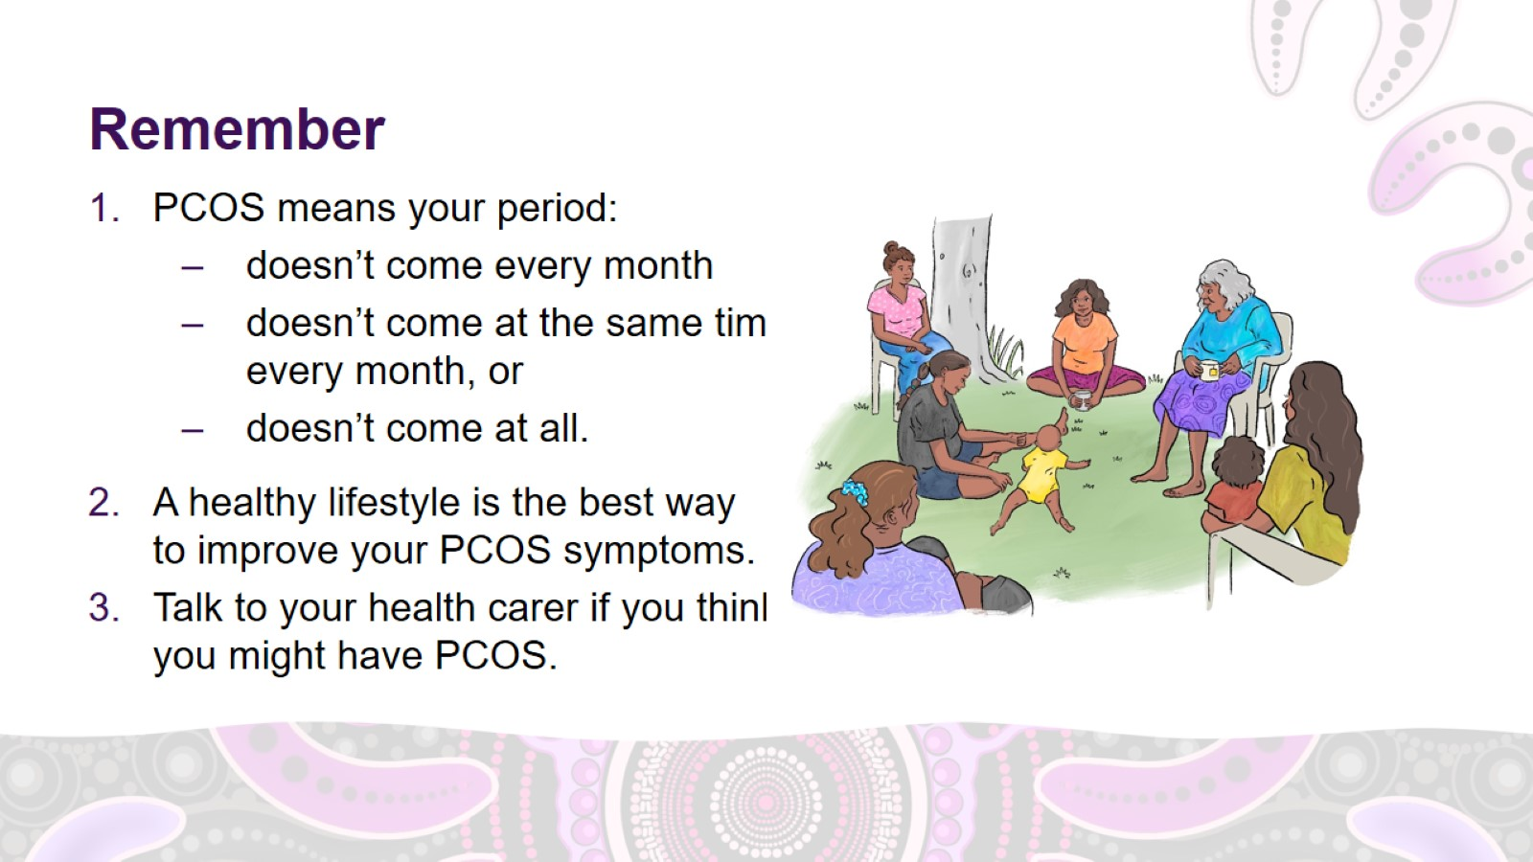
Remember

Slide 30

Thank you

Slide 31


