Slide 1
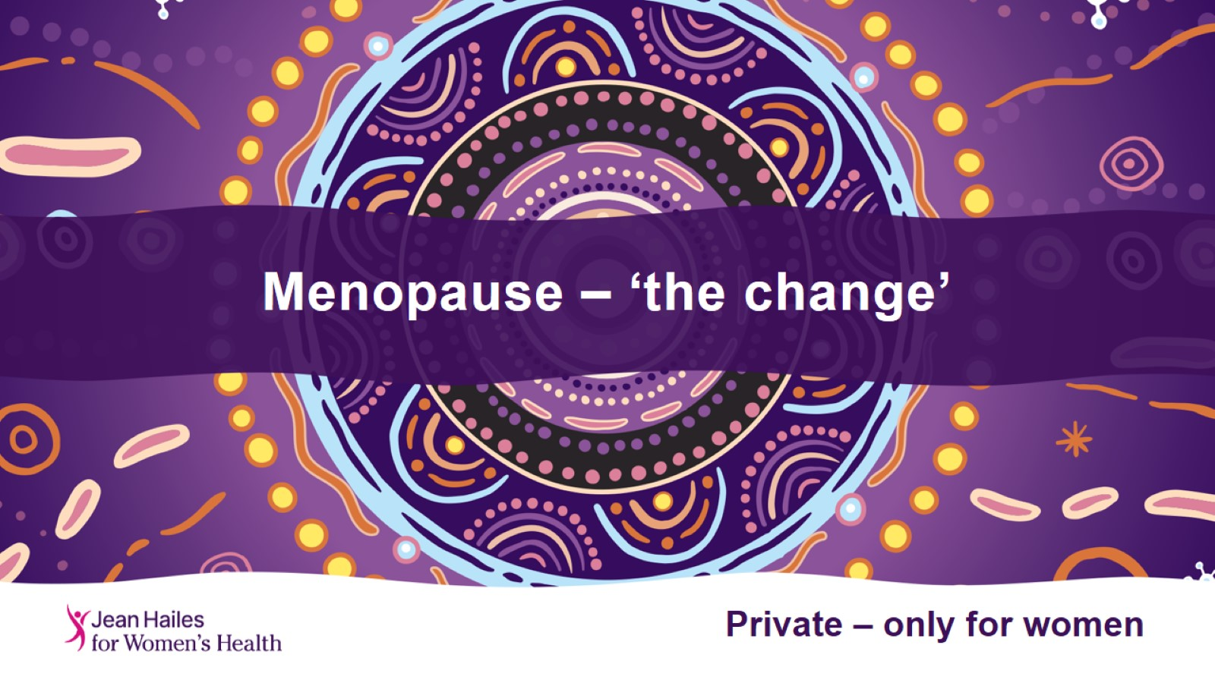
Menopause – ‘the change’

Slide 2
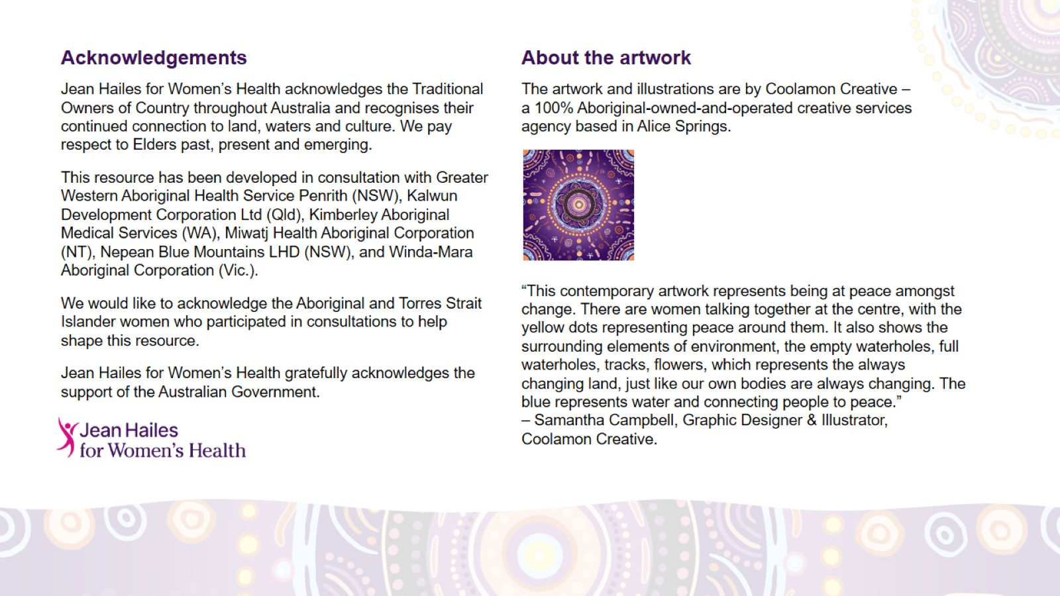
Acknowledgements

Slide 3
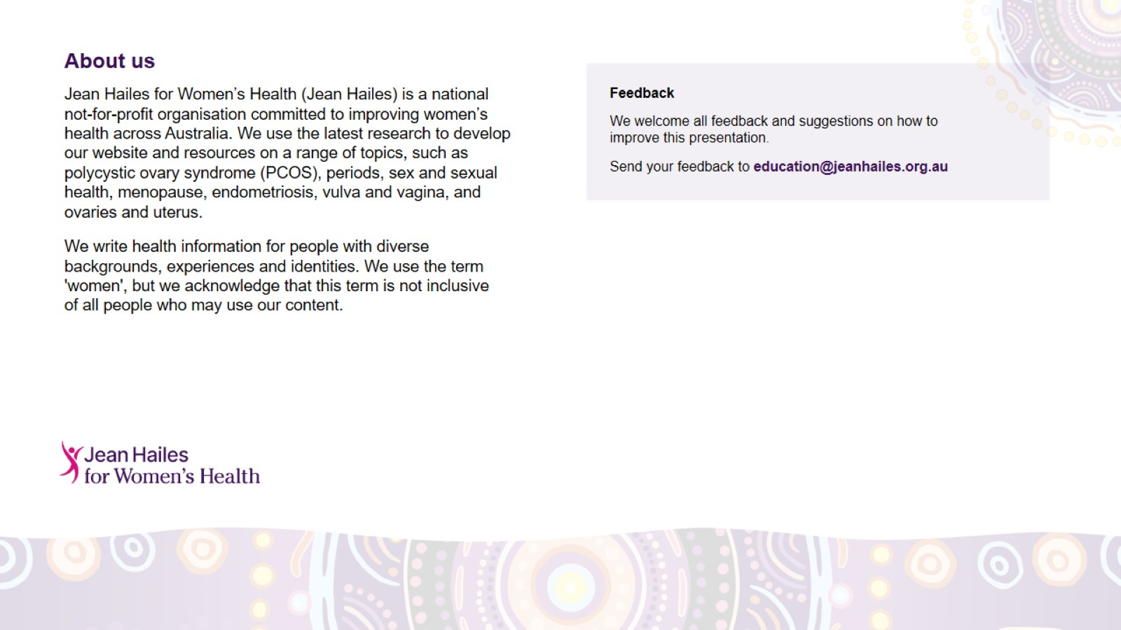
About us

Slide 4
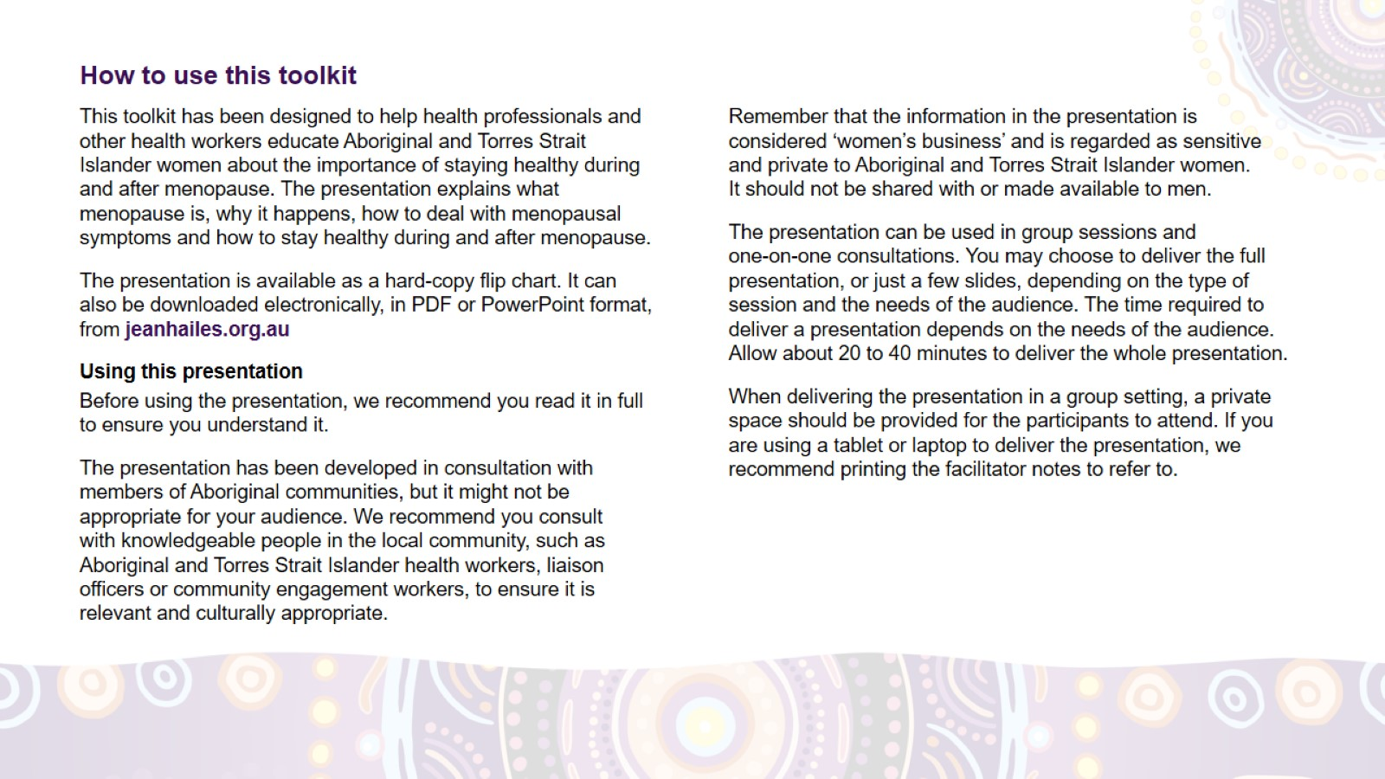
How to use this toolkit

Slide 5
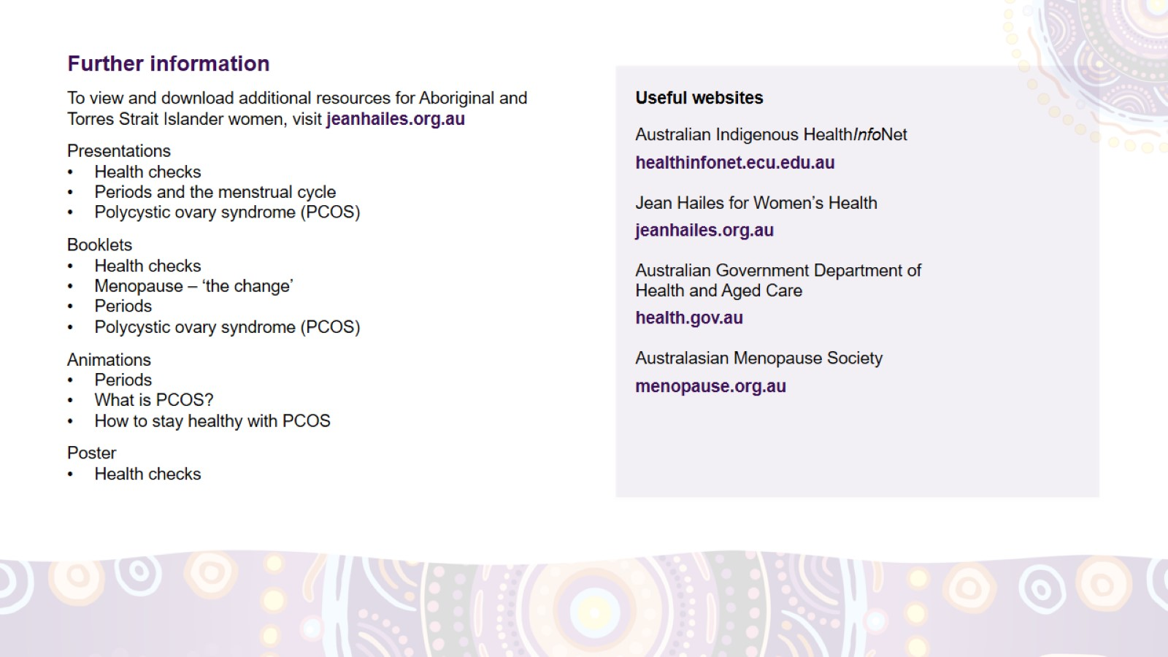
Further information

Slide 6
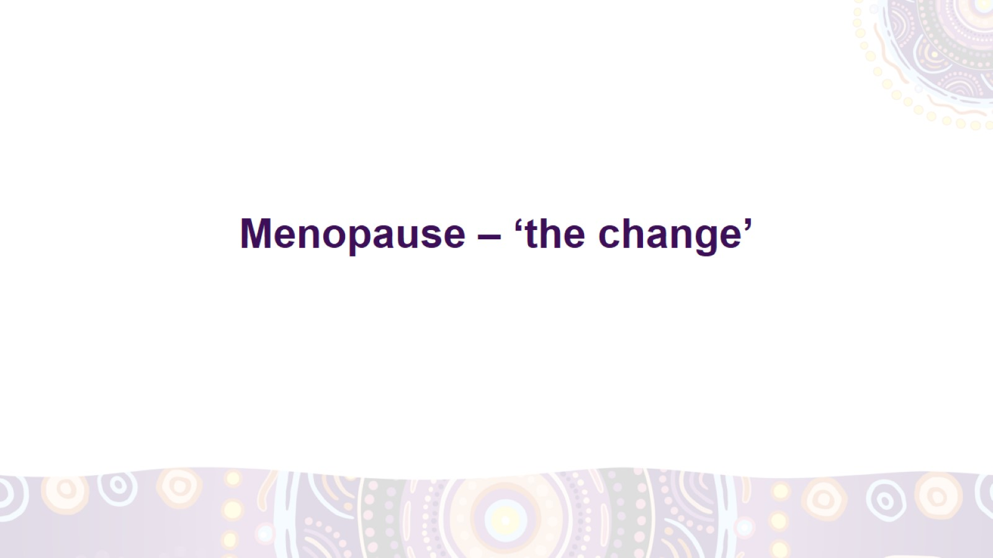
Menopause – ‘the change’
Notes:
Today we will be yarning about ‘the change’, also called ‘menopause’.
We will explain:
what menopause means
why it happens
when it happens
the symptoms of menopause
how to deal with the symptoms
how to take care of your health during and after menopause.

Slide 7
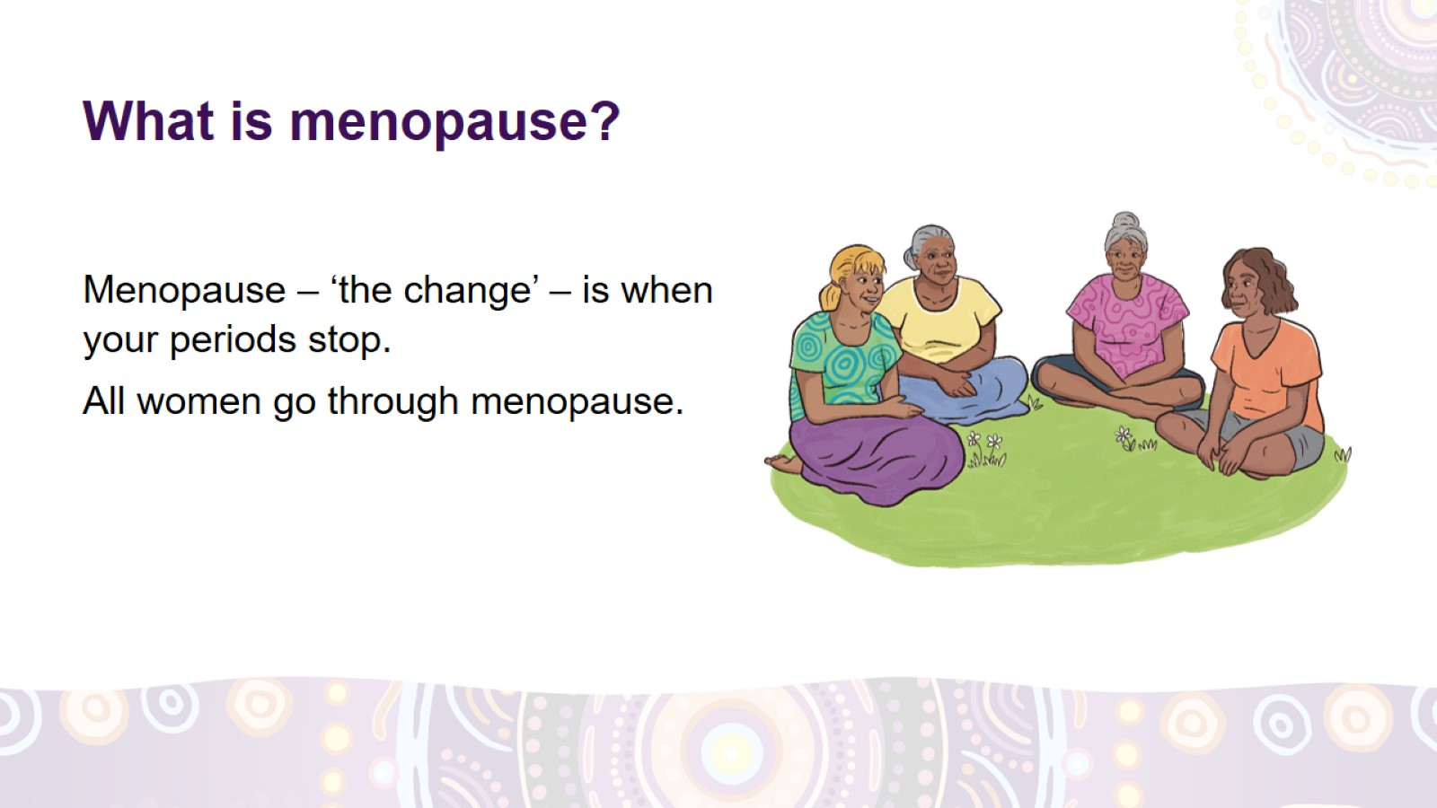
What is menopause?
Notes:
What is menopause?
Menopause is a time of change in your life. It’s when your final period (monthlies, monthly bleeding) happens.
Menopause is a natural thing. All women go through menopause.

Slide 8
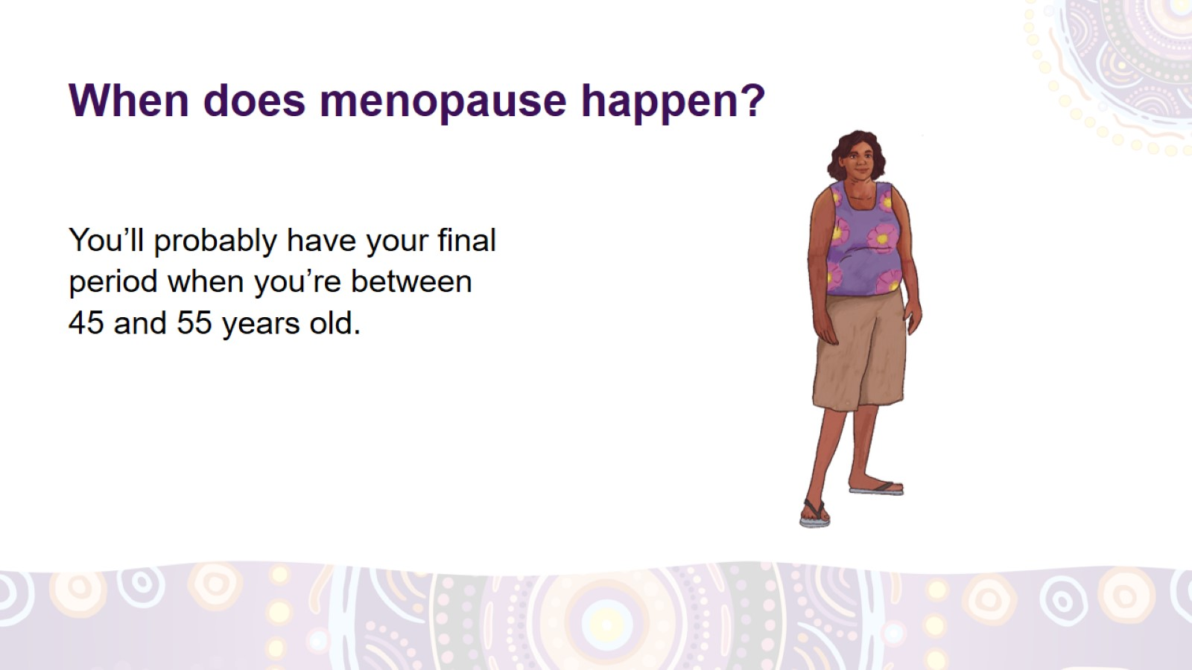
When does menopause happen?
Notes:
When does menopause happen?
For most women in Australia, menopause happens when they are between 45 and 55 years old.
For some women, it happens in their 30s or even 20s, but that’s not common.
If your periods stop before you’re 45, you need to see your doctor, nurse or Aboriginal Health Worker to check your health.

Slide 9
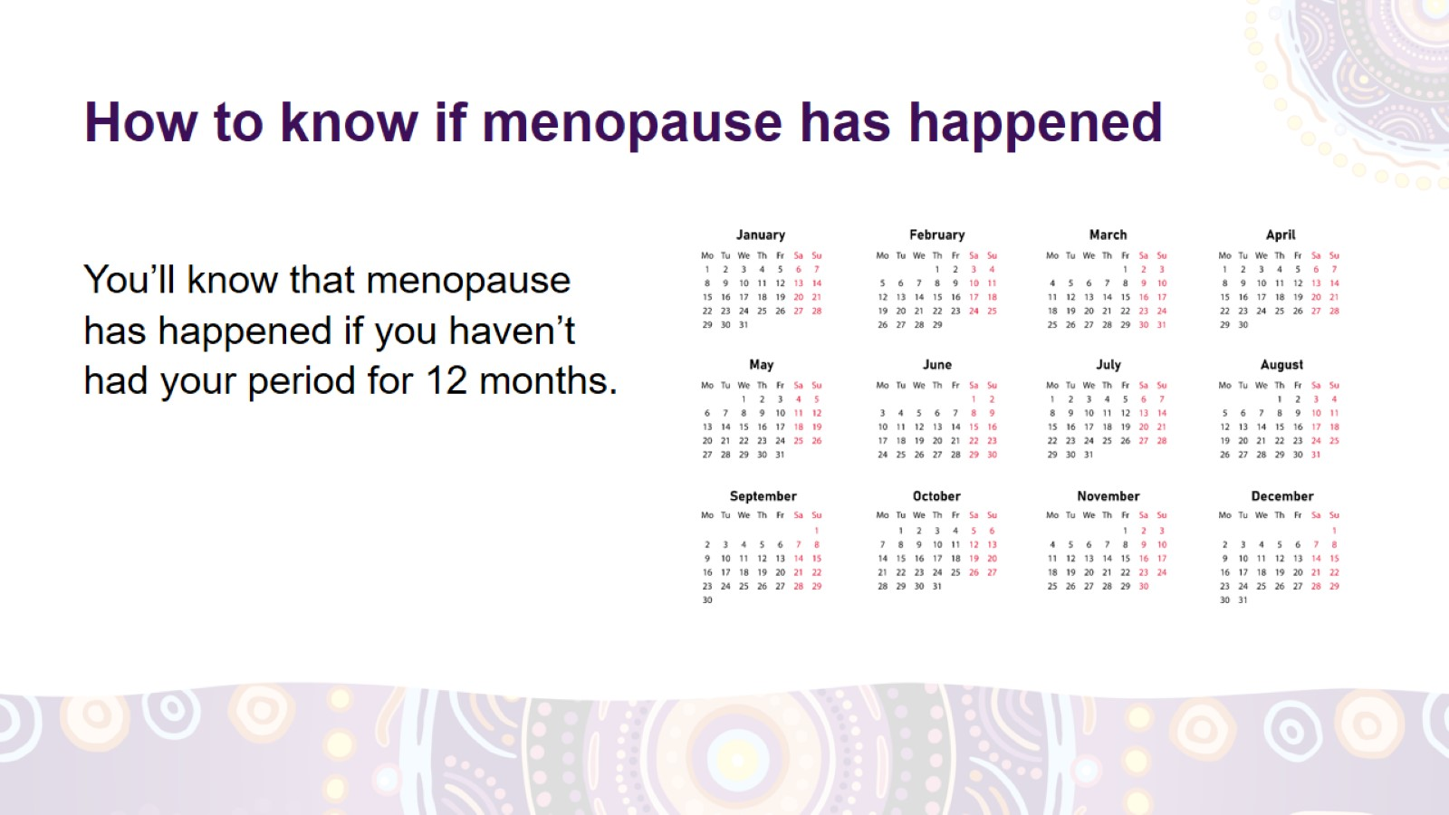
How to know if menopause has happened
Notes:
How to know if menopause has happened
You’ll know that menopause has happened if you haven’t had your period for 12 months.
If you’re using contraception and don’t have periods, or if your periods are not regular, it’s harder to know if you’ve reached menopause. Talk to a doctor, nurse or Aboriginal Health Worker about it.

Slide 10
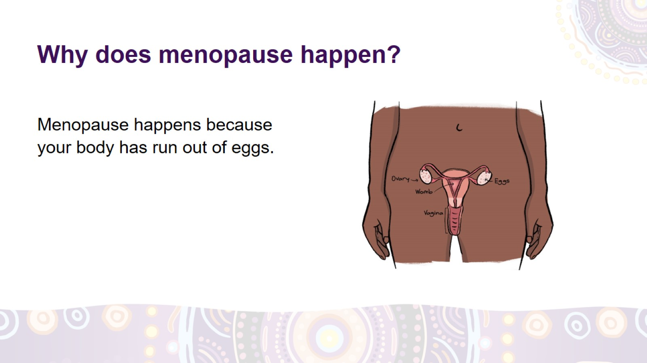
Why does menopause happen?
Notes:
Why does menopause happen?
You were born with lots of eggs in your body. You need the eggs to be able to have babies.
Menopause happens when your body has run out of eggs.
This means that your periods will stop and you won’t be able to become pregnant anymore.

Slide 11
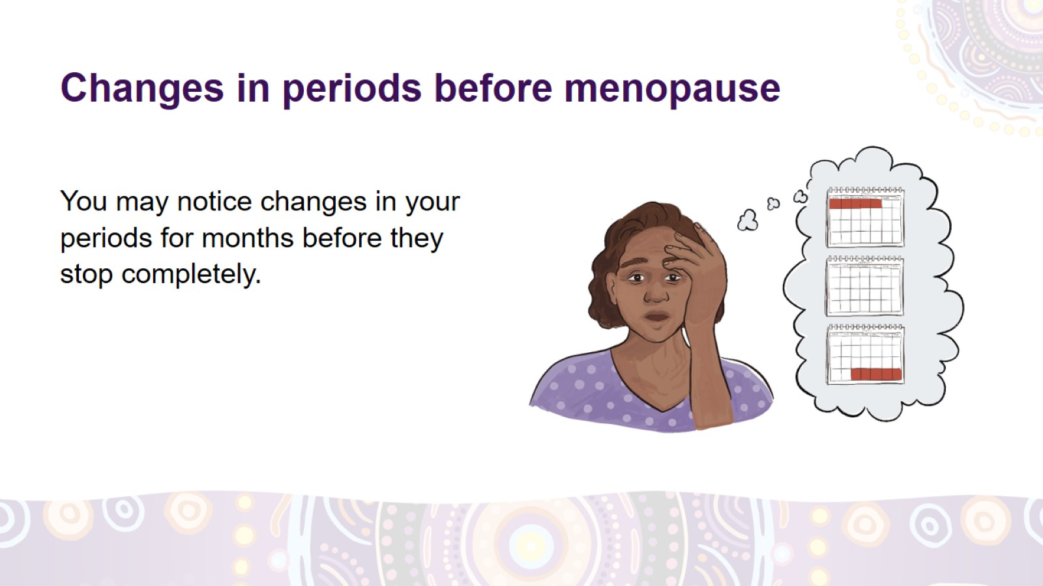
Changes in periods before menopause
Notes:
Changes in periods before menopause
You may notice changes in the pattern of your periods for months or even years before your periods stop completely.
Your periods may:
come less or more often than before
become lighter or heavier
be shorter or longer than usual.

Slide 12
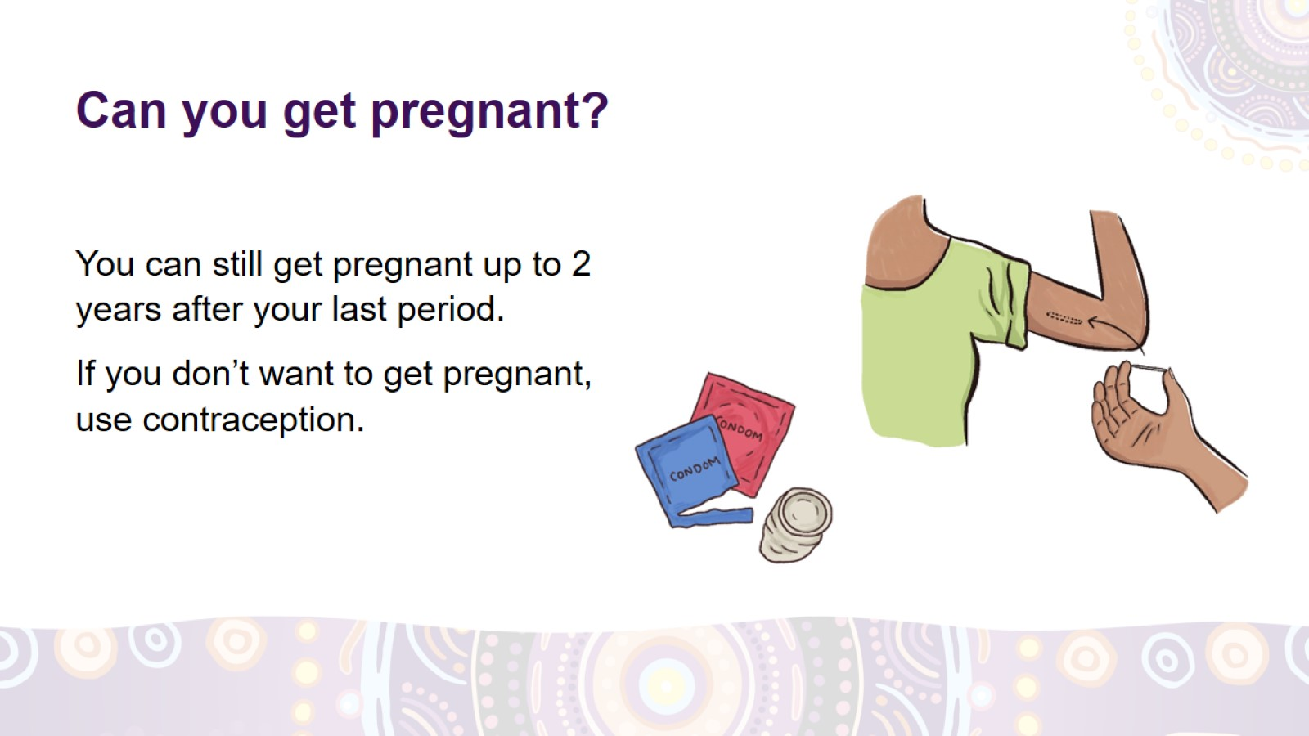
Can you get pregnant?
Notes:
Can you get pregnant around the time of menopause?
You can still get pregnant before menopause while you’re having irregular periods.
You can also get pregnant up to 2 years after your final period. If you don’t want to become pregnant, use contraception.
Contraception is something you can use if you don’t want to get pregnant. For example, condoms, ‘the rod’, Depo, or the Pill.

Slide 13
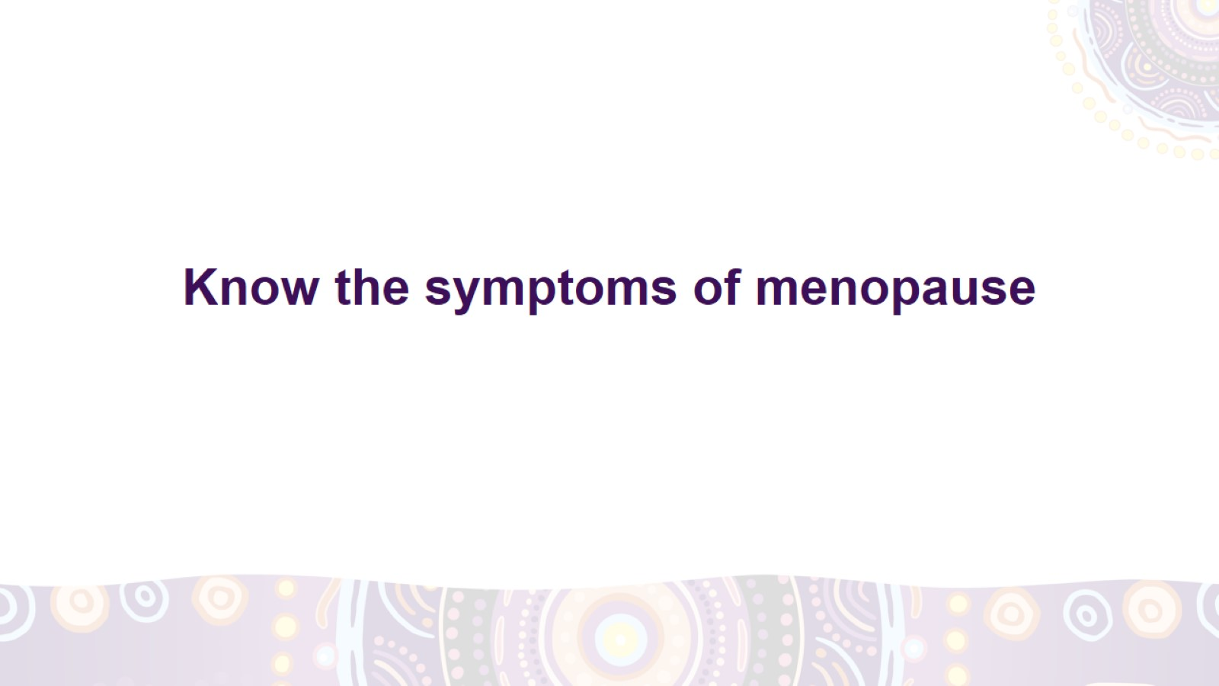
Know the symptoms of menopause
Notes:
Let’s yarn about the things you might notice around the time of menopause.

Slide 14
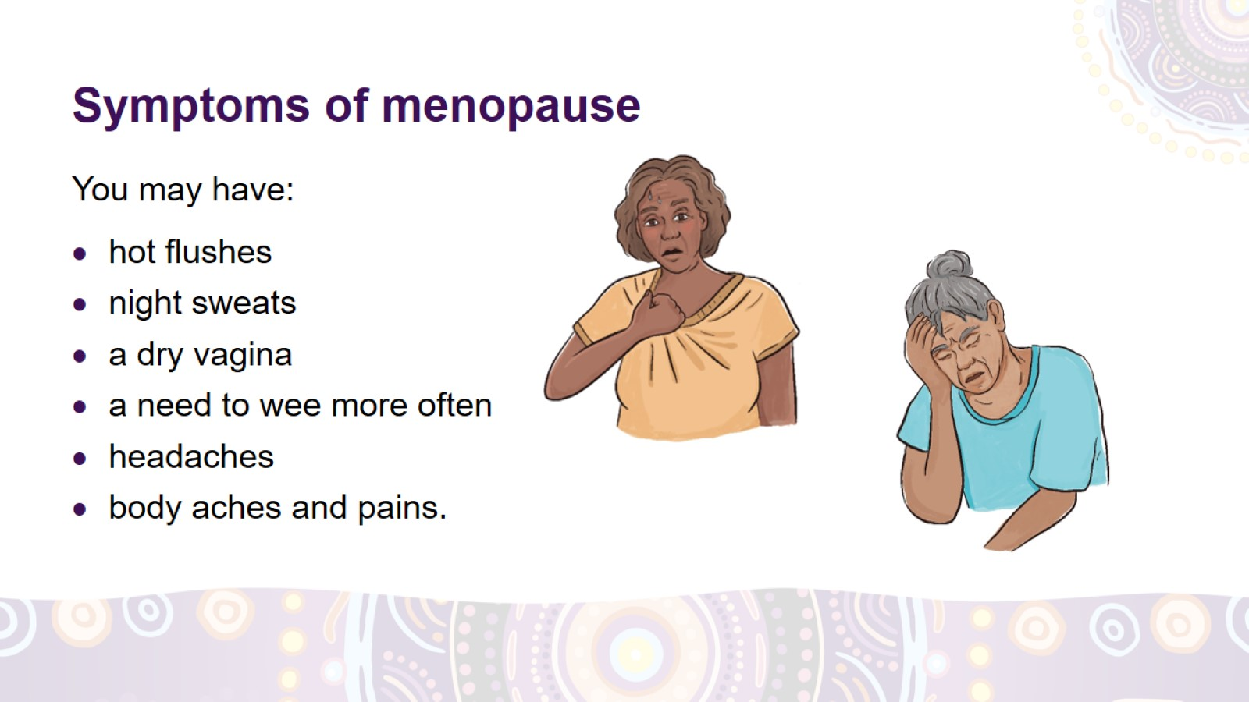
Symptoms of menopause
Notes:
What are the symptoms of menopause?
Around the time of menopause, you may notice changes in your body and how you feel. These changes are the symptoms of menopause. Many women have them.
You may have:
hot flushes – when you suddenly feel hot and start sweating
night sweats – when you sweat a lot during the night, making your clothes and bedsheets wet
a dry vagina, which can make it painful to have sex
a need to wee more often than usual, including at night
body aches and pains
headaches.

Slide 15
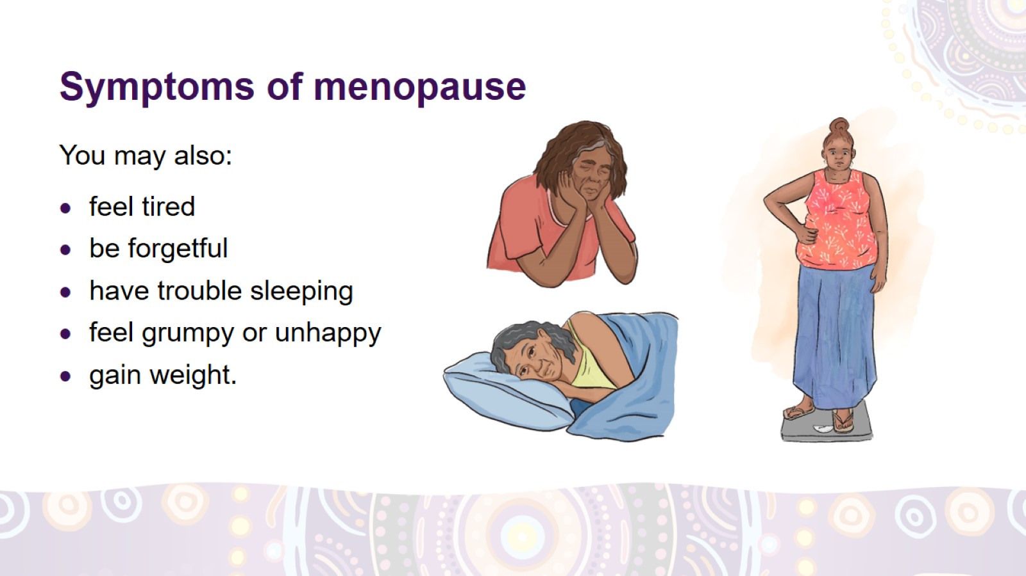
Symptoms of menopause
Notes:
The symptoms of menopause
You may also:
feel more tired than usual
have trouble remembering things
have trouble falling asleep or staying asleep
feel really grumpy, worried or unhappy
gain weight, especially around your belly.

Slide 16
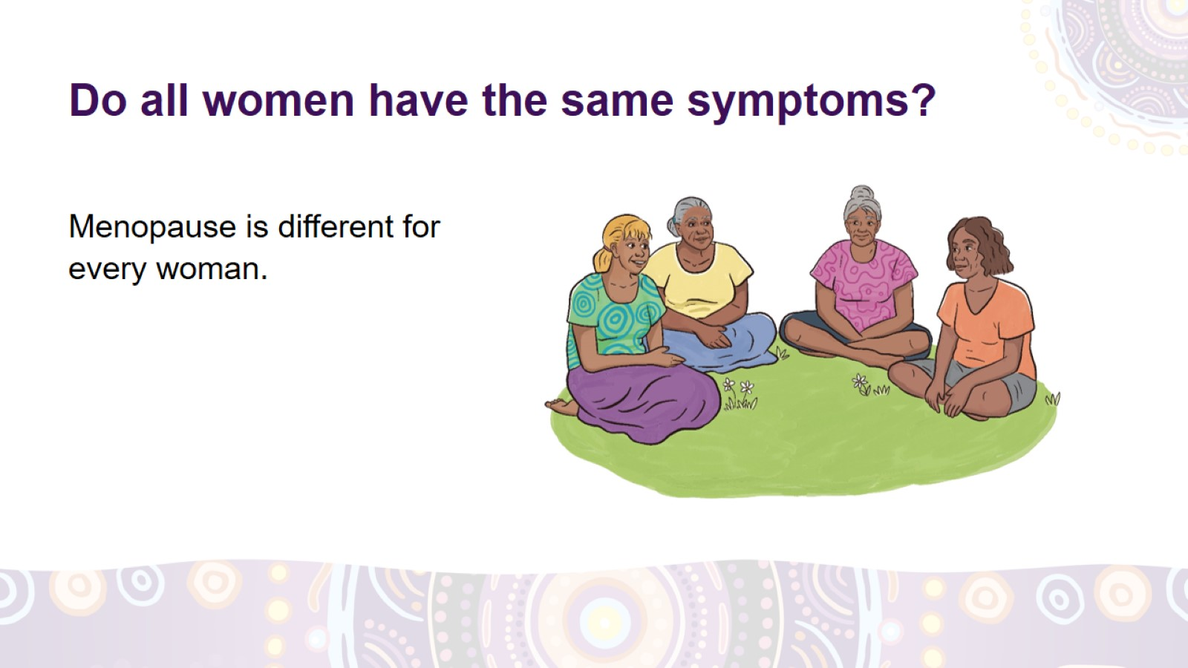
Do all women have the same symptoms?
Notes:
Do all women have the same symptoms?
Menopause is different for every woman.
You may have no symptoms, you may have only a few symptoms, or you may have symptoms that you find very hard to deal with.
It might be good to yarn with Elders and Aunties about how they dealt with the change.

Slide 17
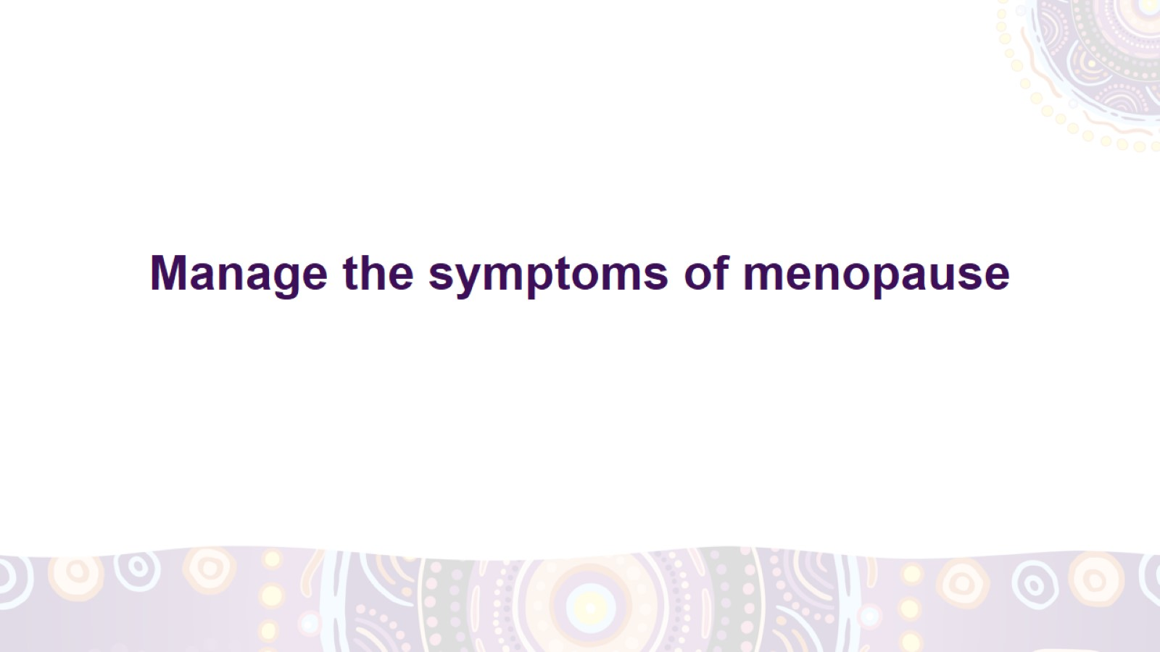
Manage the symptoms of menopause
Notes:
If menopause is bothering you, you can try different things to feel better.

Slide 18
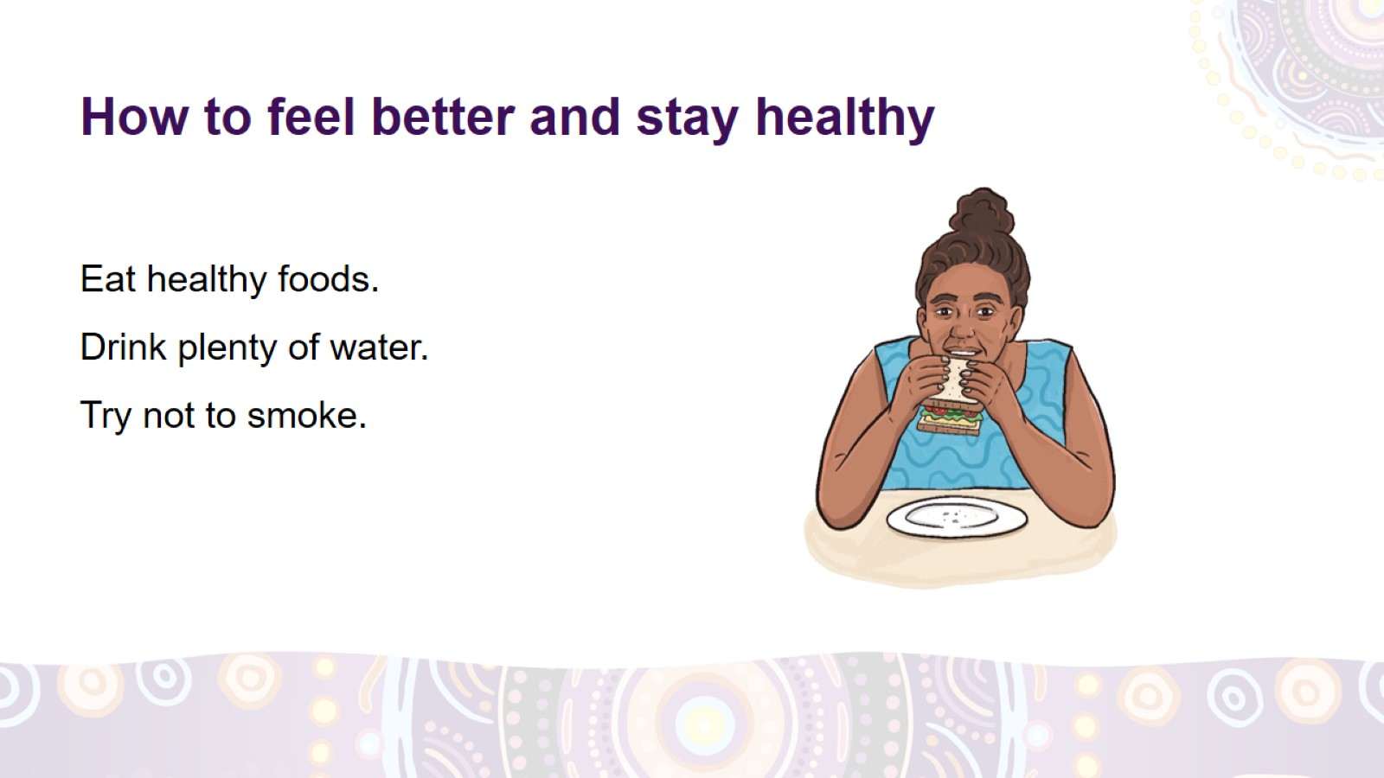
How to feel better and stay healthy
Notes:
How to feel better and stay healthy around the time of menopause
Eat healthy foods – vegetables, fruit, whole grains, lean meats (like kangaroo or chicken), fish, milk and natural yoghurt.
Limit:
sugary foods, such as cakes, cookies, pastries, lollies, chocolates
sugary drinks, such as soft drinks, cordials, sports and energy drinks
fried foods, such as fries (hot chips), fast-food burgers, chips (crisps).
Drink plenty of water – aim for 8 cups (2 litres) a day.
If you drink alcohol, don’t drink more than 1 drink a day, for example, a small beer, a small glass of wine or a can or bottle of pre-mixed spirits.
Try not to smoke. Get help if you want to quit smoking.
Smoking and alcohol can make your hot flushes and sleep worse.

Slide 19
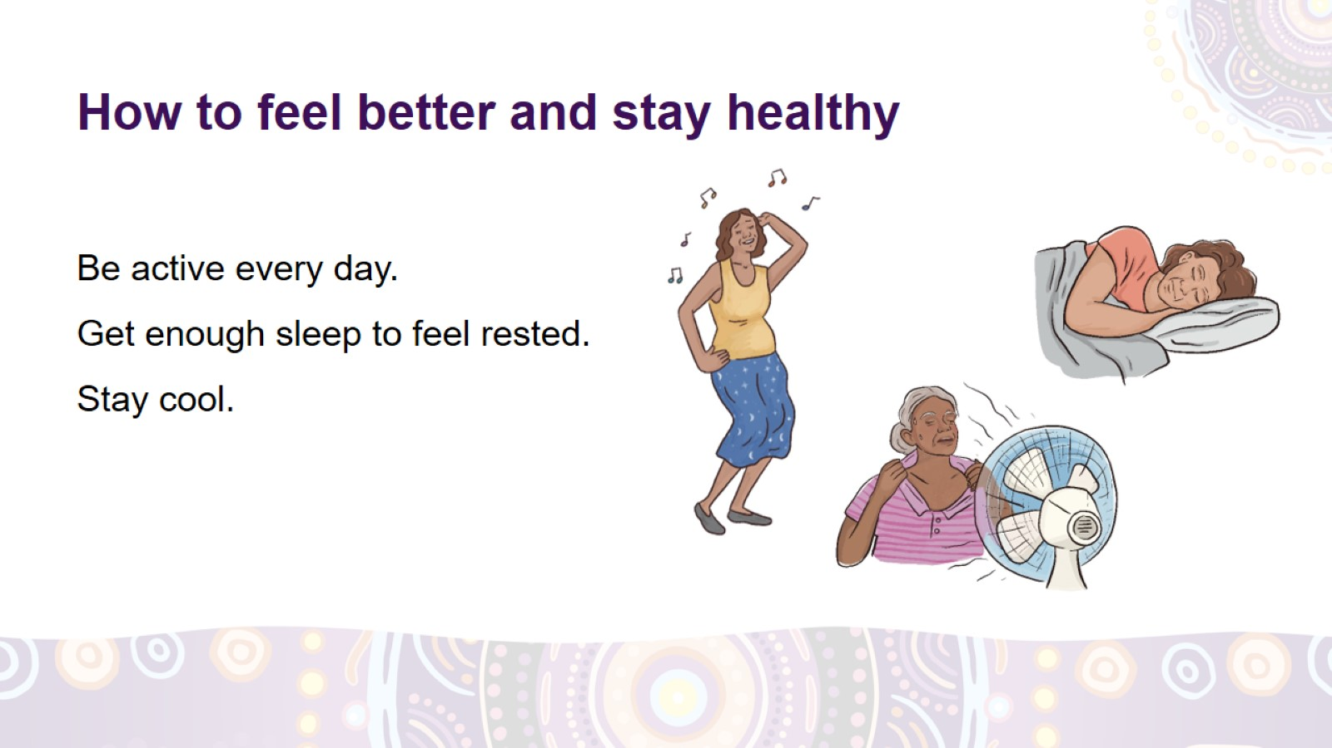
How to feel better and stay healthy
Notes:
How to feel better and stay healthy around the time of menopause
Be active every day. For example, go for a walk, exercise, work in the garden, swim or dance for at least 30 minutes a day.
Get about 8 hours of sleep every night.
Try to stay cool, for example:
use fans or air conditioning (if available), hand fans and water sprays
wear layers of clothing that you can easily take off when you are hot
have cold drinks.
If sex is painful, use lubricants (lube). Lubricants are special gels, liquids and oils that you can use when having sex. You can get them at the pharmacy, supermarket or at your local clinic.

Slide 20
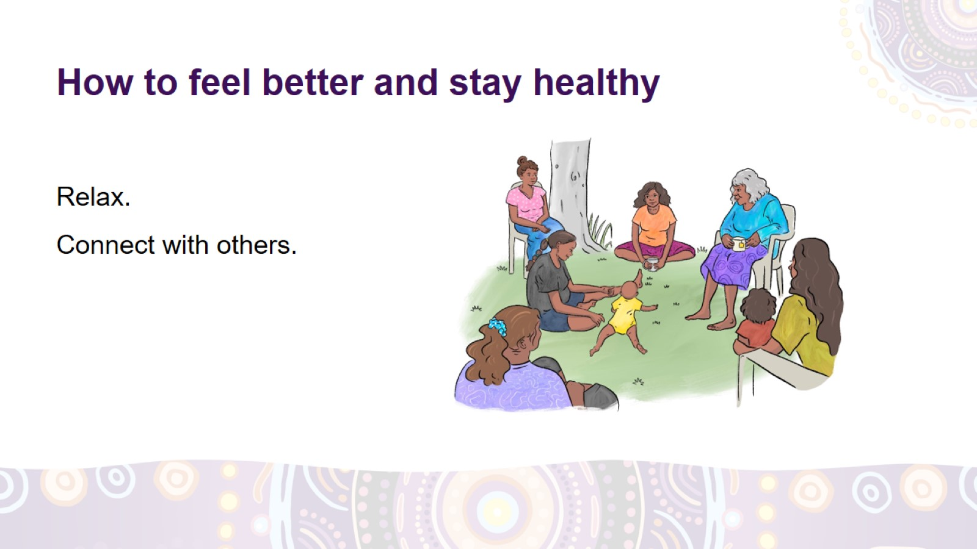
How to feel better and stay healthy
Notes:
How to feel better and stay healthy around the time of menopause
To help you relax, go fishing, hunting, or get out on country with family.
Connect with other people – yarn with your family and friends, have a feed together or go for a walk. Spend time with a women’s group or your community.

Slide 21
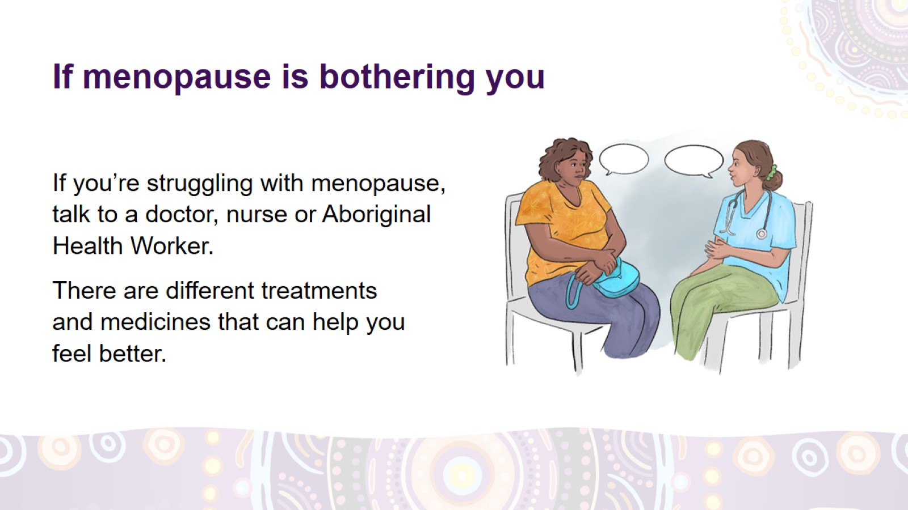
If menopause is bothering you
Notes:
Getting help
If menopause is bothering you and you don’t feel good, talk to a doctor, nurse or Aboriginal Health Worker.
There’s no shame in talking about it and asking for help.
There are different treatments and medicines that can help you feel better. For example, menopausal hormone therapy (MHT) helps with hot flushes, night sweats and a dry vagina.

Slide 22
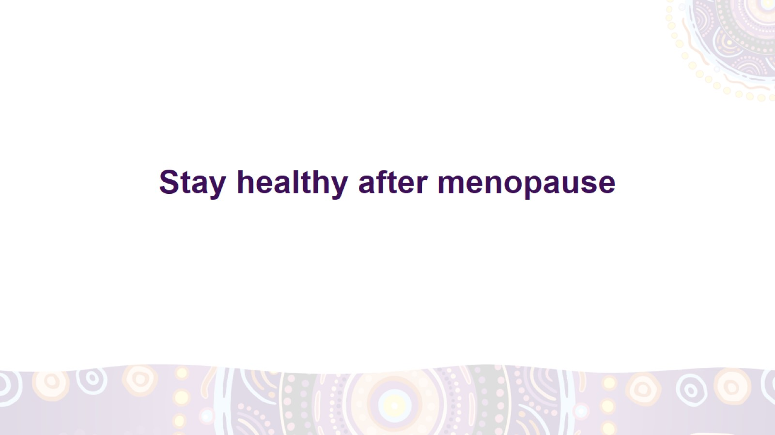
Stay healthy after menopause
Notes:
It’s very important that you stay healthy after menopause.

Slide 23
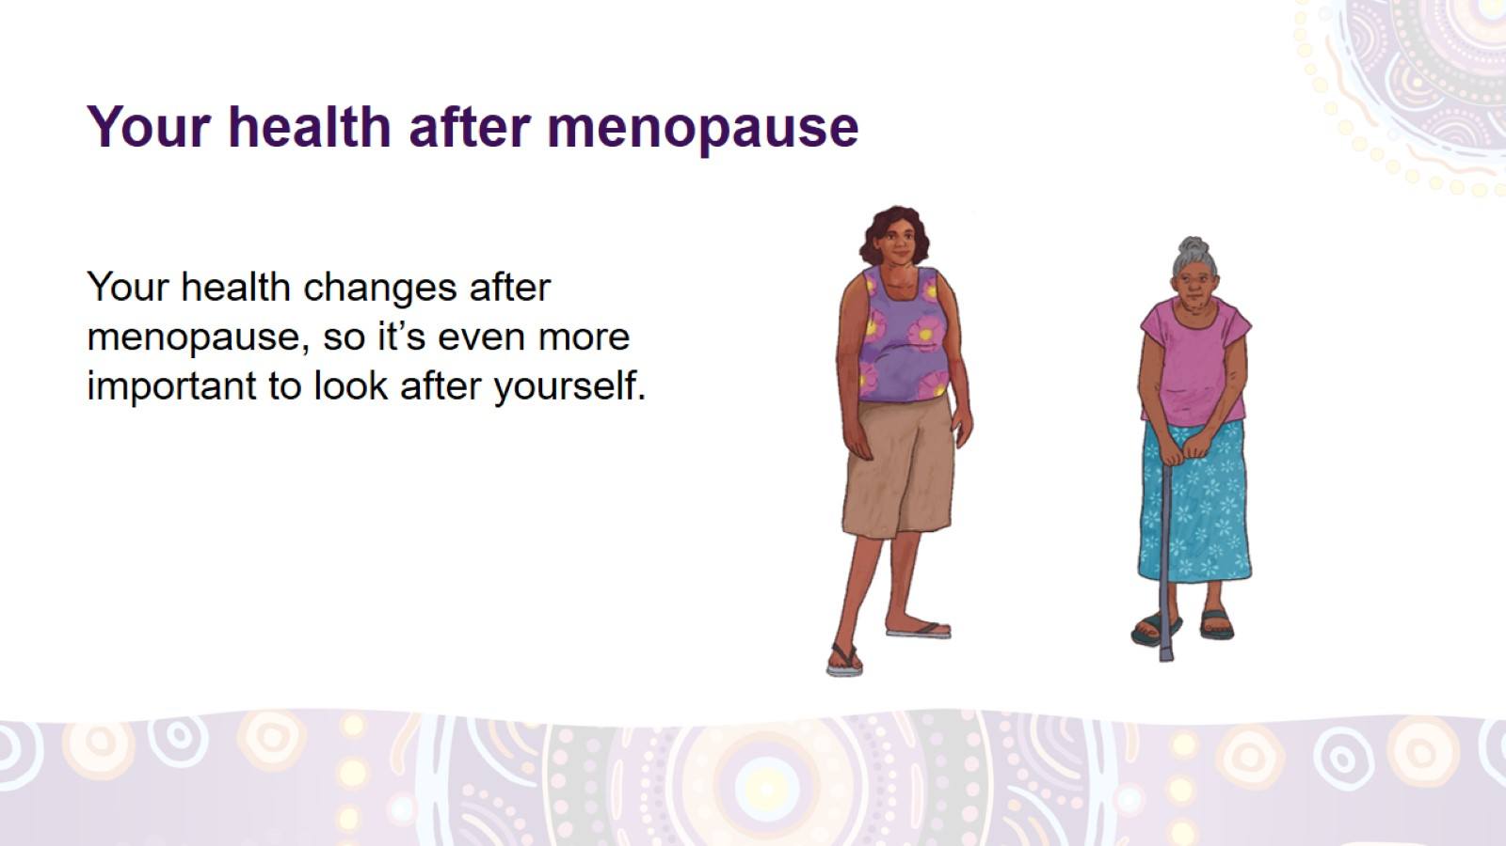
Your health after menopause
Notes:
Your health after menopause
Your health changes after menopause and you have a higher risk of:
heart disease – for example, a heart attack or a stroke
osteoporosis – when your bones become weak and can break more easily
type 2 diabetes – when there’s too much sugar in your blood, which can damage some parts of your body
dementia – an illness that affects your brain
some cancers.
It’s important to look after yourself after menopause. There are things you can do that will help you stay healthy.

Slide 24
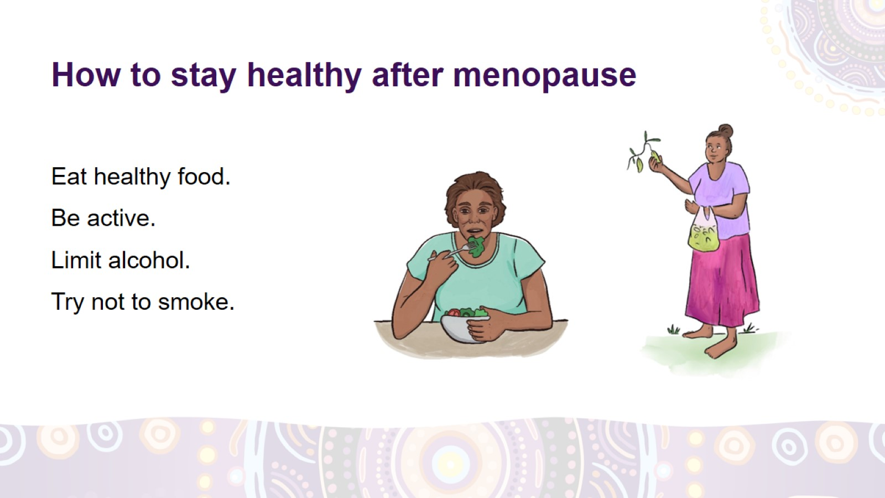
How to stay healthy after menopause
Notes:
How to stay healthy after menopause
Eat healthy foods and try to keep a healthy weight.
Be active to help your bones stay strong.
Limit alcohol.
Try not to smoke.

Slide 25
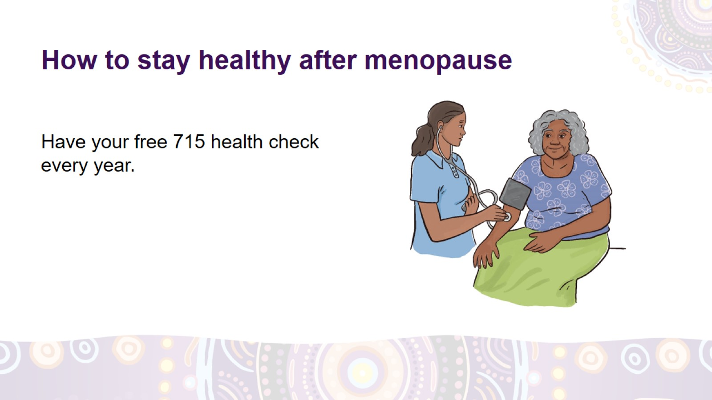
How to stay healthy after menopause
Notes:
How to stay healthy after menopause
Have your free 715 health check every year, even if you feel healthy and strong. If a health problem is found early, you can get the right treatment and you’ll have a better chance of getting healthy again.
At the 715 health check, the doctor, nurse or Aboriginal Health Worker may:
check if your blood pressure and blood sugar are good
check if your bones are still strong
tell you what tests you should have.
Remember that after menopause you still need regular cervical, breast and bowel cancer screening.

Slide 26
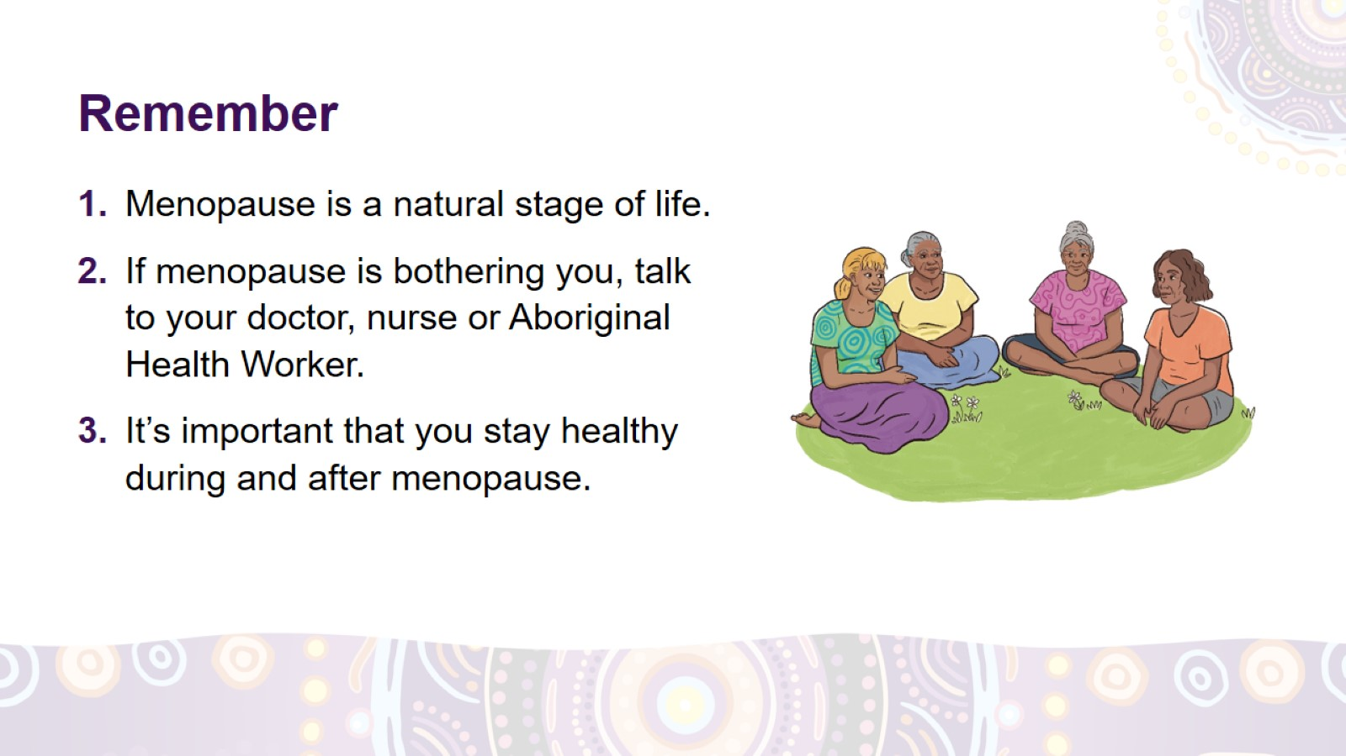
Remember

Slide 27
