Slide 1
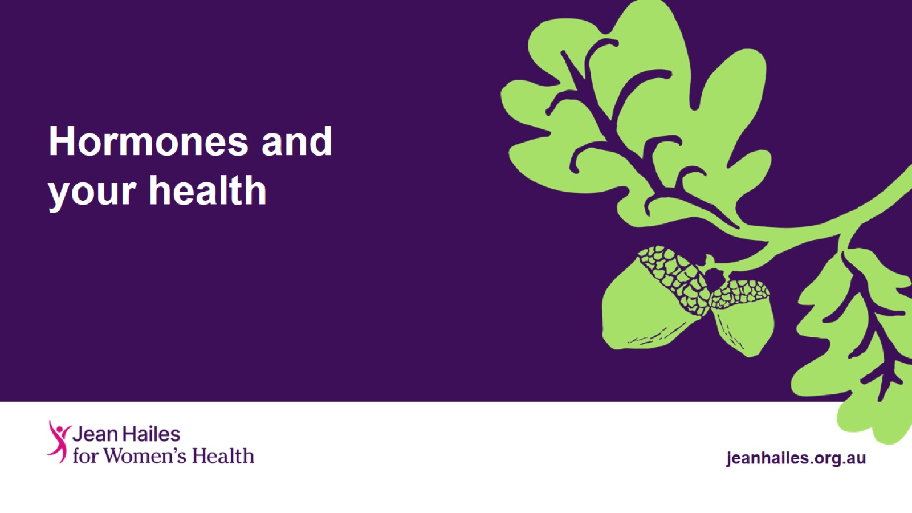
Hormones and your health
Notes:
Insert a text inbox to add presenter name and position title.

Slide 2
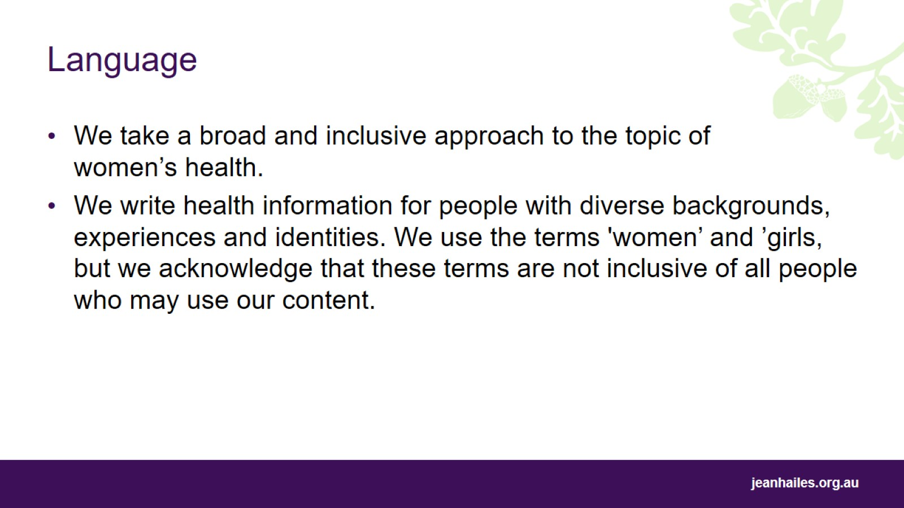
Language

Slide 3
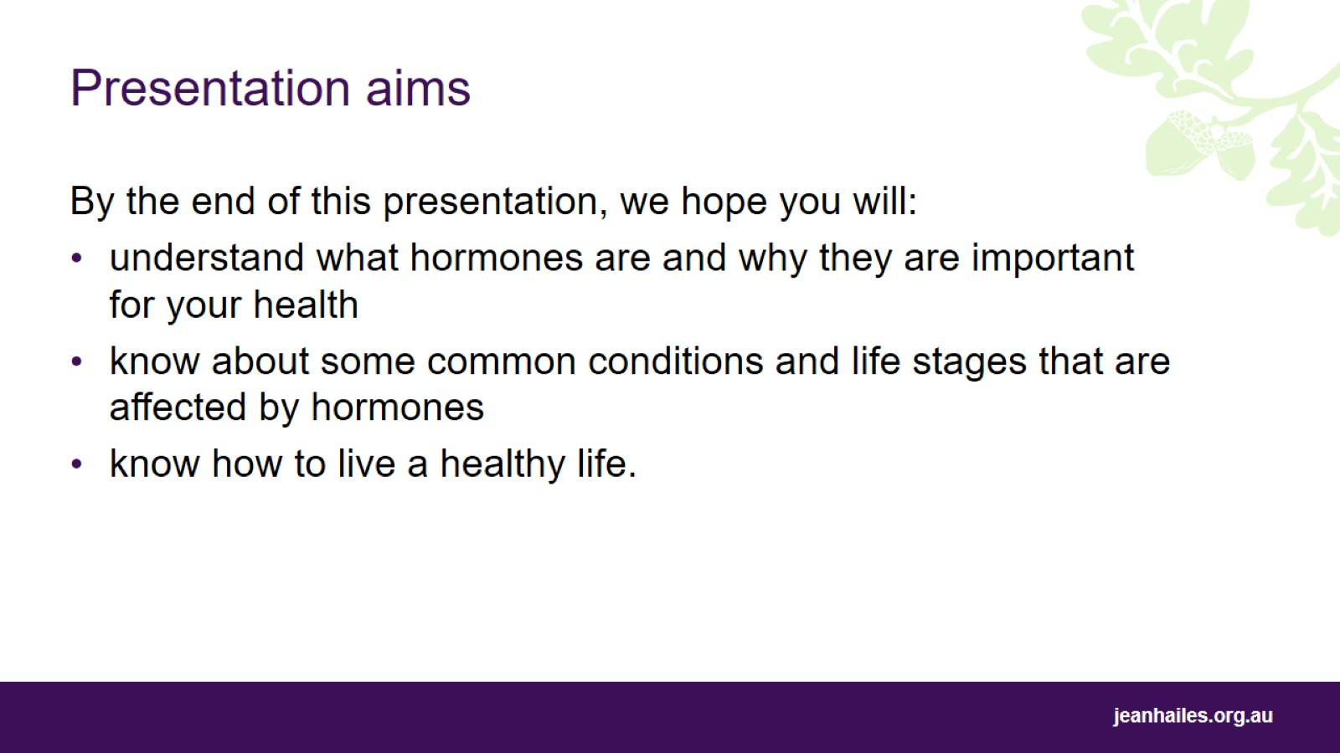
Presentation aims
Notes:
Today we’ll be talking about hormones.
By the end of this presentation, we hope you will:
understand what hormones are and why they are important for your health
know about some common conditions and life stages that are affected by hormones
know how to live a healthy life.

Slide 4
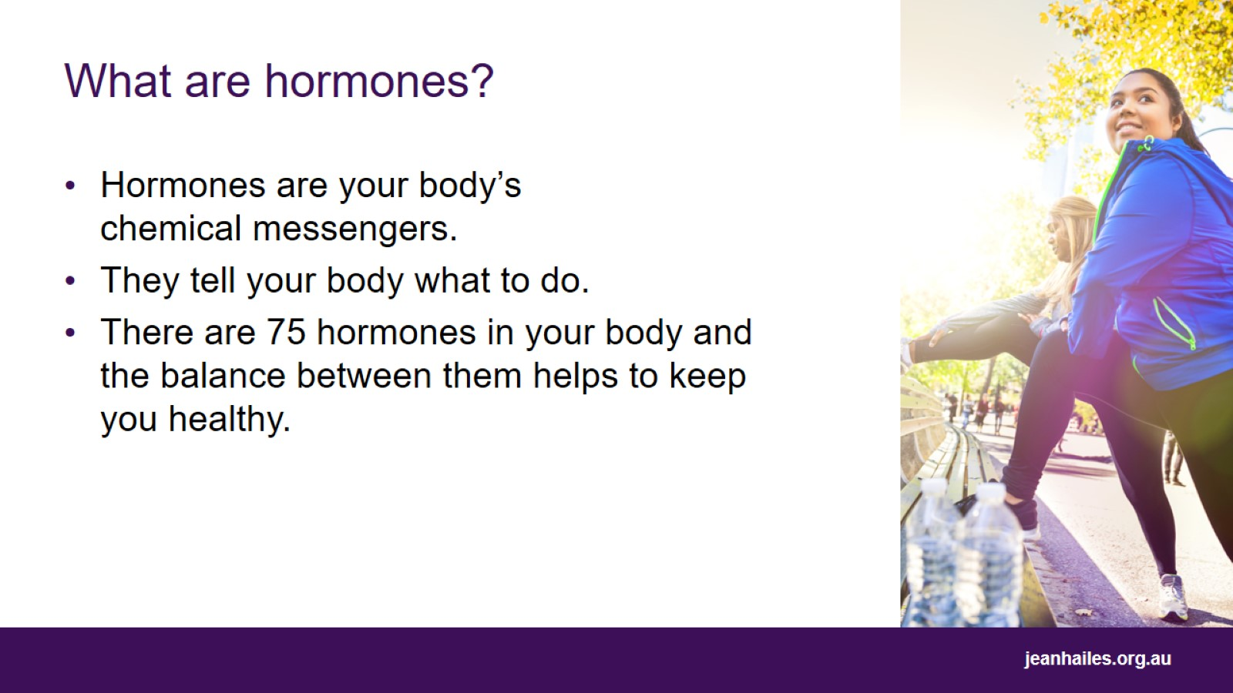
What are hormones?
Notes:
Hormones are chemicals made in your body that send messages through the bloodstream to tissues and organs.
They help control many of your body's functions, such as temperature, growth, energy, repair of cells, reproduction, sexual function and digestion.
Hormones tell your body what to do, for example when to eat, stop eating, sleep, wake up, grow or stop growing.
There are 75 hormones in your body, and they influence each other. The balance between them helps to keep you healthy.
Hormone imbalances can lead to health issues such as weight gain or loss, diabetes, infertility, weak bones, heart issues and mood changes.

Slide 5
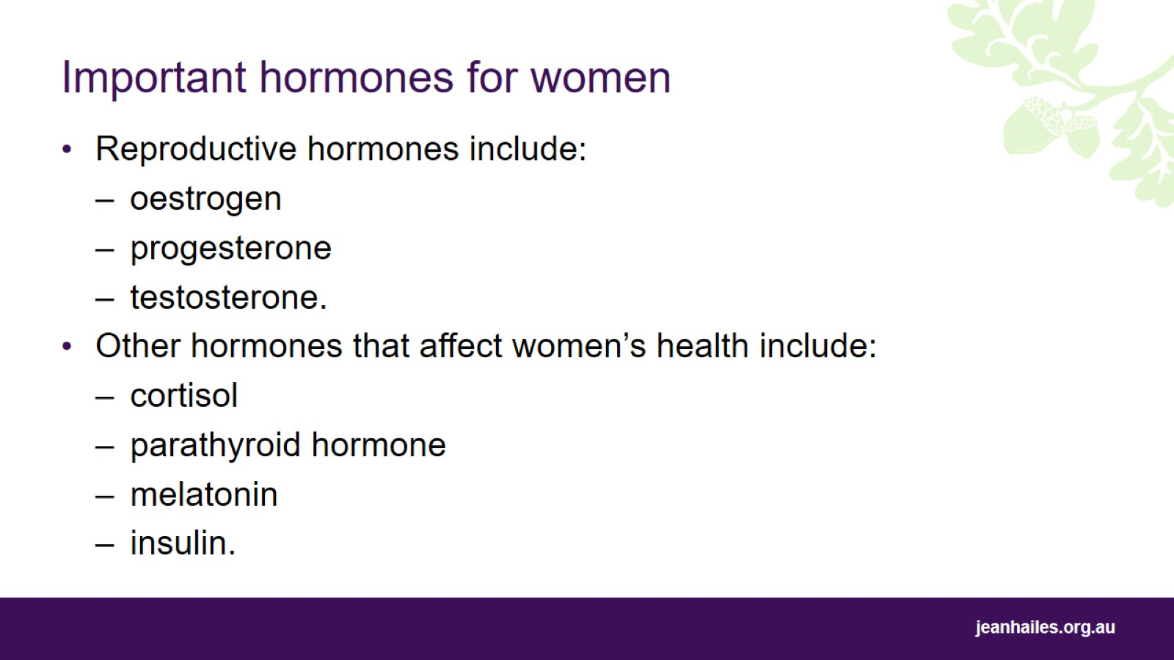
Important hormones for women
Notes:
Many hormones are important for women. Some of these are:
Reproductive hormones:
oestrogen
progesterone
testosterone.
Other hormones that impact women’s health that you’ll hear mentioned in this presentation include:
cortisol (stress hormone)
parathyroid hormone (helps to balance levels of calcium in your blood)
melatonin (helps to regulate your body clock)
insulin (allows your body to use sugar from the food you eat as energy).

Slide 6
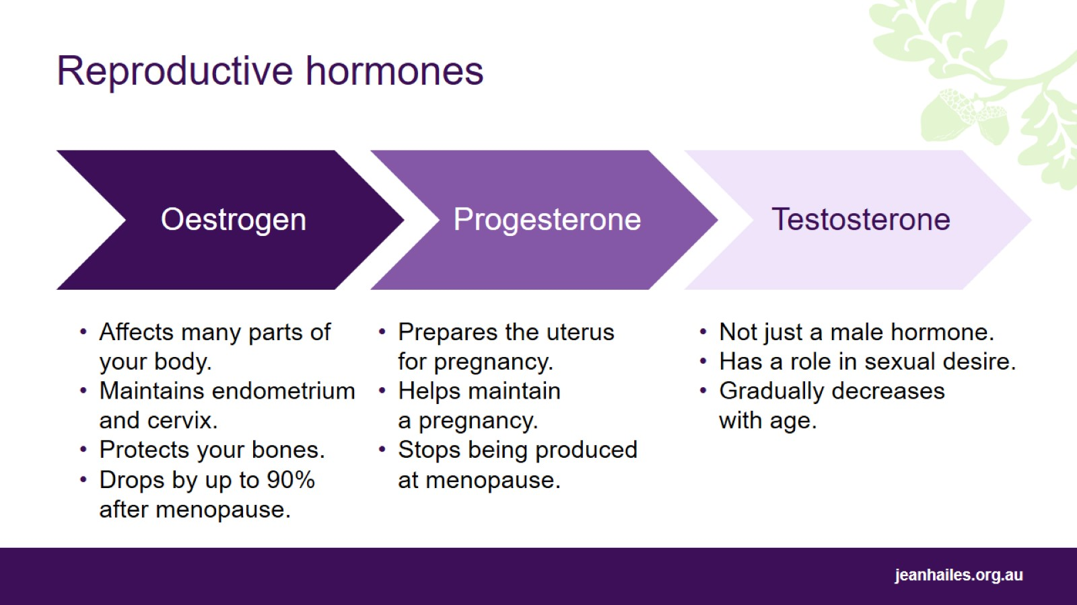
Notes:
Oestrogen, progesterone and testosterone are known as ‘reproductive hormones’.
Oestrogen affects many parts of your body, including bones, brain, heart, skin and bladder. It also helps maintain the endometrium (lining of the uterus) and the cervix (the lower part of, or entrance to, the uterus). The level of oestrogen in your body drops significantly after menopause.
Progesterone thickens the lining of the uterus so that a fertilised egg can be implanted. It also helps maintain a pregnancy. Progesterone production stops at menopause when ovulation ceases.
Testosterone plays a role in sexual desire and libido. Levels of testosterone in your body are highest during your 20s, and then gradually decline with age. By menopause, testosterone levels are about one quarter of what they used to be. But after the age of 65–70 years, testosterone rises again and is thought to offer protection against cardiovascular disease.
Production of these 3 hormones is controlled by other hormones produced in the brain.

Slide 7
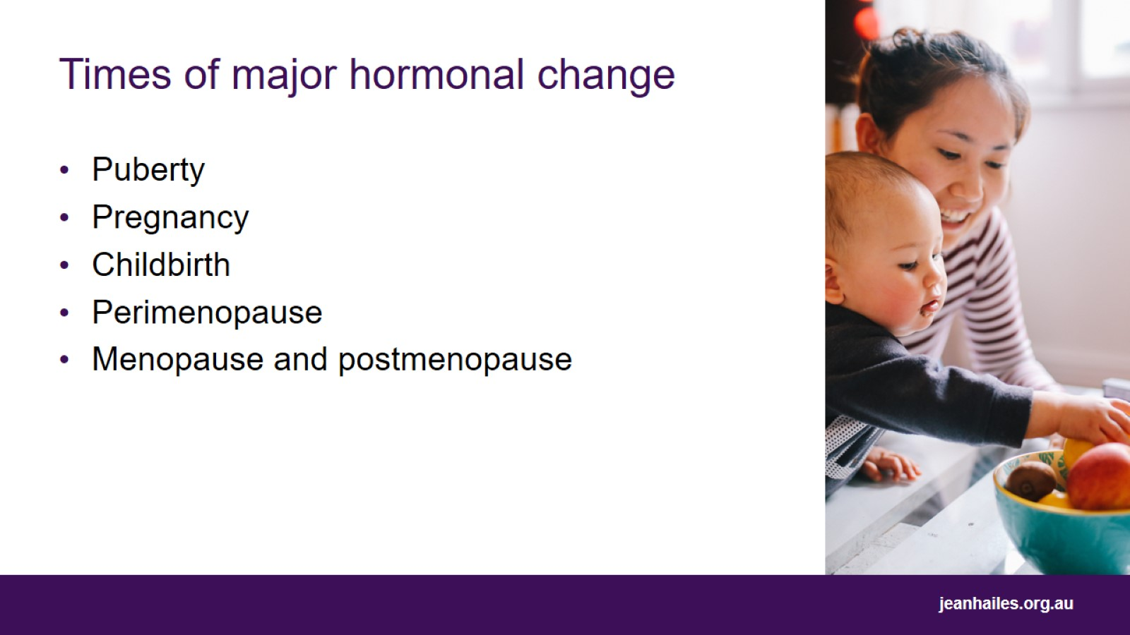
Times of major hormonal change
Notes:
Different stages in women’s lives trigger significant changes in hormone production. These include puberty, pregnancy, childbirth, perimenopause, menopause and postmenopause.
Puberty
The amount of oestrogen and progesterone increases which affects breast tissue, the vulva, the vagina, pubic and underarm hair, periods and mood.
Pregnancy
During pregnancy there is a sudden and dramatic increase in oestrogen and progesterone. This helps the foetus to develop. It can also change the pregnant woman’s skin and hair, create the ‘glow’ of pregnancy and affect mood.
Later in the pregnancy there is an increase in other hormones such as oxytocin and relaxin. Oxytocin is produced in large amounts during labour, and relaxin helps to relax ligaments in the pelvis and widen the cervix in preparation for childbirth.
Childbirth
Immediately after childbirth, there is a sudden and dramatic decrease in the hormones oestrogen and progesterone. This can lead to changes in mood, including postnatal depression and the ‘baby blues’. The drop in oestrogen can also cause vaginal dryness and painful sex.
Prolactin hormone is responsible for the production of breastmilk.
Perimenopause
Perimenopause is often described as a time of ‘hormonal chaos’. During this time, hormone levels can change rapidly, swinging up and down. This causes many common menopausal symptoms such as hot flushes and night sweats.
Menopause and postmenopause
After menopause there is a significant drop in oestrogen, leading to increased risk of developing cardiovascular disease and osteoporosis.

Slide 8
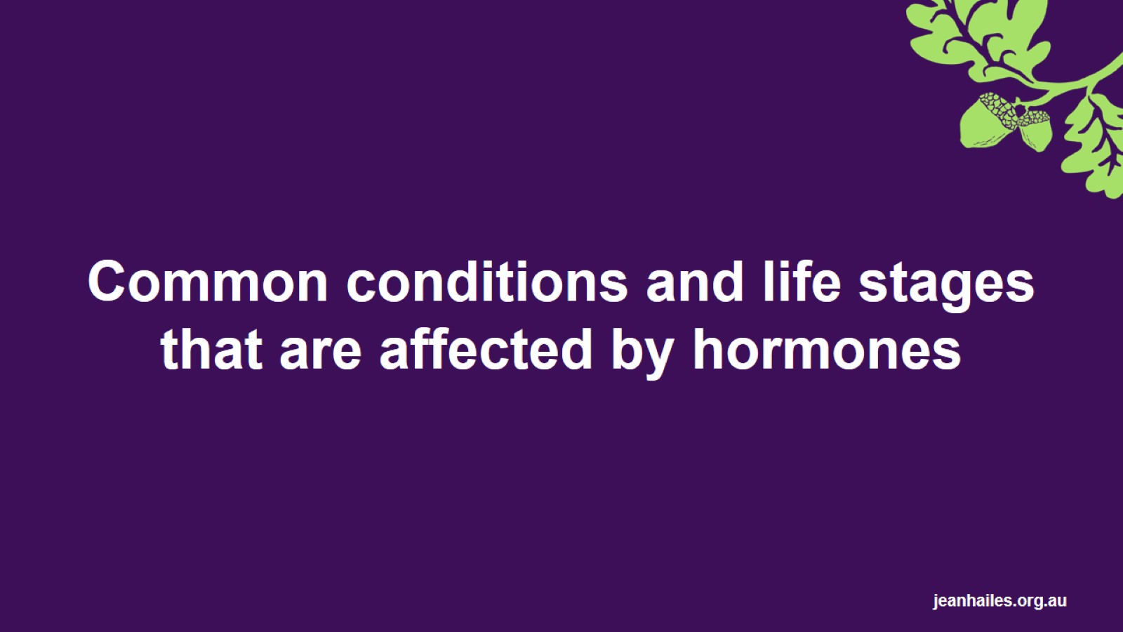
Common conditions and life stages that are affected by hormones
Notes:
Some conditions or stages that are affected by reproductive hormones include:
premenstrual syndrome (PMS)
premenstrual dysphoric disorder (PMDD)
polycystic ovary syndrome (PCOS)
endometriosis
menopause.
The next slides will discuss these in greater detail.
Note: menopause is a normal life stage, not a disease or medical condition. However, due to the symptoms associated with menopause, it often requires treatment or management.

Slide 9
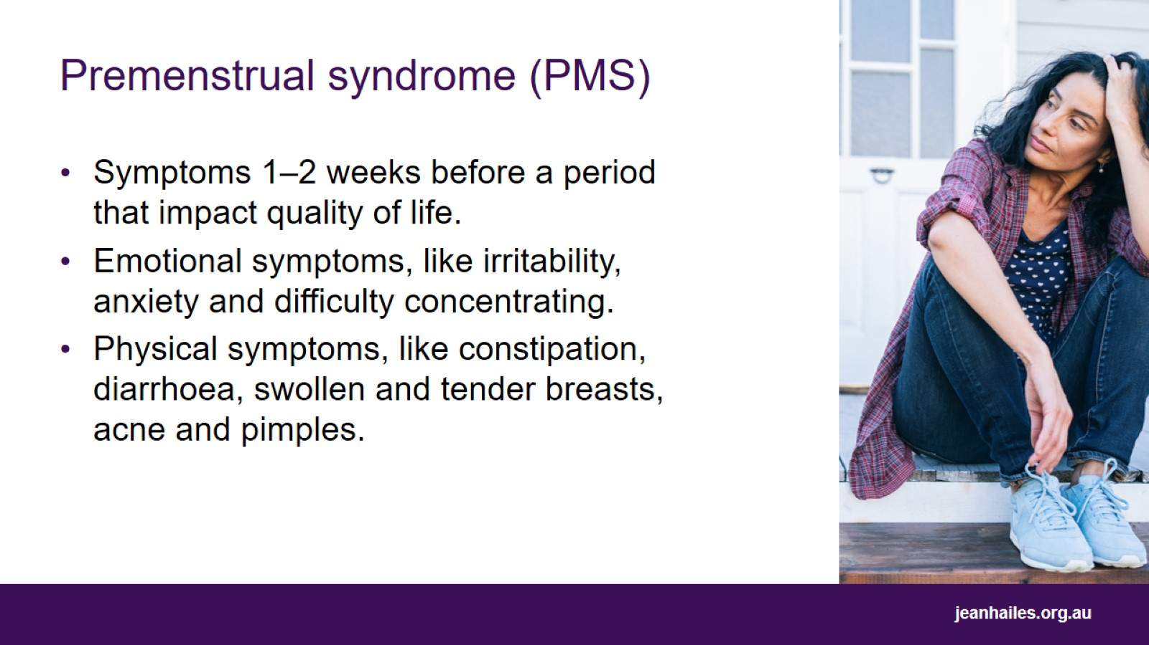
Premenstrual syndrome (PMS)
Notes:
Many women experience at least 1 or 2 symptoms in the lead-up to their period, which go away once the period starts.
Most women experience symptoms that they can manage themselves.
When these symptoms impact on your quality of life, they are known as ‘premenstrual syndrome’ or PMS.
Anyone can experience PMS, but it is most common in women in their 20s and 30s.
Common symptoms include:
emotional symptoms, like irritability, anxiety, and difficulty concentrating
physical symptoms, like constipation, diarrhoea, swollen and tender breasts, acne and pimples, fatigue, and food cravings.
If you have premenstrual symptoms that trouble you, speak to a doctor or nurse.

Slide 10
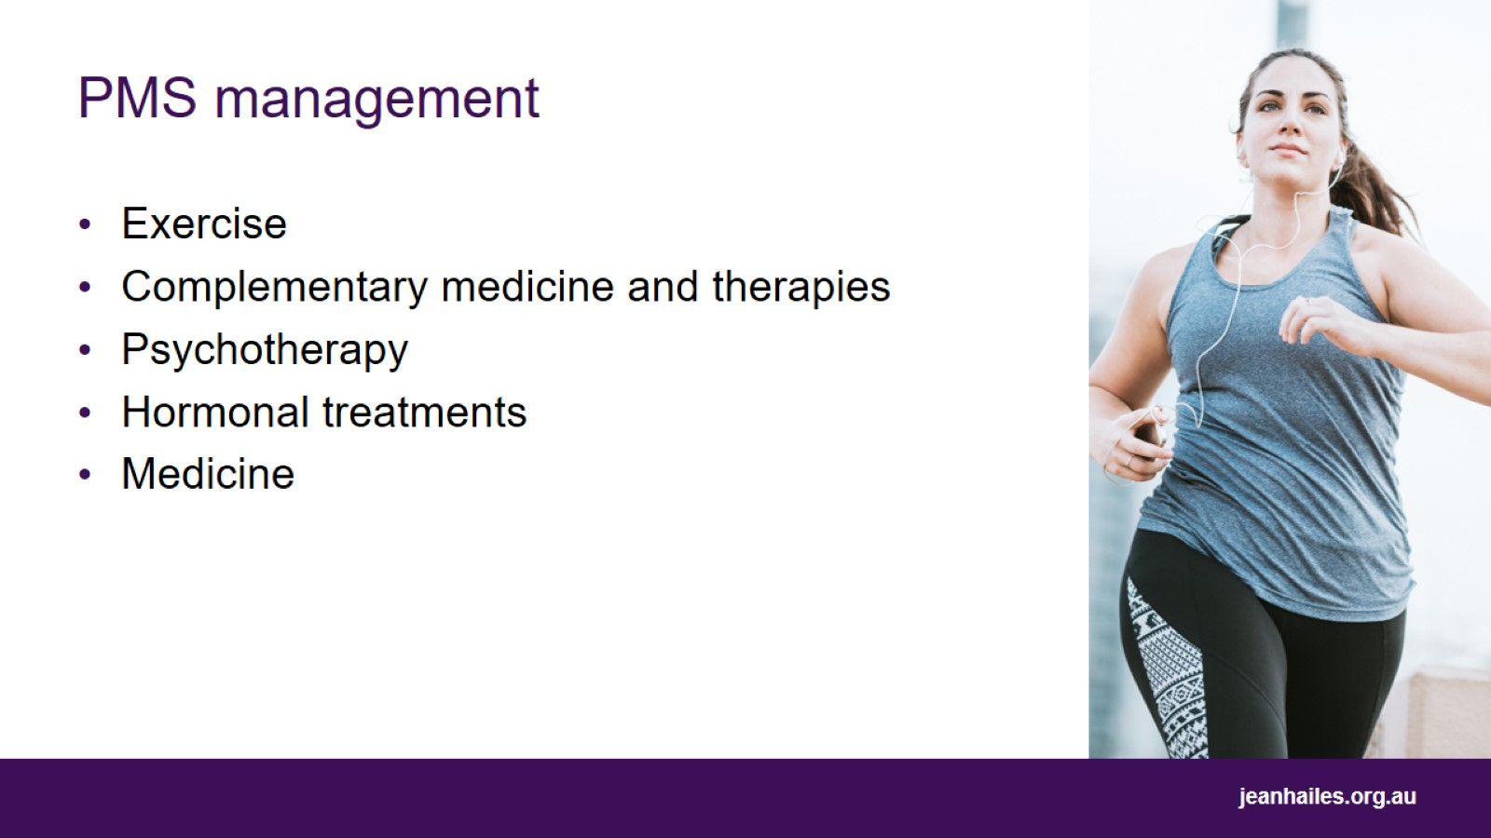
PMS management
Notes:
There are things you can do to manage PMS.
Evidence-based treatments for PMS include:
exercise – releases the hormone ‘endorphin’ which has a positive effect on mood
complementary medicine and therapies, such as evening primrose oil, vitamin B6, magnesium, chaste tree berry and acupuncture
psychotherapy, such as cognitive behavioural therapy
hormonal treatments, such as the oral contraceptive pill (‘the Pill’)
other medications, such as anti-anxiety medication or antidepressants.
Talk to your doctor about these treatments.

Slide 11
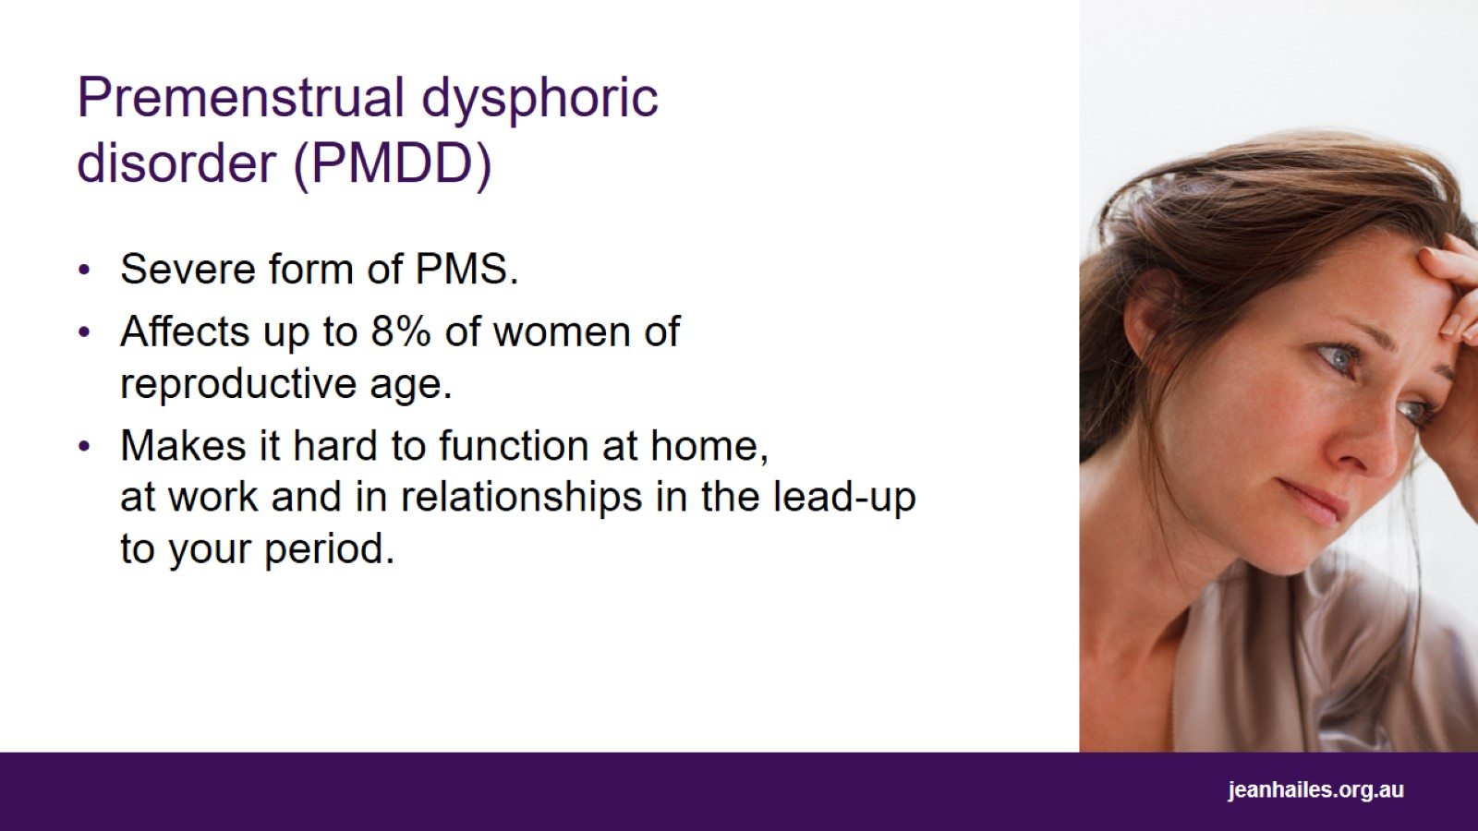
Premenstrual dysphoric disorder (PMDD)
Notes:
Premenstrual dysphoric disorder (PMDD) is a severe form of PMS that affects between 3 and 8% of women of reproductive age.
It is a severe negative reaction in the brain to changing levels of hormones in the second half of the menstrual cycle, in the lead up to the period.
PMDD is similar to PMS, in that symptoms appear in the lead-up to your period and go away in the first few days of bleeding.
However, in PMDD, symptoms are much more severe. People with PMDD have difficulty functioning at home, at work, and in relationships in the lead-up to their period when they have symptoms.
Symptoms include emotional symptoms, such as mood swings, depression, irritability and anxiety, and physical symptoms, such as breast tenderness and swelling, joint or muscle pain and weight gain.

Slide 12
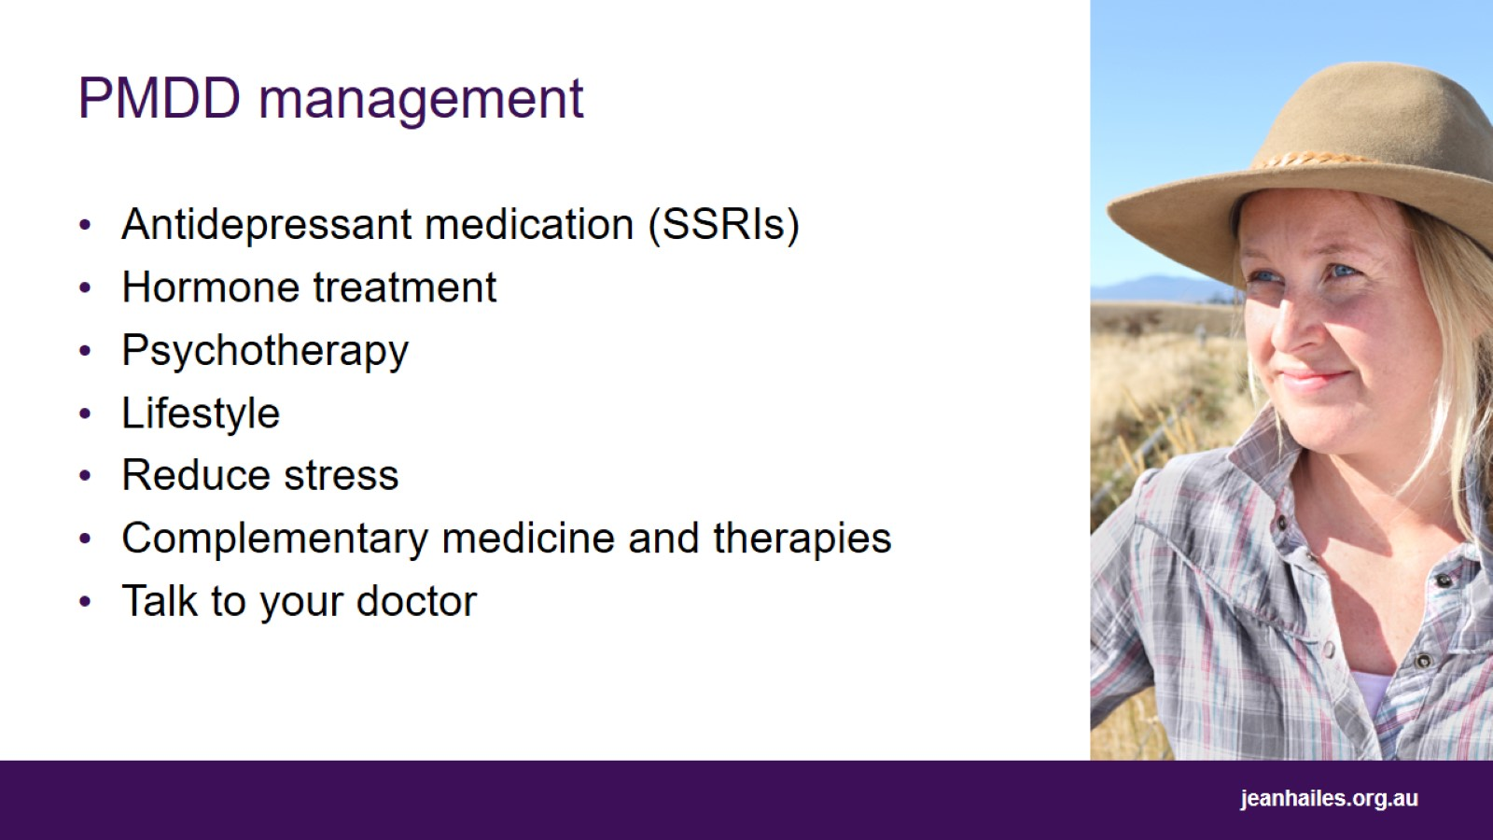
PMDD management
Notes:
PMDD usually requires treatment with medication. This can include antidepressants (SSRIs) or hormonal treatment to stop ovulation.
Other strategies that can help include:
psychotherapy – can help to develop coping strategies
healthy lifestyle – healthy eating, regular exercise, diary management (avoid planning big events or meetings in the second half of your menstrual cycle), consistent sleep pattern, limited or no alcohol and no smoking or illicit drug use
reduce stress – reducing stress as much as possible is important. If you are experiencing workplace bulling or domestic violence, get help to address these issues
complementary medicine and therapies – vitamin B6, calcium and vitex agnus-castus extract can help to manage PMDD. If you choose to use complementary medicine and therapies to treat PMDD it’s important to get advice from a health professional trained in this area.
If you have premenstrual symptoms that concern you or that interfere with your daily life, talk to your doctor.

Slide 13
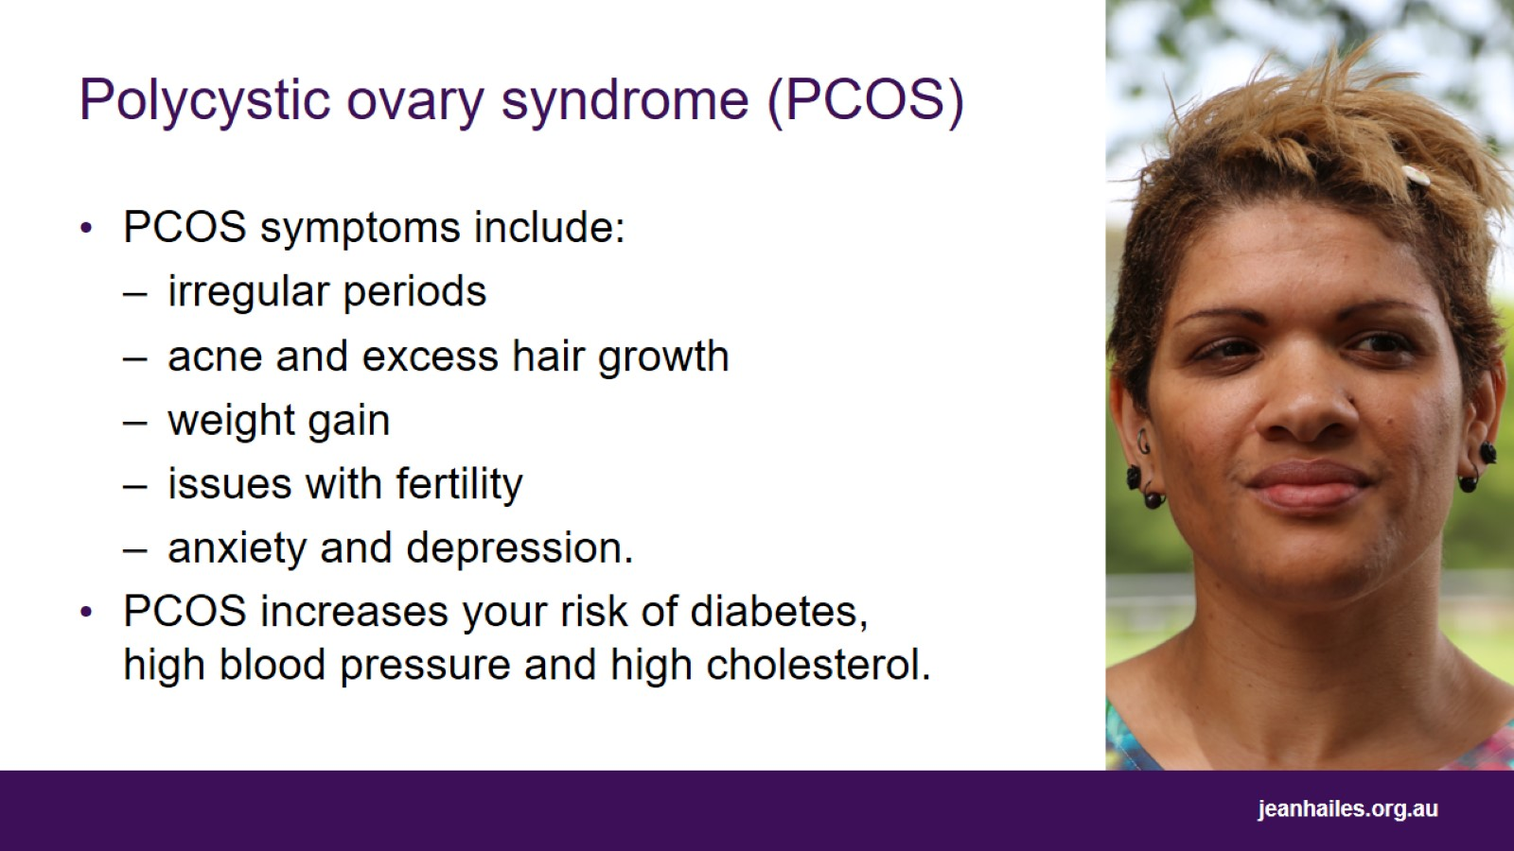
Polycystic ovary syndrome (PCOS)
Notes:
Polycystic ovary syndrome affects 1 in 10 women of reproductive age.
PCOS is a hormonal condition in which two hormones, insulin (hormone that controls sugars in blood) and androgens (male-type hormones such as testosterone), are produced at higher-than-normal levels.
Symptoms of PCOS include:
irregular or absent periods
excess hair growth on face and body
acne
easy weight gain
issues with fertility
anxiety and depression.
Women with PCOS have an increased risk of gestational diabetes, type 2 diabetes, high blood pressure and high cholesterol.

Slide 14
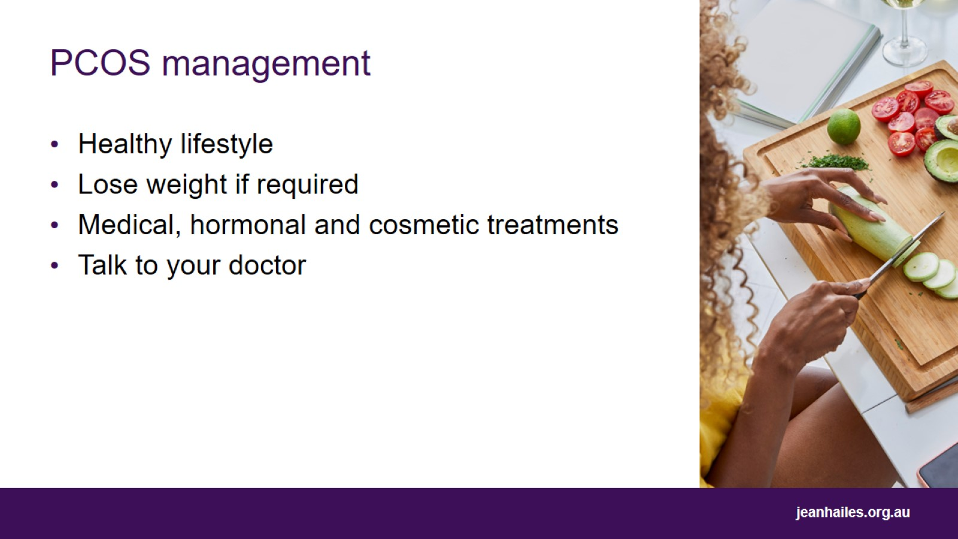
PCOS management
Notes:
A healthy lifestyle is the most effective way to improve PCOS symptoms.
This includes eating a balanced and nutritious diet, maintaining a healthy weight, being as active as possible, not smoking, and avoiding excessive drinking.
If you are overweight, losing 5–10% of your body weight can improve your PCOS symptoms.
Medical, hormonal or cosmetic treatments may also be used, depending on which symptoms trouble you the most.
While most women with PCOS will be able to have children, it may take them longer and many will need fertility assistance.
A range of health professionals may be involved in helping you manage PCOS. These include:
GP
dietitian
exercise physiologist
psychologist
endocrinologist
fertility specialist.
Talk to your doctor if you think you might have PCOS.

Slide 15
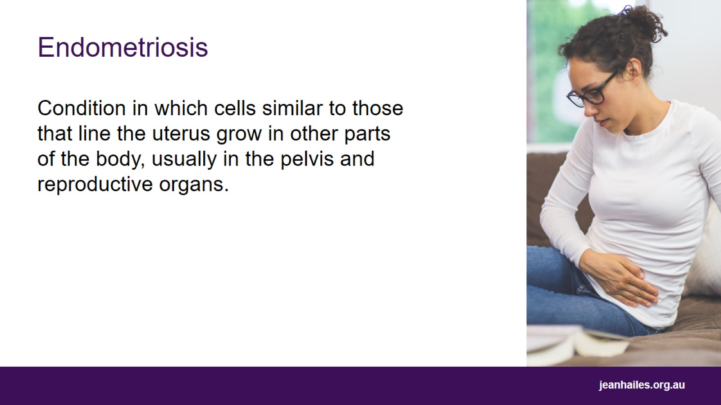
Endometriosis
Notes:
Endometriosis, or ‘endo’, is a condition that occurs when cells similar to those that line the uterus grow in other parts of the body, usually in the pelvis and reproductive organs.
When these cells grow outside the uterus, they form lesions or patches that bleed and leak fluid in response to your hormones at the time of your period. This leads to inflammation and scarring.
Endometriosis is common and affects around 1 in 10 women of reproductive age.
Despite this, it takes 7–10 years, on average, for a woman to be diagnosed with endometriosis.

Slide 16
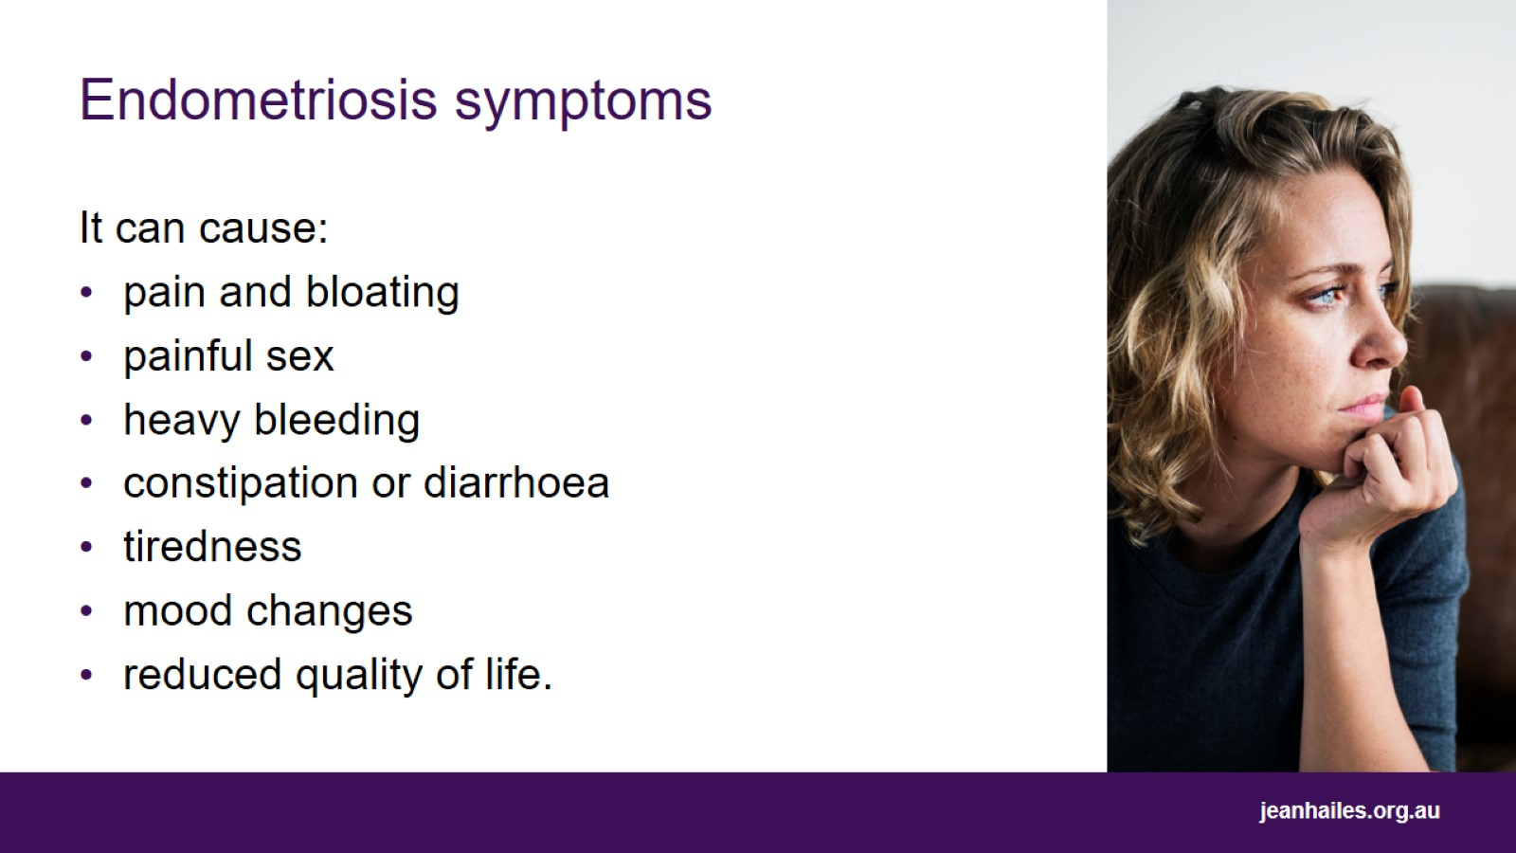
Endometriosis symptoms
Notes:
Endometriosis can cause many signs and symptoms, which may be different from person to person.
Some women have many symptoms, while some women have none at all.
Symptoms may include:
pain and bloating
painful sex
heavy bleeding
constipation or diarrhoea
tiredness
mood changes
reduced quality of life.

Slide 17
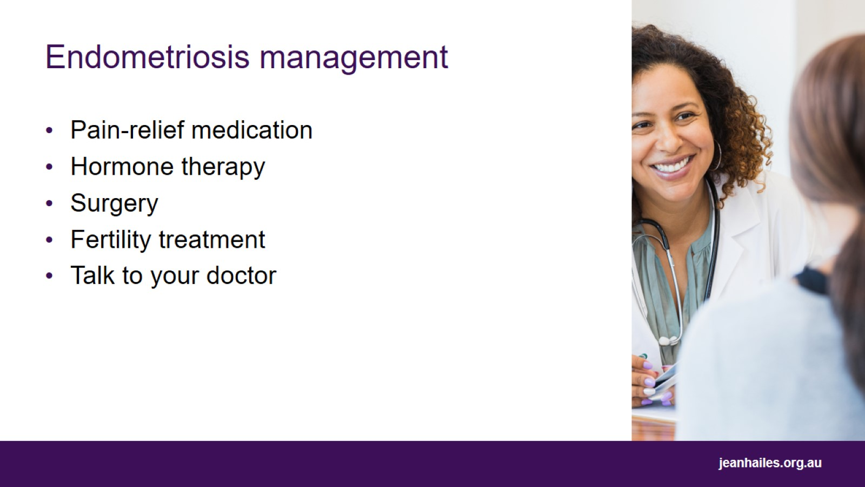
Endometriosis management
Notes:
There is no cure for endometriosis.
Management depends on your symptoms and treatment goals, but may include:
pain-relief medication to help manage pain associated with endometriosis
hormone therapy, such as the contraceptive pill, to help manage pain and slow the growth of endometriosis
surgery to remove endometriosis patches
fertility treatment if you want to get pregnant but are having trouble doing so.
There is no direct evidence that a healthy lifestyle reduces the severity of endometriosis symptoms, but getting enough sleep, regular exercise and relaxation are all important for general health and wellbeing.
More research is required to understand whether complementary therapies such as yoga or acupuncture help in managing pain associated with endometriosis.
Talk to your doctor if you have painful periods that impact your quality of life.

Slide 18
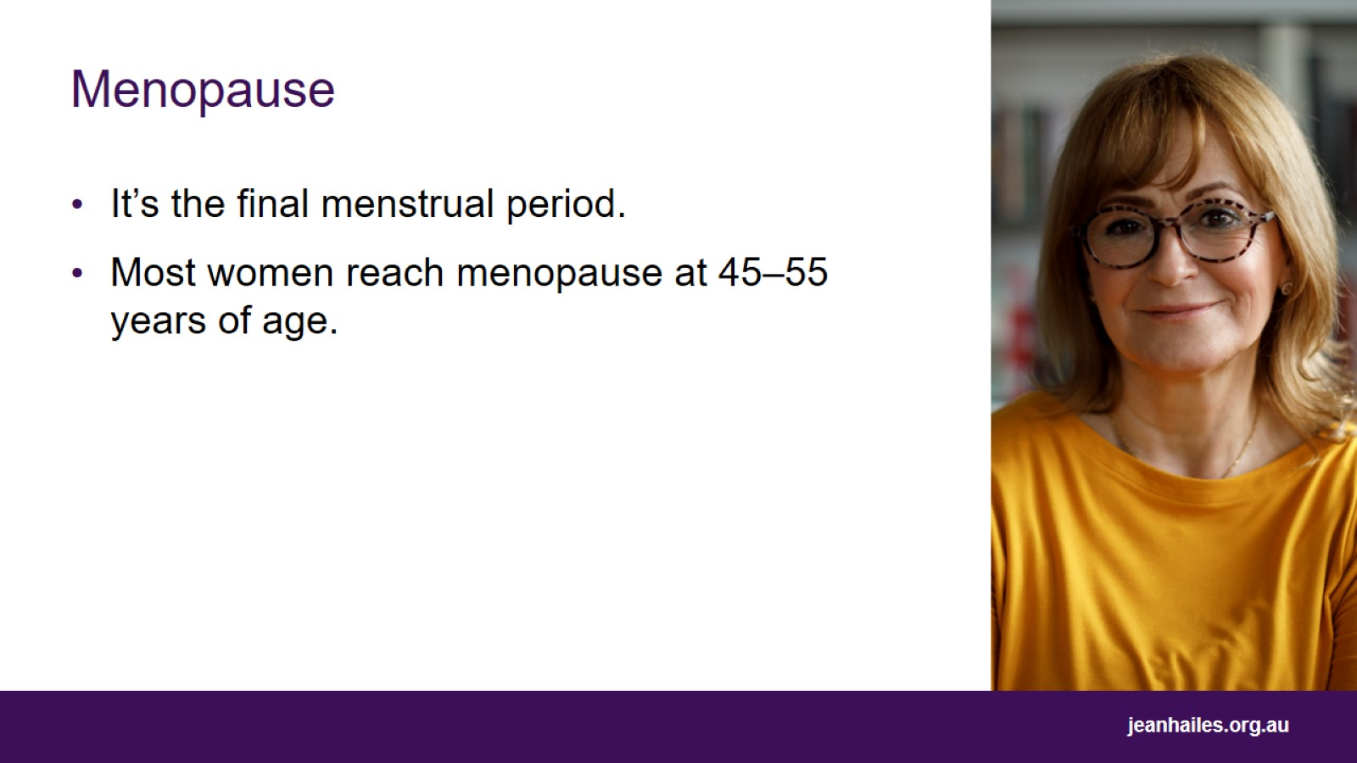
Menopause
Notes:
Menopause is the final menstrual period when ovaries have run out of eggs.
It may occur naturally, or some women may have an induced menopause as a result of chemotherapy, radiotherapy or surgical removal of ovaries.
Most women reach menopause between 45–55 years of age and the average age for women in Australia is 51 years.

Slide 19
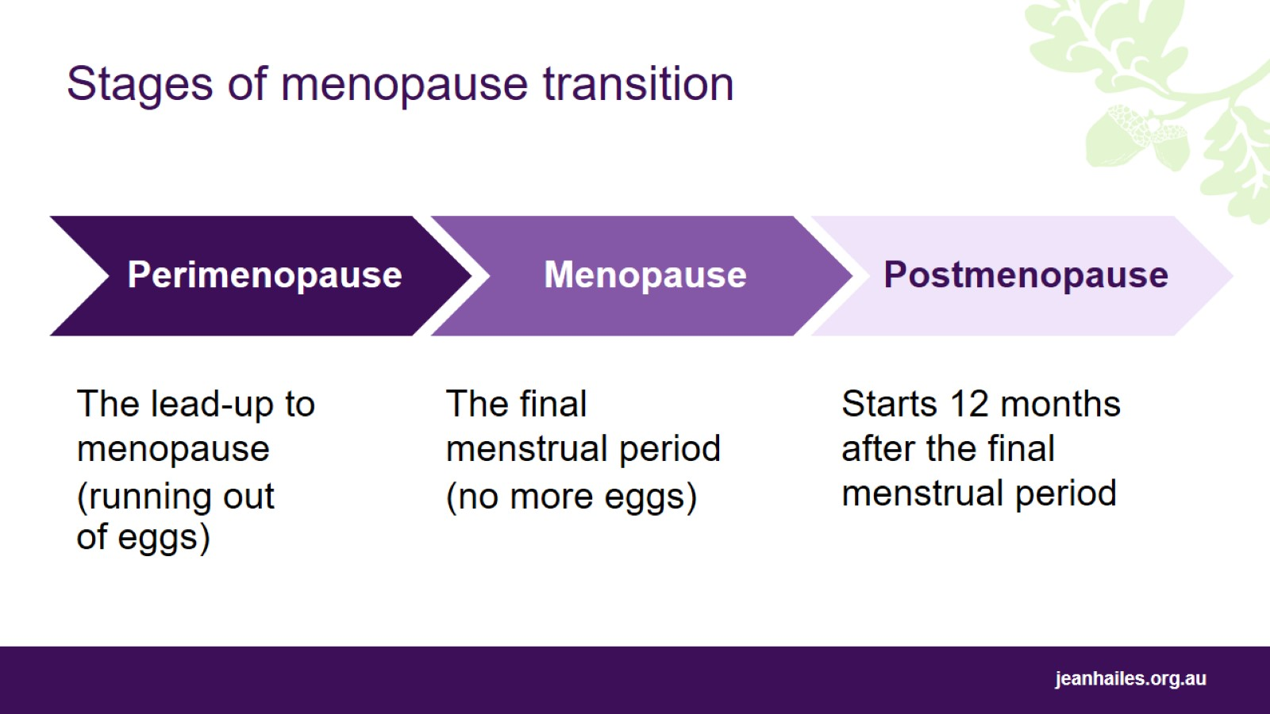
Stages of menopause transition
Notes:
Stages of the menopause transition:
perimenopause – the lead-up to menopause. Perimenopause is often described as a time of ‘hormonal chaos’
menopause – the final menstrual period
postmenopause – starts 12 months after the final menstrual period.
During perimenopause:
hormone levels can change rapidly, swinging up and down. This causes many common menopausal symptoms such as hot flushes and night sweats
periods start to change and become irregular and may be lighter or heavier than usual
ovulation (the release of an egg) may occur twice in a cycle, or not at all, so contraception is still important if you are not planning to become pregnant.
As hormones change around the time of menopause, you may begin to experience physical and emotional symptoms. For example:
physical symptoms may include hot flushes, night sweats, dry vagina, migraines, aches and pains, trouble sleeping, bladder problems, problems with weight, or itchy skin.
emotional symptoms may include feeling anxious or irritable, mood swings, trouble concentrating, or lowered libido (less interest in sex).
If menopause is a result of surgery or chemotherapy treatment, the symptoms might be more severe.
There is no definitive test to diagnose perimenopause or menopause-the best way to predict approaching menopause is to use the symptoms you have as a guide to whether you are close to menopause.

Slide 20
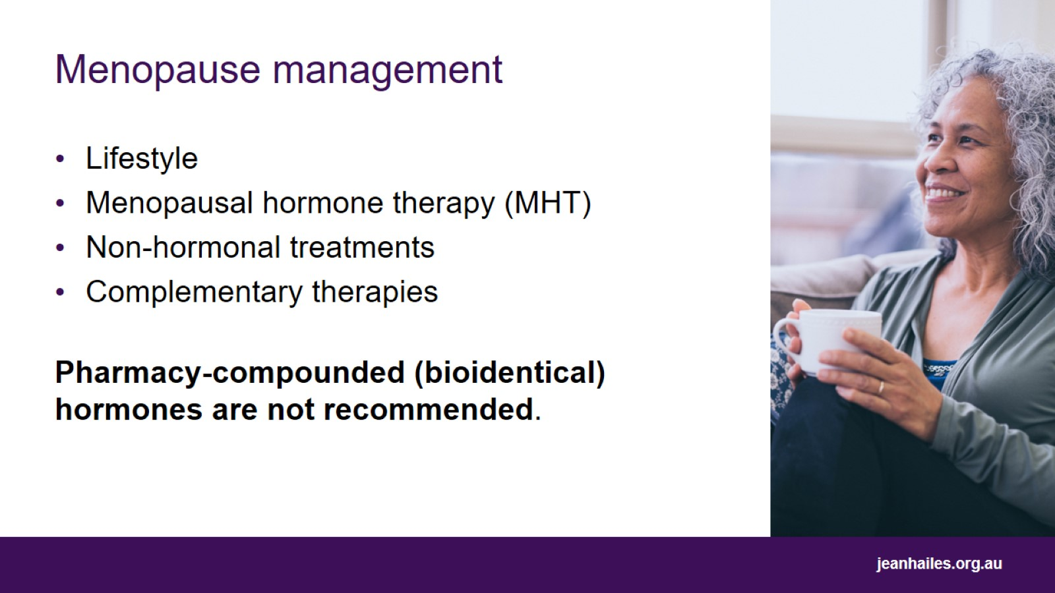
Menopause management
Notes:
Management and treatment of menopausal symptoms depend on each individual woman's experience.
Many women cope with mild menopausal symptoms and don't need to use any medication or therapies.
Some women manage their symptoms well with lifestyle measures such as eating well and getting regular physical activity.
Some women with symptoms that are affecting their quality of life will need to seek treatment to help them manage them.
Menopausal hormone therapy (MHT, formerly known as ‘hormone replacement therapy’, or HRT), non-hormonal options, treatment for vaginal dryness and complementary therapies are available to women as management options.
Pharmacy-compounded (bioidentical) hormones, also called ‘bioidentical hormones’, are not recommended as there’s no evidence to support their safety or effectiveness.
A third or even half of your life will happen after menopause, so it’s very important that you maintain good health during and after menopause. Stay healthy to help prevent:
cardiovascular disease
osteoporosis
central weight gain
type 2 diabetes.

Slide 21
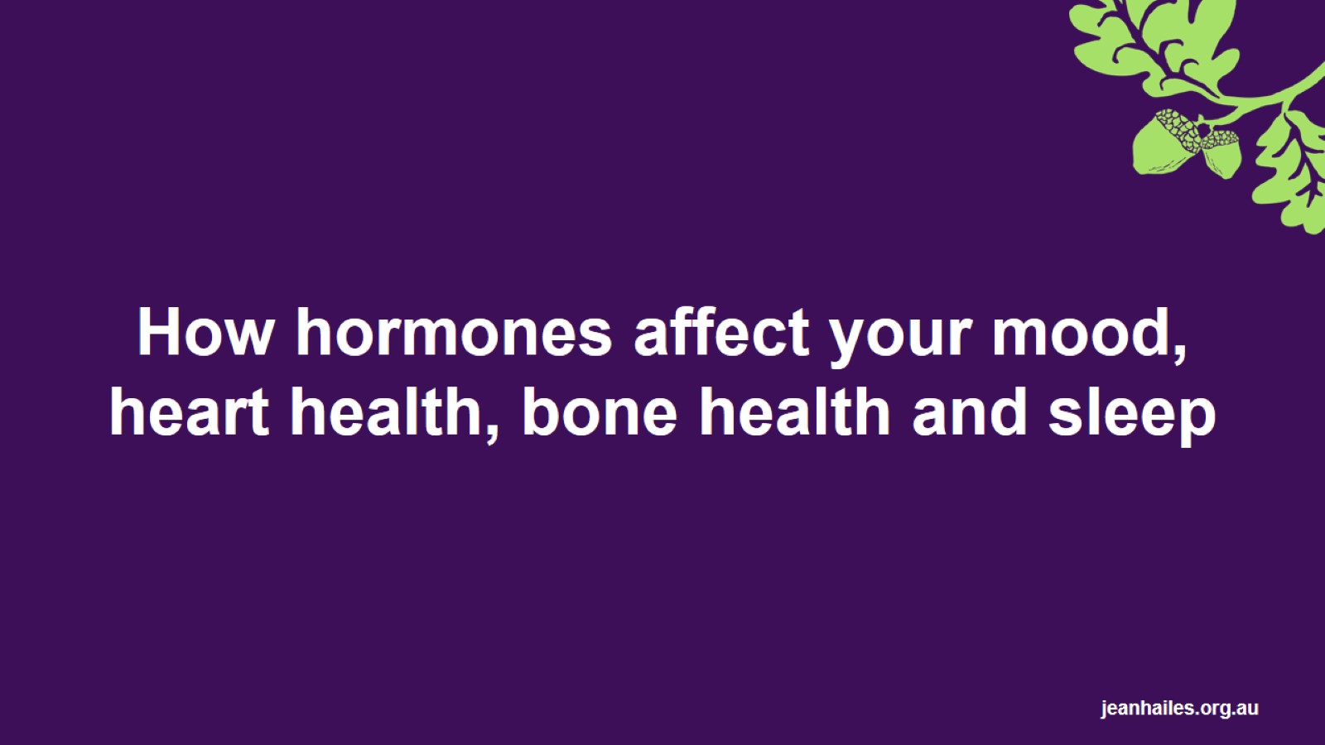
How hormones affect your mood, heart health, bone health and sleep
Notes:
The next slides will talk about how hormones affect your mood, heart health, bone health and sleep.

Slide 22
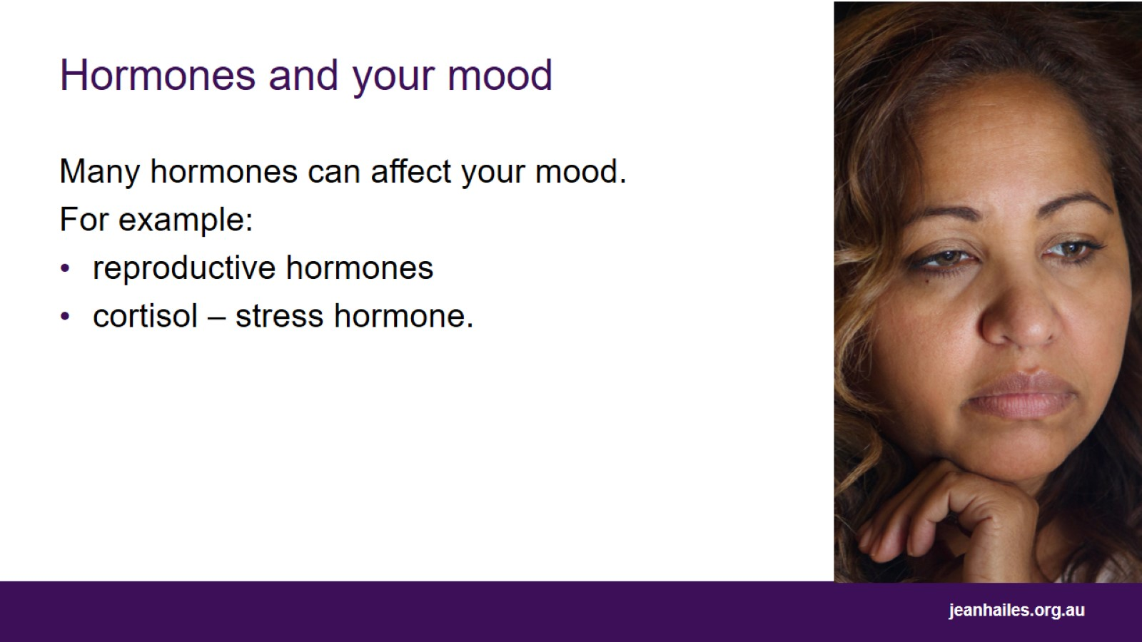
Hormones and your mood
Notes:
Many hormones can affect your mood, including reproductive hormones and cortisol. For example:
changing levels of hormones after childbirth can lead to mood changes including postnatal depression
changing levels of reproductive hormones during perimenopause means that women are at increased risk of developing depression and anxiety during this time.
Cortisol has many functions throughout the body, including helping your body respond to stress. However, if cortisol levels are high for extended periods, this can have a serious impact on your mental health. Cortisol levels might be high for extended periods due to chronic stress, trauma or experiences of violence.

Slide 23
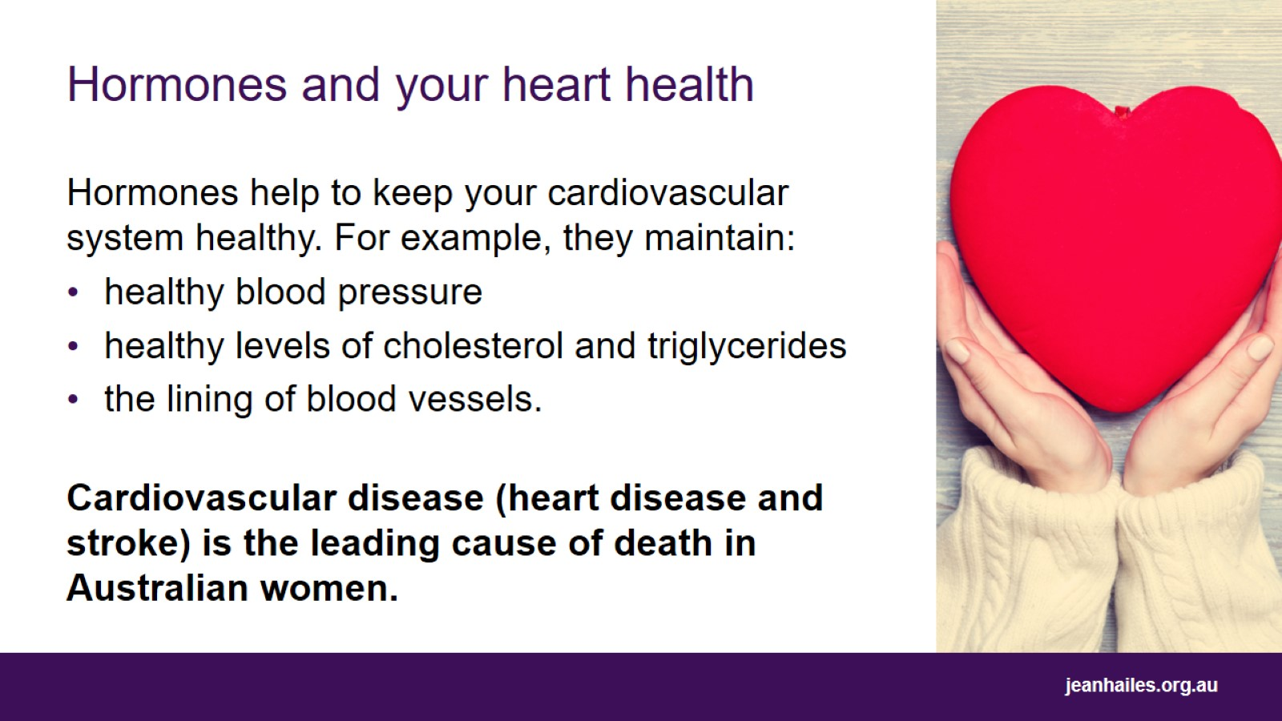
Hormones and your heart health
Notes:
The cardiovascular system is responsible for transporting oxygen, nutrients and hormones throughout the body. It is made up of your heart, blood and blood vessels.
Hormones help to keep your cardiovascular system healthy.
They help to maintain blood vessels and blood pressure, and healthy levels of cholesterol and triglycerides.
Cardiovascular disease (heart disease and stroke) is the leading cause of death in Australian women.

Slide 24
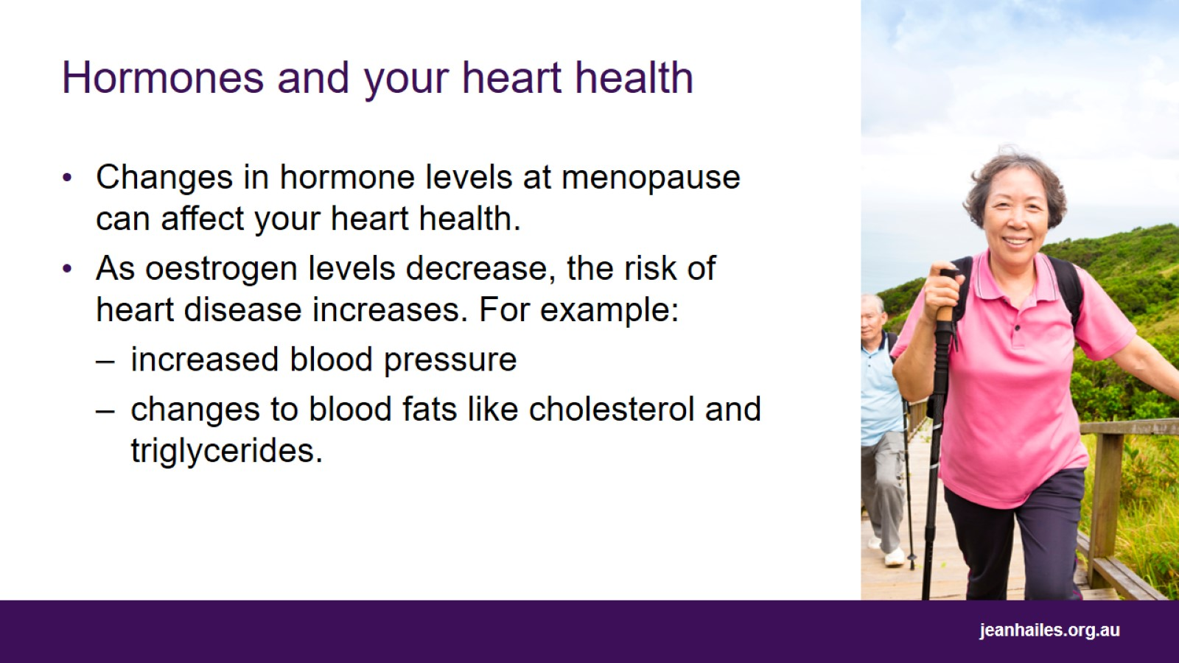
Hormones and your heart health
Notes:
Before menopause, women have a lower risk of heart disease than men.
After menopause the risk of heart disease increases due to loss of oestrogen.
This fall in estrogen at menopause causes a change in body shape with increases in fat around the tummy, and increases in blood fats like cholesterol and triglycerides, and blood pressure.
This contributes to an increased risk of heart disease and stroke.

Slide 25
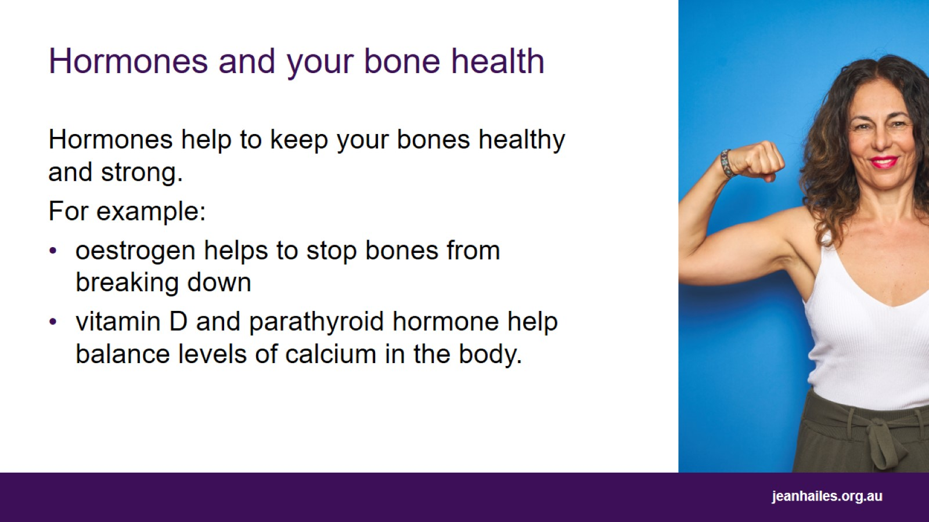
Hormones and your bone health
Notes:
Bone is a living tissue, constantly breaking down and being replaced.
Oestrogen and parathyroid hormone, along with vitamin D, are very important for your bone health.
Oestrogen helps stop the bone from breaking down. Vitamin D and parathyroid hormone regulate the ideal amount of calcium in the body to build bone.
Our childhood and teenage years are the most important time for developing bones, and we reach peak bone mass in our early 20s.
During our 30s and 40s more bone is lost than made.
At menopause, the dramatic fall in oestrogen further speeds up bone loss.
Good bone health means getting an initial strong bone mass in adolescence, keeping strong building blocks for bone such as calcium and protein in the body and minimising bone loss from the 30s onwards.

Slide 26
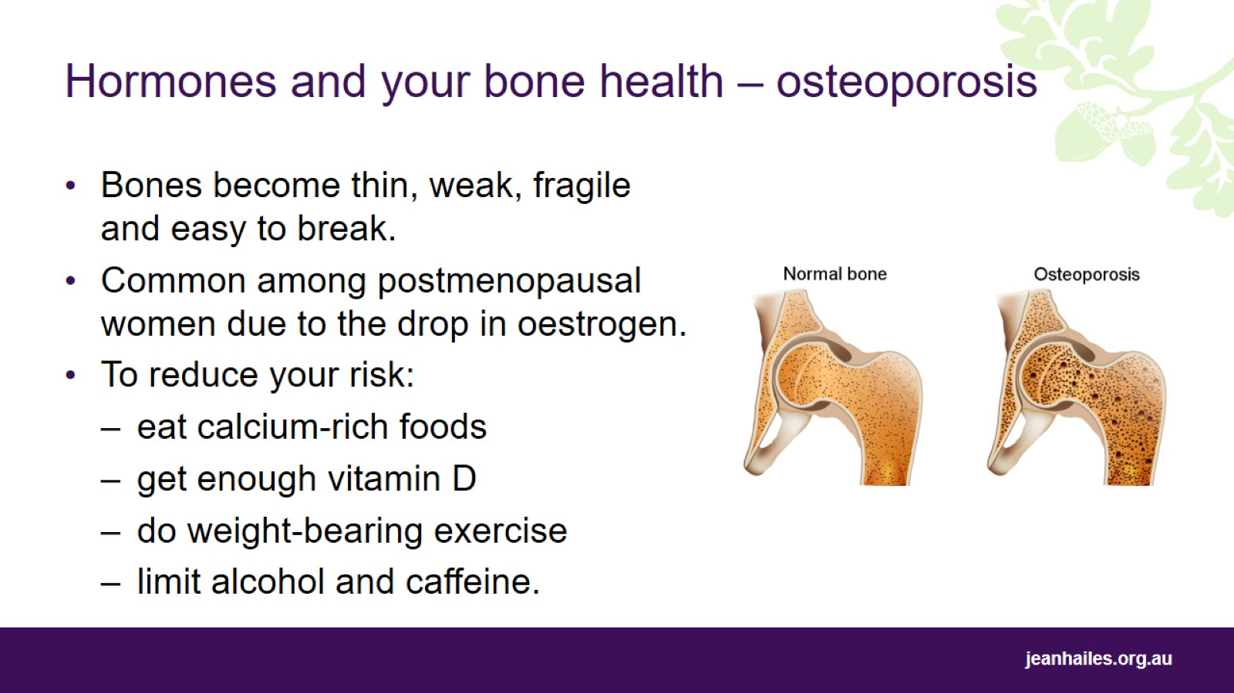
Hormones and your bone health – osteoporosis
Notes:
Osteoporosis is a condition in which bones become thin, weak, fragile and easily broken. The image on the slide shows a healthy bone (left) and a bone with osteoporosis (right).
Brittle bones are more prone to breaks, particularly from a minor injury or fall.
Breaking a bone is painful and requires recovery time, disrupts normal living and affects your level of independence and mobility.
Osteoporosis is particularly common among postmenopausal women, due to the drop in oestrogen at menopause.
Other risk factors include:
family history of fractures
smoking
excess alcohol consumption
not enough calcium and vitamin D
lack of weight-bearing exercise
long-term use of certain drugs such as steroids and thyroid and cancer medication.
To reduce your risk:
get the building blocks: eating calcium-rich foods for bones, and protein for healthy muscles
vitamin D: safe sun exposure every day or take supplements
physical activity: weight-bearing, strength training, balance
limit alcohol and caffeine intake.

Slide 27
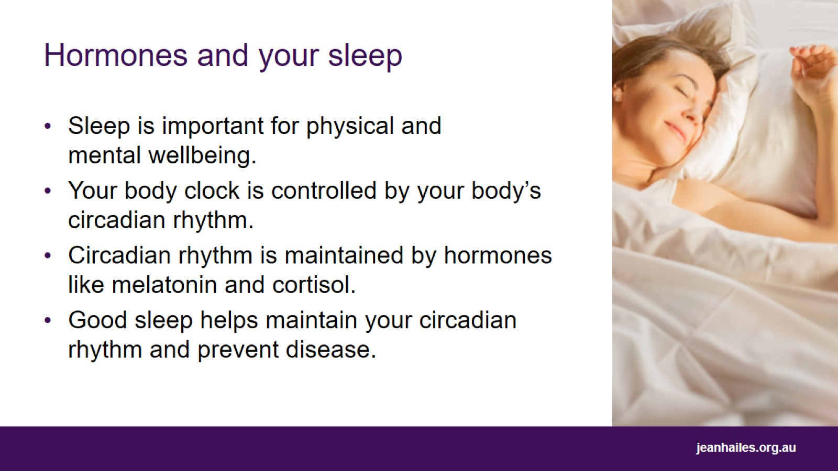
Hormones and your sleep
Notes:
Consistent, high-quality sleep is important for physical and mental wellbeing.
Your body clock tells you when to go to sleep and wake up and is controlled by your body’s circadian rhythm.
Circadian rhythms are physical, mental and behavioural changes that happen in a 24-hour cycle. They influence processes such as sleep, thinking, energy levels and metabolism.
Circadian rhythms are essential for maintaining a healthy hormonal balance and, in turn, are maintained by a number of hormones.
An example of disruption to your circadian rhythm is jet lag.
Regular sleep means between 7 and 9 hours, with a similar sleep and wake time every day, including on weekends.

Slide 28
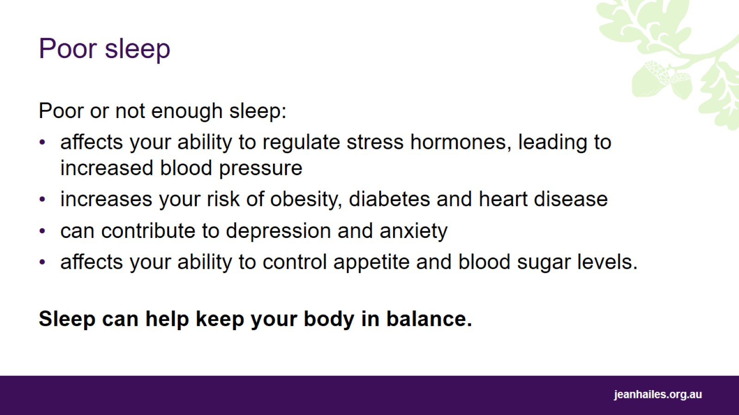
Poor sleep
Notes:
Poor sleep and lowered energy levels are common among women, especially when oestrogen levels are low, such as before and during a period, during breastfeeding and postmenopause.
Poor or not enough sleep affects the body’s ability to regulate stress hormones, appetite and blood sugar levels.
It can lead to increased blood pressure and increased risk of obesity, diabetes, heart disease, depression and anxiety.

Slide 29
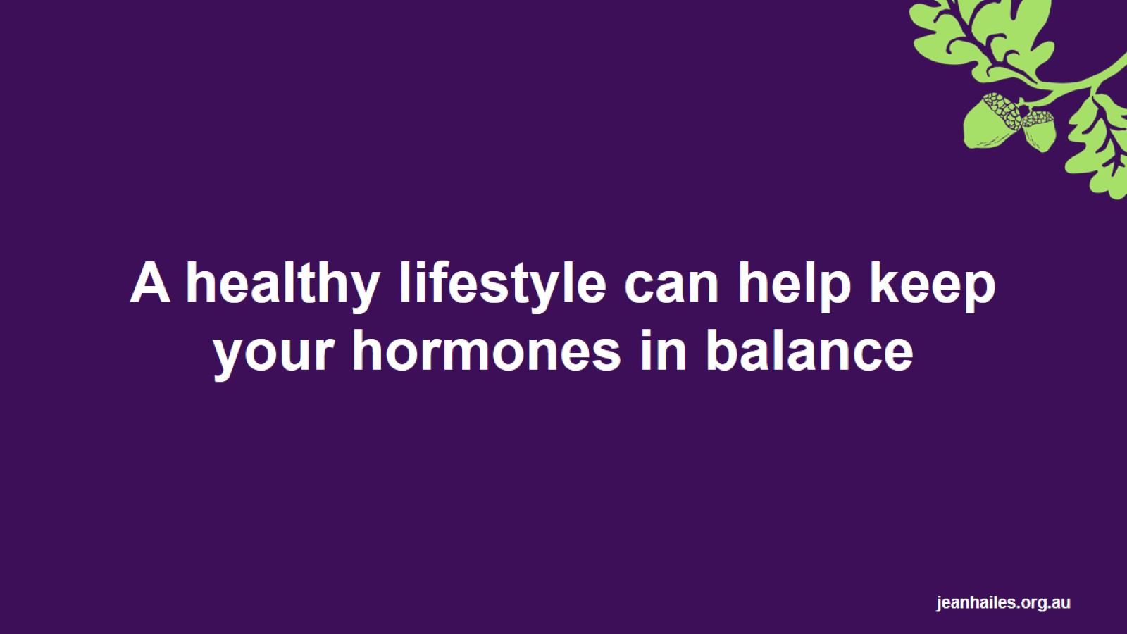
A healthy lifestyle can help keep your hormones in balance
Notes:
A healthy lifestyle is important for general health and wellbeing, as well as helping to keep your hormones in balance and working properly. The next slides will talk about some ways you can live a healthy life. These are:
eat well
move more
sleep better
see your doctor for a check-up.

Slide 30
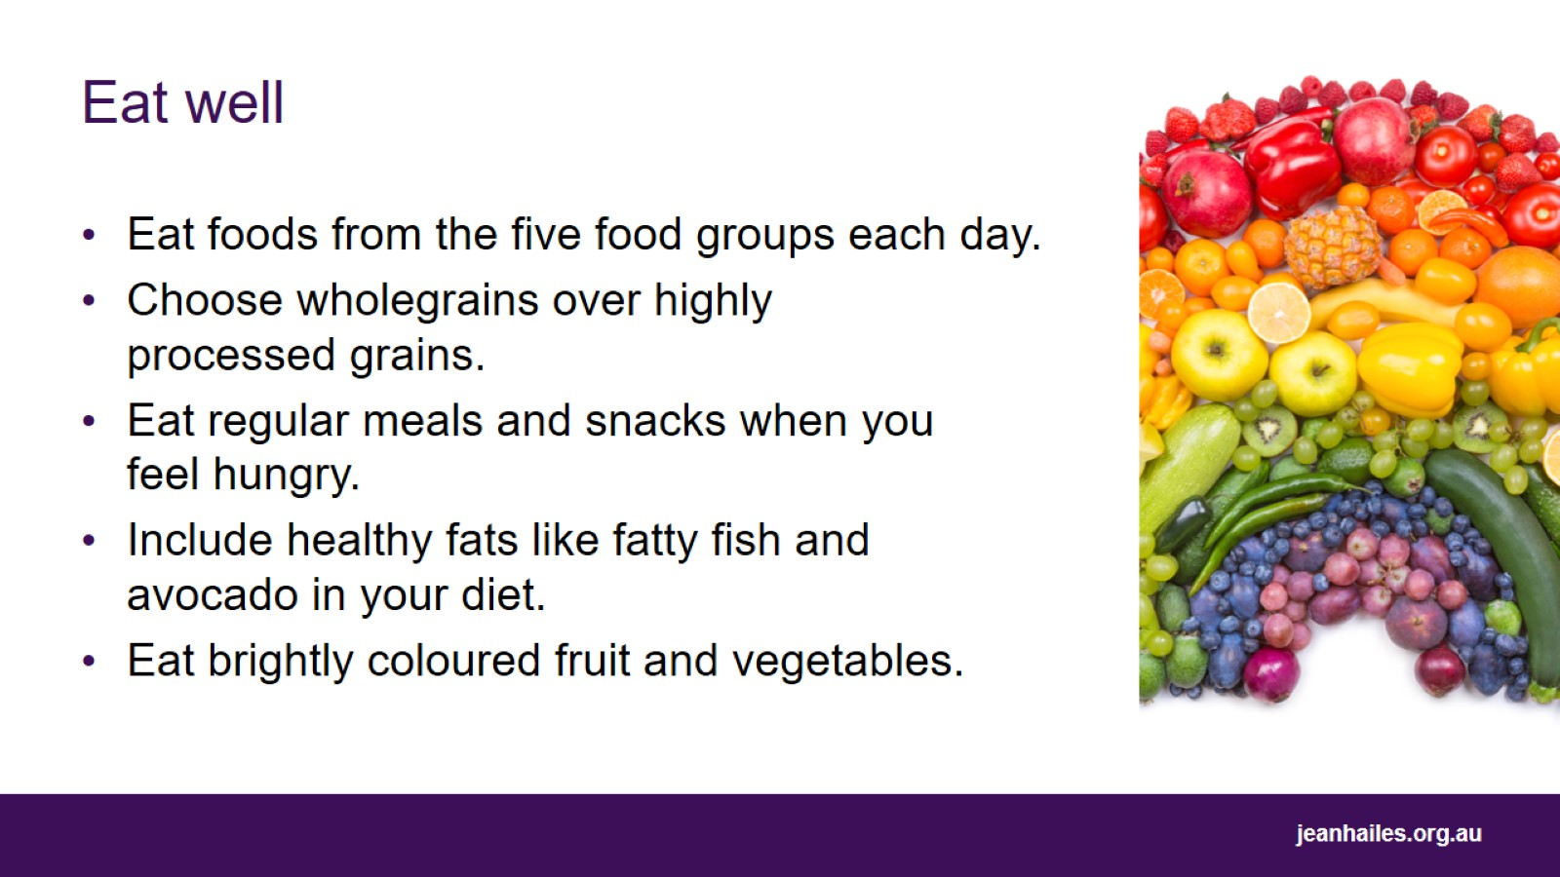
Eat well
Notes:
Choosing healthy and nutritious foods is one way you can lower your risk of developing many chronic health problems such as diabetes, heart disease and obesity. Here are some tips for eating a balanced and nutritious diet.
Eat foods from the 5 food groups each day. The five food groups are:
grain (cereal) foods
vegetables and legumes/beans
fruit
lean meats and poultry, fish, eggs, tofu, nuts and seeds
milk, yoghurt, cheese or alternatives.
Choose wholegrains over highly processed grains.
Eat regular meals and snacks when you feel hungry.
Healthy fats are important for maintaining good cholesterol and heart health, blood sugar control, managing inflammation and absorbing some vitamins. Some healthy fats to include in your diet include:
fatty fish like salmon, sardines and tuna
nuts and seeds
avocado and
extra virgin olive oil.
Eat a variety of brightly coloured fruit and vegetables. Different-coloured plant foods have different nutrients and health benefits. So eating a wide variety of colours will help you get different nutrients and could benefit different areas of your health.
Drink 6–8 glasses of water each day and avoid high-sugar drinks such as soft drink, cordial and energy drinks.
Be mindful of what you eat, as well as portion sizes.

Slide 31
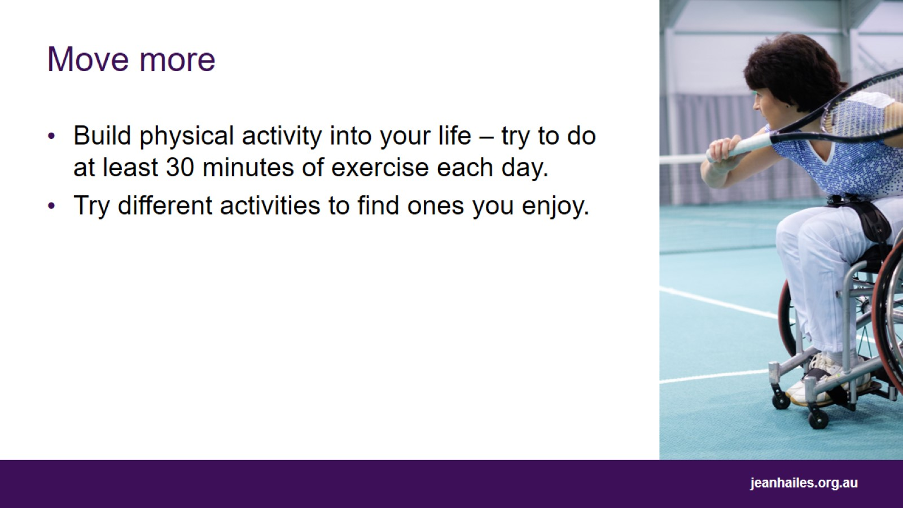
Move more
Notes:
Physical activity can help to balance your hormones.
Build physical activity into your life-try to do at least 30 minutes of exercise each day.
Try out different activities to find ones you enjoy.
Weight-bearing activities like dancing, skipping, strength training or using weights are especially important after menopause.
If you have a medical condition, are overweight, are pregnant, are over 40 years of age or have not exercised regularly for a long time, see a health professional for medical advice before increasing your activity.

Slide 32
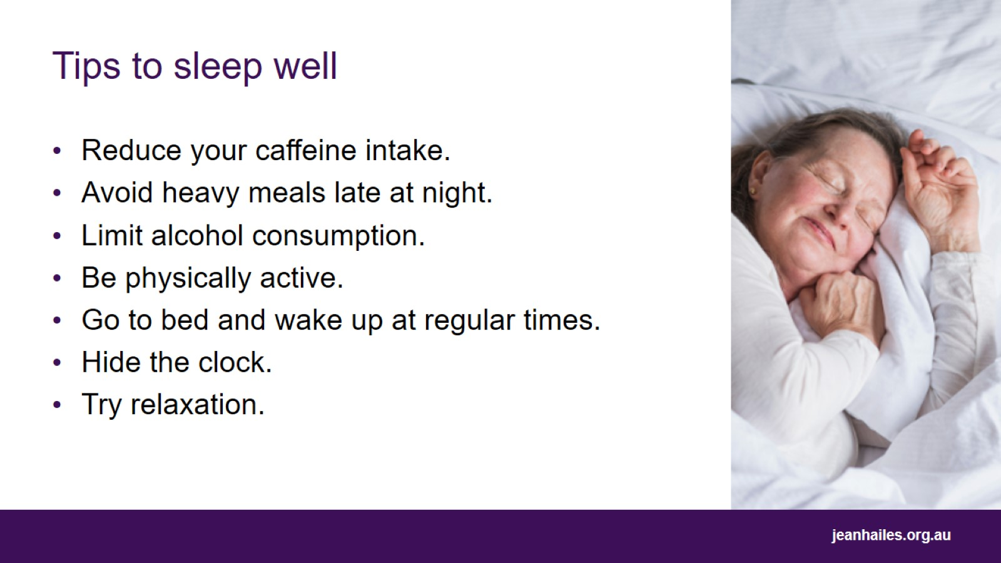
Tips to sleep well
Notes:
There are things you can do to help you have regular, high-quality sleep. Some of these are:
cut down on caffeinated beverages, especially later in the day - caffeinated beverages include tea, green tea, coffee, cola and energy drinks
avoid eating heavy meals late at night
limit the amount of alcohol you drink
be physically active, but avoid exercising in the four hours before bedtime
try to go to bed and wake up at the same time each day, even on weekends
if you have a clock in your bedroom, put it somewhere where you cannot see it
try relaxation strategies before bedtime.
Talk to your doctor if you still have trouble sleeping.

Slide 33
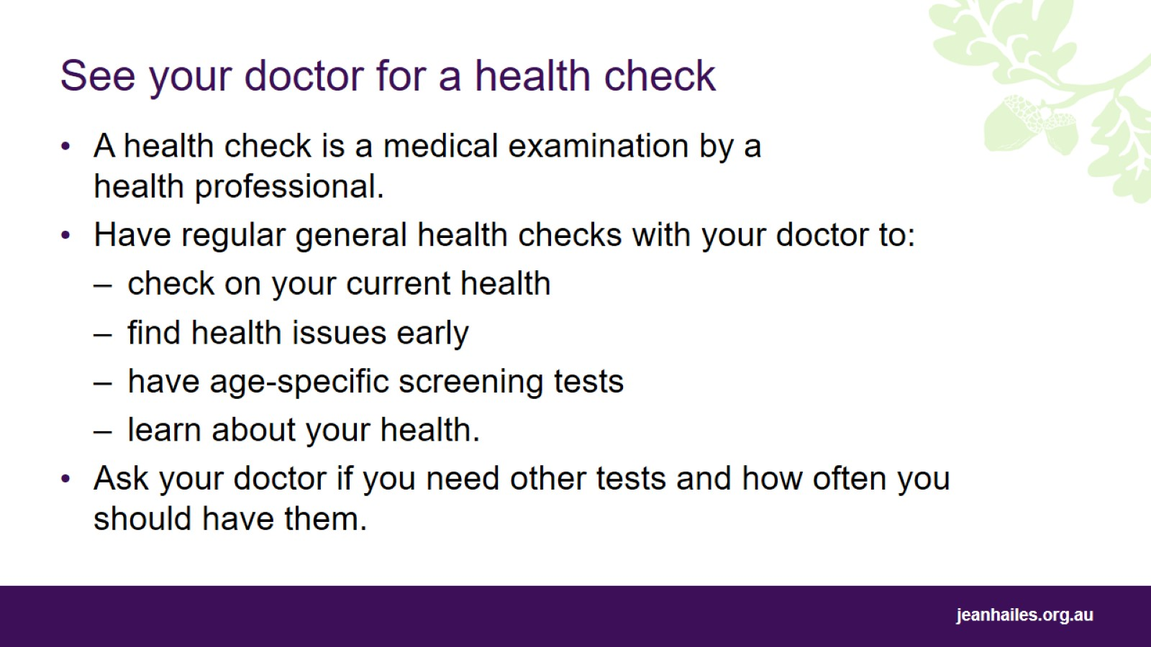
See your doctor for a health check
Notes:
A health check is a medical examination by a health professional to look for health issues.
Have regular general health checks with your doctor.
A health check will involve checking your current health, talking to your doctor about your medical history and your family history of disease, and discussing your lifestyle such as diet, exercise habits and whether or not you smoke or drink alcohol.
Regular health checks will help find health issues or signs of an illness early. Many diseases such as cardiovascular (heart) disease, diabetes and some cancers can be picked up in their early stages when treatment is often more effective.
Depending on your age, the doctor may also do or recommend specific screening tests.
It’s a good opportunity to ask questions and gain information from your doctor.
Some women may need more frequent health checks compared to others depending on their age, risks of certain conditions, medical background and family history. Talk to your doctor about what tests you need to maintain your health and how often you should have them.

Slide 34
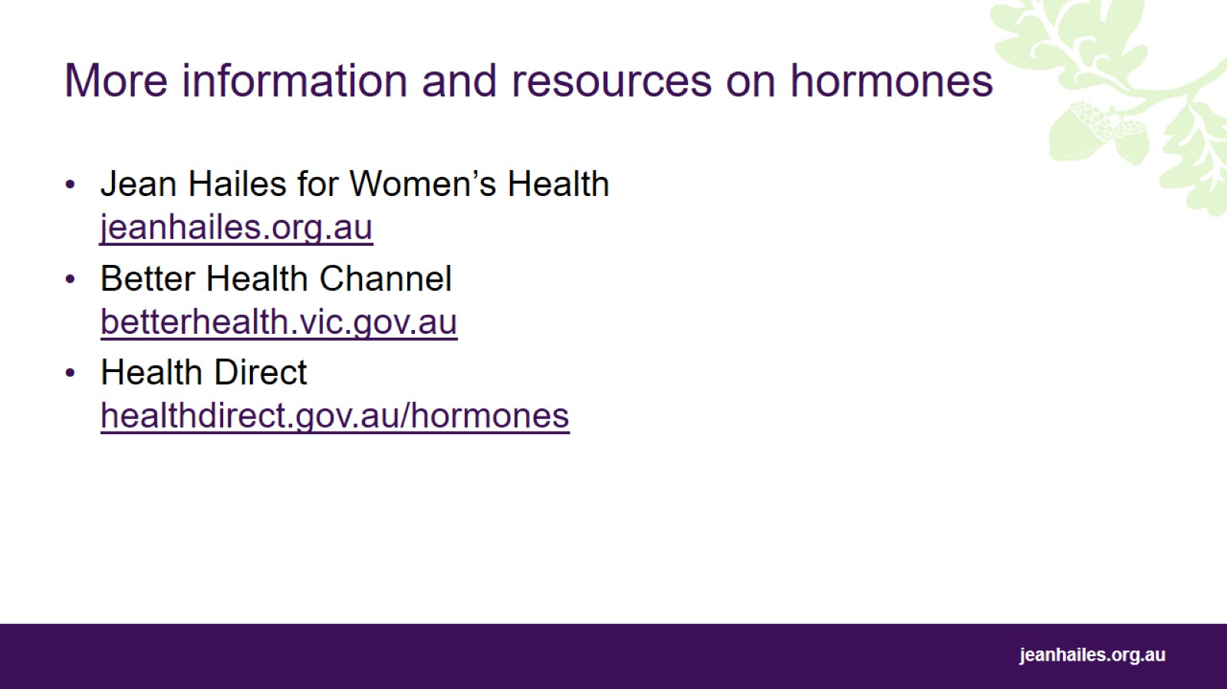
More information and resources on hormones

Slide 35
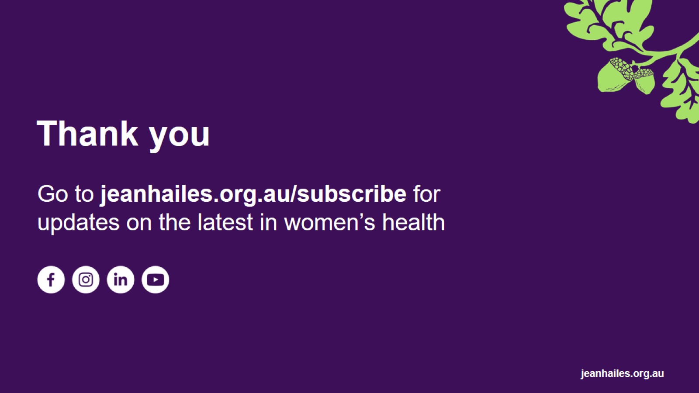
Thank you

Slide 36
