Slide 1

Anxiety
Notes:
Insert a text box to add presenter name and position title.

Slide 2
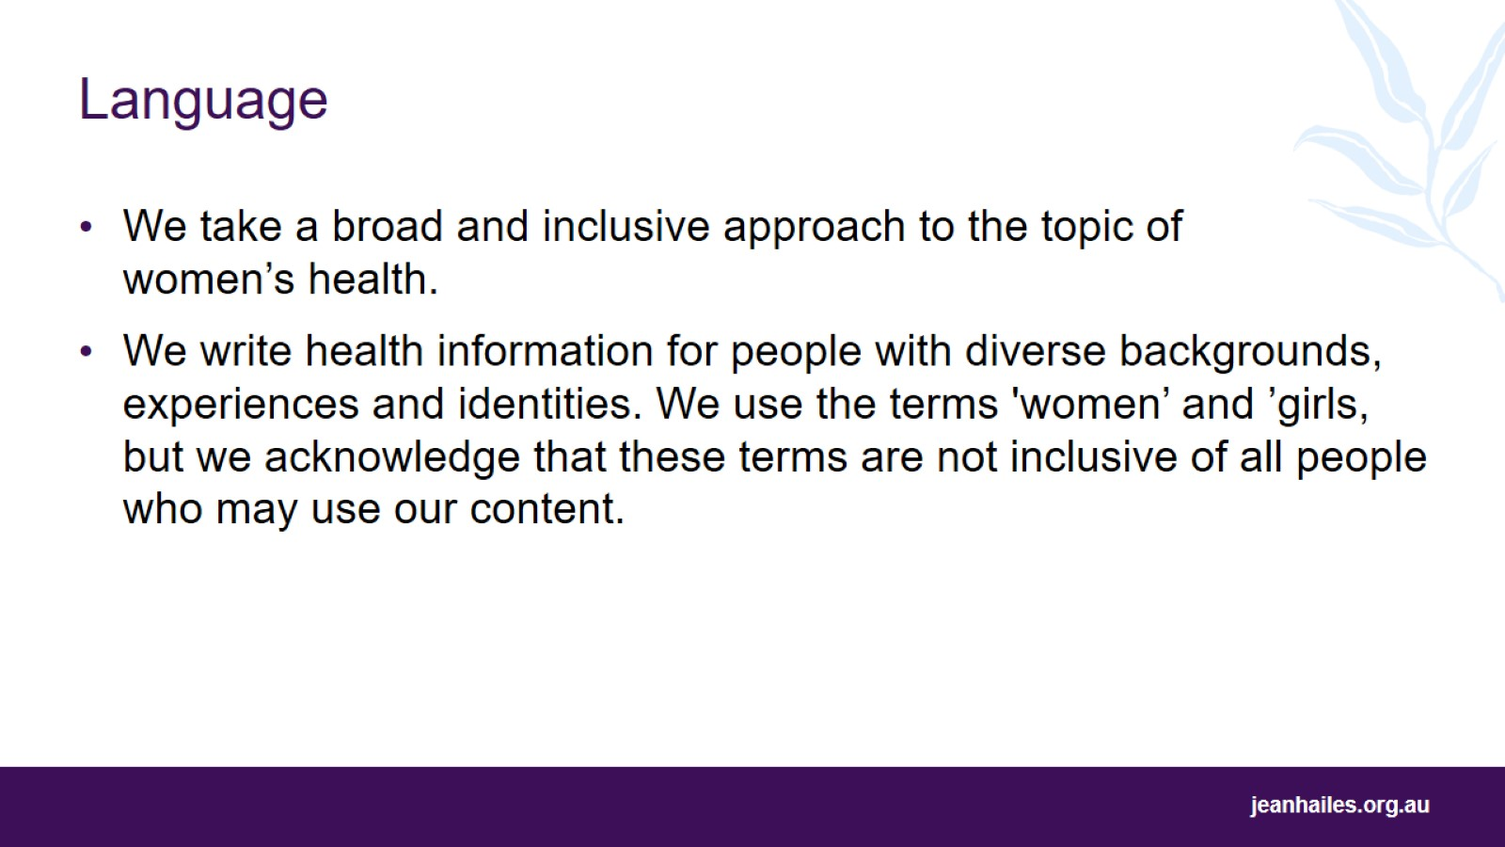
Language

Slide 3
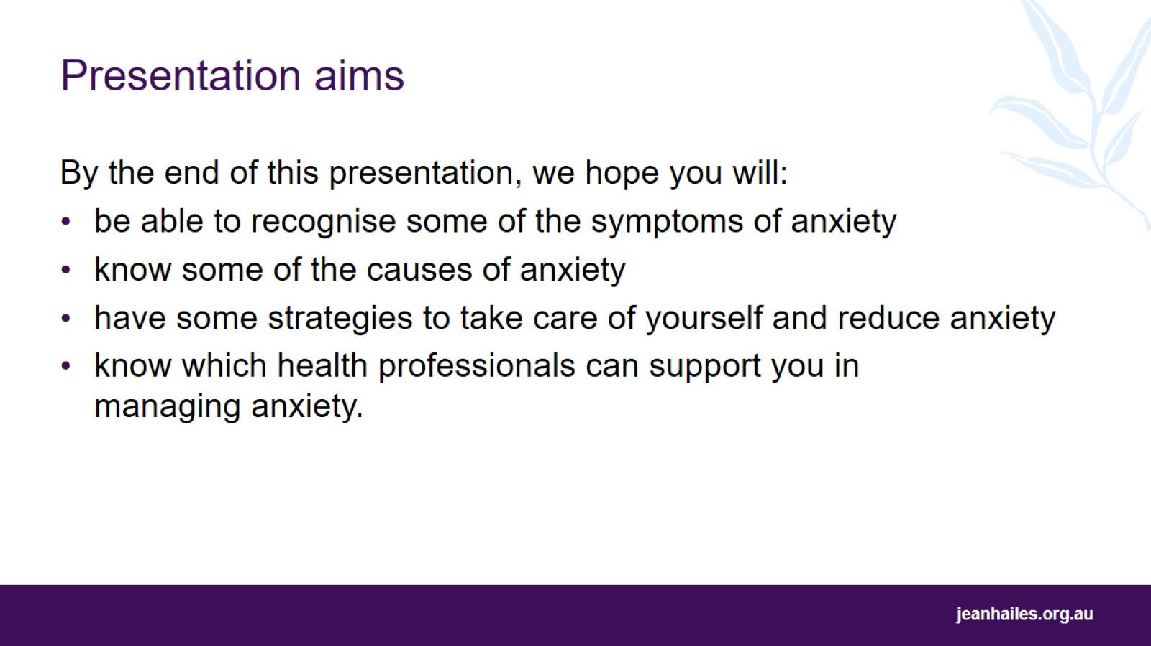
Presentation aims
Notes:
Today we will be talking about anxiety.
By the end of this presentation, we hope you will have a better understanding of:
what anxiety is, and what it feels like
the different symptoms and causes
how to take care of yourself to reduce anxiety
how to get help from health professionals to support you in managing anxiety.

Slide 4
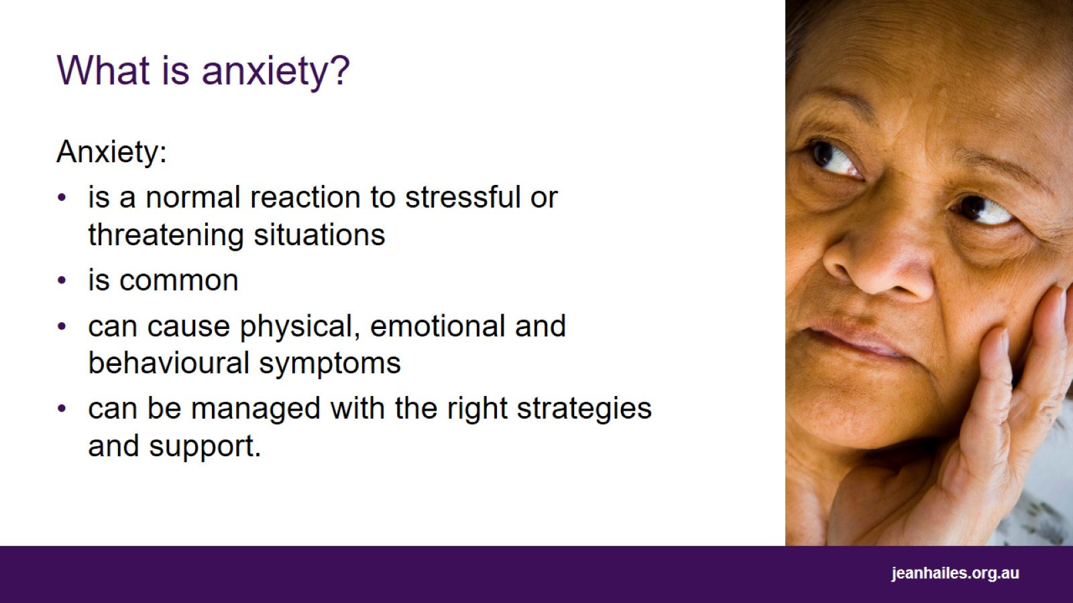
What is anxiety?
Notes:
What is anxiety?
Anxiety is an uncomfortable emotion you can feel when you are stressed, worried, or scared. You might feel it in response to situations that seem threatening, for example, going for a job interview.
Anxiety is common and some level of anxiety can be helpful by keeping you alert. It can help you react better to certain situations.
Anxiety causes a range of physical, mental and emotional, and behavioural symptoms.
It can be overwhelming, but with the right support it can be managed. You might need to ask friends, family, a doctor or other mental health professionals for help.

Slide 5
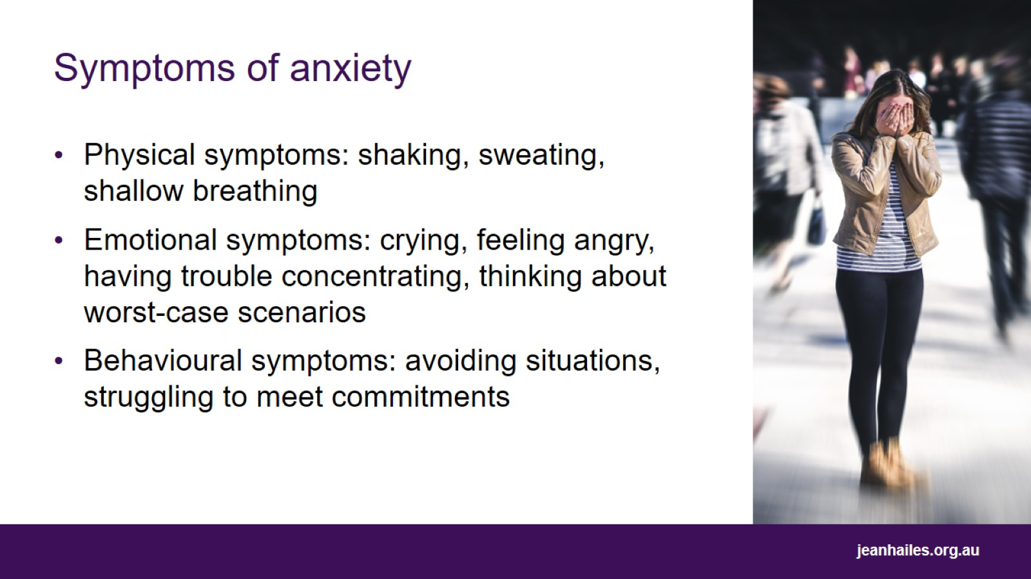
Symptoms of anxiety
Notes:
What does anxiety feel like?
Anxiety can make you feel a range of physical, mental and emotional, and behavioural symptoms. These can differ from person to person and can change throughout your life.
Anxiety can present in your body in different ways. Physical symptoms you might experience include shaking, sweating, dizziness, heart racing, feeling sick, stomach issues, faster breathing, a tight chest, or difficulty taking a deep breath.
Anxiety can present with mental and emotional symptoms. Some mental and emotional symptoms you might experience are crying, feeling angry, feeling restless, thinking about things you are fearful of, and thinking a lot about worst-case scenarios.
Sometimes anxiety can present itself with behavioural symptoms. You might avoid situations or social gatherings where you feel you could be embarrassed or judged. You might want to avoid going to certain places that might overwhelm you, such as shopping centres. You might struggle to meet commitments at work, school or home. You might also struggle to get to sleep or stay asleep or use alcohol or drugs to help manage anxiety.

Slide 6
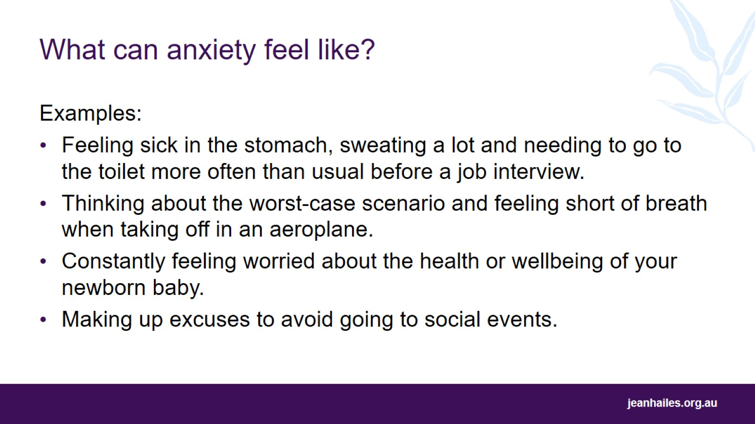
What can anxiety feel like?
Notes:
Anxiety can appear in different ways for different people, and at different times in life. For example, you might:
feel sick in the stomach, sweat a lot and need to go to the toilet more often than usual before a job interview
think about the worst-case scenario and feel short of breath when taking off in an aeroplane
constantly feel worried about the health of your newborn baby
make up excuses to avoid going to social events.

Slide 7
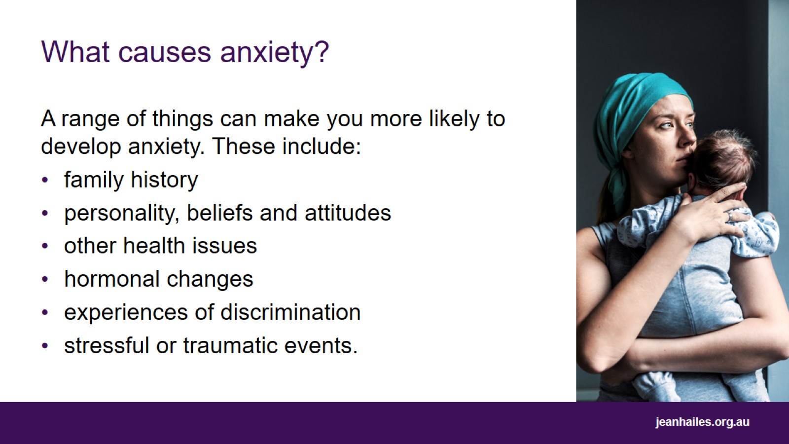
What causes anxiety?
Notes:
What causes anxiety?
There is no one known cause for anxiety. Usually, it is caused by a range of factors, which may be different from person to person.
Your family history, such as a close family member having anxiety, makes you more at risk of developing it.
Certain personality traits, beliefs and attitudes can make you more likely to develop anxiety. For example, suppose you are a perfectionist with low self-esteem or low self-confidence. In that case, you are more likely to develop or have anxiety.
Having other diagnosed mental health issues, such as depression or substance abuse, may cause an increased risk of developing anxiety. Health conditions such as polycystic ovary syndrome (PCOS) and endometriosis can also make you more likely to develop anxiety.
Experiences of racism, homophobia and other forms of discrimination can make you more at risk of developing anxiety.
Times of hormonal changes can cause anxiety, for example, after childbirth, during menopause, or before your menstrual period.
A stressful event or major life change can cause anxiety, for example, having children, moving home, changing jobs, family or relationship issues, financial problems, or the death of a loved one.

Slide 8
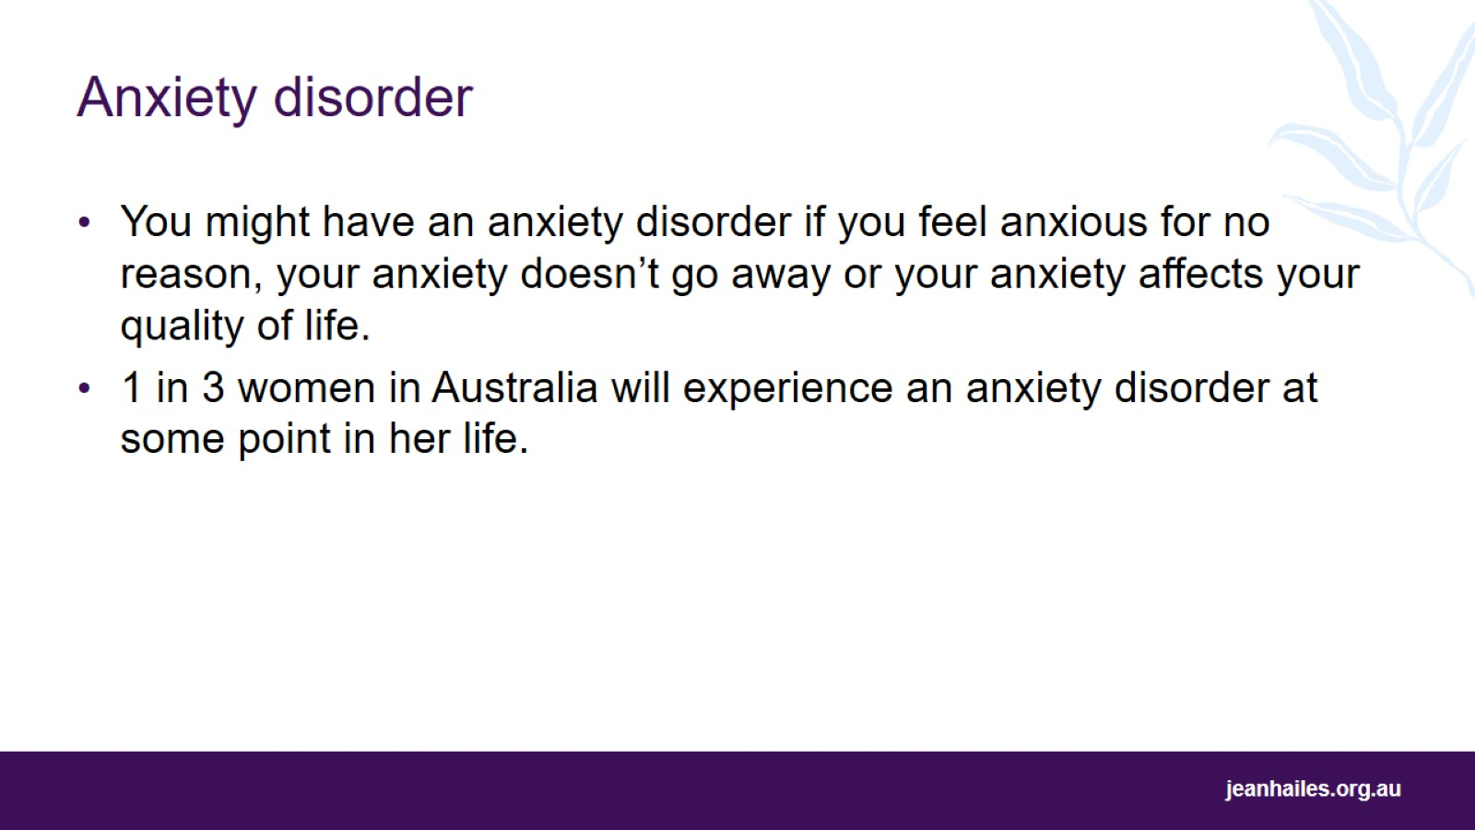
Anxiety disorder
Notes:
It is normal to experience some anxiety from time to time. But if you feel anxious for no reason, your anxiety doesn’t go away or your anxiety affects your quality of life, you might have an anxiety disorder.
Anxiety is a common emotion that can occur in our daily lives. In contrast, anxiety disorder is diagnosed as a mental illness where a person experiences excessive anxiety that is distressing and has a big impact on their daily life. Anxiety disorder must be diagnosed and managed by a medical professional.
1 out of every 3 women in Australia will experience an anxiety disorder at some point during her life.
Women from some groups experience anxiety disorders at high rates, including members of LGBTQI+ communities.
There are different types of anxiety disorder, including:
generalised anxiety disorder – when you constantly worry about things that don’t represent a serious threat
panic disorder – when you have sudden and intense feelings of fear resulting in a panic attack (e.g. racing heart, breathing fast, sweating or thinking you are going to die)
phobia – when you have an intense fear of something and you try to avoid it (e.g. fear of heights, fear of spiders or fear of flying)
obsessive-compulsive disorder (OCD) – when you repeat thoughts and behaviours over and over again to reduce feelings of anxiety (e.g. counting things or excessive handwashing)
social phobia (social anxiety disorder) – when you avoid being in social situations because you have intense fear and worry about being judged
health anxiety – when you have intense fear that something is wrong with your body.

Slide 9
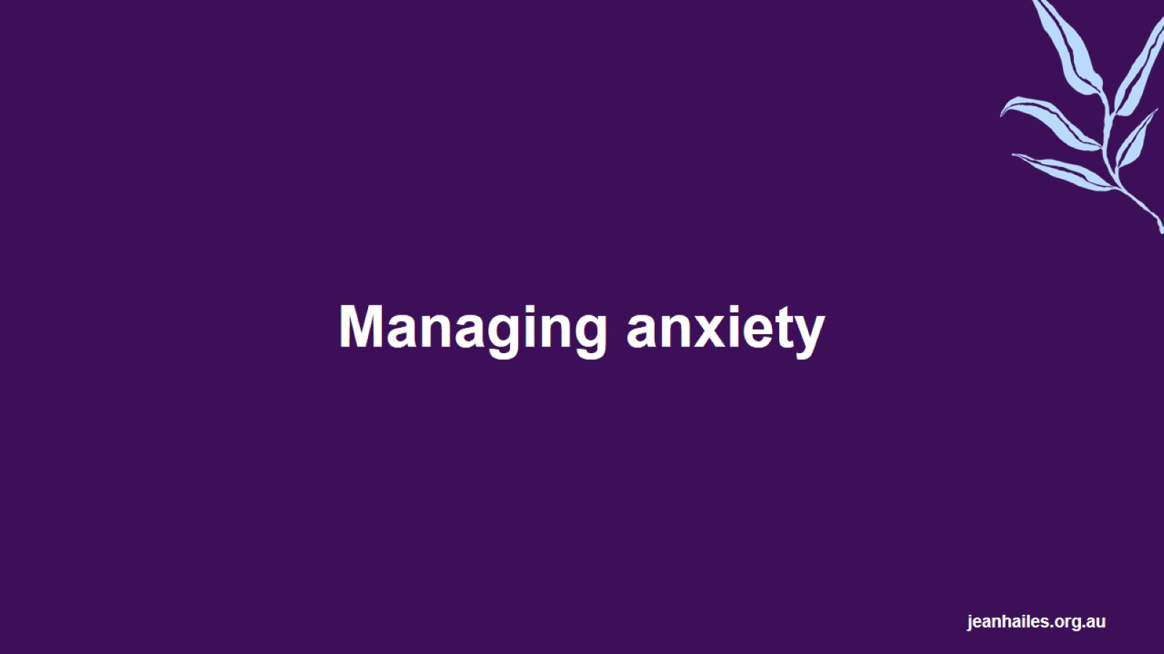
Managing anxiety
Notes:
Anxiety can be overwhelming, but there are strategies and supports available to help you manage.
This section discusses some strategies you can try to manage anxiety.
It’s best to be kind to yourself when managing your anxiety.
Keep an open mind and you can discover ways to manage it as there are many options to help you.
If you experience anxiety from time to time, there are lots of strategies you can try yourself to help manage your anxiety.
If you experience anxiety often, you might need to get help from a GP or mental health professional to help manage your anxiety.

Slide 10
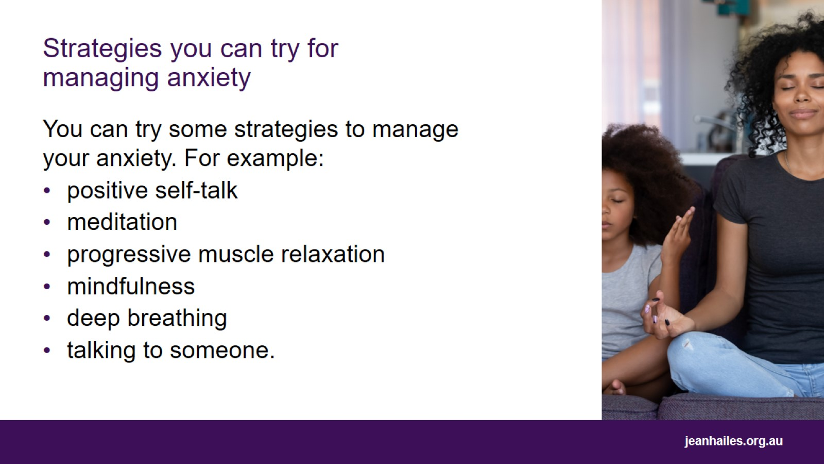
Strategies you can try for managing anxiety
Notes:
If you experience anxiety from time to time, you might be able to use self-help strategies to manage your anxiety. Here are some examples you can try:
Positive self-talk
It is helpful to think of different words when you are anxious.
Positive self-talk involves repeating words to yourself that you want to happen, such as saying ‘I am okay’, ‘I can do this’, ‘I am strong’, or ‘I am letting go of what I can’t control’.
Meditation
Meditation involves concentrating your mind on one thing, such as breathing, your body or sounds.
It can help you stay calm and focused on the present moment rather than worrying about something that may or may not happen in the future.
You can use meditation apps, such as Smiling Mind or Headspace, or find videos on YouTube.
Progressive muscle relaxation
Progressive muscle relaxation involves noticing where in your body you feel tense and then trying to release the tension.
Mindfulness
Practicing mindfulness helps by focusing on the present moment and bringing awareness to what is around you.
Concentrate on what you can hear, what you can I see, what you can touch.
Doing this helps reduce anxious thoughts and notice what is happening around your body.
Deep breathing
Taking slow, deep breaths can help manage anxiety in the moment.
There are many techniques you can try to slow down your breathing. For example, the 4-7-8 technique is breathing in for 4 seconds, holding your breath for 7 and releasing for 8.
Talking to someone
When you have anxiety, you can feel isolated, so talking to a friend, family member, or partner you trust can make you feel less alone and more supported.

Slide 11
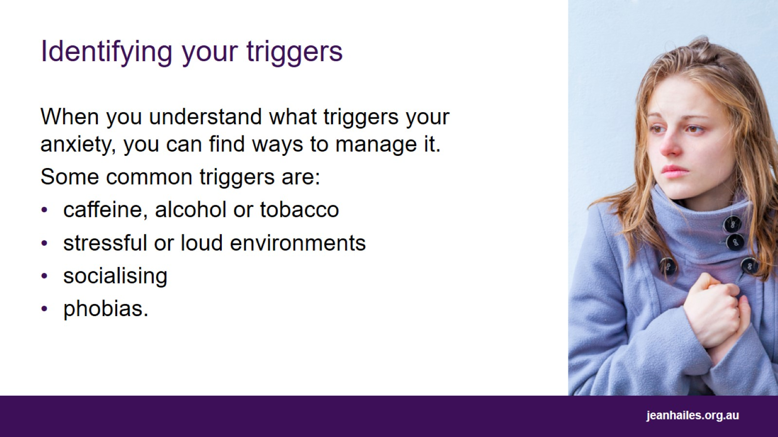
Identifying your triggers
Notes:
Triggers are things that lead to anxiety.
They are different for everyone.
You can’t avoid everything that triggers you, but you can learn to recognise triggers and develop strategies to help minimise their effects.
Common triggers are caffeine, alcohol, tobacco, stressful or loud environments, socialising or phobias.
If you find it hard to identify what triggers your anxiety, a mental health professional such as a psychologist or registered counsellor may be able to help you.

Slide 12
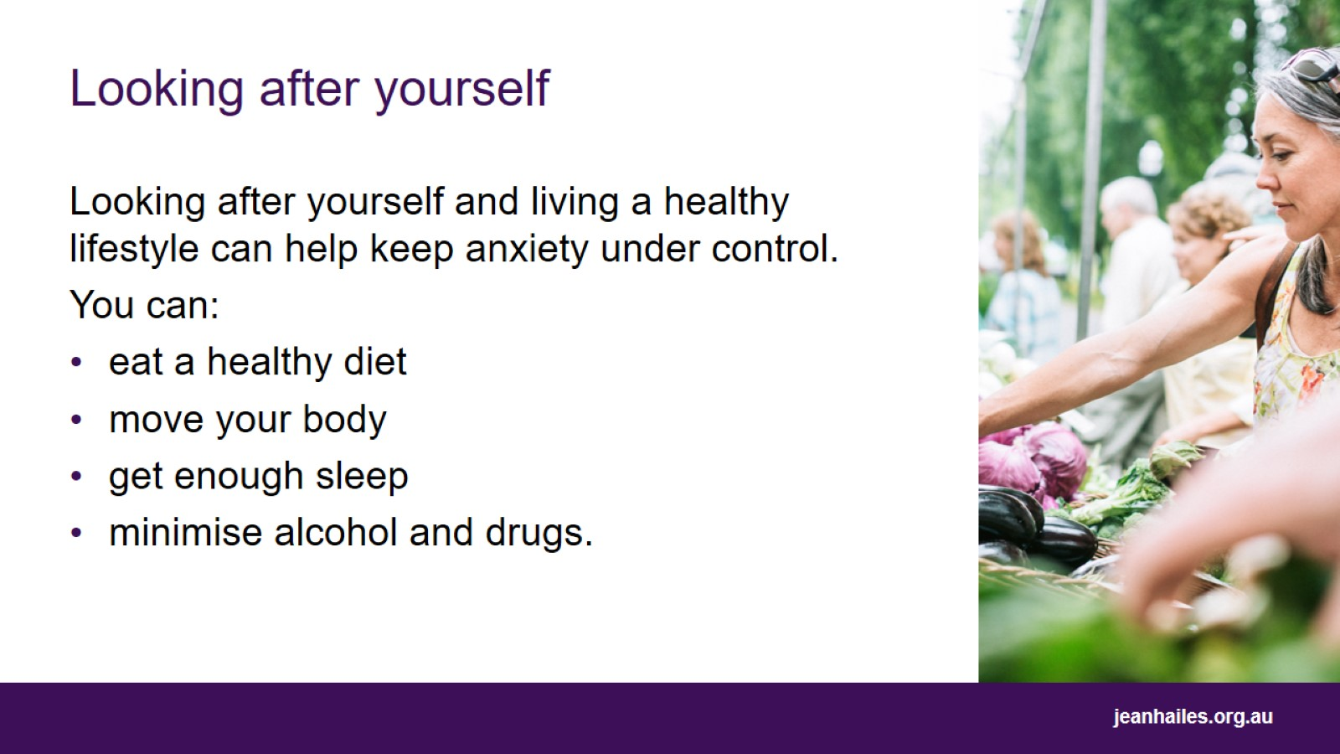
Looking after yourself
Notes:
Looking after yourself and living a healthy lifestyle can help keep anxiety under control.
Looking after yourself includes:
eating a healthy diet
being active and moving your body
getting enough sleep
cutting down on alcohol and other drugs.

Slide 13
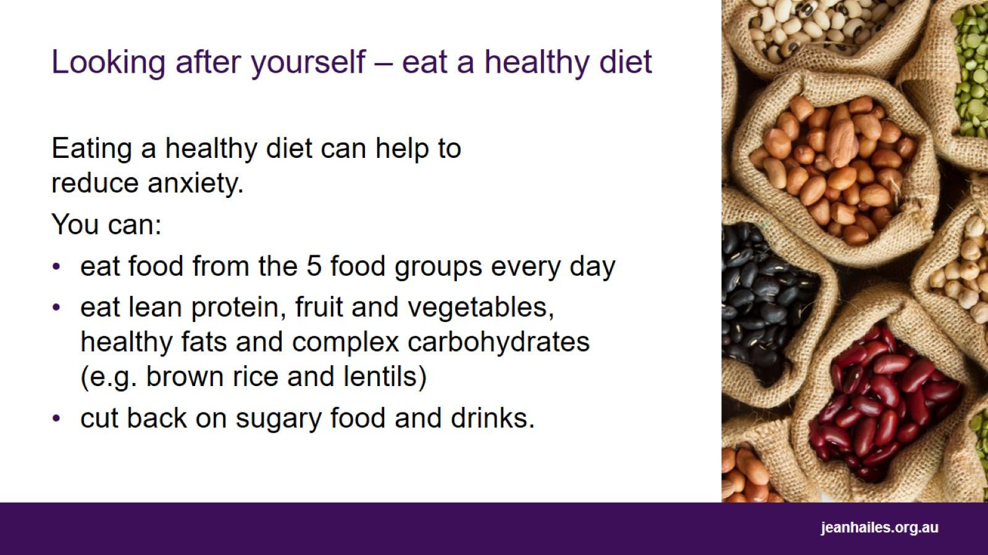
Looking after yourself – eat a healthy diet
Notes:
A healthy, balanced diet helps your body get all the necessary vitamins and nutrients. Research shows that healthy foods may help reduce anxiety, whereas sugar, coffee and alcohol can increase anxiety.
Eat a variety of food from the five food groups every day to ensure you’re getting all the nutrients and minerals your body needs to stay healthy. This includes:
fruit
vegetables, including legumes and beans
wholegrain bread and cereals
lean meats, chicken, eggs, fish, tofu, nuts, and seeds
dairy foods like milk, cheese, and yoghurt.
Include lean protein, fruit and vegetables, healthy fats like fish and walnuts, and complex carbohydrates like brown rice and lentils in your daily diet. Research suggests that these foods may improve general mental health.
Cut back on sugary foods and drinks, like lollies and soft drinks, which can affect your mood.

Slide 14
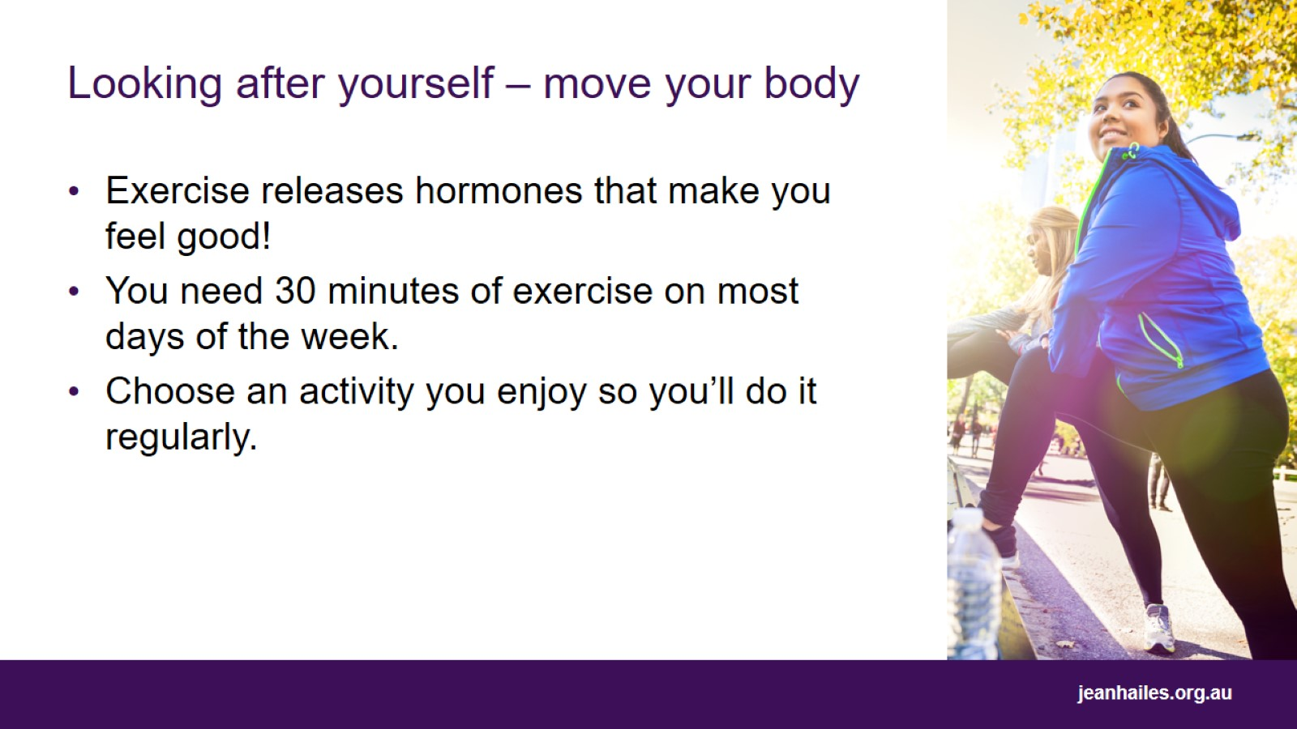
Looking after yourself – move your body
Notes:
Research suggests that people who exercise regularly have better physical and mental health.
Exercise releases feel-good hormones called endorphins and serotonin, which help improve your mood.
It is recommended that adults do 30 minutes of moderate to intense exercise on most days of the week to feel the benefits.
Some good examples are walking, doing yoga, swimming, gardening or even home workouts that you could do by yourself or with your friends and family.
It doesn’t matter what activity you choose, just find one you enjoy so you’ll do it regularly.

Slide 15
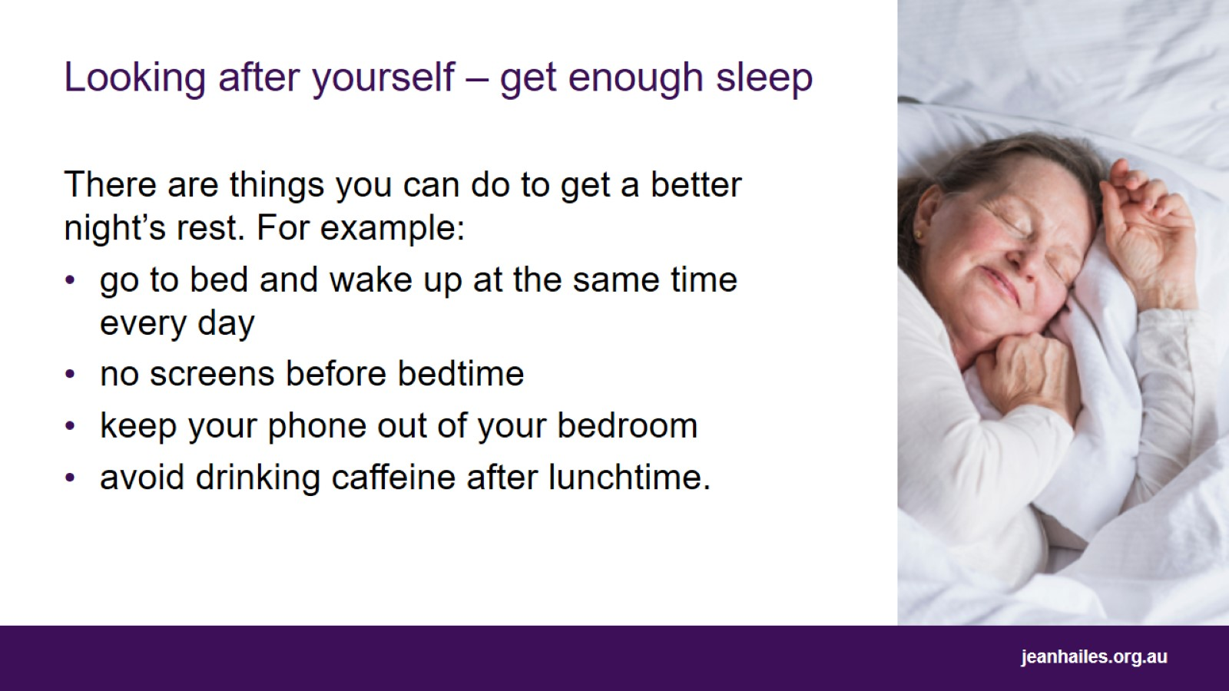
Looking after yourself – get enough sleep
Notes:
A good night’s sleep is as important as healthy eating and exercise for good mental health. You should aim for 7 to 8 hours of sleep every night.
Good sleep hygiene is important for getting a good night’s sleep. Strategies include:
going to bed at the same time every night, and getting up at the same time every morning
having no screens 30 minutes before bedtime
keeping your mobile phone out of your bedroom
avoiding caffeinated drinks like coffee after lunchtime.

Slide 16
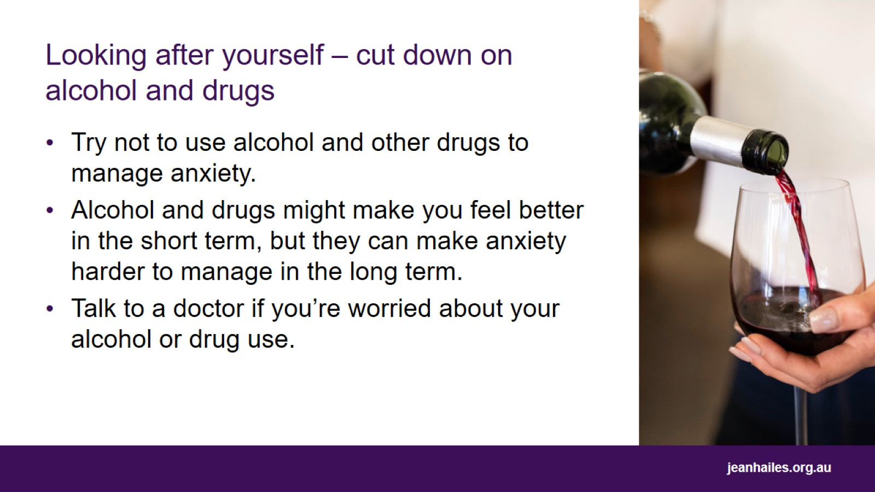
Looking after yourself – cut down on alcohol and drugs
Notes:
Many people use alcohol and drugs to help them relax and reduce their anxiety.
Using drugs and alcohol to manage your anxiety can make you rely on them. In the long term, it may increase your anxiety, especially when you don’t have access to them.
High levels of drinking alcohol and taking drugs can cause short-term and long-term health risks and worsen your anxiety.
If you are worried about your alcohol consumption or drug use, talk to your doctor or other mental health professional. They can help you find other ways to help you relax and manage your anxiety.

Slide 17
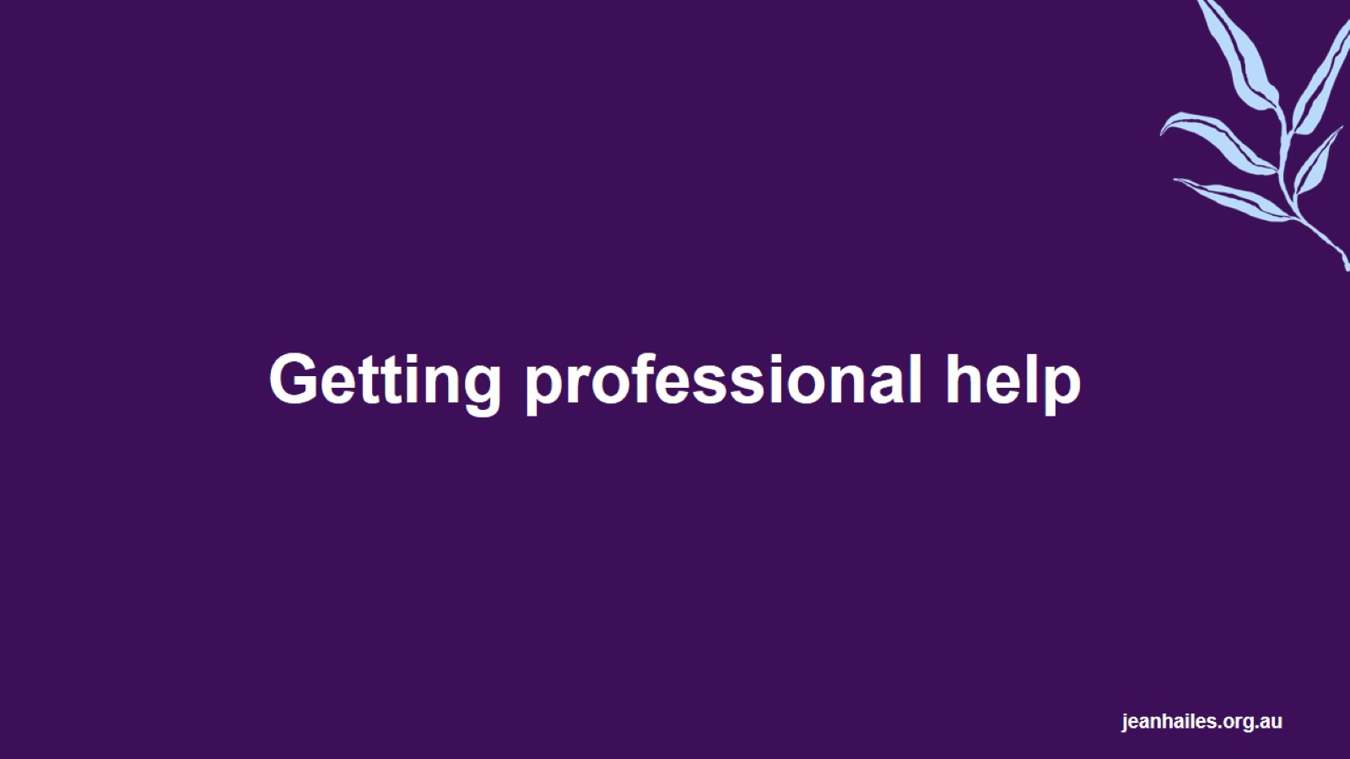
Getting professional help
Notes:
If you are having trouble with anxiety, you might need to see a doctor or other mental health professional to help you manage it. The following slides help you know when you should think about seeking professional help, and what kind of supports are available.

Slide 18
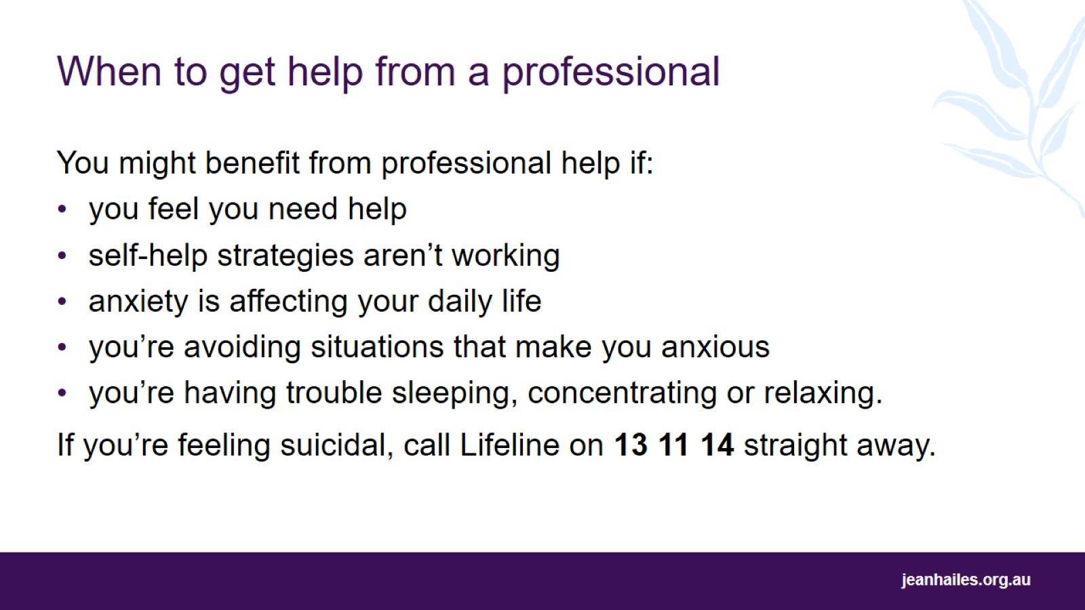
When to get help from a professional
Notes:
Sometimes you will need professional help to manage anxiety.
Think about getting help from a health professional if:
strategies aren’t working to reduce anxiety
you feel like you need help
anxiety is affecting your day-to-day life and getting worse
your anxiety is so bad that you’re avoiding places or certain situations
you’re having trouble sleeping, relaxing, or concentrating
you’re feeling suicidal. If you feel suicidal, please call lifeline on 13 11 14 and get help immediately.

Slide 19
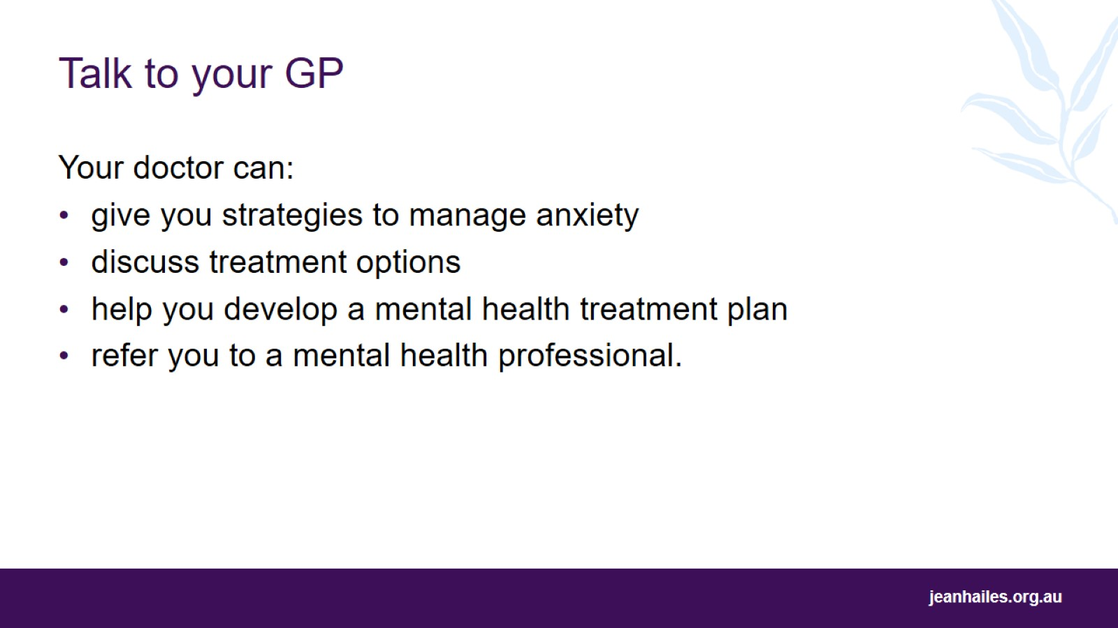
Talk to your GP
Notes:
If you’ve decided to seek professional support to manage anxiety, talking to your doctor is a good place to start. Your doctor can help you in a range of ways, including by:
giving you strategies to manage your anxiety
discussing your options for treatment, including medication
developing a mental health treatment plan for you, which outlines your diagnosed mental health issue, goals for treatment. It also allows you to claim Medicare rebate for a number of treatment sessions with a mental health professional
referring you to a mental health professional to help you with your anxiety.

Slide 20
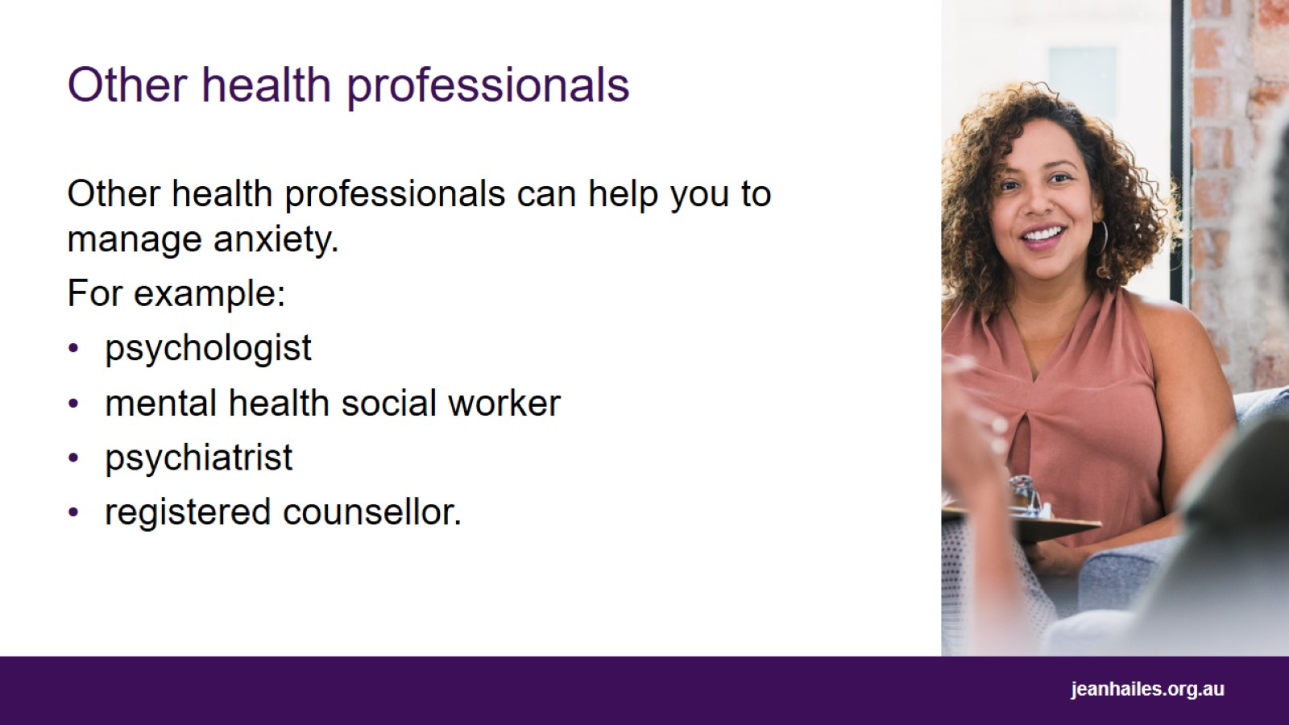
Other health professionals
Notes:
Your GP might also refer you to another mental health professional to help you manage your anxiety. For example:
Psychologists are registered mental health professionals who are trained in psychological strategies to help you manage your mental health. They use talk therapies such as cognitive behavioural therapy (CBT) to help you manage your anxiety.
Mental health social workers are trained mental health professionals who can help you manage mental health problems such as anxiety, as well as helping you to address social and environmental issues such as housing.
Psychiatrists are specialist doctors who have done extra training to specialise in mental illness. They can use talk therapy such as CBT and prescribe medications to help you manage anxiety.
Registered counsellors can help you by using talk therapy to work through your anxiety.

Slide 21
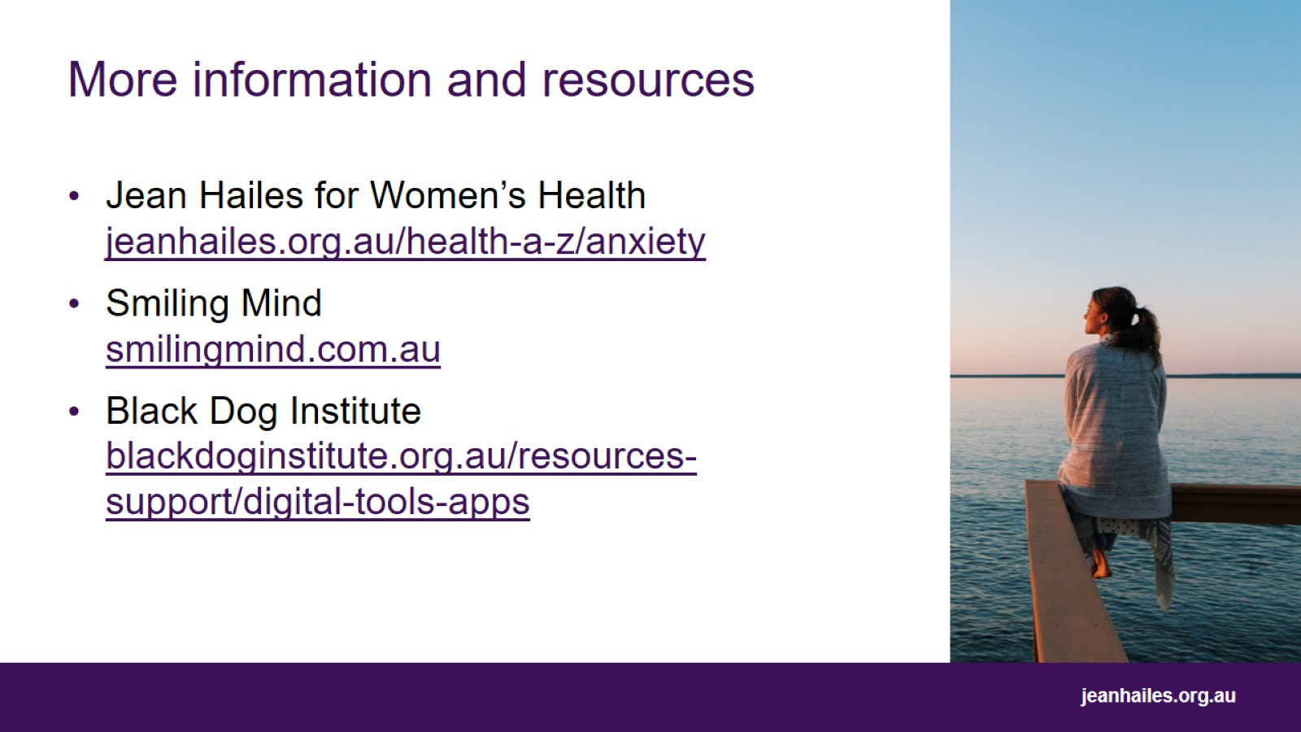
More information and resources

Slide 22

Thank you

Slide 23


