Slide 1

Periods

Slide 2
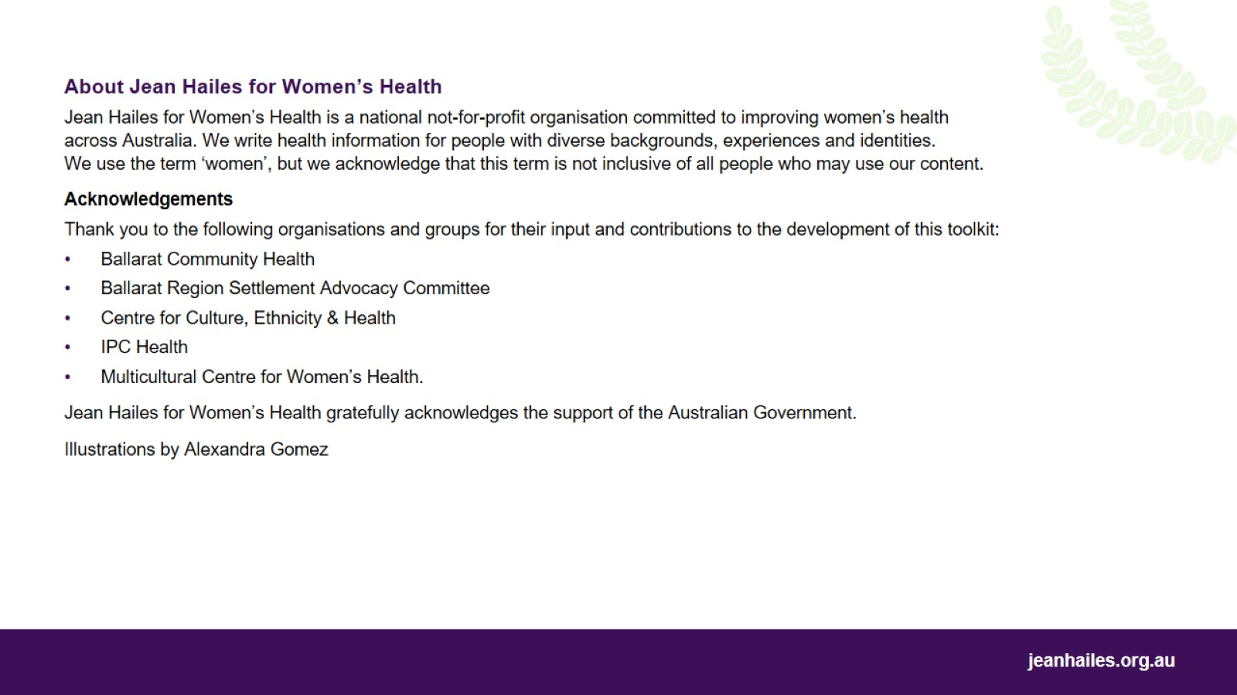

Slide 3

My body. My health.
A health education toolkit

Slide 4

Let’s
Notes:
Today we’ll talk about periods:
what menstrual cycle is
what to expect during a period
what is not normal during a period
when to see a doctor or nurse about your period
what different period products are.
Note to the facilitator: choose a few questions (examples below) to lead a brief group discussion on how the participants understand the role of periods.
Questions to consider:
What do you call a period in your language?
What is a period?
Why do women have periods?
What happens in a woman's body during a period and between periods?
Is it OK in your culture to talk about periods?
Did you know about periods before you got your first period?
How did you learn about periods? From school, other women in your family or community?
What period products do women in your culture use?

Slide 5
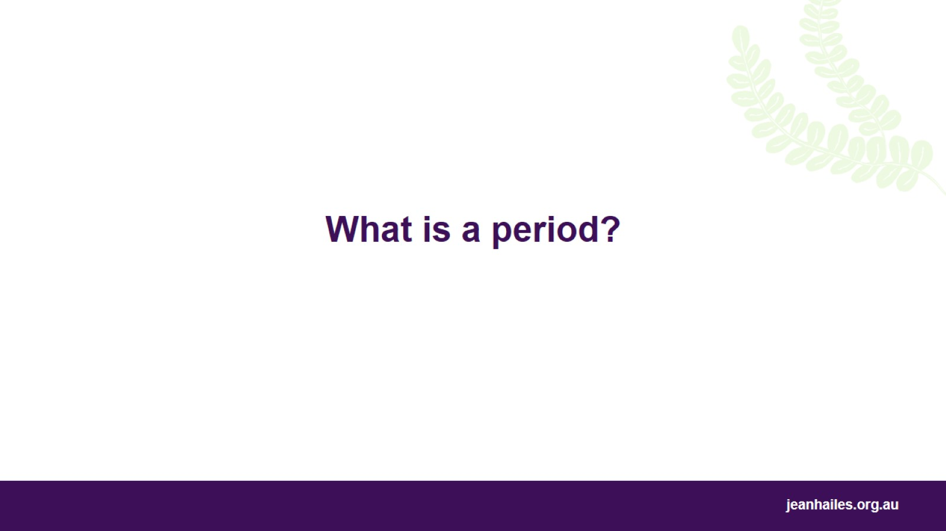
What is a period?
Notes:
All periods are different, but it’s important to know what a period is like usually and what symptoms are normal.
First, we’ll talk about what to expect during a period. Then we’ll talk about things that aren’t normal and when you should talk to a doctor or nurse.

Slide 6
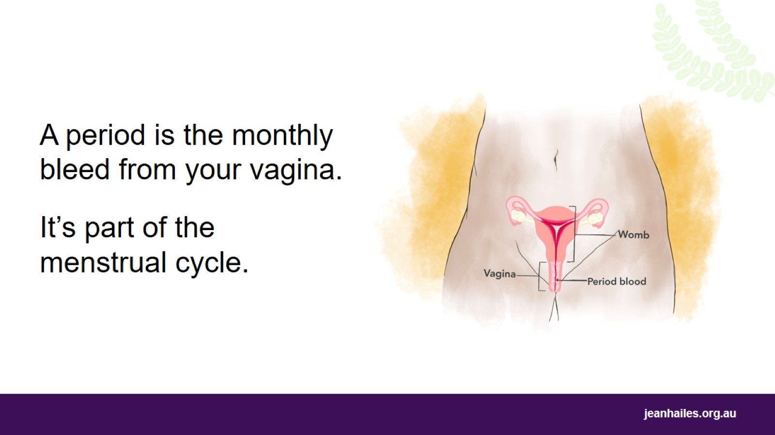
Notes:
A period, also called menstruation or bleeding:
is when you bleed from your vagina about once a month
means you’re not pregnant
is part of the menstrual cycle.
Most girls in Australia have their first period at age 12 or 13, but some would have it as early as nine or as late as 16.
Most women will have their final period when they’re 45 to 55 years old.

Slide 7
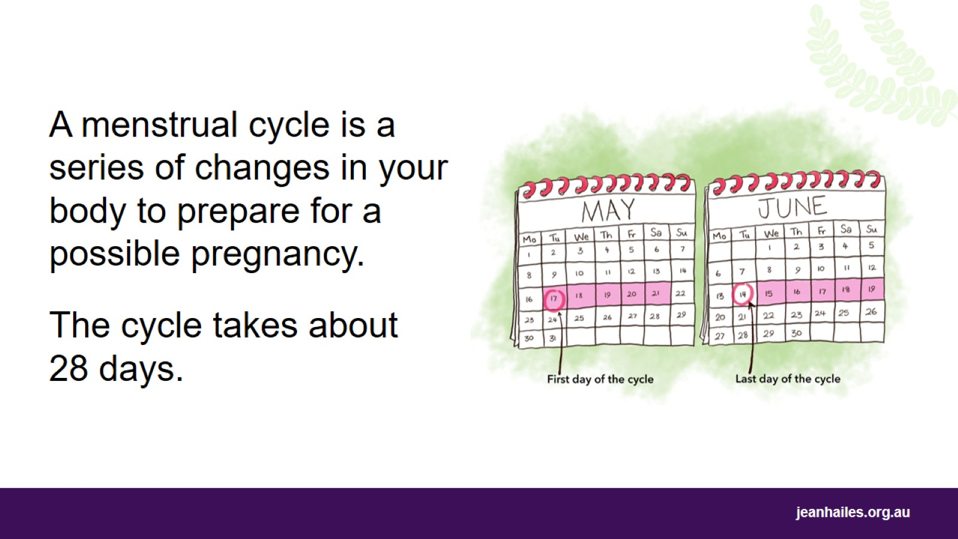
Notes:
Every month, your body goes through a series of changes called a menstrual cycle. The role of the menstrual cycle is to prepare your body for a possible pregnancy.
An average menstrual cycle takes about 28 days but it can be a few days shorter or longer.
The cycle starts on the first day of your period and lasts until the last day before your next period.
In the middle of your cycle, you are most likely to get pregnant (if you have penis-in-vagina sex with a man and don’t use contraception).
If you don’t get pregnant, your period comes as usual and the menstrual cycle begins again.

Slide 8
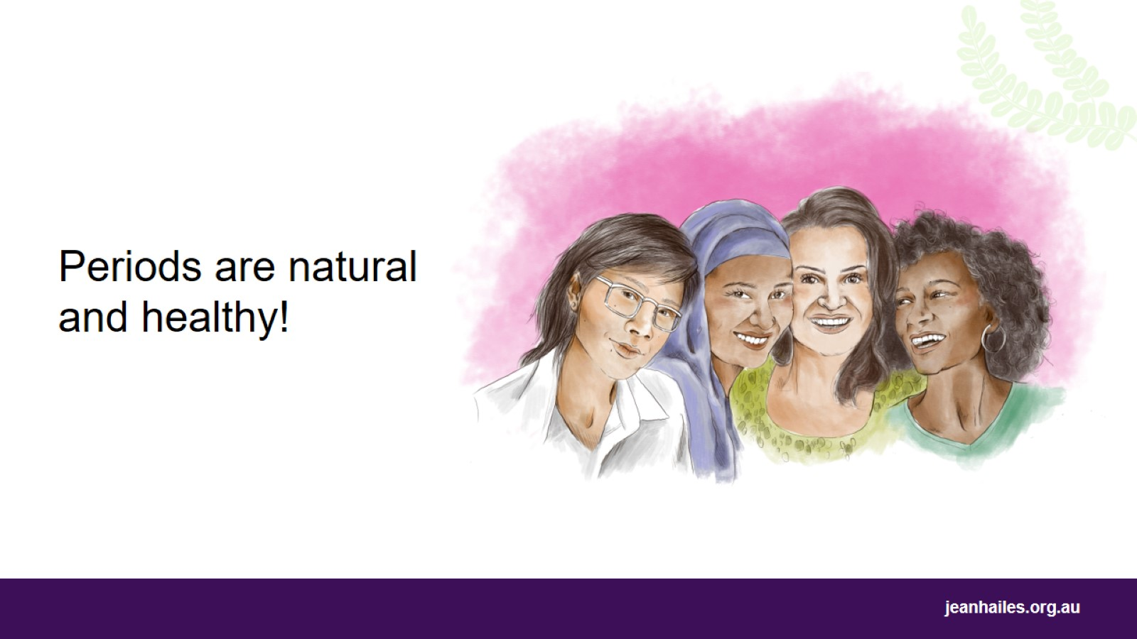
Notes:
Periods are natural, healthy and nothing to feel ashamed or embarrassed about.

Slide 9
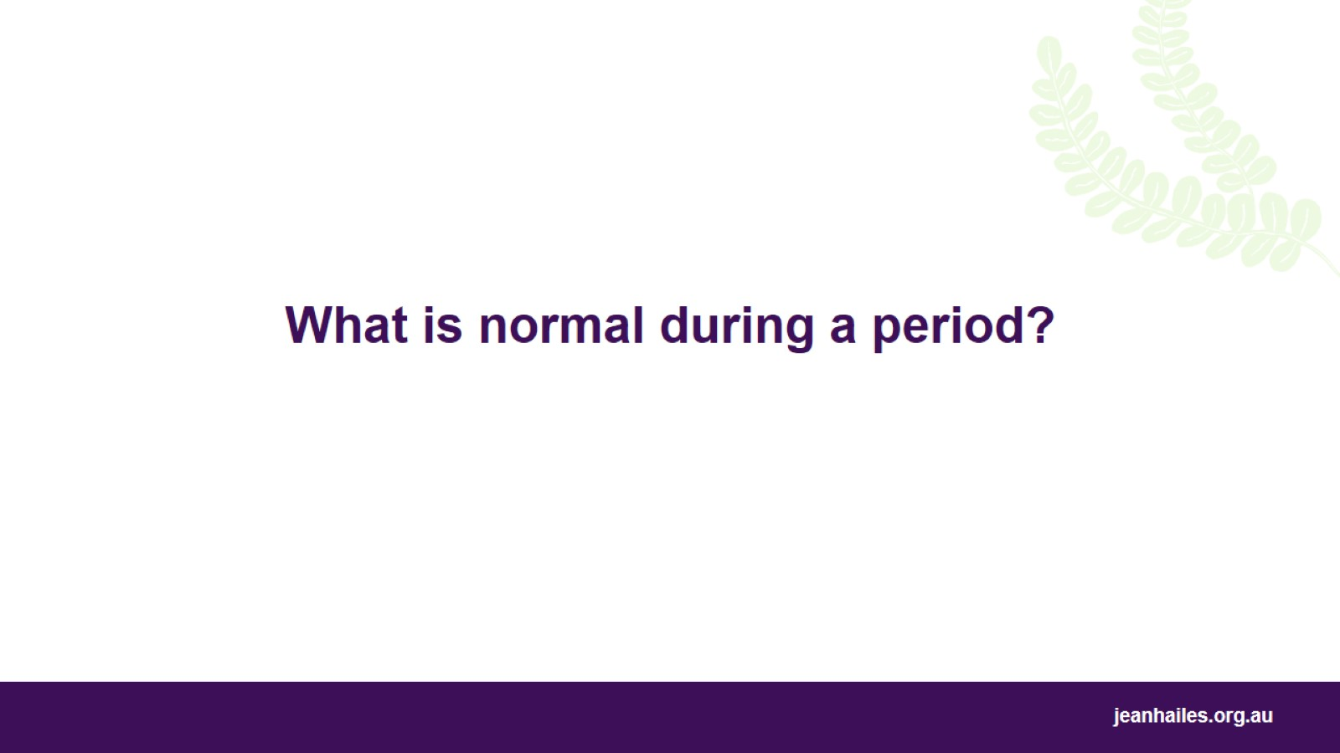
What is normal during a period?
Notes:
Let’s talk about what to expect during a period.

Slide 10
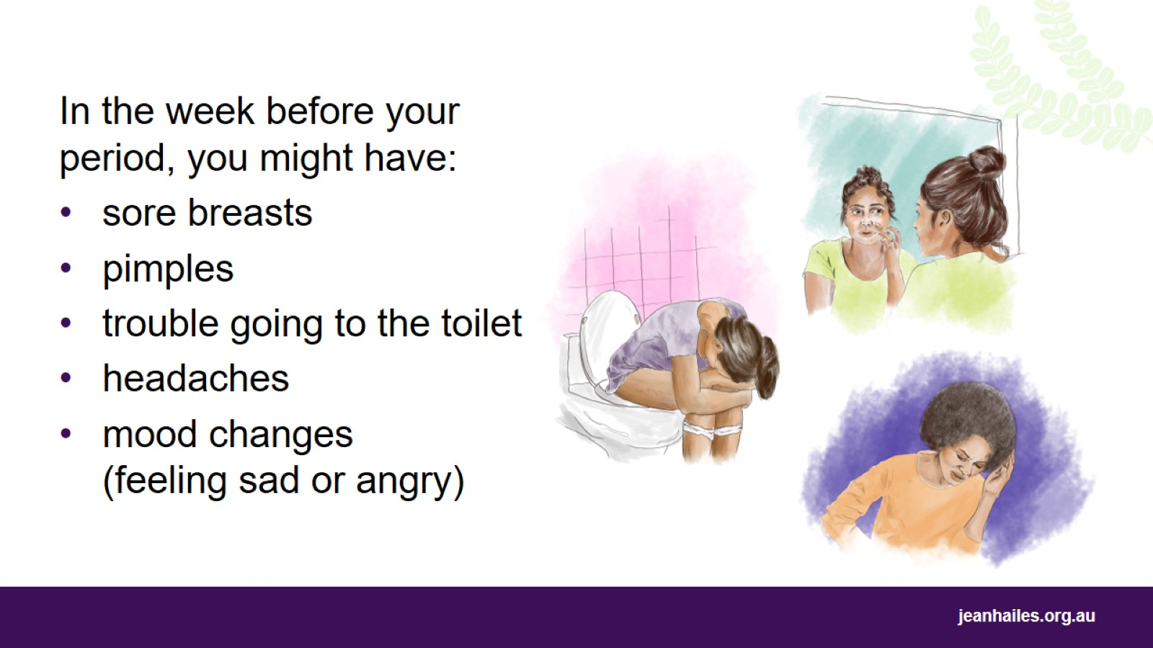
Notes:
In the week before your period, you might notice some symptoms. You might have:
sore breasts
pimples
trouble going to the toilet (constipation)
headaches
mood changes, for example suddenly feeling sad or angry or irritable.
These symptoms usually stop once your period starts.
Most women can manage these symptoms themselves and continue with their daily activities as usual.

Slide 11
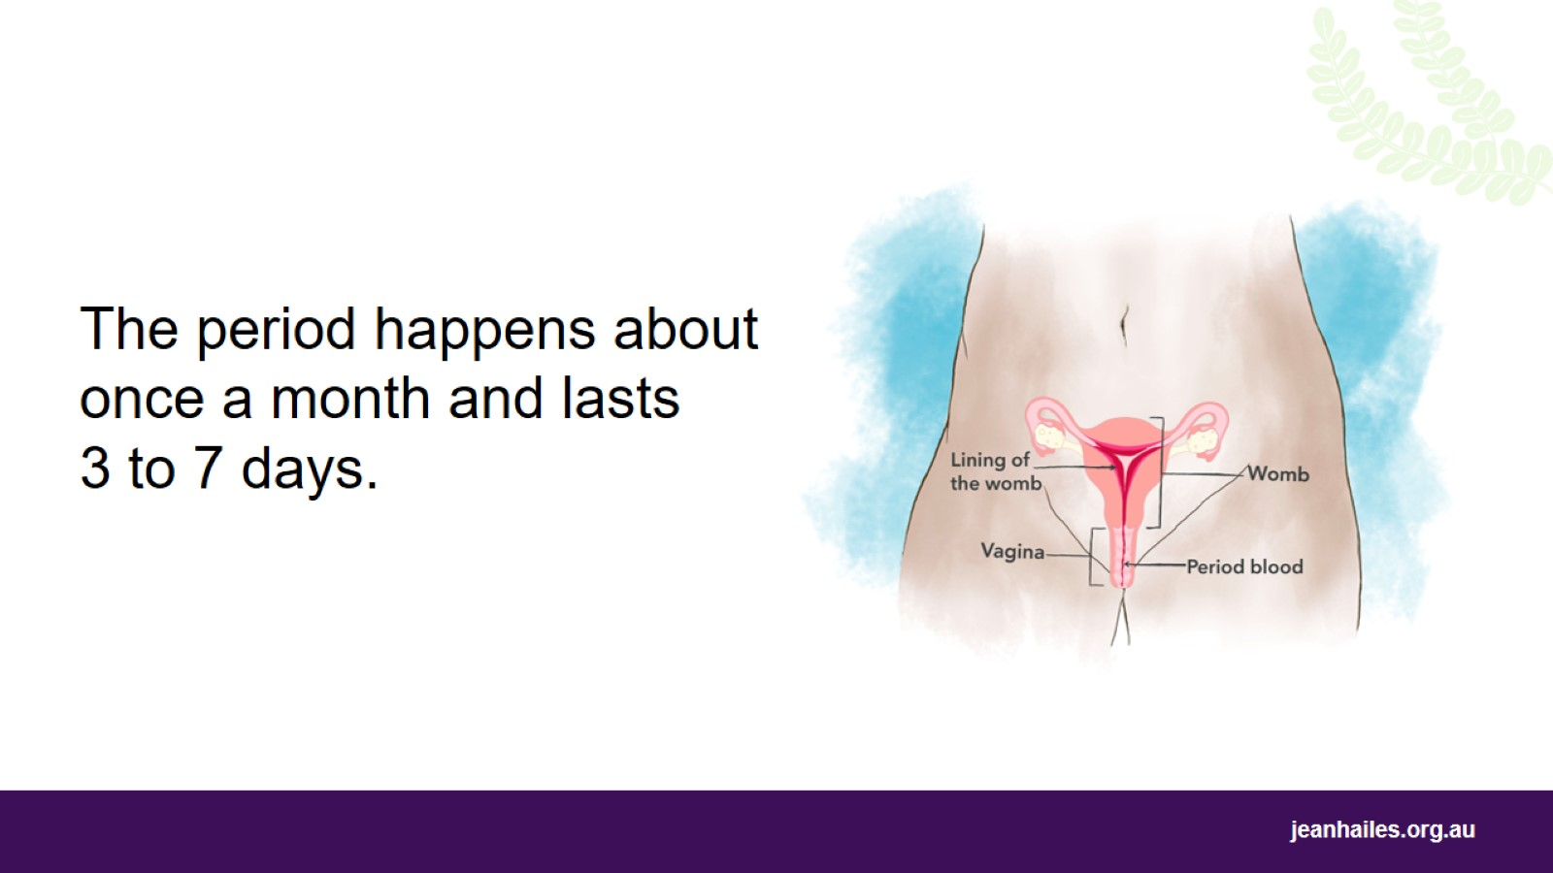
Notes:
The first day of your menstrual cycle is the first day of your period.
The period happens about once a month and lasts 3 to 7 days.
During this time, the lining of your womb breaks down because you didn’t become pregnant and leaves the body through your vagina. This is your period blood.
For the first 1–2 years after you start having periods, your period might not come regularly every month.

Slide 12
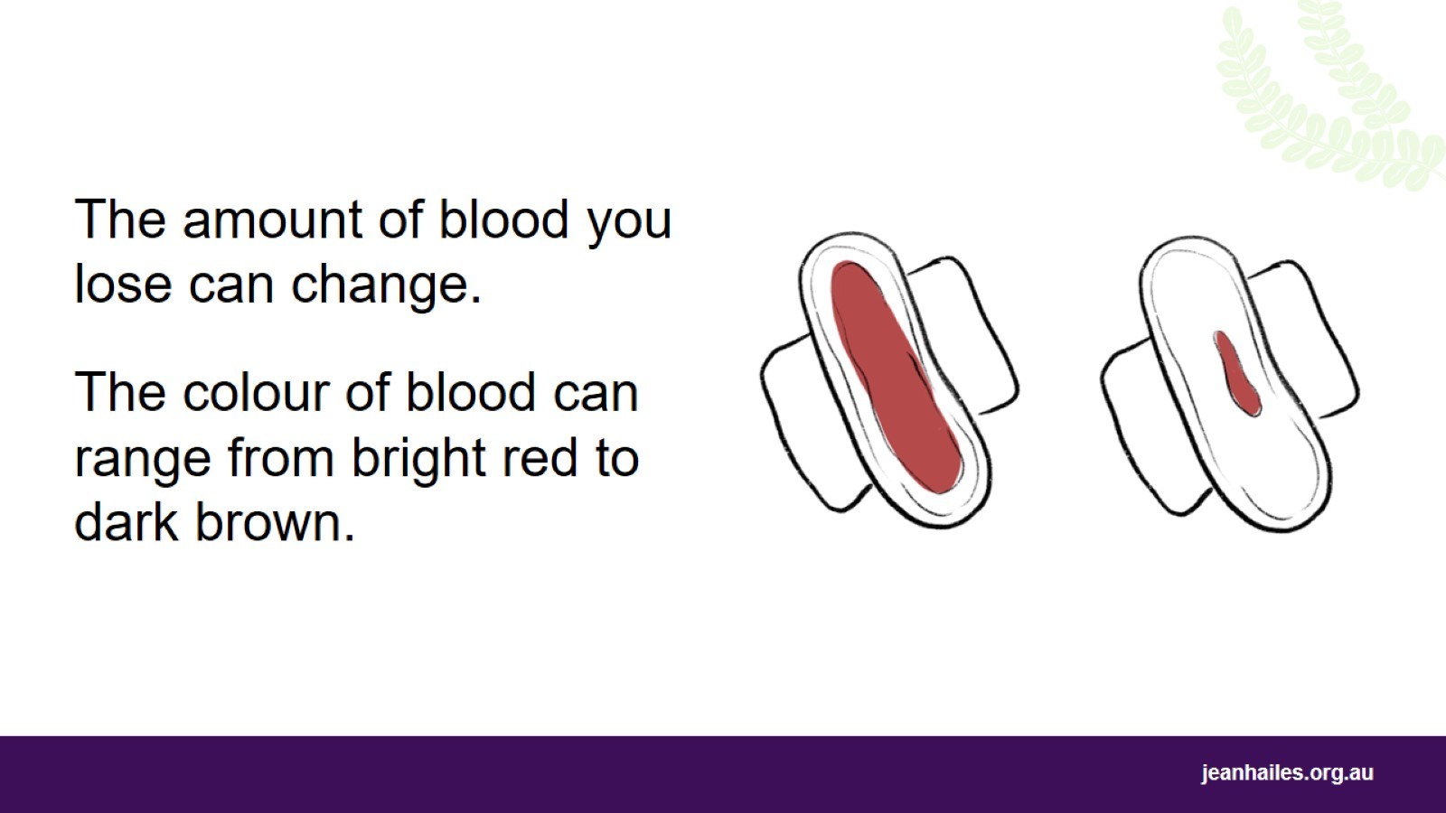
Notes:
The amount of blood you lose changes throughout your period.
The bleeding is lighter at the beginning, gets heavier in the middle of your period and then becomes lighter again at the end.
On some days, you might just have spotting.
The colour of your period blood can range from bright red to dark brown and change during your period.

Slide 13
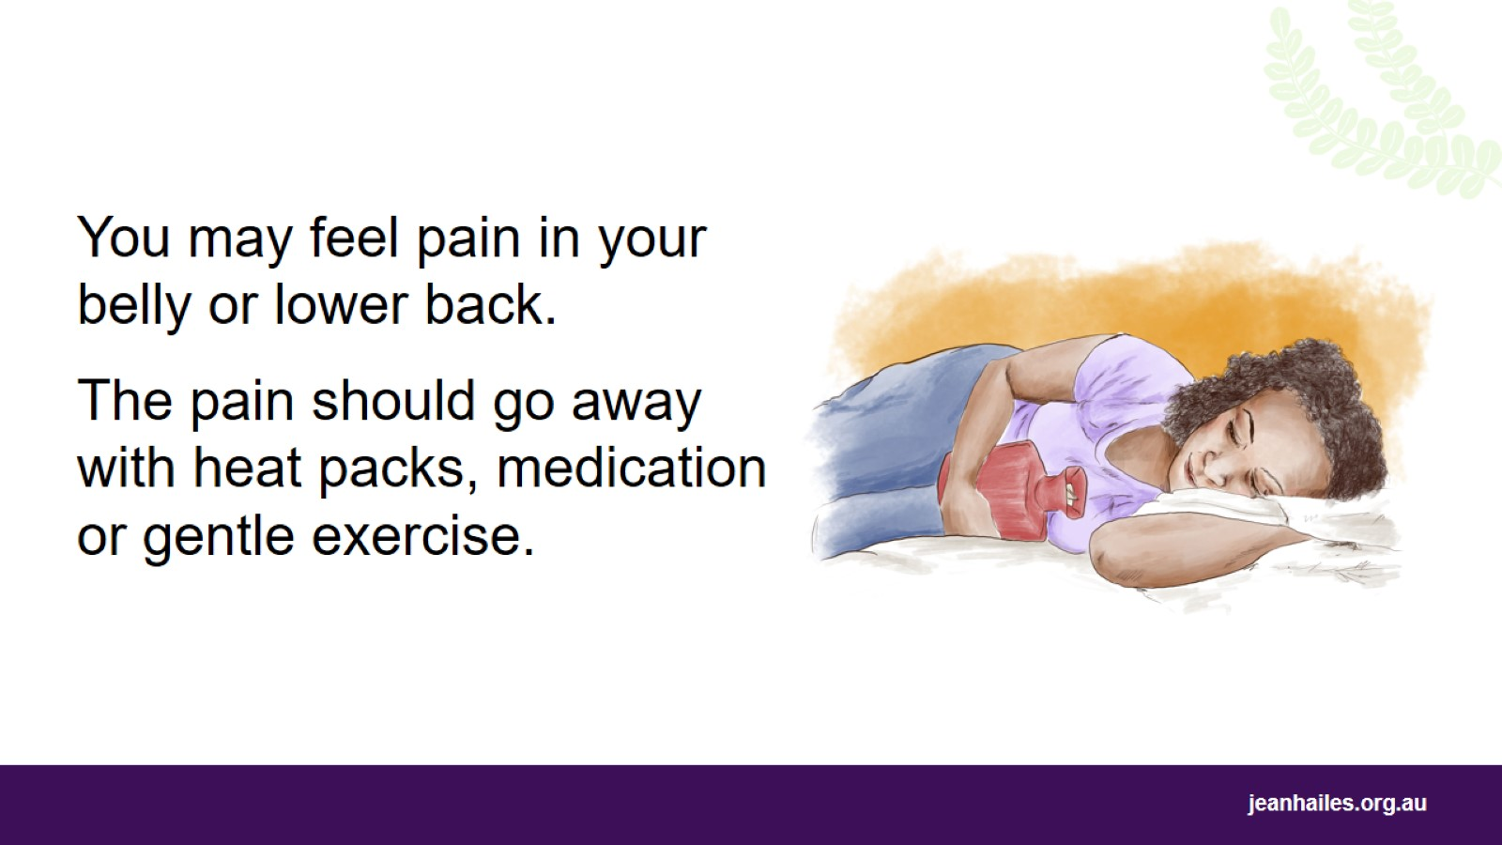
Notes:
During the first two days of your period, you may feel pain in your belly or lower back.
Period pain is normal if:
it’s only there for the first one or two days of your period
it goes away when you use:
heat packs or hot water bottles
period pain medication, such as ibuprofen (NurofenTM)
gentle exercise such as stretching or yoga.

Slide 14
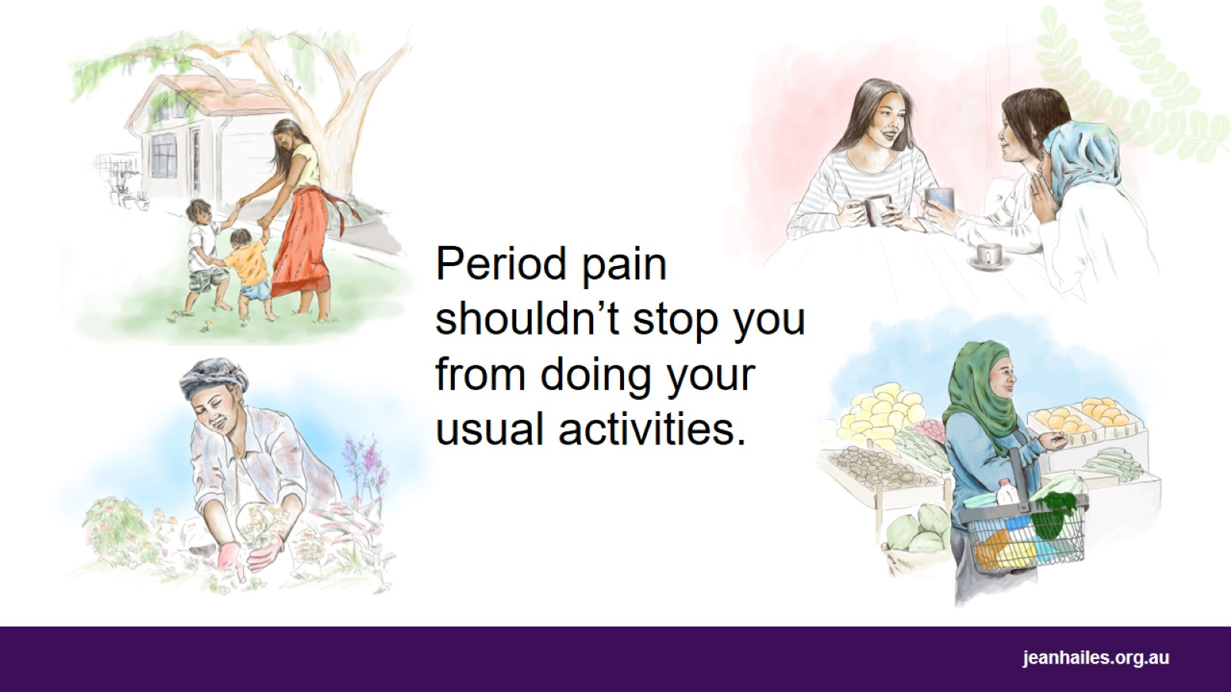
Notes:
Period pain shouldn’t stop you from doing your usual daily activities, such as:
taking care of your family
meeting up with friends
gardening
going shopping
working or going to school.

Slide 15
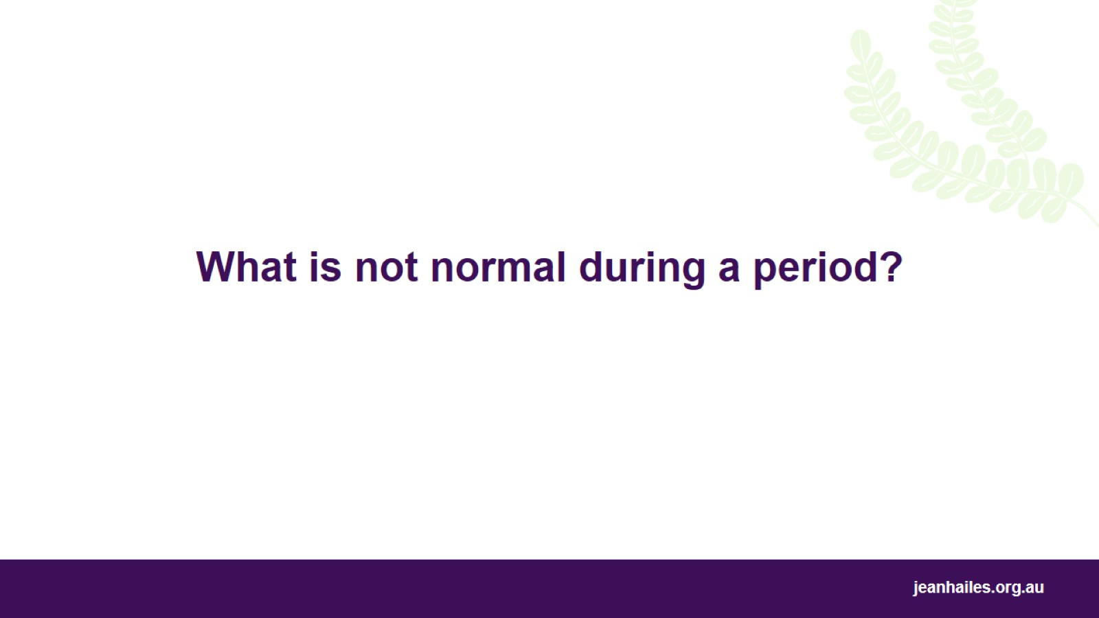
What is not normal during a period?
Notes:
Now we’ll talk about what isn’t normal during your period and when you should talk to a doctor or nurse.

Slide 16
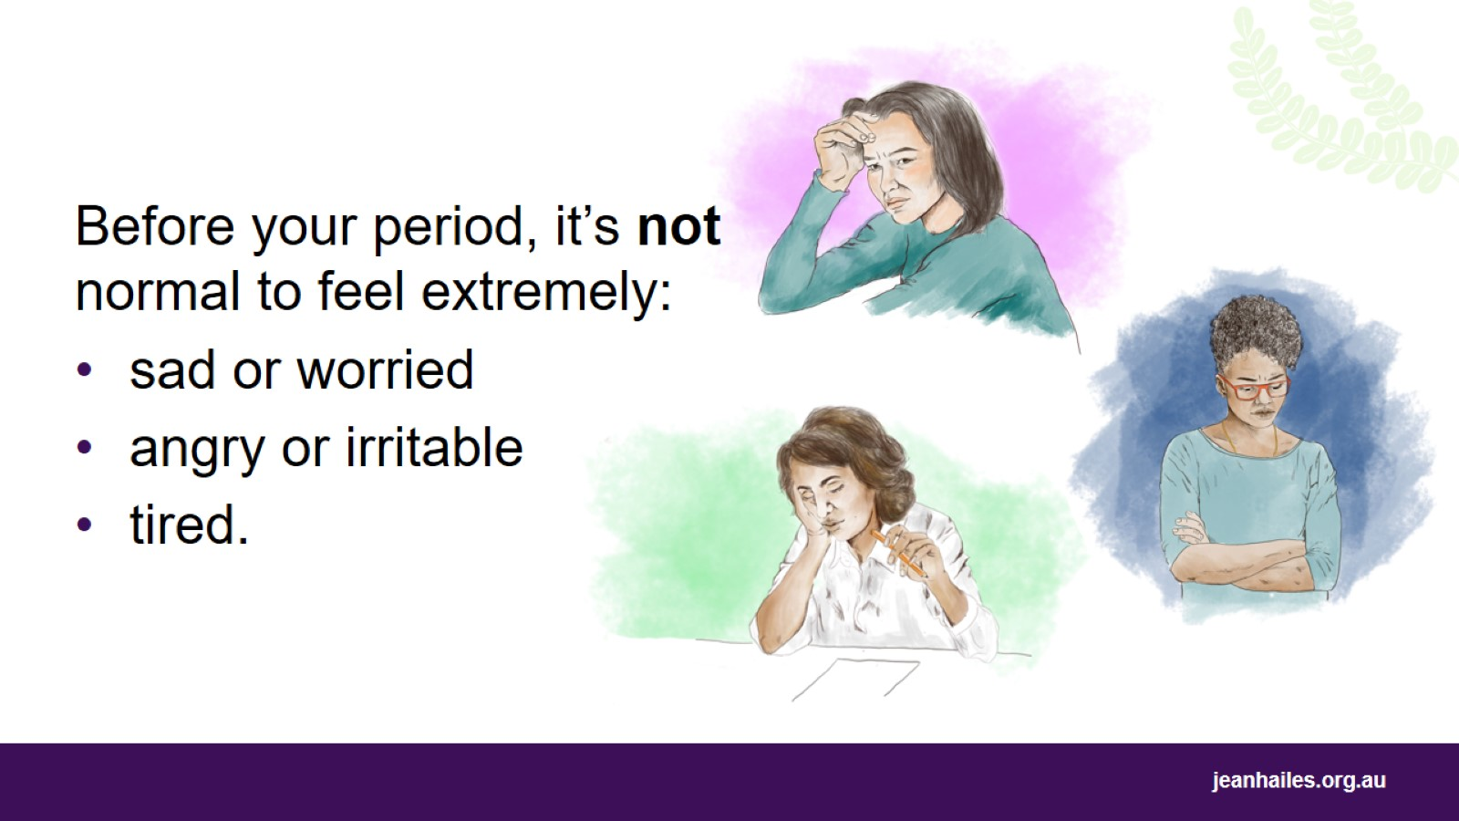
Notes:
Some women feel really bad a week or so before their every period up until their period starts.
They may have symptoms such as:
feeling extremely sad or worried
extremely angry or irritable
unusually tired or overwhelmed
having panic attacks
having thoughts of self-harm.
If you have these intense symptoms and they stop you from doing your daily activities, that is not normal.

Slide 17
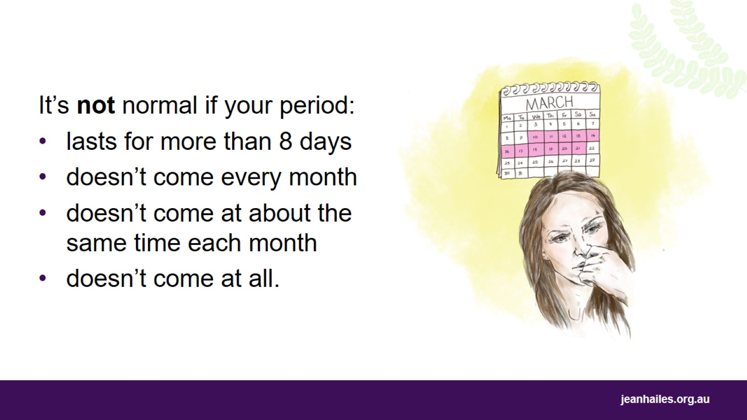
Notes:
It’s not normal if your period:
lasts for more than 8 days
doesn’t come every month
doesn’t come at around the same time each month
doesn’t come at all (and you know you’re not pregnant).

Slide 18
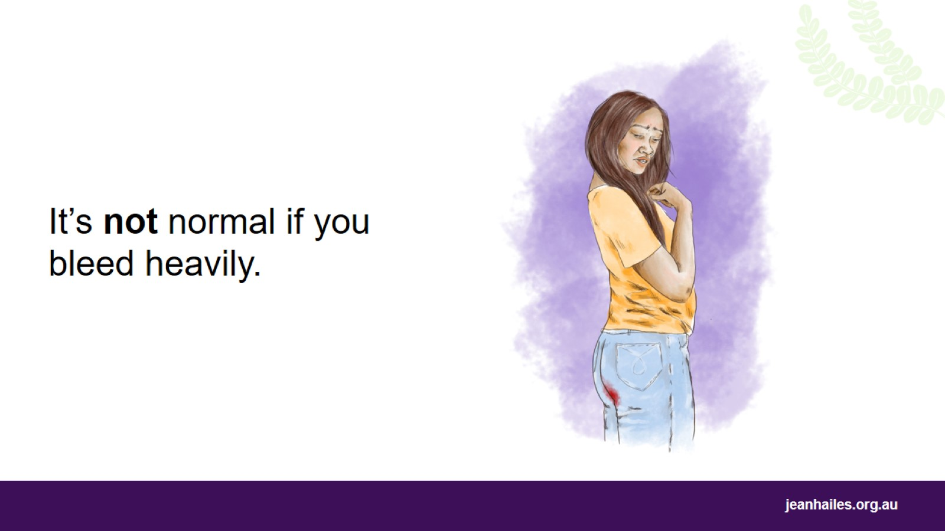
Notes:
It’s not normal if you bleed heavily during your period. Your bleeding is heavy if you:
have to change your pad or tampon every two hours or more often
have to change your pad overnight
bleed through your clothes
see blood clots bigger in size than 50-cent coin.
It is also not normal if you bleed between periods or after sex.

Slide 19
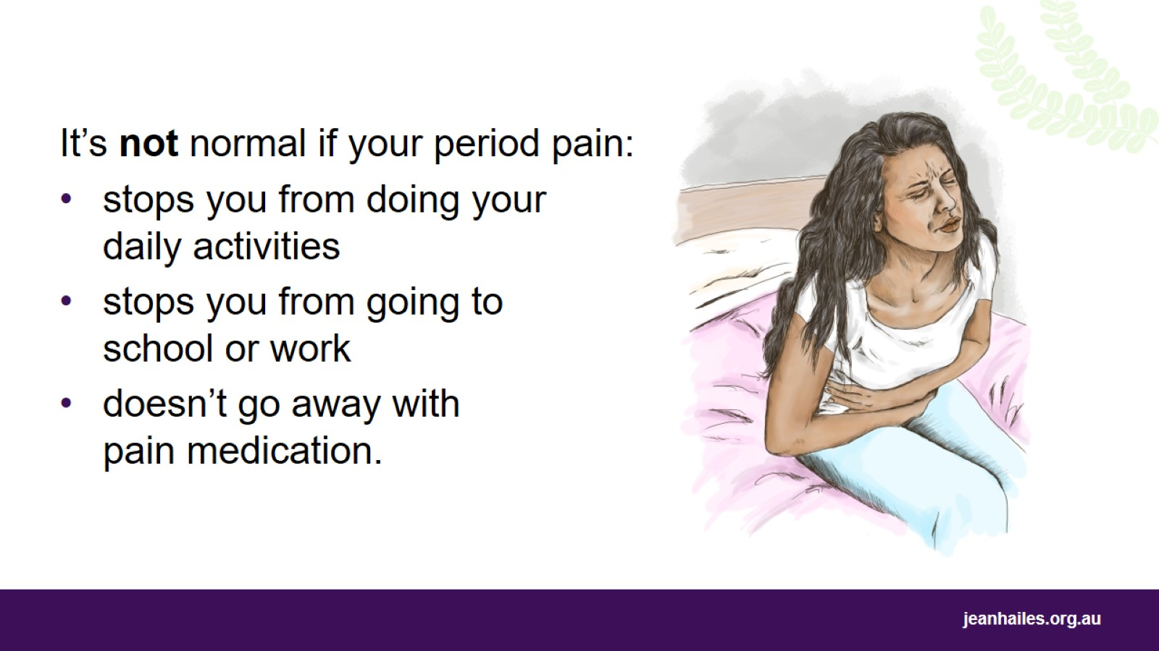
Notes:
Your period pain is not normal if:
it stops you from doing your daily activities and enjoying your life
you can’t go to school or work because of it
it doesn’t go away with pain medication, such as ibuprofen (NurofenTM).

Slide 20
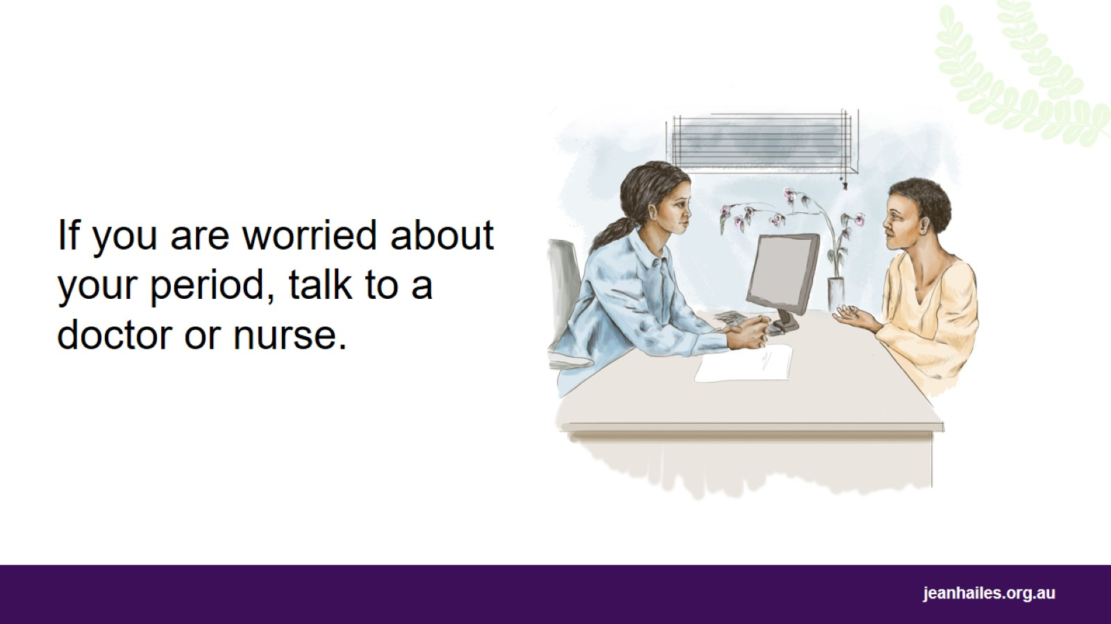
Notes:
If you are worried about your period or have any of the symptoms that are not normal, talk to a doctor or nurse.

Slide 21
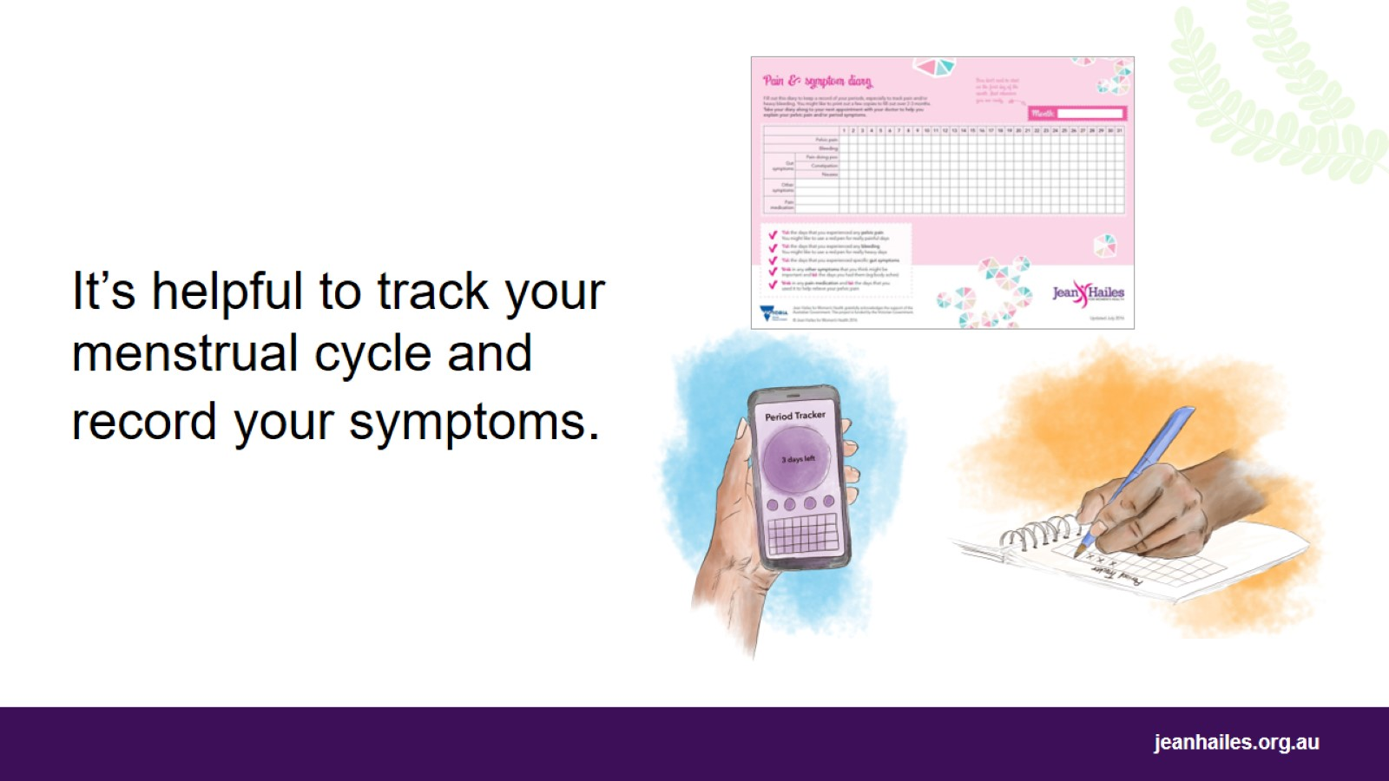
Notes:
Tracking your menstrual cycle and recording all the symptoms, like your pain, your mood, how much you bleed or if you’re constipated, can help you:
understand your period better
know when your period will come and be ready for it
notice any changes that are not normal for you, so you know if you need to see a doctor or nurse.
Track your menstrual cycle using a calendar, diary, or smartphone app.
Record when your period starts, how long it lasts, and any symptoms you have, like pain or heavy bleeding.
This information will be important if you need to see a doctor or nurse about your period.

Slide 22

Period products and hygiene during a period
Notes:
Let’s talk about different period products and hygiene during your period.

Slide 23
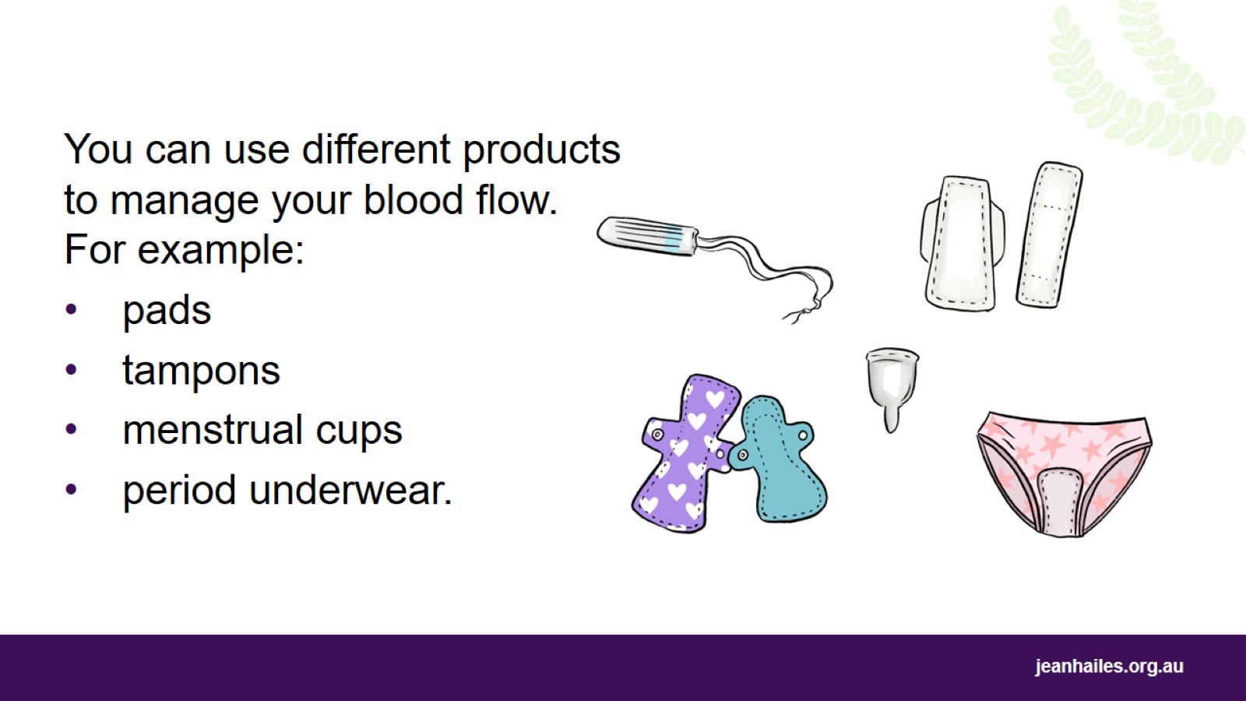
Notes:
There are different products you can use to manage the blood flow when you have your period. These include:
pads
tampons
period underwear
menstrual cups.
We’re going to talk more about each of these products. The most important thing is to find what works for you and helps you feel more comfortable when you have your period.

Slide 24
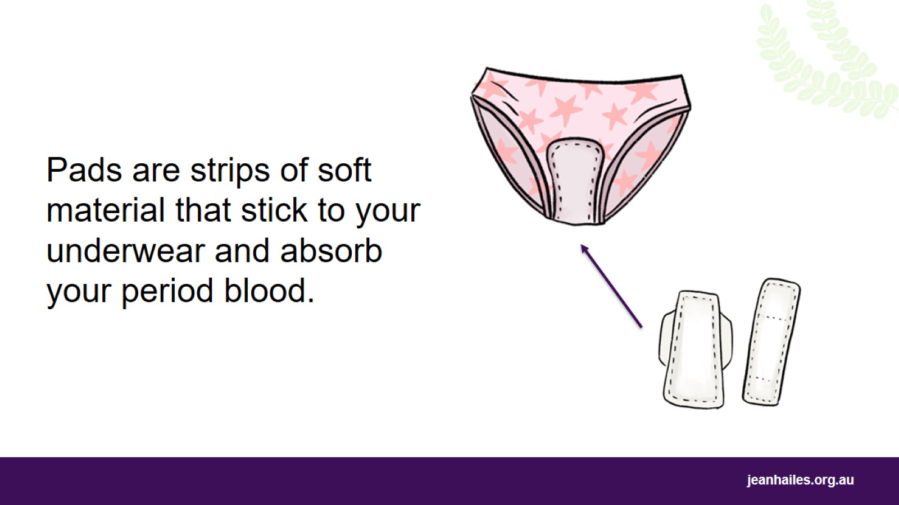
Notes:
Pads are strips of soft material that stick to your underwear and absorb your period blood.
Pads have different sizes, such as ‘light’, ‘medium’, ‘heavy’ or ’super’. You can choose the size that suits your blood flow.
It’s good to change your pad every 3 to 4 hours.
You can also get reusable pads. These pads are made from fabric. They can be washed and used again.

Slide 25
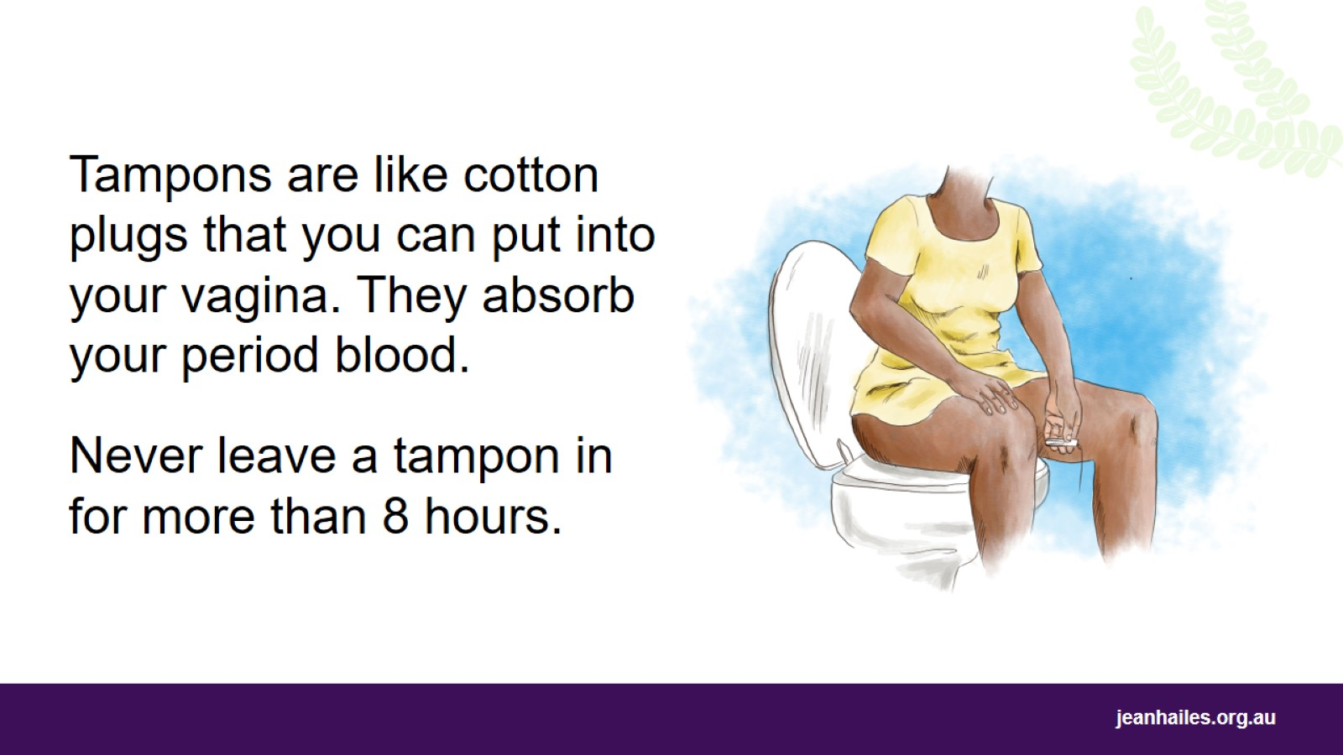
Notes:
Tampons are like cotton plugs that you can put into your vagina. They absorb your period blood. They come in different sizes to suit your blood flow.
You can still play sport and go swimming while wearing a tampon.
When you insert a tampon, make sure to insert it far enough. An applicator can be useful when you are learning to insert tampons.
Every tampon has a string so you can pull it out easily.
Change your tampon every 4 to 6 hours, or more often if you need to, depending on how heavy your blood flow is.
Never leave a tampon in for more than 8 hours because it may cause toxic shock syndrome. This is a very rare but serious infection.
Remember to use pads instead of tampons overnight and always wash your hands before inserting a tampon.

Slide 26
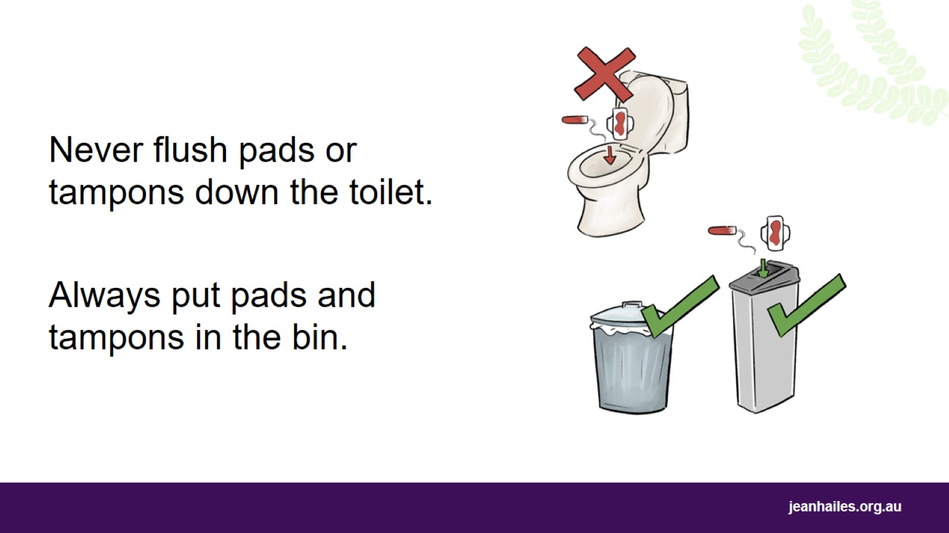
Notes:
Never flush pads or tampons down the toilet.
If you flush pads or tampons, you can block the toilet and damage the plumbing.
Wrap used pads and tampons in toilet paper and put them in the rubbish or sanitary bin.

Slide 27
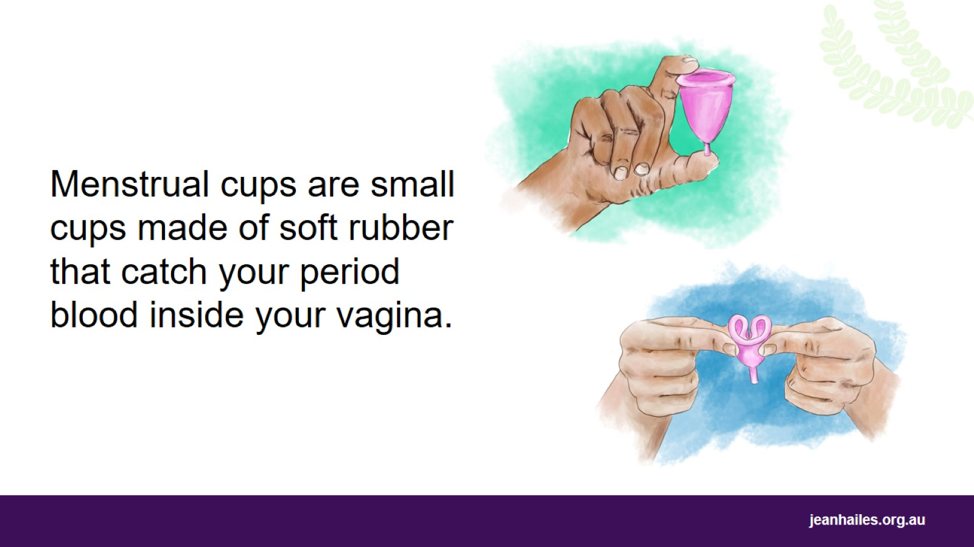
Notes:
Menstrual cups are soft cups that you can insert into your vagina. They catch your period blood. They have different shapes and sizes.
To insert a menstrual cup, you need to fold it and insert it into your vagina like a tampon. The cup unfolds inside your vagina and catches your period blood.
Once you remove it, empty it, rinse it with water and insert it again.
You can wear a menstrual cup for up to 12 hours at a time. It is safe to wear it overnight.
Menstrual cups can hold 2–3 times more blood than a pad or tampon.
You can reuse the same cup for up to 10 years.
It might take some practice before you’re confident in using menstrual cups.

Slide 28
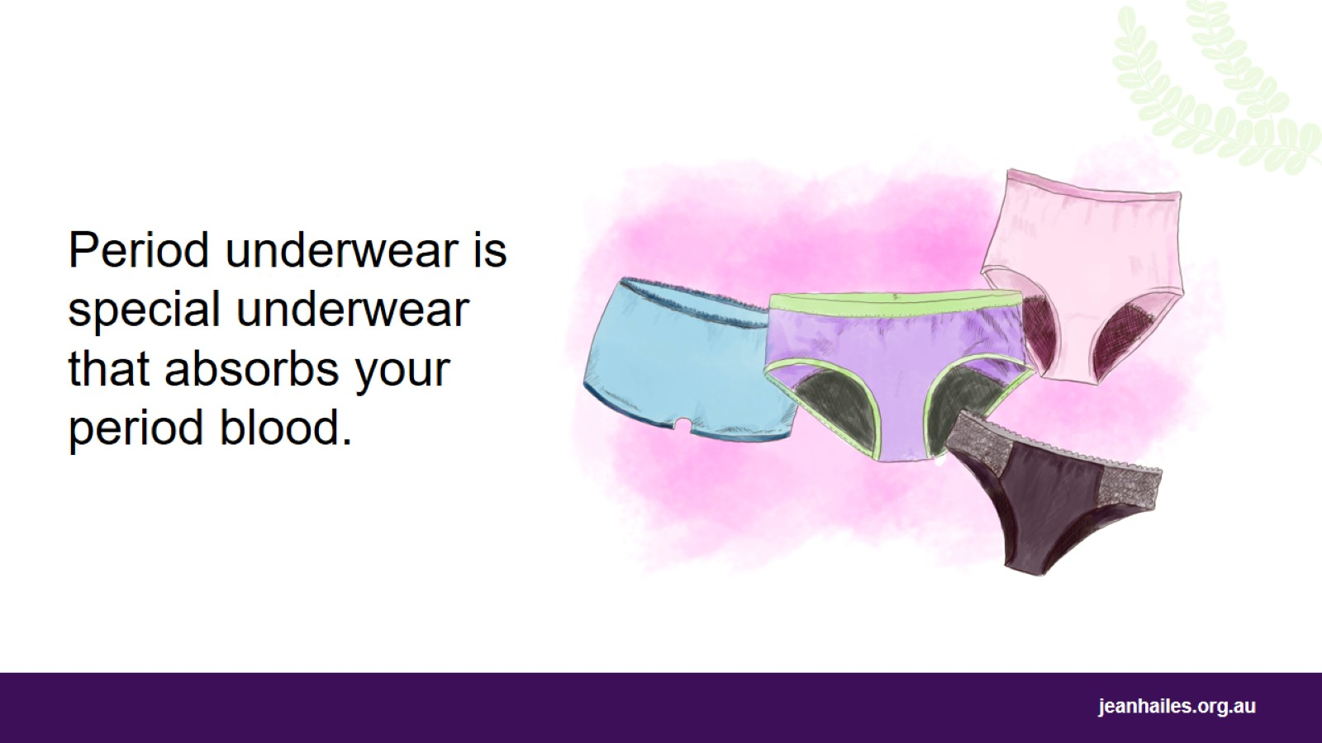
Notes:
Period underwear is special underwear that absorbs your period blood. It looks like normal underwear but has a lining that acts like a pad.
Depending on how heavy your period is, you can wear period underwear for up to 12 hours. You can wear it overnight.
You can wash and reuse your period underwear.
You can use period underwear on its own or as a backup for tampons or a menstrual cup when your period is heavy.

Slide 29
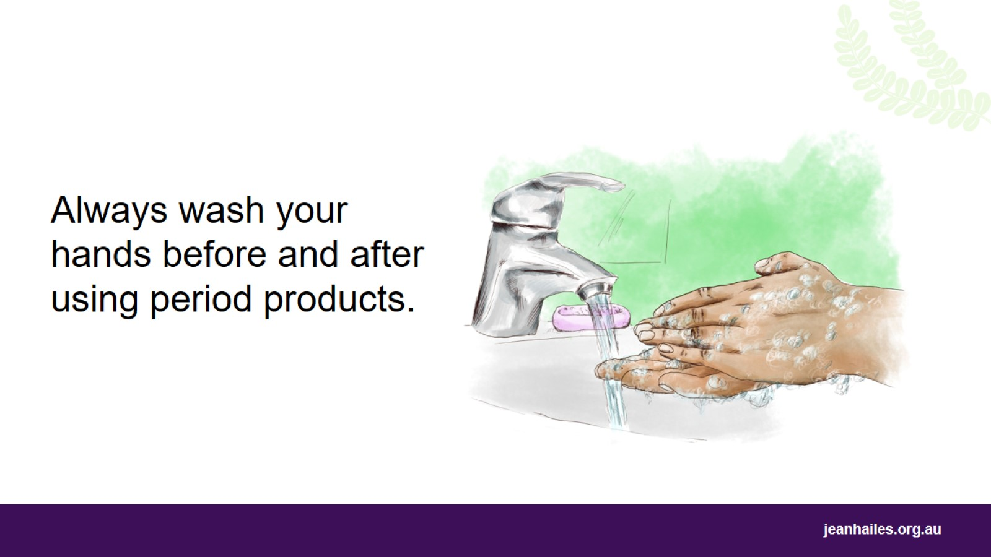
Notes:
Always wash your hands before and after using period products.

Slide 30
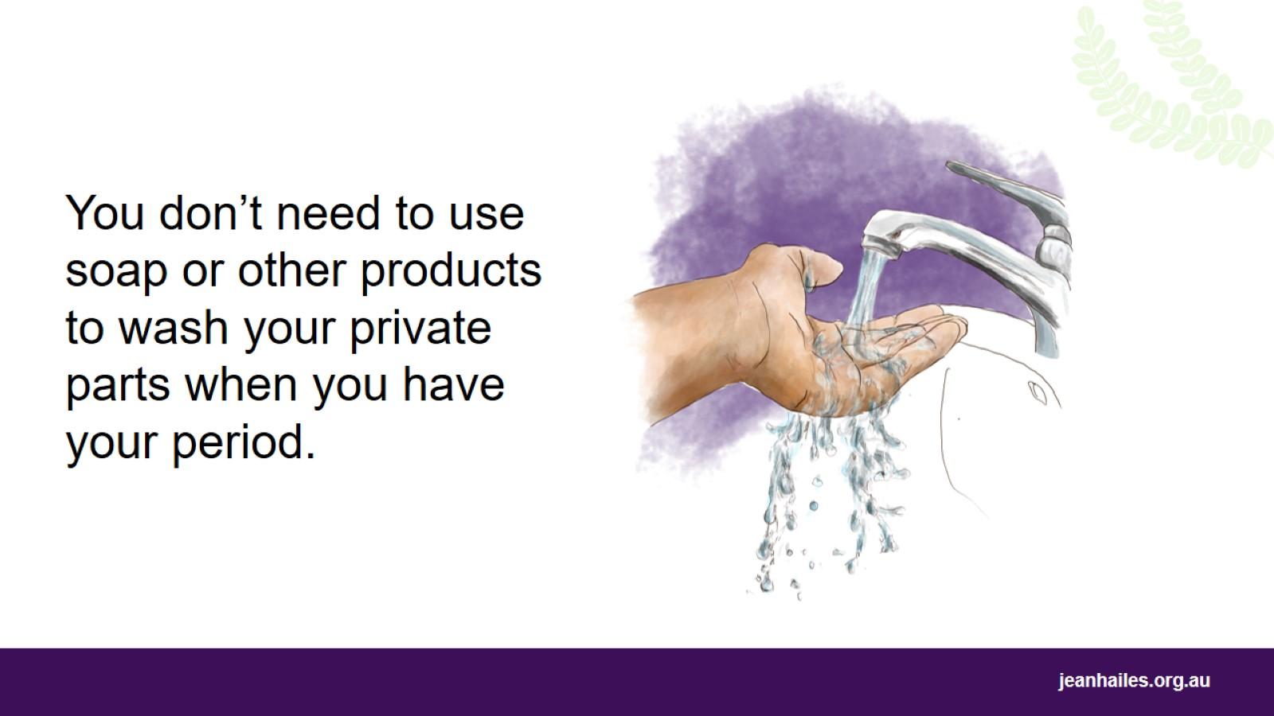
Notes:
You don’t need to use soap, shower gels or special products to wash your private parts.
It’s enough to gently wash your private parts with water to stay clean when you have your period.
Using soaps and other products on your private parts can make your skin feel dry or itchy.

Slide 31
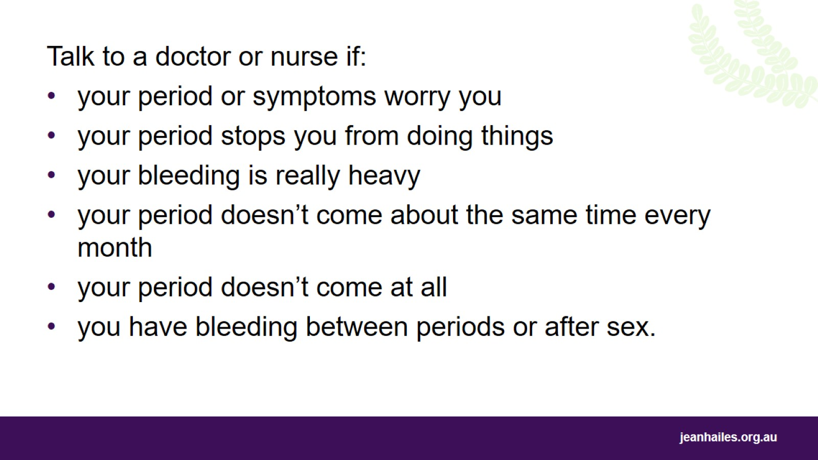
Notes:
You should talk to a doctor or nurse if:
your period or menstrual cycle worries you
your period stops you from doing things
your bleeding is really heavy
your period doesn’t come at around the same time every month
your period doesn’t come at all
you have bleeding between periods or after sex.

Slide 32
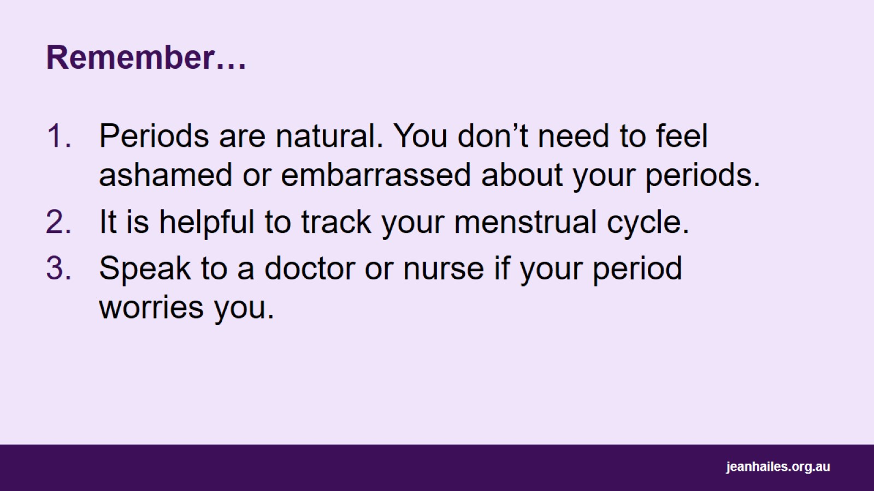
Remember…
Notes:
Remember:
Periods are natural. You don’t need to feel ashamed of or embarrassed about your periods.
It is helpful to track your menstrual cycle.
Speak to a doctor or nurse if your period worries you.

Slide 33

Local services
Notes:
Note to the facilitator: provide details of local health services.

Slide 34


