Slide 1
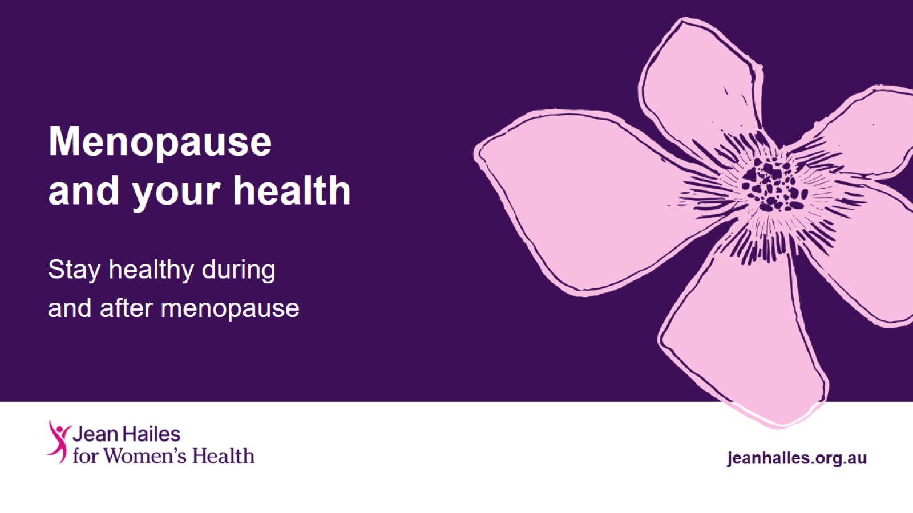
Menopause and your health

Slide 2
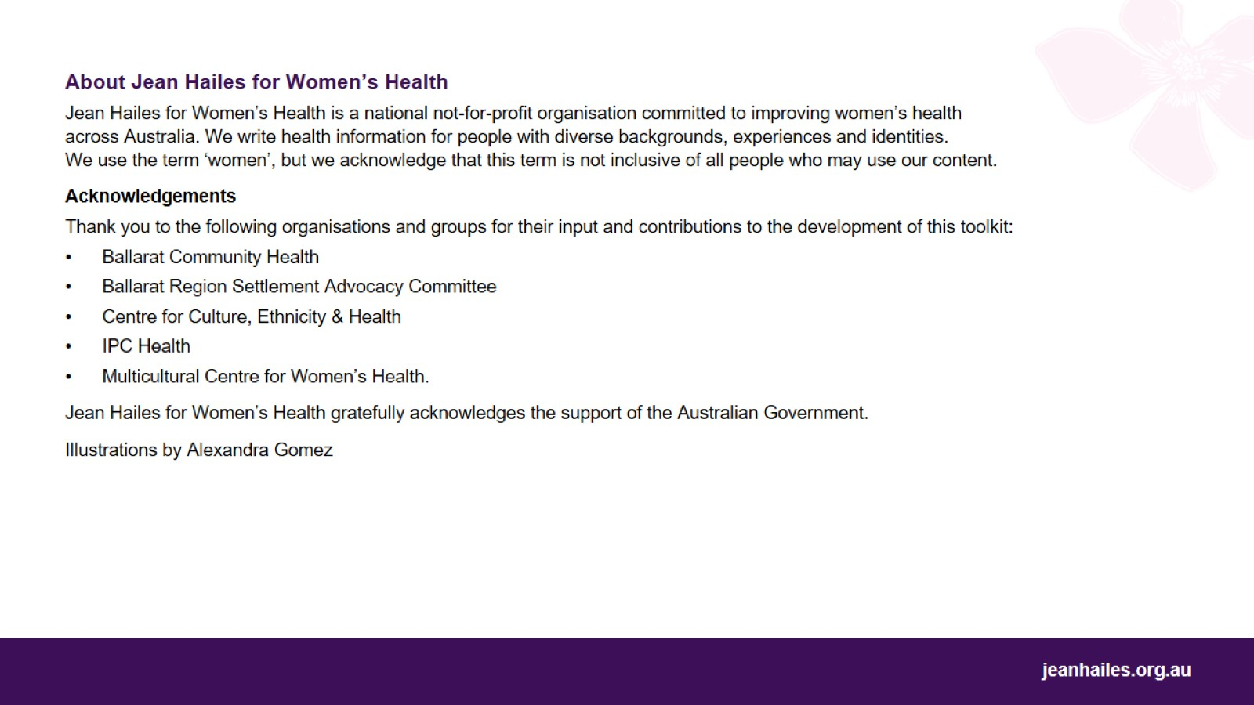

Slide 3
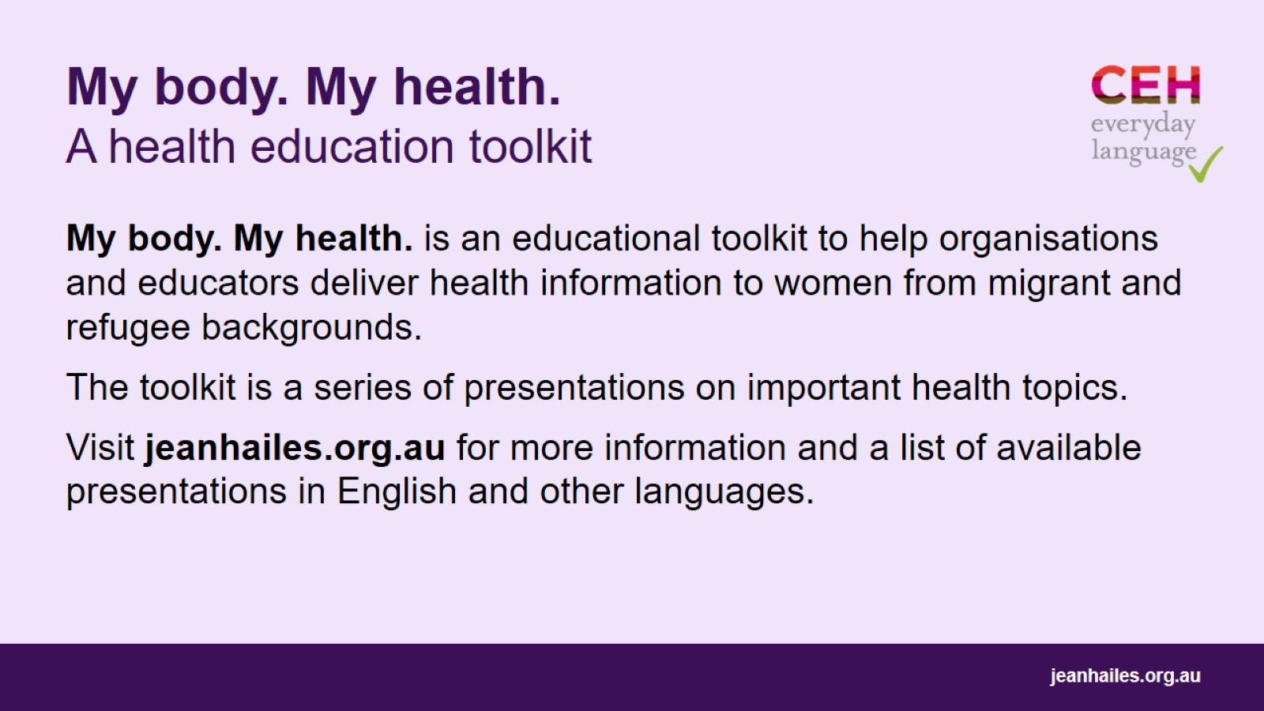
My body. My health. A health education toolkit

Slide 4
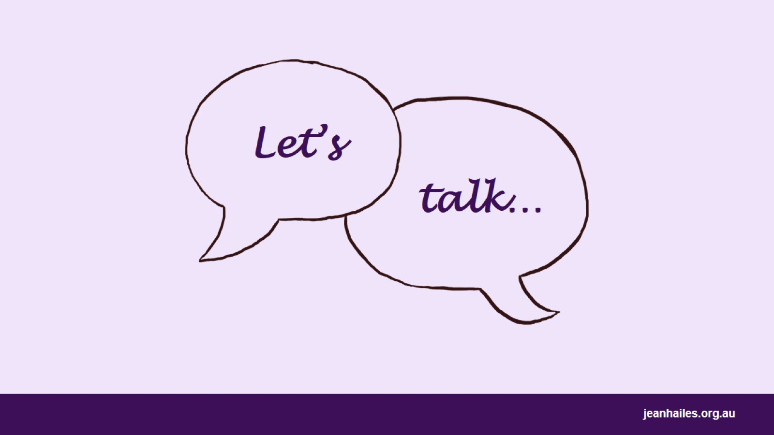
Let’s
Notes:
Today we’ll talk about menopause:
what it is
why and when it happens
what the symptoms of menopause are and how to manage them
how to take care of your health during and after menopause.
Note to the facilitator: participants from some cultures may find certain health messages confronting, such as discussions about sex and contraception. You may choose not to deliver those messages or change the way you deliver them to suit the participants.
Choose a few questions (examples below) to lead a brief group discussion on what the participants know about menopause and its impact on their health.
Questions to consider:
What is menopause?
Is it polite to discuss menopause in your home country?
Is it easy/do you feel comfortable to talk about menopause?
Are you/Were you afraid of menopause or are you/were you looking forward to it?
Where do you get information about menopause (e.g., older family members, resources from your home country)?
What menopause symptoms have you experienced?

Slide 5
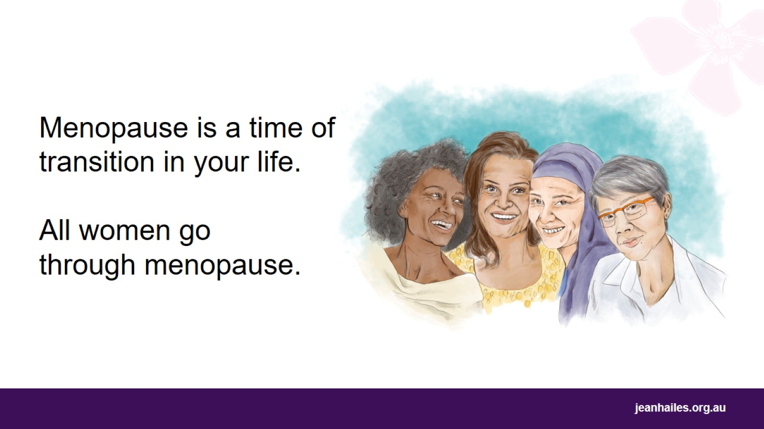
Notes:
Menopause is a time of transition in your life. It’s when your final period happens and a new stage of your life without periods begins. You may use a different name for period, for example, monthly bleeding, spotting or staining.
Menopause is a natural thing. All women go through menopause.
Menopause actually means the ceasing (end) of periods.

Slide 6
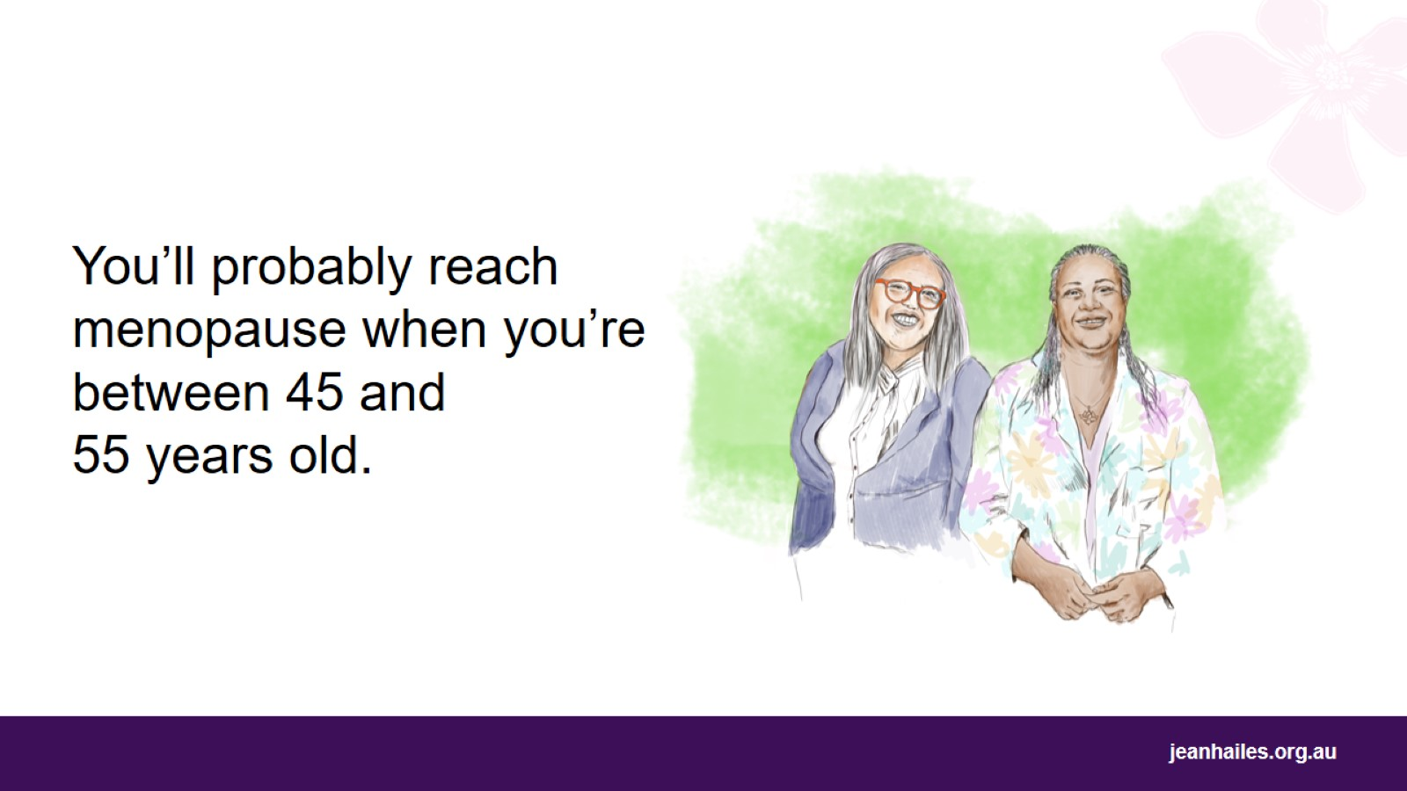
Notes:
For most women in Australia, menopause happens when they are between 45 and 55 years old.
Some women can go through menopause in their 30s or even 20s, but it is not common.
If your periods stop naturally before you’re 45, you need to see your doctor to check your health.

Slide 7
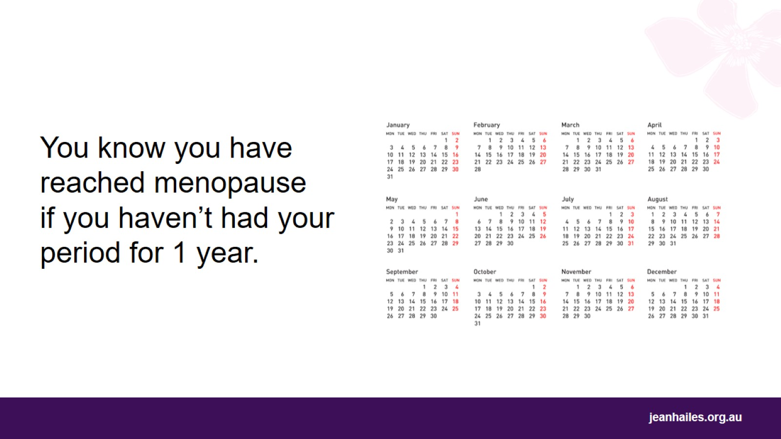
Notes:
You know you have reached menopause when you haven’t had your period for 1 year (12 months).
If you’re using contraception and don’t have periods, it’s harder to know if you’ve reached menopause. Talk to a doctor or nurse about it because you may need a blood test to confirm that you’ve reached menopause.

Slide 8
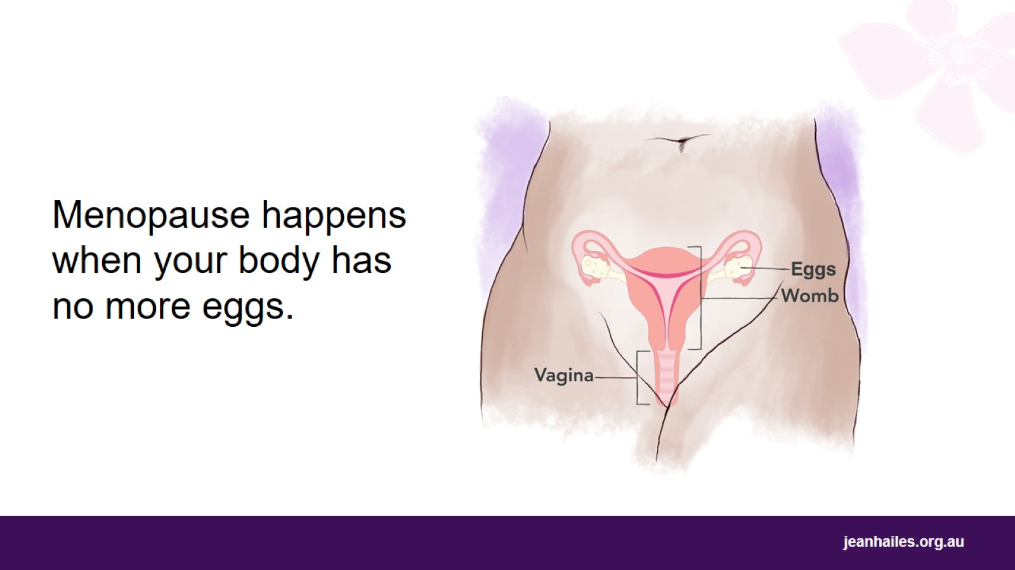
Notes:
You were born with eggs in your body. You need the eggs to be able to have a baby.
Menopause happens when your body has run out of eggs.
This means that your periods will stop, and you won’t be able to become pregnant anymore.

Slide 9
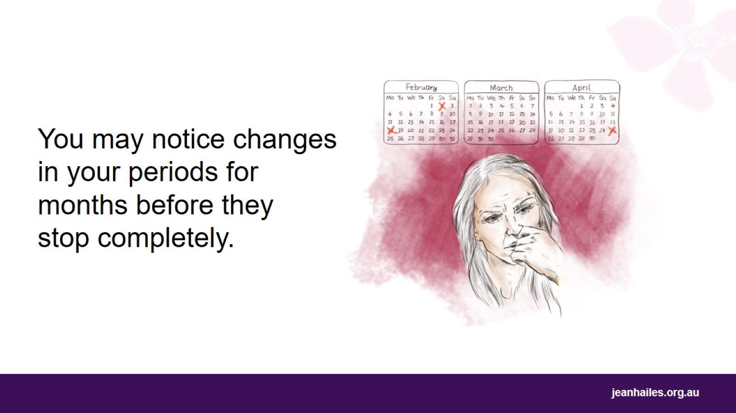
Notes:
You may notice changes in the pattern of your periods for months, even a year or two, before your periods stop completely.
You may get your periods more often or less often than before. They may become lighter or heavier than usual or last more days or fewer days.

Slide 10
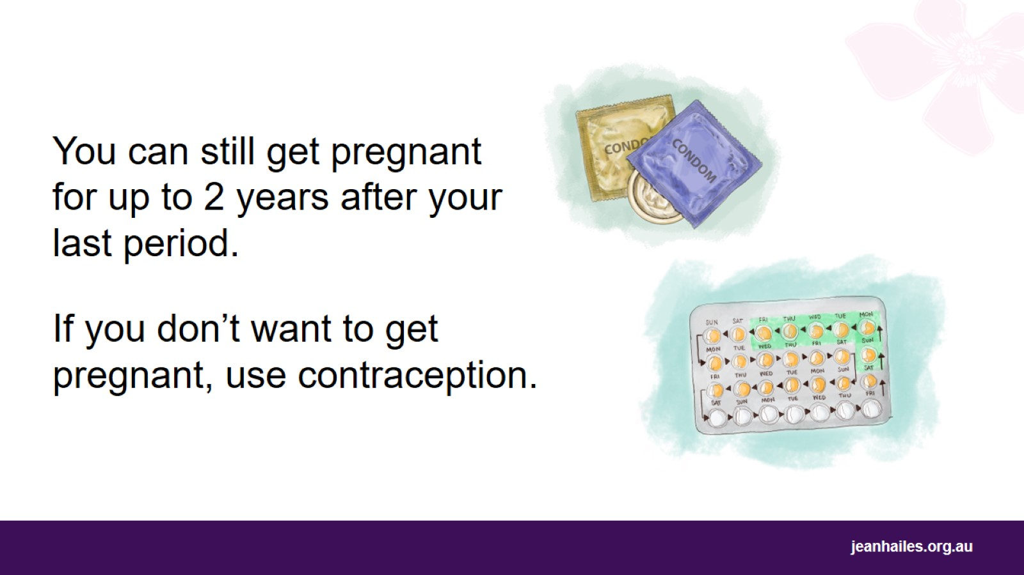
Notes:
You can still get pregnant when you’re having irregular periods and for up to 2 years after your last period.
If you don’t want to become pregnant, use contraception for up to 2 years after your last period.
Contraception is something you can do, take, or use if you have sex but don’t want to get pregnant, like using condoms or taking special pills that stop women from getting pregnant.
Note to the facilitator: you may omit this message or deliver it differently if it’s not appropriate for the participants.

Slide 11
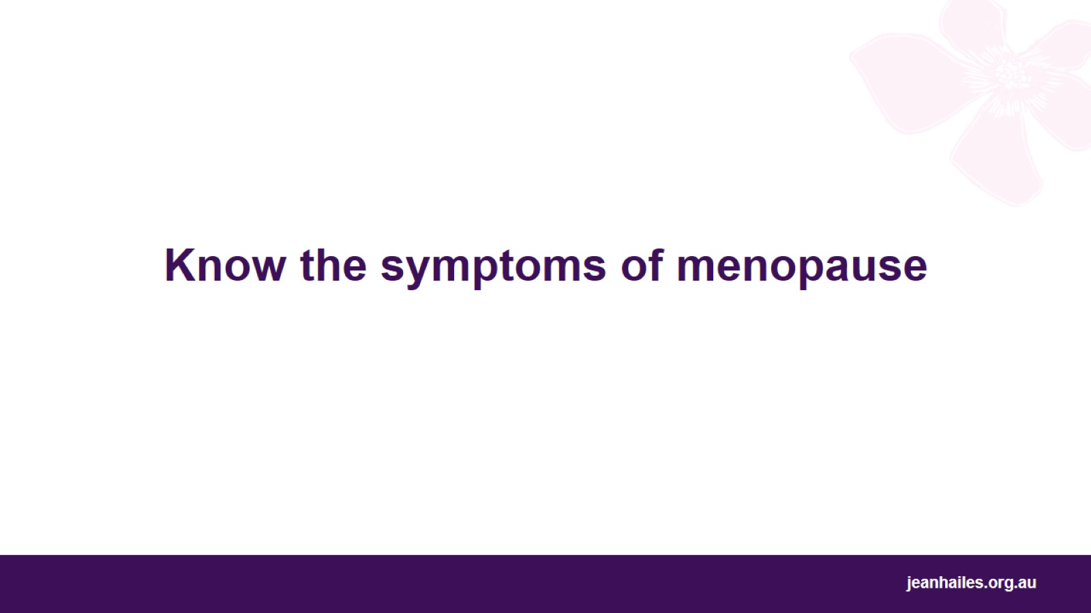
Know the symptoms of menopause
Notes:
Let’s talk about the symptoms of menopause.

Slide 12
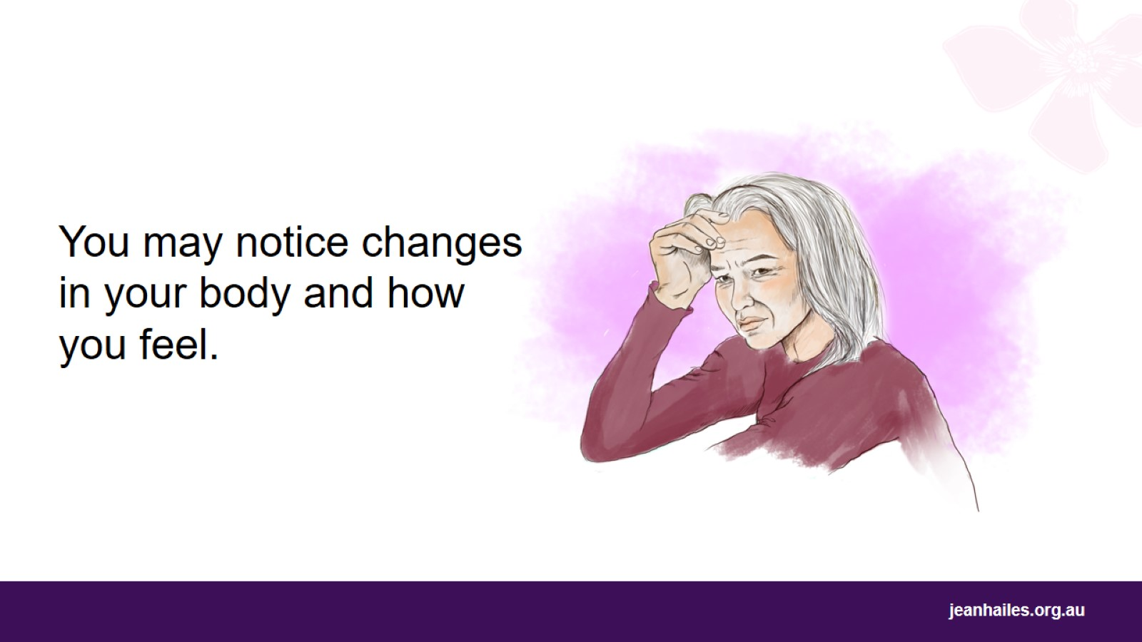
Notes:
Around the time of menopause, you may also notice changes in your body and how you feel. These changes are the symptoms of menopause.

Slide 13
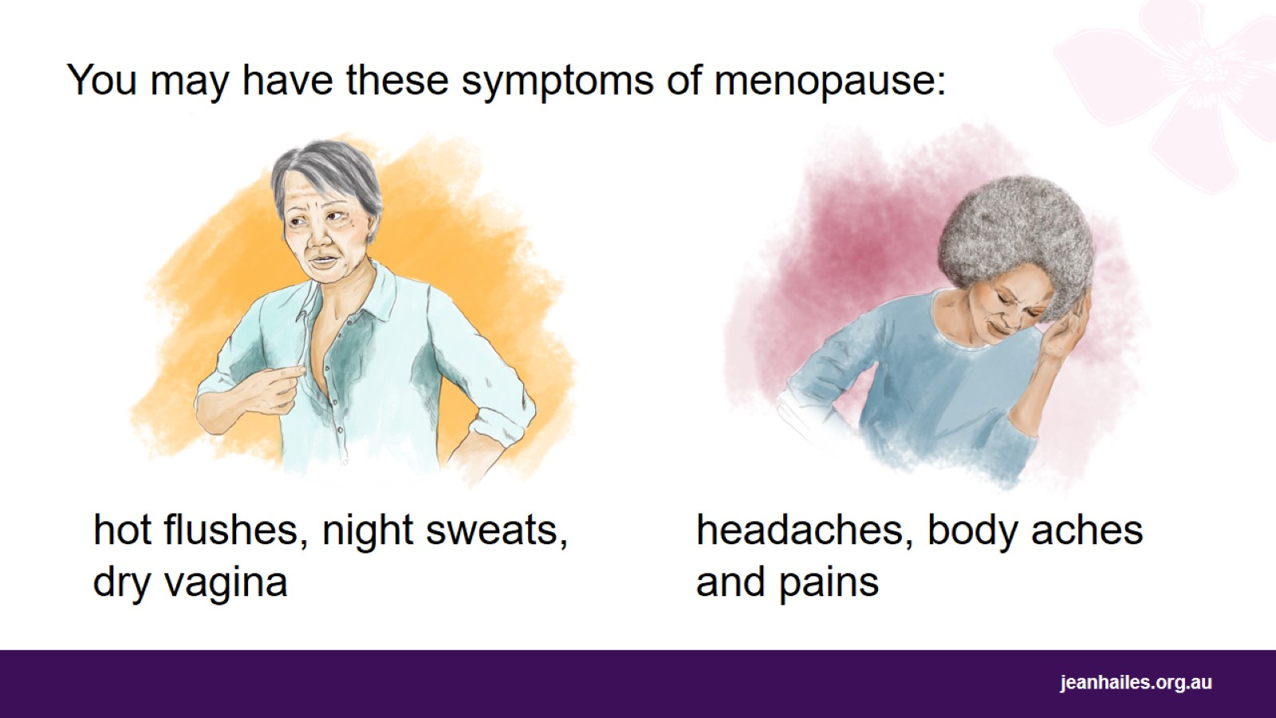
You may have these symptoms of menopause:
Notes:
You may have these symptoms of menopause:
hot flushes – when you suddenly feel hot and start sweating
night sweats – when you sweat a lot during the night, making your clothes and bedsheets wet
a dry vagina, which can cause sex to be painful for you
pain when weeing and repeated infections
body aches and pains – when your body feels sore
headaches.
Many women have these symptoms.

Slide 14
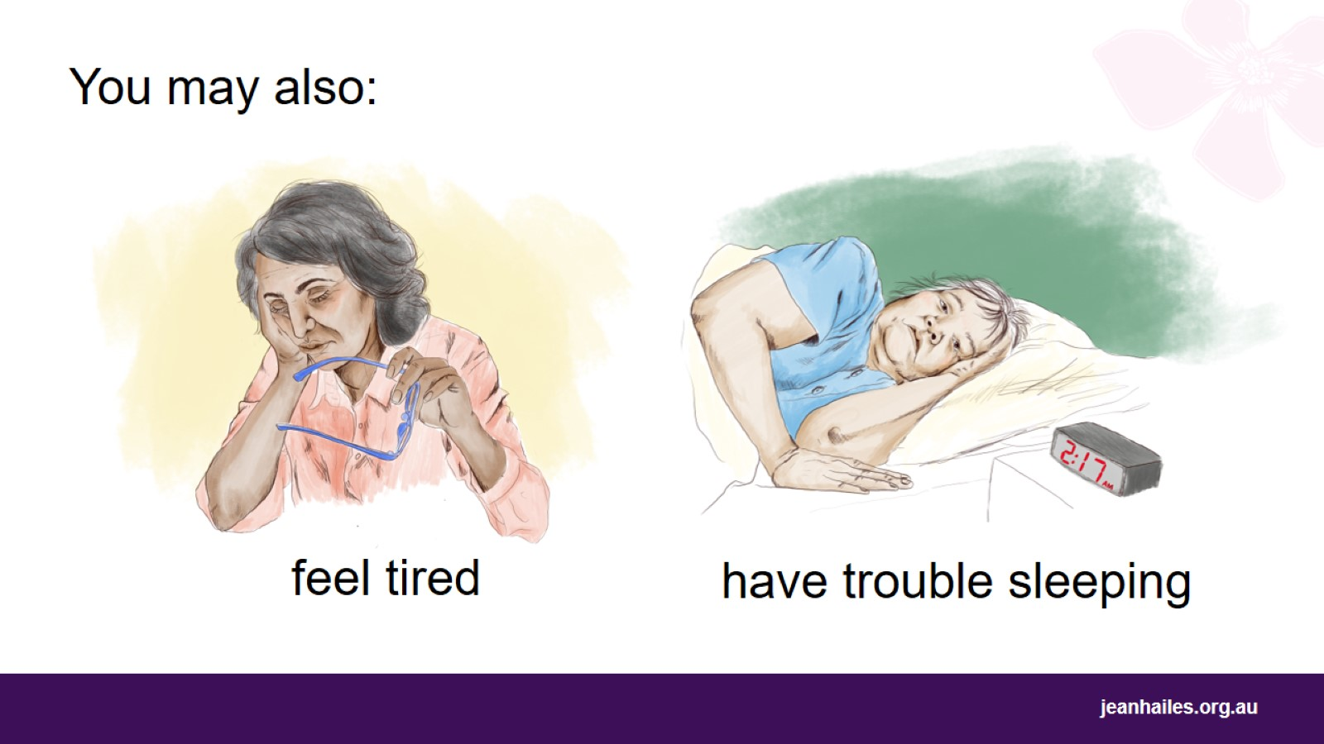
You may also:
Notes:
You may also:
feel tired more than usual
Have trouble falling asleep or staying asleep.

Slide 15
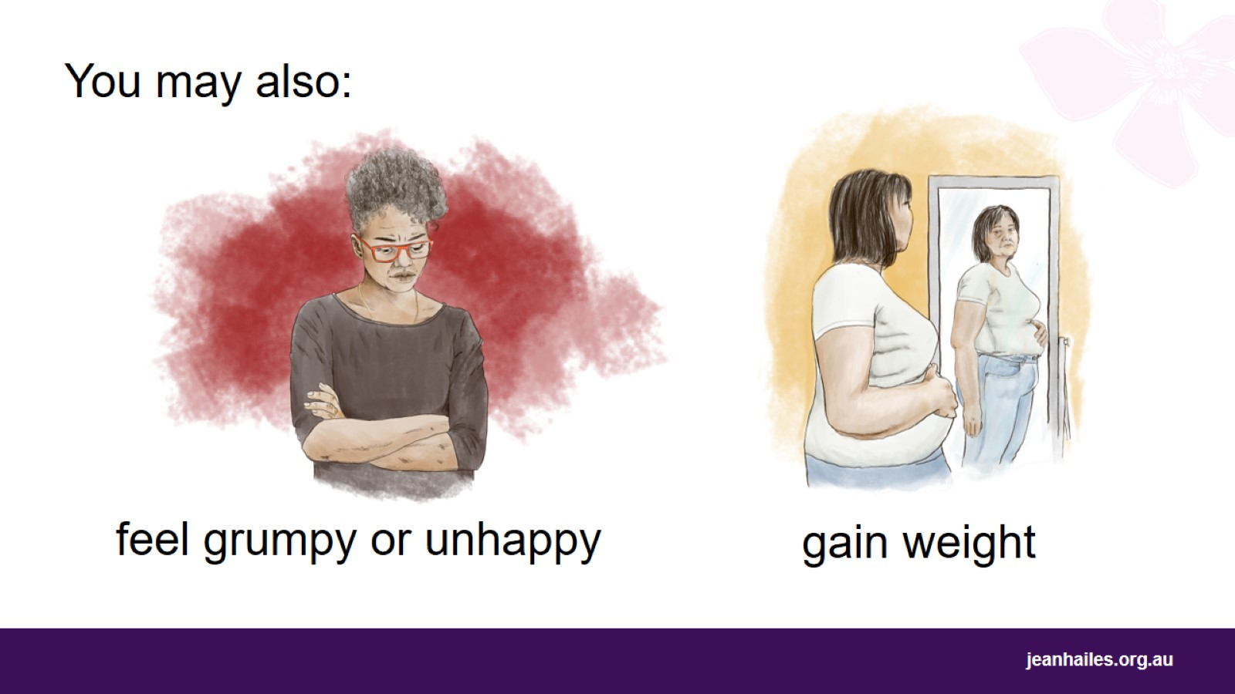
You may also:
Notes:
You may also:
feel grumpy or unhappy
gain weight, especially around your waist.

Slide 16
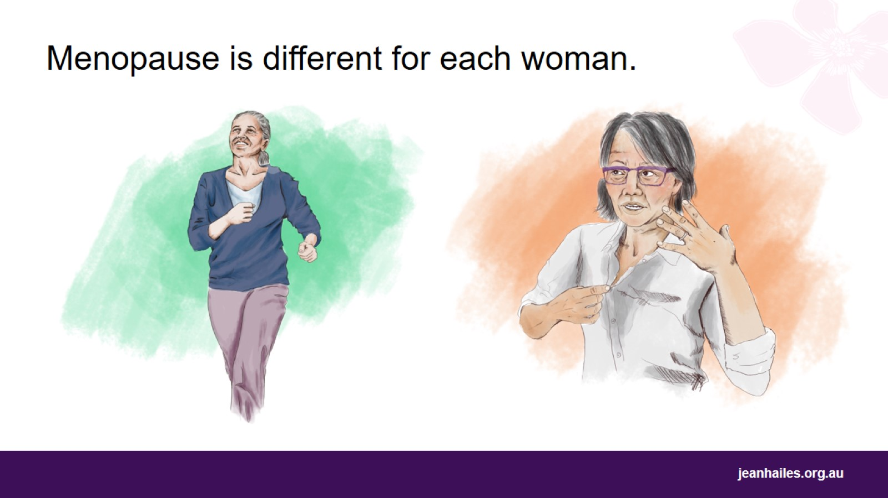
Menopause is different for each woman.
Notes:
Each woman will have a different experience with menopause.
You may have no symptoms, you may have only a few symptoms, or you may have symptoms that you find very hard to cope with.

Slide 17
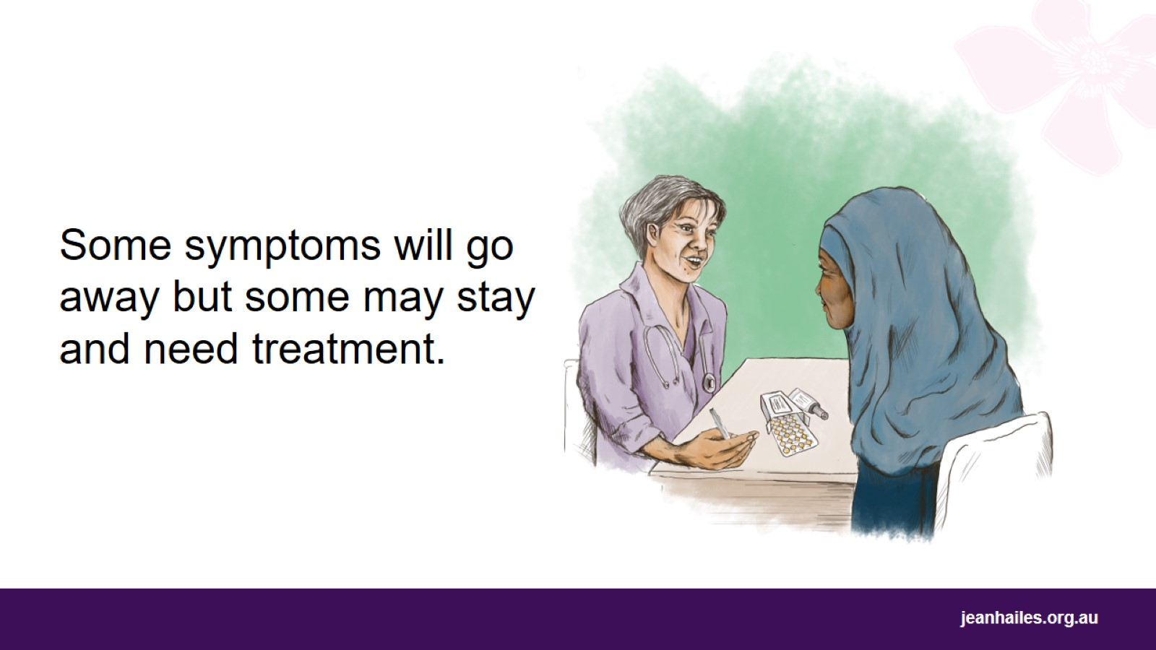
Notes:
The common symptoms, like feeling hot and sweaty, will often go away on their own. Many women can cope with these symptoms without any medical treatment.
Some changes in your body, like a dry vagina, may be ongoing and may need medical treatment to help you cope with them.
Let’s now talk about what we can do to ease the symptoms and feel better.

Slide 18
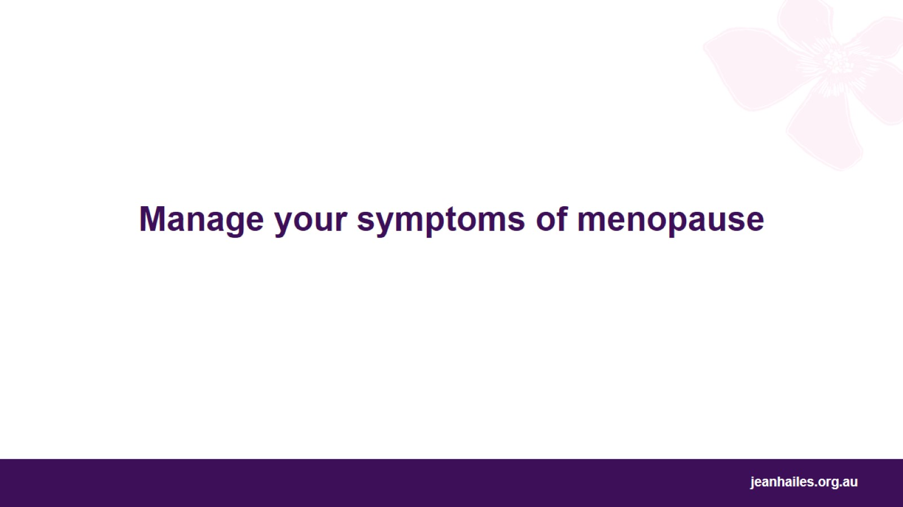
Manage your symptoms of menopause
Notes:
If menopause symptoms bother you, you can try different things to feel better.

Slide 19
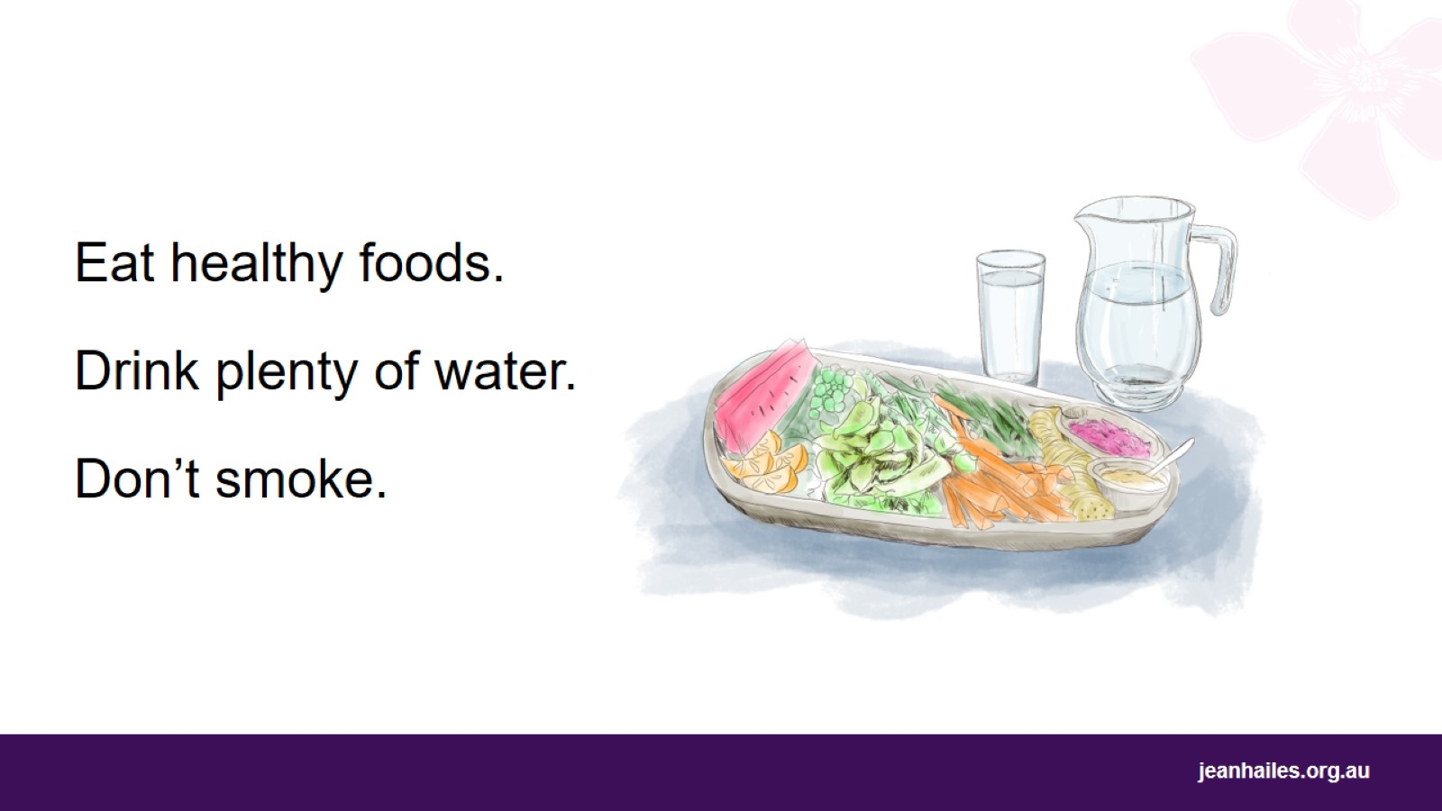
Notes:
To feel better and to stay healthy during and after menopause:
eat healthy foods – vegetables, fruit, whole grains, lean meats (with not much fat), fish, milk, and natural yoghurt
drink plenty of water – aim for 2 litres, which is 8 cups, of fluids a day, most of it water
don’t smoke.

Slide 20
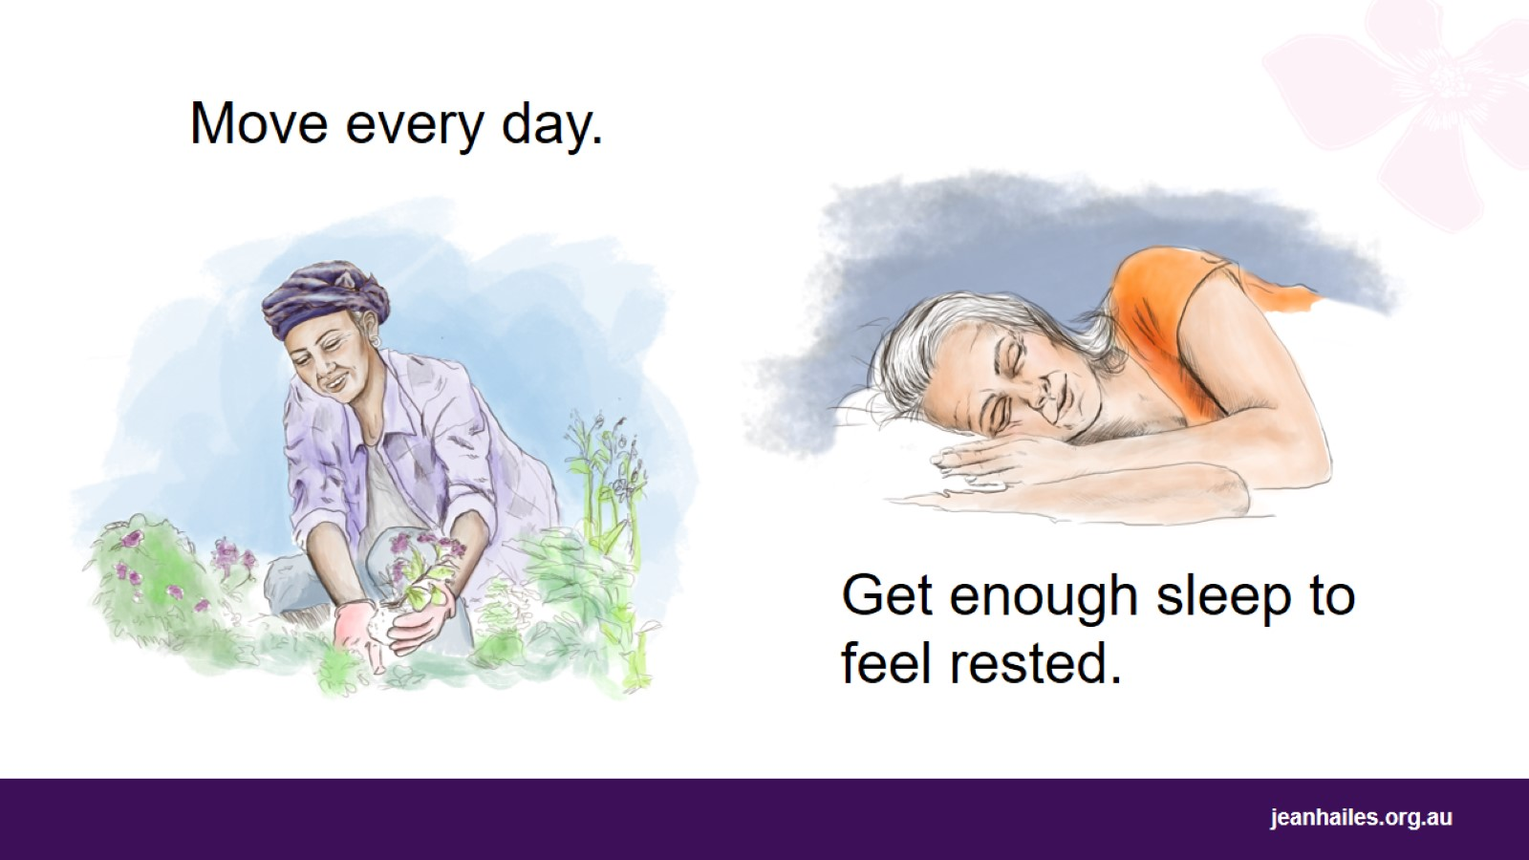
Get enough sleep to feel rested.
Notes:
Move every day. For example, go for walks, exercise, work in the garden, swim, dance.
Get around 8 hours of sleep every night.

Slide 21
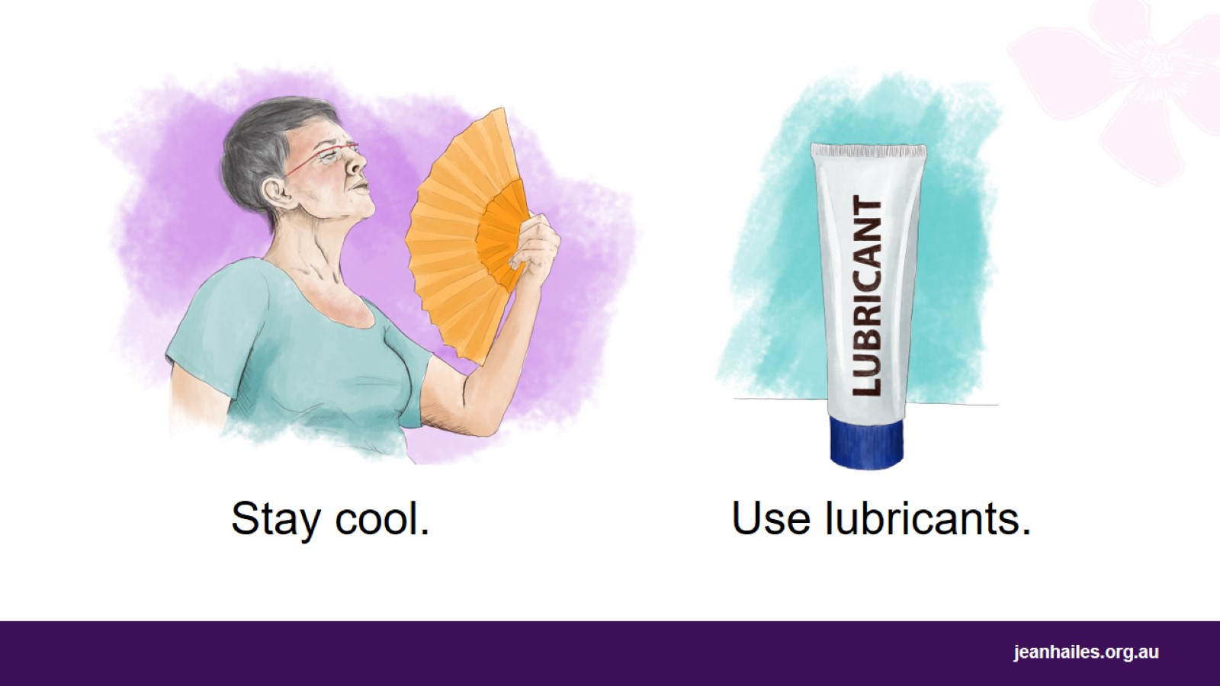
Notes:
Try to stay cool:
use fans or air conditioning, hand fans and water sprays
wear layers of clothing that you can easily take off when you are hot
have cold drinks.
Use lubricants. Lubricants are special gels, liquids and oils that you can apply inside your vagina and on your partner's penis to make the vagina more moist and to avoid pain during sex. You can buy them at the pharmacy or supermarket.
Note to the facilitator: you may omit the message about lubricants or deliver it differently if the wording provided is not appropriate for the participants.

Slide 22
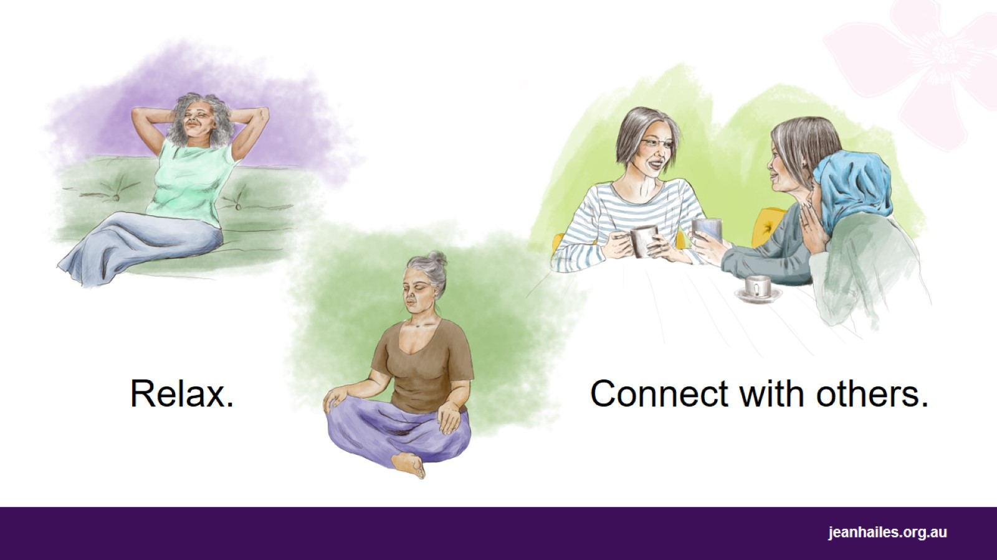
Notes:
Try things like yoga or meditation to help you relax.
Connect with other people – spend time with your family, call your friends or go for a walk or a meal with them, chat with neighbours.

Slide 23
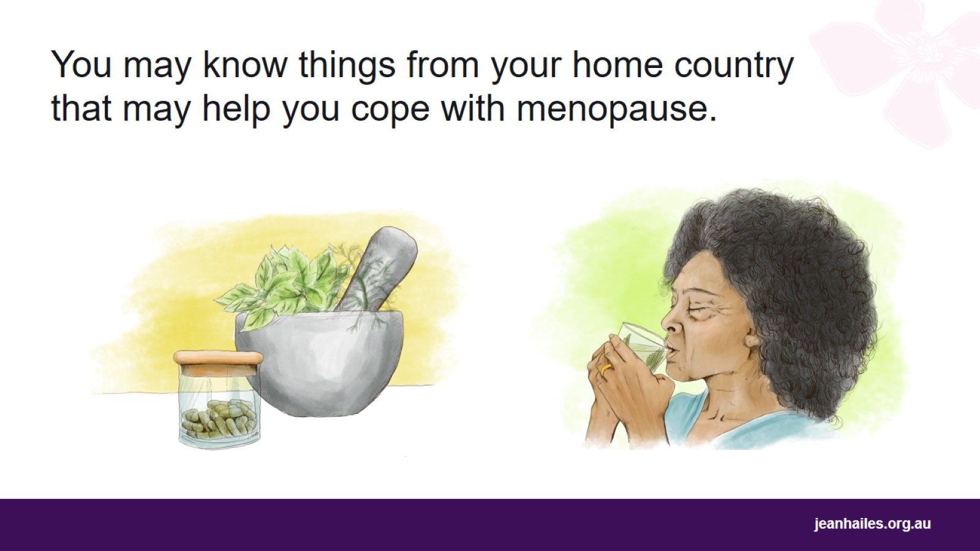
You may know things from your home country that may help you cope with menopause.
Notes:
You may know things from your home country and your culture that may help you cope with your symptoms of menopause.
Some of those things are OK but some may not be safe. Talk to your doctor or nurse if you’re not sure about them.

Slide 24
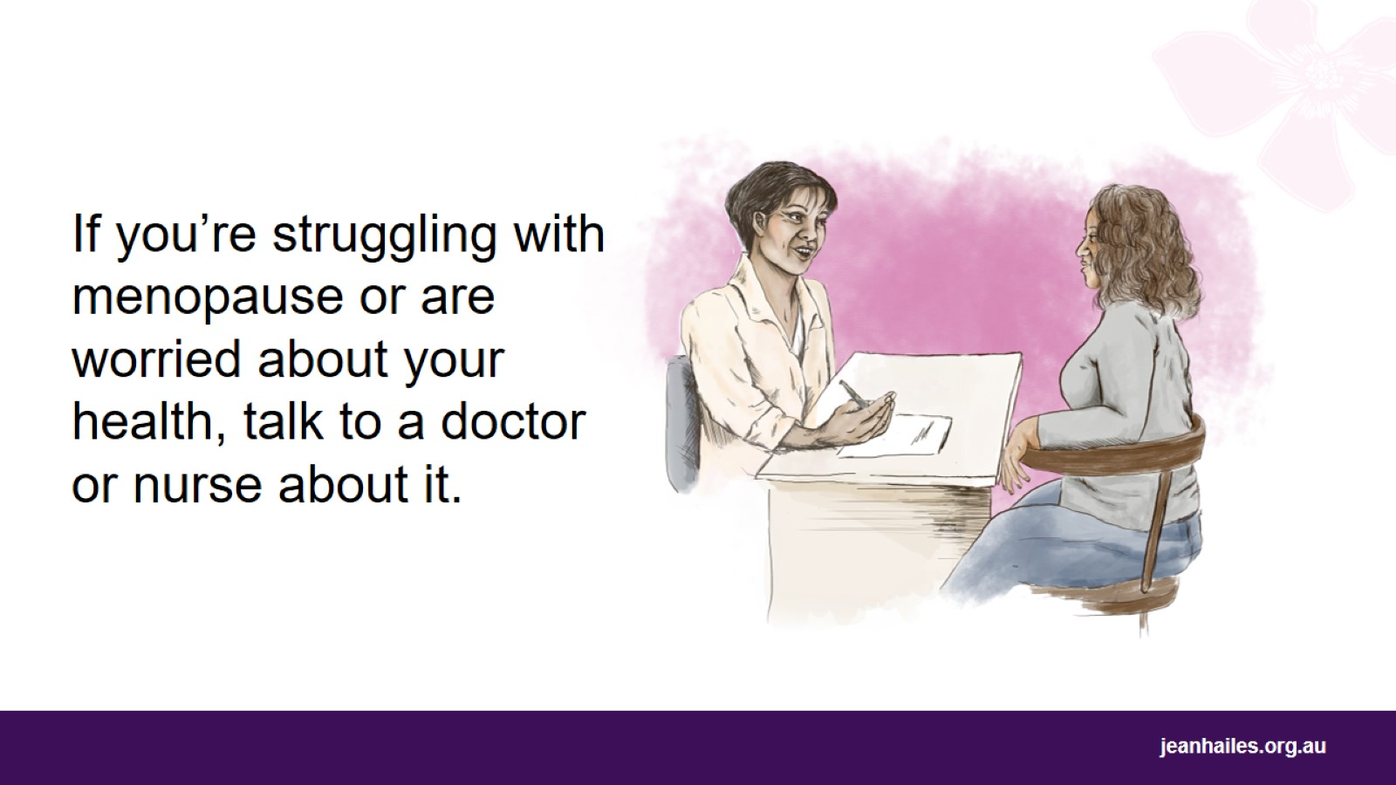
Notes:
Talk to your doctor or nurse if:
it’s too hard for you to cope with menopause
menopause symptoms are bothering you or stopping you from doing what you want to do in your everyday life
you are worried about your health.

Slide 25
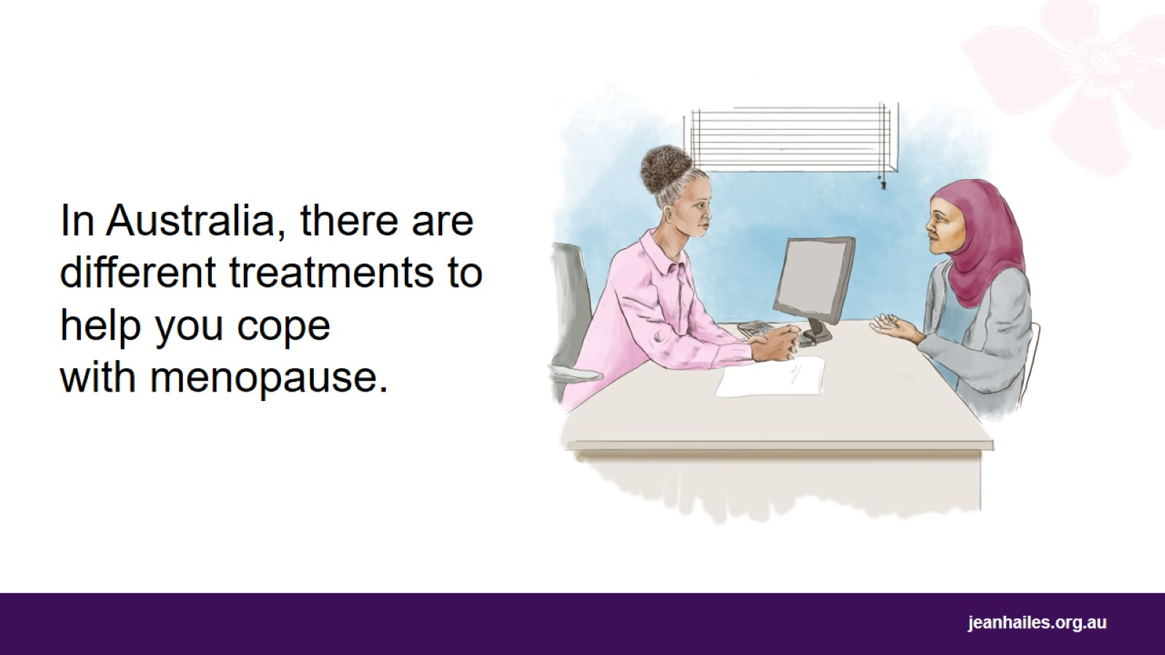
Notes:
In Australia, there are different treatments available to help you cope with the menopause symptoms.
Make an appointment to see your doctor or nurse to talk about different options and find a treatment that is right for you.
A doctor can also recommend medicine for you to help you feel better.

Slide 26
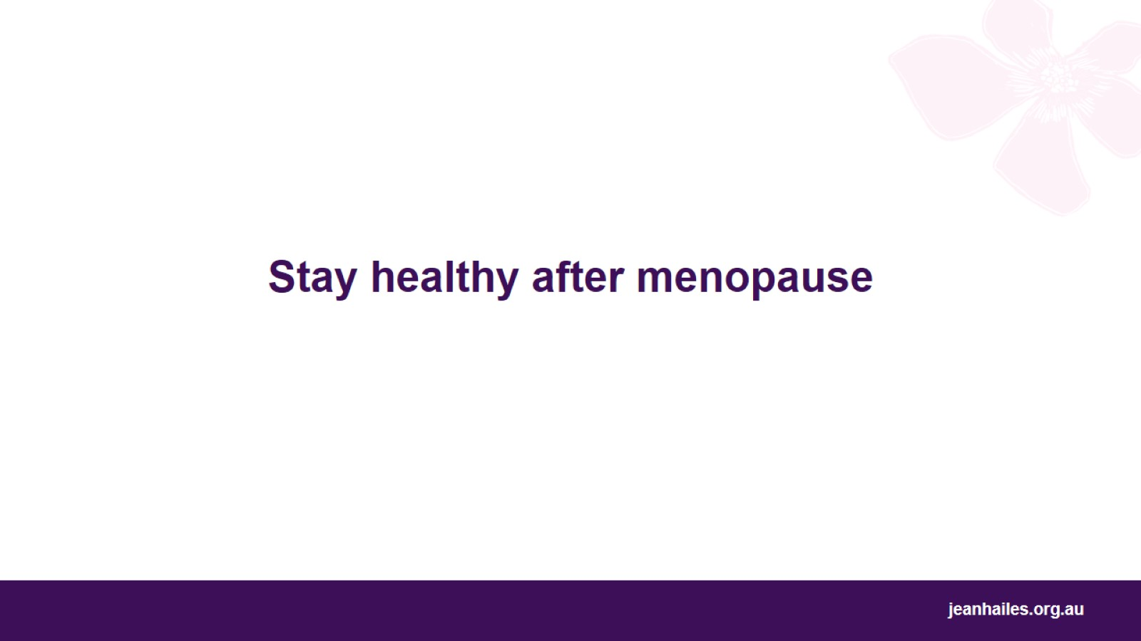
Stay healthy after menopause
Notes:
It’s very important that you stay healthy after menopause.

Slide 27
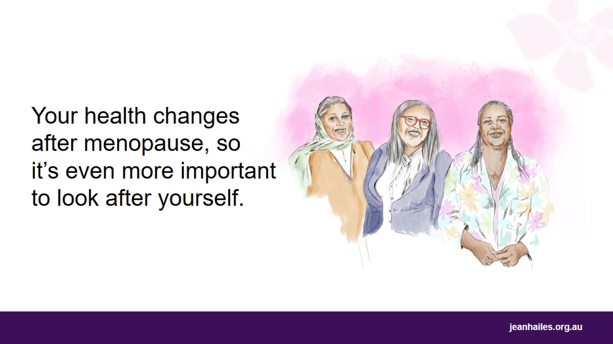
Notes:
Your health changes after menopause. You have more chance of getting these illnesses:
heart disease – for example, a heart attack or a stroke
osteoporosis – when your bones become weak and can break more easily
type 2 diabetes – when there’s too much sugar in your blood, which can damage some parts of your body
dementia – an illness that affects your brain
some cancers.
It’s very important that you take care of your health after menopause.

Slide 28
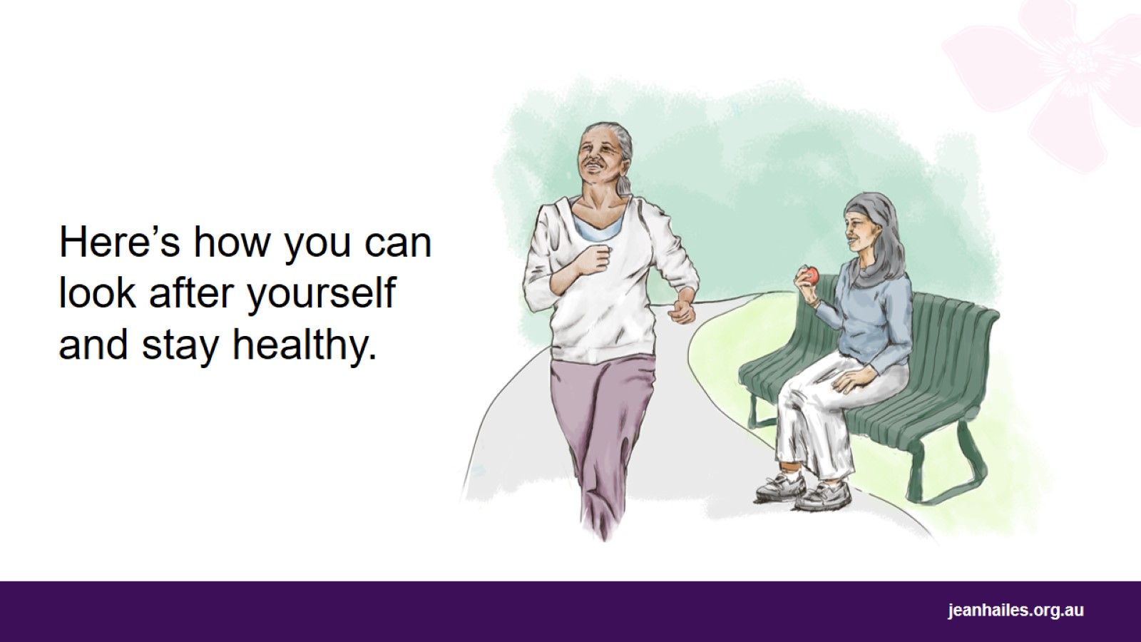
Notes:
There are many things you can do that will help you stay healthy after menopause.

Slide 29
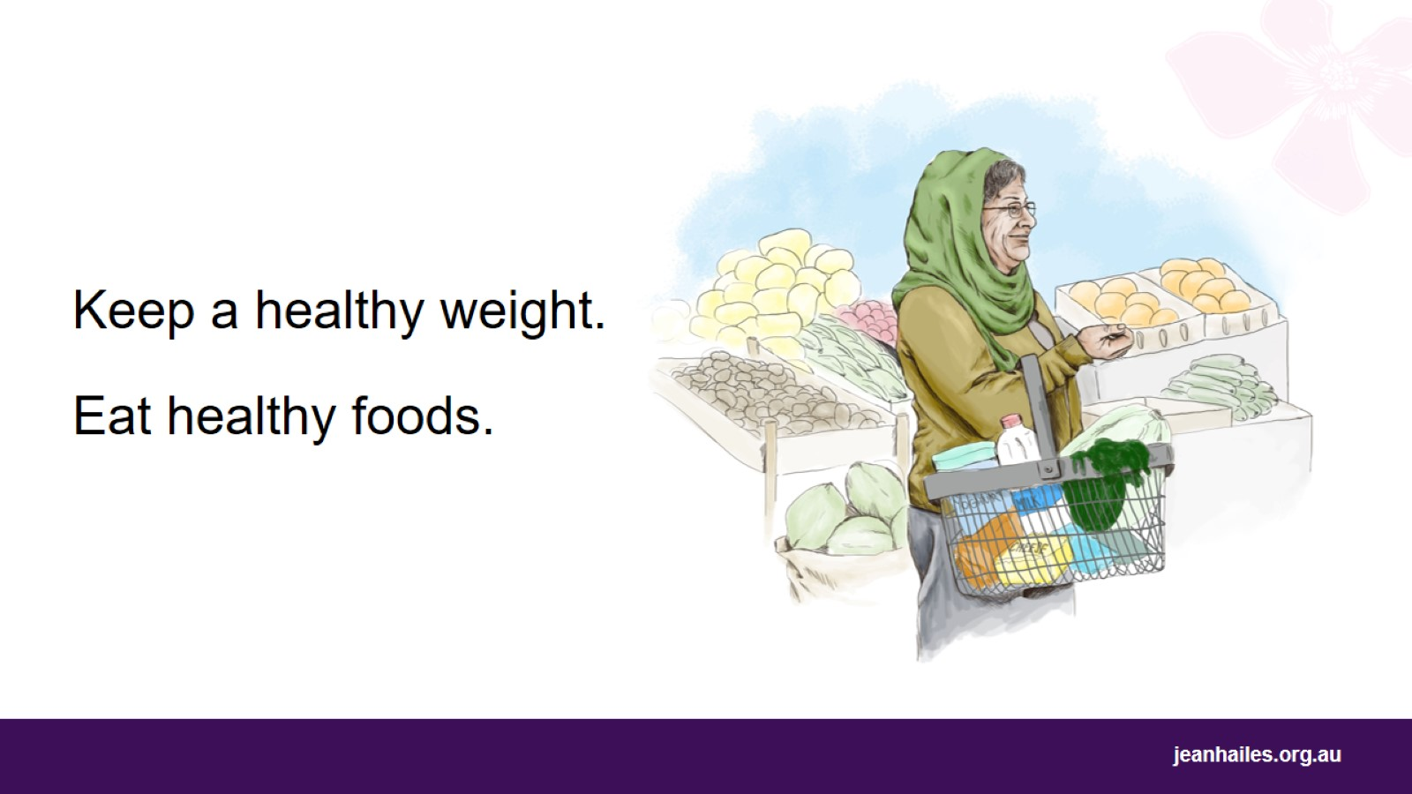
Notes:
Try to keep a healthy weight.
Eat healthy foods, such as colourful fruit and vegetables, whole grains, lean meat, chicken, fish, tofu, nuts and seeds, milk, yoghurt.
Limit:
sugary foods, such as cakes, cookies, pastries, lollies, chocolates
sugary drinks, such as soft drinks, cordials, sports and energy drinks
fried foods, such as potato chips, fast-food burgers, crisps.

Slide 30
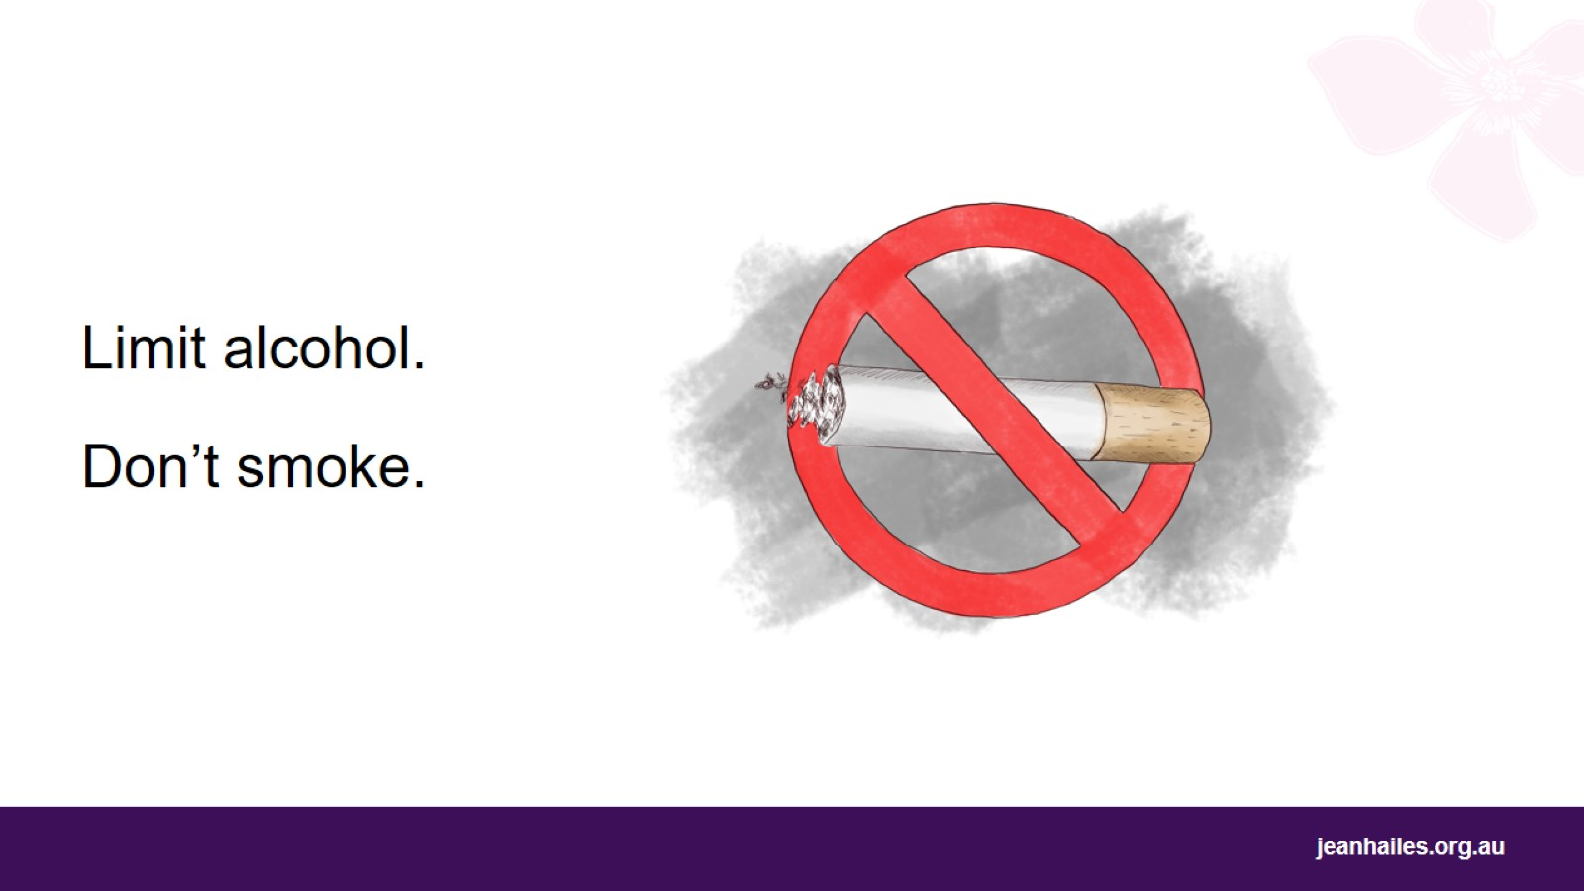
Notes:
If you drink alcohol, don’t drink more than 1 drink a day.
Don’t smoke.

Slide 31
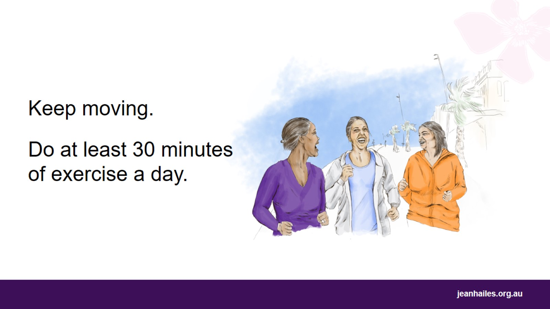
Notes:
Do some exercise - try to do at least 30 minutes of exercise every day.
You can go for a walk, swim, cycle, work in the garden or do household tasks.
Don’t sit for a long time – try to get up and move every 30 minutes.

Slide 32
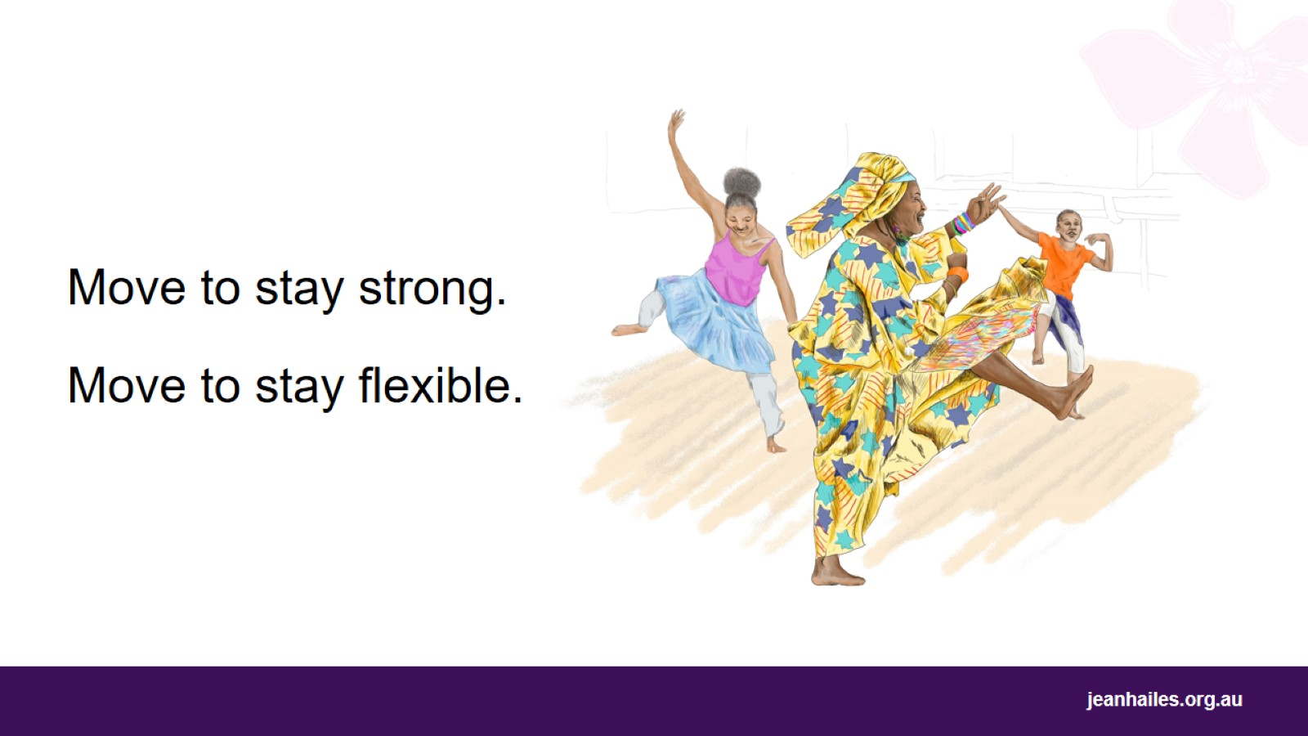
Notes:
To help you and your bones stay strong, do exercises like climbing stairs, jogging or brisk walking, skipping or dancing.
To help you stay flexible, do yoga, tai chi, stretching, or dancing.

Slide 33
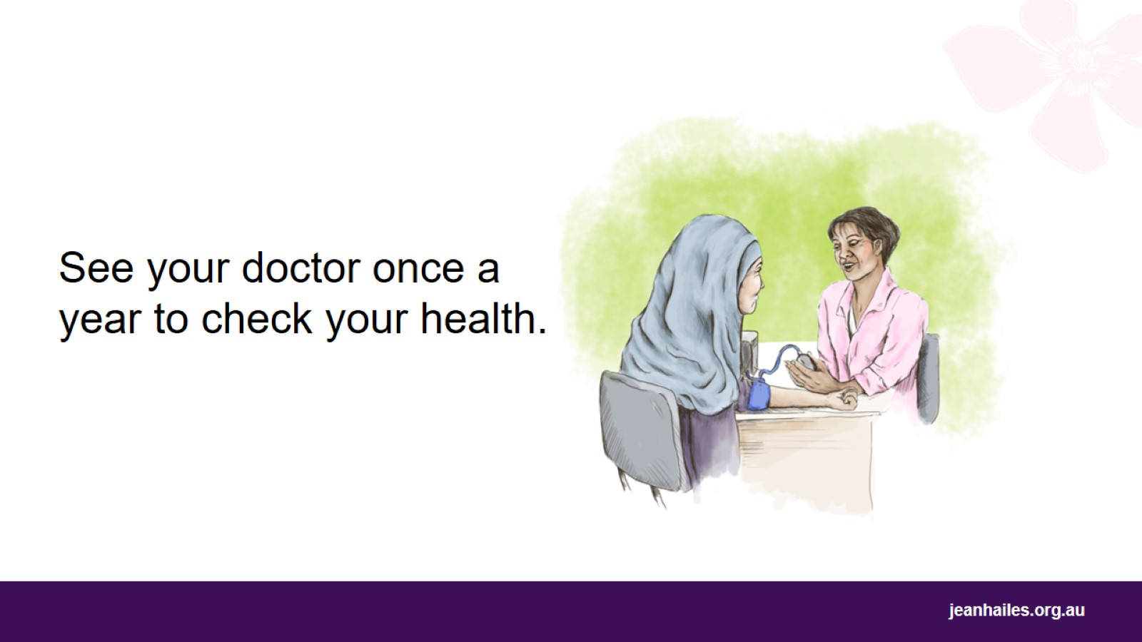
Notes:
Put a note in your calendar to visit your doctor at least once a year to check your health, even if you’re feeling well. The doctor will:
check if your blood pressure and blood sugar are good
check if your bones are still strong
tell you what tests you should have to make sure there’s no cancer in your body.
If a health problem is found early, it will be easier to treat. This way you’ll have a better chance to get healthy again.
Note to the facilitator: if the audience is familiar with health checks, you can mention the below checks. You may also choose to run the Health checks presentation from the toolkit with your audience at a later date.
Continue with regular health checks and screening tests to find any illness or medical condition early.
Have:
regular blood pressure, cholesterol and blood sugar tests
bone health and skin checks
breast screening test every 2 years – 50-74 years of age
cervical screening test every 5 years – 25-74 years of age
bowel cancer screening test every 2 years – 50-74 years of age.

Slide 34
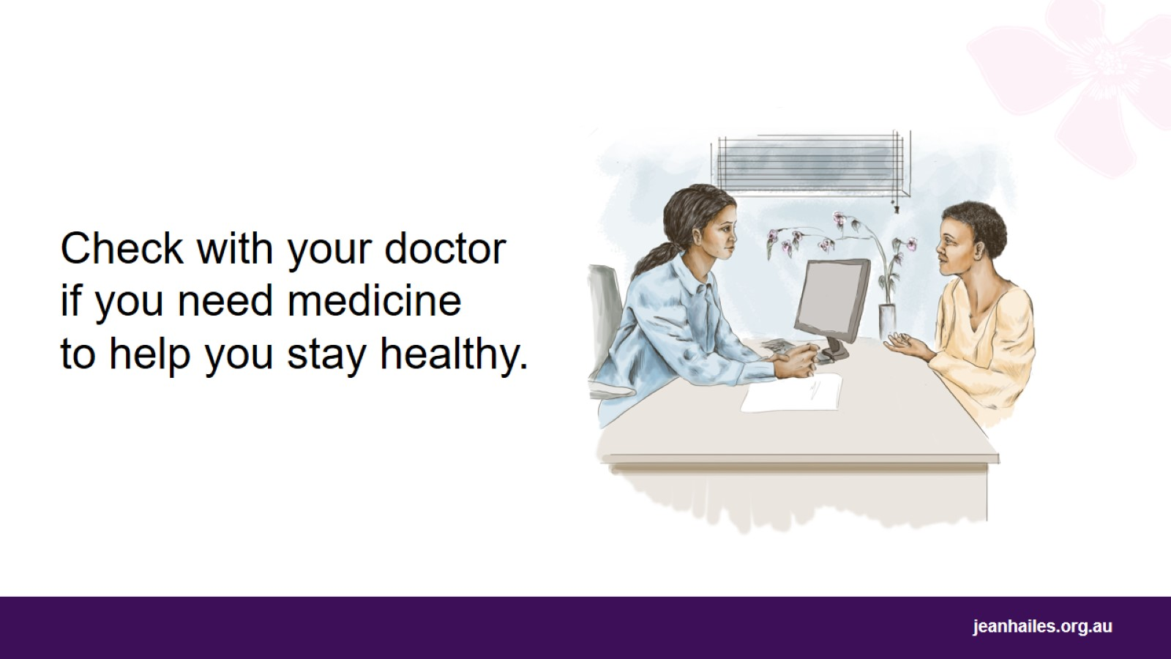
Notes:
Sometimes all those things mentioned before aren’t enough to keep you healthy.
Check with your doctor if you need medicine to help you stay healthy after menopause.

Slide 35
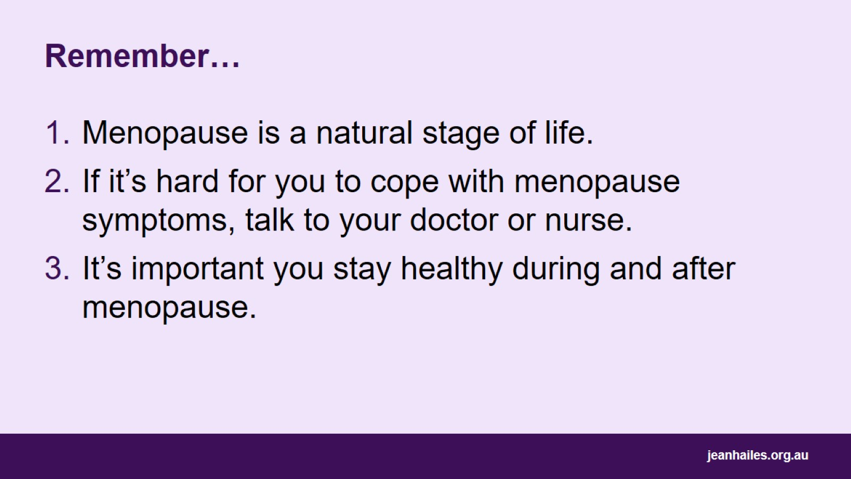
Remember…

Slide 36
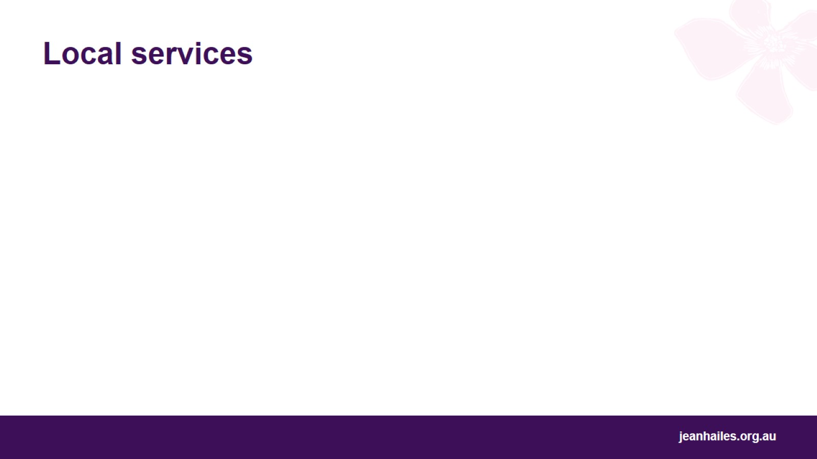
Local services
Notes:
Note to the facilitator: provide details of local health services.

Slide 37
