Slide 1

The importance of vitamin D
Notes:
Today we’ll talk about why vitamin D is important for our health and how we can get it.
Note to the facilitator: this presentation can be incorporated into another topic or be used as a standalone presentation.

Slide 2
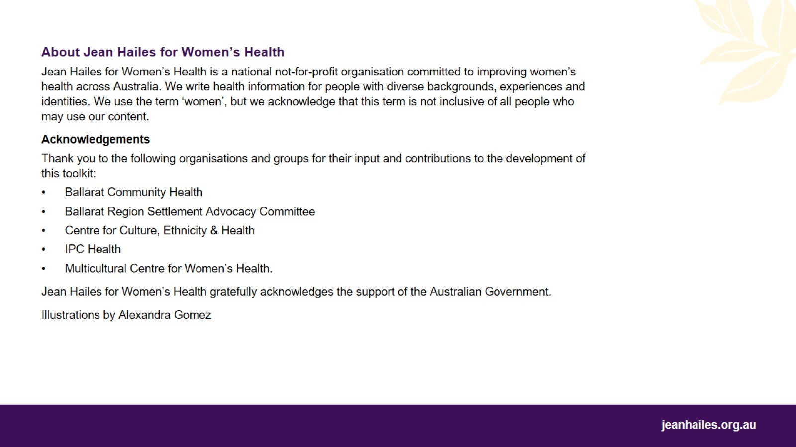

Slide 3
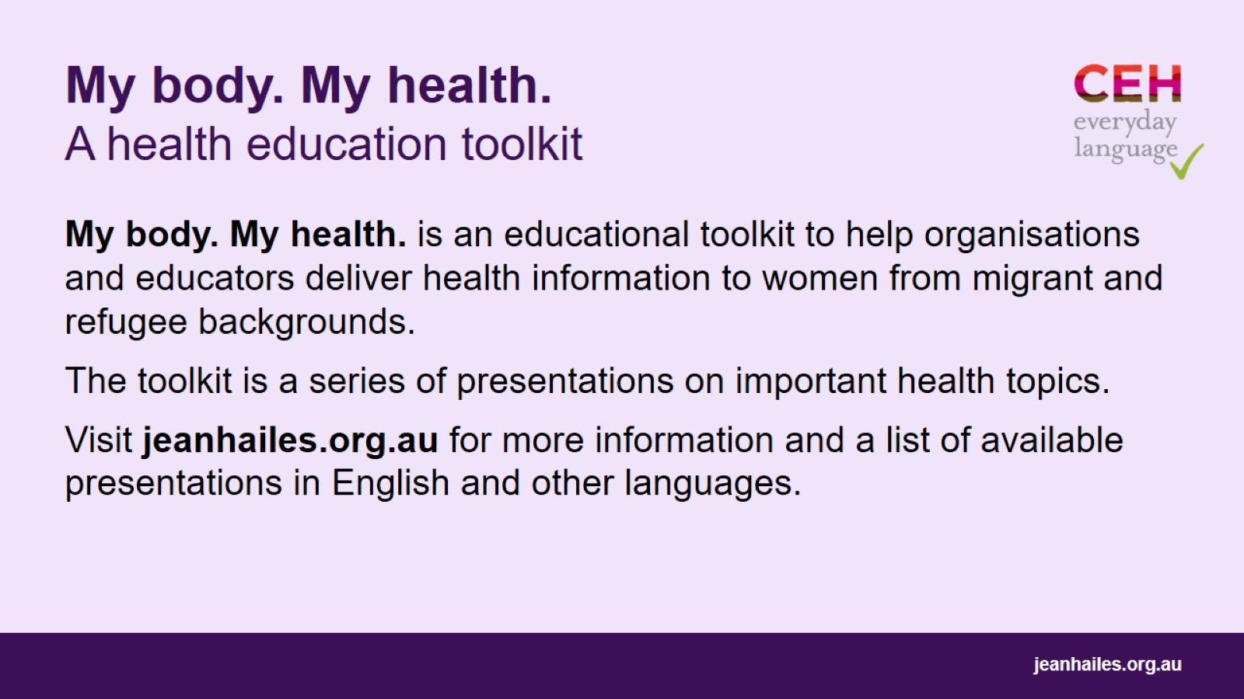
My body. My health. A health education toolkit

Slide 4

Notes:
Why is vitamin D important?
Vitamin D helps your body in lots of ways. You need it to have healthy bones, muscles and teeth.
It keeps you healthy.

Slide 5
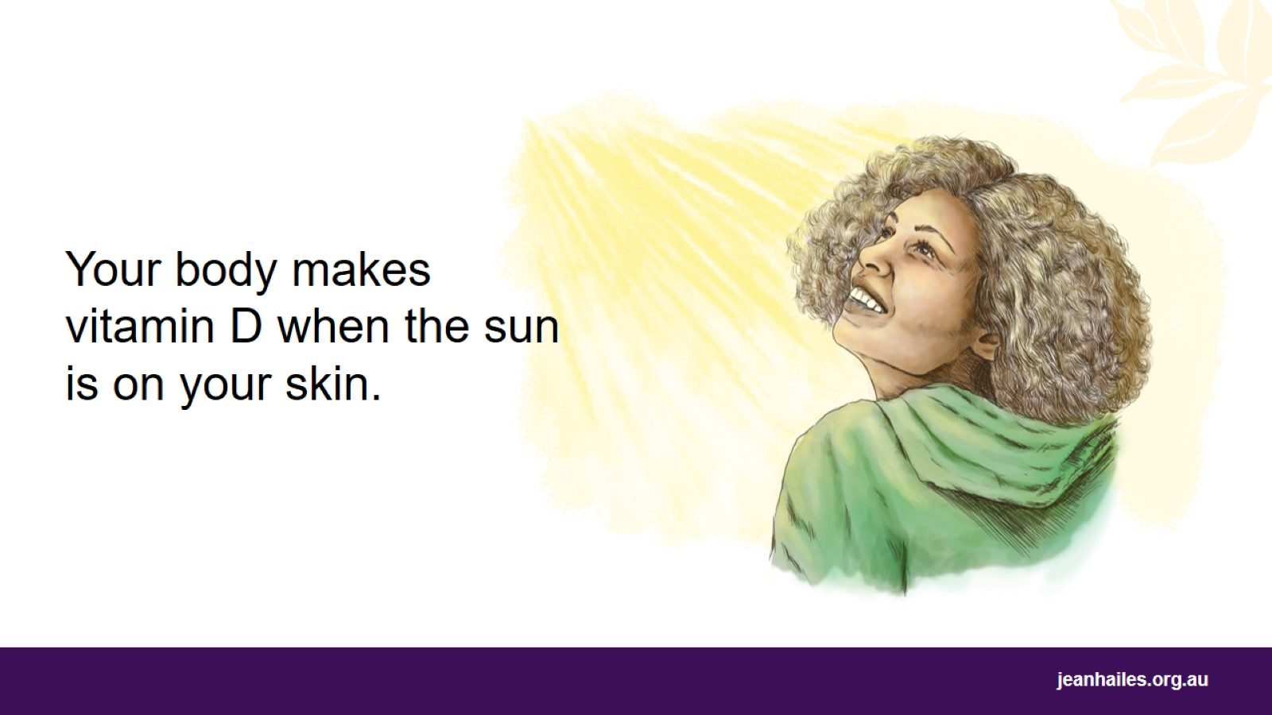
Notes:
How do I get vitamin D?
Most people get their vitamin D from sunlight (when sunlight is on your bare skin – not through glass). This is the best natural way to get vitamin D.
You can get a small amount of vitamin D from your food, but usually it is not enough. Fatty fish, like salmon, tuna and mackerel, and eggs naturally have some vitamin D, while margarine and some types of milk have added vitamin D.
You need vitamin D all year. During winter, or if your skin is covered most of the time, you might not get enough vitamin D.

Slide 6
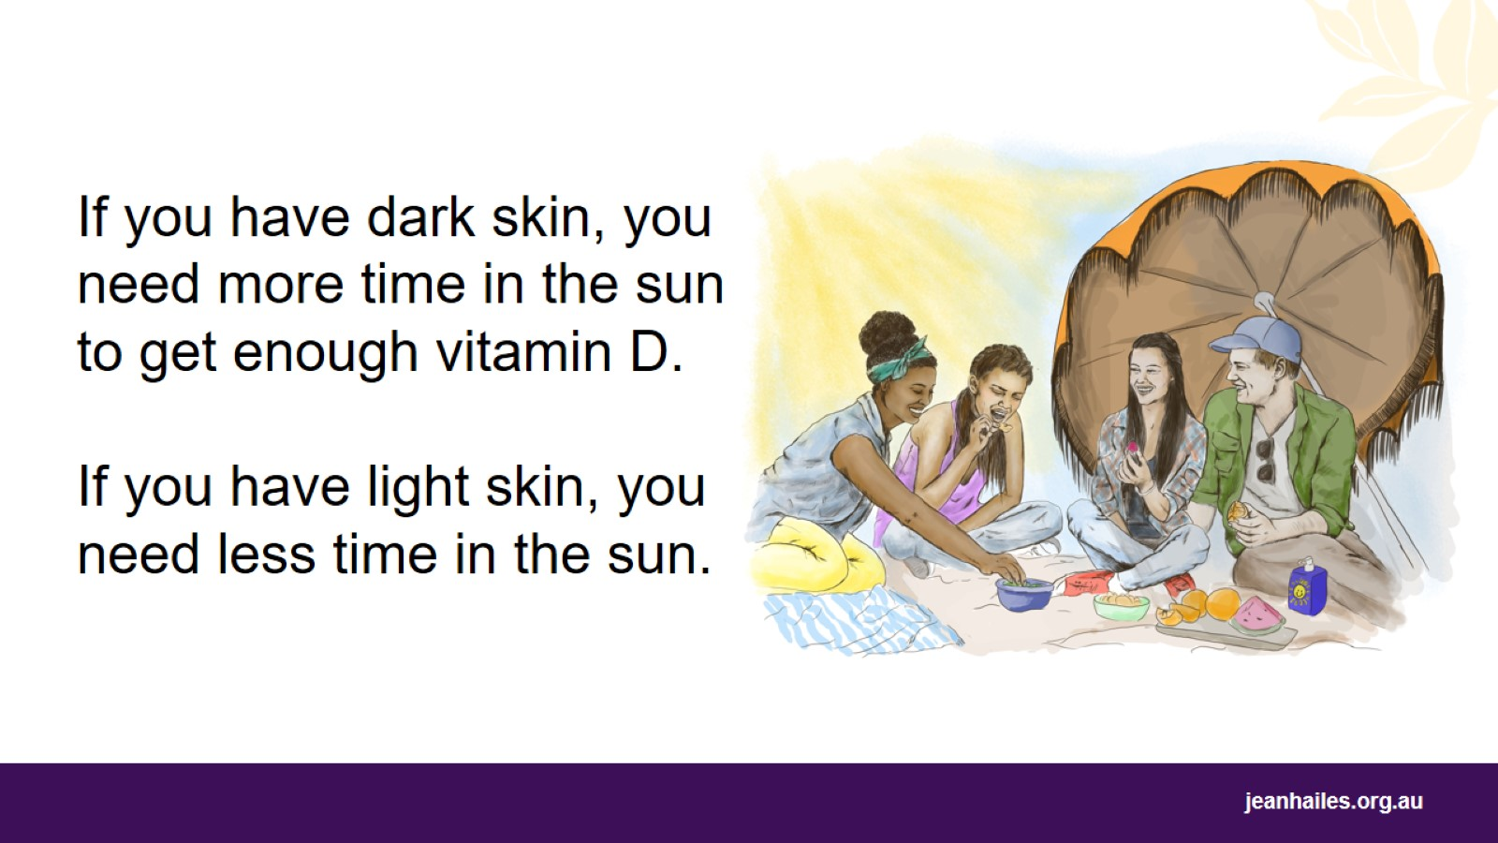
Notes:
How much sun do I need to get enough vitamin D?
How much sun you need depends on
your skin colour
how much skin your clothes cover
the time of year and day
where you live in Australia.
For example:
If you have light skin, a few minutes in the sun in the morning or afternoon gives you enough vitamin D. In winter, get the sun in the middle of the day.
If you have dark skin, you need more time in the sun to get enough vitamin D – up to 6 times as long as someone with light skin.
Pregnant and breastfeeding women should ask their doctor if they need vitamin D supplements.
Sun protection
Remember that too much sun – getting sunburnt – can damage your skin and may lead to skin cancers.

Slide 7
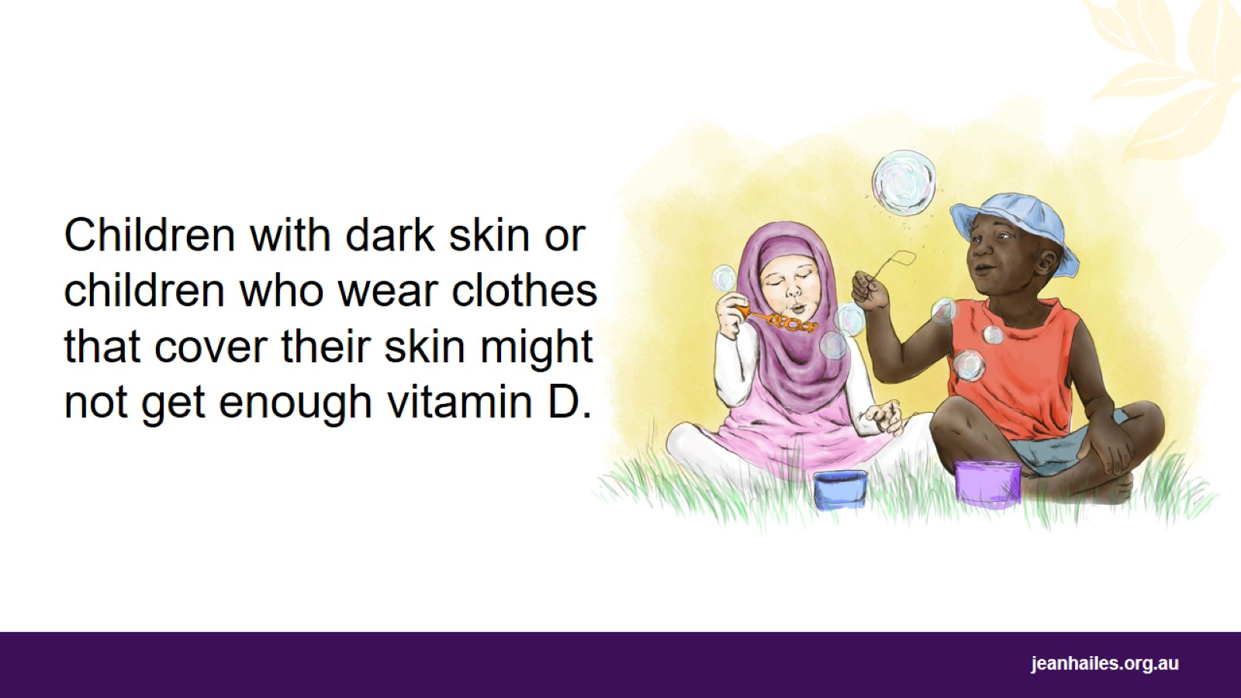
Notes:
It’s very important that babies and children get enough vitamin D.
Children who might not get enough vitamin D include:
Babies born early – before 37 weeks of pregnancy
Babies who are breastfed if their mothers have low vitamin D
Children whose skin is rarely exposed to the sun
Children with very dark skin
Children with certain medical conditions, such as liver disease, kidney disease, cystic fibrosis, coeliac disease, inflammatory bowel disease, and those on epilepsy medicines.
Children and sun protection
Make sure that your children always use sunscreen, a hat and sunglasses when they go in the sun. This will protect them from cancer.
Children with very dark skin also need sun protection, especially because they might need a longer time in the sun to get enough vitamin D.

Slide 8
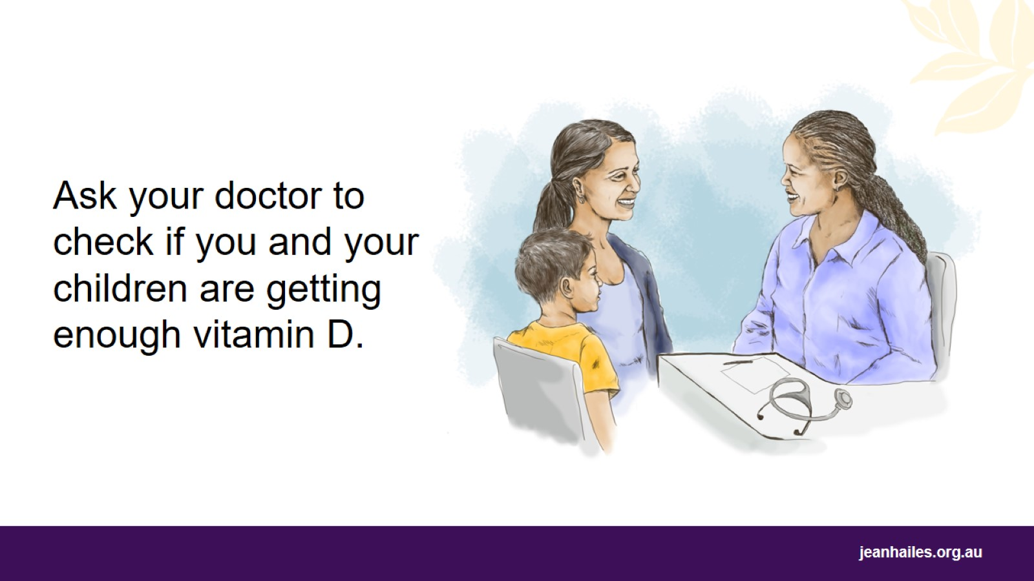
Notes:
How do I know if my children and I are getting enough vitamin D?
Your doctor can give you and your children a blood test to check your vitamin D levels.
Your doctor may recommend that you take tablets to get your vitamin D to a good level again.

Slide 9

Local services
Notes:
Note to the facilitator: provide details of local health services.

Slide 10


