Slide 1

Feeling good
Notes:
Today we’ll talk about different types of feelings, how they can impact our lives and what we can do to feel better.
Note to the facilitator: the session focuses on strategies that can help when a person feels bad and needs some help. It’s important to acknowledge the different cultural experiences in the room and that it can be challenging to hear and discuss feelings. However, this is not intended to be a counselling session.

Slide 2
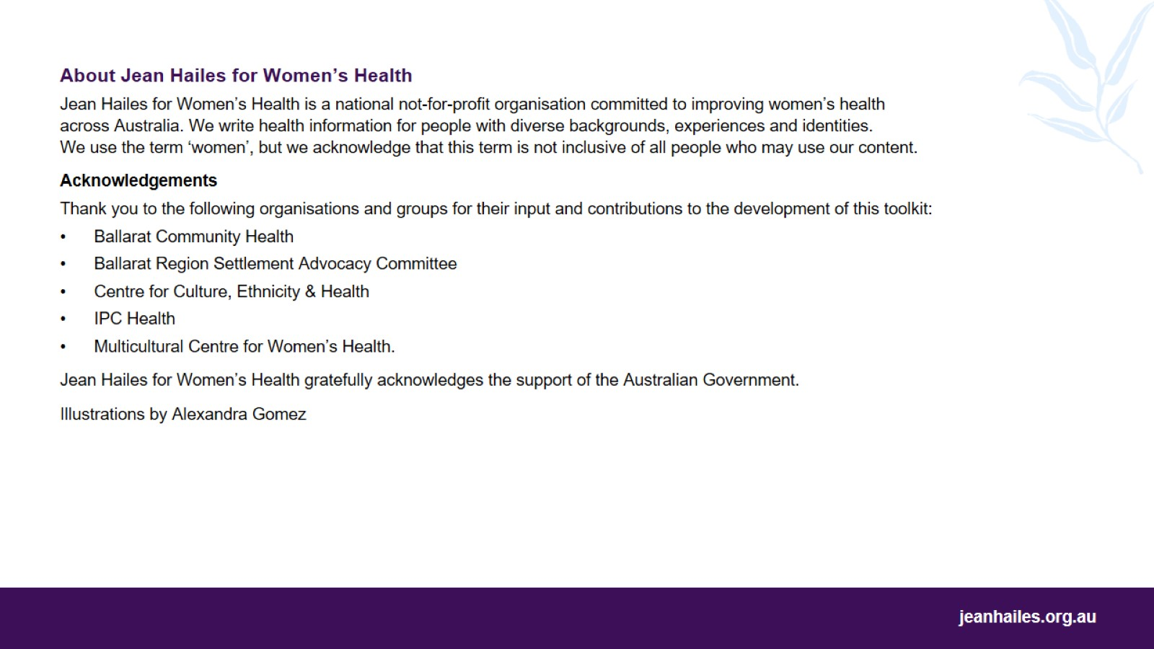

Slide 3
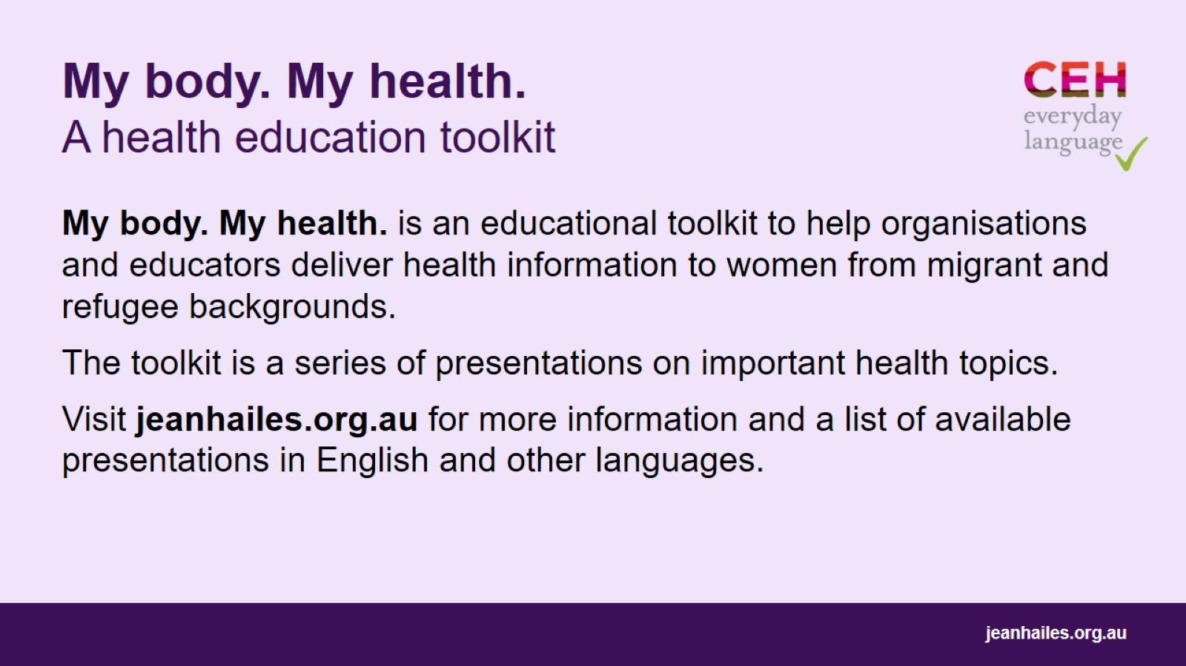
My body. My health. A health education toolkit

Slide 4
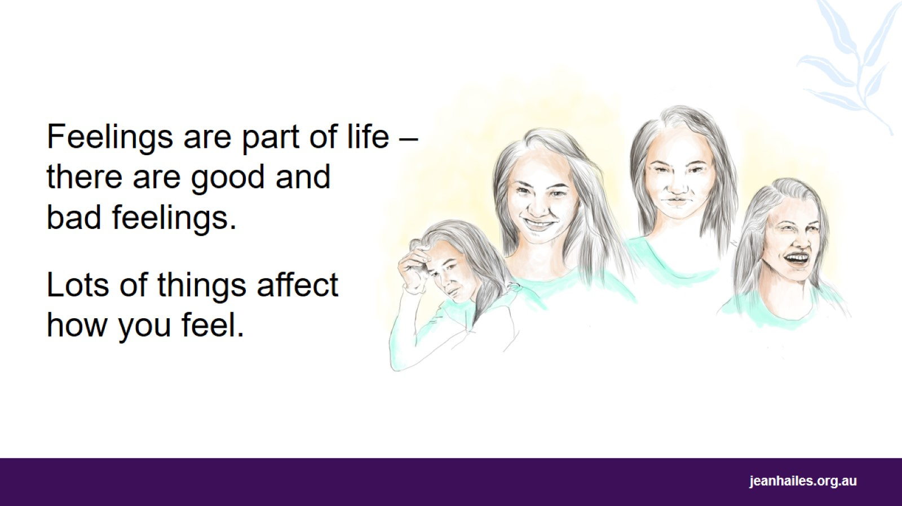
Notes:
What are feelings?
Feelings are how you respond to what happens in your life. For example, when you’re away from family, you can feel sad or worried. But when you see a friend you haven’t seen for a long time, you can feel very happy.
There are good feelings, such as:
happiness
love
joy
excitement.
There are also bad feelings, such as:
sadness
anger
loneliness
fear
worry.
Bad feelings are a normal part of life. It’s ok to have them sometimes. We call them bad in this presentation to explain that they’re not nice feelings to have. If you have them all the time or they don’t go away, it can become a problem.
What things affect how you feel?
There are many things that affect how you feel, such as:
what happened in the past
how your life is now
how healthy you are
how often you see your friends and family.

Slide 5
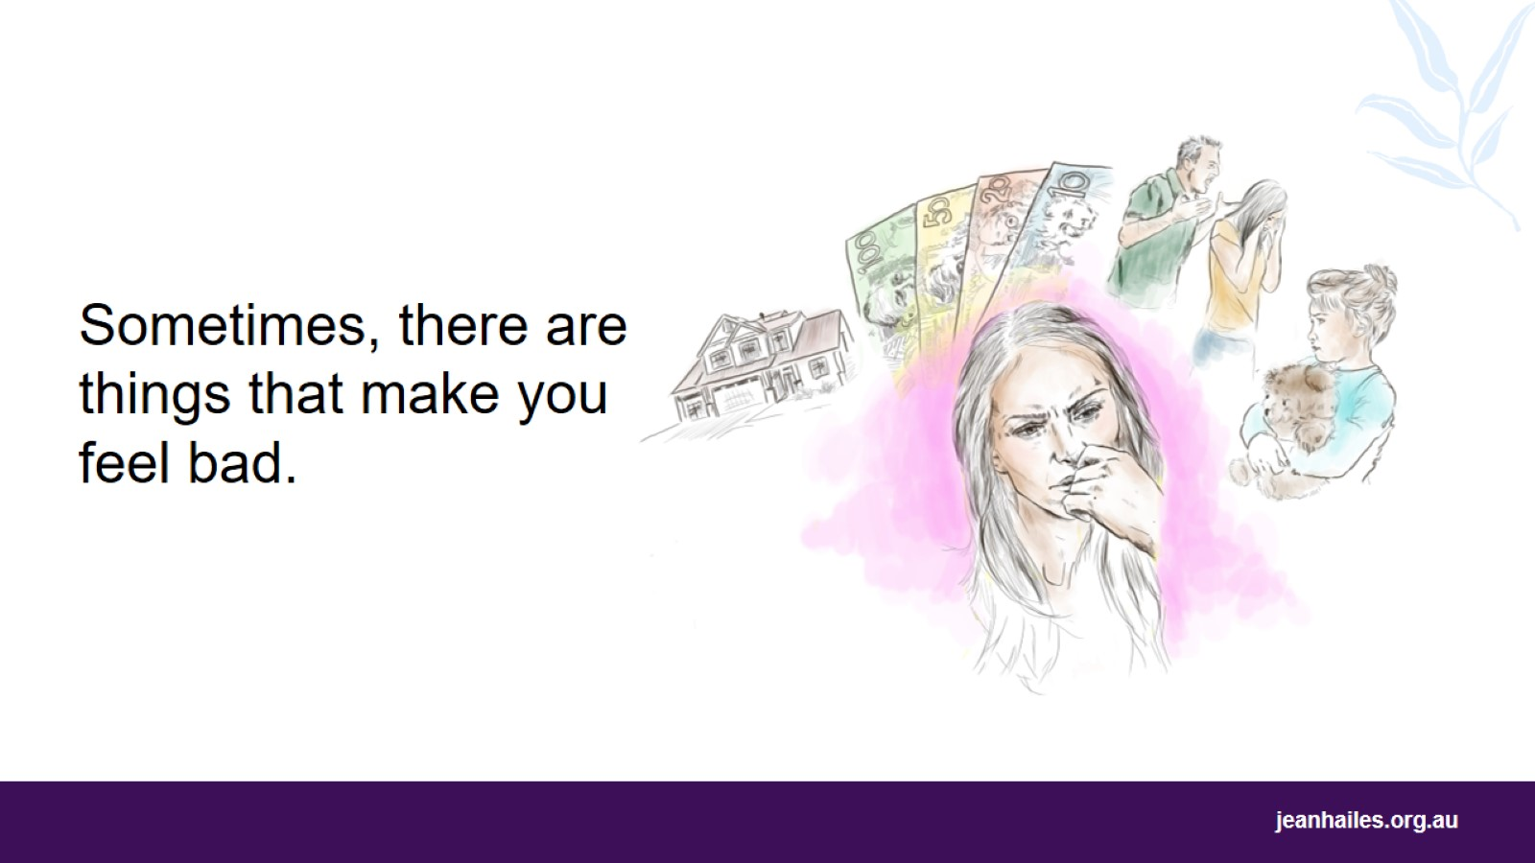
Notes:
What things can make you feel bad?
There are many things that can make you feel sad, worried, stressed, angry or afraid, such as:
not knowing a new country and culture – everything can feel strange, different and difficult to understand
not being able to speak or understand English
being alone
not having family and friends near
not having enough money
having problems finding a house
not working or having problems finding a job
being in a violent or abusive relationship – violence is not okay in Australia
difficult experiences you and your family had in the past.
Bad feelings are part of life, but it’s important to notice when you’re having them so you can look after yourself.
Sometimes feelings, such as worry, fear, stress or sadness, can help you think about what is happening in your life and how you can deal with it.
When you feel bad, it can be a sign that things are not right in your life.

Slide 6
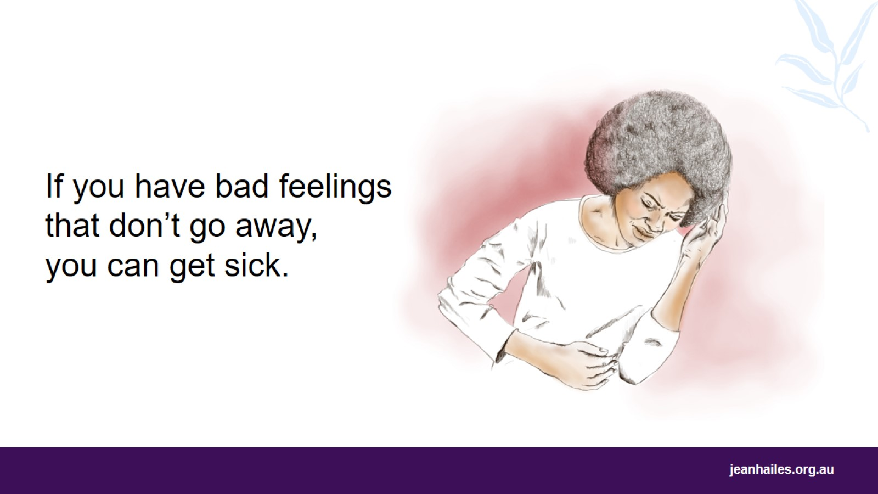
Notes:
If bad feelings don’t go away, they can lead to problems, such as:
headaches
stomach pains
chest pain
diarrhoea or constipation
not sleeping enough or sleeping all the time
difficulty eating – too little or too much
anxiety and depression.
If these problems don’t stop, you need to talk to a doctor. They can check if anything else is causing you to feel that way.

Slide 7
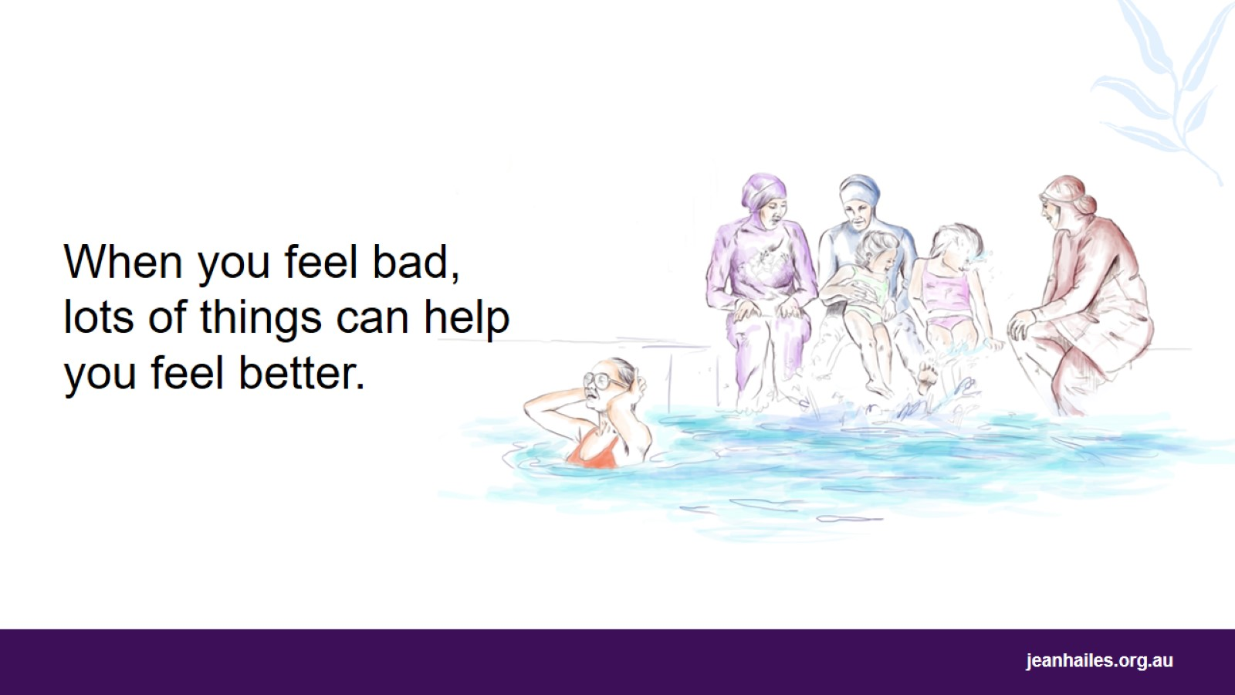
Notes:
You can’t avoid bad feelings. Everyone has bad feelings sometimes. They can be very difficult, but you can learn to handle them.
There are things that can help you change the bad feelings.
Facilitator questions for a group discussion (time permitting)
What do you do when you’re not feeling good?
What are the things that make you feel better when you feel bad?

Slide 8
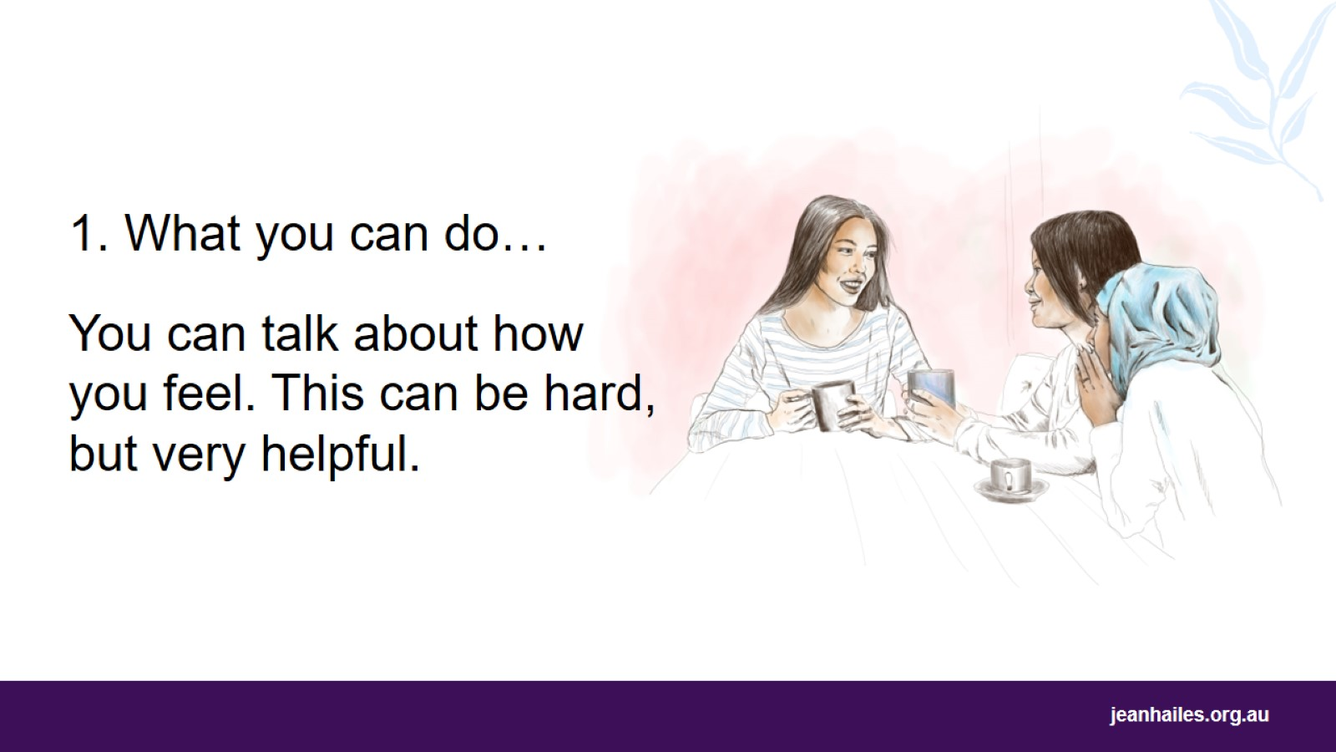
Notes:
If you talk to someone when you feel bad, it can make you feel better.
If people know that you’re feeling bad, they can help you.
Talking to someone you trust can help you:
understand a problem or find a solution
see a situation more clearly or in a different way
feel less lonely.
If you don’t talk to anyone when you feel bad, things can get worse.
What might stop you from talking about feeling bad?
You might find it difficult to talk about your bad feelings. But if you don’t talk about what’s wrong, it’s harder to get better.
You might think that talking about things won’t help. But talking can be very helpful if you talk to the right person.
You might find it embarrassing or shameful to talk about your life and worries. But many people have similar difficulties, so you’re not alone.

Slide 9
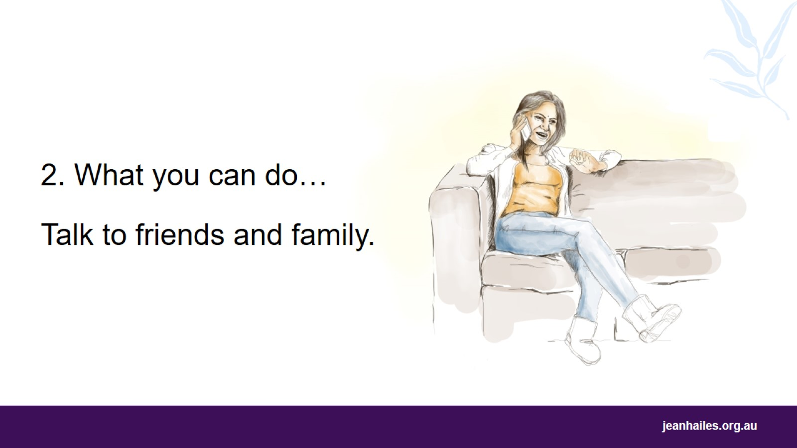
Notes:
When people feel bad, they can stop talking to family and friends, which can make things worse.
Talking to people you trust about what worries you can make you feel better.
Stay connected with your family and friends.
Ask a friend to come to your house or meet at the cafe.
Go for a walk with family, a friend, or a neighbour near your home.
Use social media, like Skype, Facebook, or WhatsApp, to talk to your friends and family.

Slide 10
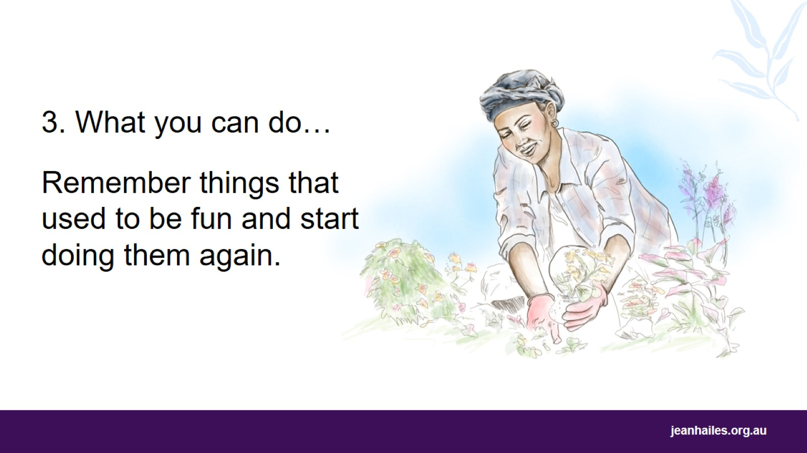
Notes:
Remember things you loved doing in the past that made you happy. Start doing them again.
Examples of things you can do:
visit local markets
find a group of women from your own country
do tai chi or yoga
sew or do craft projects
work in the garden
ride a bike
meditate or pray
meet with people on special days.
Facilitator note
You might like to start this discussion by sharing with the group an example of what you did in the past or do now that helps you feel good.

Slide 11
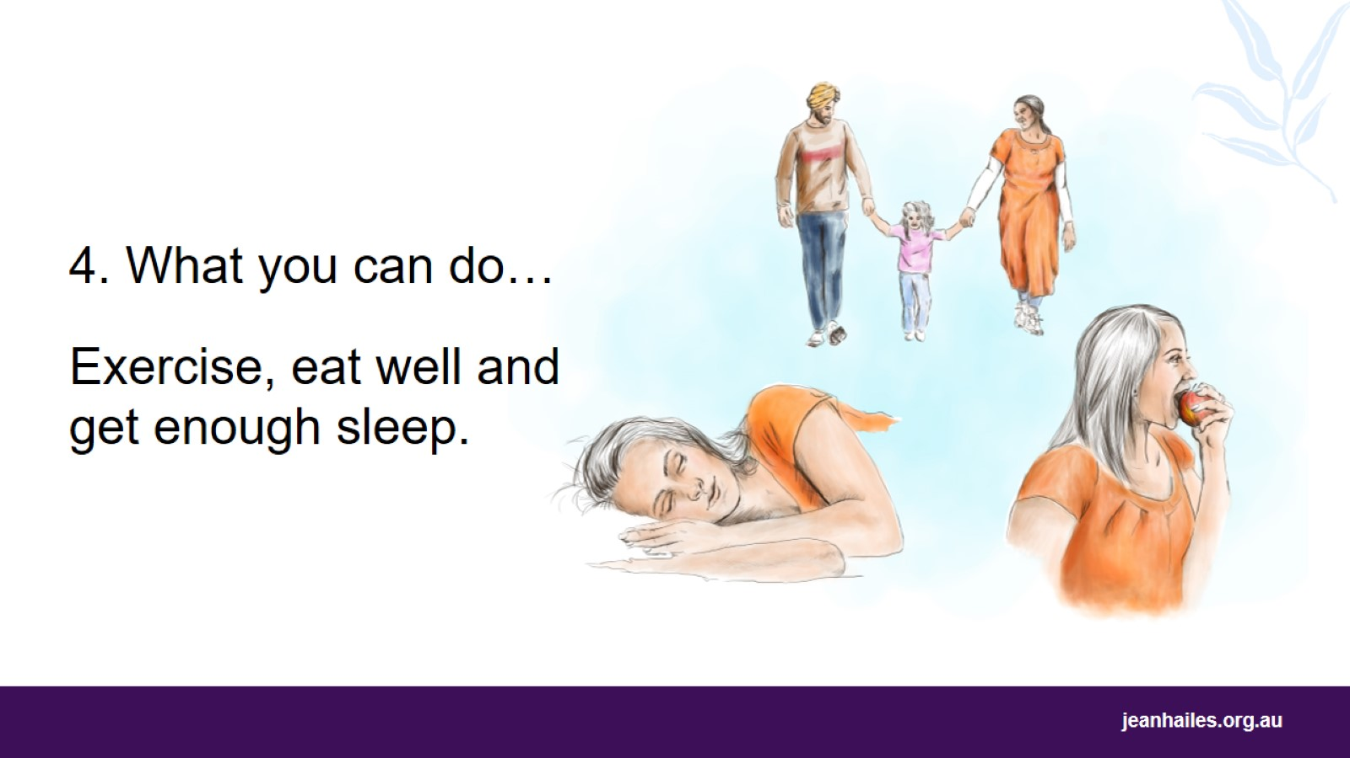
Notes:
Exercise, sleep and healthy foods will help keep your body and mind strong.
Exercise for 30 minutes every day to help keep your mind and body strong. Exercising releases good chemicals in the body to make you feel better.
For example:
walk to the shops rather than drive or take public transport, if possible
get off one or two stops earlier or park further away
stand up to get something rather than ask someone to pass it to you
play with your children
find a fitness or sports club to try.
Sleep for 7 to 8 hours a night to feel better, have more energy and think more clearly.
If you are worried or sad, it can be difficult to get enough sleep.
If you’re having trouble sleeping:
go to bed at the same time every night and wake up at the same time every day
have a bath before you go to bed
have a warm drink before you go to bed – but no caffeine or sugar!
do some deep breathing or meditation.
If you can’t sleep, get up and do something you like for 30 minutes and then try to go back to sleep.
Eat healthy foods to have more energy and feel good. Eat foods like:
meat, fish, eggs, tofu
vegetables and fruit
rice, bread, pasta, couscous, and grains
milk, cheese, yoghurt
good fats, like avocado, olive oil, nuts
lots of water.
Coffee, cola and drinks with lots of sugar can have a negative impact on your health. Have these drinks in small amounts. Avoid alcohol and drugs. Your doctor can help you if you need to understand the effects of these things.
Facilitator questions
In your home country: did you exercise more? did you sleep better? did you eat healthier foods?

Slide 12
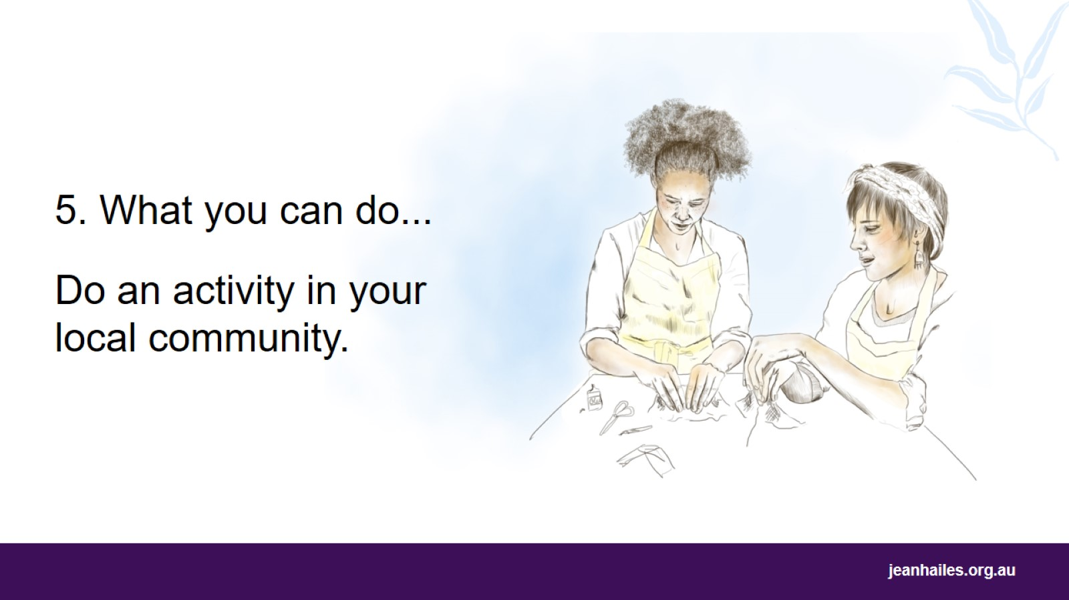
Notes:
If you do an activity or join a group in your local community, it can help you feel better and more positive.
You can also:
learn new skills or try something different
make new friends
help other people
have fun.
If you feel nervous or scared, start slowly:
ask the person running the group to explain what happens in the group and to look after you
go to the group and just listen – you don’t have to say anything
try it, but if you don’t like it, you can leave at any time
ask a friend or family member to come with you.
Places where you can find groups include:
neighbourhood houses
community centres
local schools
sporting clubs and centres
cultural organisations
religious institutions
the local paper has information about local groups.

Slide 13
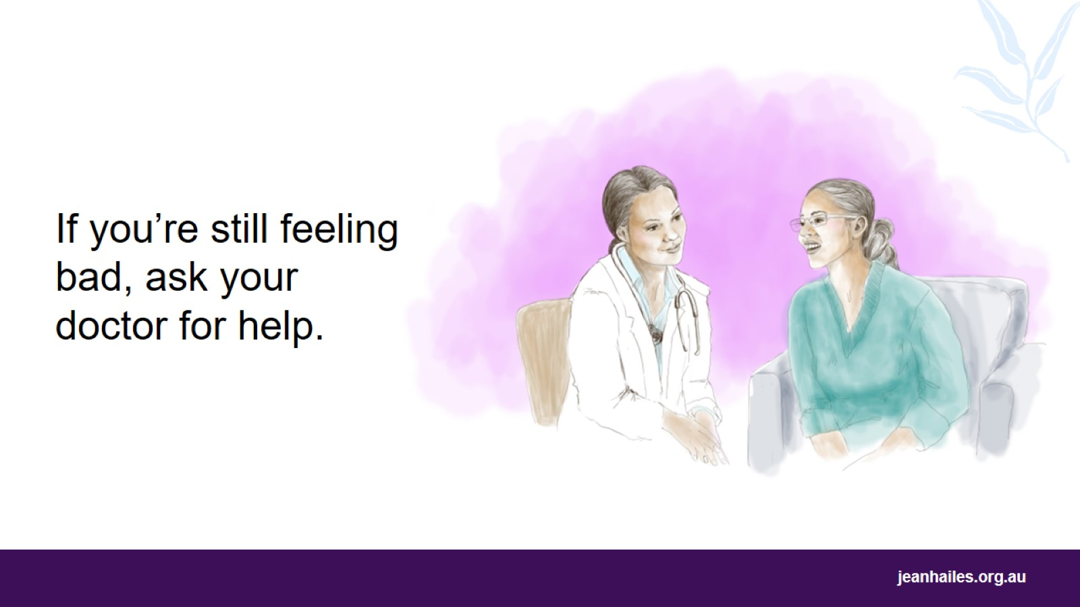
Notes:
Feeling bad can be a normal part of life. But if you don’t stop feeling bad, it can be a problem.
When you keep feeling worried, angry, scared or sad, you should visit the doctor.
What will the doctor do?
The doctor will ask you to explain how you're feeling
The doctor can do tests to check if you have a physical illness
If the doctor thinks you need help with your bad feelings, they will give you treatment options.
If you have a Medicare card, it will cost less or be free to see a doctor.
How can you make going to the doctor a good experience?
Ask for a female doctor when you make an appointment
Ask for an interpreter when you make an appointment if you feel better speaking your own language
Take a support person to the doctor with you
Write down what the doctor says so you can remember it later.

Slide 14
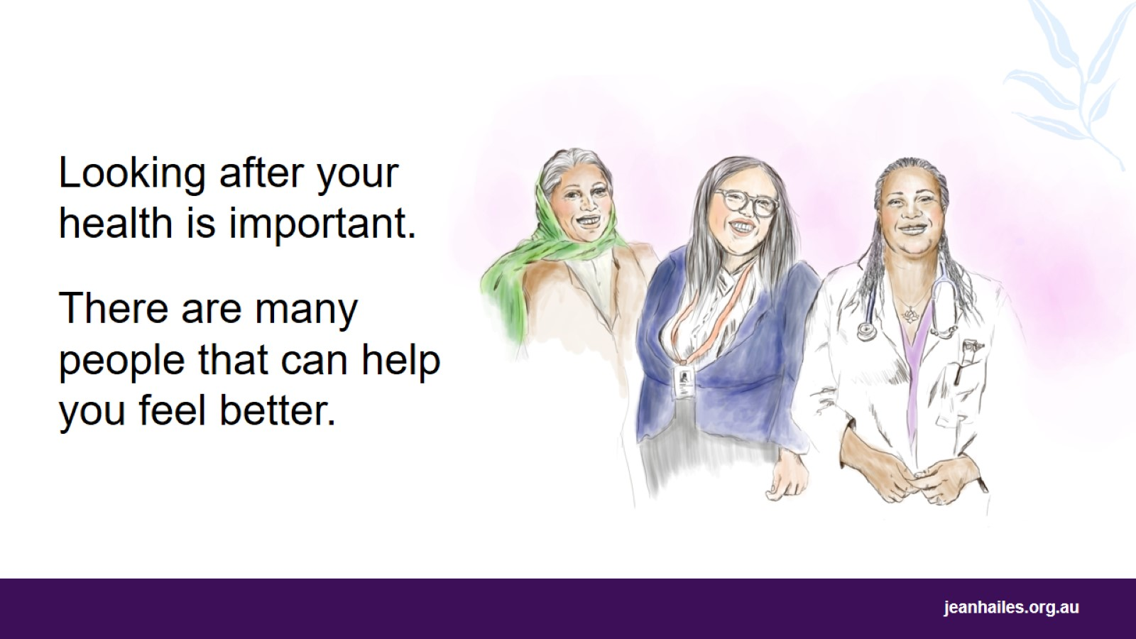
Notes:
You are important. Your health is important. It is okay to ask for help.
It can be hard to ask for help or know where to go. You might also feel embarrassed.
But there are many people that can help you find the support you need.
Who can you ask?
A community health nurse or a social worker
A religious or community leader that you trust
A family member, a friend, a neighbour, or someone from your community you trust
Your doctor will know what is available and good for you
Interpreters may also know services and people that can help you
A counsellor - you might need a referral letter from the GP.
In Australia, it is common for people who are feeling bad to talk to trained support workers.

Slide 15
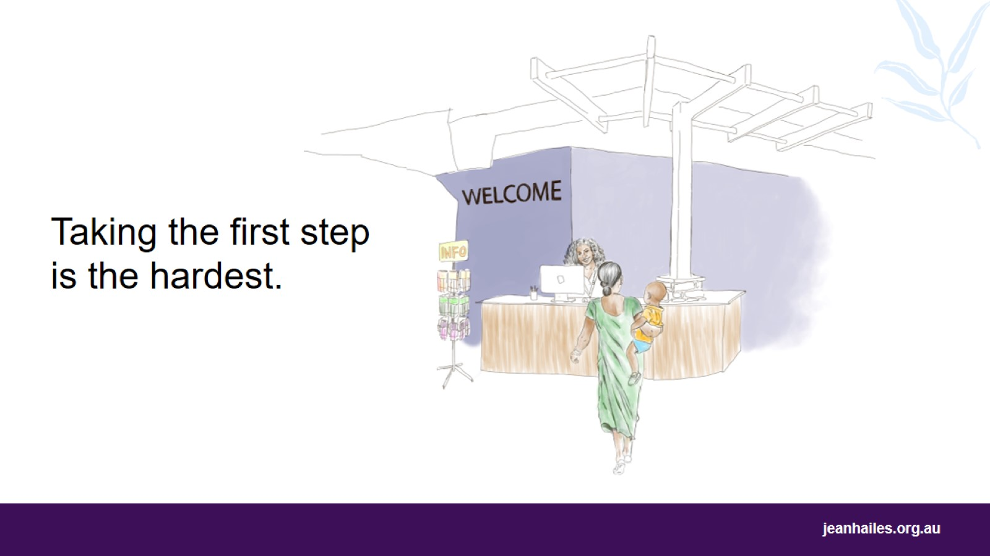
Notes:
Taking the first step to look after yourself can be the hardest.
Women often take care of their families or other people before they take care of themselves.
But if you look after your health, you’re also looking after your family.
Small things can make a big difference – start slowly.
If you think it is difficult, ask someone to help you.
Be kind and talk to yourself like you would talk to a friend.
What would you say to a friend or a child who is not feeling well? Can you say this to yourself?

Slide 16
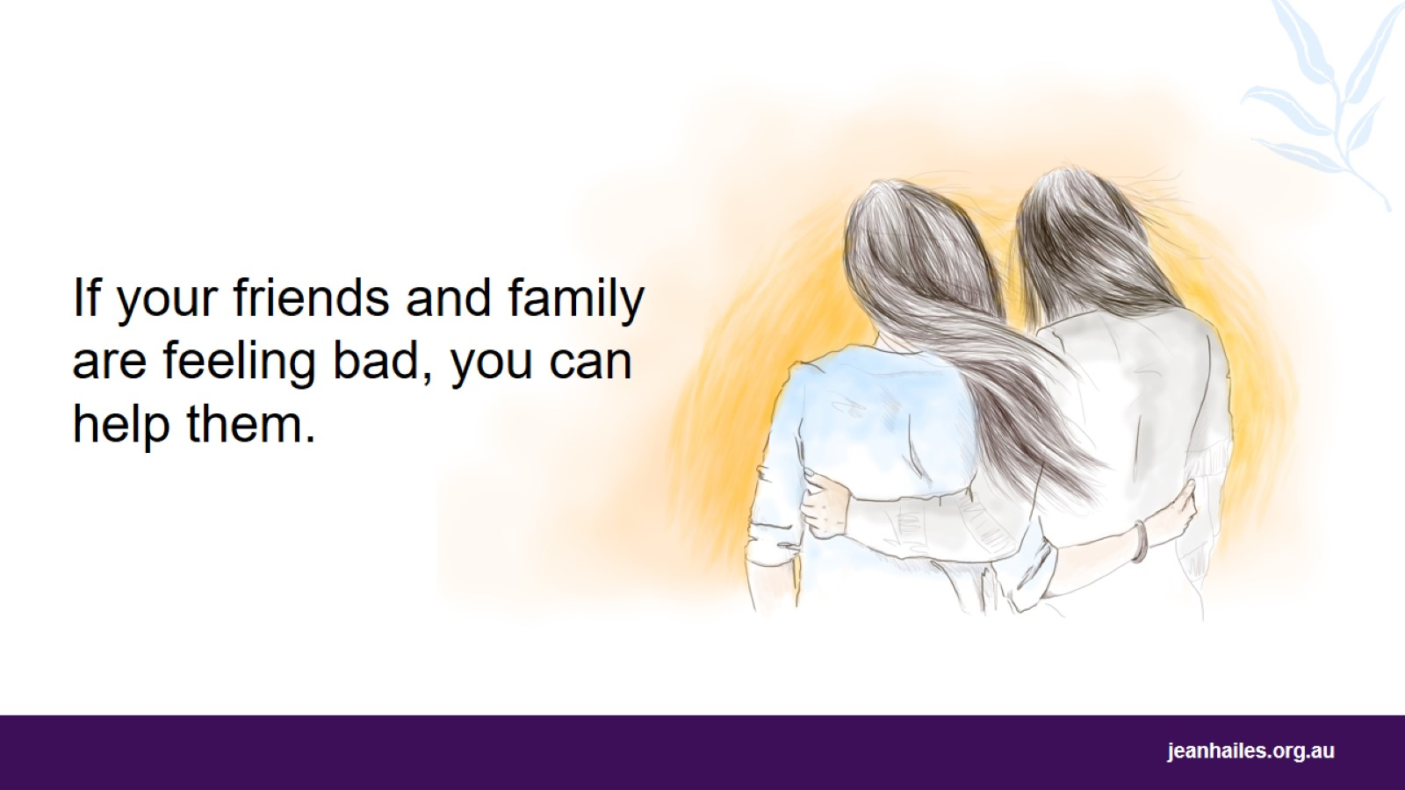
Notes:
Help others who don’t feel well.
Women often have similar problems in life, especially women who have moved to a new country.
You may know women who don’t feel good, or who are going through difficult times.
Ask if they’re okay.
Even if you can’t fix their problems, let them know that you care
Encourage the person to talk to someone they trust
Ask them how you can help. For example, if you can go for a walk together, visit them at home, do some shopping for them or take care of their children for a while.
Facilitator note
Ask the group to think of what they could say to a friend or a family member who is feeling bad.

Slide 17
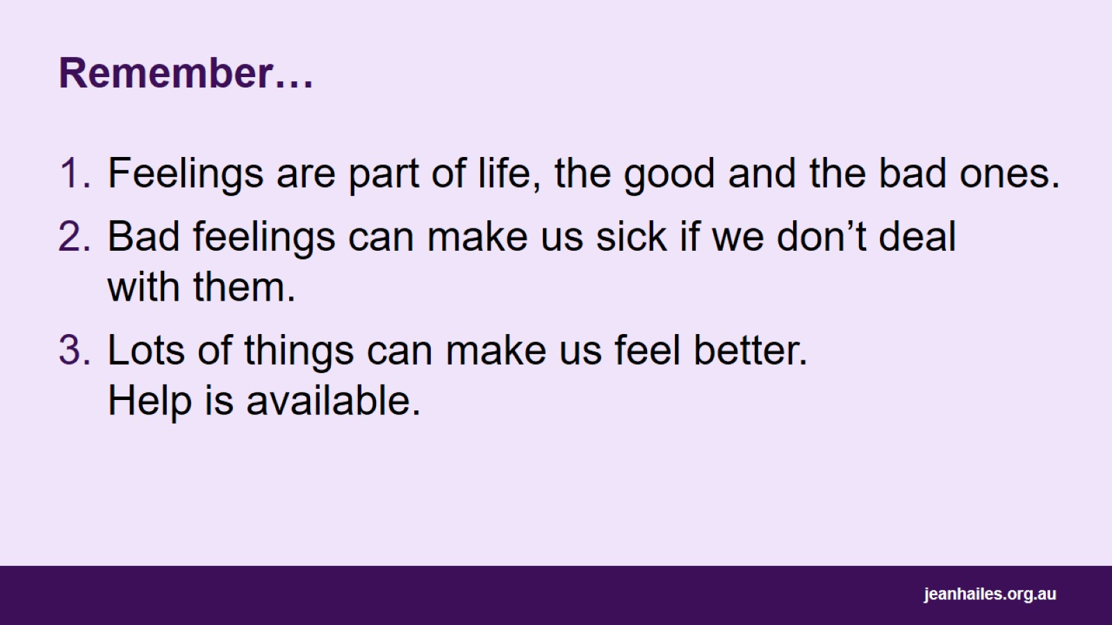
Remember…

Slide 18

Local support services
Notes:
Note to the facilitator: provide details of local support services.

Slide 19


