Slide 1
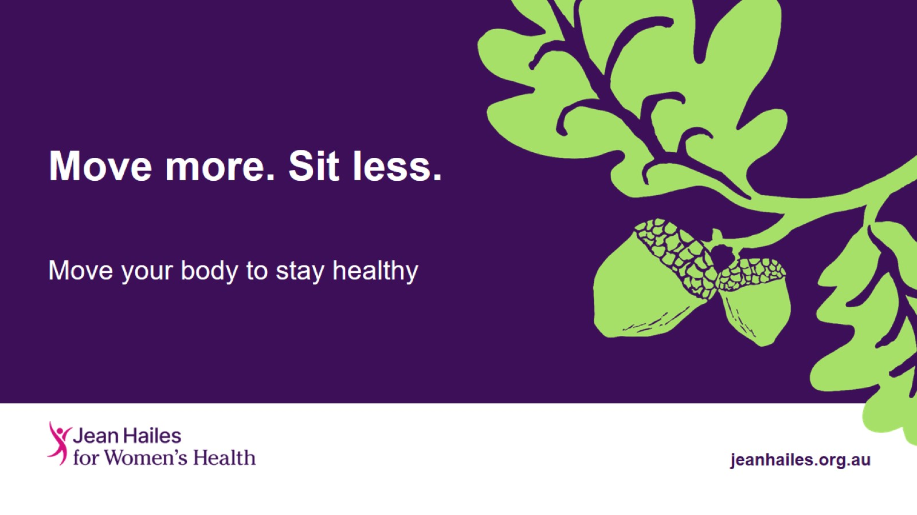
Move more. Sit less.

Slide 2
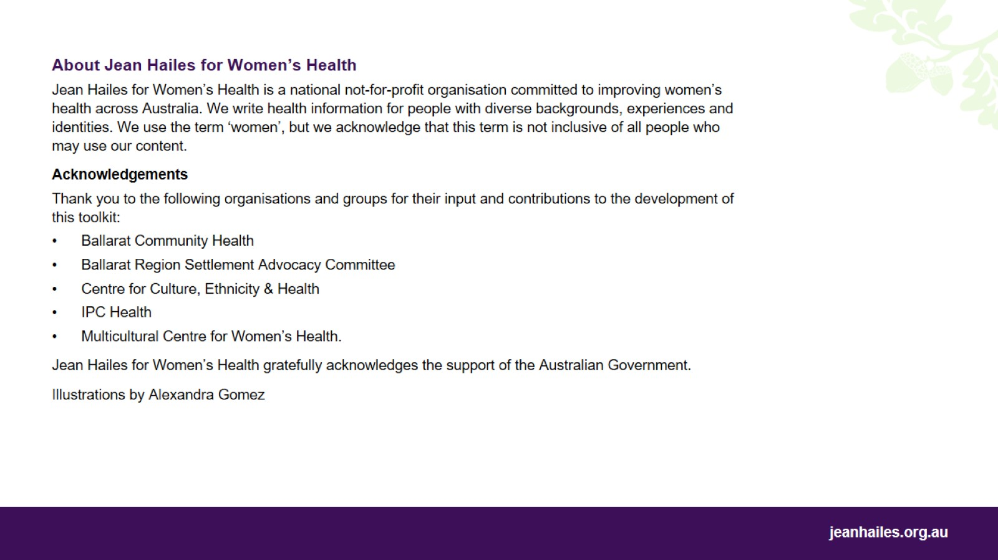

Slide 3

My body. My health. A health education toolkit

Slide 4
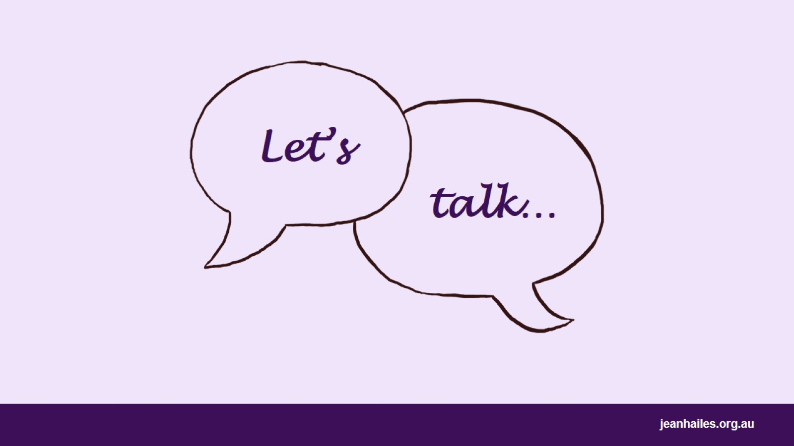
Let’s
Notes:
Today we'll talk about what physical activity is, how important it is to move every day and how we can increase our physical activity.
Note to the facilitator: choose a few questions (examples below) to lead a brief group discussion on how the participants understand ‘health’ and what their beliefs are about health and illness.
Questions to consider:
How do people in your home country/in your culture move every day: walk a lot, run, carry food from the shops, dance?
Were you more active in your home country than in Australia?
Do you know that it is very important for your health to move your body every day?
Do you do any sport or exercise? Is it any different to what you did in your home country?

Slide 5
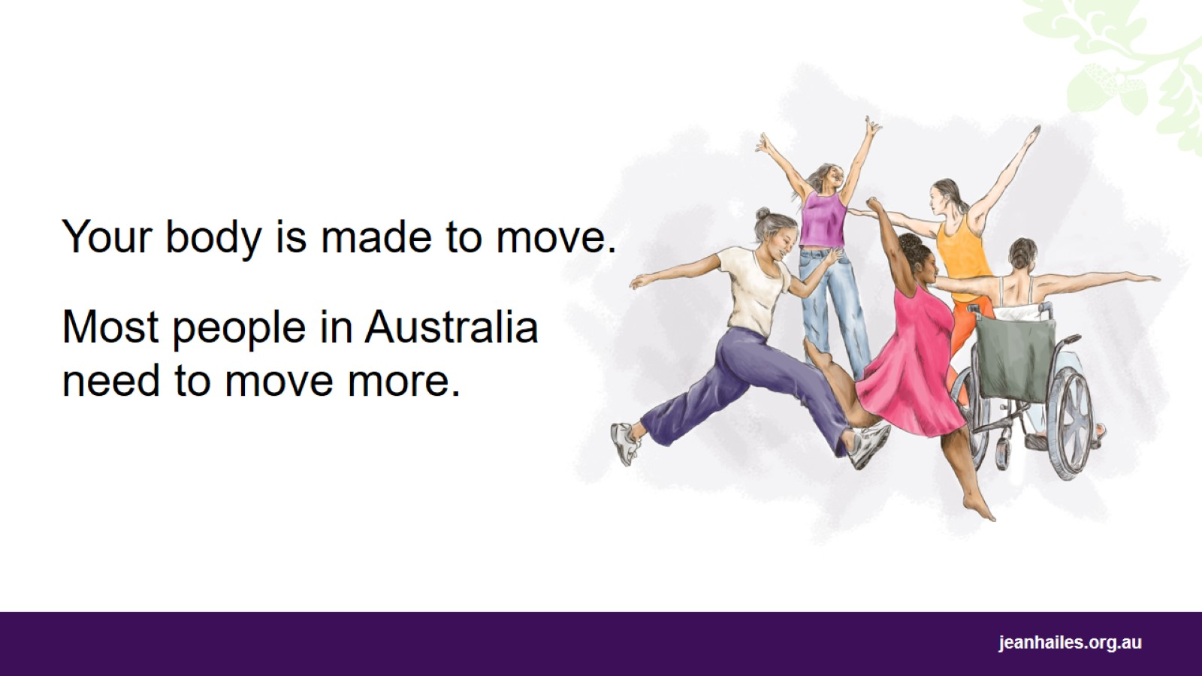
Notes:
Your body is designed to run, jump, stretch and move. It is very important for your health to move your body every day.
However, in Australia,
more than half of all adults, and
4 out of 5 children
don’t move enough.
Women move less than men.
People in Australia are spending more time sitting or lying down.
Examples include:
sitting or lying down while watching television or playing electronic games
driving a car or catching public transport
sitting or lying down to read, write, or work at a desk or computer
having a meal or coffee with friends and family.

Slide 6
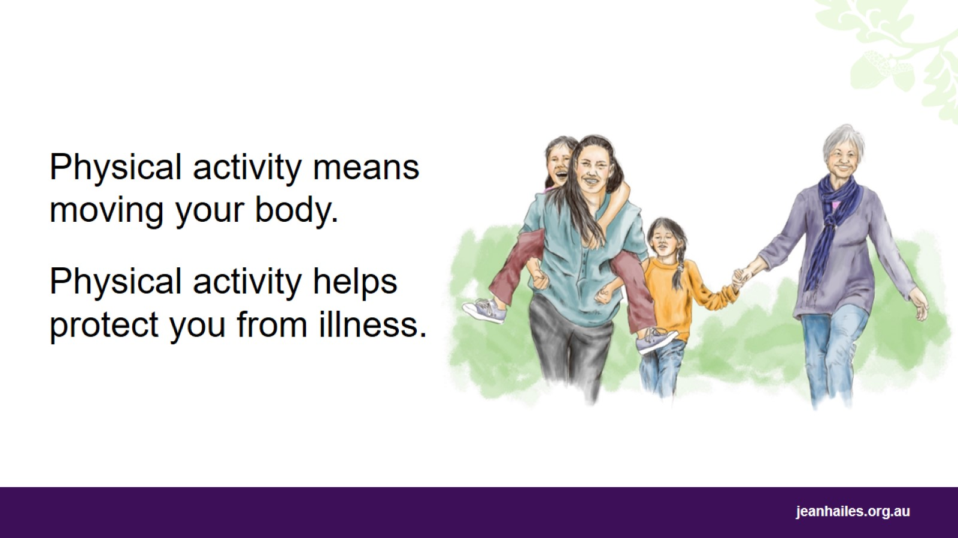
Notes:
What is physical activity?
Physical activity is moving your body so that:
you’re breathing quicker
your heart is beating faster.
You can do this by exercising at the gym or playing sport, but also by everyday activities like cleaning the house or taking the stairs instead of a lift.
What can happen if I don’t move enough?
If you don’t move enough, you can get sick. Over time, you can get:
obese (very overweight)
high blood pressure
diabetes
back pain
cancers
heart disease
depression.

Slide 7
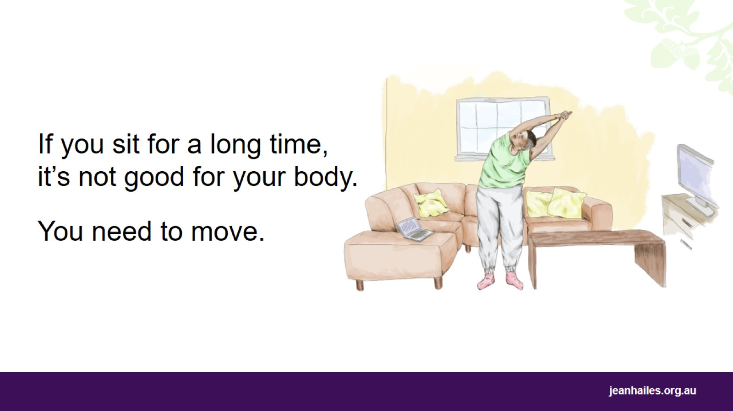
Notes:
What can I do to sit less during the day?
Break up long periods of sitting as often as possible. Every 20-30 minutes, get up, move and stretch for a few minutes.
If you’re spending a lot of time in front of a TV or computer screen, get up often and move around.
Take any chance you can to move, no matter how short it is.

Slide 8
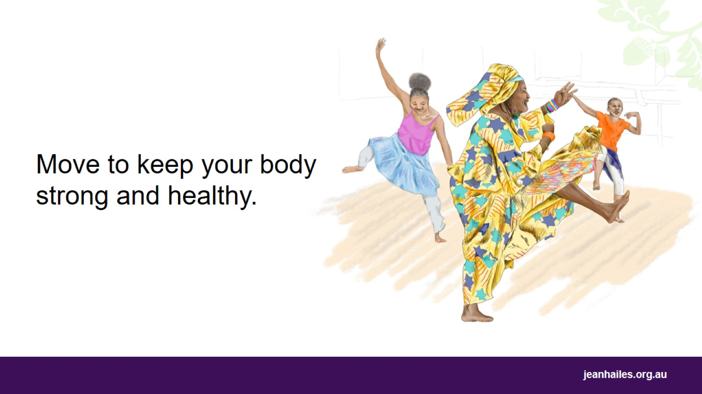
Notes:
Why is physical activity good for my health?
Being physically active and reducing the time you spend sitting every day is very important for your health.
Being physically active:
reduces the risk of heart disease and stroke
reduces the risk of some cancers
lowers levels of bad fats in your blood
helps to lower blood pressure
builds strong muscles and bones
increases strength, balance and flexibility
helps you to lose weight and maintain a healthy weight.

Slide 9
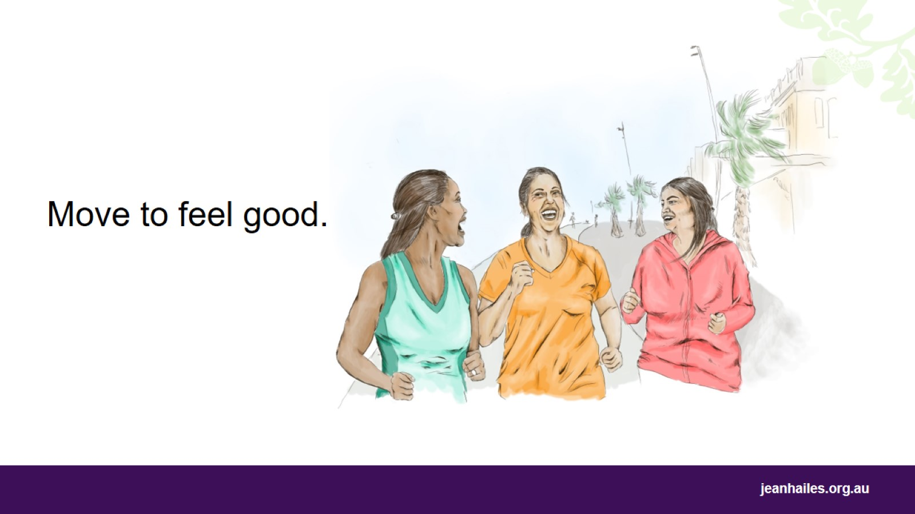
Notes:
How can physical activity make me feel good?
Physical activity may help you:
relax
enjoy life
be happy
sleep better
gain more energy
make friends
spend time with other people.

Slide 10
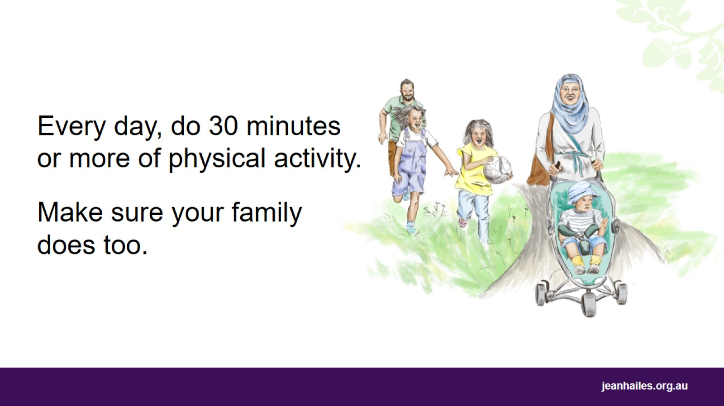
Notes:
What do I need to do every day to stay healthy?
To improve your health, you need to:
be active on most days, preferably all days, of every week
do at least 30 minutes of physical activity every day, for example:
fast walking, dancing, tai chi
pushing a stroller or playing with your kids outside
household jobs like cleaning windows, raking leaves.
You can break up the physical activity into smaller periods of activity throughout the day, like three 10-minute sessions.
As little as 15 minutes of fast walking, 5 days each week, can improve your health.
Each week, do some activities that take more effort, like:
jogging, aerobics, fast cycling, many organised sports
household tasks that involve lifting, carrying or digging.
Remember – doing any physical activity is better than doing none!

Slide 11
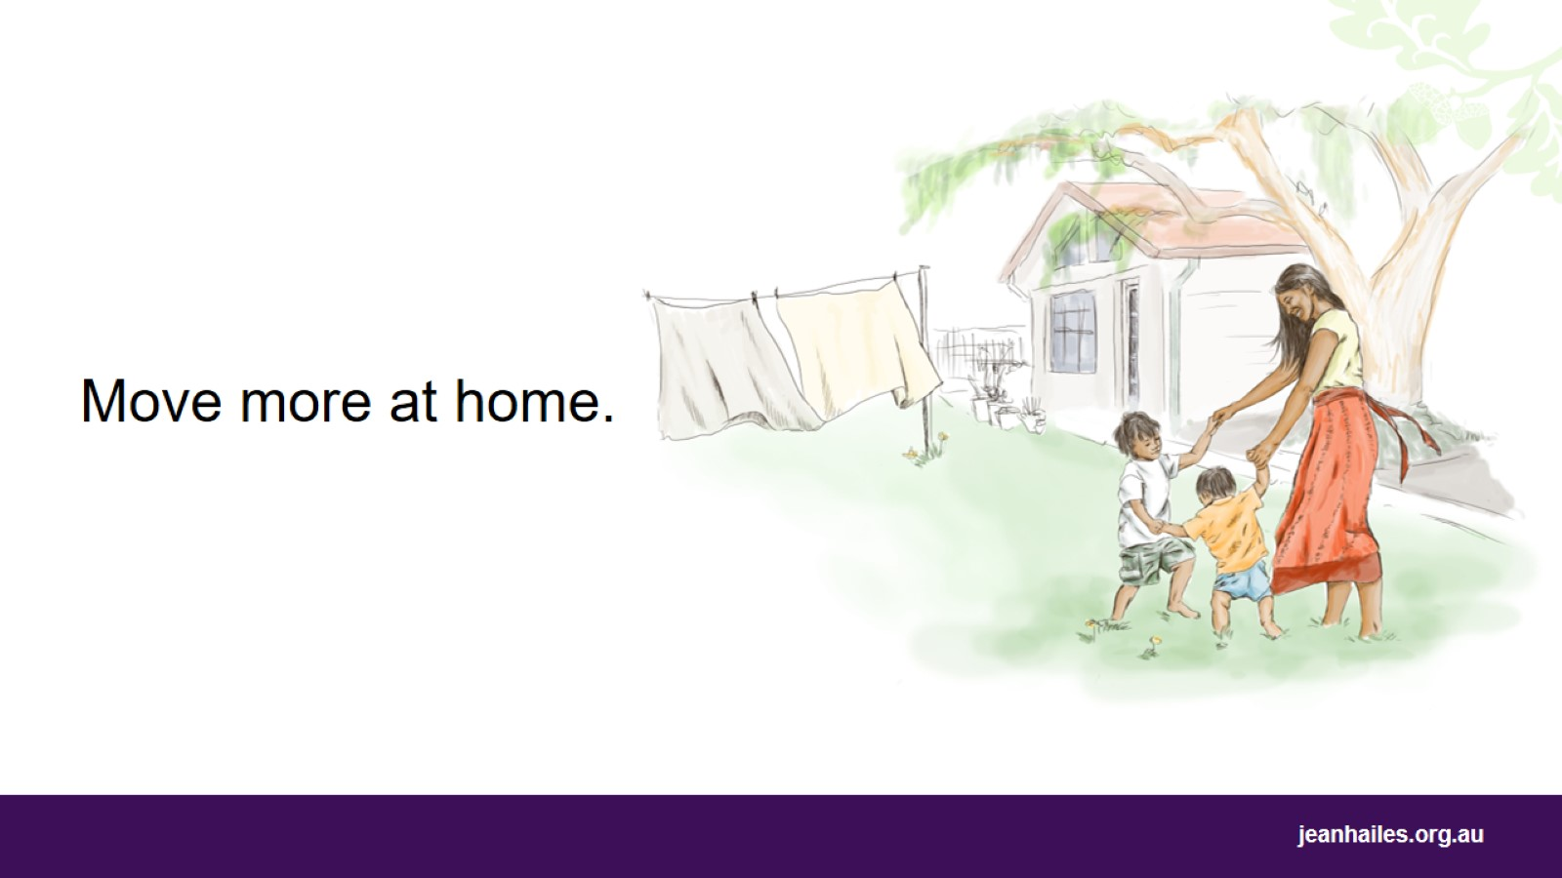
Notes:
How can I move more at home?
There are lots of ways you can move more at home:
get active with your kids – make family time a chance to move more, play more and have fun together
work in the garden
mow the lawn
vacuum the floors
clean the windows
wash your car
take the dog for a walk
get up to change the TV channel
walk to or park further away from the shops so you have to walk.

Slide 12
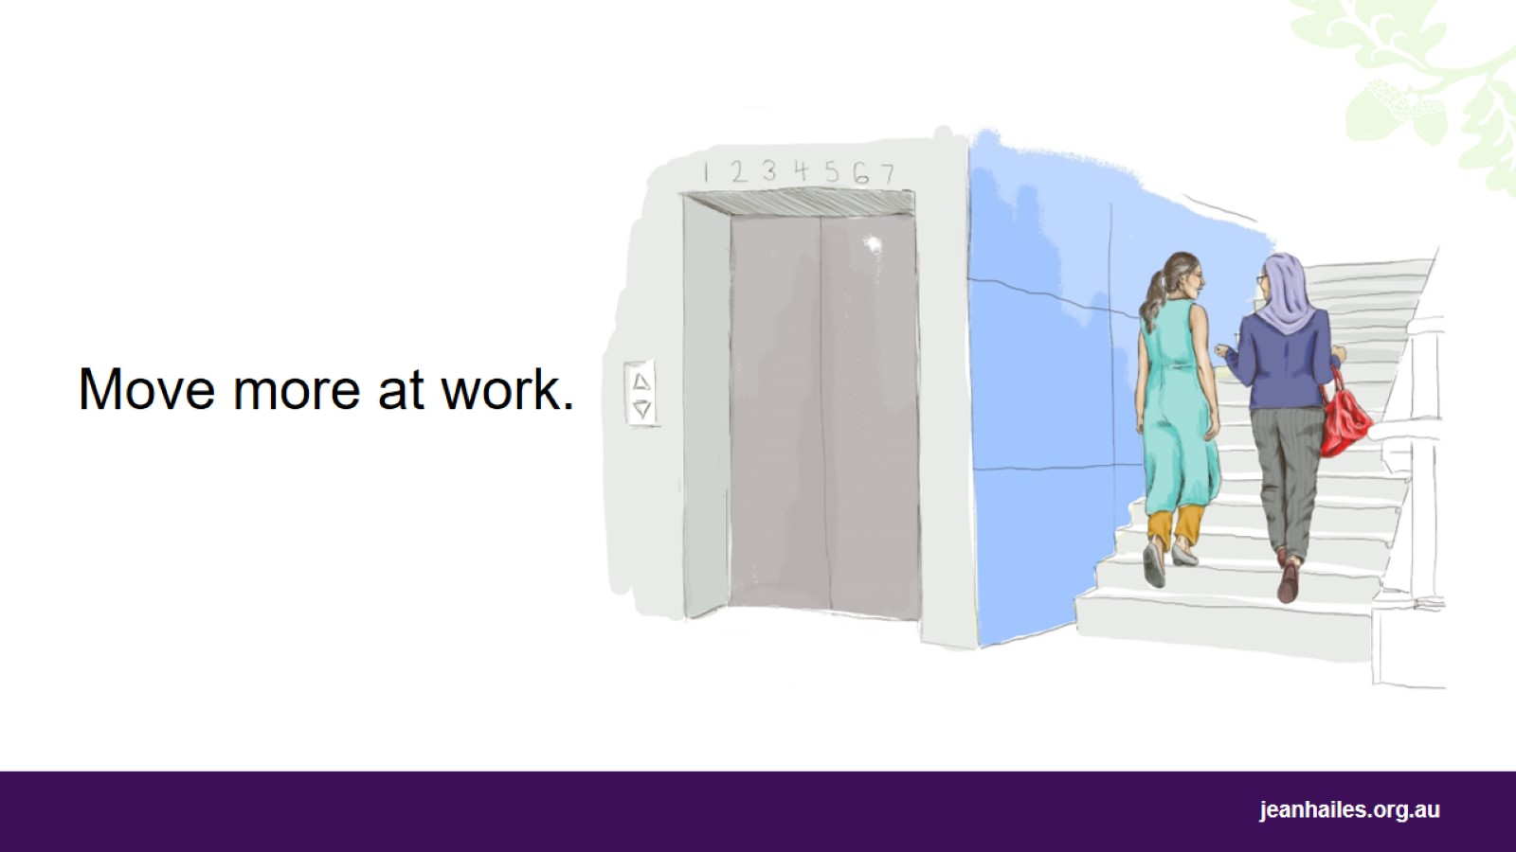
Notes:
How can I move more at work?
There are lots of ways you can move more at work each day:
walk, ride a bike or use public transport to get to work instead of driving
take the stairs instead of the lift
get off the bus or tram a stop or two earlier, or park further away from your workplace
suggest a walking meeting instead of sit-down ones
walk around while talking on the phone
if possible, walk to deliver a message rather than emailing or calling
enjoy a walk outside during lunch.

Slide 13
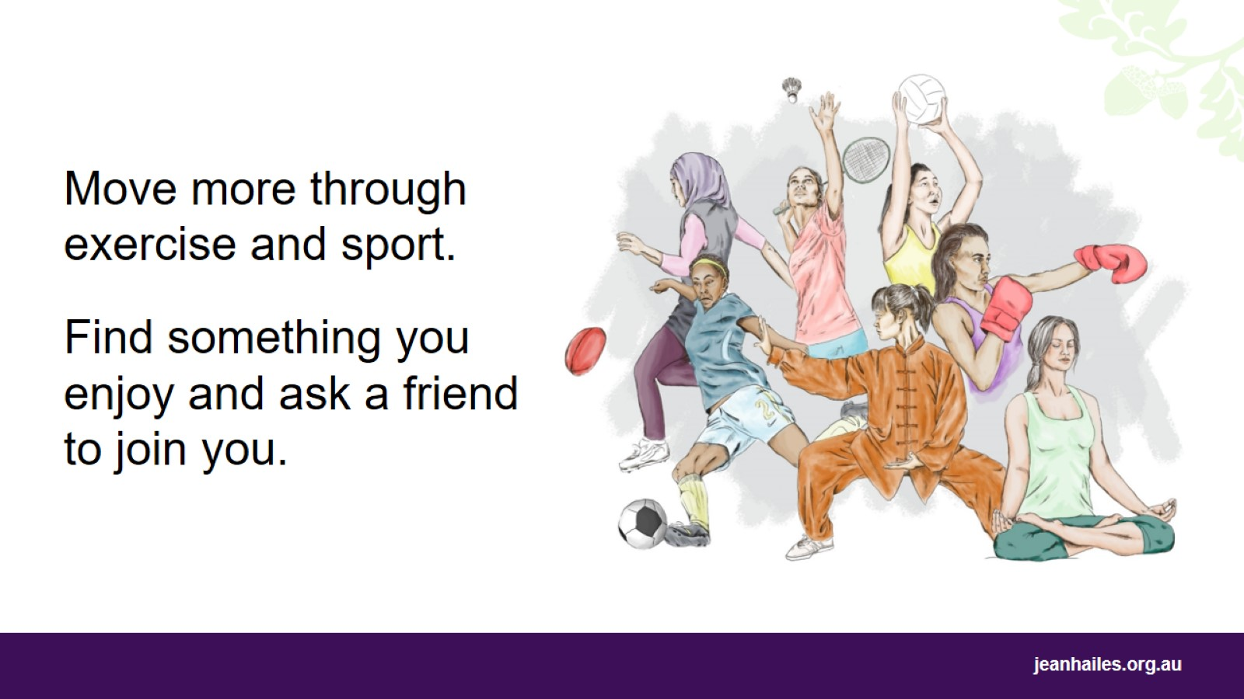
Notes:
How can I do more?
You can move more by exercising and doing sports.
In Australia, there are many different sports and activities that you can choose from, such as swimming, dancing, badminton, yoga, martial arts, joining the gym, joining a walking club, or playing team sports like volleyball, basketball, cricket, soccer.
Try different activities, find what you enjoy doing and ask a friend to join you.

Slide 14
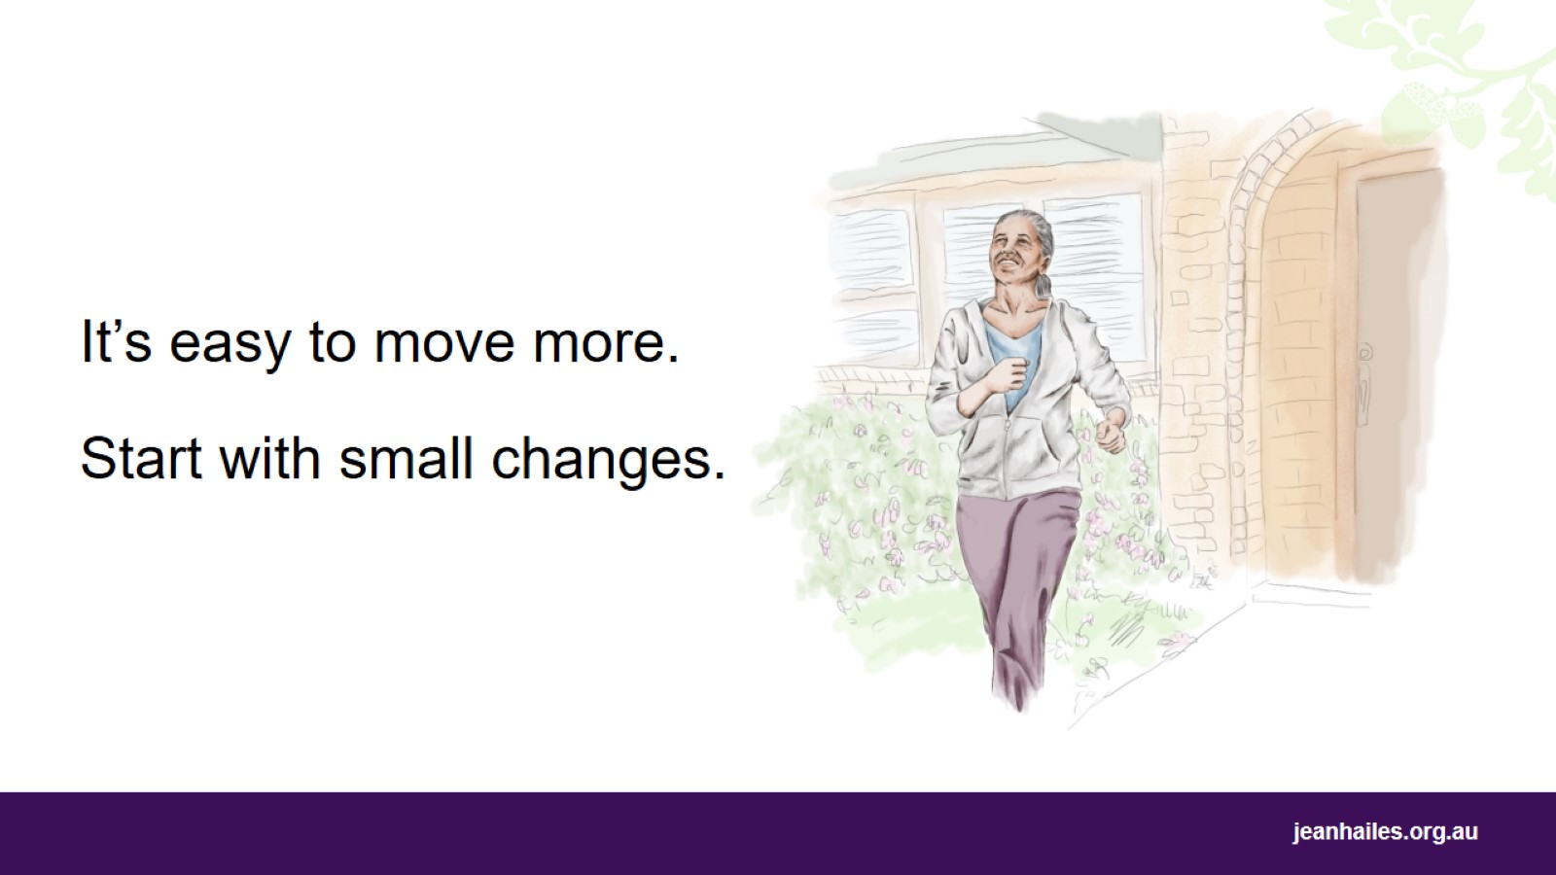
Notes:
If you’re not doing any physical activity at the moment, it’s easy to start, no matter how old you are.
You can start slowly and increase the amount of physical activity you do each week.
The more you move the healthier you will be.
If you are 65 years old or older, it is especially important to move.
If you are new to physical activity, have a health problem, or don’t know if it’s safe for you to be more active, speak with your doctor or nurse first about the best activities for you.

Slide 15
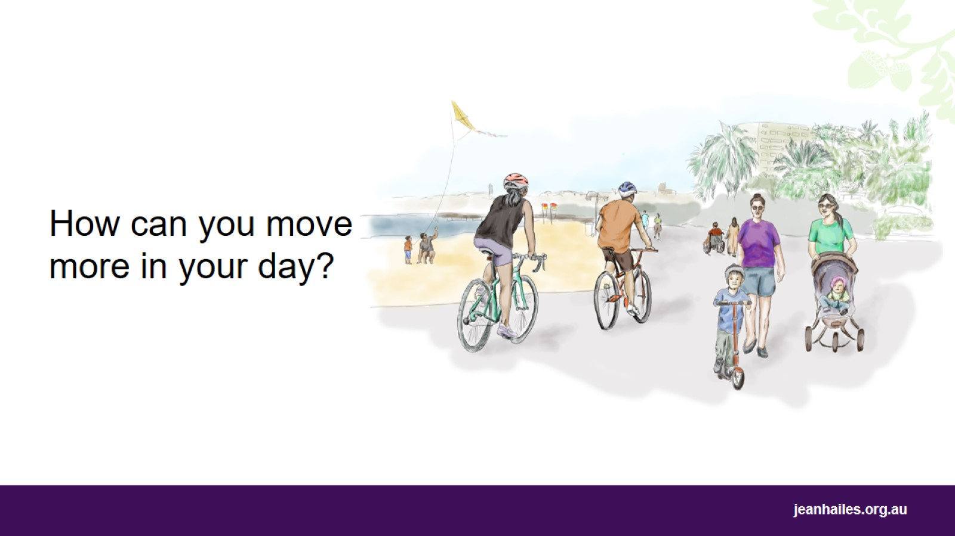
Notes:
Note to the facilitator: wrap up the session with a discussion on how participants can include more physical activity in their day.

Slide 16
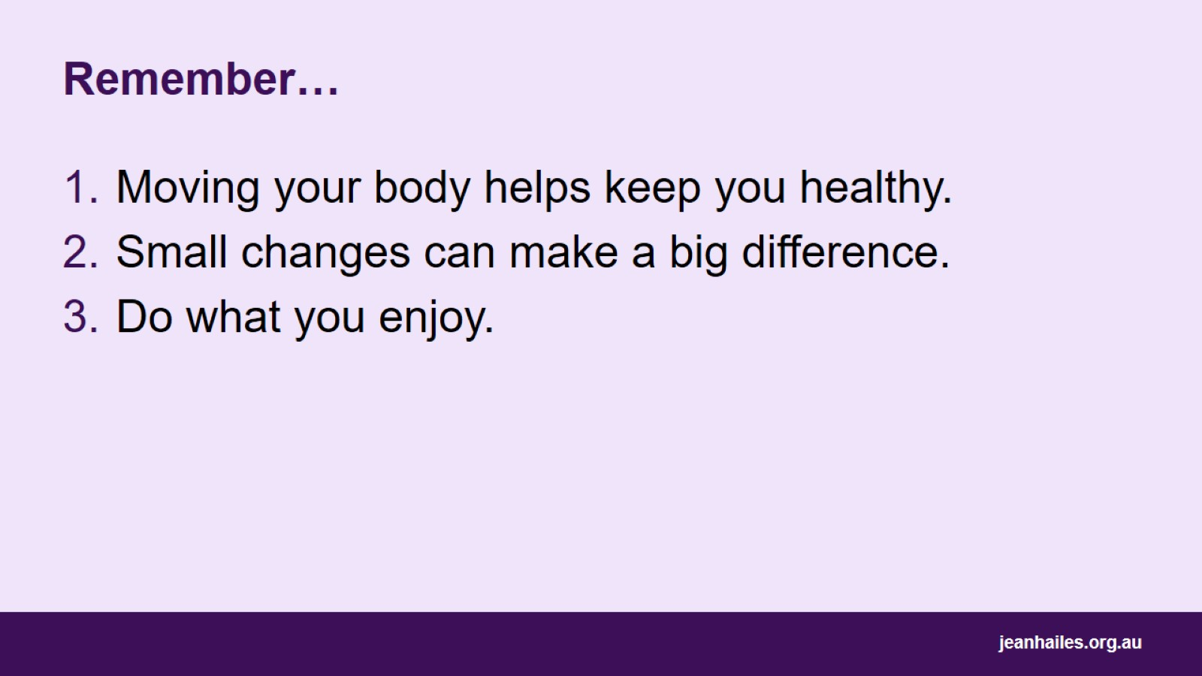
Remember…

Slide 17

Local programs and services
Notes:
Note to the facilitator: provide local options/programs/facilities etc.

Slide 18


