Slide 1

Good food for good health

Slide 2
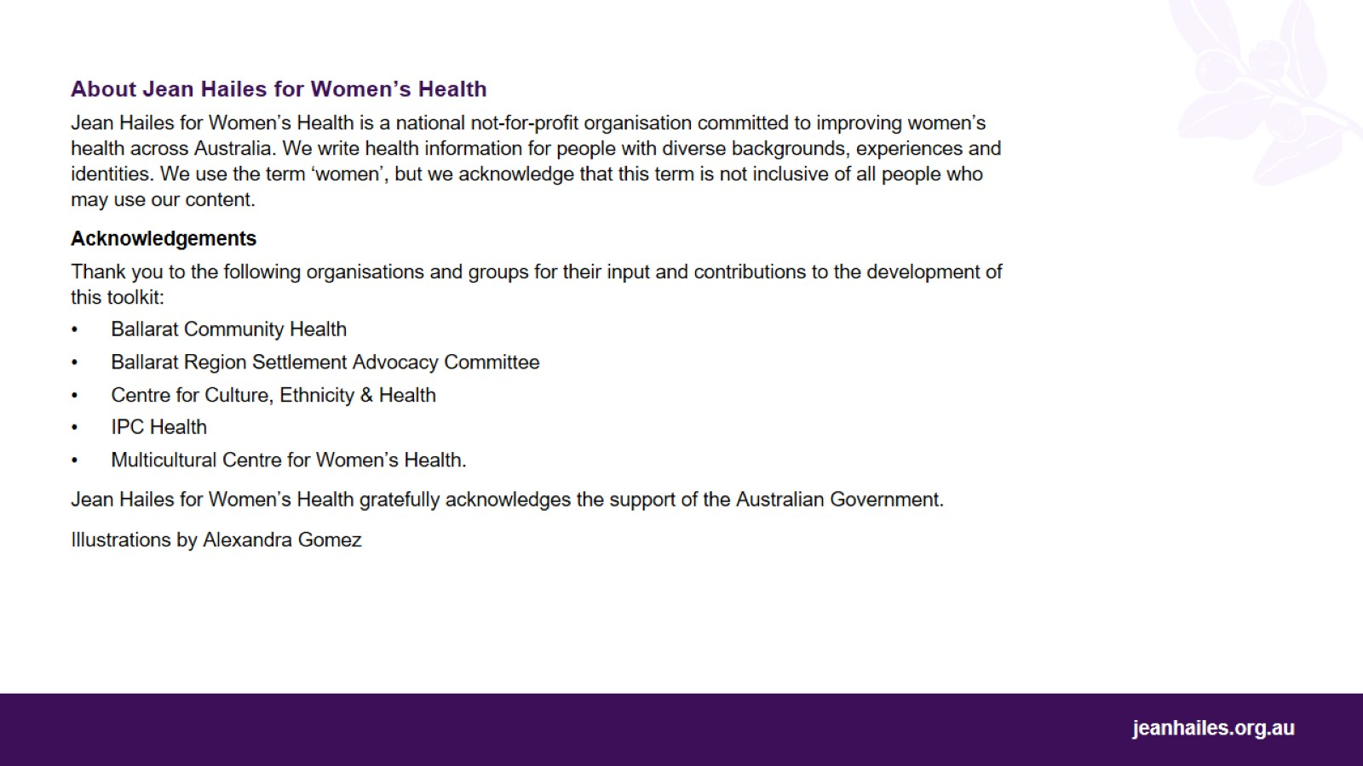

Slide 3
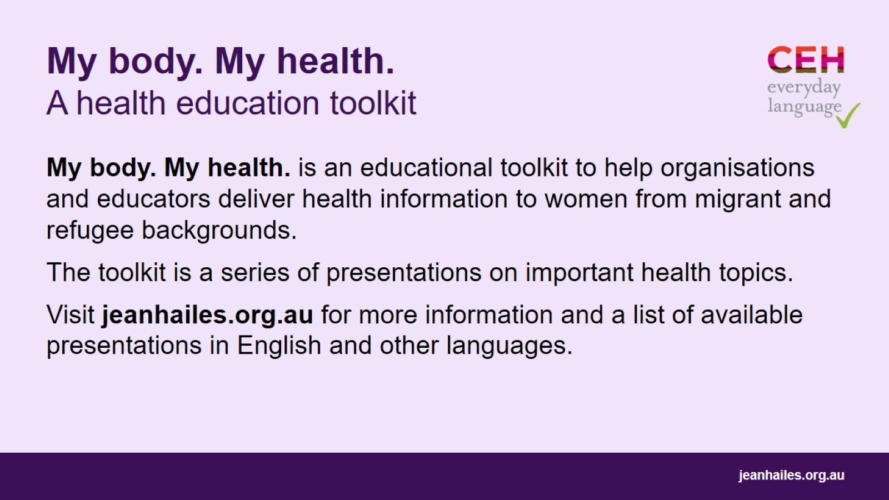
My body. My health. A health education toolkit

Slide 4

Let’s
Notes:
Today we’ll talk about what we should eat to help us stay healthy:
what types of food are the best to eat
how much of these foods we need to eat to be healthy
what a healthy school lunch for children is.
Note to the facilitator: choose a few questions (examples below) to lead a brief group discussion on the role of food in our lives.
Questions to consider:
What is the role of food in our lives?
Who is responsible for the food in your house?
Who is responsible for choosing the food you eat?
What does it mean to ‘eat good food’?
What are good types of food?
What are healthy foods in your everyday cuisine?
Do you think that what you eat can change how you feel?

Slide 5
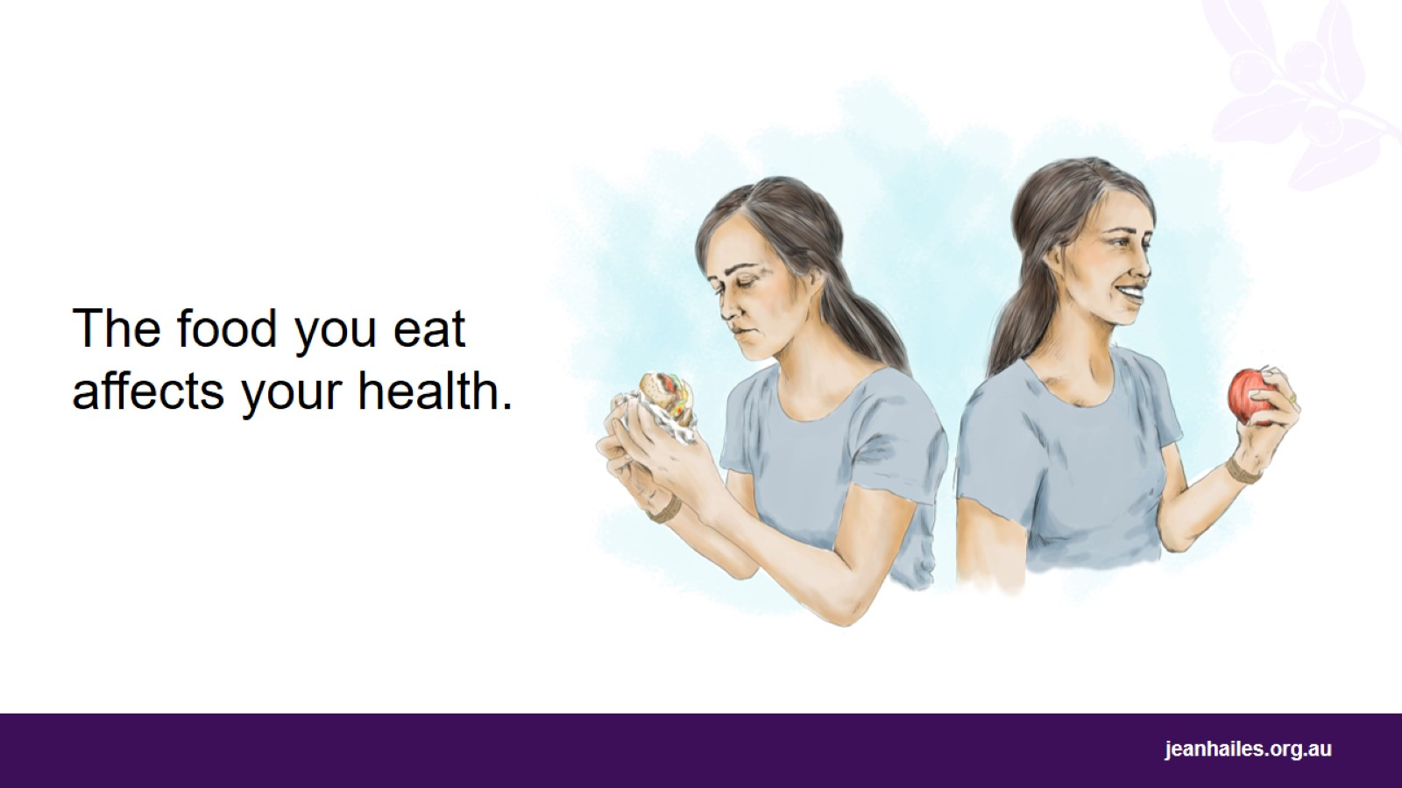
Notes:
How does food affect my health?
What you eat can affect:
your physical health – how healthy your body is
how much energy you have
your mood – how happy you feel.
Eating healthy foods can make you and your family feel better, which can help you enjoy your life more.

Slide 6
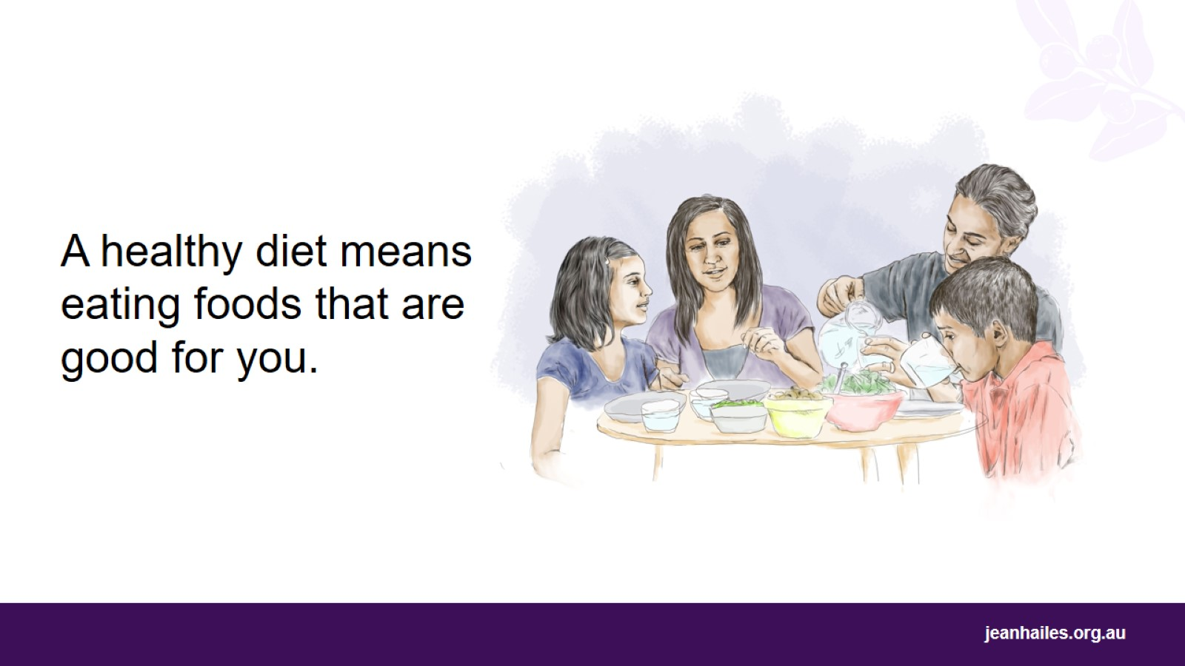
Notes:
What is a diet?
Your diet is the foods that you eat every day.
What is a healthy diet?
A healthy diet means eating the right types of food, and the right amount. A healthy diet is good for your body, your health and your life.
Every day:
Have a mix of different foods – this is important for good brain, heart and gut health
Eat regular meals
Eat fruit, vegetables and wholegrains, such as multigrain bread and brown rice
Don’t have much sugar, salt and bad fats*
Drink lots of fluids – aim for 2 litres or 8 cups a day, most of it water.
*Note to the facilitator: there are bad and good fats; try to limit the bad fats.
Examples of bad fats: junk and processed foods - chips, cookies, cakes, lollies, fried food, fast-food meals, vegetable oil, which often means palm oil, and animal-fat products, like butter, cream, ghee, fatty meats, and cheese. However, cheese is part of a healthy diet if eaten in small amounts, for example a matchbox-size piece of hard cheese per day.
Examples of good fats: olive oil, avocado, nuts, canola oil, peanut oil, macadamia nut oil, and margarines containing these oils.

Slide 7
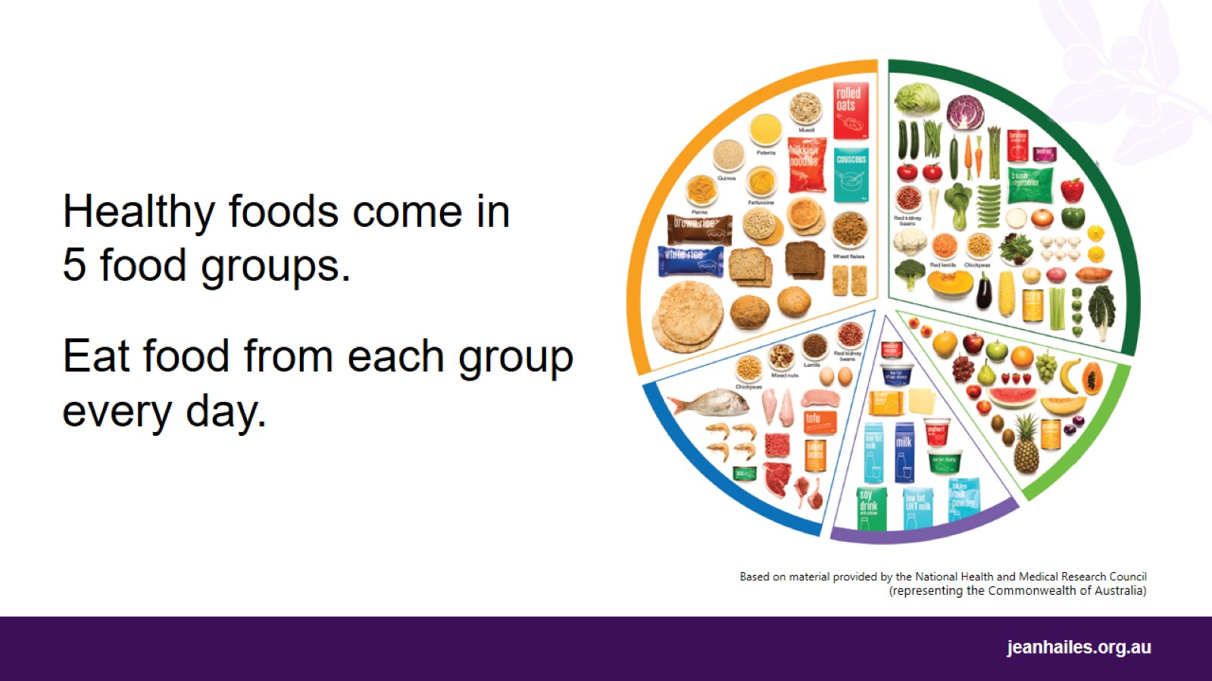
Notes:
What are the 5 food groups?*
5 food groups are:
Grains, such as wheat, oats, rice, corn, quinoa, and rye
Vegetables
Fruit
Meat and other protein, such as eggs, tofu, nuts, seeds, and peas/lentils/beans
Dairy, such as milk, yoghurt, cheese, and dairy alternatives.
What do I need to eat every day?
Every day you need to eat food from each of the 5 food groups. This will help to keep you healthy.
It’s good to mix up the foods from each group and use healthy oils, such as olive oil, canola oil, peanut oil.
*Note to facilitator: Australian Guide to Healthy Eating provides a guide for the 5 food groups.
The image shows the proportion of the 5 food groups we should eat every day and not the amounts.

Slide 8
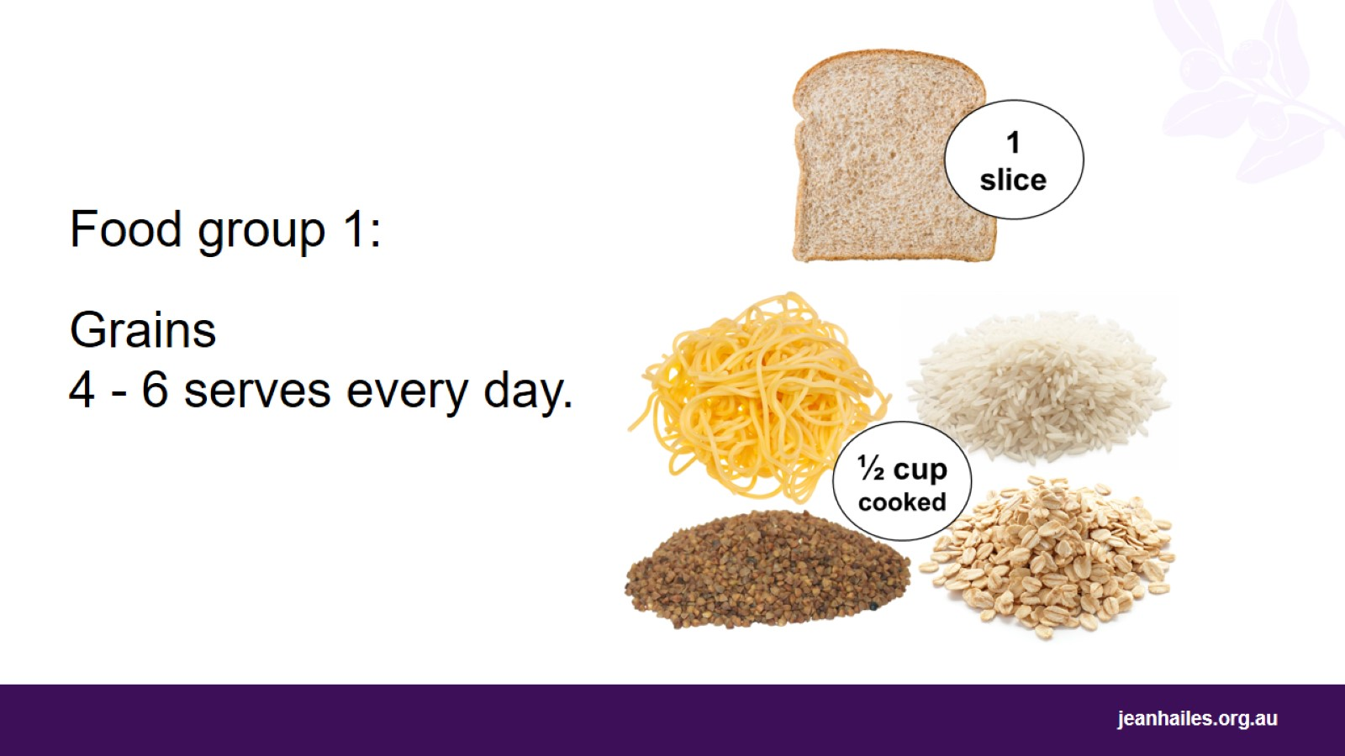
Notes:
What are grains?
Foods in this group come from a variety of grains like rice, corn, quinoa, semolina, buckwheat, rye, oats and sorghum. They are often ground into flours to make things like bread, noodles and pasta.
Wholegrains, like multigrain bread, brown rice, rolled oats, are the best choice.
How much grain do I need to eat every day?
You need to eat 6 serves of grains every day, but only 4 if you’re over 50 years old.
How much is 1 serve of grains?
Here are 5 examples of 1 serve of grains:
1 slice of bread
3 dry wholegrain biscuits
half a cup* of cooked rice, pasta, noodles, barley, buckwheat, corn, semolina, polenta, bulgur or quinoa
half a cup of cooked porridge
quarter of a cup of muesli.
*Note to the facilitator: explain to the participants that a measuring cup (250ml) might be a different size than the cup they drink from.

Slide 9
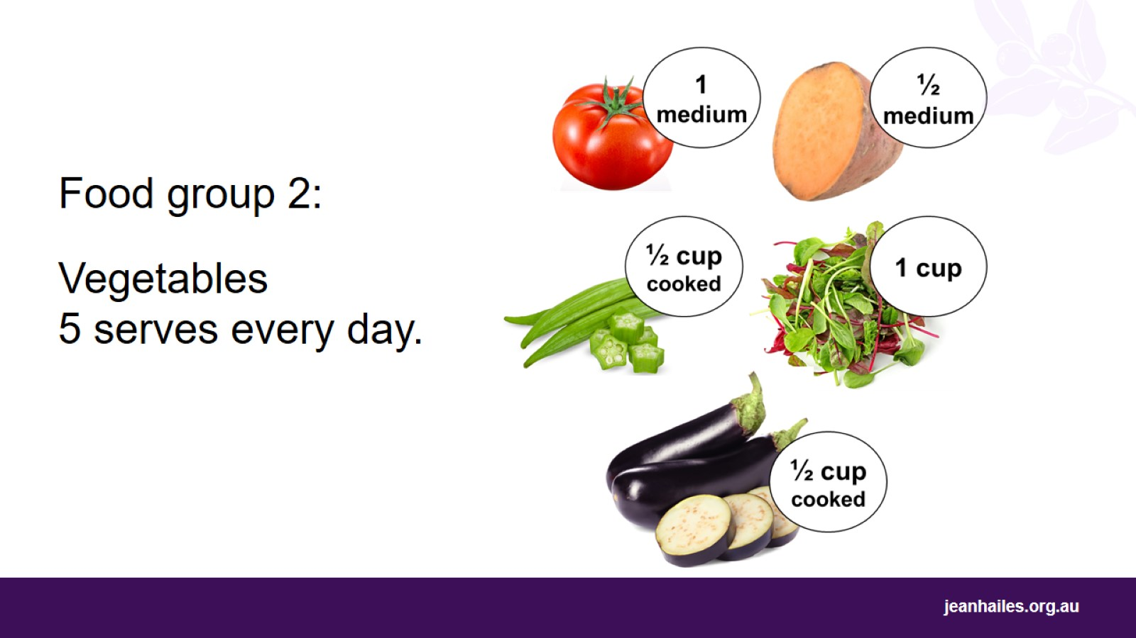
Notes:
Why are vegetables important?
Vegetables give your body vitamins and minerals. They help make your body work well. If you don’t eat vegetables, your body cannot work well.
Eat a rainbow of vegetable colours because they all have different vitamins and minerals for your body.
How many vegetables do I need to eat every day?
You need to eat 5 serves of vegetables every day.
How much is 1 serve of vegetables?
Here are 6 examples of 1 serve of vegetables:
half a cup of cooked vegetables
half a cup of baked beans
half a cup of sweet corn
1 cup of salad
half a medium sweet potato
1 medium tomato.

Slide 10
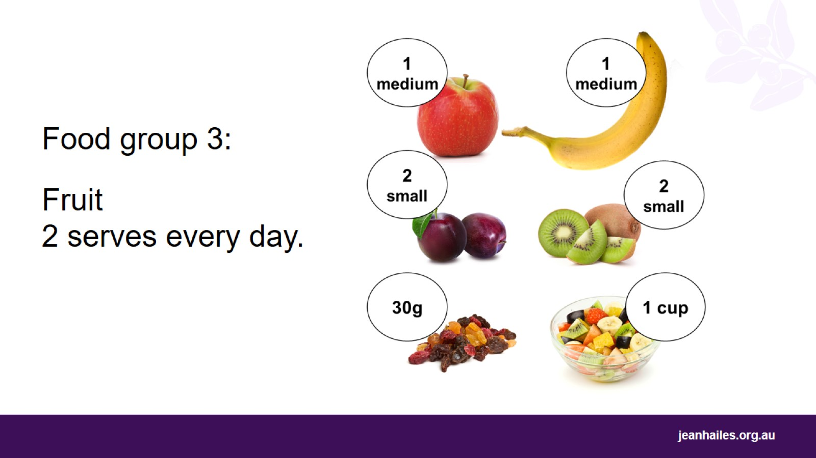
Notes:
Why are fruits important?
Fruits, just like vegetables, give your body vitamins, minerals and fibre, which make your body work well. Fruits also have sugar, which gives you energy.
Eat different coloured fruits, because different coloured fruits have different vitamins and minerals. The different vitamins and minerals help your body stay healthy in different ways.
How much fruit do I need to eat every day?
You need to eat 2 serves of fruit every day.
How much is 1 serve of fruit?
Here are 5 examples of 1 serve of fruit:
1 medium apple, banana, orange or pear
2 small apricots, kiwi fruits or plums
1 cup of diced or canned fruit with no added sugar
half a cup of fruit juice with no added sugar
30g dried fruit, for example 2 dried apricots, 1 and a half tablespoons of sultanas.

Slide 11
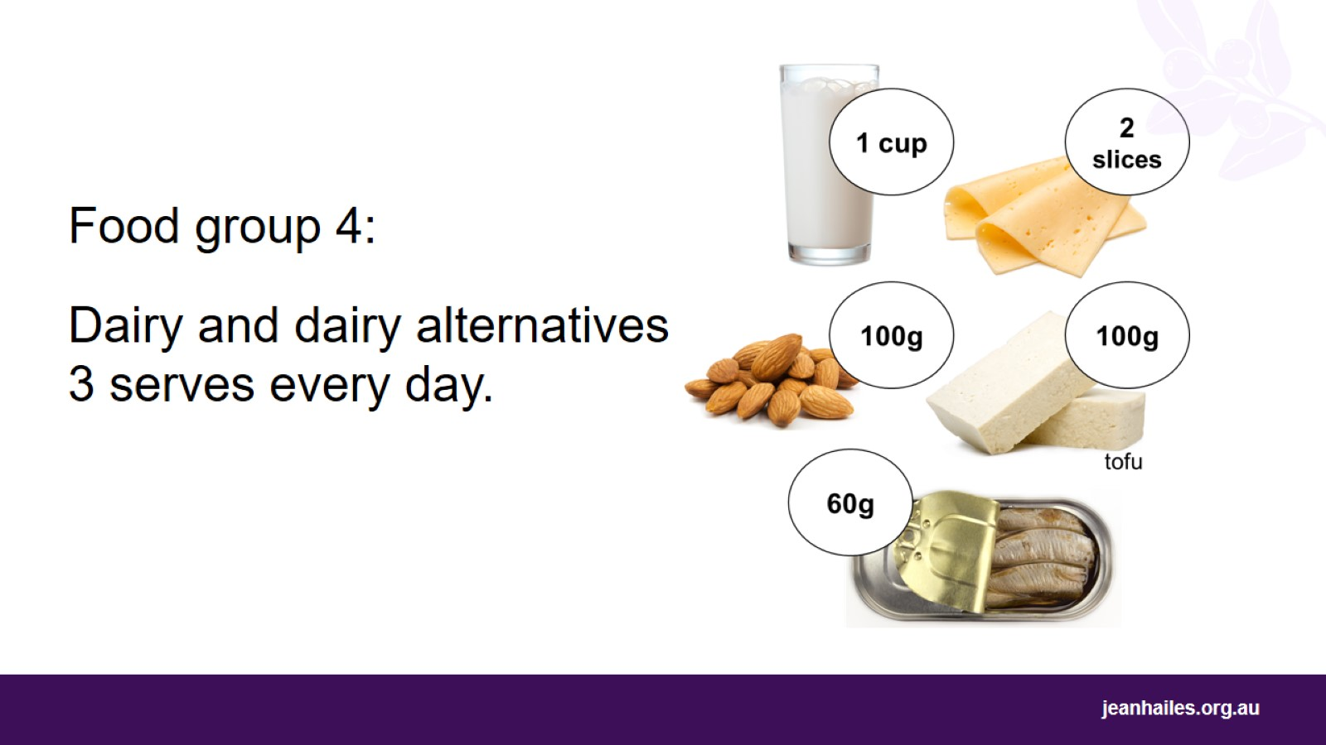
Notes:
What is dairy?
Dairy products are made from animal milk, for example yoghurt, cheese and butter. Eat dairy to have strong bones and muscles. Remember to choose reduced-fat products.
If you can’t eat dairy products, try dairy alternatives like soy/rice/almond milk (with added calcium), tofu or canned sardines or salmon.
How much dairy do I need to eat every day?
You need to eat 3 serves of dairy or dairy alternatives every day.
How much is 1 serve of dairy?
Here are 5 examples of 1 serve of dairy:
1 cup of milk or buttermilk
half a cup of evaporated milk
2 slices of hard cheese, such as cheddar
half a cup of ricotta cheese
1 small tub of yoghurt.
How much is 1 serve of dairy alternatives?
Here are 5 examples of 1 serve of dairy alternatives:
100g almonds with skin
60g sardines, canned in water
half a cup of canned pink salmon with bones
100g firm tofu
1 cup of soy, rice or other cereal drink with at least 100mg of added calcium per 100ml.

Slide 12
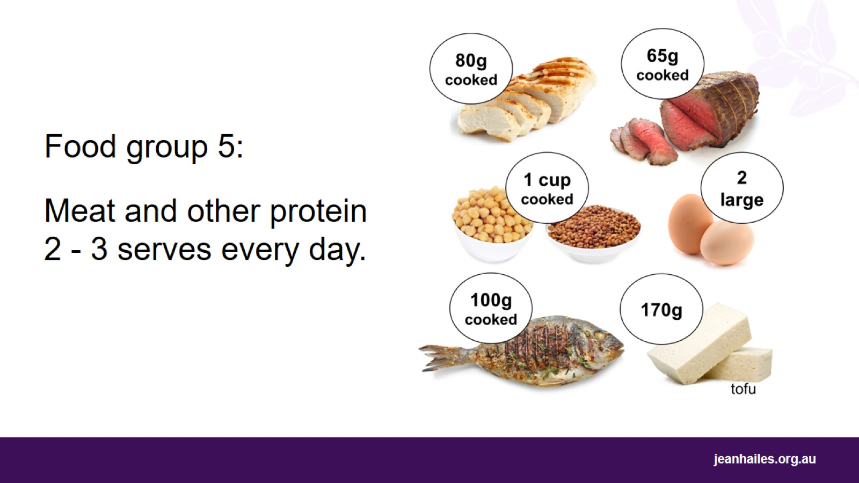
Notes:
What is protein?
Protein helps you and your family to grow and develop muscles. Protein comes from red meat, chicken, fish, and eggs.
Non-animal sources of protein include seeds, nuts, legumes, and soy products, like tofu or tempeh.
How much protein do I need to eat every day?
You need to eat 2 to 3 serves of protein every day, but no more than 3 serves of red meat a week.
How much is 1 serve of protein?
Here are 7 examples of 1 serve of protein:
65g cooked lean red meat, such as beef, lamb, veal, pork, goat or kangaroo. This is about the size of the palm of your hand.
80g cooked lean chicken or turkey. This is about the size of the palm of your hand
100g cooked fish fillet, or one small can of fish
2 large eggs
1 cup of cooked or canned legumes, such as lentils, chickpeas or split peas, preferably, with no added salt
170g tofu
a small handful of nuts or seeds, some peanut or almond butter, tahini or other nut or seed paste with no added salt.

Slide 13
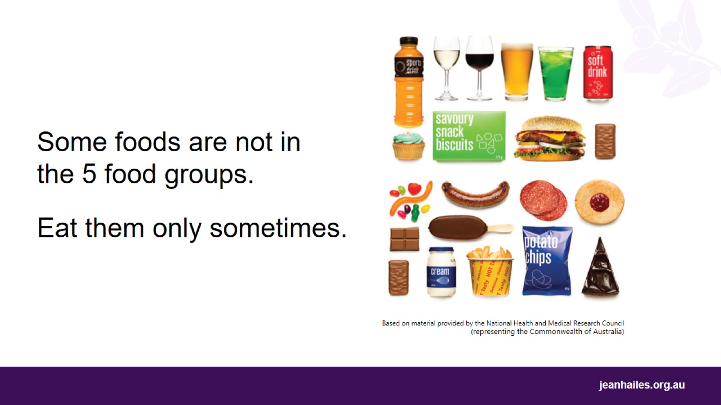
Notes:
What are ‘sometimes’ foods?
‘Sometimes’ foods are not part of the 5 food groups. They are not part of a healthy diet.
They have too much fat, sugar, and salt and nothing of the good things your body needs.
If you eat too much of these foods, you might increase your weight and it can make you sick. So, eat them only sometimes and in small amounts or not at all.
Examples of ‘sometimes’ foods are:
sweet biscuits, cakes, desserts and pastries
ice-cream, lollies and chocolate
potato chips, crisps and other fatty and/or salty snack foods including some savoury biscuits
pastries and pies, fast-food burgers, fried foods
processed meats and fatty/salty sausages
sugary soft drinks, cordials, sports and energy drinks, and alcohol
sweetened condensed milk, cream, butter and spreads.

Slide 14
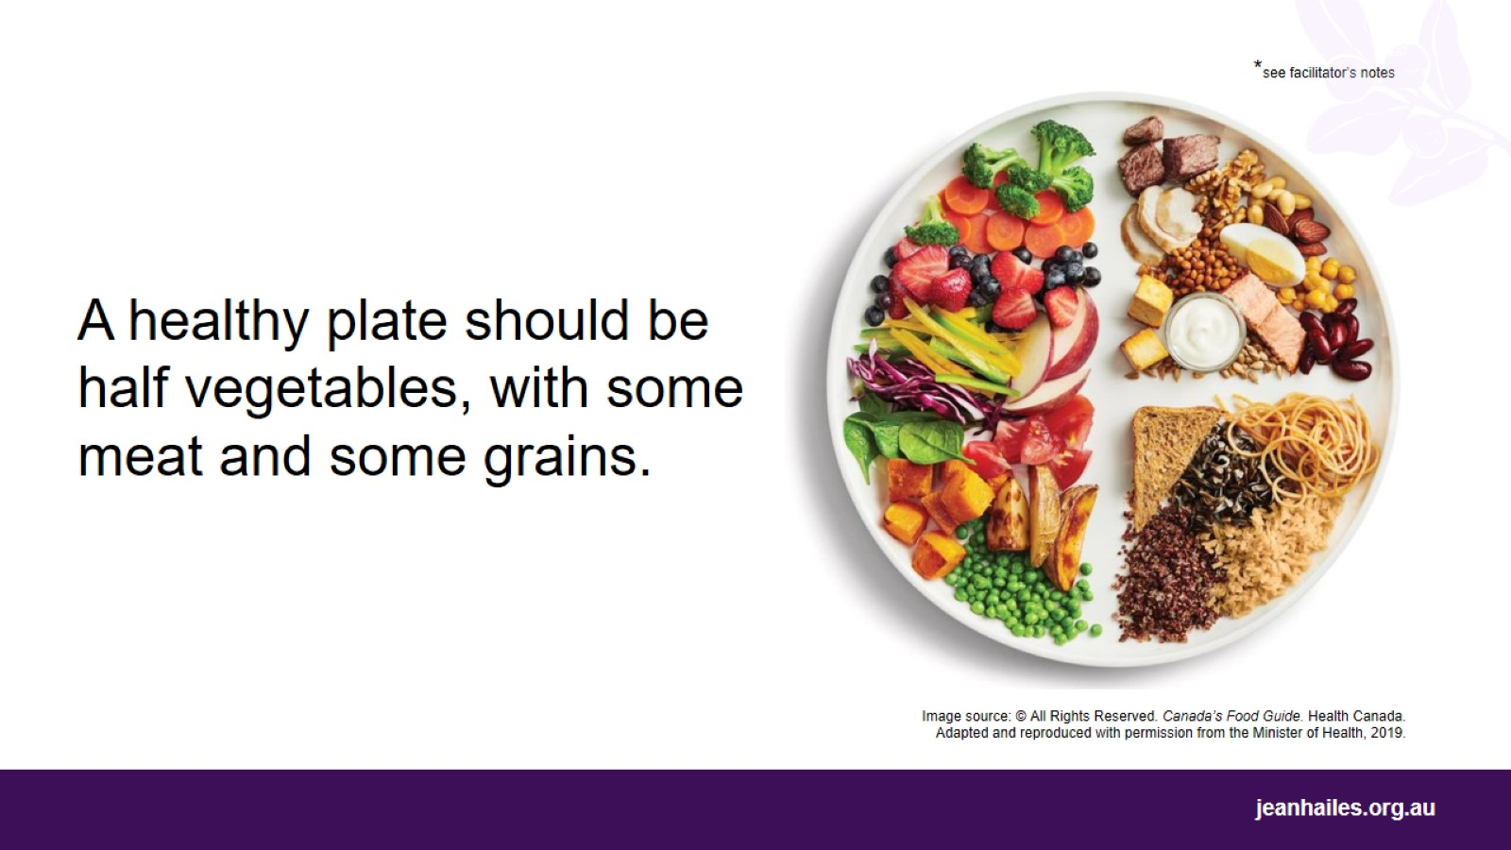
Notes:
What do healthy meals look like?
Healthy meals include a variety of foods from the 5 food groups.
For a healthy meal:
Fill half of your plate with vegetables
Add some protein, like meat, eggs, fish, tofu, or legumes
Add some grains, like rice, noodles, quinoa, pasta, or bread
Eat fruit or dairy as a snack or for dessert.
Instead of using a ‘sometimes’ food in your meal, like a sausage or fried potato, choose something from the 5 food groups, like chicken or rice.
Serve vegetables or salad as a side dish when eating meals like pasta, lasagna or risotto.
*Note to facilitator: the image shows how much food on a plate should come from one food group compared to another – not the actual amounts of food to be eaten.

Slide 15
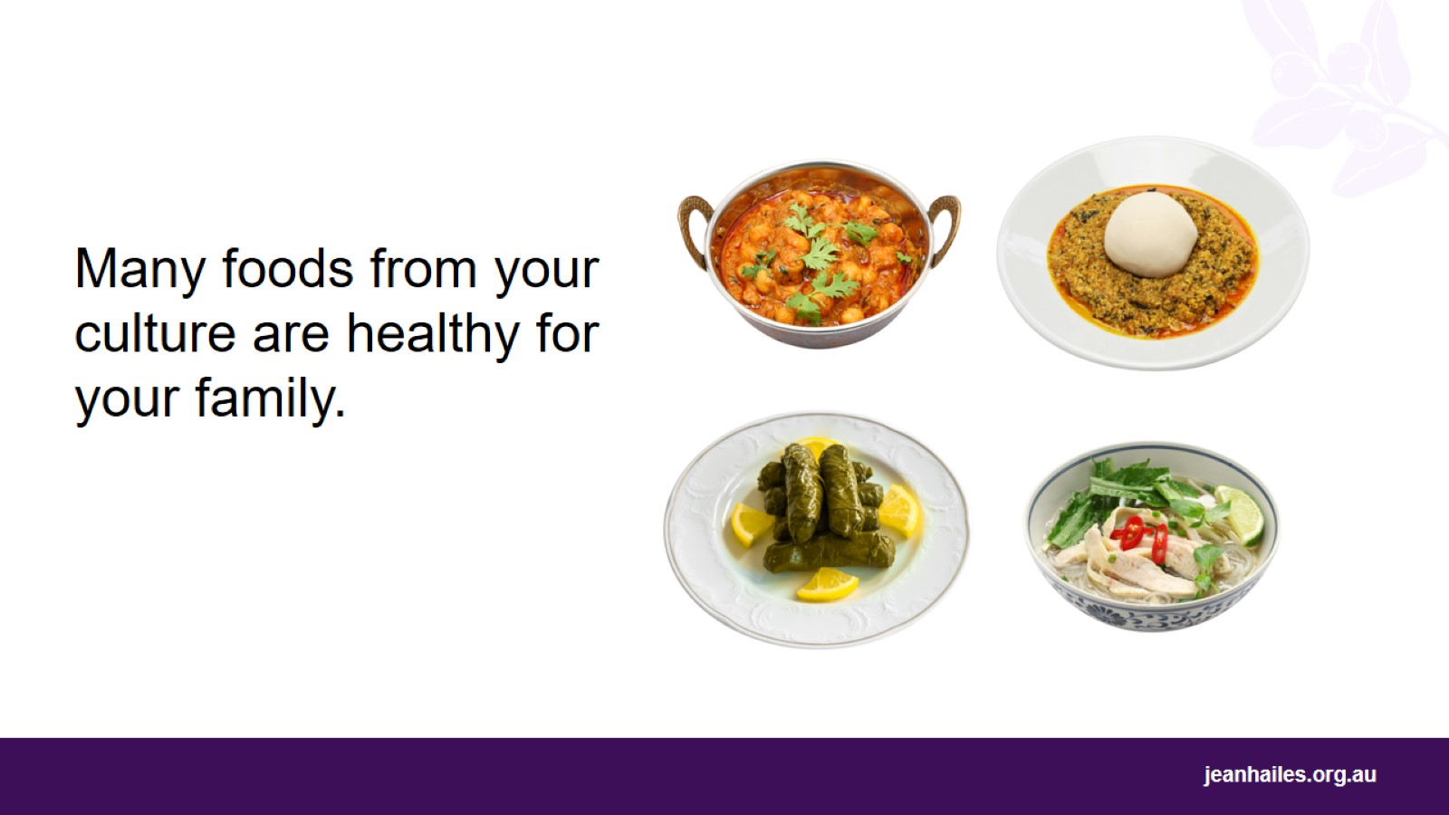
Notes:
Should I cook my traditional foods?
Often the traditional foods from your culture are really healthy. It’s good to keep these foods as part of your diet.
Traditional home-cooked meals, such as lentil-based dishes and curries, flavoured with herbs and spices, are better choices than meals and processed foods from a shop. These foods often have a lot of sugar, salt and fats.

Slide 16
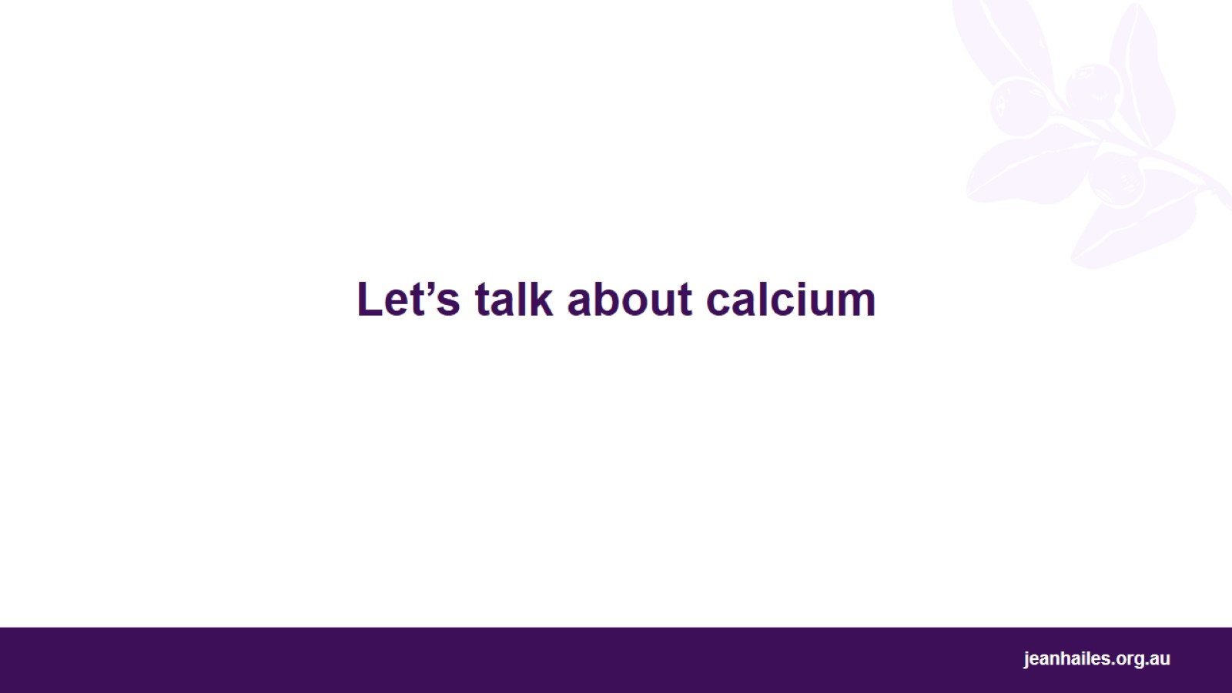
Let’s talk about calcium

Slide 17
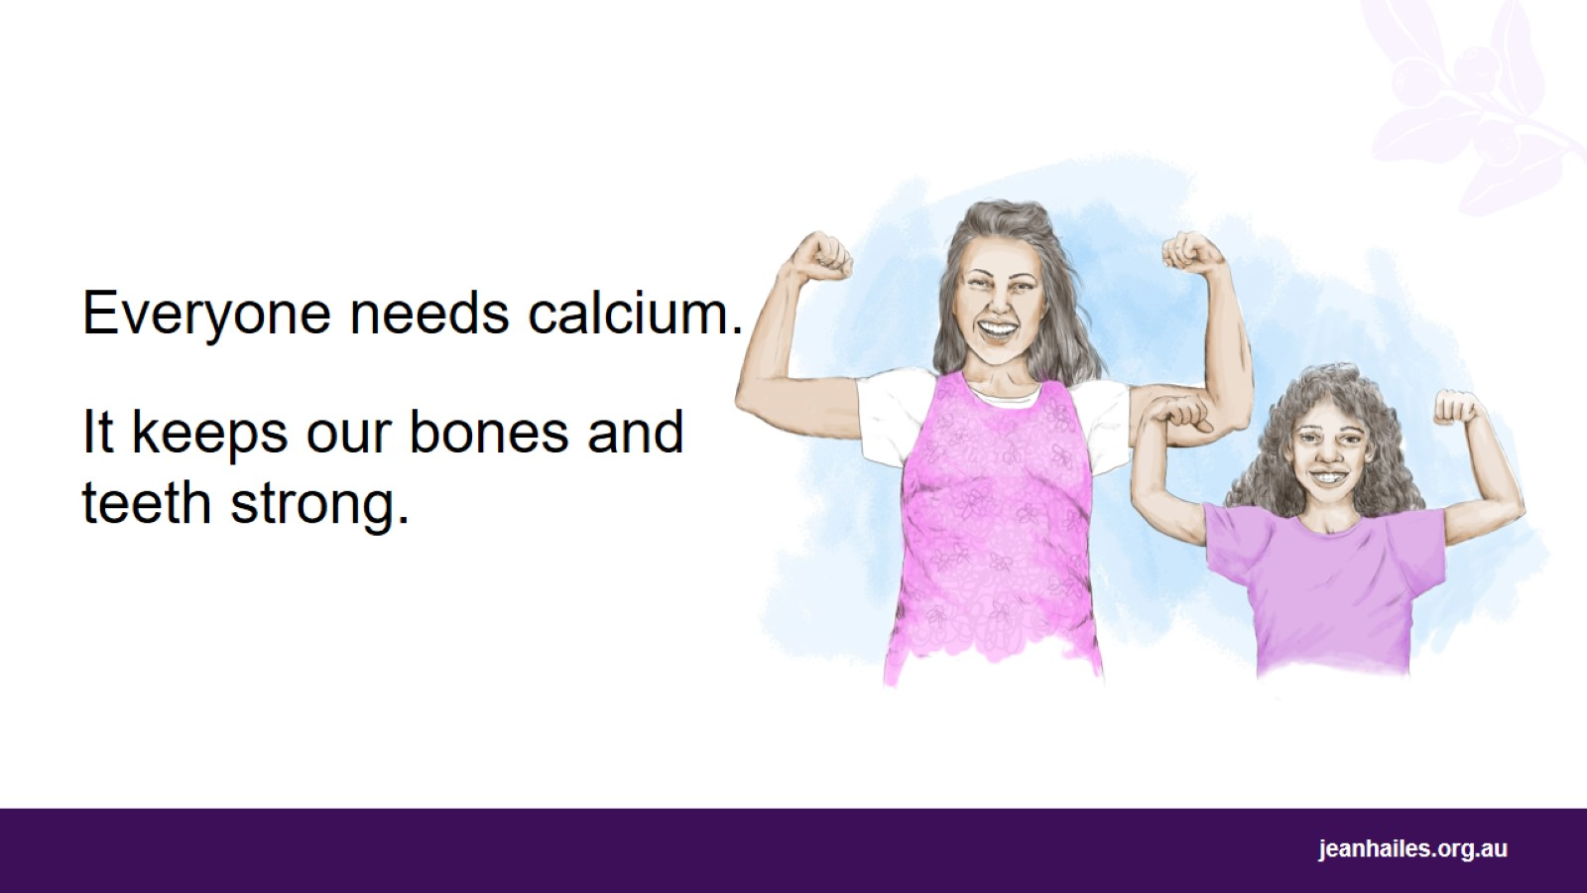
Notes:
Why is calcium important?
You need calcium in life. It is super important for healthy:
teeth and bones
muscles
heart
nervous system.
If you don’t get enough calcium, your bones will become weak.

Slide 18
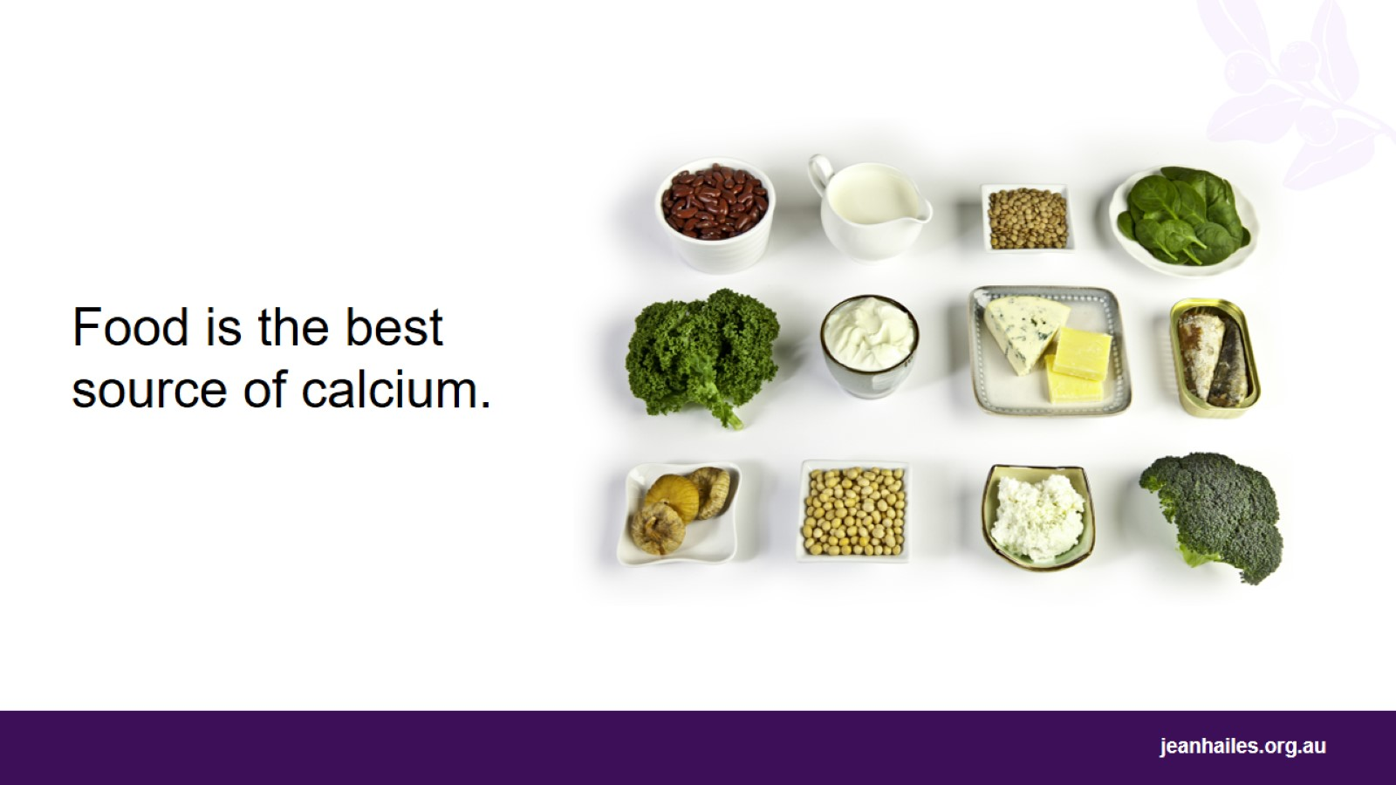
Notes:
What are the best foods for calcium?
The best sources of calcium are dairy products such as milk, yoghurt, and hard cheeses.
You need to have 3 serves of dairy per day or 4 serves per day if you are older than 50 years of age.
Other non-dairy sources of calcium include:
soy, rice and almond milk with added calcium
tofu and tempeh
fish with edible bones, such as tinned salmon with bones and sardines
nuts and seeds, such as Brazil nuts, almonds and sesame seed paste (tahini)
green leafy vegetables, like broccoli, bok choy, Chinese cabbage and spinach
dried fruit, such as figs, dates, prunes, and apricots.
You can also get calcium from tablets, but it is much better to get it from your food.
Ask your doctor if you need to take calcium tablets.

Slide 19
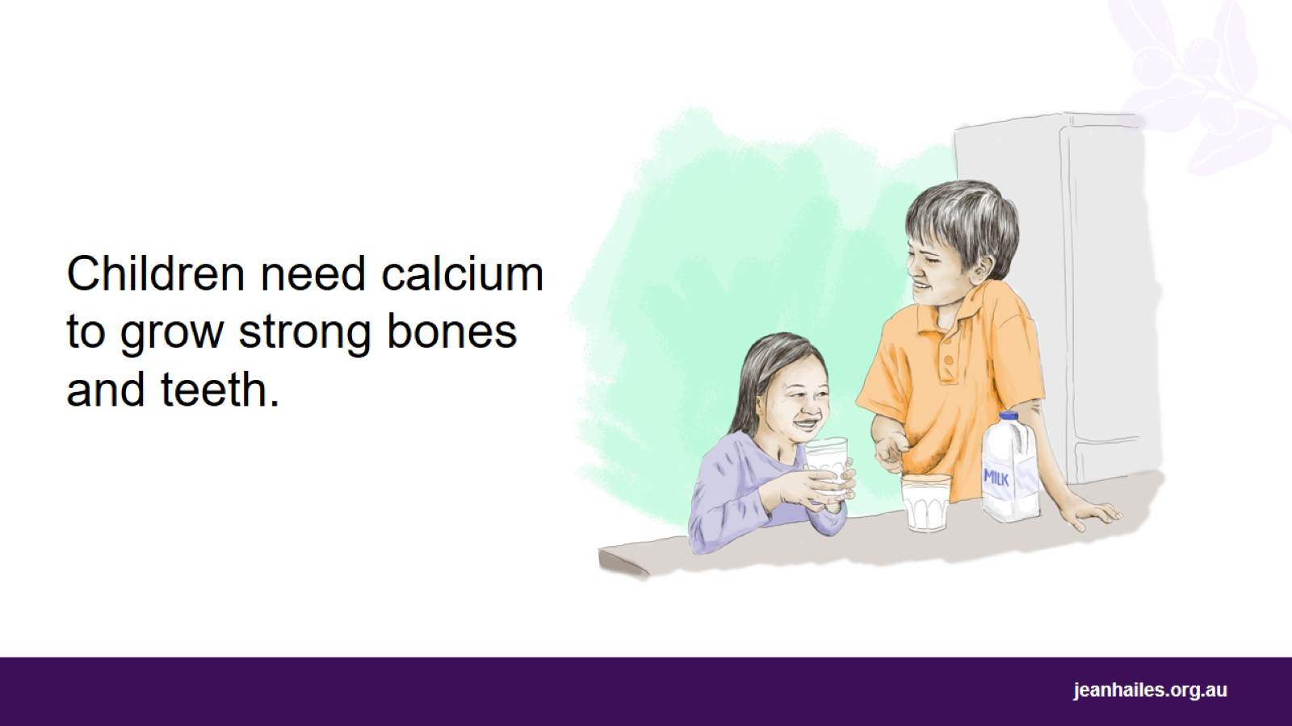
Notes:
Why do children and teenagers need more calcium?
The bones of young children are constantly growing. It is very important that children get enough calcium each day to build strong bones and teeth.
Teenagers need more calcium because they grow a lot during puberty.
Talk to your nurse or doctor about how much calcium your child needs every day.

Slide 20
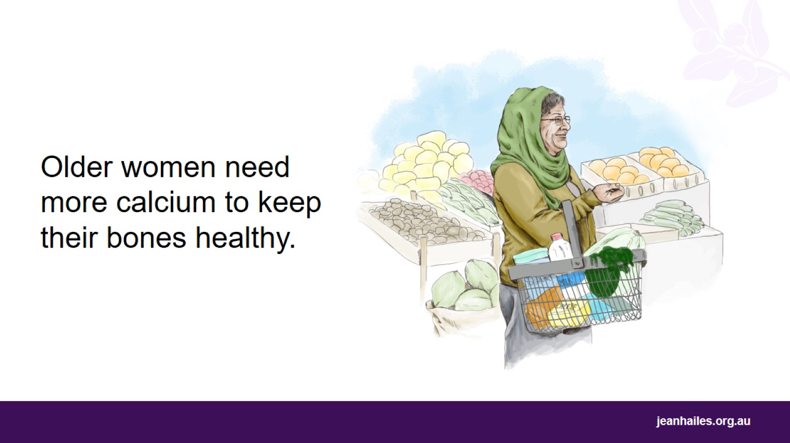
Notes:
Why do older women need more calcium?
As women get older, their bones get weaker. Older women need to eat more calcium to keep their bones strong.
This is especially important in the 5 to 10 years around menopause* when more calcium is lost from the bones. Eating more calcium cannot stop this bone loss, but it can slow it down.
How much calcium per day do women aged over 50 need?
If you are over 50 years of age, you need to have 1300mg of calcium per day, which means 4 serves of dairy per day.
*Menopause is your final period/menstrual bleed. You will only know that you have reached menopause when you haven’t had any bleeding for 12 months.

Slide 21

Let’s talk about healthy school lunches
Notes:
It might be a good idea to facilitate a short discussion about school lunches.
Questions to consider*:
What kind of foods did you have for your lunch at school when you were a child?
What kind of foods do your children have in their school lunchbox?
Who chooses the foods for your children's lunchboxes?
Can your children decide what goes into their lunchbox?
Do you prepare the school lunch together with your children?
Do you talk to your children about different kinds of foods and how healthy they are?
*Note to the facilitator: choose only a few questions.

Slide 22
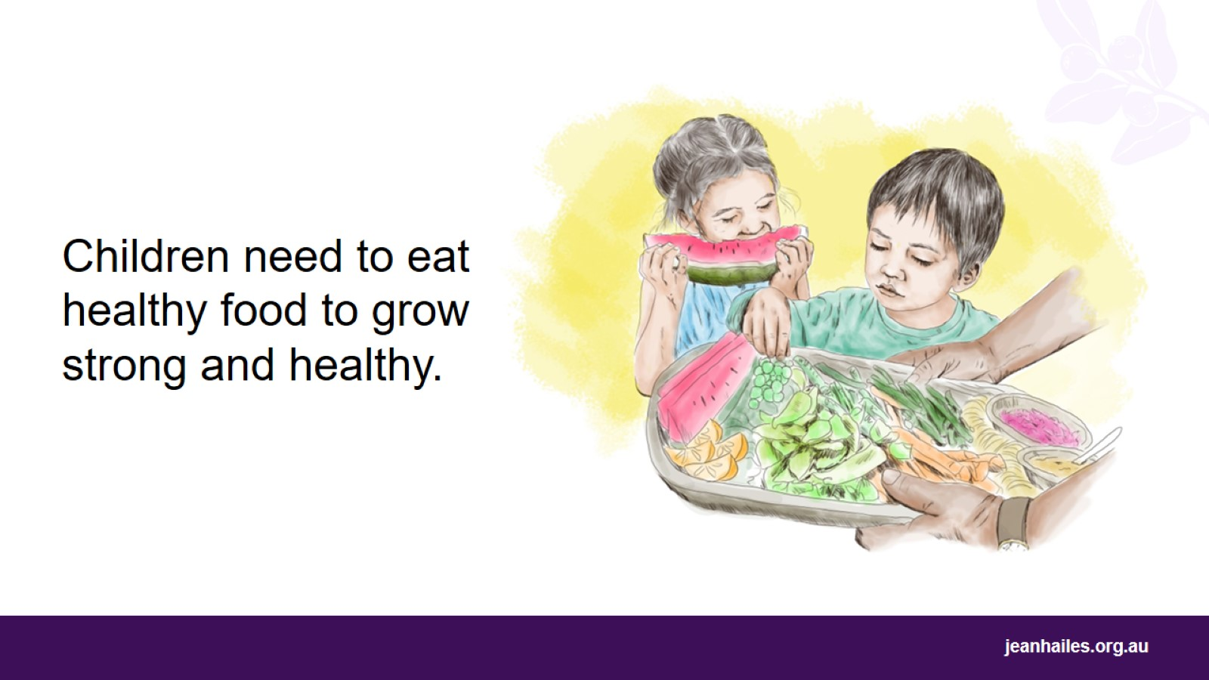
Notes:
Why is it so important that children eat good food?
Healthy food is important for children so they can grow and develop healthy brains and bodies.
Your children need lots of good food to be strong and do well at school.
You are responsible for the types of food you offer your children, but you need to let them choose what they want to eat.
Your children watch you and learn from you, so it’s important to show them that you also choose healthy food to eat.

Slide 23
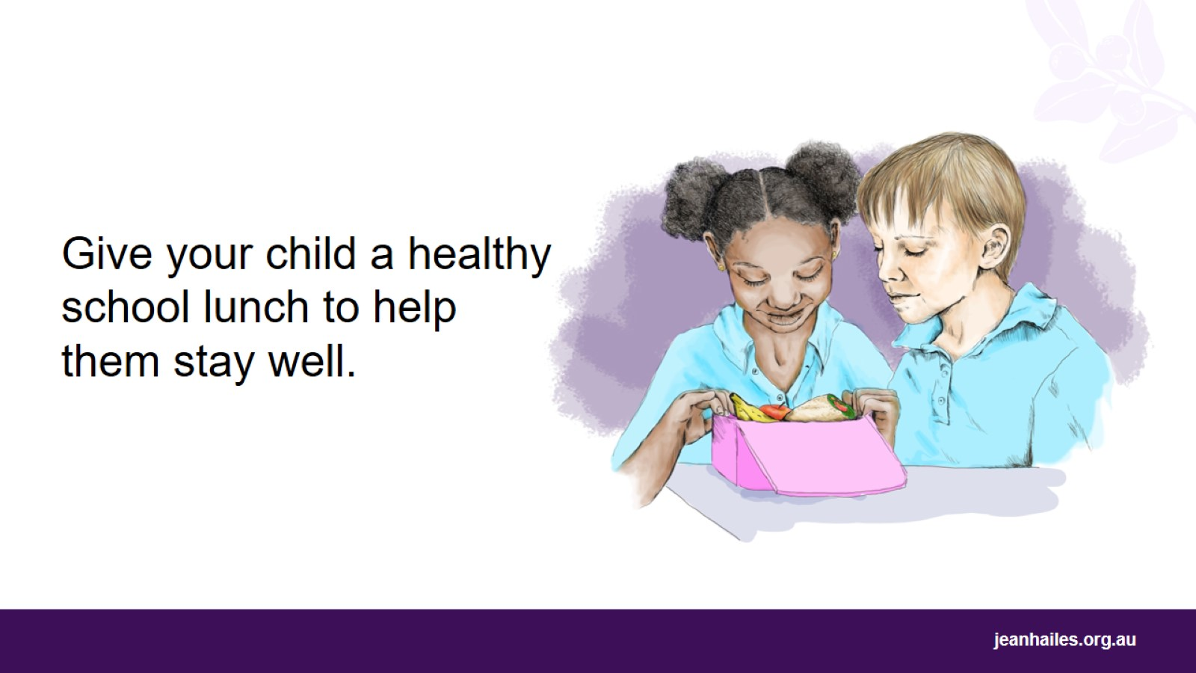
Notes:
The school lunch is a great opportunity to give your children food that makes them grow strong and healthy.

Slide 24
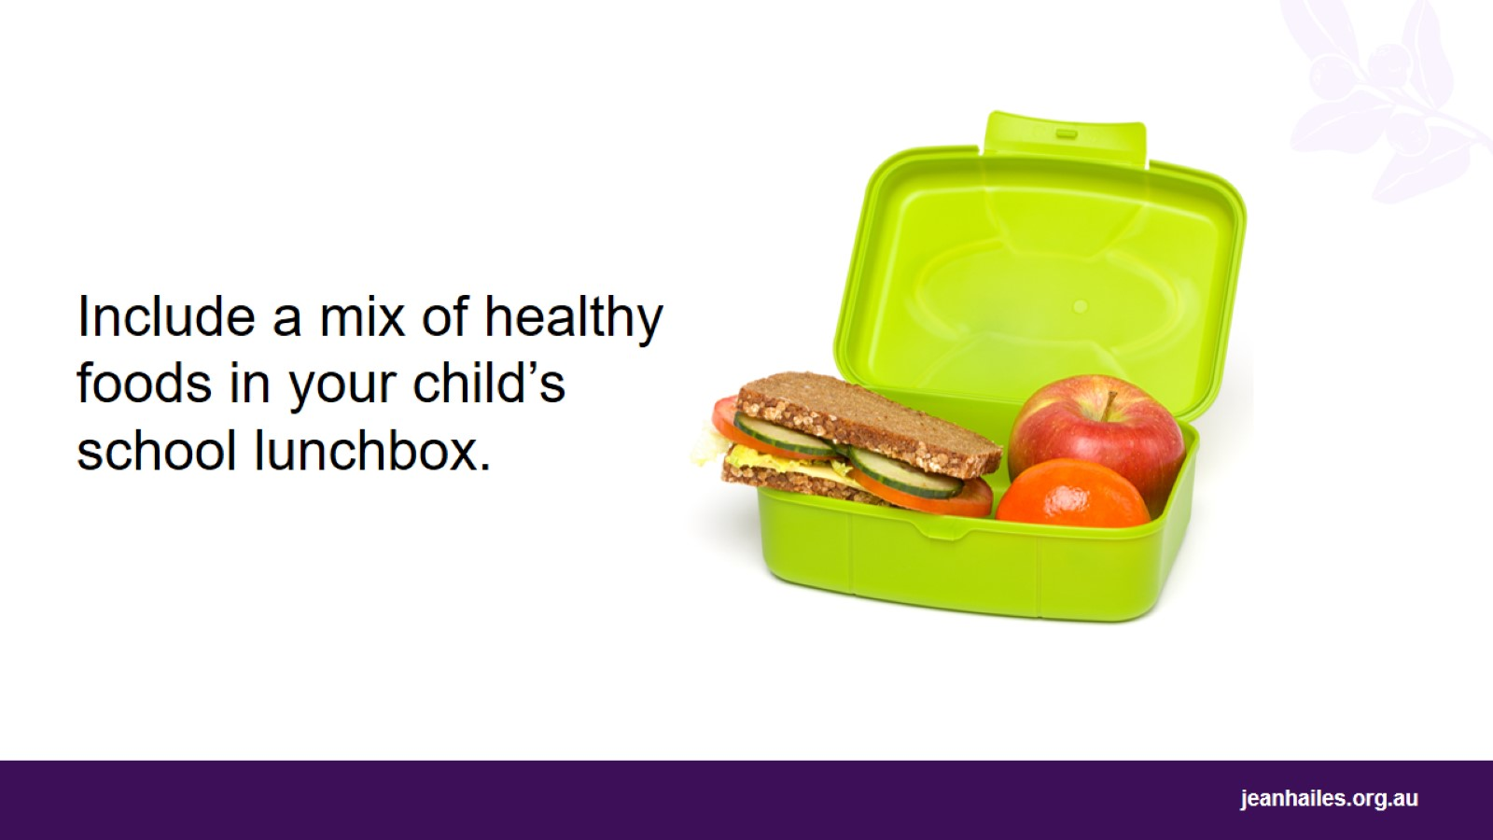
Notes:
What to put in a school lunchbox?
A healthy lunchbox should include:
fresh fruit and vegetables
milk, yoghurt or cheese (or dairy alternatives)
meat or other protein, like hard-boiled egg or peanut butter*
grains like bread, a roll, flat bread, fruit bread, or crackers. Remember, wholegrain or wholemeal choices are best
tap water.
Home-cooked, traditional foods can be great for lunchboxes. It also shows children that traditional foods are often nutritious and healthy.
What should NOT go into a healthy lunchbox?
Do not include these foods, as they have too much sugar, salt or fat:
all sweet drinks, such as fruit juices, fruit drinks, cordials, sports drinks, energy drinks, flavoured waters, flavoured mineral waters, iced teas and soft drinks
dried fruit bars and ‘straps’
'dairy desserts', chocolate bars and muesli bars
chocolate spreads, jams and honey in sandwiches
fatty, salty processed meats, such as salami and sausages
potato chips or savoury biscuits.
*If your school has a nut-free policy, don’t put peanut butter or any nuts in your child’s lunchbox.

Slide 25
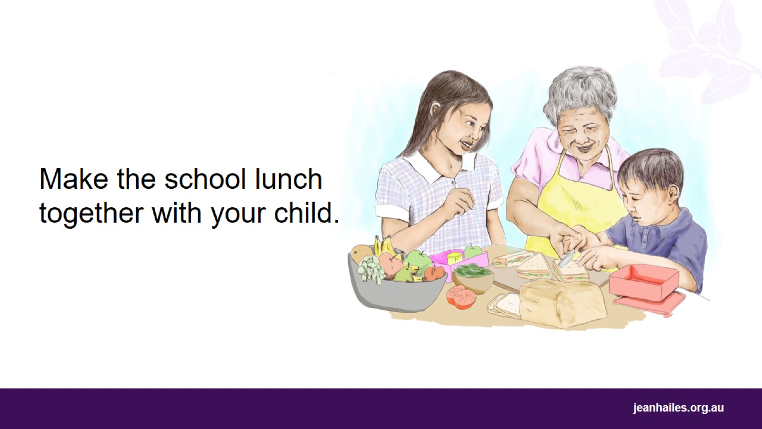
Notes:
Why is it good to make school lunches with my child?
School is a time when children start to make their own decisions about what’s important. They learn fast and are influenced by you, their friends and popular things they see. Preparing the school lunch is a perfect time to talk to them about healthy foods and to show them what good food choices are.
Things you can do while preparing school lunches together:
Show your child different healthy foods and let them choose what they will eat at school.
Let older children make their lunch themselves.
Let younger children help make sandwiches or cut up soft fruit.
Prepare the school lunch together with your child the night before. This way you will have more time, as mornings can be very busy.

Slide 26
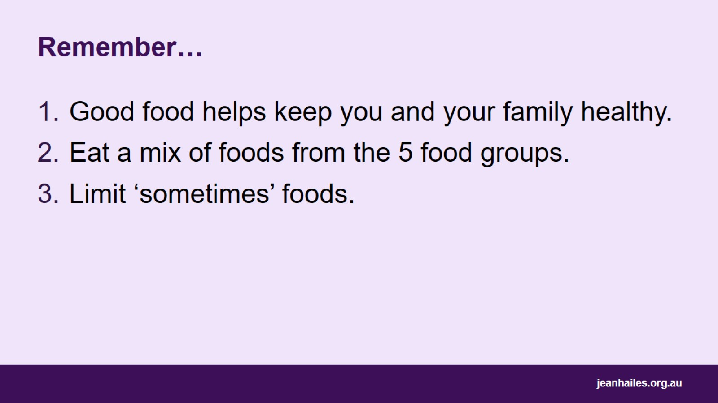
Remember…
Notes:
What you eat every day affects your health.
When you eat healthy foods, you feel better and have a better life. It helps keep you well and protect you from illness.
Healthy eating is very important for babies and children to grow and develop well.
Remember:
Eat food that is good food helps keep you and your family healthy.
Eat a mix of foods from the 5 food groups.
Limit ‘sometimes’ foods.

Slide 27

Local services
Notes:
Note to the facilitator: provide details of local health services.

Slide 28


