Slide 1

Health checks for women

Slide 2
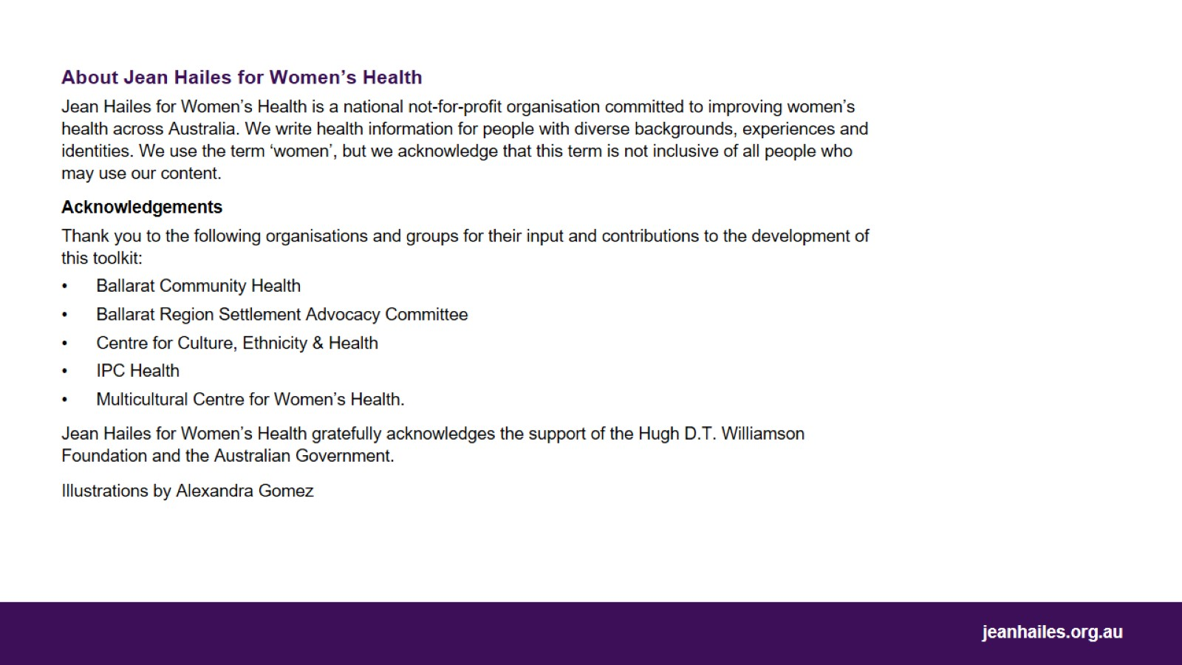

Slide 3
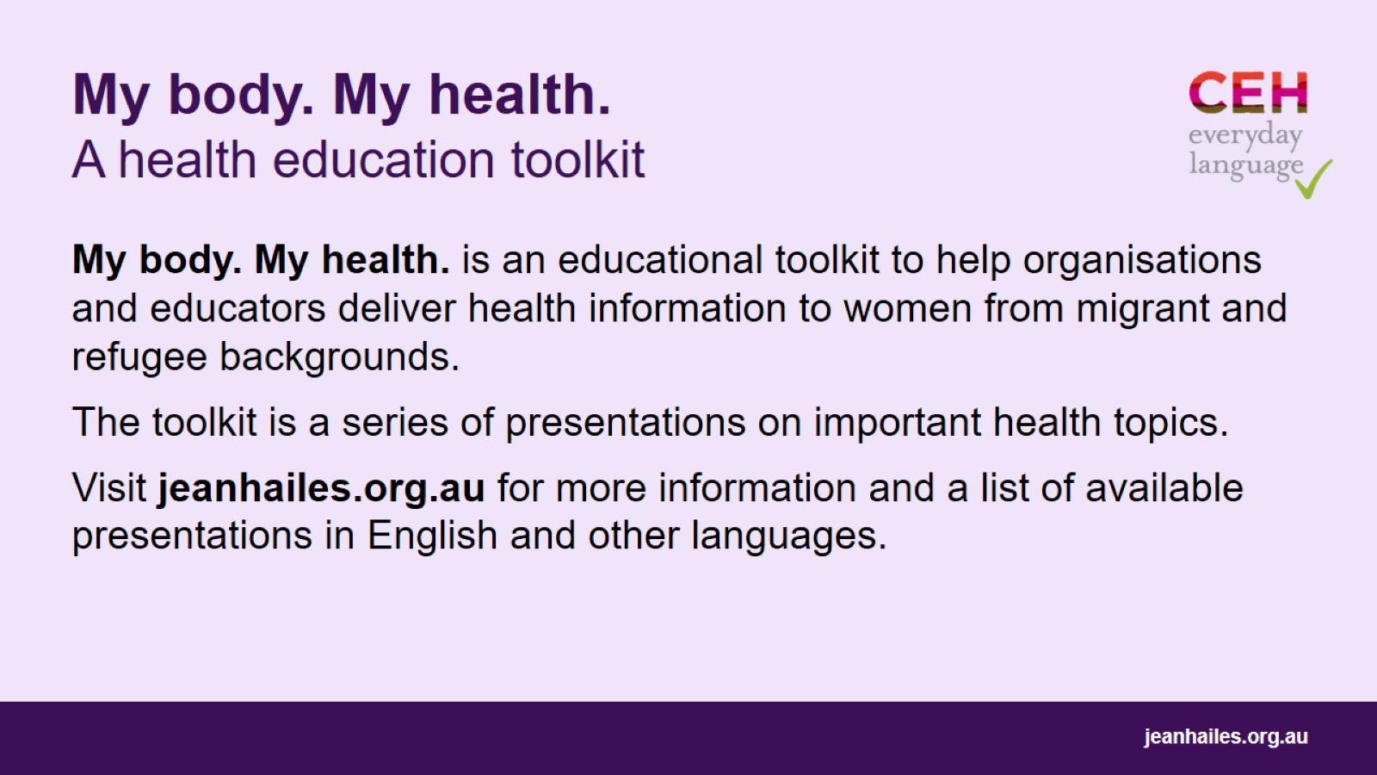
My body. My health. A health education toolkit

Slide 4

Let’s
Notes:
Today we’ll talk about important health checks for women in Australia:
what they are
why and when you need to have them
how you can make an appointment with a doctor.
Note to the facilitator: choose a few questions (examples below) to lead a brief group discussion on how the participants understand ‘health’ and what their beliefs are about health and illness.
Questions to consider:
What is illness? Where does it come from? Can anyone get sick?
Can you do anything to prevent illness, especially a serious one like cancer?
What does it mean to take care of your health?
How do you take care of your health?
How do people take care of their health in your home country?
Do you go to the doctor or nurse only when you feel sick or have a problem?
Do you do anything NOT to get sick in the first place?
Do you know that there are things you can do to prevent illness?

Slide 5
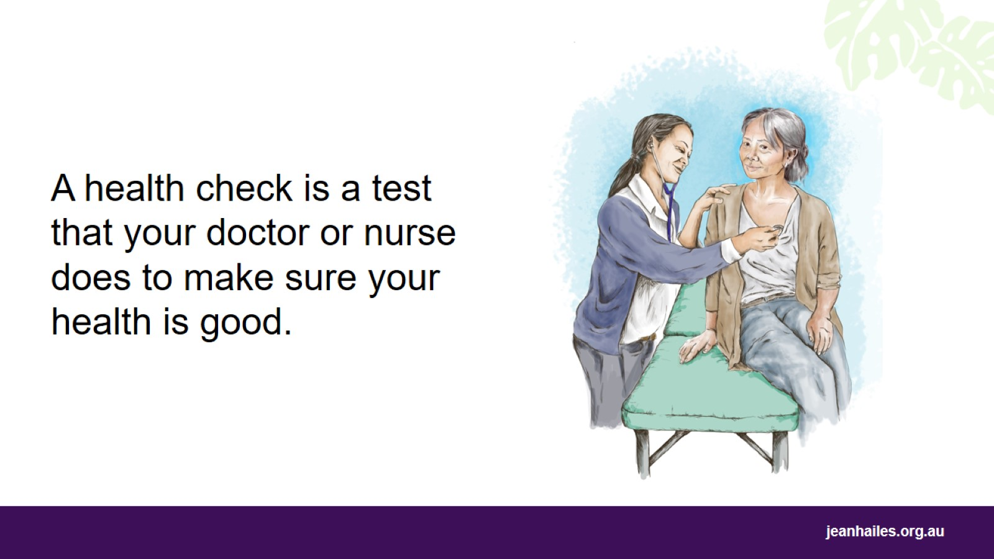
Notes:
What is a health check?
A health check is when a doctor or nurse examines you at your local clinic or health centre. They might do some tests using special tools or equipment.
Doctors are also called GPs or general practitioners.
Here are good reasons why you should have a health check:
to check you are healthy and well
to help you stay healthy and well for a long time
to find any health problems early and get treatment
to get information on how to stay well, such as what exercise to do and what foods to eat
to ask your doctor or nurse any questions about your health.

Slide 6
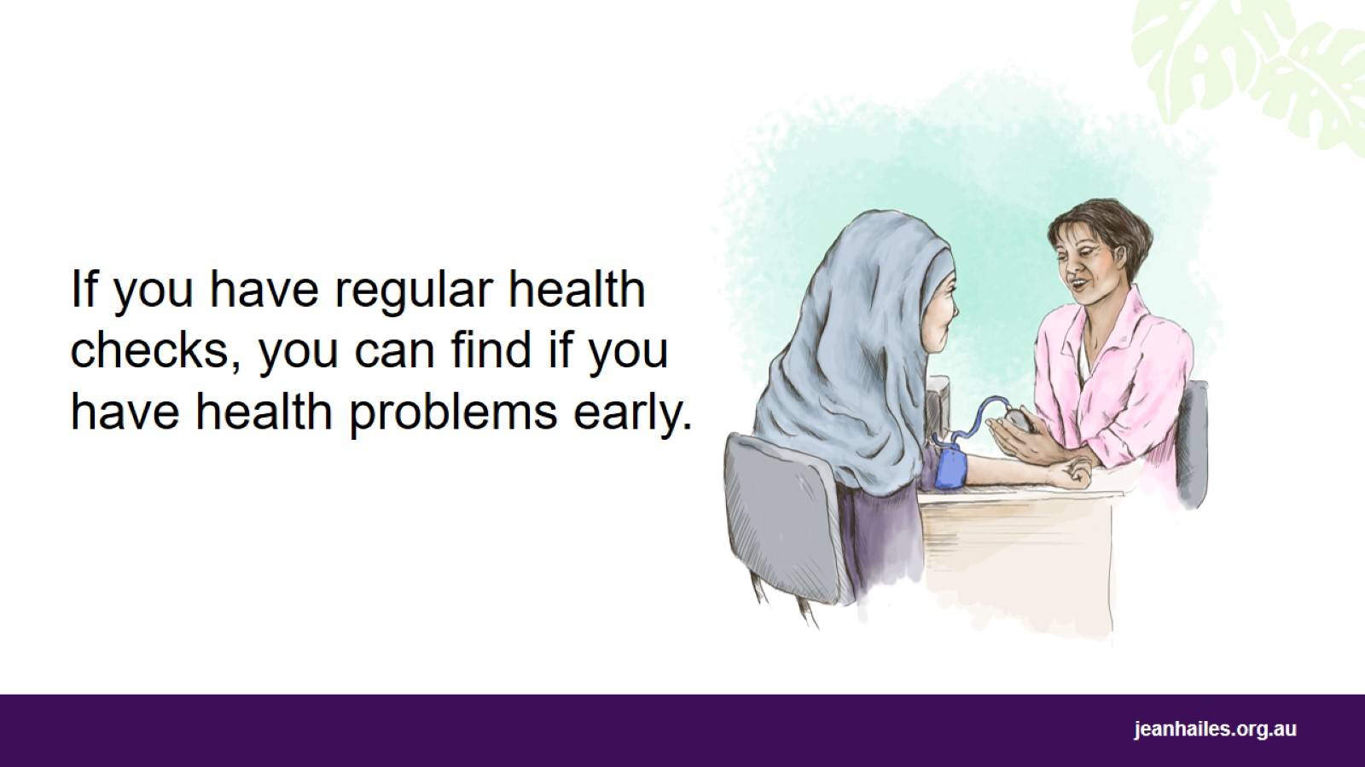
Notes:
How often do I need to have a health check?
You need to have a health check with your doctor or nurse once a year. You should do this even if you feel healthy. When you have regular health checks, you can find out about health problems sooner, before they get worse.
At a health check, the doctor or nurse will ask you about:
any illness or treatment that you have or have had. This is called your medical history
the medical history of your family – your mother, father, brothers and sisters. If other people in your family have certain diseases, these health checks are even more important
what you eat, how much you exercise, and if you smoke or drink alcohol.
Does everyone get the same health check?
No. You will need different health checks or tests at different times in your life. This is because different things can happen to the body at different ages.
Your doctor or nurse will tell you which tests you need.

Slide 7
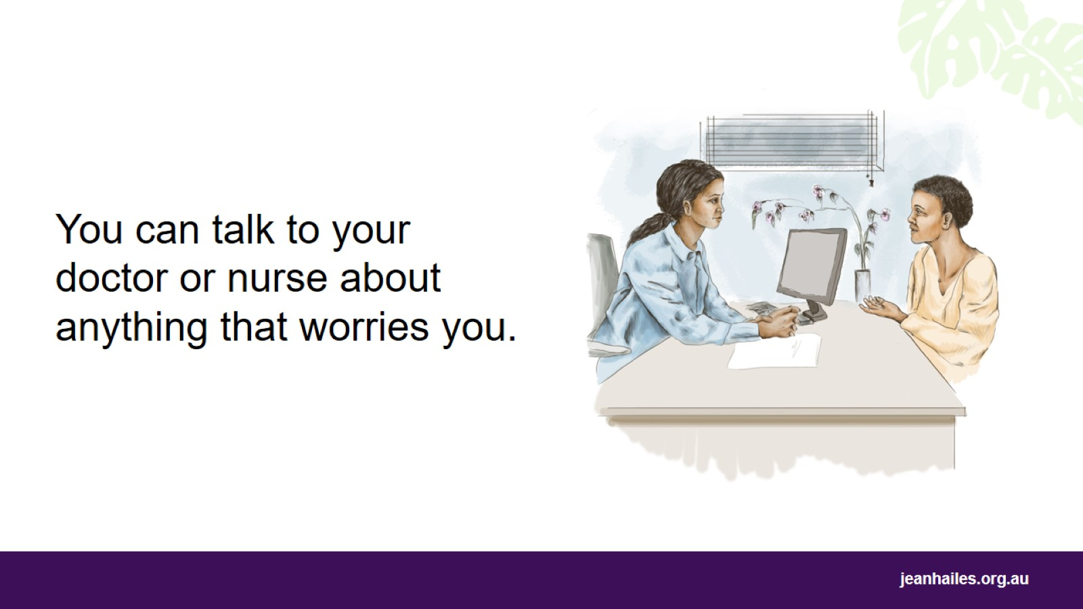
Notes:
What can I talk to my doctor or nurse about when I go for my health check?
In Australia, your doctor or nurse expects you to talk about anything that is worrying you. Your doctor or nurse might not know if you have a health problem if you don’t say anything.
For example, you can talk to your doctor or nurse about:
any pain you feel in your body
any trouble you have going to the toilet
how you are feeling; if you have been sad or worried for a long time, etc.
You should also talk to your doctor or nurse about what cancer screening tests you need to have.

Slide 8
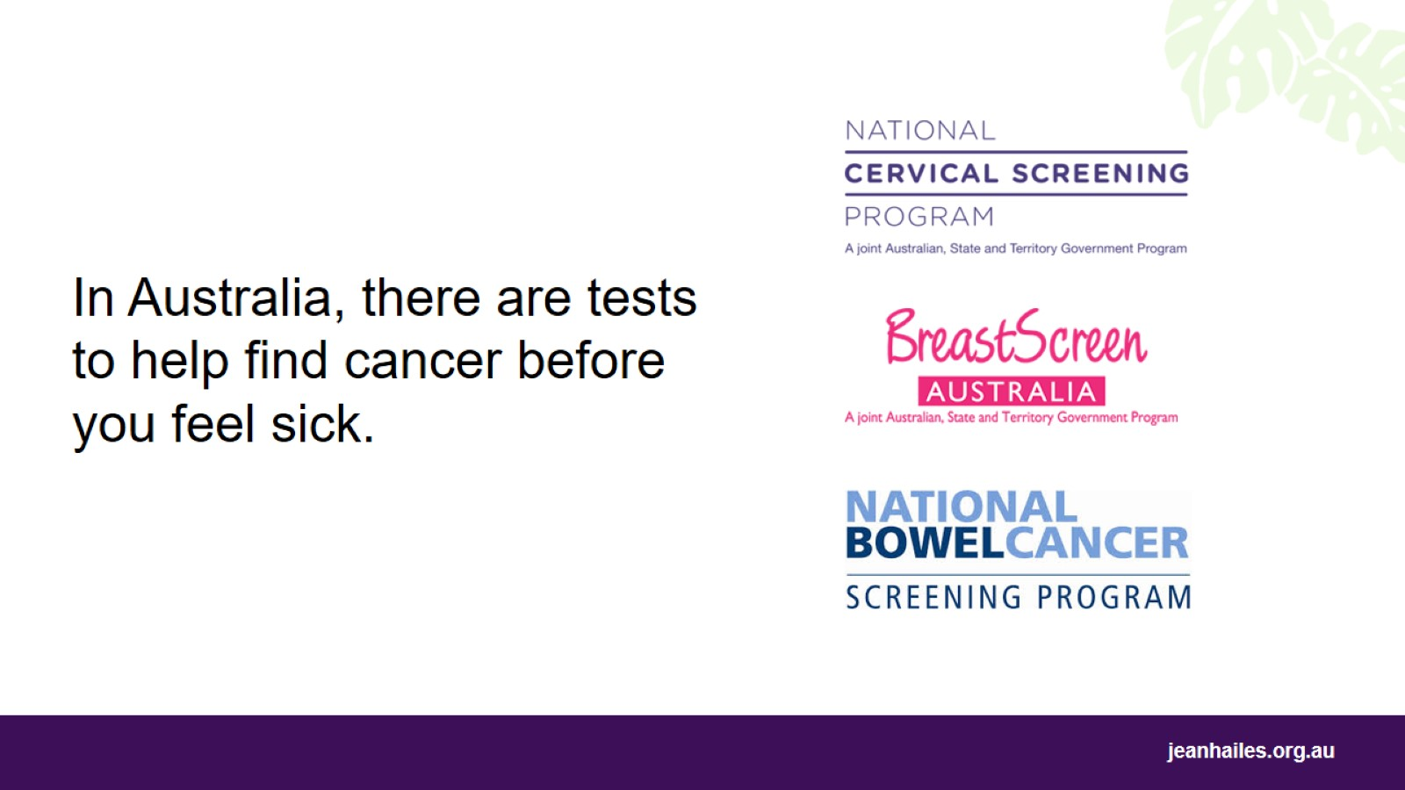
Notes:
What cancer screening tests are available in Australia?
There are 3 cancer screening tests for women:
cervical screening
breast screening
bowel screening.
These tests help find cancer early.
If you can find out early that you are sick, you have a better chance of getting well.

Slide 9
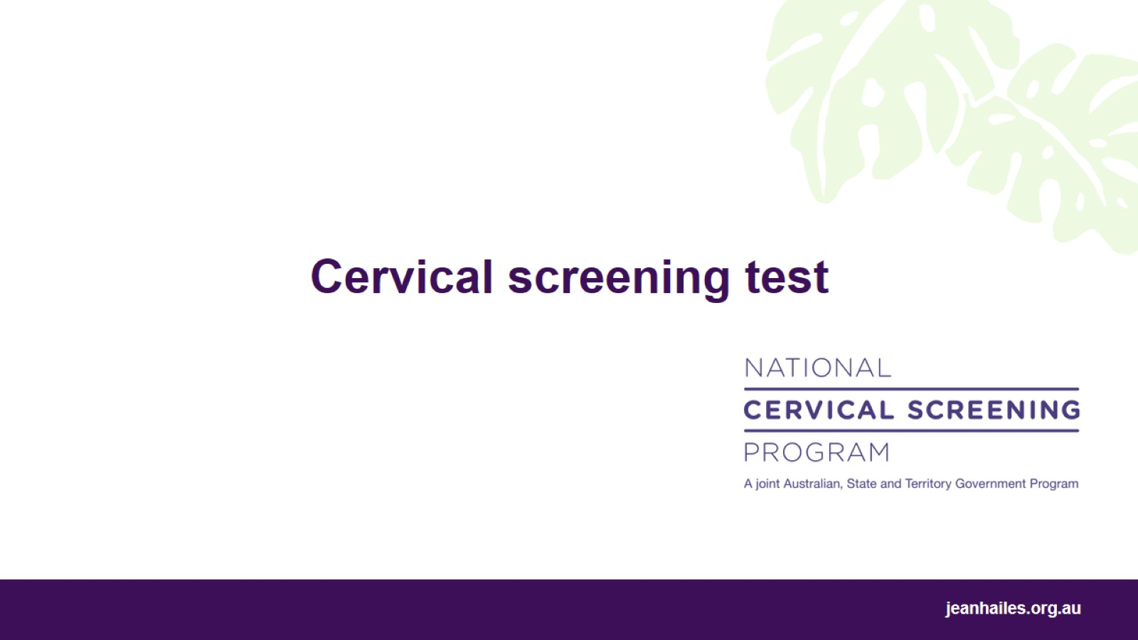
Cervical screening test

Slide 10
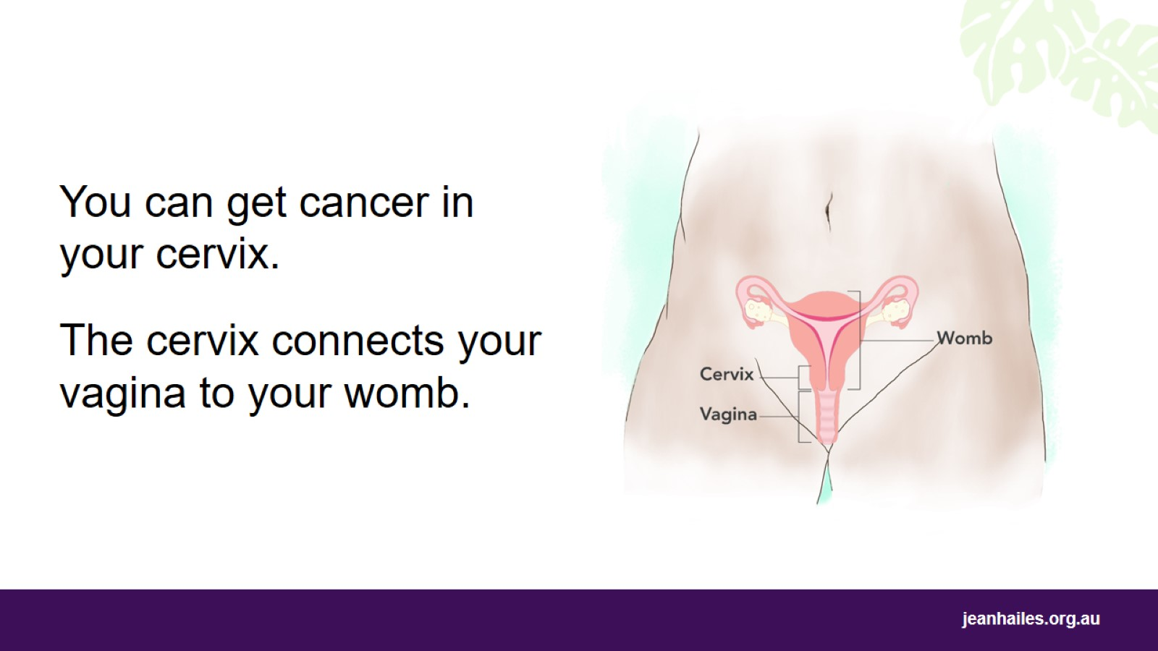
Notes:
What is the cervix?*
The cervix is the entrance to the womb. It connects your vagina to your womb.
What is cervical cancer?
Cervical cancer is cancer that grows in the cervix. Any woman can get this cancer. It’s one of the easiest types of cancer to prevent. It can also be easy to cure.
What causes cervical cancer?
Usually, this cancer is caused by a common virus called HPV. You can get HPV through contact with someone else’s private bits (genitals) during sex. Sometimes HPV can cause cancer.
People should get the HPV vaccine before becoming sexually active. The HPV vaccine helps prevent cervical, genital, anal and throat cancers. Boys and girls between 9 and 19 years old can get a free HPV vaccine. Talk to a doctor or nurse for more information.
*Note to the facilitator: refer to the image.

Slide 11
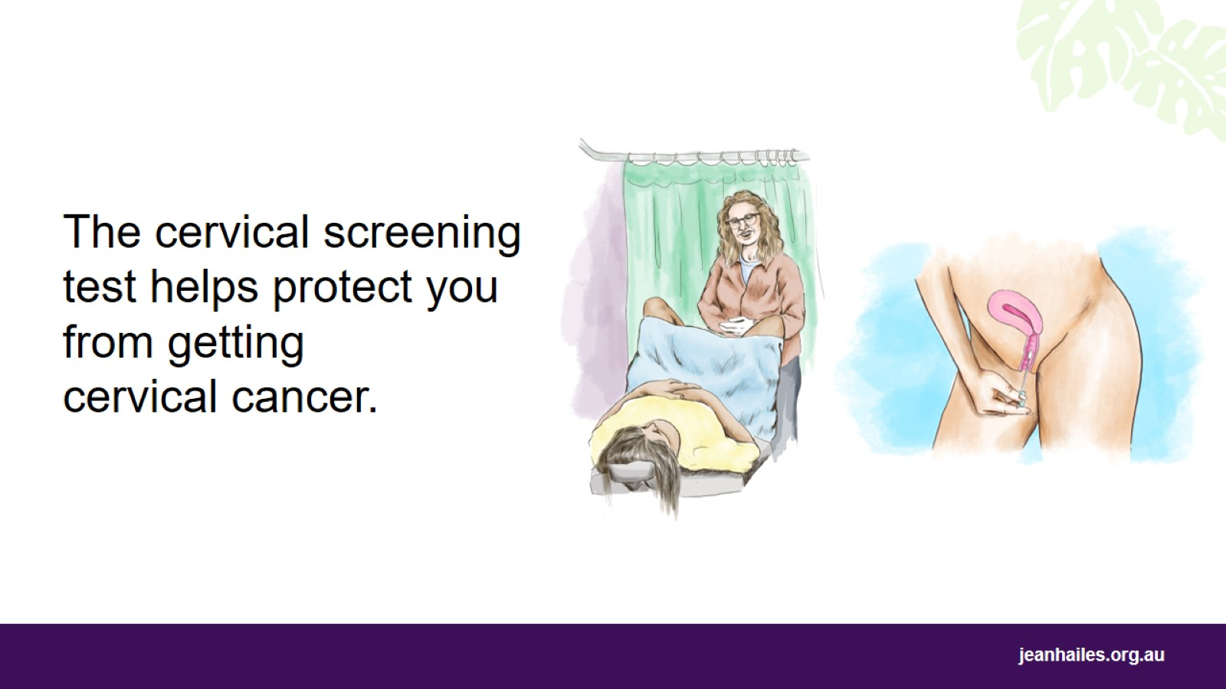
Notes:
What is the cervical screening test?
The cervical screening test is quick and easy. It checks if you have HPV, the virus that can cause cancer.
A doctor or nurse will gently take a sample from your cervix. This should not hurt and only takes a few seconds.
If you prefer, you can take a sample from your vagina yourself, in a private space. Ask your doctor or nurse about it.
If you have this test regularly, it’s your best protection against getting cervical cancer.

Slide 12
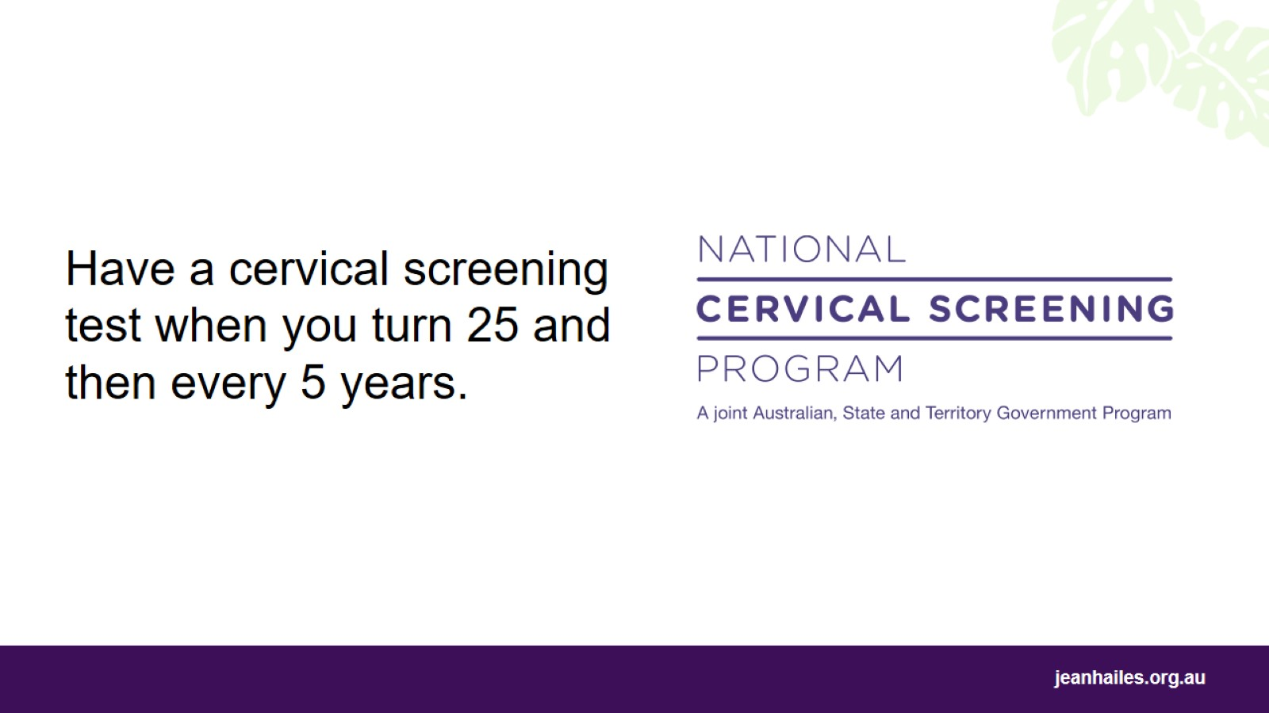
Notes:
When do I have this test?
If you are between 25 and 74 years of age, you need to have the cervical screening test every 5 years. If you don’t know when you need your next test, ask your doctor or nurse.
Where do I have this test?*
Here are places where you can have this test:
a doctor’s clinic
a community health centre
a women’s health centre
a family planning clinic
a sexual health clinic.
Having a cervical screening test every 5 years can save your life.
*Note to the facilitator: give examples of the local clinics and centres where women can have this test.

Slide 13
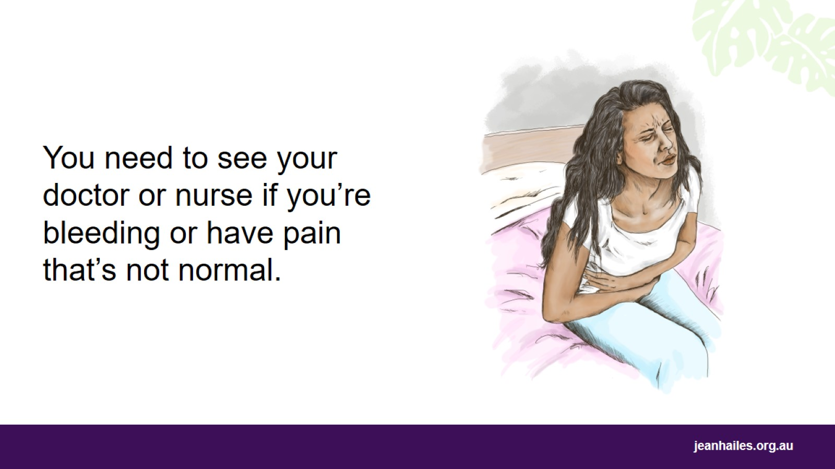
Notes:
What if I think something is wrong?
If something is happening with your body that is not normal for you, like:
bleeding
unusual liquid coming out of your vagina
pain in your lower belly
pain after having sex,
you need to see a doctor or nurse as soon as you can.
Don’t wait until your next cervical screening test.

Slide 14
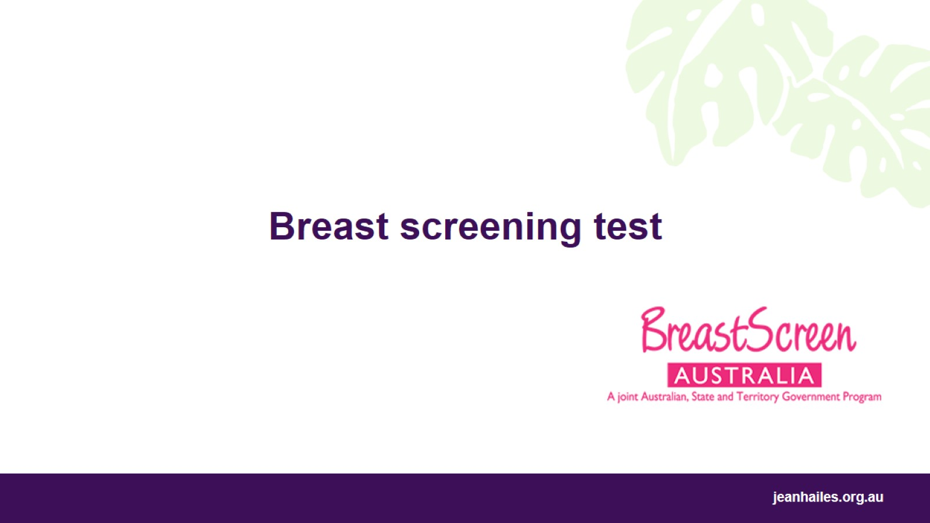
Breast screening test

Slide 15
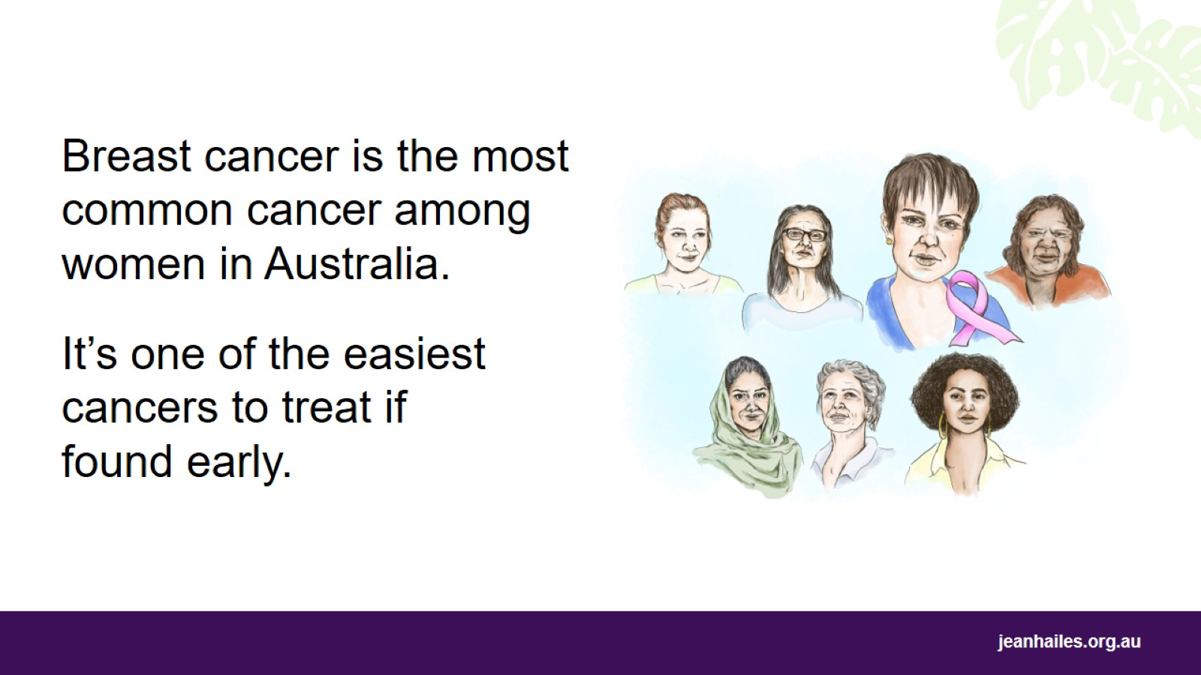
Notes:
What is breast cancer?
Breast cancer is cancer that grows in the breast. It is the most common cancer for women in Australia and can develop at any age.
About 1 in 7 women in Australia will develop breast cancer at some time in their life.
Why is it important to find breast cancer early?
If you find breast cancer early, there is a good chance you will get better. The cancer will be smaller and there will be more ways to treat it.

Slide 16
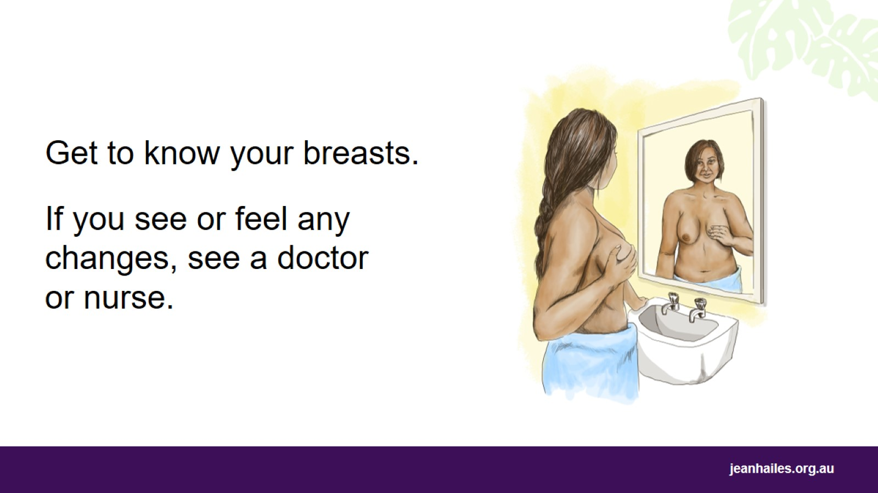
Notes:
You need to know your breasts well so you can see if there is a change in either of them.
What do I need to know about my breasts?
It’s a good idea to look at your breasts in the mirror and learn:
what they look like
their shape, size and colour
what they feel like.
Most changes in the breast are not breast cancer. But if you do notice a change, you must get it checked by a doctor or nurse as soon as possible.

Slide 17
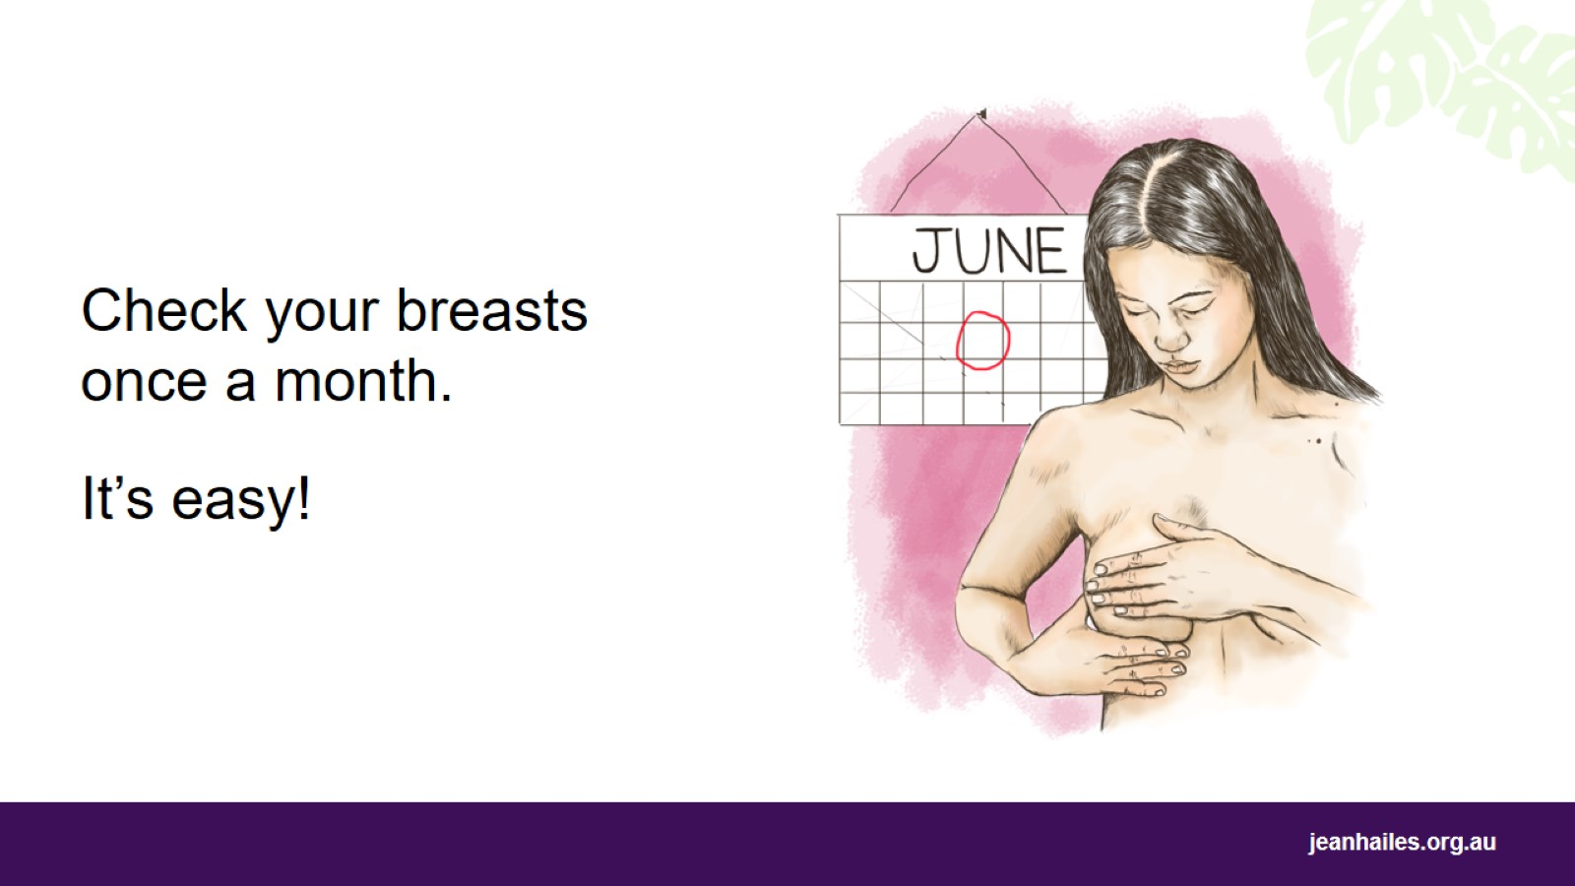
Notes:
One way to find changes in the breast early is to check your breasts every month.
How do I check my breasts?
Once a month, check the shape, colour and size of your breasts.
It’s best to check your breasts a few days after the end of your period (menstruation). Set a reminder in your phone or on your calendar to check your breasts on the same day every month.
Feel your breasts using the pads of your fingers, in the shower or lying down.
Look out for lumps and changes to the skin or nipple, or for any redness, pain or discharge.
Make sure you feel the entire breast area from your collarbone to your tummy and include your armpits.
You can ask your doctor or nurse to show you how to check your breast.
There is no right or wrong way to feel your breasts – it is important to find a way that works for you and do it regularly.

Slide 18
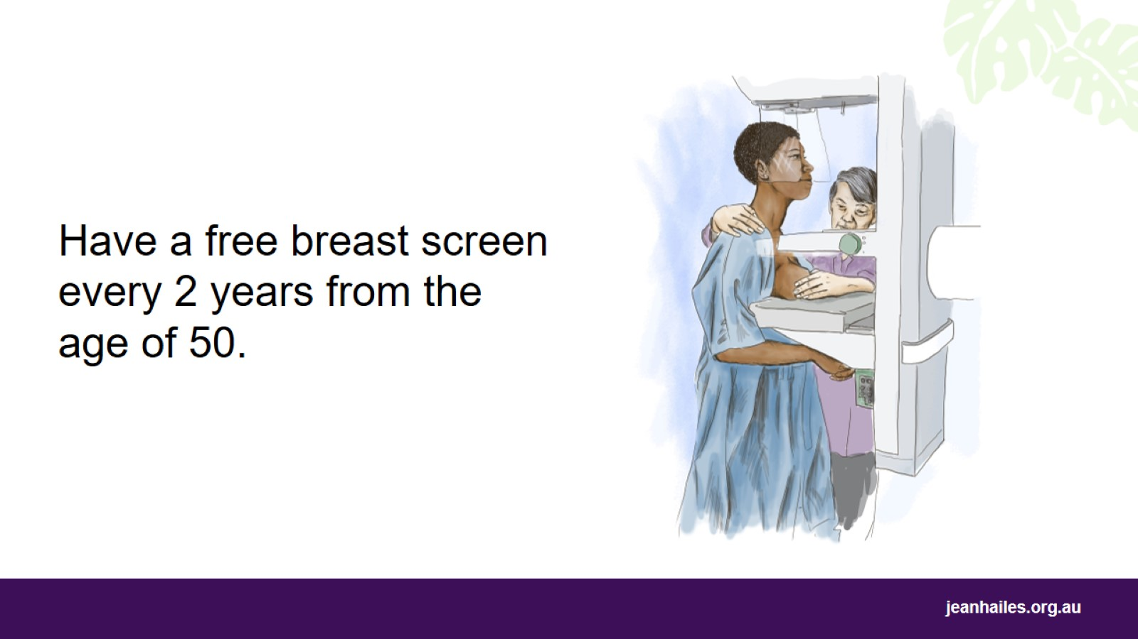
Notes:
Another way to find changes in the breast is by having a breast screen every 2 years.
What is a breast screen?
A breast screen is a photo of the inside of your breast. It shows changes that are too small for you or your doctor or nurse to see or feel.
When should I have a breast screen?
If you are between 50 and 74 years old, have a breast screen every 2 years.
If you are between 40 and 49 or over 74 years old, you may choose to have a breast screen.
If you are under 40, your doctor might ask you to have a breast screen if they think you need one, or if someone else in your family has had breast cancer.
Breast screens can only be done from 35 years of age.
How do I book a breast screen appointment?
BreastScreen Australia provides breast screens for free if you have no breast symptoms. To book a breast screen appointment, call BreastScreen Australia on 13 20 50. This number will connect you to a BreastScreen service in your area.
You can also book an appointment online at breastscreen.org.au
Need an interpreter?
If you need an interpreter, call the Translating and Interpreting Service (TIS National) on 131 450 and ask to be connected to BreastScreen in your state/territory.

Slide 19
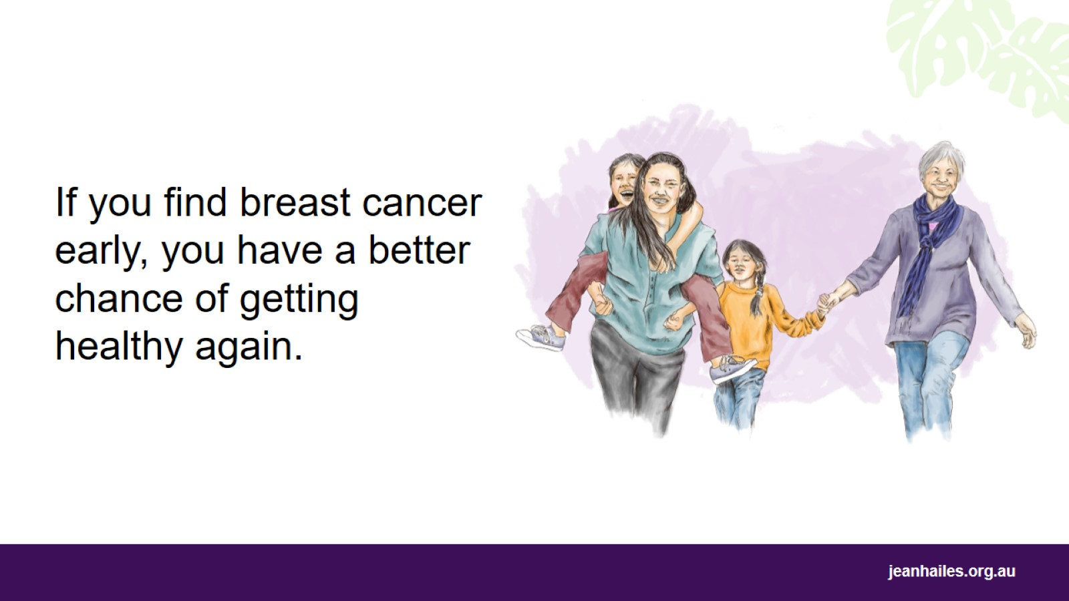
Notes:
Why is it so important to have a breast screen?
Regular breast screens find most breast cancers early and help prevent deaths.
If breast cancer is found early, it is more likely to be small and successfully treated.
This helps you to get healthy again to enjoy your life and family.
If you find any changes in your breasts, see a doctor or nurse as soon as you can.

Slide 20
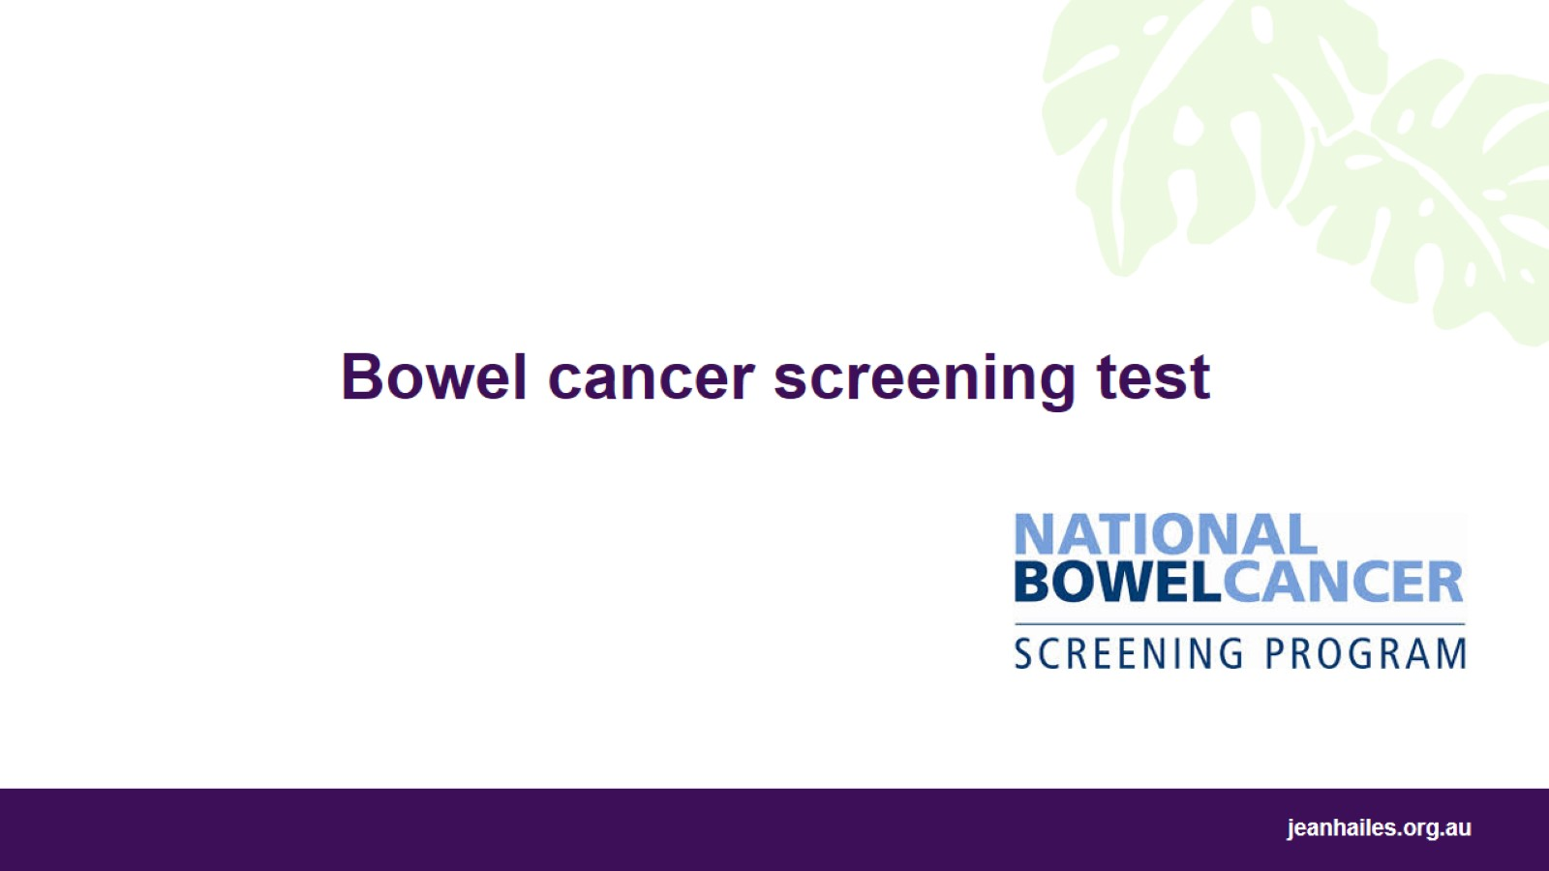
Bowel cancer screening test

Slide 21
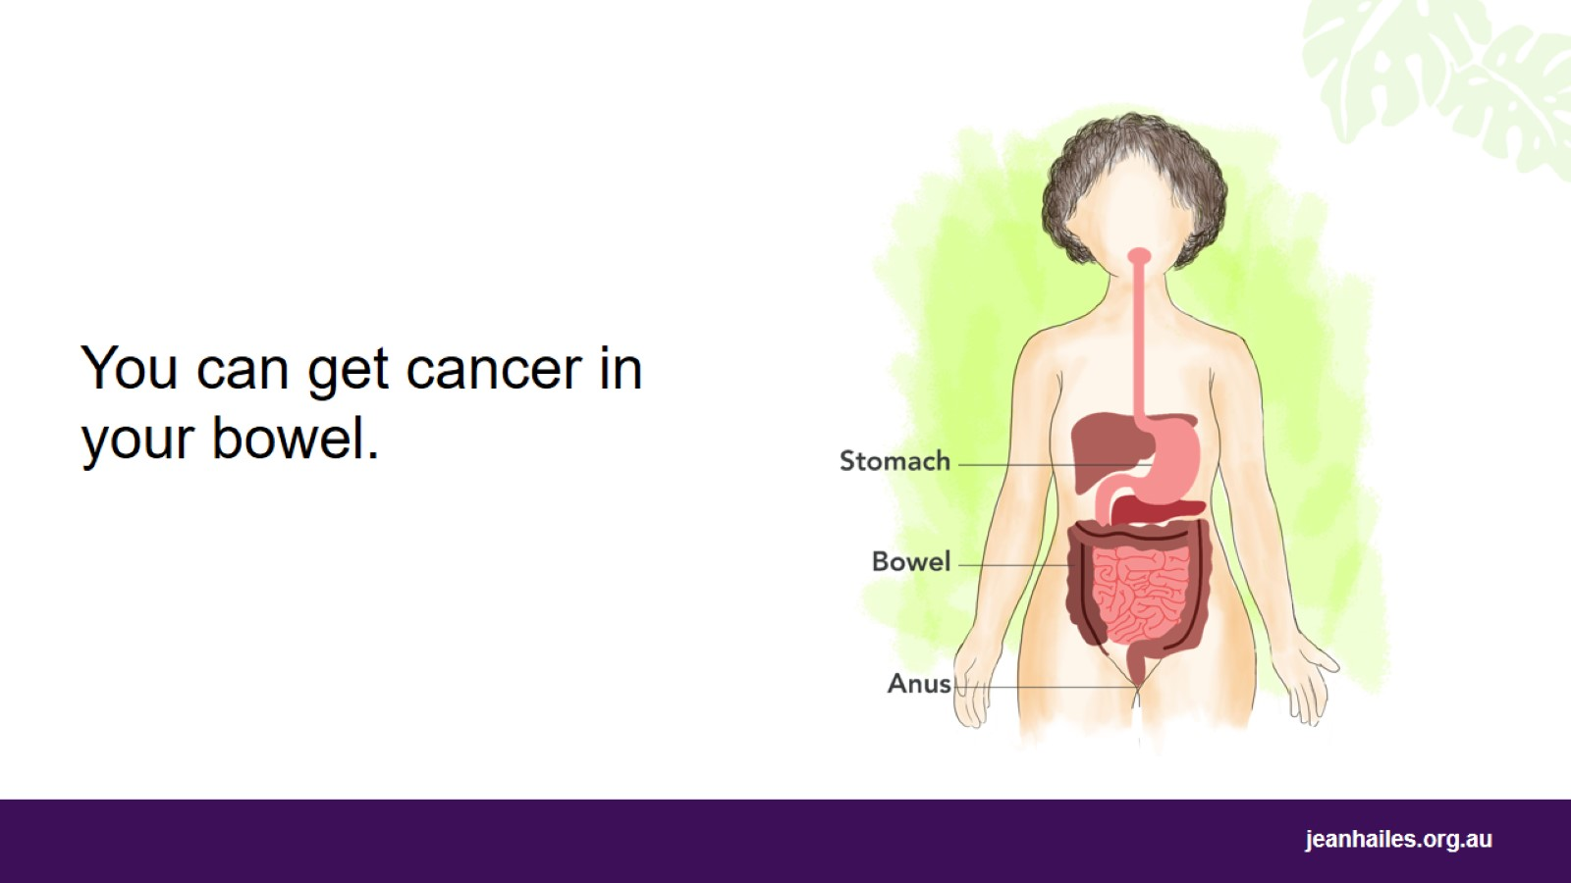
Notes:
What is the bowel?
The bowel is part of the digestive system*. The bowel is the tube that takes food from your stomach to your anus (where you poo from).
What is bowel cancer?
Bowel cancer is cancer that grows in the bowel. It is a common cancer in Australia and is easier to treat and cure if found early.
A screening test is the best way to find bowel cancer early.
*Note to the facilitator: use the image if you want to briefly explain the digestive system.

Slide 22
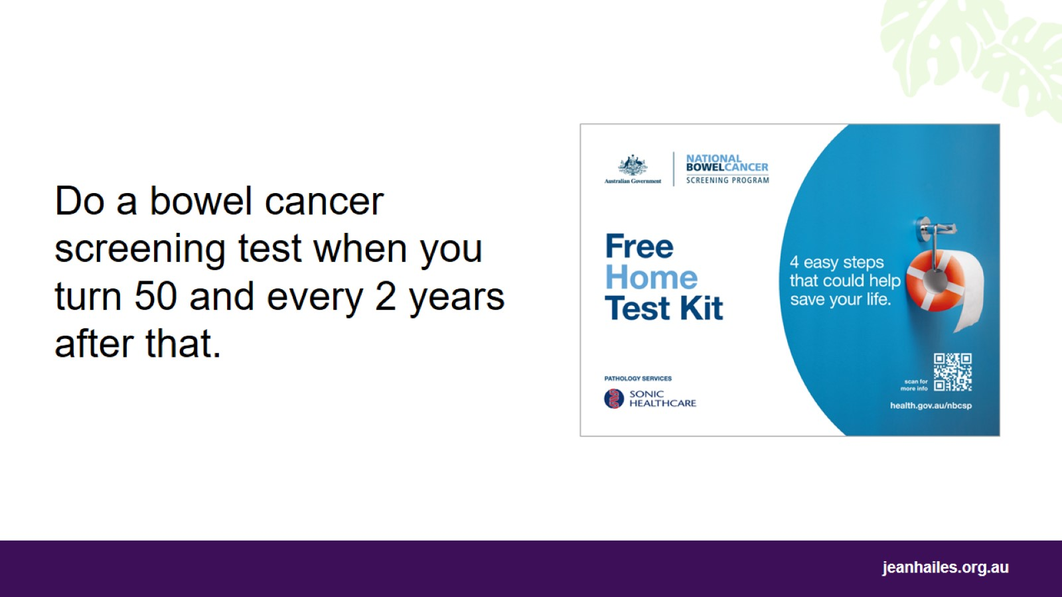
Notes:
What is the bowel cancer screening test?
The bowel cancer screening test checks for blood in your poo, which can be an early sign of bowel cancer.
When do I need to do the bowel screening test?
You need to do the test from the age of 50. And you need to do it every 2 years until you’re 74.

Slide 23
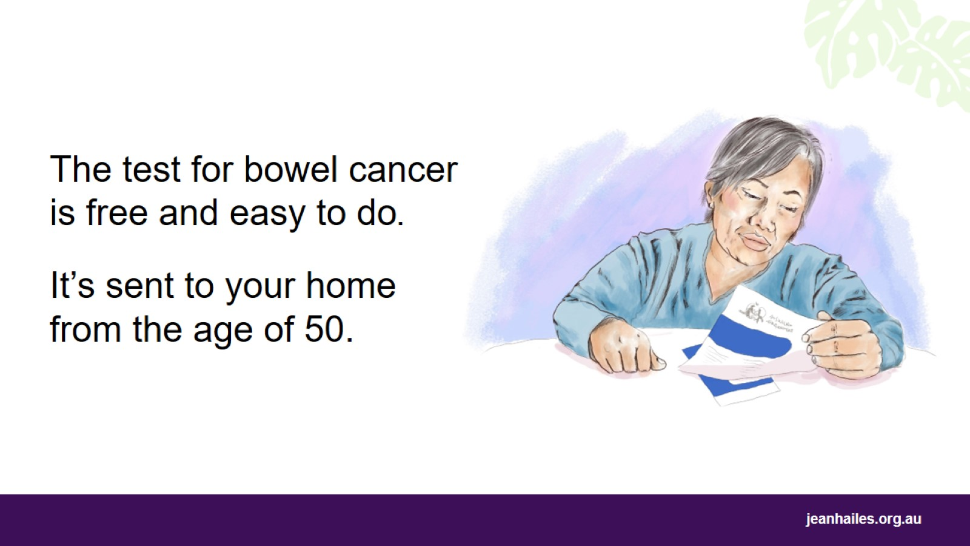
Notes:
How do I get the test?
This free test is sent to your home address every 2 years once you turn 50.
If you don’t get the test, call the National Bowel Cancer Screening Program on 1800 627 701 or talk to your doctor or nurse.
How will I know what to do?
The test is easy to do. When the test arrives at your home, it comes with instructions that show you exactly what to do.

Slide 24
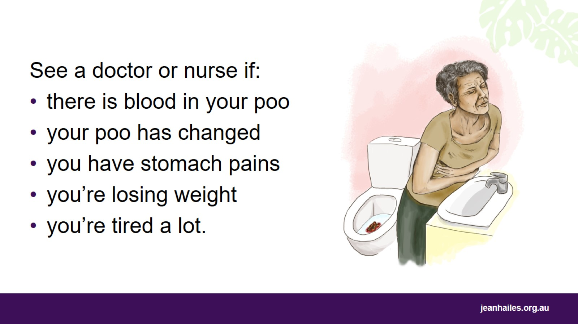
Notes:
Bowel cancer usually has no signs in the early stages.
That’s why it’s important to see your doctor or nurse straight away if you notice any of these changes:
there is blood in your poo
your poo has become different from what it normally is, such as harder, looser or a different shape
you have stomach pains or you can feel a lump
you’re tired a lot and you don’t know why
you’re losing weight and you don’t know why.

Slide 25
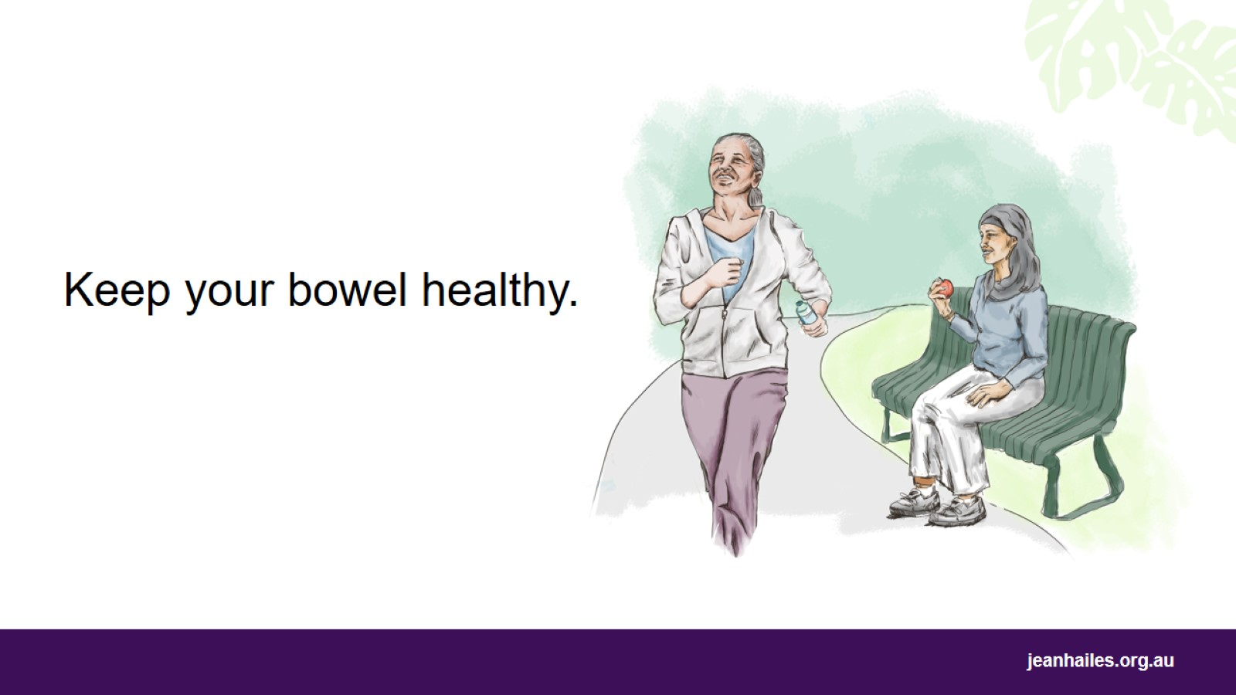
Notes:
What can I do to keep my bowel healthy?
You can help keep your bowel healthy if you:
don’t smoke
keep a healthy weight
eat a diet high in fibre
avoid alcohol
drink plenty of water
exercise regularly
have screening tests every 2 years after you turn 50 years old.

Slide 26
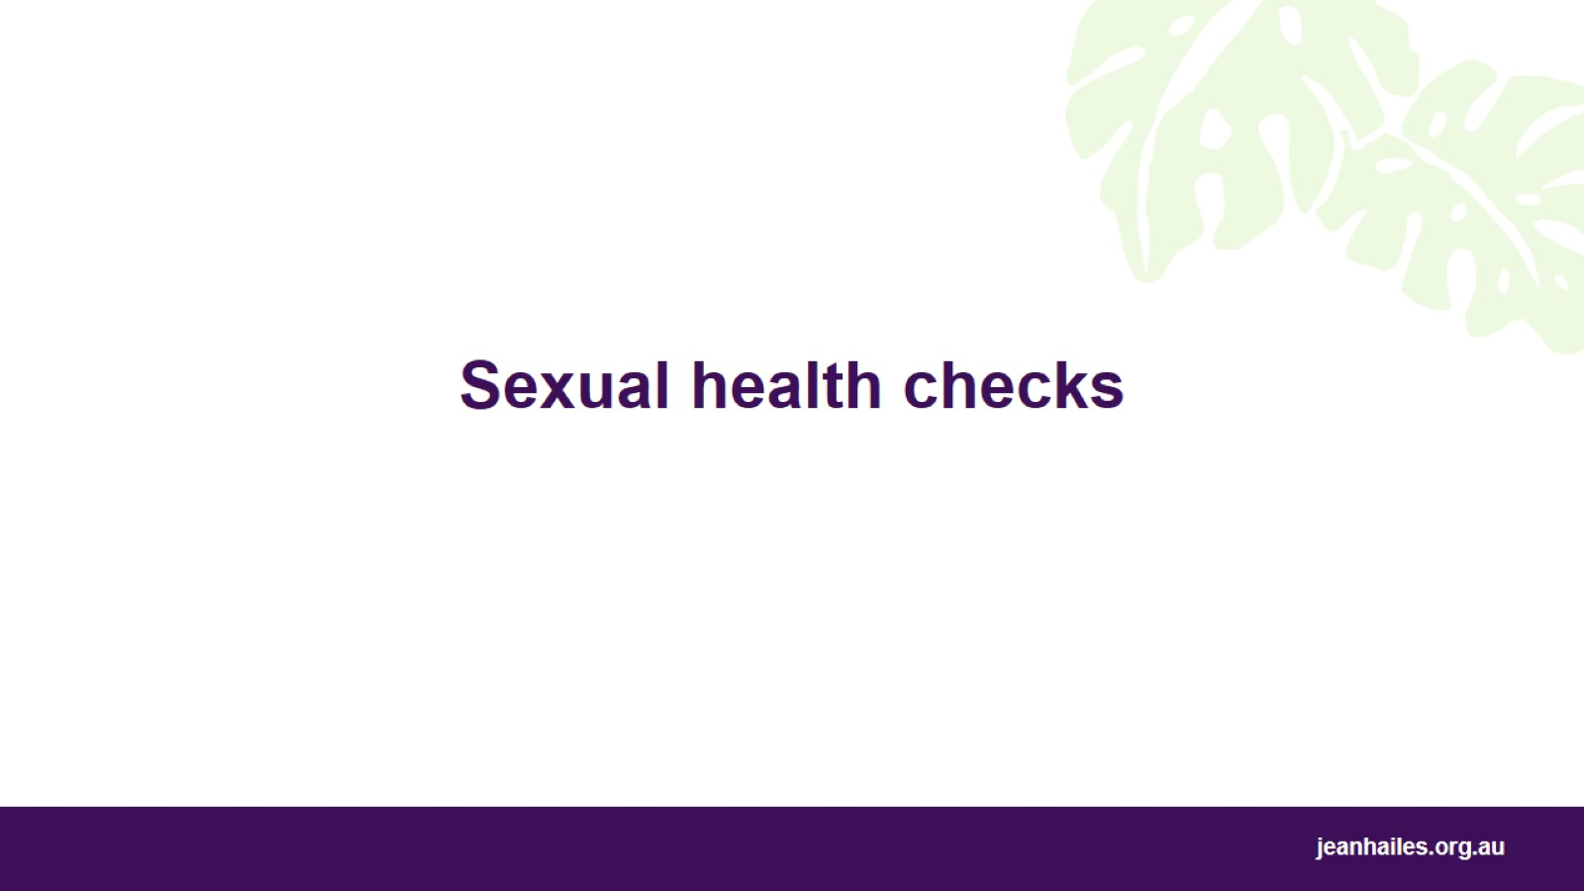
Sexual health checks

Slide 27
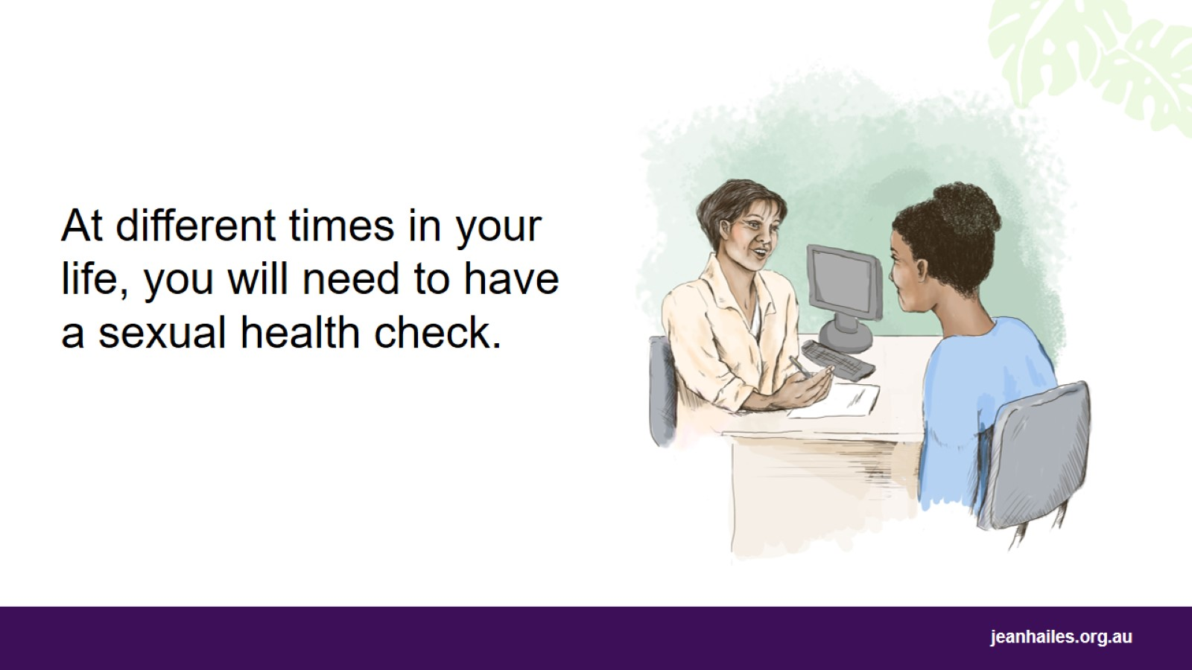
Notes:
What is a sexual health check?
A sexual health check is a visit to your doctor or nurse to:
talk about safe sex
talk about your rights when you’re in a relationship with someone
talk about your right to decide if you do or don’t want to get pregnant
talk about what sort of contraception you can use if you don’t want to get pregnant
get a cervical screening test
have a test for sexually transmitted infections (STIs).
When do I need to have a sexual health check?
Have a sexual health check if:
you are starting a new sexual relationship
you have had unprotected sex. Unprotected, or unsafe sex, is sex without a condom or dental dam (a thin layer of latex)
the condom broke or fell off during sex
you think you might have an STI
your partner has sex with other people
you have sex with more than one person
you share needles with other people when using drugs or getting tattoos or piercings.
If you’re having sex, it’s a good idea to have a sexual health check regularly.
You may feel nervous about having a sexual health check, but doctors and nurses are there to help you.

Slide 28
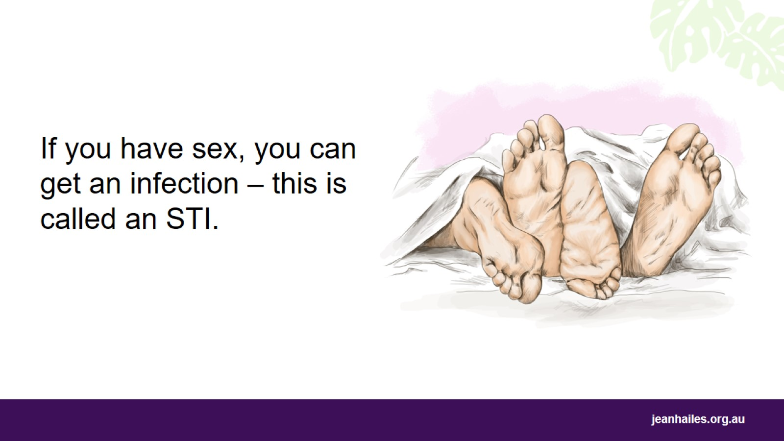
Notes:
What is an STI?
STI stands for sexually transmitted infection. It’s an infections that you can get when you have sex.
STIs are common all around the world. There are many different STIs, such as:
genital herpes
chlamydia
gonorrhoea
syphilis
hepatitis B and C
HIV.
How can I get an STI?
You can get an STI if you:
have unprotected sex with someone
put your mouth on a penis or vulva
touch a penis, vulva, vagina or anus together
touch another person’s body fluids.
If STIs are not treated, they can:
cause irritation and pain
make it hard for women to have children
cause health problems that can last a long time.

Slide 29
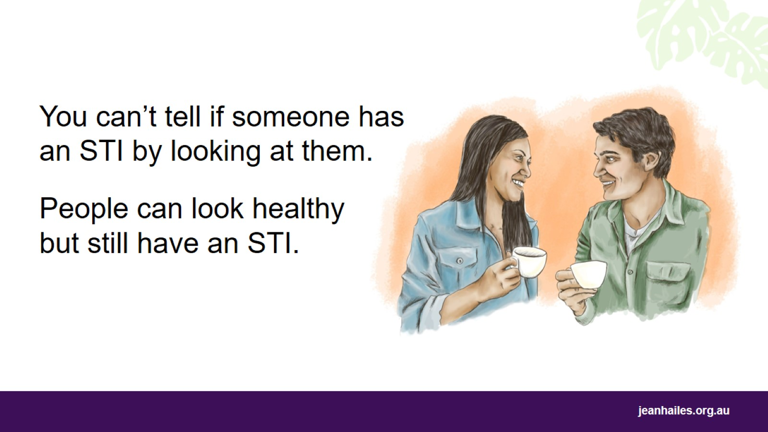
Notes:
You can’t tell if a person has an STI just by looking at them. Even if a person looks strong and healthy, they can still have an STI and pass it on to another person.
It’s possible to have an STI and not know about it.
Sometimes there are signs that you or another person could have an STI.
Some possible signs include:
sores, blisters, broken skin or irritation on the penis, vulva, anus or mouth
unusual liquid coming out of the penis, vagina or anus
the vulva or vagina looks red, hurts, is itchy or smells bad
lumps and bumps on the penis, vulva, vagina or anus
pain or bleeding during sex
pain when you wee.

Slide 30
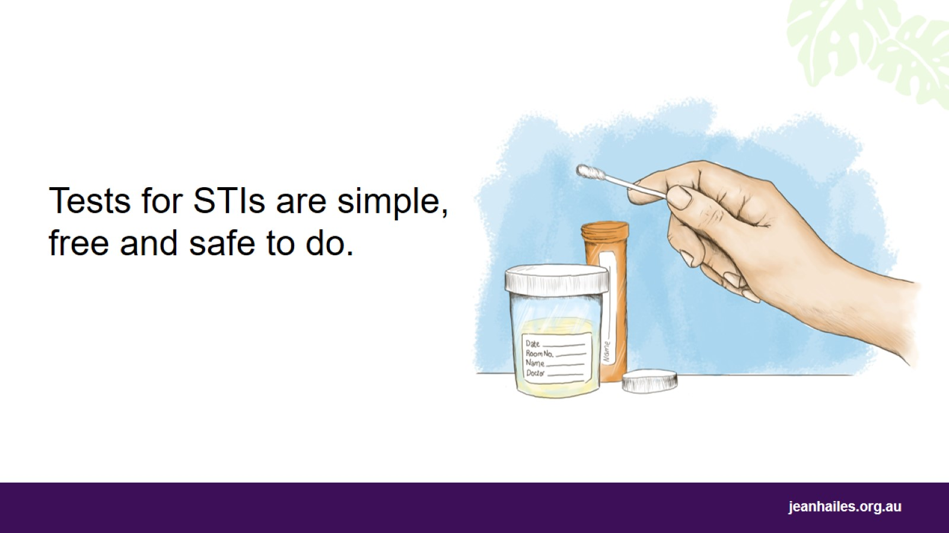
Notes:
If you think you have an infection, you need to get tested.
Tests for STIs are simple, free and safe to do.
If the test shows you have an infection, you can start treatment straight away. This will help you to get better sooner and stop you from giving the infection to someone else.
Where do I go for an STI test?*
You can have an STI test done at:
your local medical clinic
your local community health centre
a sexual health clinic
a family planning clinic.
What if I am embarrassed?
If you feel embarrassed about having an STI test, remember that doctors and nurses:
won’t judge you
do the tests every day and it’s their job to look after you
won’t share your information with anyone.
If you are worried about your privacy, you can go to a different clinic and not your usual doctor or nurse.
Chlamydia
Women under 30 years of age who are having sex need to get their wee tested for chlamydia every year.
Chlamydia can make it hard for you to get pregnant. Most women who have chlamydia have no signs, so they don’t know they have it.
*Note to the facilitator: indicate where sexual health checks are available locally.

Slide 31
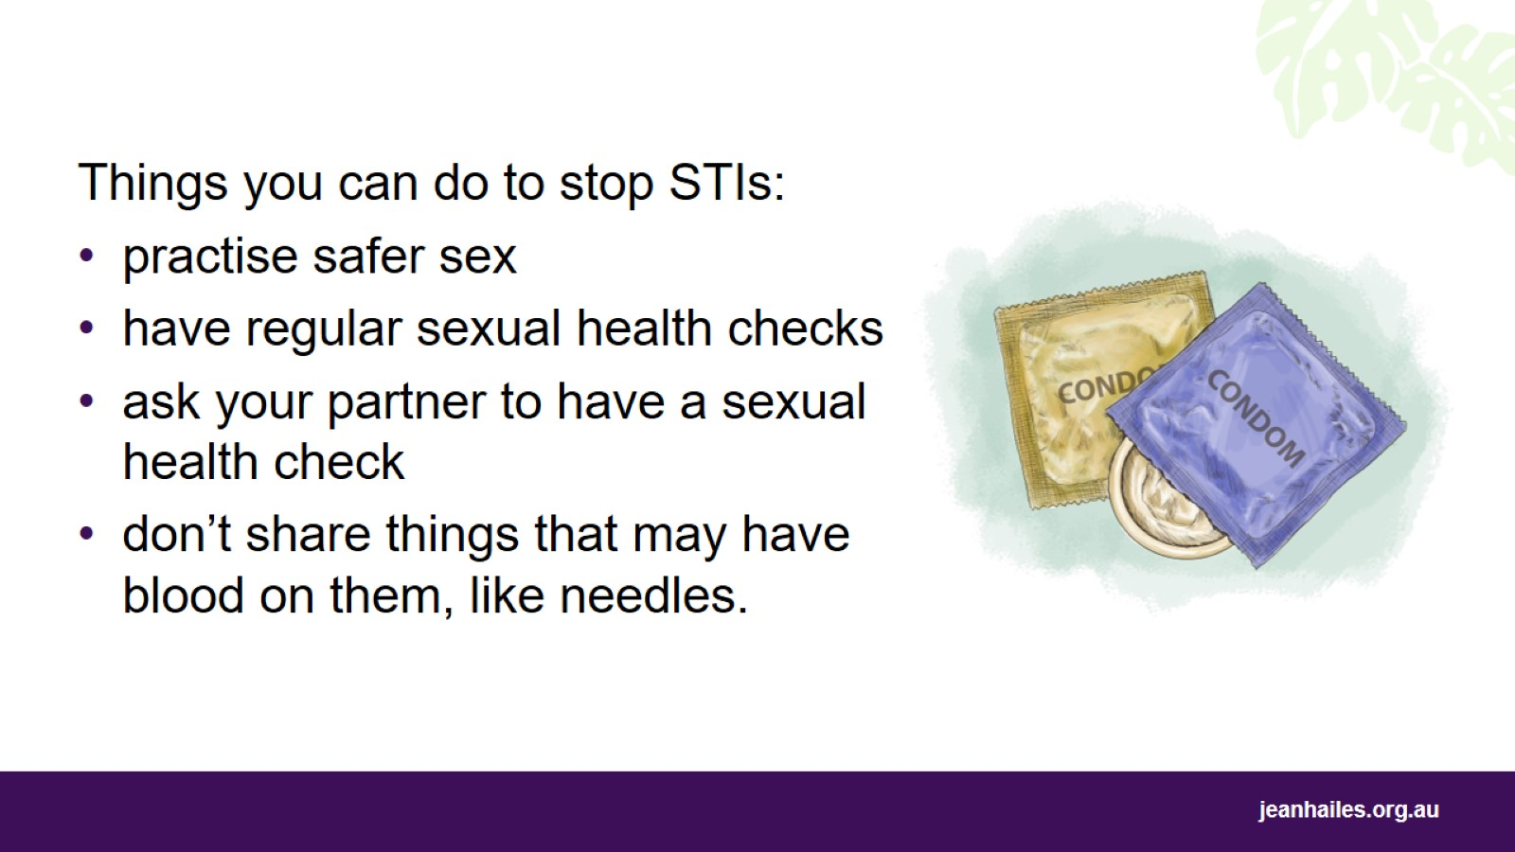
Notes:
Ways to stop getting an STI:
Practise safer sex – don’t allow your partner's semen, blood, or vaginal fluids into your body. Use a condom, female condom or dental dam every time you have sex, even if you have your period (menstruation).
If you have sex, have regular sexual health checks.
Before you have sex with someone new, have a sexual health check and ask them to have one too.
Don’t share needles, tattoo equipment, razors, or other things that might have blood from someone else.

Slide 32

Making an appointment and seeing your doctor

Slide 33
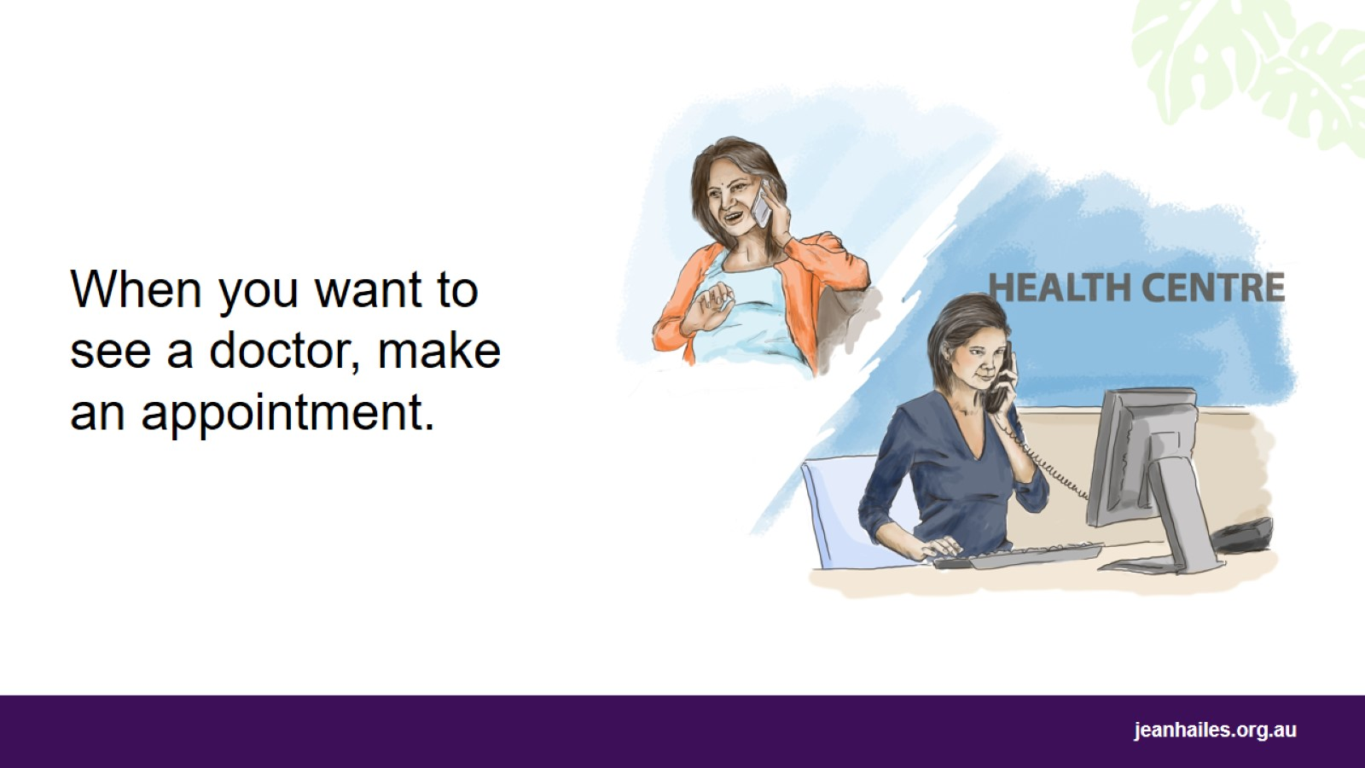
Notes:
If you or your family need to see a doctor, make an appointment right away because it may take a few days before the doctor can see you. If you need an interpreter, call the Translating and Interpreting Service (TIS National) on 131 450.
If it’s an emergency, call 000.
How do I make an appointment?
You can make an appointment with your doctor by:
calling the health centre
visiting the health centre in person
booking on the internet if the health centre has a website.
When you make an appointment, you can:
ask for a female doctor
ask for an interpreter at your appointment – you can ask for a phone interpreter, a female interpreter, or an interpreter who is in another state
ask for an immediate appointment if you need urgent attention for a serious medical issue
ask how much you need to pay for the appointment
choose a short or long appointment:
ask for a short appointment if you need a new prescription
ask for a long appointment if you have a few things to talk about.
You will need to make a separate appointment for each family member who needs to see a doctor.

Slide 34
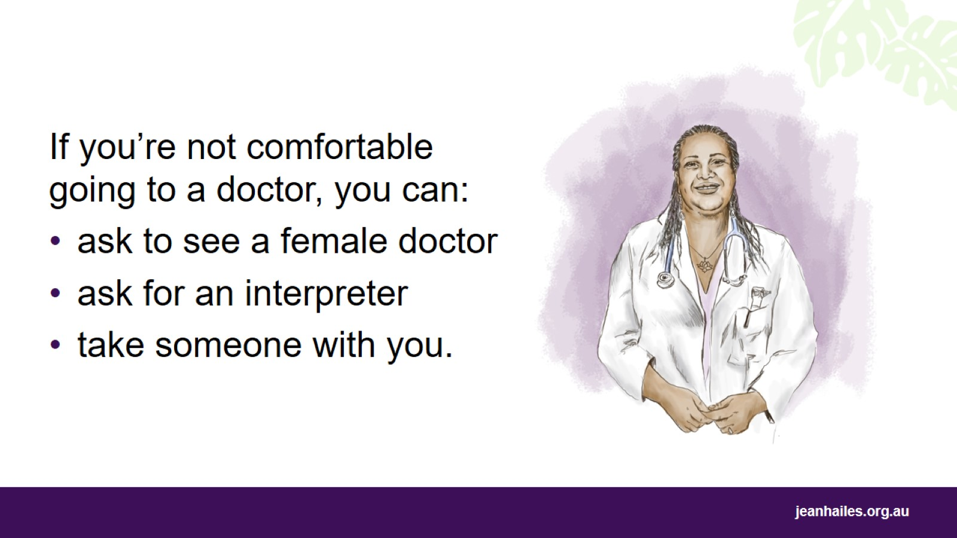
Notes:
What if I don’t feel comfortable going to a doctor?
There are things you can do to make yourself more comfortable and confident when you see a doctor.
You can:
ask to see a female doctor or nurse
use an interpreter – ask the clinic to arrange one. Interpreters can’t talk to other people about what you say in the appointment
take a family member, friend or support worker with you, but they shouldn’t interpret for you
prepare for your appointment before you go.

Slide 35
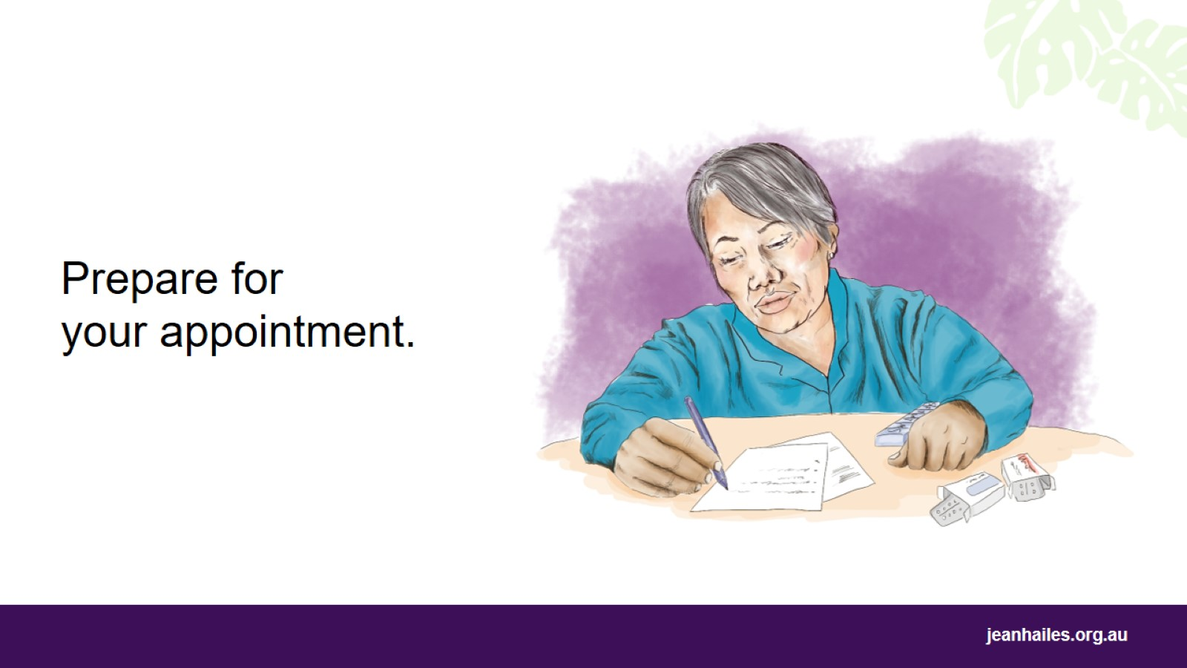
Notes:
How can I prepare for my appointment?
To prepare for your appointment, write down:
a list of things you want to talk about
any signs of illness you have; when they started, how long they last, how often they happen
all the medicines, vitamins and herbal remedies you’re taking
any medicines that you can’t take (e.g. aspirin, penicillin)
any serious illnesses that you or other members of your family have had.
Remember to bring:
your Medicare card and healthcare or concession card if you have them
copies or reports from any recent tests if you have them
your notes
someone to support you if you need it.

Slide 36
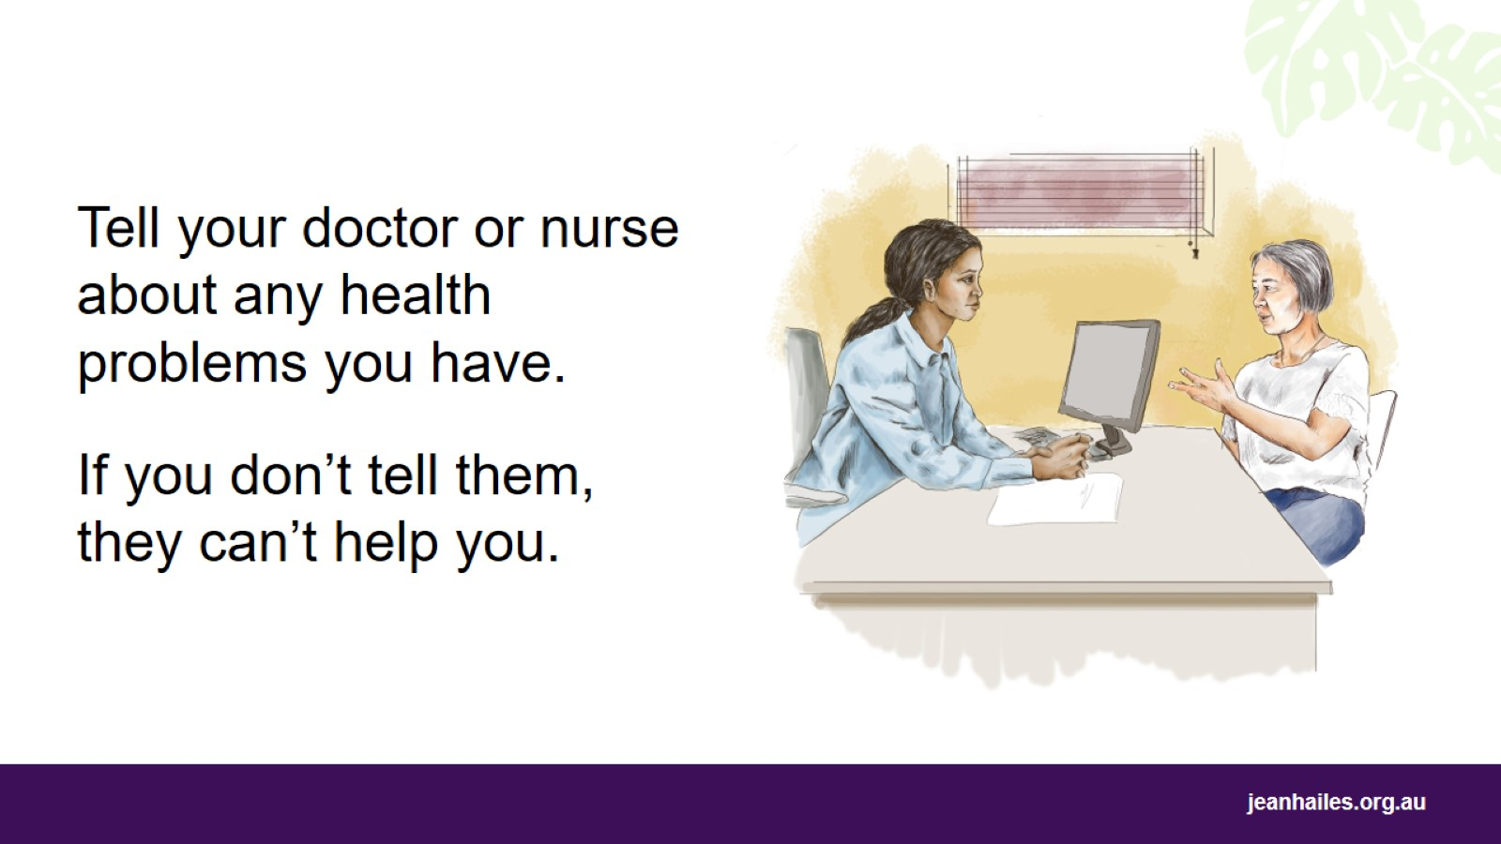
Notes:
What can I talk to my doctor or nurse about?
The most important thing when speaking with your doctor or nurse is to always tell the truth.
Your health, your worries and your situation are important, so speak up. Doctors and nurses will not judge or criticise you.
Don’t think something is normal or not important enough to mention.
What you talk to them about is private, so don’t be afraid to tell them anything.
For the doctor or nurse to help you, they need to know:
when you were sick in the past
what medicines you are taking. Some medicines don’t work with other medicines, so they could make you sick or sicker
if something is different to how you normally are
if you exercise, smoke, drink alcohol or take drugs.

Slide 37
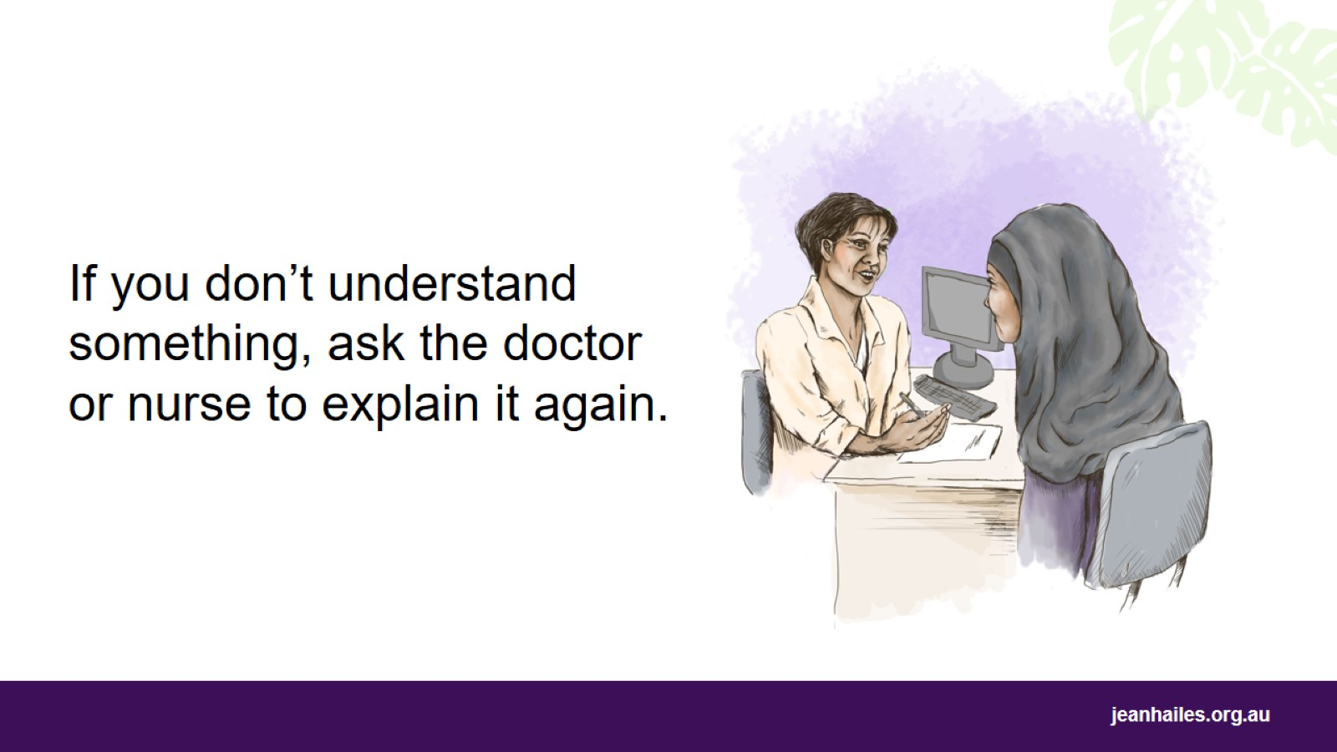
Notes:
Doctors and nurses can talk about lots of important information that can be hard to understand or remember.
To help you understand what the doctor or nurse says, you can:
take a notebook and write things down
ask your doctor or nurse to write down important things, especially about medicines
ask if there is printed information you can take home
repeat what you need to do before you leave your appointment to make sure you understand and know what to do
ask the doctor or nurse to explain things again.
What if I don’t like the treatment?
If you’re not comfortable with the treatment the doctor or nurse gives you, ask if there are other treatments you could try.
Ask your doctor or nurse to explain all the good and not-so-good things about each treatment so you have all the information before you decide.
If you have problems with your treatment, remember:
Don’t change the treatment without talking to your doctor or nurse first, or you could become sicker.
Tell your doctor or nurse about all the problems you are having with your treatment.
Work with your doctor or nurse to find a treatment that works best for you.

Slide 38
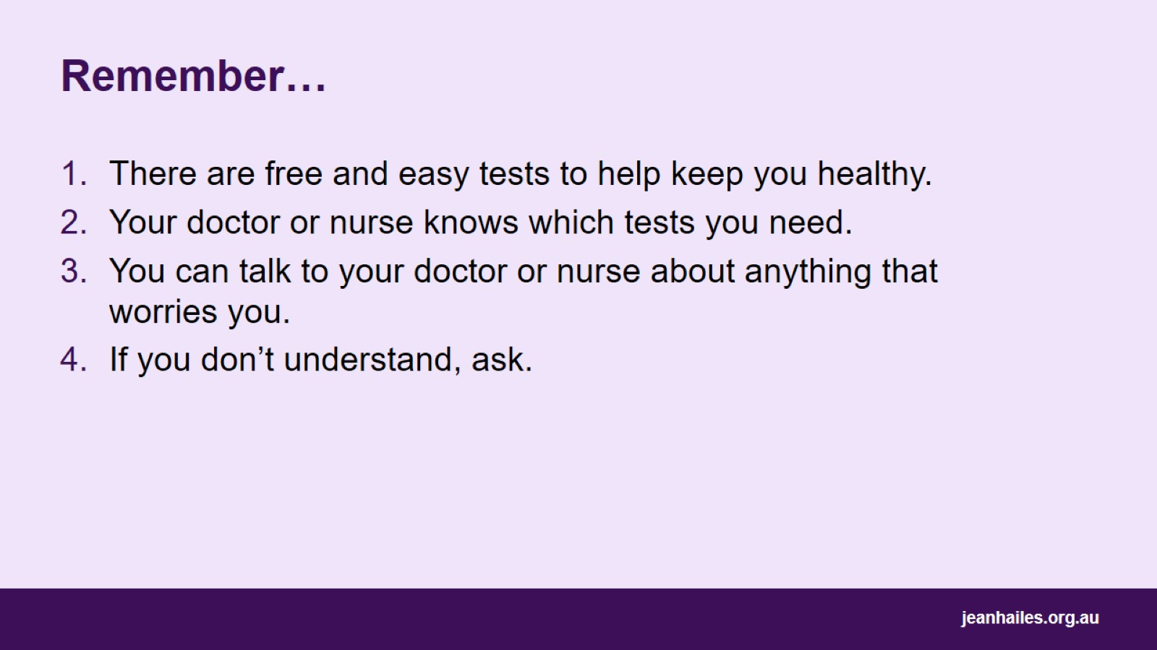
Remember…

Slide 39

Local services
Notes:
Note to the facilitator: provide details of local health services.

Slide 40
