Slide 1

Sexual health and healthy relationships
Notes:
Note to the facilitator:
This presentation is a collection of different topics and messages related to sexual health. It’s intended as a tool to help facilitators – bilingual support workers, health professionals, educators, and community leaders – talk about sexual health with women from refugee and migrant communities.
You don’t have to deliver the whole presentation. Choose topics and messages that are relevant to your audience. We appreciate that certain messages might not be appropriate for some cultures or that participants may find certain messages or topics confronting, such as contraception or abortion. If a message is important to your audience but you wish to deliver it in a different way, feel free to use words that are more suitable for your audience.
We are using the pronouns ‘you’ and ‘your’ in this presentation, as we do in the other presentations in the toolkit. We believe that this form of talking directly to the audience works well and makes the messages clear and relatable. If this direct form is too confronting for your audience, you can use pronouns ‘we’, ‘our’ or ‘she’, ‘her’ instead.

Slide 2
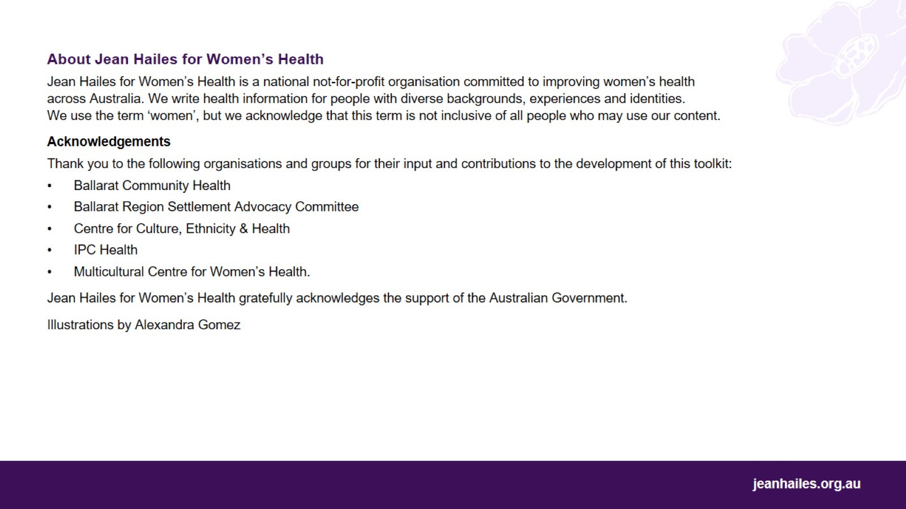

Slide 3
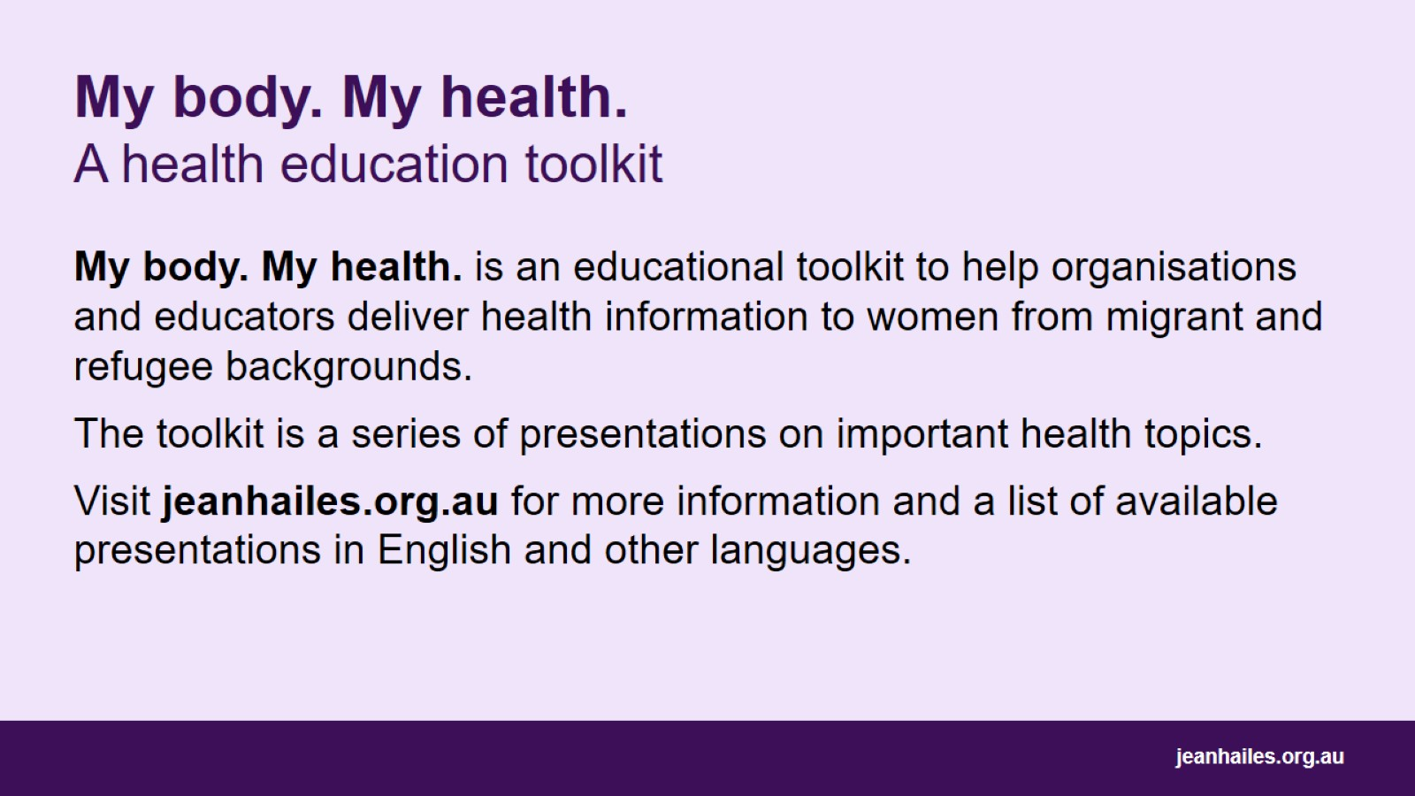
My body. My health.
A health education toolkit

Slide 4
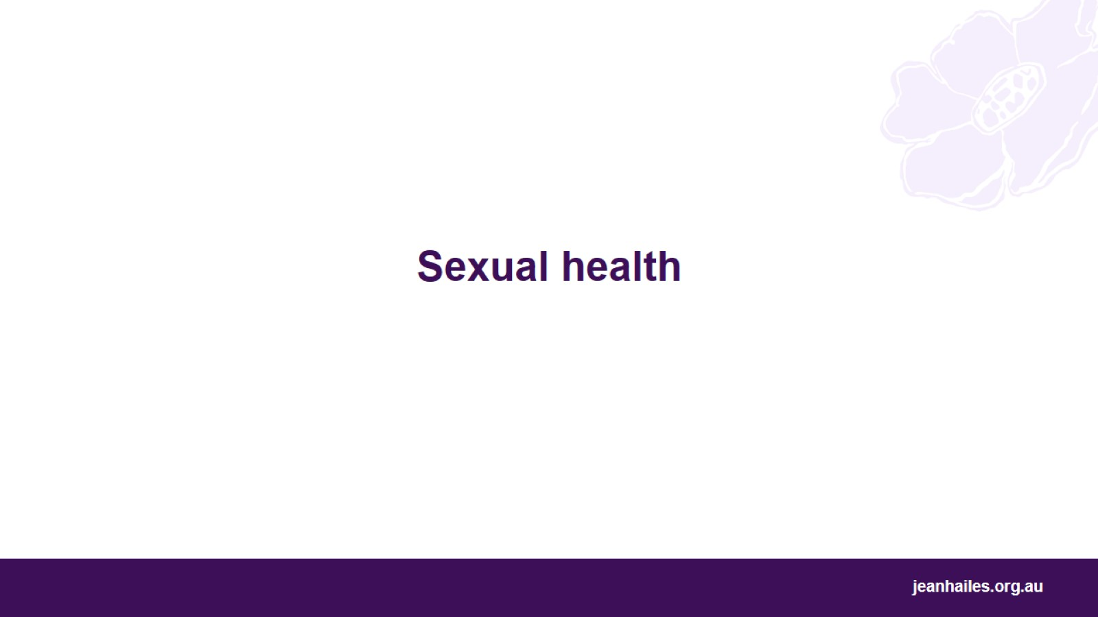
Sexual health
Notes:
Let’s talk about sexual health.

Slide 5
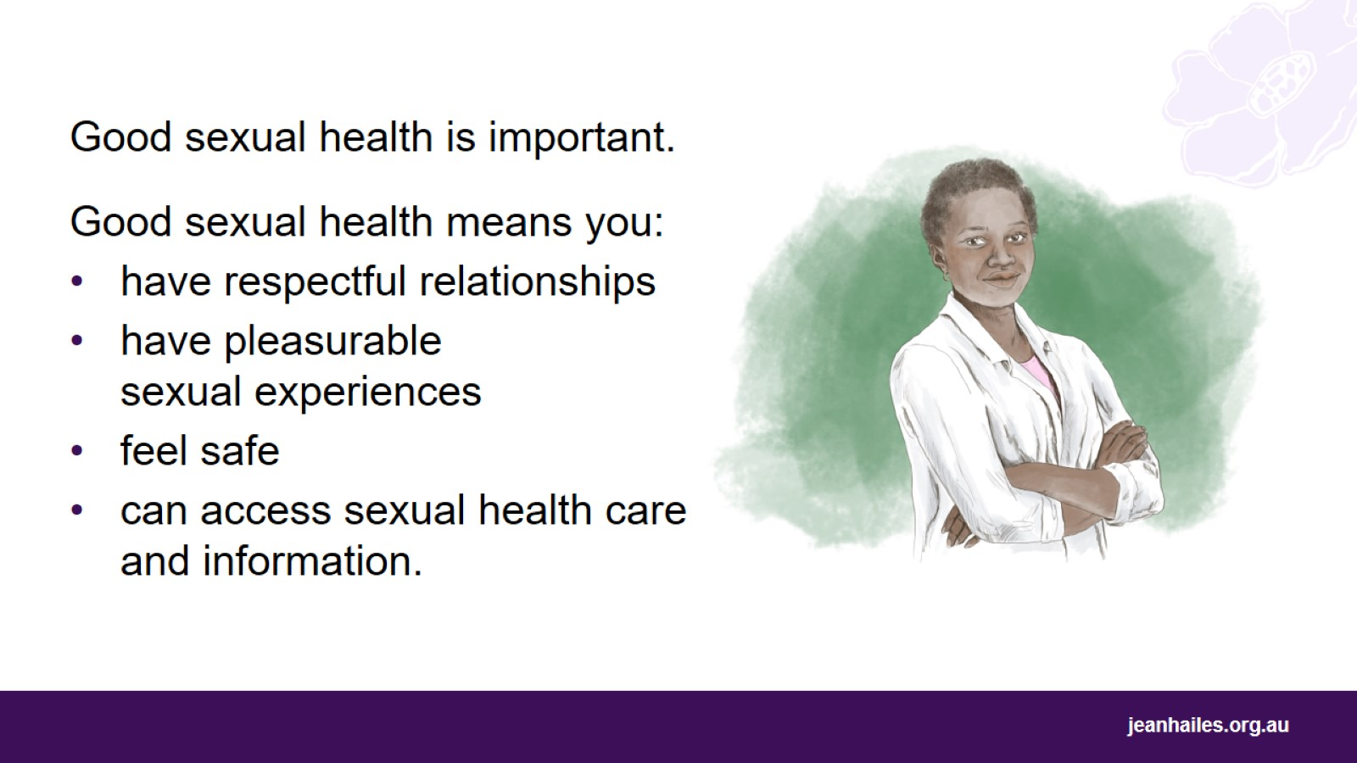
Notes:
Good sexual health is important.
Good sexual health means you:
have respectful relationships
have pleasurable and safe sexual experiences
feel safe and don’t have to worry about violence or coercion - coercion is when someone uses force or threats to make you do something
can access sexual health care and information. You should be able to seek and get help for any sexual problems, for example, how to avoid sexually transmissible infections (STIs).

Slide 6
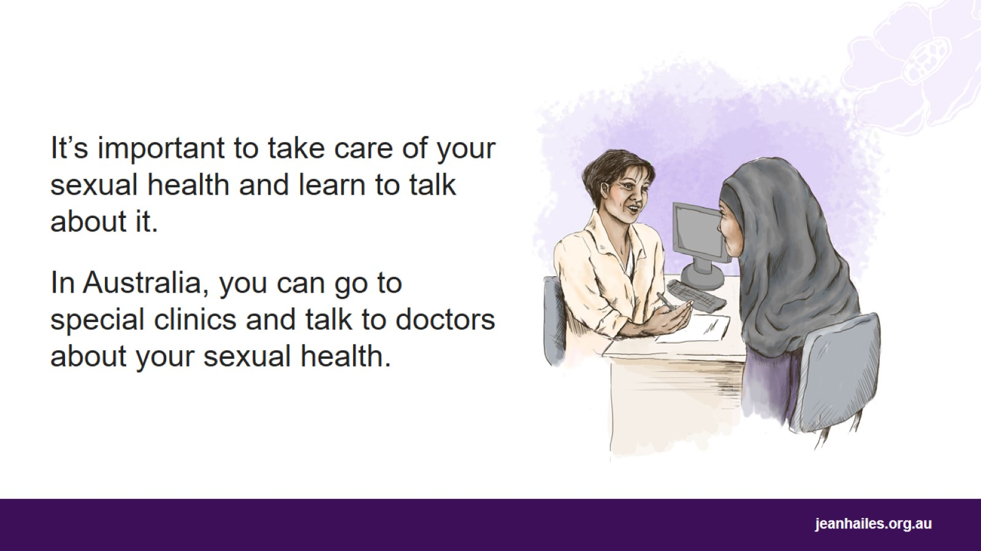
Notes:
It’s important to take care of your sexual health.
It’s good to learn to talk about sexual health with:
your partners, to have a respectful relationship
your children, to make sexual health less awkward to talk about and to help them make good decisions about their own sexual health.
In Australia, it’s OK to talk about sexual health. Children learn about sexual health at public schools.
You can go to special clinics and talk to doctors or nurses who can help if you have problems with your sexual health.
It’s important to see a doctor or nurse if you have a problem with your health.

Slide 7

Sexuality
Notes:
Let’s talk about sexuality.

Slide 8
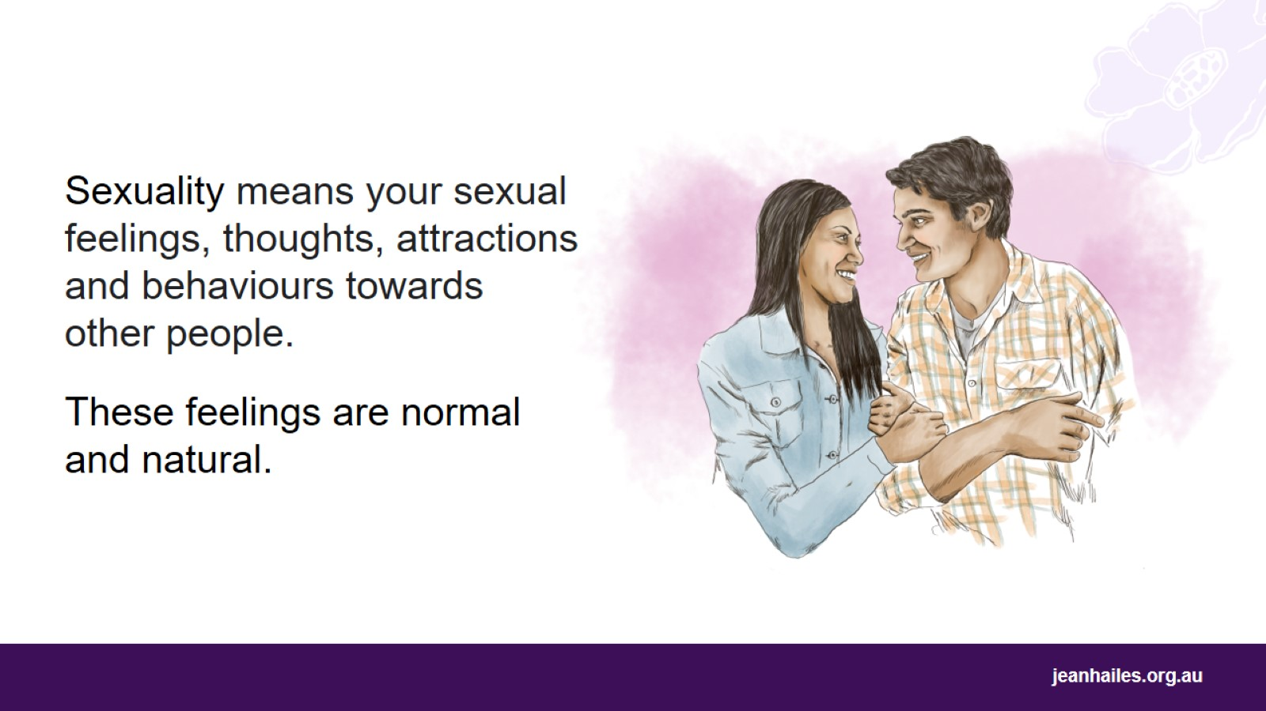
Notes:
Sexuality is an important part of your health and wellbeing throughout your life. It’s complex and personal.
It’s about your sexual feelings, thoughts, attractions and behaviours towards other people. These feelings and thoughts are normal and natural.
Sexuality is also influenced by:
your biological sex – whether you were born a woman, man or other
the gender you feel you are – a woman, man or other
who you are attracted to
eroticism, pleasure, intimacy
reproduction (having children).

Slide 9
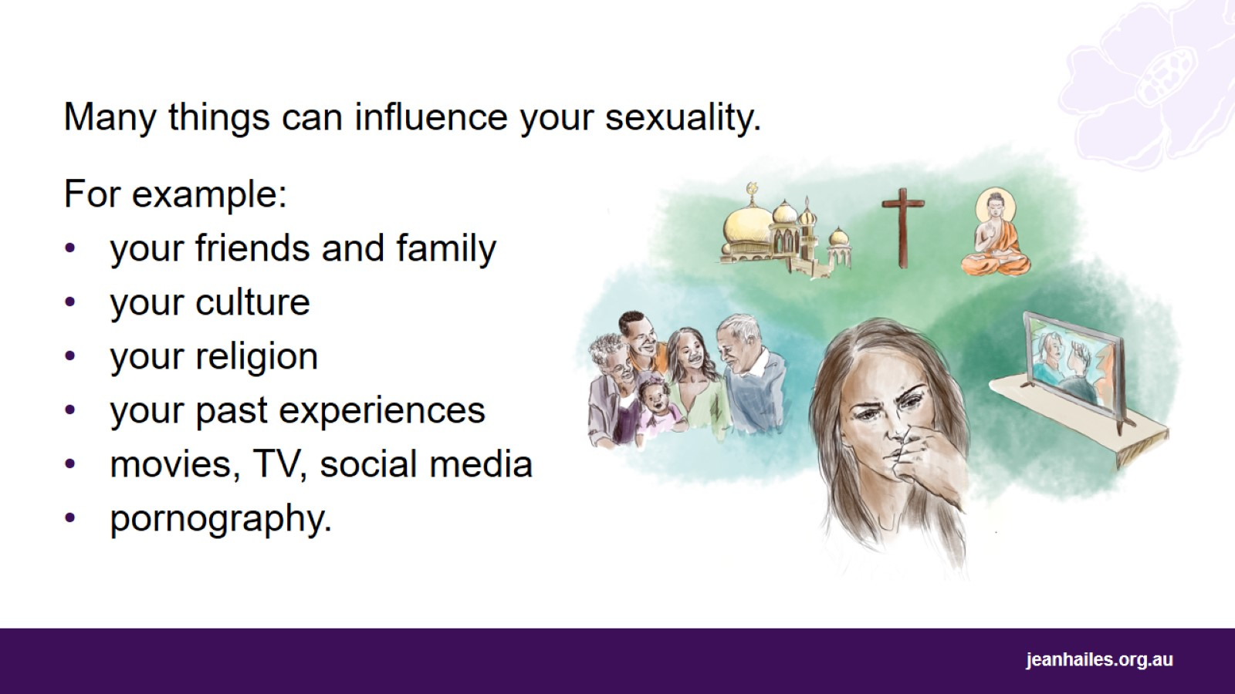
Notes:
Your sexuality can develop and change over time.
Many things can influence your sexuality:
your friends and family
your culture
your religion
your past experiences
media, like movies, TV, social media
pornography.

Slide 10
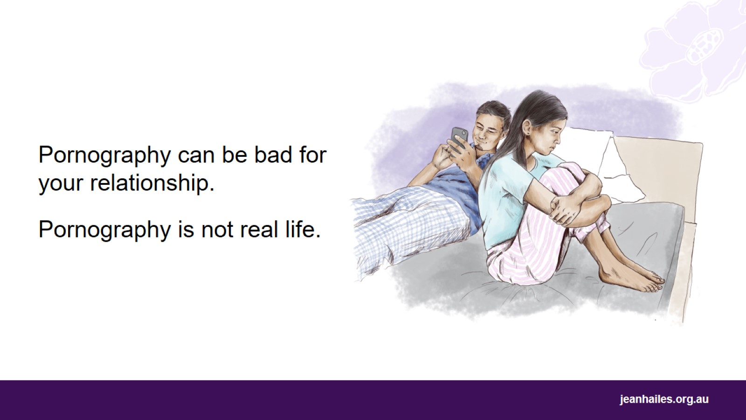
Notes:
Unfortunately, pornography can influence what people think about sex and sexuality. And this can have a bad impact on people’s relationships.
It’s easy to find and watch pornography, so it is important to be aware of the impact it can have on your sexuality and relationships.
Remember, pornography is made for entertainment. It doesn’t show what sex looks like in real life.
Pornography often shows:
men controlling women
sex without consent – when a person doesn’t agree to have sex or is forced or pressured to have sex
exaggerated pleasure.
Pornography is not real life.

Slide 11

Sexual pleasure
Notes:
Let’s talk about sexual pleasure and what can influence your sex life.

Slide 12
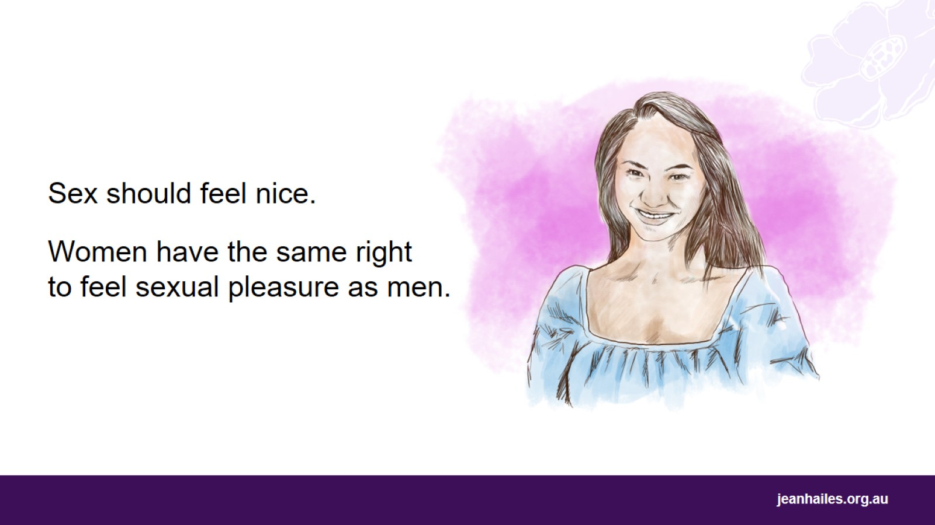
Notes:
Even though for some people sex is mainly about trying to have children, it should also feel nice.
Women have the same right to feel sexual pleasure as men. It’s good for a woman to enjoy sex and feel pleasure. It’s good for a woman to know her body, to know what feels nice to her, to know where she likes to be touched but also what she doesn’t like.
Having pleasurable sexual experiences is also good for your health. It can help you to: sleep better, reduce stress, lower blood pressure and improve your heart health.
In Australia, it’s OK to talk about sex, sexuality and sexual pleasure.

Slide 13
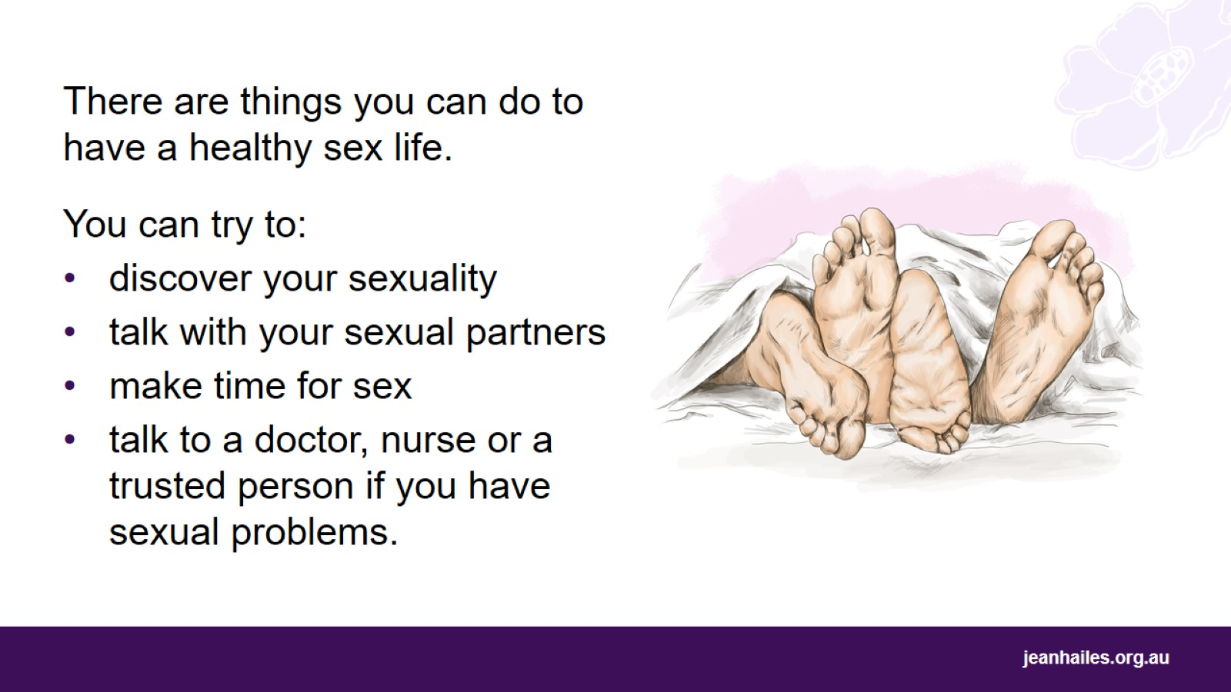
Notes:
There are things you can do to help you feel pleasure and have a better sex life.
You can try to:
discover your sexuality by getting to know your body – by exploring what feels good through your partner’s or your own touch
talk with your sexual partner – it’s important to try to talk about what feels right and what doesn’t. If you and your partner feel respected and happy with your sex life, your relationship can be better and stronger
make time for sex – we live busy lives, but it’s good to have sex when you and your partner feel like it
talk to a doctor, nurse or a trusted person if you have sexual problems.

Slide 14
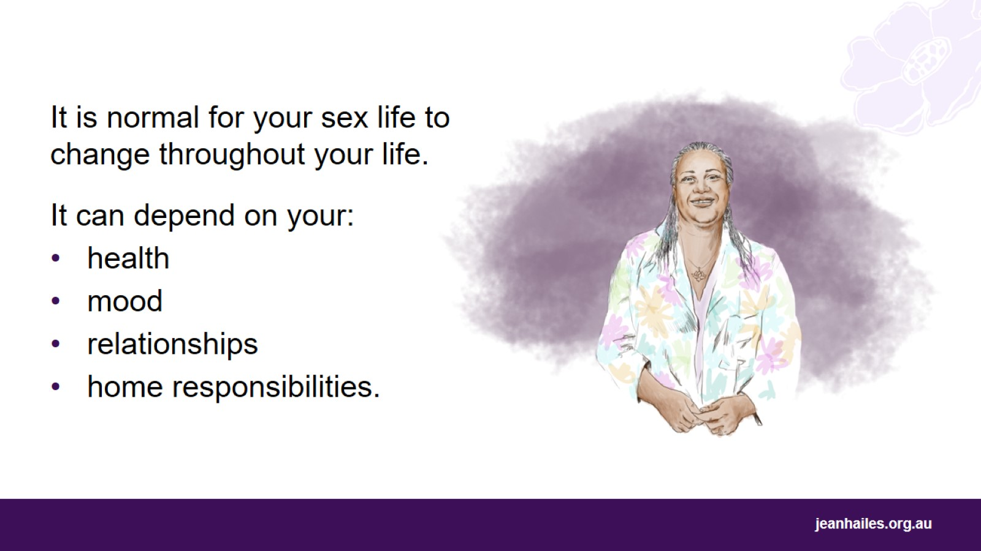
Notes:
It’s normal for your sex life to change throughout your life.
Many things can influence your sex life, like:
changes in your body at different times in your life. For example, after childbirth or when you get older, you may not feel like having sex or sex may be painful
your health and your partner’s health
your mood - how you feel, if you’re stressed
whether you are happy in your relationship
your responsibilities at home, such as caring for young children, elderly parents or others.

Slide 15
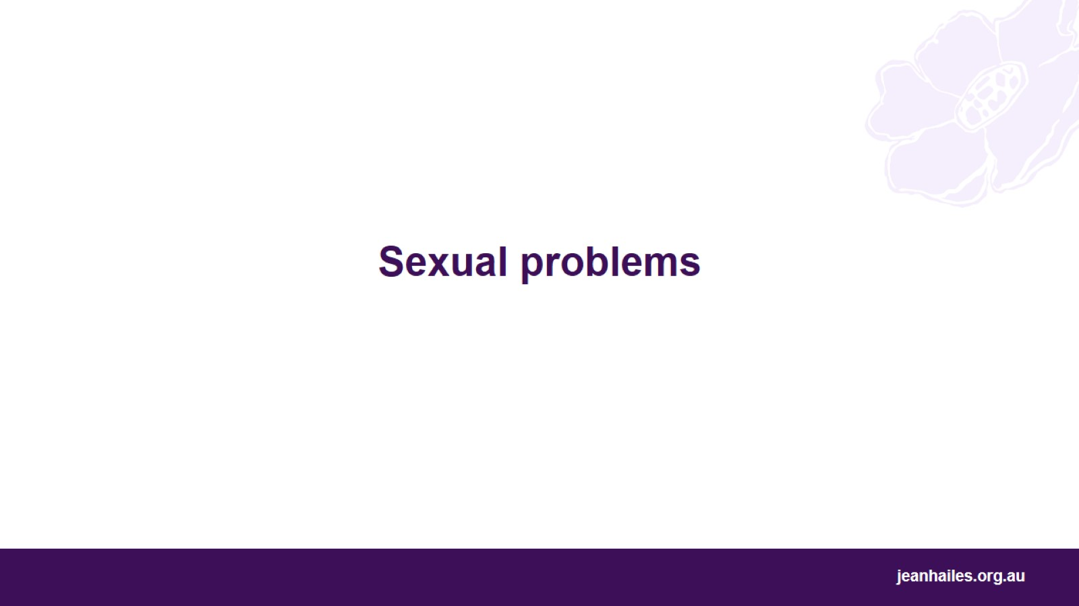
Sexual problems
Notes:
Let’s talk about some common sexual problems.

Slide 16
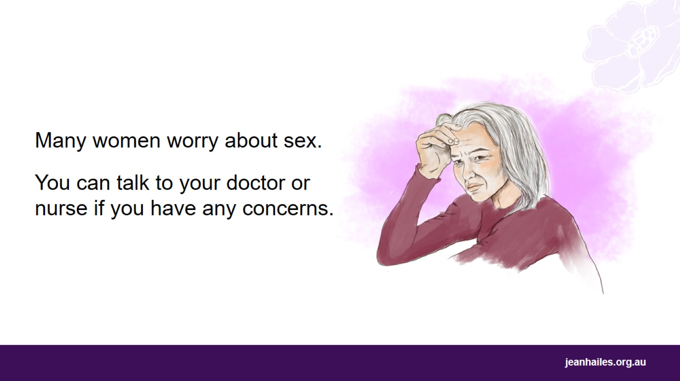
Notes:
Many women worry about sex. For example, you might find sex painful, or you might worry that you don’t feel like having sex.
You can talk to your doctor or nurse if you have any concerns.

Slide 17
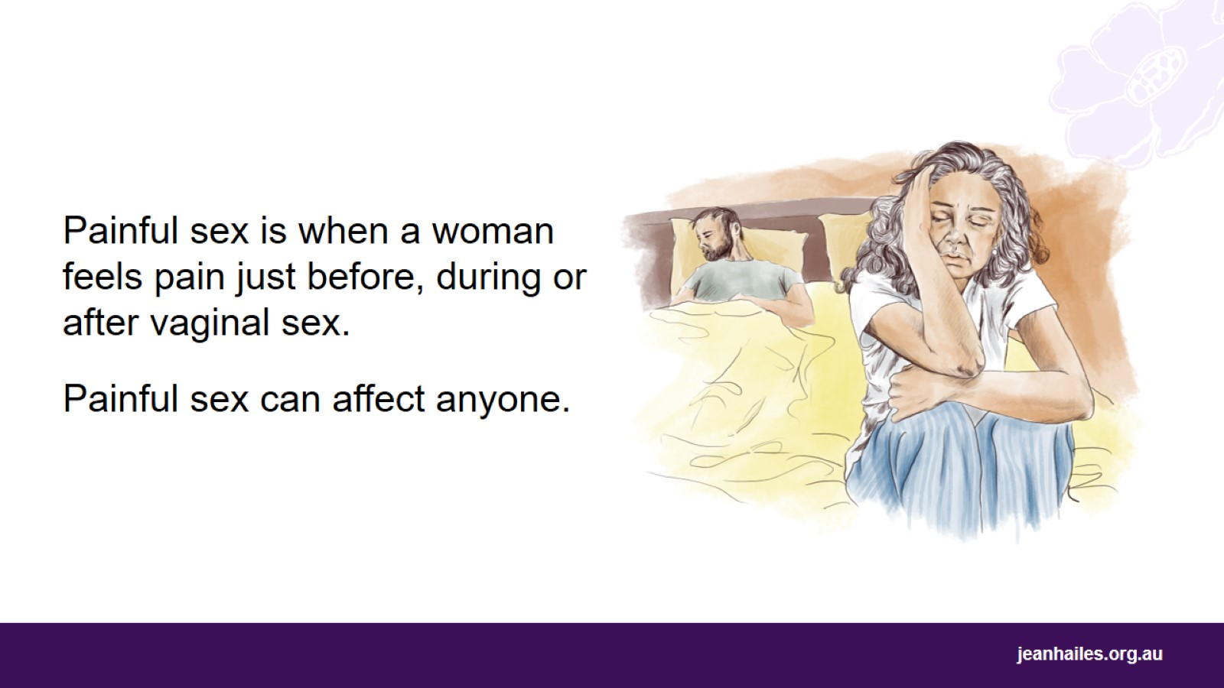
Notes:
Some women worry about painful sex.
Painful sex is when a woman feels pain just before, during, or after having vaginal sex.
Painful sex can affect anyone, but is more common in:
young women
women who have recently given birth or who are breastfeeding
older women who don’t have periods anymore.

Slide 18
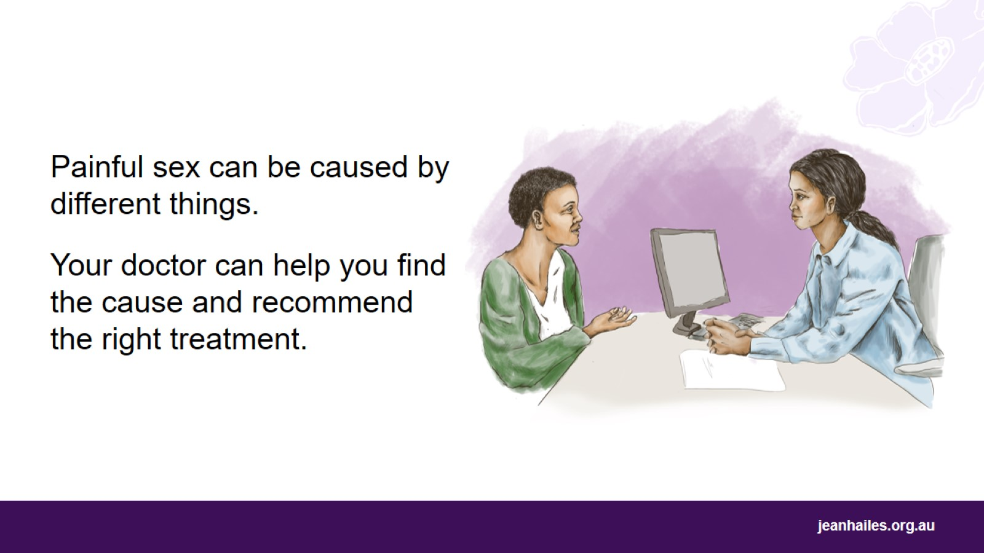
Notes:
Painful sex can be caused by different things.
If you experience painful sex, you can talk to your doctor or nurse.
They can help you find out why sex is painful and recommend the right treatment.
They might:
treat the cause of the pain
recommend using lubricants - lubricants are special gels, liquids and oils that you can apply inside your vagina and on your partner's penis to make your vagina moist and avoid pain during sex
recommend using special cream for your vagina if you’ve recently given birth or if you’re at a later stage in life - around the time when your periods stop coming
suggest ways to relax during sex
refer you to a specialist, for example a physiotherapist that specialises in women’s health.

Slide 19
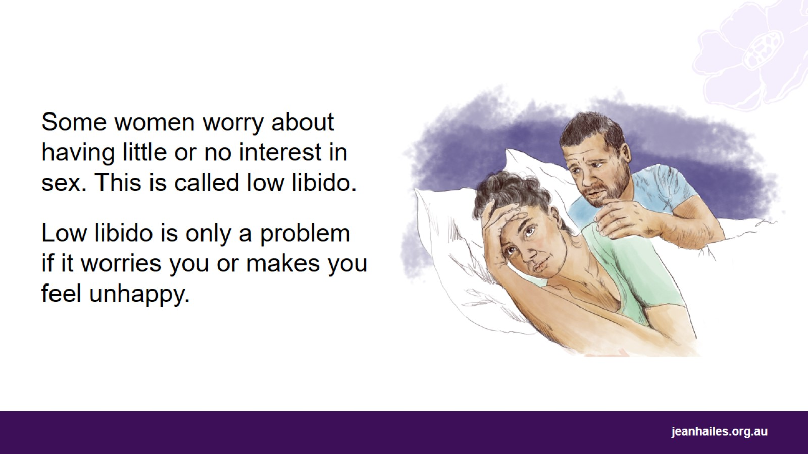
Notes:
For some women not feeling like having sex could also be a worry. Having little or no interest in having sex is called low libido. Libido is how much you feel like having sex, with a partner or by yourself.
Anyone can experience low libido. It can happen at any age, but it becomes more common the older we get.
If low libido doesn’t bother you, it’s not a problem. Low libido is only a problem if it worries you or makes you feel unhappy.

Slide 20
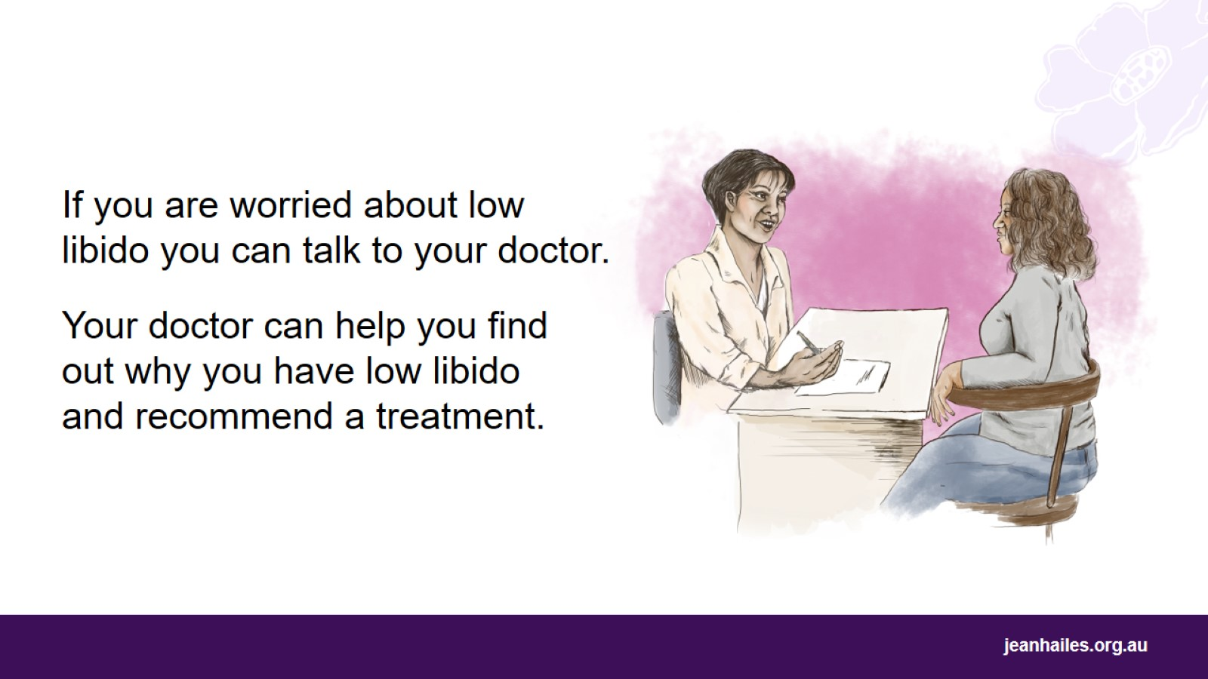
Notes:
If you have low libido and it worries you or makes you feel unhappy, there are treatments available.
Your doctor can help your find out why you have low libido and recommend the right treatment. For example, if your low libido is because of some problems in your relationship, your doctor may recommend relationship therapy.

Slide 21
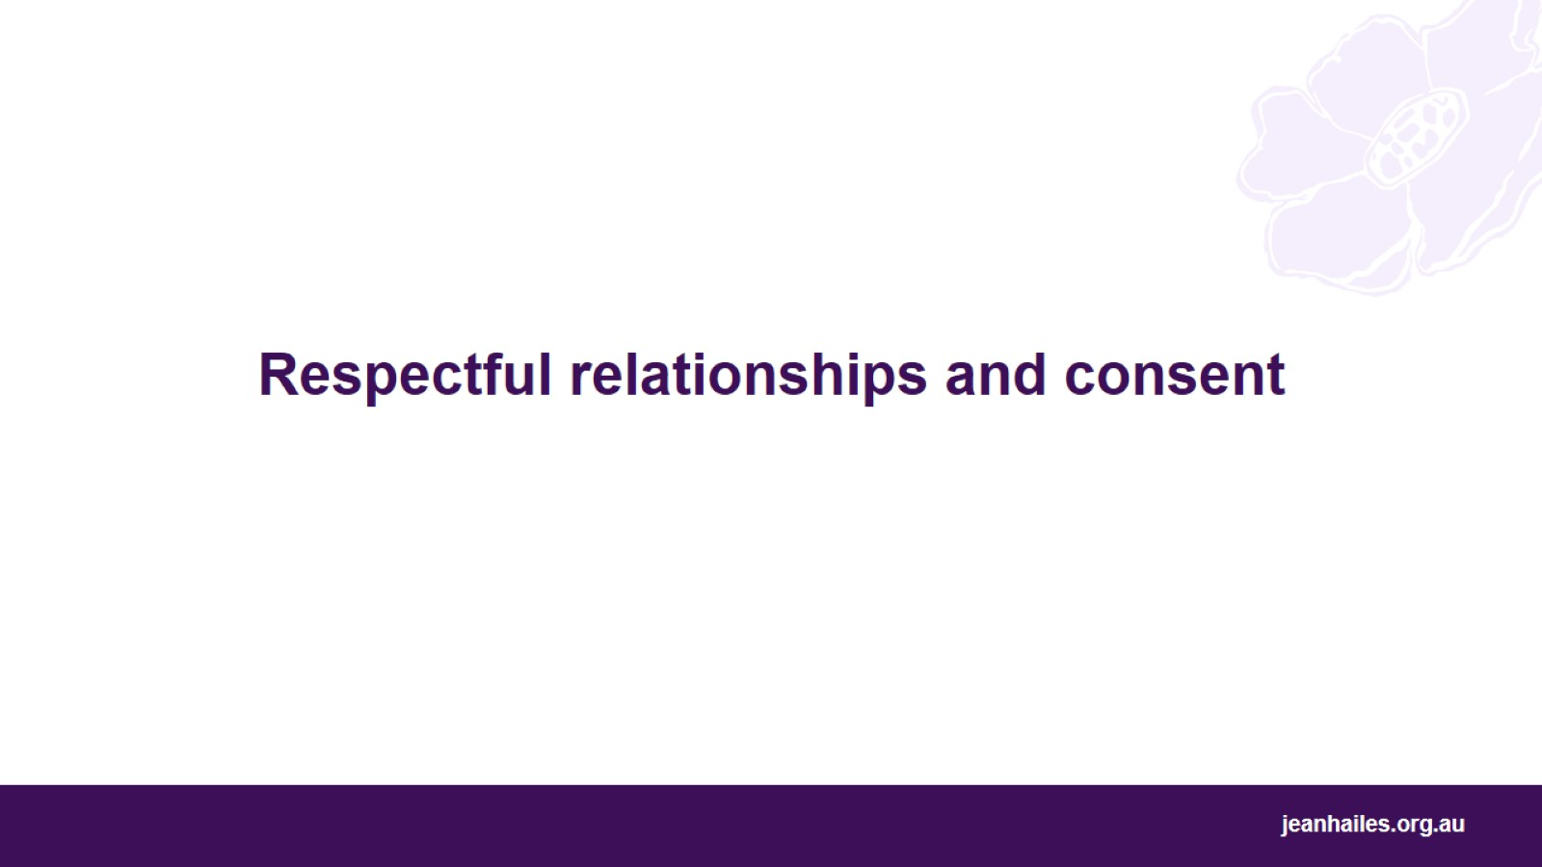
Respectful relationships and consent
Notes:
Let’s talk about respectful relationships and consent.

Slide 22
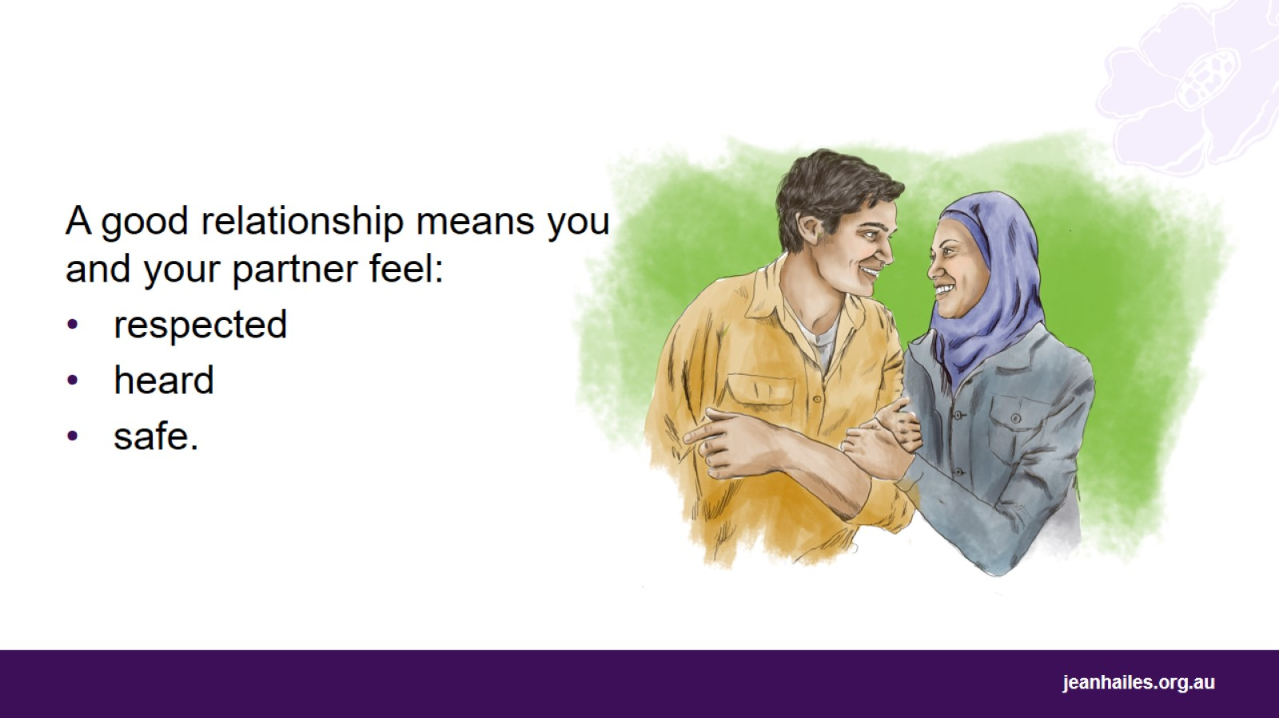
Notes:
Having a respectful, honest and safe relationship is important for your health and wellbeing.
The most important things in every relationship are:
respect – when both partners accept each other the way they are, including their likes, dislikes, and boundaries
open communication – when you can speak freely with your partner about your thoughts, feelings, needs, what you like and don’t like
safety – you should never feel scared of your partner or make your partner feel scared.

Slide 23
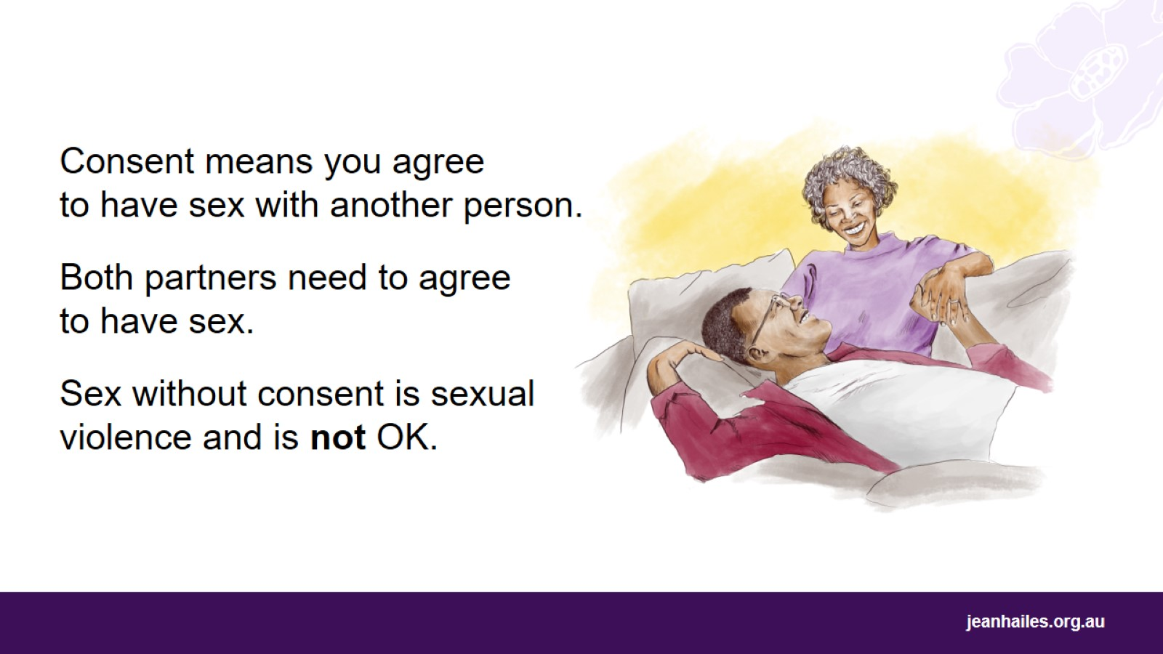
Notes:
A healthy sexual relationship includes consent.
When talking about sex, consent means that you freely and happily agree to have sex or do sexual things with another person because you want to at that time. It includes any type of sex: vaginal, oral or anal sex, or any sexual things that you enjoy doing, as long as you both want to do them.
Consent must be mutual, which means that both partners agree.
It doesn’t matter if it’s the first time you’re having sex or doing sexual things with someone or the 100th time, consent is always important.
You have the right to say ‘no’, even if they’re your husband or long-term partner. You might not be in the mood for sex, you might not like the sexual things your partner suggests, or it might be painful for you.
Even if you agreed to have sex with someone but have changed your mind, you can say ‘stop’ at any time, even while having sex.
Sex without consent is sexual violence and is not OK.

Slide 24
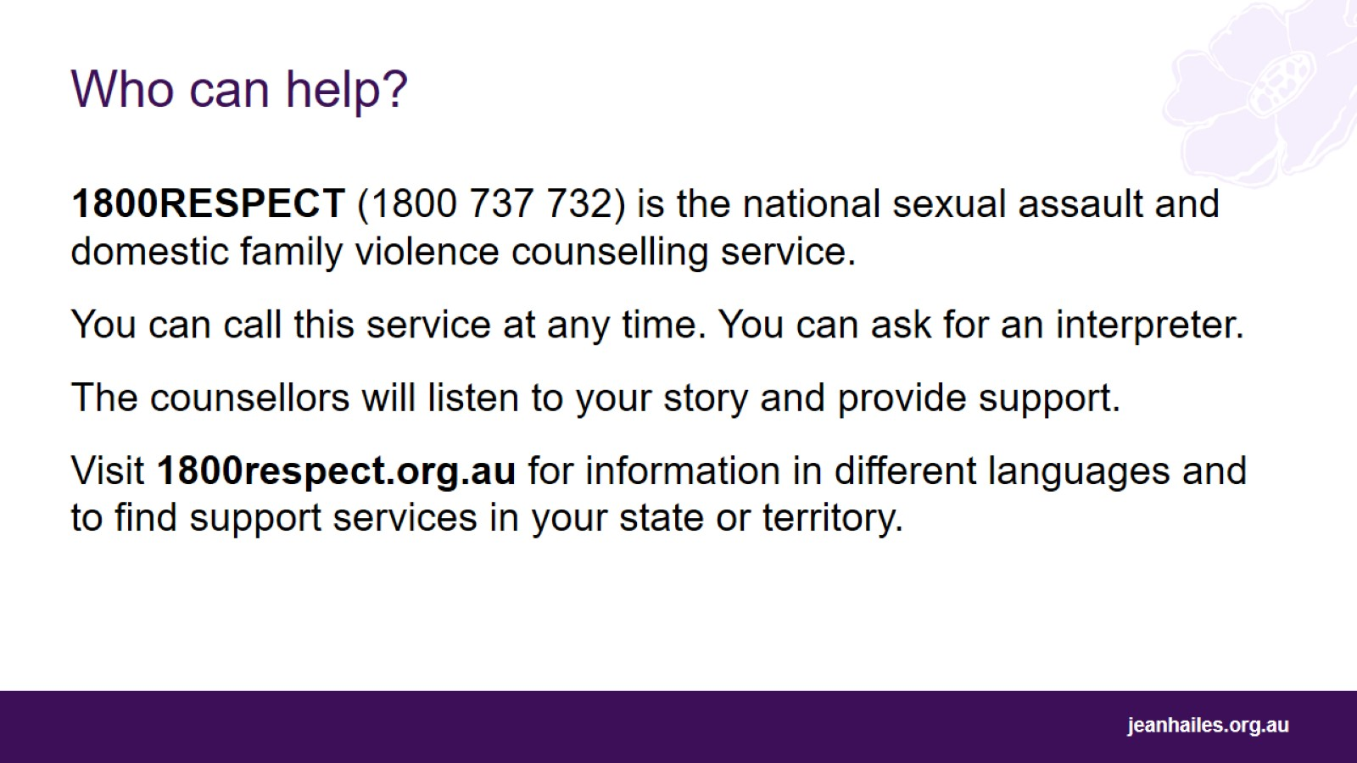
Who can help?
Notes:
If you are worried that someone has had sex or done sexual things to you without your consent, or if you are concerned about your sexual relationship, you can call 1800RESPECT.
1800RESPECT is the national sexual assault and domestic family violence counselling service.
You can call this service at any time - 24 hours a day, 7 days a week.
If English is not your first language and you prefer speaking in your language, you can ask for an interpreter.
The counsellors will listen to your story and provide support that is right for you and your situation.
You can also visit their website 1800respect.org.au for information in different languages and to find support services in your state or territory.
You might also have a friend, family member, community elder or health worker that you trust and ask them for their advice or support.

Slide 25
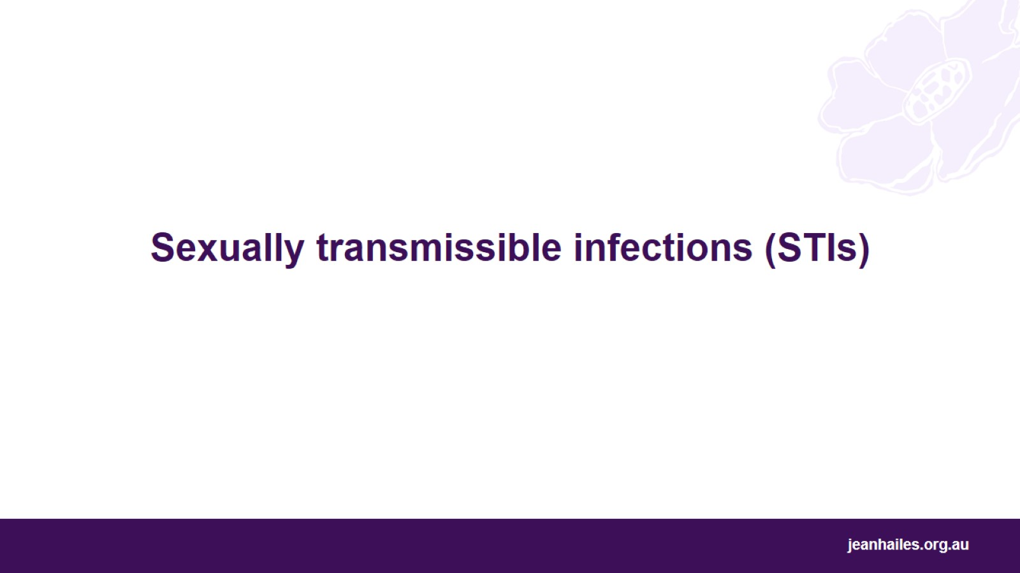
Sexually transmissible infections (STIs)
Notes:
Let’s talk about sexually transmissible infections, or STIs, and what you should do if you get them.

Slide 26
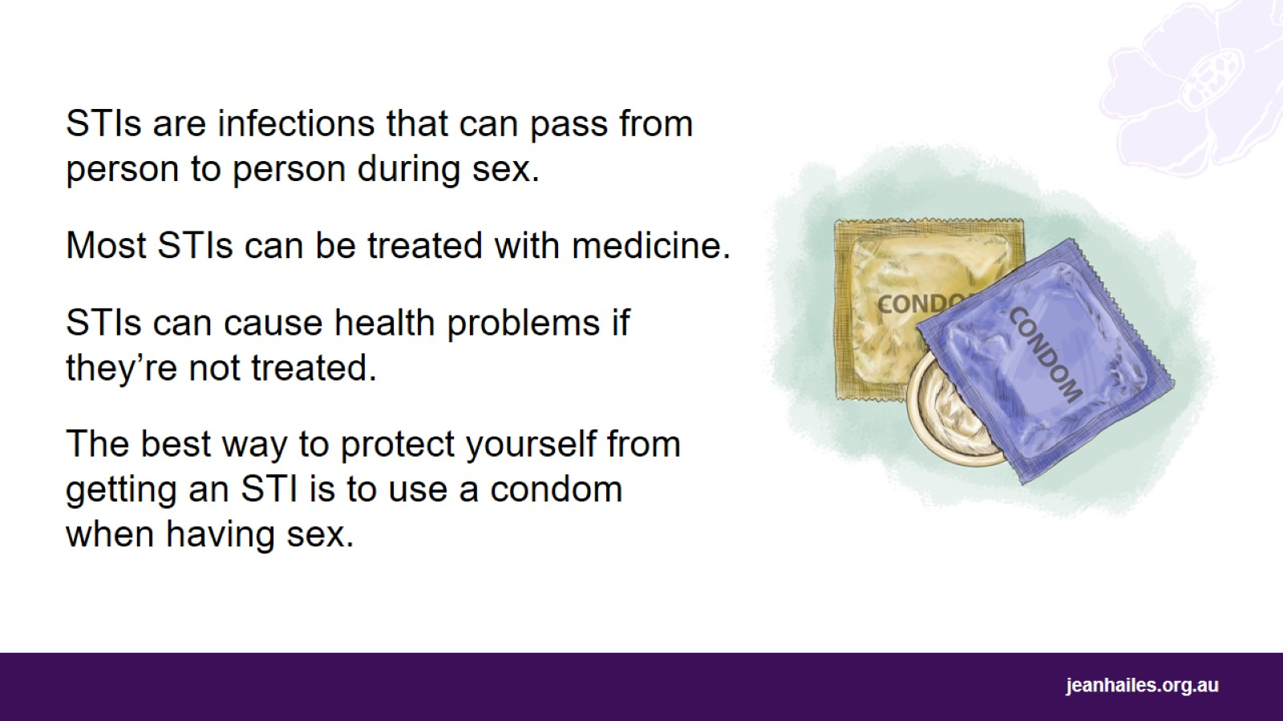
Notes:
STIs are sexually transmissible infections that can pass from one person, the infected one, to another person during sex. There are different types of STIs, for example chlamydia, genital herpes, hepatitis B, or syphilis.
Anyone can get an STI – if you have sex with different people, or your partner has sex with other people, you can get an STI.
Most STIs can either be cured or controlled with medicine.
STIs can cause health problems if they’re not treated.
The best way to protect yourself from getting STIs or passing them to other people is to use a condom when having sex. Condoms stop the exchange of body fluids that can transmit STIs.

Slide 27
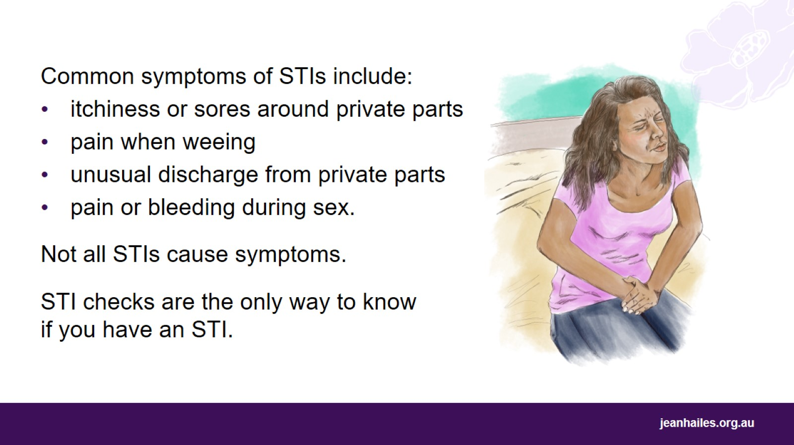
Notes:
Common symptoms of STIs include:
itchiness, irritation, blister, sores or ulcers around private parts: vulva, penis or anus
pain when weeing
unusual liquid or discharge coming out of private parts: vagina, penis or anus
pain or bleeding during sex.
But not all STIs cause symptoms.
STI checks are the only way to know if you have an STI.
If you are worried you might have an STI, ask a doctor or nurse for an STI check.

Slide 28
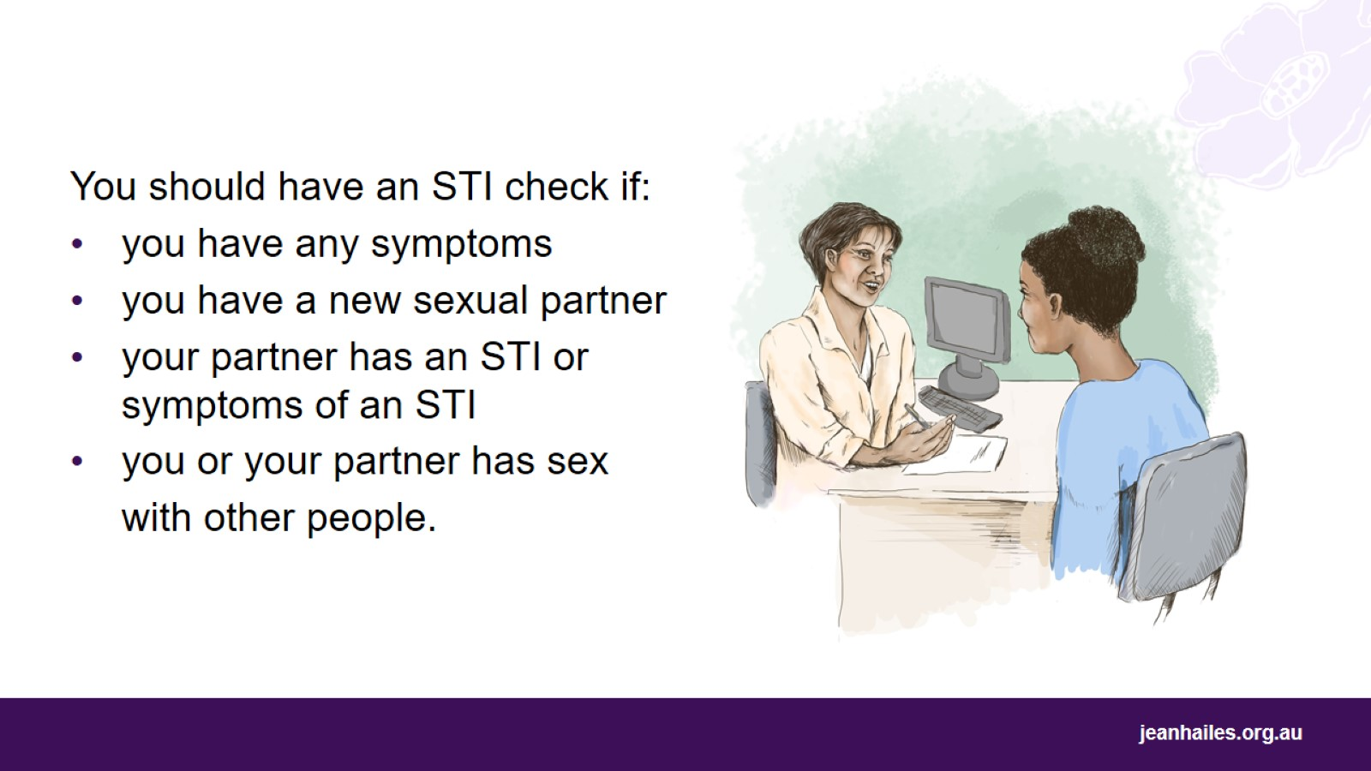
Notes:
If you have sex, you should have an STI check if:
you have any symptoms
you have a new sexual partner
your partner has an STI or symptoms of an STI
you or your partner has sex with other people.

Slide 29
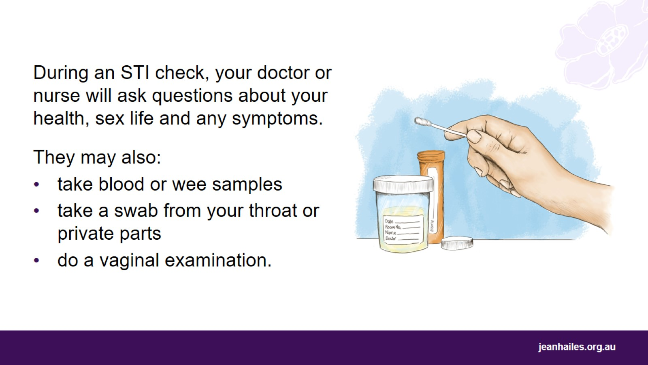
Notes:
Knowing what will happen when you go for an STI check can help you feel more comfortable.
A doctor or nurse will ask you questions about your health, sex life and if you have any symptoms. For example:
Have you had an STI check in the past? When was your last STI check?
Do you have vaginal sex? Do you have oral sex? Do you have anal sex?
Do you have any symptoms?
Many STIs don't cause symptoms – but some women may experience pain when having sex, pain when weeing, unusual liquid or discharge from their vagina, or bleeding.
It’s important to answer these questions honestly and not hide anything. Doctors and nurses won’t talk about your health issues with anyone else.
Your doctor or nurse will do some tests. They may:
take your blood or wee samples
take a swab from your throat, vagina or anus
do a vaginal examination (look at your vulva and vagina).
It usually takes 1–2 weeks to get the test results. Then, the doctor or nurse may send you a text, call you, or ask you to come in for another appointment.
An STI check is also a good opportunity to get more information or ask questions about anything that worries you.

Slide 30
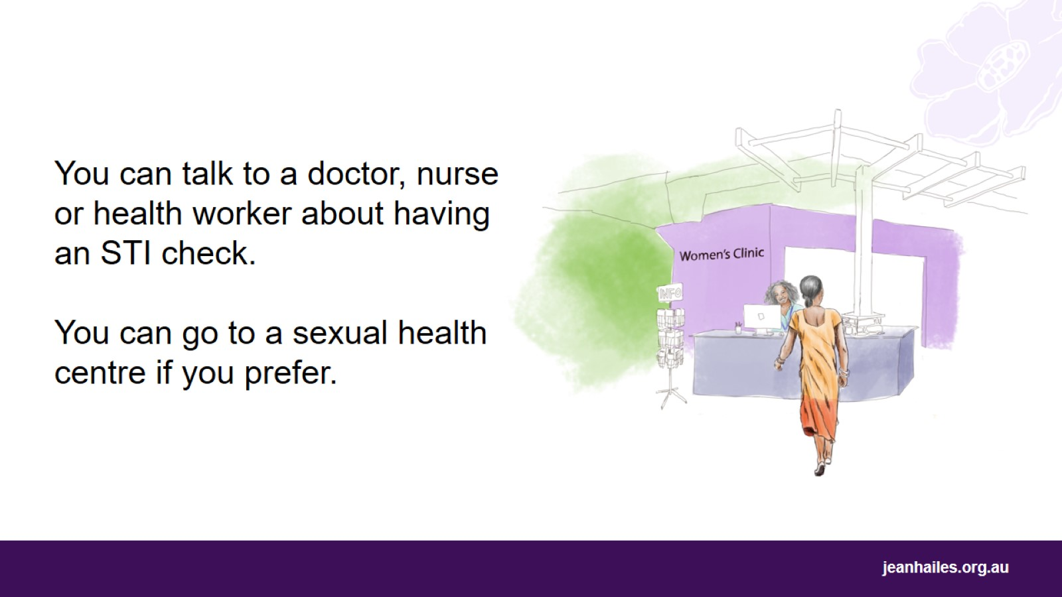
Notes:
You can talk to a doctor, nurse or health worker about getting an STI check.
You can go to a women’s health clinic, or a sexual health centre. These clinics specialise in sexual health and STI checks. They are a good option, if you feel embarrassed or uncomfortable going to your regular doctor or nurse.

Slide 31

Contraception
Notes:
Let’s talk about different types of contraception.
Note to the facilitator: if messages in this section are inappropriate for your audience, you can skip them or change the wording to better suit your audience.

Slide 32
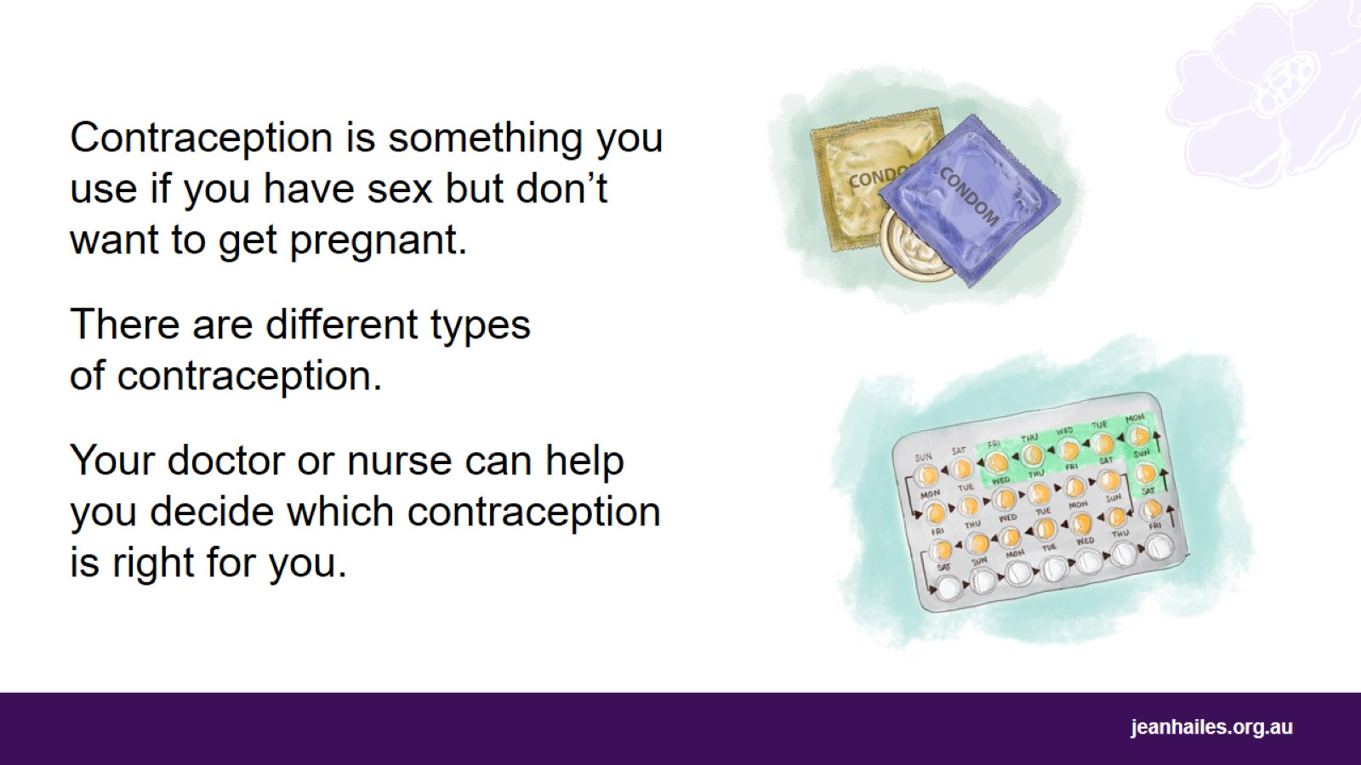
Notes:
Contraception is something you do, take or use if you have sex but don’t want to get pregnant.
There are different types of contraception.
Most contraception can be stopped or removed at any time so you can get pregnant again if you want to.
Your doctor or nurse can help decide which contraception is right for you.

Slide 33
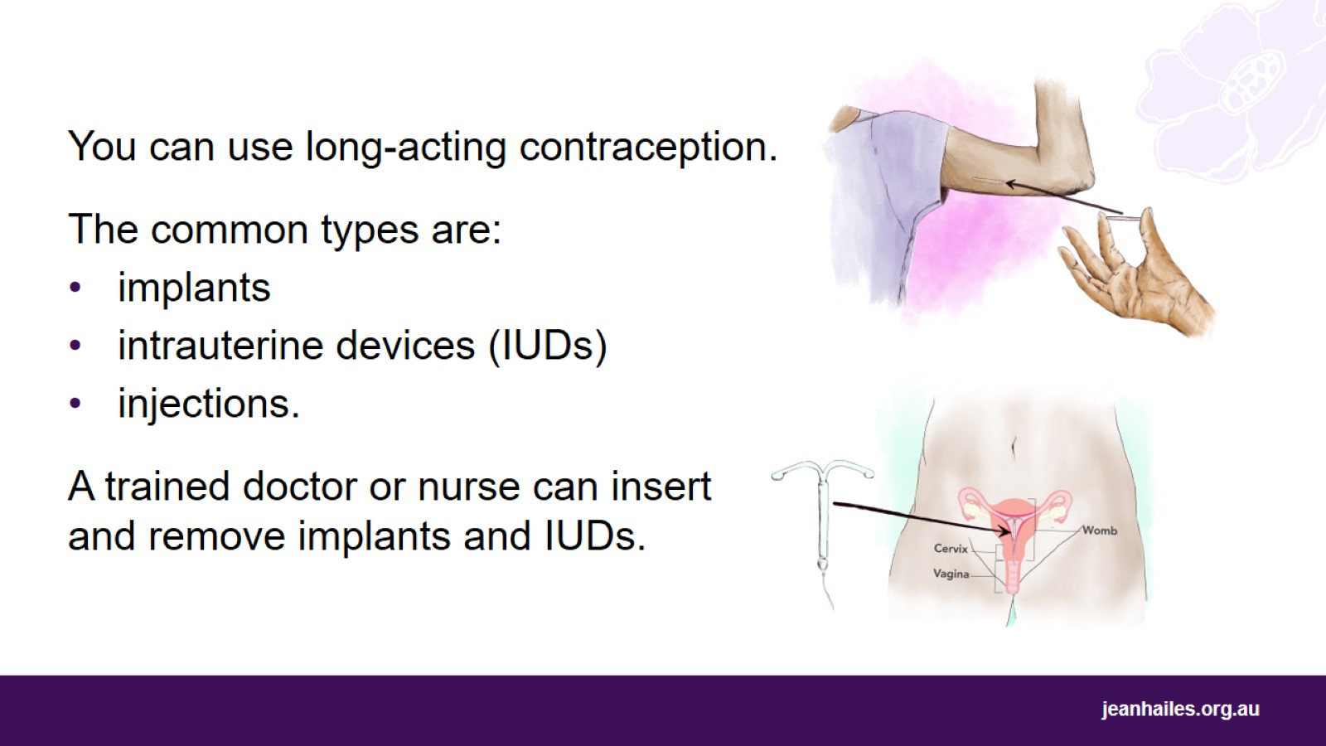
Notes:
You can use long-acting contraception that is convenient, cost effective and prevents pregnancies for up to 10 years.
The common types are:
an implant – a thin, flexible, plastic rod, the size of a matchstick, that is inserted under your skin on your arm. It prevents pregnancy for up to 3 years
an intrauterine device (IUD) – a small, plastic or metal device that is inserted into your womb. It prevents pregnancy for 5 to 10 years
an injection – an injection given to you every three months by your doctor to prevent pregnancy.
Specially trained doctors and nurses insert implants and IUDs at places like family planning clinics, your doctor’s or gynaecologist’s rooms or women's health clinics.
They can also remove your implant or IUD at any time if you don’t want it anymore. Once removed, you’ll be able to get pregnant again.
No one can tell if you use these types of contraception.

Slide 34
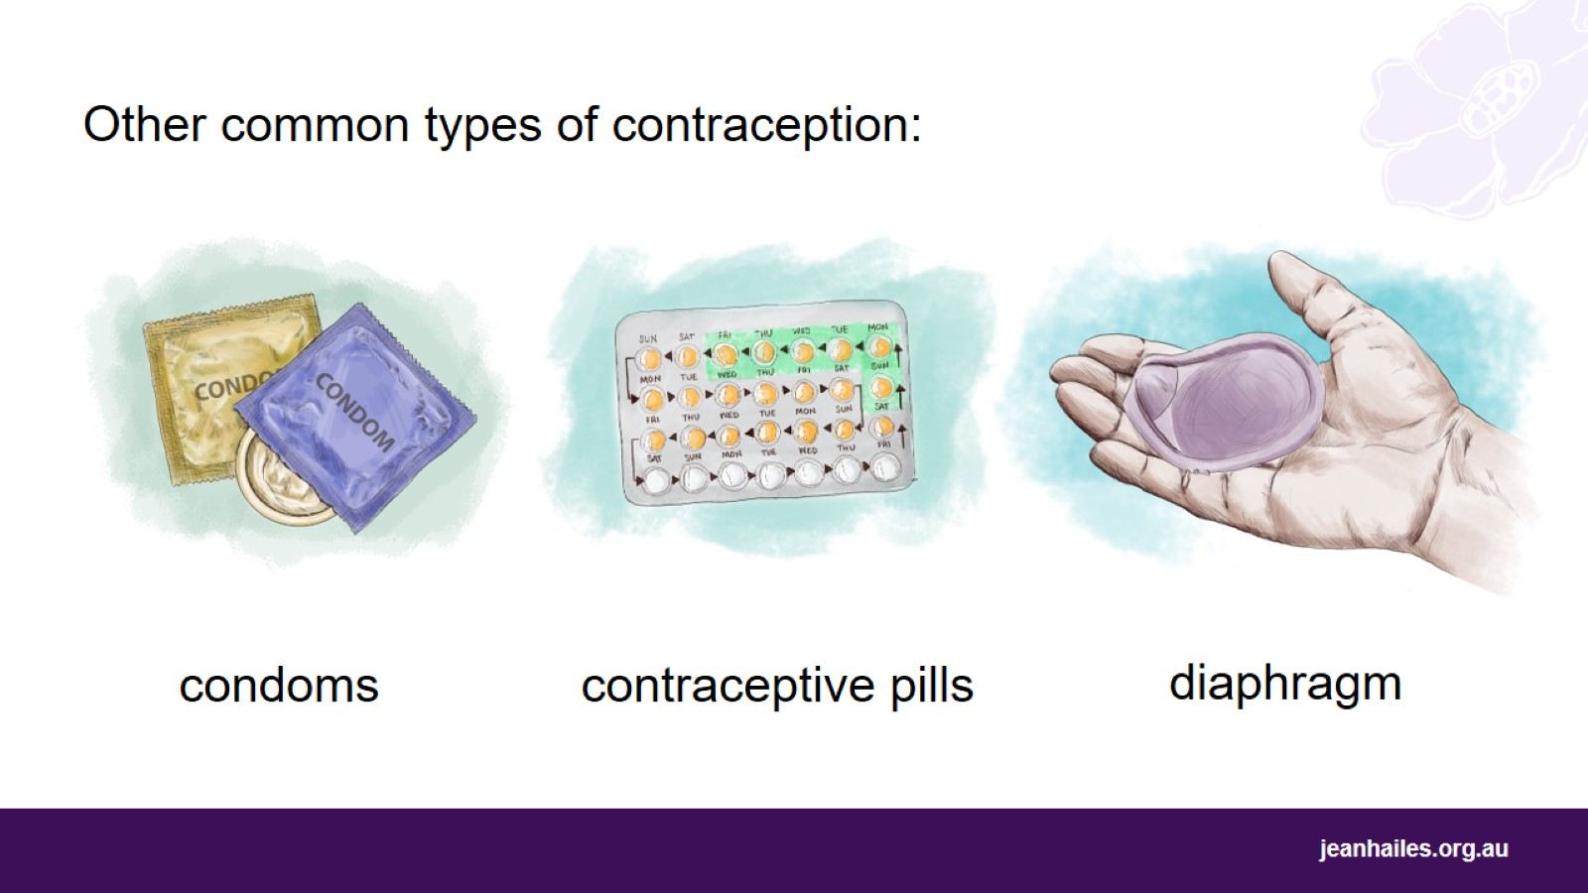
Notes:
There are other common types of contraception, but they are not as good at preventing pregnancy as long-acting contraception, so there is a small chance you might get pregnant when using them.
Condoms:
A male condom is a plastic or rubber sheath that your partner puts on his erect penis before sex.
A female condom is a plastic or rubber sheath that you put into your vagina before sex.
Condoms are the only type of contraception that protects against STIs.
Contraceptive pills are pills that prevent pregnancy. You need to take a pill every day if you don’t want to get pregnant. Once you stop taking the pill, you’ll be able to get pregnant.
A diaphragm is a small cap that you put into your vagina (at the entrance of the womb) before sex.
A vaginal ring is a soft plastic ring that you put into your vagina for 3 weeks of every month.

Slide 35
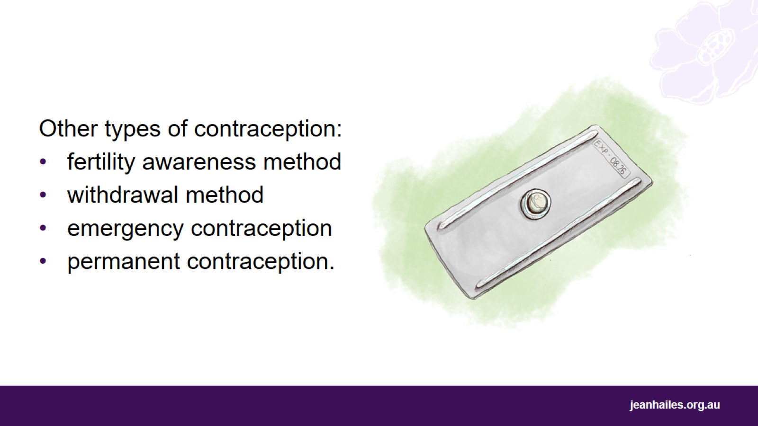
Notes:
Other types of contraception:
Fertility awareness method – when you monitor your ‘fertile window’ and don’t have sex during that time. Your ‘fertile window’ is around the time when an egg is released, sometime between your periods. This is one of the least effective types of contraception as it’s hard to know exactly when your ’fertile window’ happens every month.
The withdrawal method means your partner takes his penis out of your vagina before ejaculating. The withdrawal method is the least effective method of contraception.
Emergency contraception is a pill that you can take up to 3 days after having unprotected sex to prevent pregnancy.
Permanent contraception means an operation to prevent pregnancy permanently. Men and women can have this operation.

Slide 36
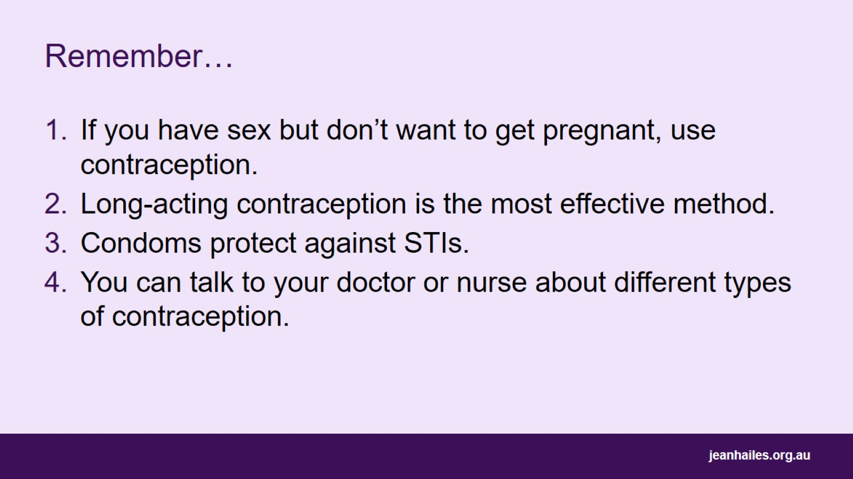
Remember…
Notes:
Remember:
If you have sex but don’t want to get pregnant, use contraception.
Long-acting contraception is the most effective method.
Condoms protect against STIs.
You can talk to your doctor or nurse about different types of contraception.

Slide 37
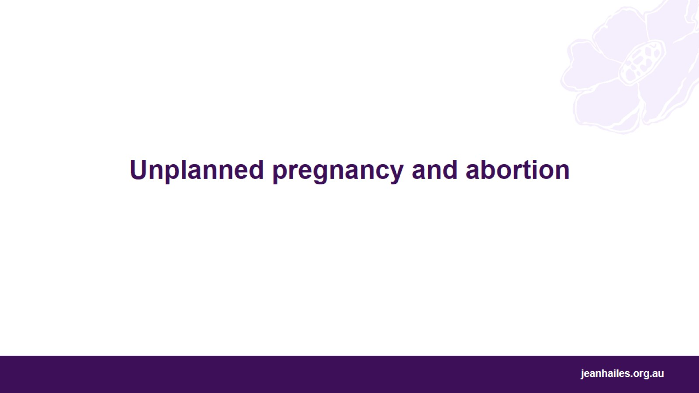
Unplanned pregnancy and abortion
Notes:
Let’s talk about pregnancies that are unplanned and unwanted and what you can do about them.
Note to the facilitator: if messages in this section are inappropriate for your audience, you may choose to skip them or change the wording to better suit your audience.

Slide 38
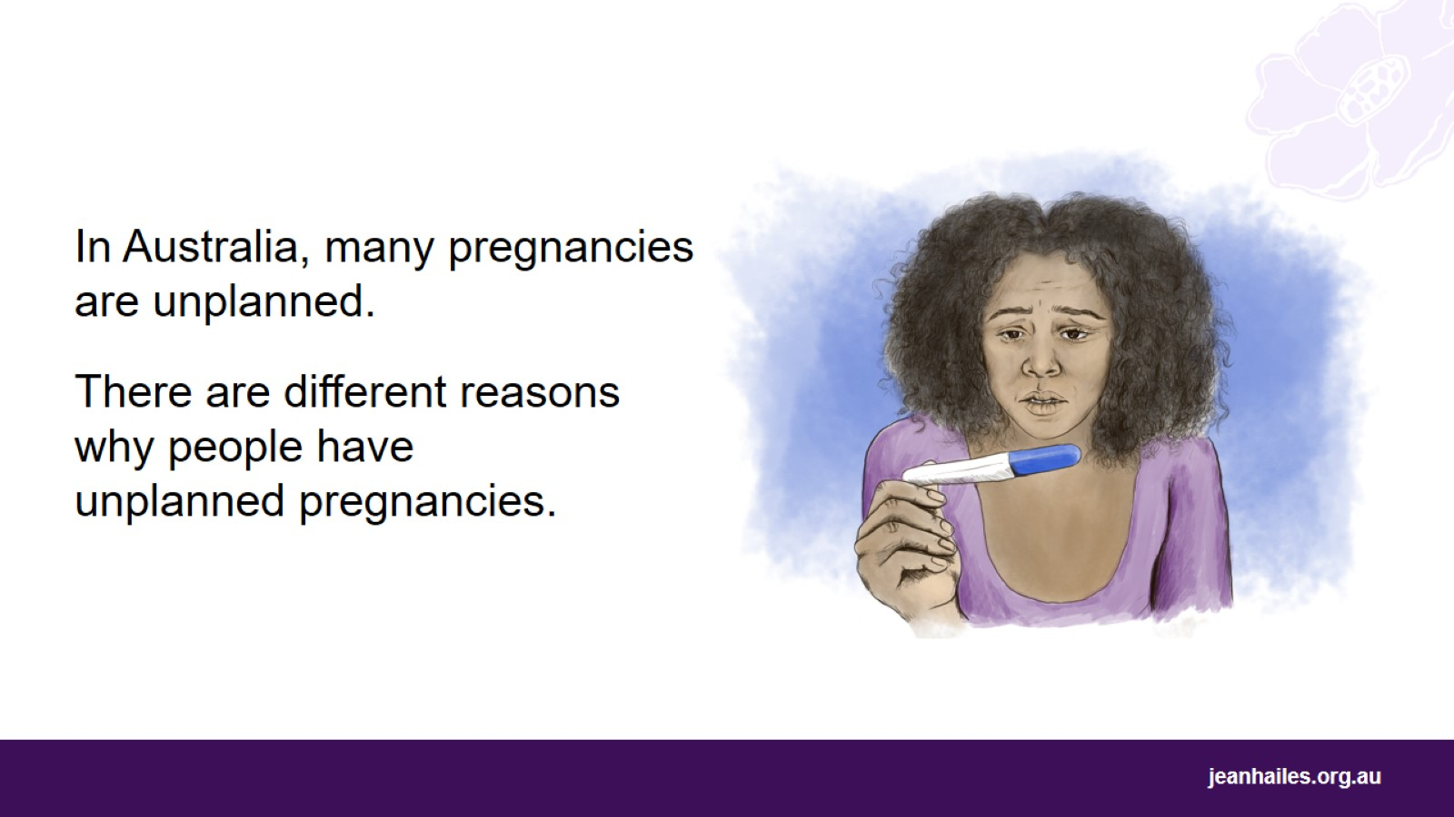
Notes:
In Australia, many pregnancies are unplanned. Unplanned pregnancy means you don’t want to get pregnant when having sex.
This might happen because:
you forget to use contraception
your contraception doesn’t work properly
your pregnancy is a result of rape. Rape is when someone forces you to have sex without your consent and against your will.
Rape is a crime.
Rape can happen in a relationship.
If you have been raped or sexual assaulted and need help, you can call 1800RESPECT (1800 737 732). You can call this service at any time - 24 hours a day, 7 days a week. Their counsellors will listen to your story and give you the help you need. You can ask for an interpreter if you prefer to speak in your language.

Slide 39
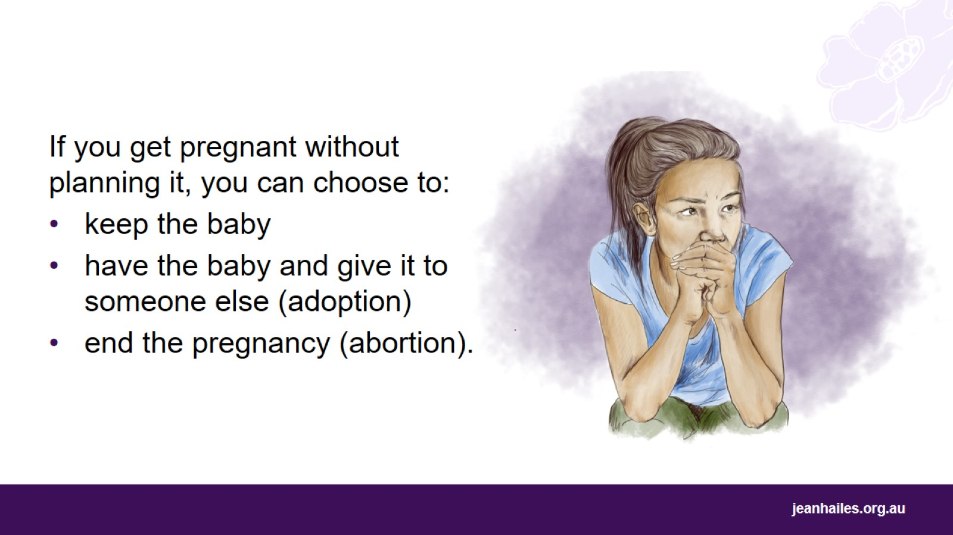
Notes:
If you get pregnant without planning it, you can choose to:
keep the baby
place the baby for adoption – which means you continue the pregnancy and have the baby, then legally give the baby to someone else to raise it
have an abortion – which means you take medicine or have surgery to end the pregnancy. You can only have an abortion up until halfway through your pregnancy (around 20 weeks).

Slide 40
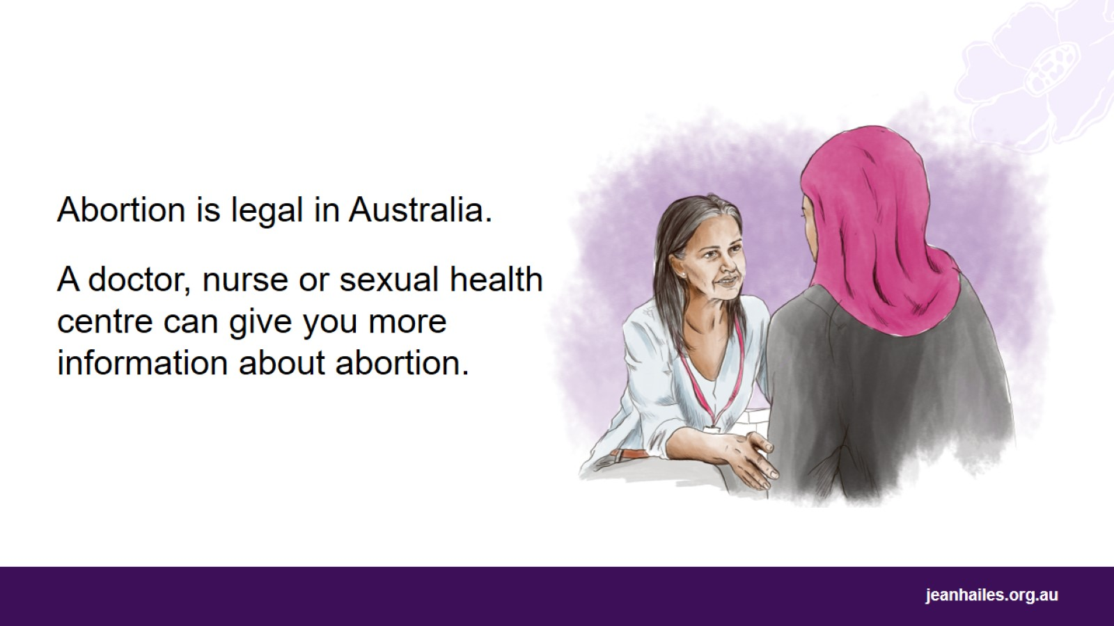
Notes:
It is important to know that abortion is legal in Australia. This means that abortion is not a crime.
In Australia, you have the right to end your pregnancy if you want.
Abortion is quite common in Australia.
Talk to your doctor, nurse or local sexual health centre for more information about how to get an abortion in your state or territory.

Slide 41

Your choice
Notes:
Let’s talk about reproductive coercion.

Slide 42
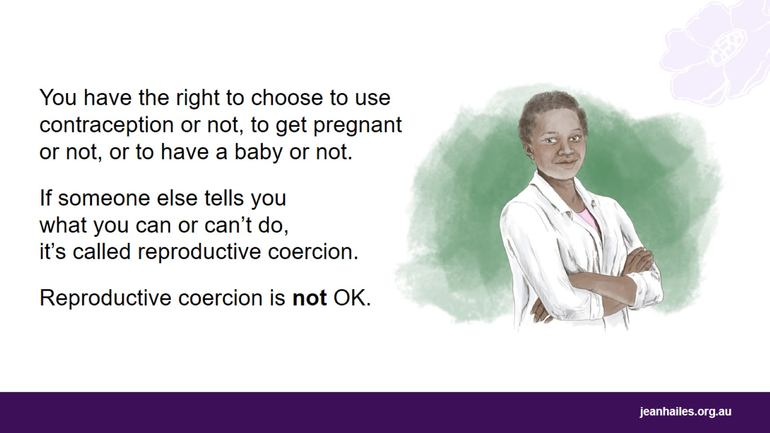
Notes:
In Australia, you have the right to choose what happens to your body. This includes your reproductive choices, which means that you can choose to use contraception to prevent pregnancy, get pregnant and have a baby, or have an abortion.
When someone else, like your partner or family member, controls your reproductive choices, it’s called reproductive coercion.
Reproductive coercion is not OK.

Slide 43
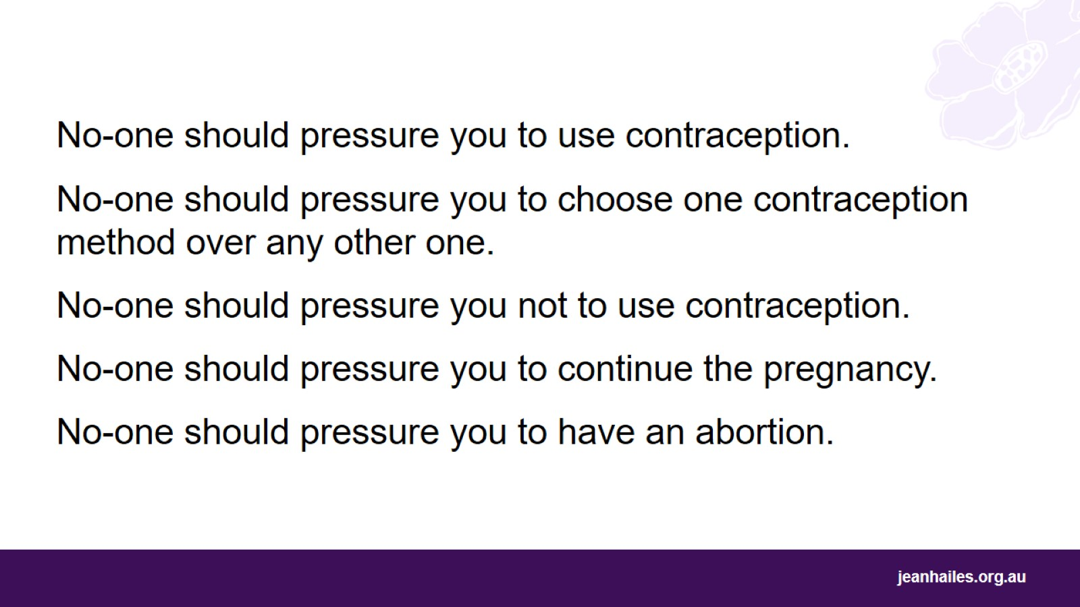
Notes:
No-one should pressure you to use contraception.
No-one should pressure you to choose one contraception method over any other one.
No-one should pressure you not to use contraception at all.
No-one should pressure you to continue the pregnancy.
No-one should pressure you to have an abortion.

Slide 44

Who can help?
Notes:
If you’re experiencing reproductive coercion, or if you’re concerned about your sexual relationship, you can call 1800RESPECT.
1800RESPECT is the national sexual assault and domestic family violence counselling service.
You can call this service at any time - 24 hours a day, 7 days a week.
If English is not your first language and you prefer speaking in your language, you can ask for an interpreter.
The counsellors will listen to your story and provide support that is right for you and your situation.
You can also visit their website 1800respect.org.au for information in different languages and to find support services in your state or territory.
You might also have a friend, family member, community elder or health worker that you trust and ask them for their advice or support.

Slide 45
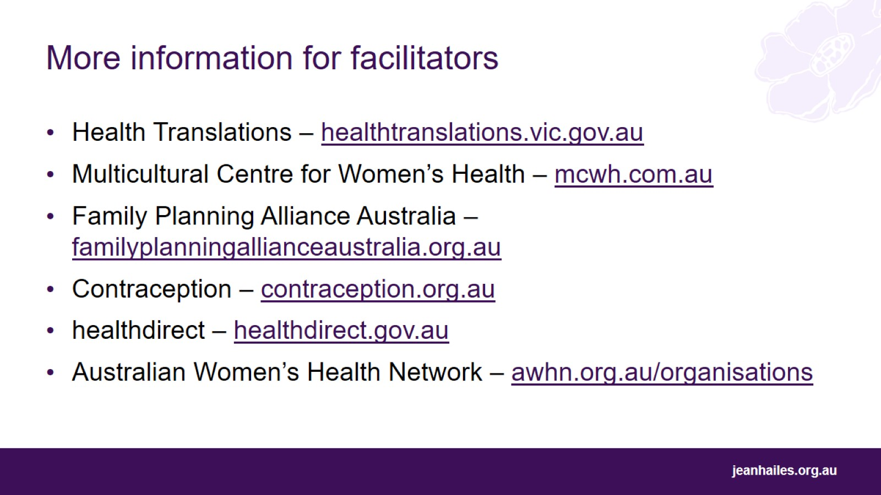
More information for facilitators
Notes:
Here are websites with more information on topics covered in this presentation:
Health Translations – healthtranslations.vic.gov.au – a free online library of translated health and wellbeing information and resources. You can search information by language and by topic.
Multicultural Centre for Women’s Health – mcwh.com.au – a national, community-based organisation, led by and for women from migrant and refugee backgrounds. They have Multilingual Library Catalogue with thousands of resources about women’s health in over 70 languages.
Family Planning Alliance Australia – familyplanningallianceaustralia.org.au – peak body in reproductive and sexual health with services in every state and territory. State-based websites offer information on various topics of sexual and reproductive health, like contraception, unplanned pregnancy, abortion, or respectful relationships.
Contraception – contraception.org.au – a website in English with information on different methods of contraception.
healthdirect – healthdirect.gov.au – Australian Government website with health information on various topics and 24-hours-a-day, 7-days-a-week helpline 1800 022 222.
Australian Women’s Health Network – awhn.org.au/organisations – a website in English with a list of organisations in all states and territories that provide accessible women’s health services.

Slide 46

Local services
Notes:
Note to the facilitator: provide details of local health services and sexual health centres.

Slide 47
