Slide 1
Sex and sexuality

Slide 2
Language
We take a broad and inclusive approach to the topic of women’s health.
We write health information for people with diverse backgrounds, experiences and identities. We use the terms 'women’ and ’girls, but we acknowledge that these terms are not inclusive of all people who may use our content.

Slide 3
Presentation aims
By the end of this presentation, we hope you will:
understand what sexual health and sexuality are, and know some of the things that can impact them
understand the importance of consent in sexual relationships
know about two common sexual problems and what you can do about them.
Notes:
Today we'll be talking about sex and sexuality. By the end of this presentation, we hope you will:
understand what sexual health and sexuality are, and know some of the things that can impact them
understand the importance of consent in sexual relationships, and feel confident talking about it with sexual partners
know about two common sexual problems and what you can do about them.

Slide 4
Sexual health

Slide 5
Sexual health
Sexual health is an important part of your health, wellbeing and quality of life.
It’s not just about physical health – it’s also about emotional, mental and social wellbeing.
Notes:
Sexual health is an important part of your health, wellbeing and quality of life.
It’s not just about physical health – it’s also about emotional, mental and social wellbeing.

Slide 6
Sexuality
Sexuality includes sex, gender identity, sexual orientation, eroticism, pleasure, intimacy and reproduction.
It is experienced and expressed in thoughts, desires, beliefs, attitudes, behaviours, roles and relationships.
Notes:
Sexuality is a broad concept that can be difficult to define.
It includes things like:
sex
gender identity, which means the gender that you most identify with. It may or may not correspond to the gender you were assigned at birth and isn’t necessarily limited to male or female.
sexual orientation, which means who you are attracted to, e.g. same-sex attracted, gay, straight, lesbian, pansexual
eroticism
pleasure
intimacy
reproduction.
Sexuality is experienced and expressed in thoughts, fantasies, desires, beliefs, attitudes, values, behaviours, practices, roles and relationships.

Slide 7
Sexuality influences
Sexuality can be influenced by:
friends and family
culture
media – including movies, TV and pornography
religion.
Notes:
Our sexuality can develop and change over time.
It can be influenced by many factors, including:
our friends and family
culture
religion
media – including movies, tv, pornography and social media.

Slide 8
Impact of pornography
Pornography can include:
gendered stereotypes
scenes showing sex without consent
unrealistic depictions of pleasure.
Pornography is entertainment – it’s not real life.
Notes:
Pornography is more accessible than ever, and it is important to be aware of the impact it can have on our sexuality and our relationships.
Pornography can often include:
gendered stereotypes
scenes showing sex without consent
unrealistic depictions of pleasure.
Remember, pornography is made as entertainment, and is not an accurate representation of most people’s sexual experiences.

Slide 9
Sexual relationships and consent

Slide 10
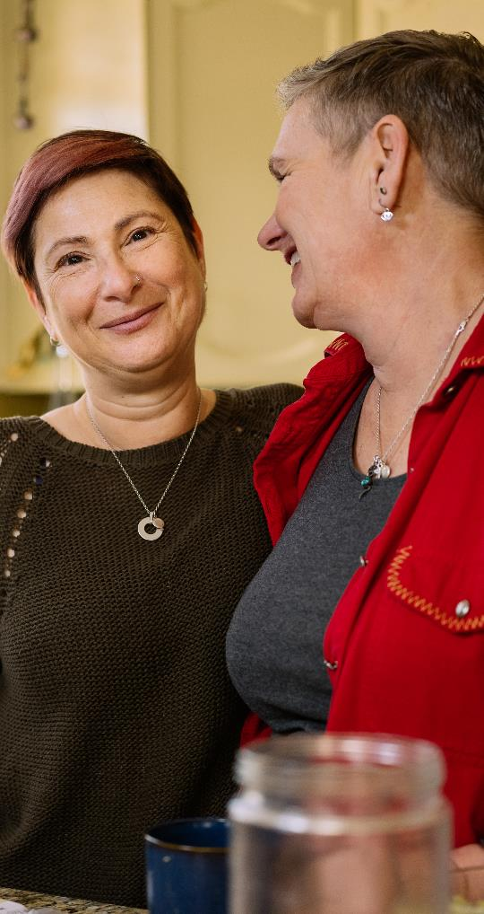
Healthy sexual relationships
Healthy sexual relationships involve:
respect
open communication
consent
safety.
Notes:
All sexual relationships are different.
You might have one sexual partner, you might have many, or you might have no sexual partners.
The most important thing is that your sexual relationships are based on mutual:
respect – accepting your partner for who they are, including their likes, dislikes, and boundaries
open communication – being able to speak freely with your partner about your thoughts, feelings, needs, and preferences
consent – voluntarily agreeing to have sex or do sexual things like kissing or touching (we will talk more about consent on the next slides)
safety – you should never be made to feel scared in a sexual relationship, and you should be able to freely access sexual and reproductive health services.

Slide 11
Consent
Consent means agreeing freely and happily to participate in a sexual activity with another person or people.
You and your sexual partner(s) need to agree to have sex or do sexual things.
Consent is more complicated than ‘yes means yes’ and ‘no means no’.
Sex without consent is sexual violence and is not okay.
Notes:
What is consent?
In the context of sex, consent means agreeing freely and happily to participate in a sexual activity with another person or people.
Consent must be mutual, meaning that both you and your sexual partner(s) need to agree to have sex or do sexual things.
Consent is more complicated than simply ‘yes means yes’, and ‘no means no’. For example:
Consent must be given voluntarily. If you say yes to sex, but you feel pressured or feel that something bad might happen if you say no, that is not consent.
Consent must be informed, which means you understand what you are consenting to.
Consent is specific. If you say yes to one thing, but then your sexual partner starts doing something else, that is not consent.
Consent needs to be given when you are sober. If you are drunk or high, you may not be able to give consent. If you are unconscious or asleep you cannot give consent.
Consent is reversible. you can say yes to sex, and then change your mind and say no. It doesn’t matter what you’re doing, or how turned on your partner is.
Finally, consent should be enthusiastic, i.e. you and your partner should be genuinely excited about having sex.
Sex without consent is sexual violence and is not okay.

Slide 12
Consent is important every time you have sex.
Notes:
Remember, consent is important every time you have sex.
It doesn’t matter if it’s the first time you’re having sex or doing sexual things with someone, or the 100th time – consent is always important.
Even if you’re married or in a long-term relationship, consent is still important – every time.

Slide 13
Making sure you have consent
Ask questions like, 'Where do you want me to touch you?', 'How does that feel?', 'What do you want to do?’.
Pay attention to verbal and non-verbal cues.
Stop if you are unsure.
Notes:
There are ways that you and your sexual partner(s) can make sure you have each other’s consent for sex. Some of these include:
checking in with your partner during sex with questions like, 'Where do you want me to touch you?', 'How does that feel?' and 'What do you want to do?'
paying attention to verbal and non-verbal cues such as body language – if your partner is silent, passive or seems upset, these could all be signs that they are not consenting to sex
if you’re not sure if your sexual partner is consenting, you should stop.

Slide 14
Who can you talk to?
1800 RESPECT (1800 737 732) is the national sexual assault and domestic family violence counselling service.
You can call the service 24 hours a day, 7 days a week.
The counsellors can listen to your story and provide support that is right for you.
Notes:
If you are concerned that someone has had sex or done sexual things to you without your consent, or if you are concerned about your sexual relationship, you can call 1800 RESPECT.
1800 RESPECT is the national sexual assault and domestic family violence counselling service.
You can call them 24 hours a day, 7 days a week.
They can listen to your story and provide support that is right for you and your circumstances.
You might also have a supportive and trusted friend, family member or health professional that you feel comfortable talking to.

Slide 15
Sexual pleasure and what can influence it

Slide 16
Sexual pleasure
Having pleasurable sexual experiences is an important part of sexual health.
You can have a more fulfilling sex life by:
getting to know your body
talking to your sexual partners about what feels good
making time for sex
getting professional help for sexual problems.
Notes:
The possibility of having pleasurable sexual experiences is an important part of sexual health. Some ways to have a more fulfilling sex life include:
get to know yourself – exploring what feels good for your body through touch and masturbation
talk with sexual partners about what feels good for you
make time for sex – we live busy lives, and it can be easy to feel like you don’t have time for sex
if you have sexual problems, talk to your doctor or sexual health service.

Slide 17
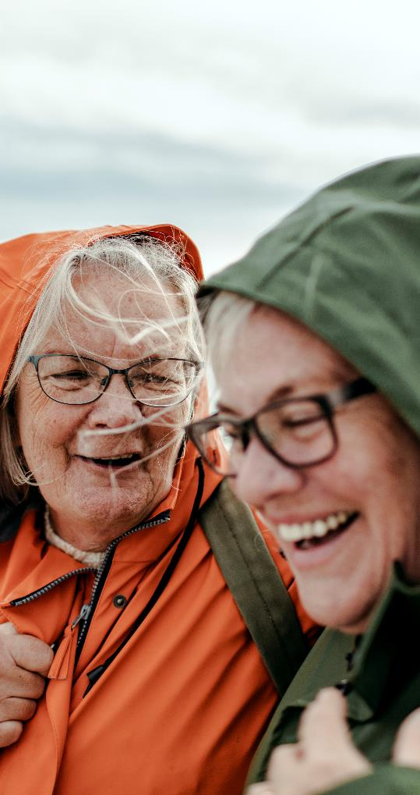
Sex across your lifetime
It is normal for your sex life to change over time.
Your sex life can be influenced by things like:
hormones
mood
desire
partners and sexual relationships
home environment
caring responsibilities.
Notes:
It is normal for your sex life, including your desire to have sex, to change throughout your life.
Many things can influence your sex life. Some of these things are:
hormonal changes due to childbirth and menopause, which can cause symptoms such as lowered desire and dry vagina
your mood
desire
your partner(s)
your satisfaction with sexual relationships
your home environment and caring responsibilities for young children, elderly parents or others
stress
sleep
your physical health
some medications.

Slide 18
Sexual problems
Many women have worries or concerns about sex.
Notes:
Worries or concerns about sex, and sexual problems, are common among women.
If you have worries or concerns about sex, talk to your doctor.
Two common sexual problems are discussed in the next slides.

Slide 19
Low libido
Libido is also known as 'sexual desire' or 'sex drive'.
All women can experience low libido, although it becomes more common as women get older.
Low libido is a problem if it causes you worry or concern.
Notes:
Libido is also known as 'sexual desire' or 'sex drive'.
Low libido can occur at any age, although it becomes more common with older age.
It is not a problem in itself. It is a problem only if it causes you distress, worry or concern.
It can also be a problem if you are in a relationship and your level of desire does not match your partner’s. This can be challenging for couples and can cause relationship issues, distress, worry and concern.

Slide 20
Low libido – what can you do?
If low libido causes you worry or concern, there are treatments available.
Your doctor can help you identify the cause and recommend appropriate treatment or therapy.
Notes:
If you have low libido that is causing you worry or distress, there are treatments available.
Your doctor can help you to identify the cause of your low libido and recommend appropriate treatment.
For example, if your low libido is caused by relationship issues, your doctor might refer you to a relationship therapist.

Slide 21
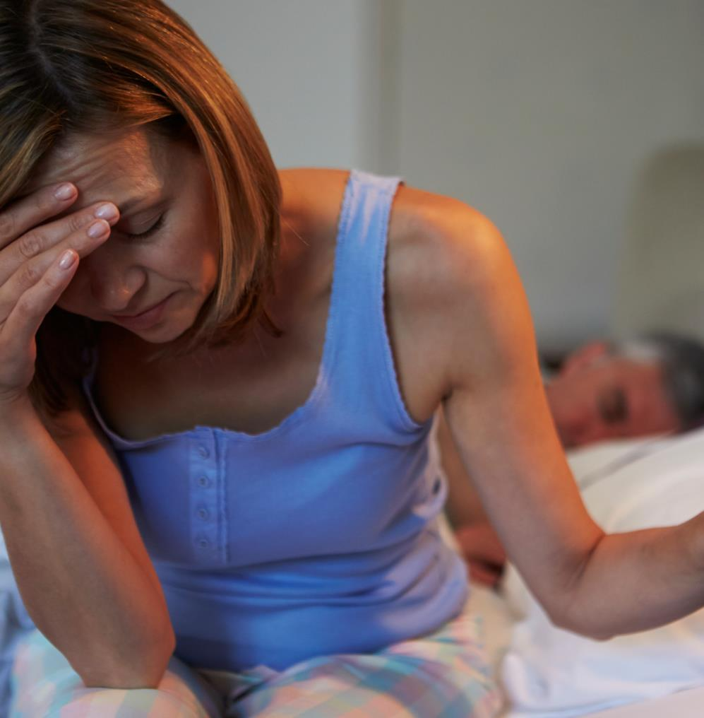
Painful sex
Painful sex means pain before, during or after vaginal sex.
It can affect all women.
Notes:
Painful sex means pain before, during or after vaginal sex.
Painful sex can affect all women, but is more common in young women, women who have recently given birth, and menopausal and postmenopausal women.

Slide 22
Painful sex – what can you do?
Painful sex can have lots of different causes. For example:
hormone changes after childbirth or around menopause
inflammation or infection
conditions such as endometriosis.
If you have painful sex, talk to your doctor. They can help find the cause and recommend the best treatment.
Notes:
Painful sex can have lots of different causes. For example:
hormone changes after childbirth or menopause causing vaginal dryness which can make sex painful
inflammation or infection
conditions such as endometriosis.
Your doctor can help you to identify the cause and recommend appropriate treatment.
Depending on the type of pain and its cause, treatments may include:
treating the underlying condition
medication
hormonal treatment such as oestrogen cream
using a lubricant when having sex
pelvic floor physiotherapy to help relax or strengthen your pelvic floor muscles
relaxation skills.

Slide 23
More information and resources on sexual health
Jean Hailes for Women’s Health jeanhailes.org.au/health-a-z
Family Planning Alliance Australia familyplanningallianceaustralia.org.au

Slide 24
Thank you
Go to jeanhailes.org.au/subscribe for updates on the latest in women’s health

Slide 25
For further information
For further information contact
Jean Hailes for Women’s Health PO Box 24098 Melbourne VIC 3001
Phone 03 9453 8999
Email education@jeanhailes.org.au
Website jeanhailes.org.au
Disclaimer. This information does not replace medical advice. If a person is worried about their health, they should talk to their doctor or healthcare team.
© 2024 Jean Hailes Foundation. All rights reserved. This publication may not be reproduced in whole or in part by any means without written permission of the copyright owner. Email licensing@jeanhailes.org.au for more information.
Updated January 2024

