Slide 1

Health checks

Slide 2
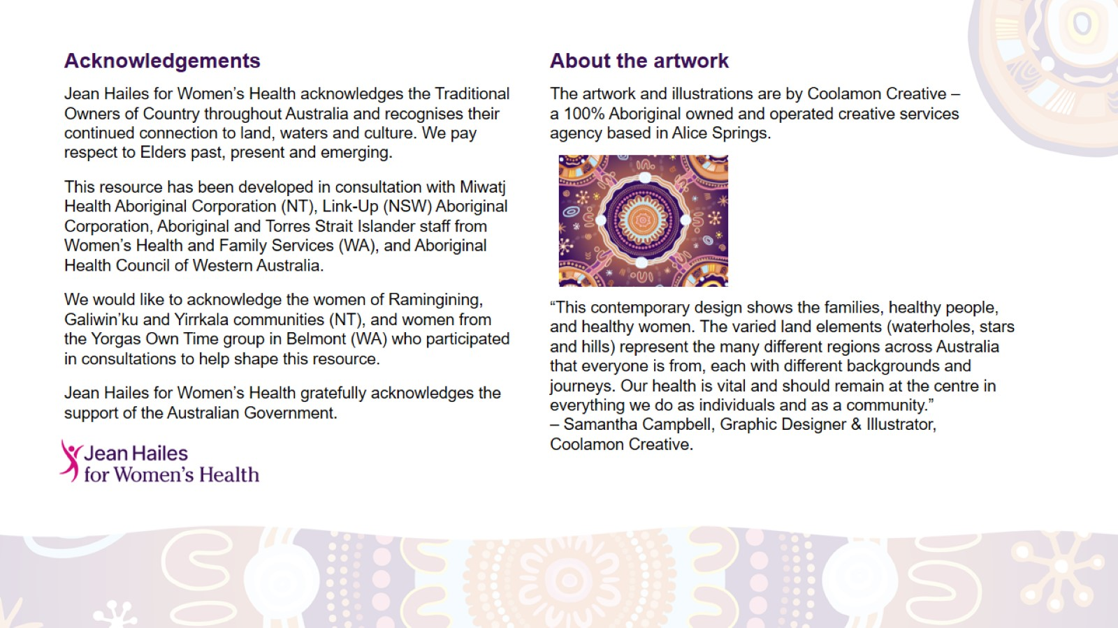
Acknowledgements

Slide 3
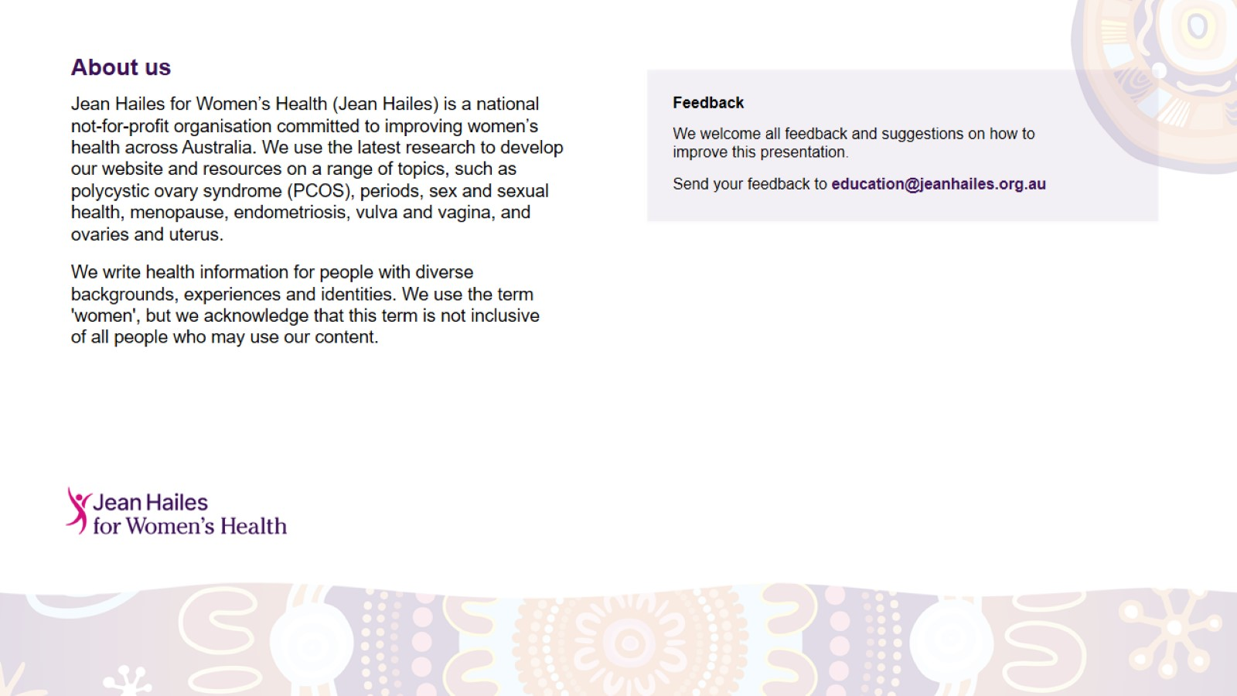
About us

Slide 4
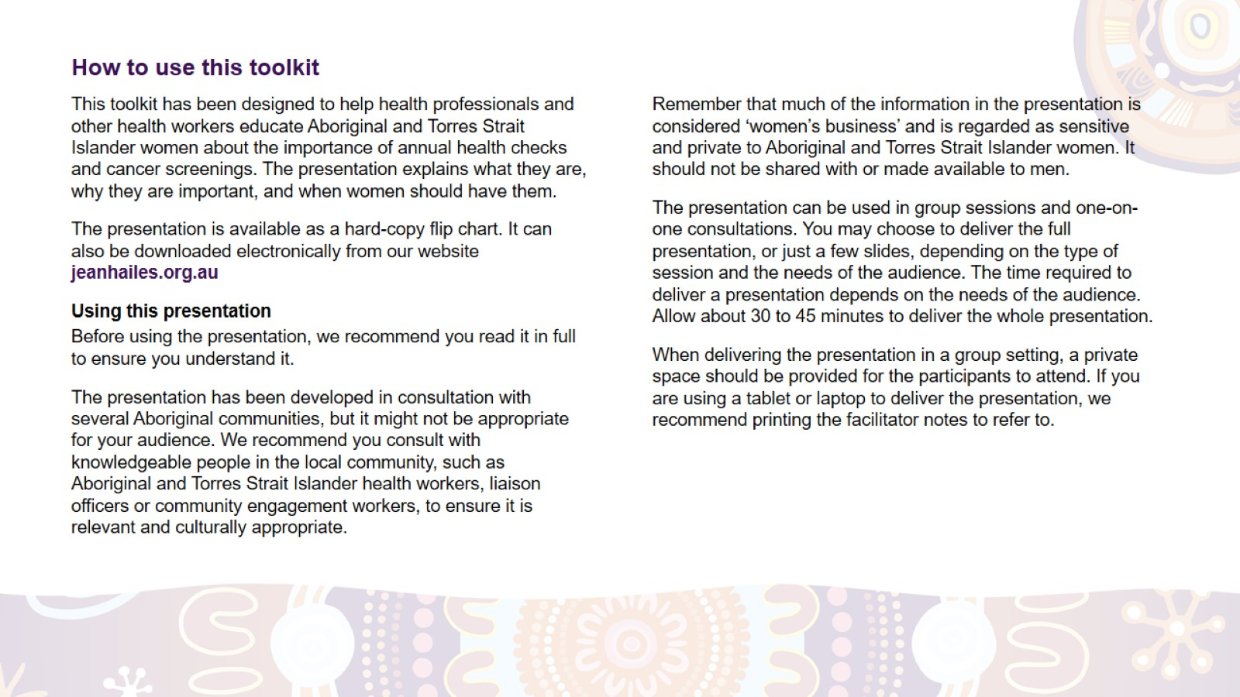
How to use this toolkit

Slide 5
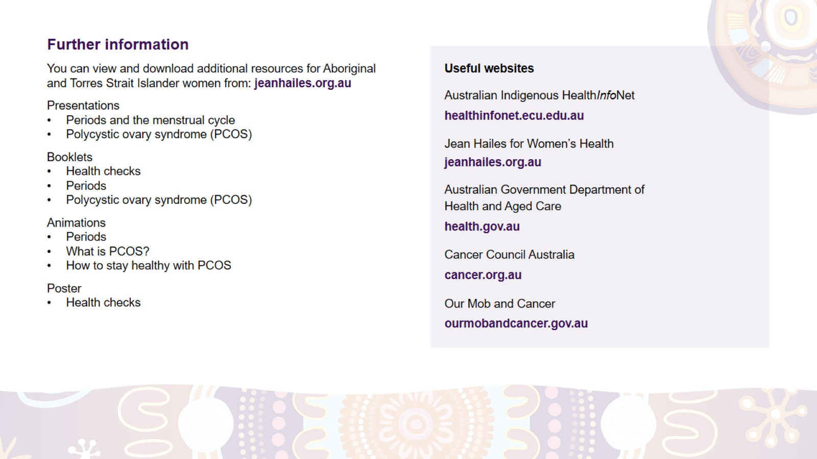
Further information

Slide 6
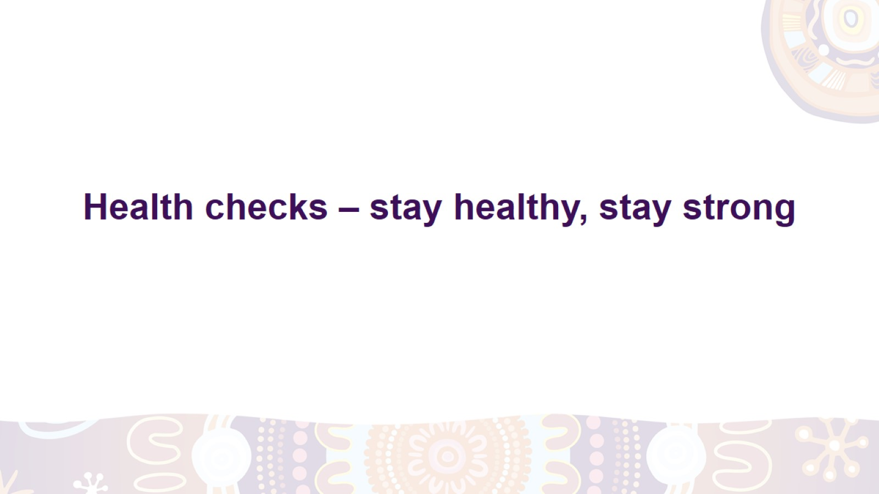
Health checks – stay healthy, stay strong
Notes:
Today we will be talking about annual health checks and cancer screening tests:
what they are
why you need them
when you need to have them
how to get ready for them.

Slide 7
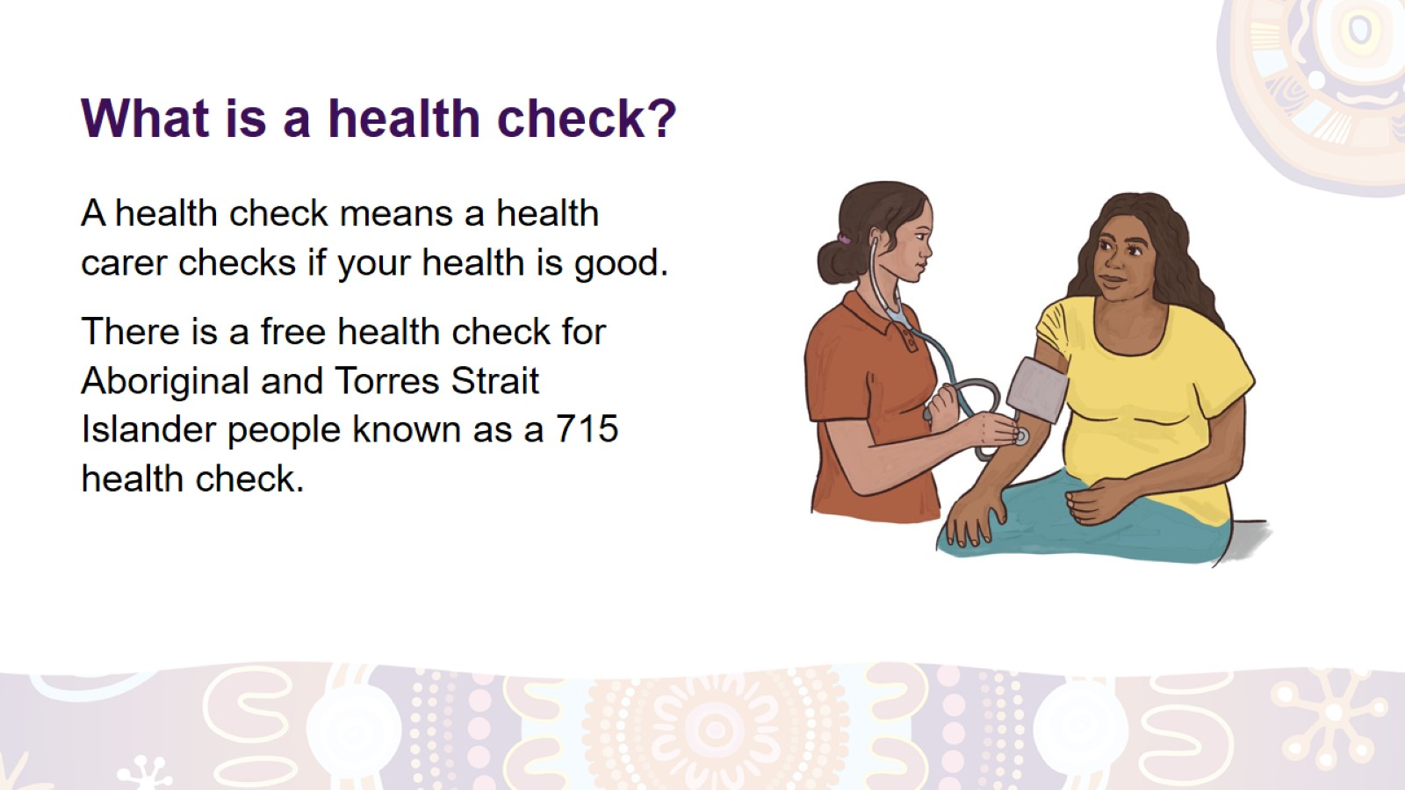
What is a health check?
Notes:
What is a health check?
A health check is when a health carer checks your overall health. The health carer could be a doctor, nurse or Aboriginal and Torres Strait Islander Health Worker or Practitioner.
At the health check, the health carer will ask you about your health and lifestyle. They might do some tests using special tools or equipment.
What is a 715 health check?
It’s a free health check specifically designed for Aboriginal and Torres Strait Islander people of all ages. You can get this health check for free once a year at your local clinic.

Slide 8
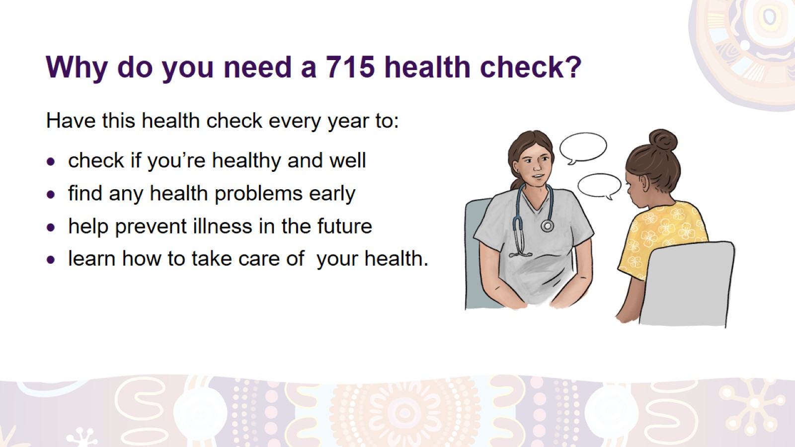
Why do you need a 715 health check?
Notes:
Why do you need a 715 health check?
Have a health check to:
check if you’re healthy and well
find any health problems early and get treatment
help prevent illness in the future
check if you’re getting the right medication and care (if you’re sick or have a chronic condition)
get information on how to stay well (e.g. what exercise to do and what foods to eat)
ask a health carer any questions about your health.
How often do you need to have a 715 health check?
Have a health check once a year even if you feel healthy and strong. You might need to have them more often if you have a chronic disease, like diabetes or heart or kidney disease.
When you have regular health checks, you can find out about health problems sooner, before they get worse, and get the right help.

Slide 9
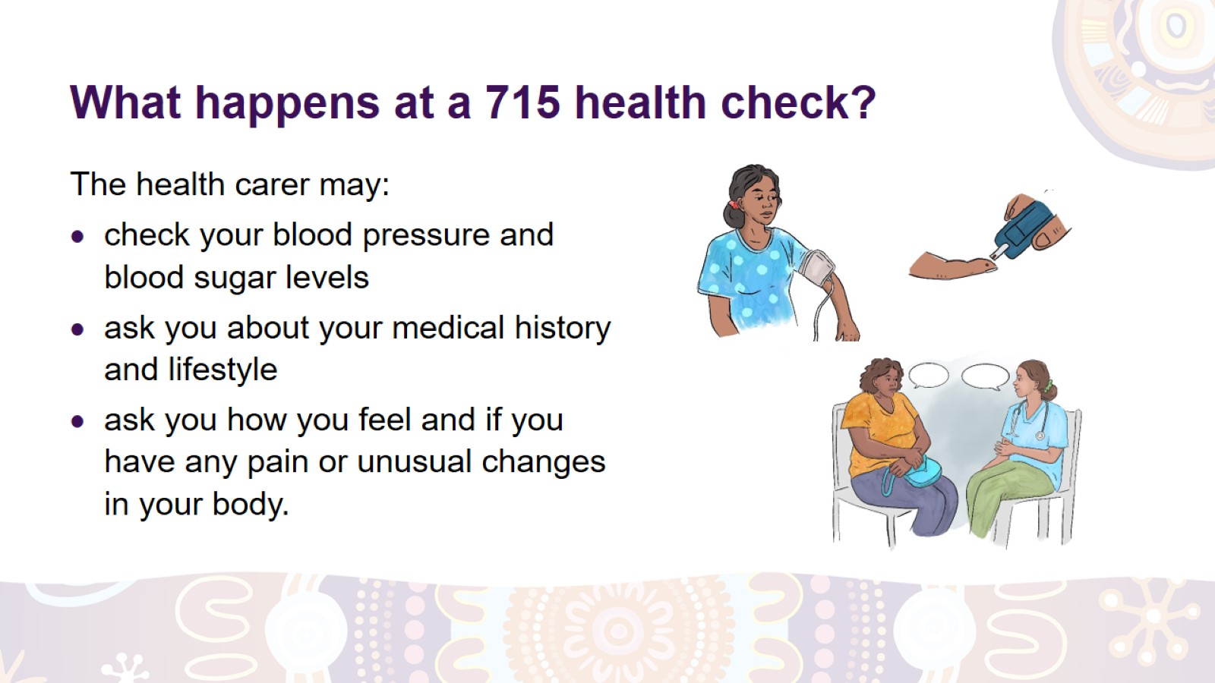
What happens at a 715 health check?
Notes:
What happens at a 715 health check?
At the health check, the health carer might check your blood pressure, blood sugar levels, height and weight. They may check if your heart and kidneys are strong and healthy.
They will also talk to you about:
any illness or treatment you have or had in the past (it’s called ‘medical history’)
the health of your close family members – if they have or had a chronic disease or health problem, like a heart attack, diabetes, kidney disease, cancer or depression
any pain or unusual changes in your body
how you are feeling (e.g. if you’ve been sad or worried for some time)
what you eat, how much you exercise or move during a day, and if you smoke or drink alcohol
how to look after your health.
It’s important to tell the health carer anything that worries you about your health. They will not judge you. It’s safe to share your medical history and lifestyle with them so you can get the best care possible.
The health carer may also suggest other tests or services to help you (for example, for your heart, vision or mental health).

Slide 10
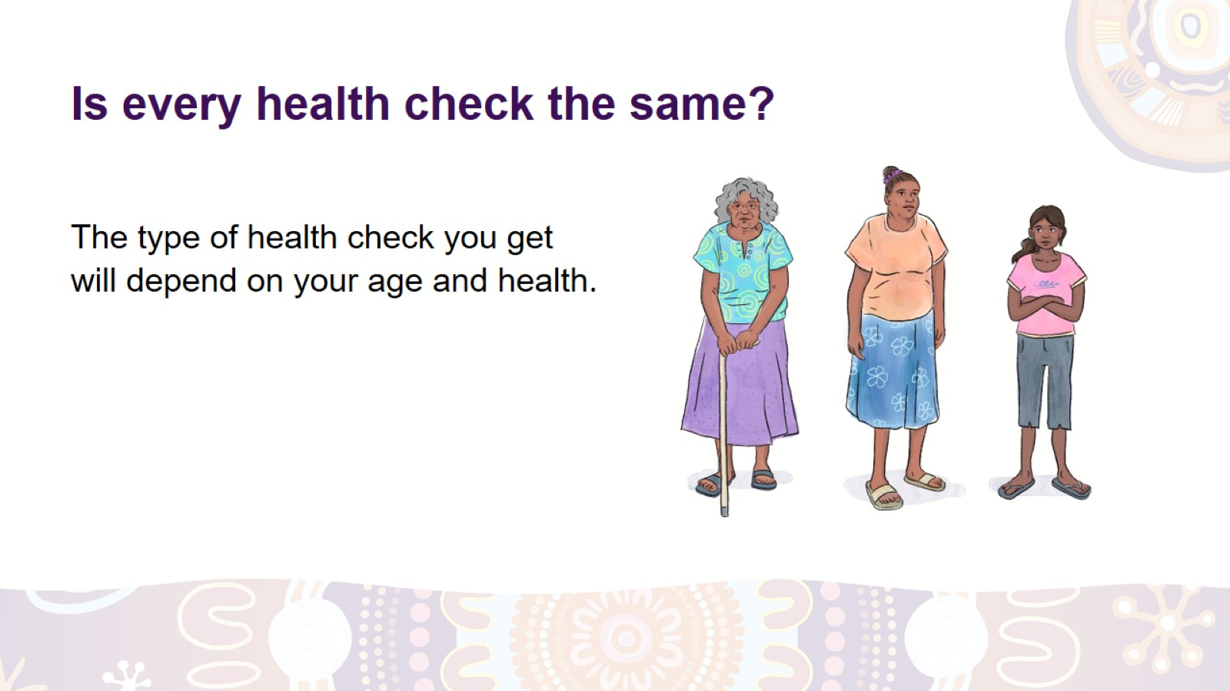
Is every health check the same?
Notes:
Is every health check the same?
No. The type of health check you get will depend on your age, health and risk of developing a chronic disease.
Some important tests you might have at your health check are:
blood pressure and heart health check
blood tests for cholesterol, diabetes and kidney disease.
Most of these tests start from the age of 18 and are usually done every 1 to 5 years.
A health carer will tell you what tests you need.

Slide 11
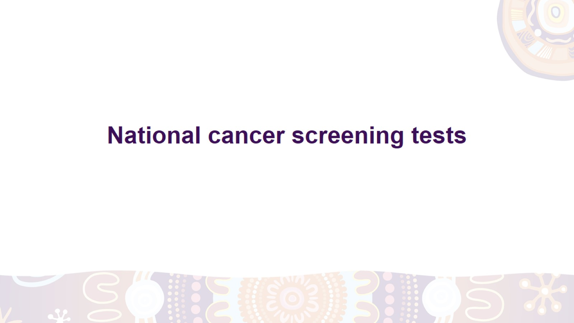
National cancer screening tests

Slide 12
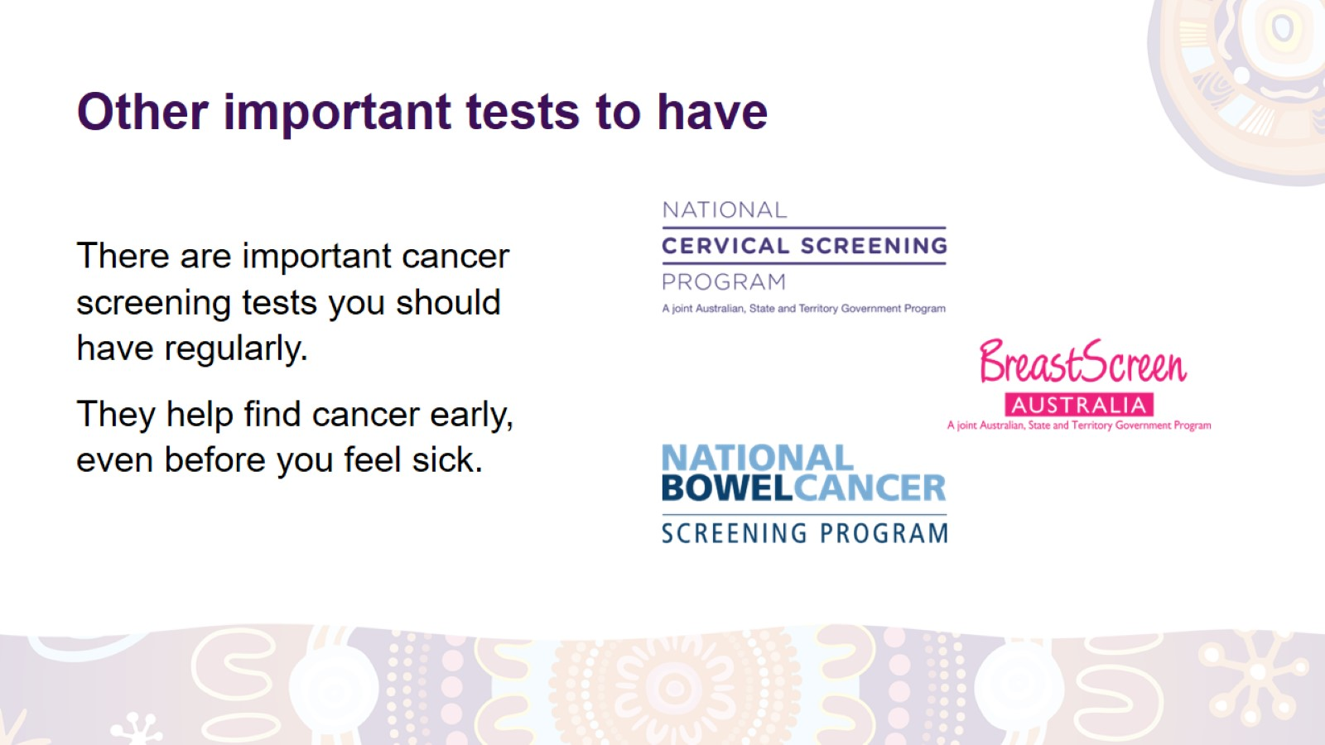
Other important tests to have
Notes:
Are there any other important tests to have?
Apart from your 715 health checks, there are other important tests you should have regularly. These tests help find cancer early, even before you feel sick.
The three national cancer screening tests for women are:
cervical screening test for women 25 to74 years old
breast screen for women 50 to 74 years old
bowel cancer screening test for people 50 to 74 years old.

Slide 13
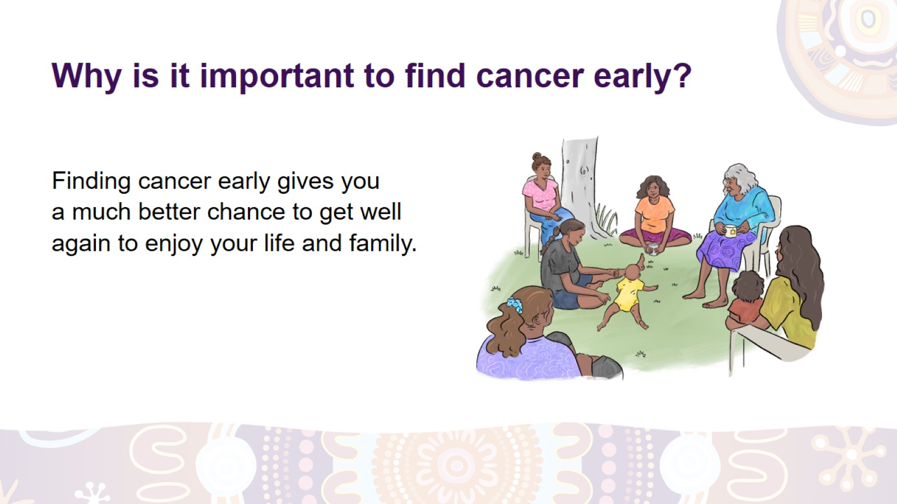
Why is it important to find cancer early?
Notes:
Why is it important to find cancer early?
If cancer is found early, it will be smaller and easier to treat. This way, you’ll have a better chance to get strong and healthy again to enjoy your life and family.
Do the cancer screening tests regularly to find cancer early.

Slide 14


Slide 15
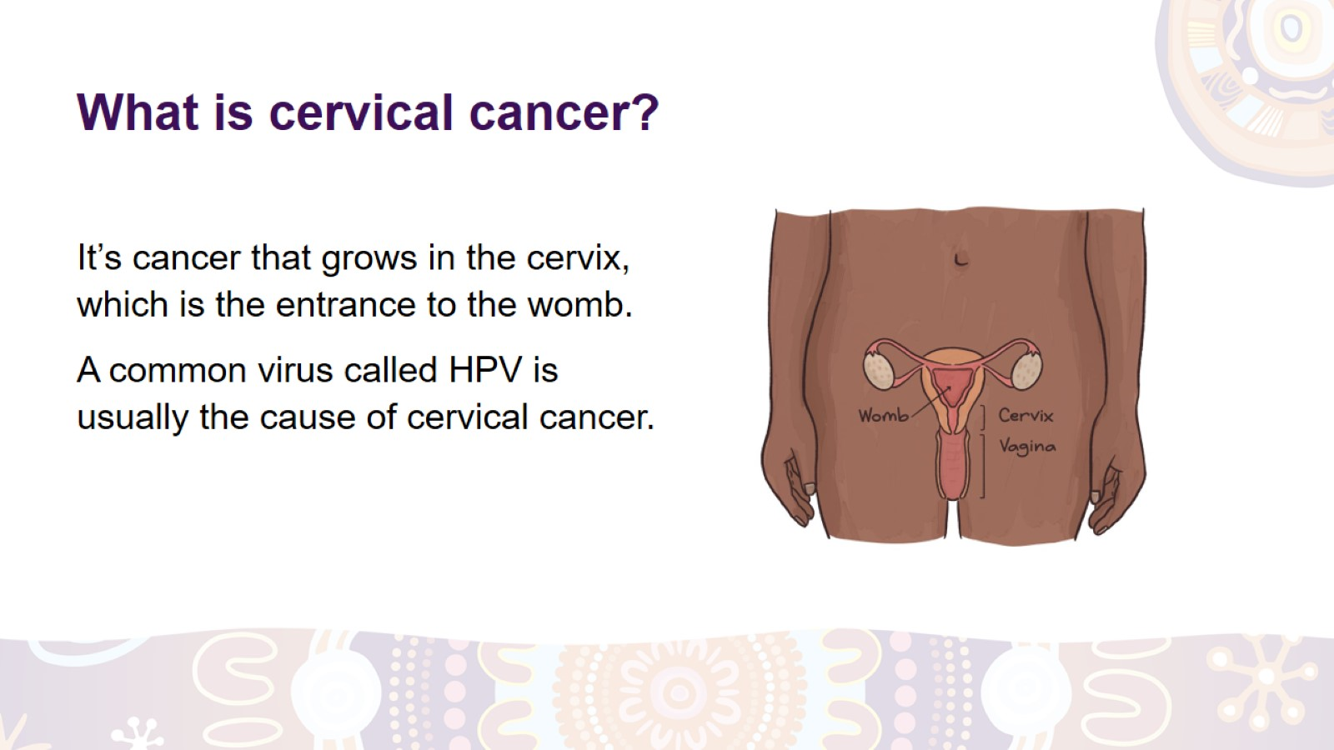
What is cervical cancer?
Notes:
What is cervical cancer?
It’s cancer that grows in the cervix, which is the entrance to the womb.* It’s one of the easiest types of cancer to prevent.
What causes cervical cancer?
A common virus called HPV can cause cervical cancer.
You can get HPV from someone during sex.
An HPV vaccine is available for people aged 9 to 25. Children aged 12 and 13 can get the vaccine for free through their schools. Talk to a health carer for more information about this vaccine.
*Note to the facilitator: Refer to the image.

Slide 16
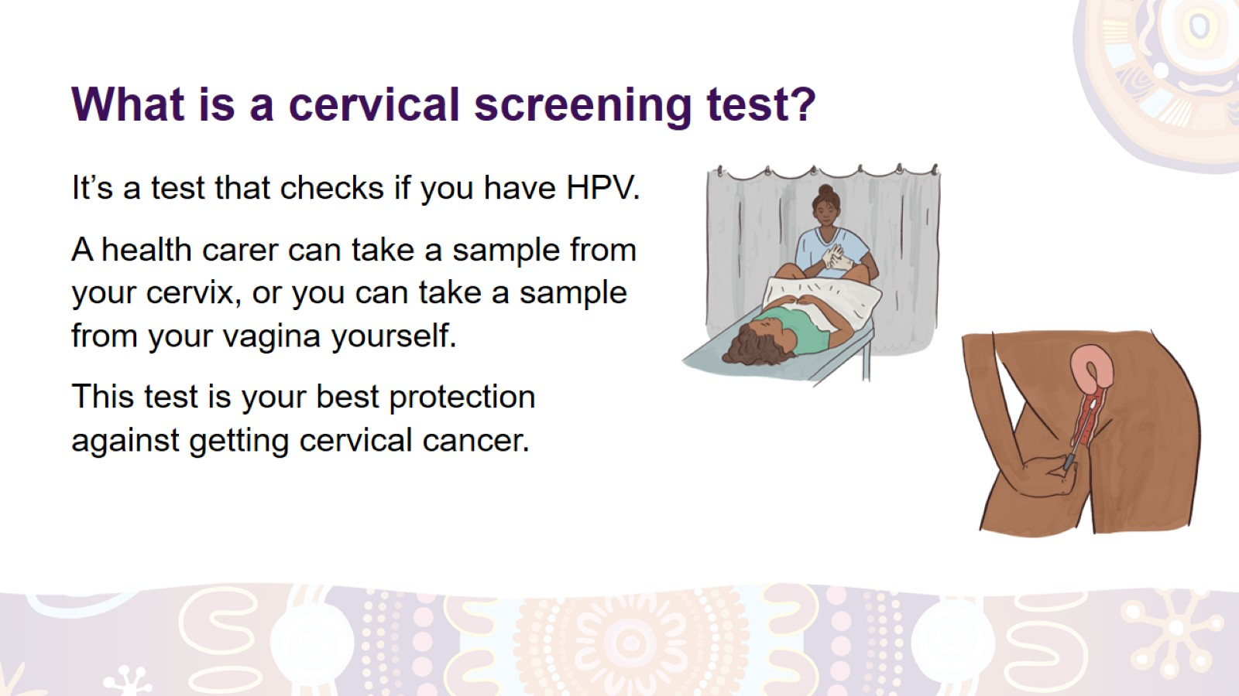
What is a cervical screening test?
Notes:
What is a cervical screening test?
A cervical screening test checks if you have HPV.
A health carer will gently take a sample of cells from your cervix with a swab. This will be quick and shouldn’t hurt.
If you prefer, you can take a sample from your vagina yourself, in a private space. Ask the health carer if it’s an option for you and how to do it.*
Your cell sample is then sent to a laboratory for testing.
The health carer will talk to you about your results.
If you have this test regularly, it’s your best protection against getting cervical cancer.
*Note to the facilitator: Consider printing the ‘How to collect your own sample’ brochure for the participants, using the following link – www.health.gov.au/NCSP-First-Nations

Slide 17
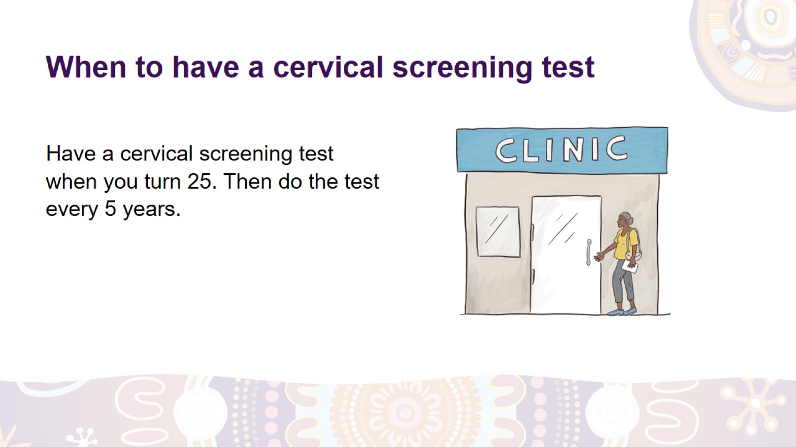
When to have a cervical screening test
Notes:
When to have a cervical screening test.
If you have a cervix, have ever had sex and are between 25 and 74 years old, have a cervical screening test every 5 years.
If you don’t know when you need to have your next test, ask a health carer.
Where can you have this test?*
You can have this test at:
your local clinic
a family planning clinic
a sexual health clinic.
Having a cervical screening test every 5 years can save your life.
*Note to the facilitator: Give examples of the local clinics and centres where women can have this test.

Slide 18
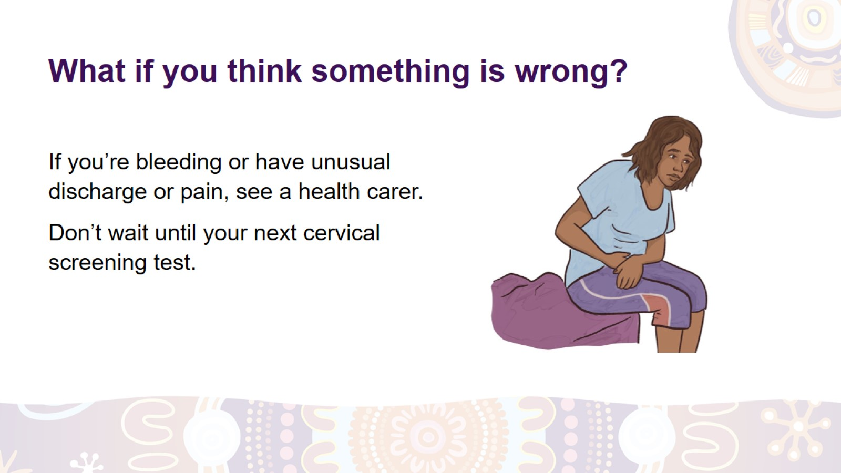
What if you think something is wrong?
Notes:
What if you think something is wrong?
If something is happening with your body that is not normal for you, like:
unusual bleeding from your vagina
unusual discharge (liquid) from your vagina
pain in your vagina or lower belly
pain during or after having sex,
you need to see a health carer as soon as you can.
Don’t wait until your next cervical screening test.

Slide 19


Slide 20
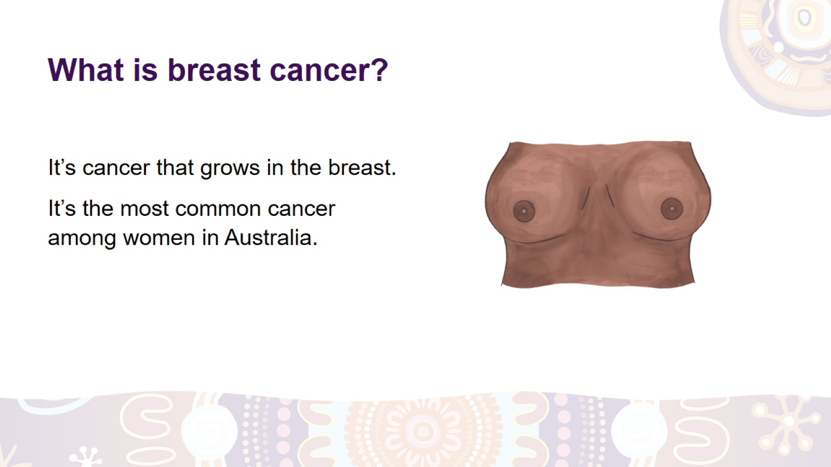
What is breast cancer?
Notes:
What is breast cancer?
It’s cancer that grows in the breast.
It’s the most common cancer among women in Australia.
It can develop at any age but is more common in women aged 50 and over.

Slide 21
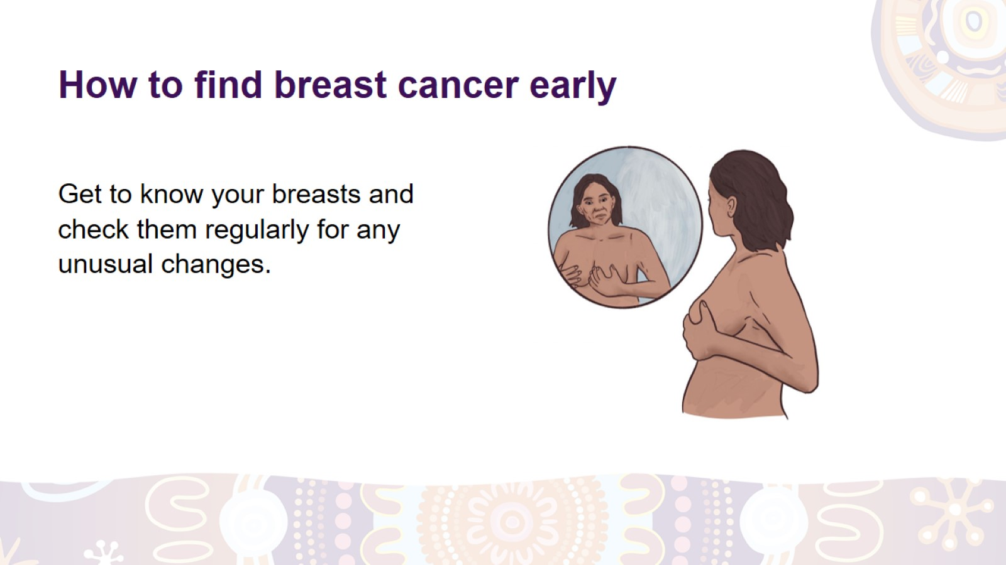
How to find breast cancer early
Notes:
What can you do to find breast cancer early?
To find cancer early:
Get to know your breasts well so you can notice if there is a change in either of them.
Look at your breasts (in the mirror if possible) and feel them to learn what they normally look and feel like.
Check your breasts regularly for any changes in them.

Slide 22
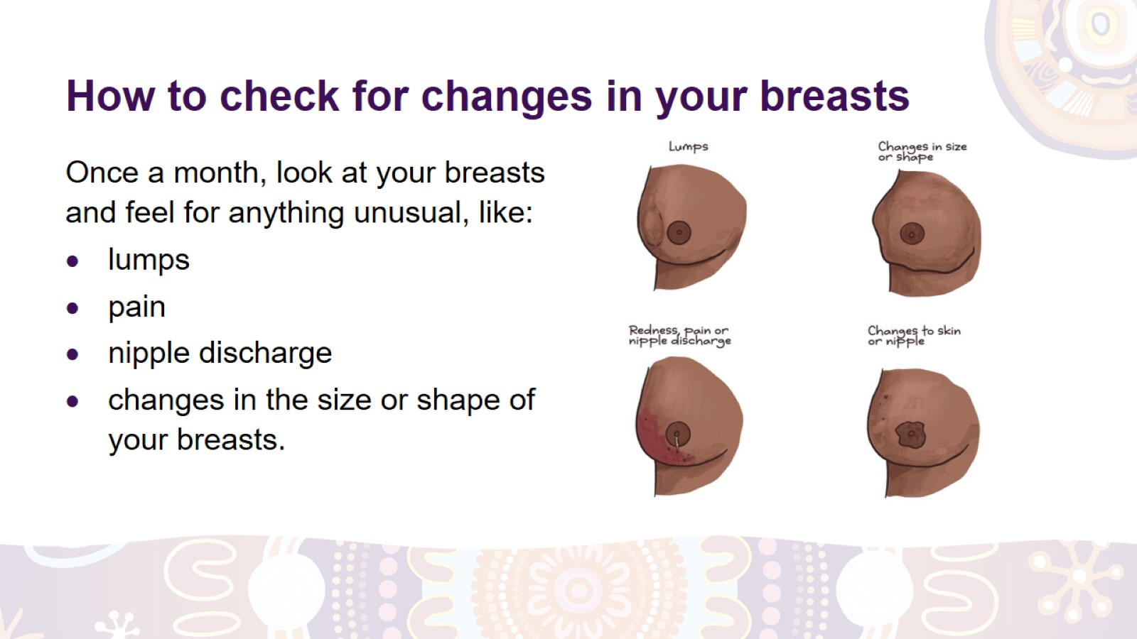
How to check for changes in your breasts
Notes:
How to check for changes in your breasts.
Check your breasts once a month (e.g. when showering, getting dressed or lying down).
Look at the shape, colour and size of your breasts.
Feel your breasts from your collarbone to below the bra line and under your armpits.
Watch out for:
lumps or thickening
redness
pain
nipple discharge
changes in the size or shape, especially of only one breast
changes to the skin or nipple.
There is no right or wrong way to check your breasts – find a way that works for you and do it regularly.
Most changes in the breast are not breast cancer. But if you notice any change, have it checked by a health carer as soon as possible.

Slide 23
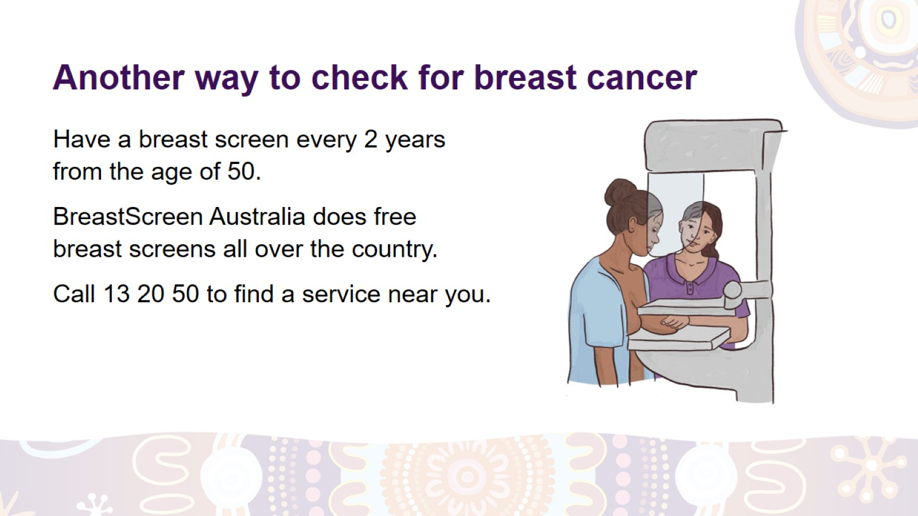
Another way to check for breast cancer
Notes:
How else to check for breast cancer?
Another way to find changes in the breast early is to have a breast screen.
What is a breast screen?
A breast screen is a photo of the inside of your breasts. It shows changes that are too small to feel or see.
When to have a breast screen
Have a breast screen every 2 years between the ages of 50 and 74.
If you’re younger than 50 or older than 74, ask a health carer if a breast screen is right for you.
Where to have a breast screen
BreastScreen Australia provides free breast screens in all states and territories for women with no breast symptoms. Breast screens in rural and remote areas are done by mobile screening vans.
Call 13 20 50 to find a BreastScreen service near you and to book your appointment.

Slide 24


Slide 25
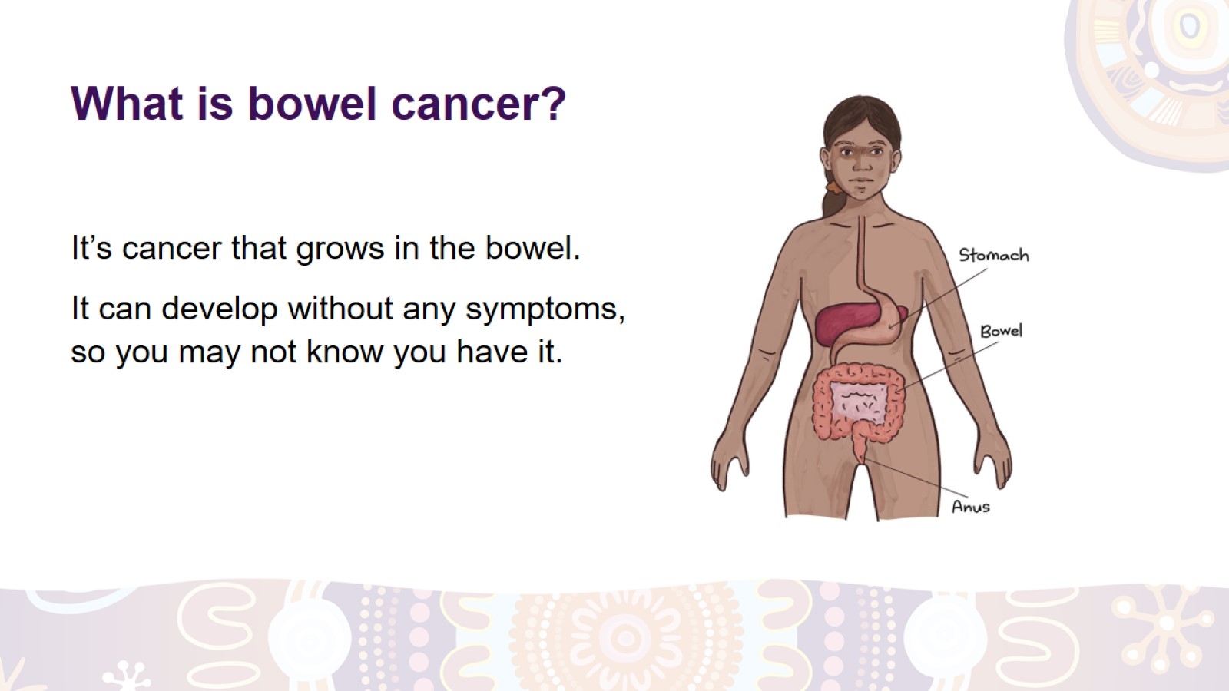
What is bowel cancer?
Notes:
What is the bowel?
The bowel is part of your digestive system*. It’s the tube in your tummy that takes the food from your stomach through to your anus (where you poo from).
What is bowel cancer?
It’s cancer that grows in the bowel. Unfortunately, it often develops without any symptoms.
*Note to the facilitator: Use the image if you want to briefly explain the digestive system.

Slide 26
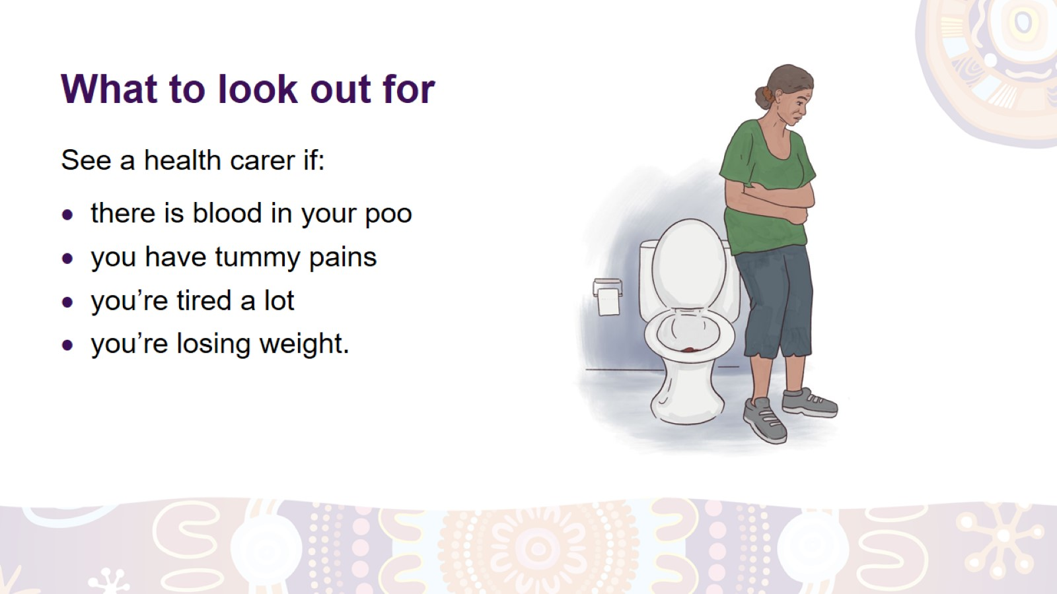
What to look out for
Notes:
What to look out for.
Even though bowel cancer usually has no symptoms at the beginning, you should look out for these changes:
There is blood in your poo.
Your poo has become different from what it normally is (e.g. it’s harder, looser or has a different shape).
You’re having tummy pain, bloating or cramping.
You can feel pain or a lump in your anus.
You’re tired a lot and you don’t know why.
You’re losing weight and you don’t know why.
If you notice any of these changes, it doesn’t mean you have bowel cancer, but you should see a health carer as soon as possible.

Slide 27
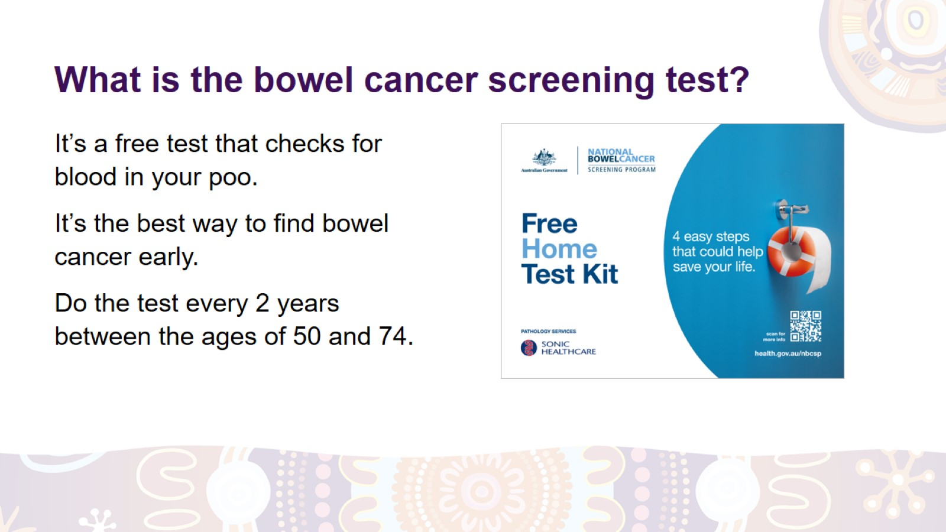
What is the bowel cancer screening test?
Notes:
What is the bowel cancer screening test?
It’s a free test that checks for blood in your poo, which can be an early sign of bowel cancer.
This test is the best way to find bowel cancer early.
Do the test every 2 years between the ages of 50 and 74.

Slide 28
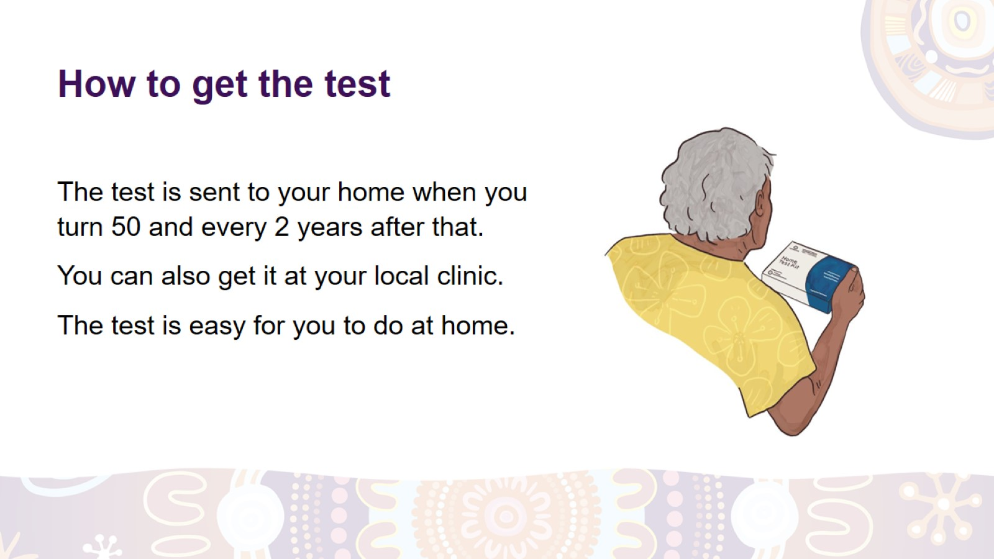
How to get the test
Notes:
How to get the bowel cancer screening test.
The test is sent to your home address when you turn 50 and every 2 years after that if you’re registered with Medicare.
If you don’t get the test, ask your local clinic for one or call the National Bowel Cancer Screening Program on 1800 627 701.
How will you know how to do the test?
The test is easy for you to do at home. It comes with instructions that show you exactly what to do. You can also ask a health carer how to do the test.
Usually, the results are sent to you within four weeks after doing the test.

Slide 29
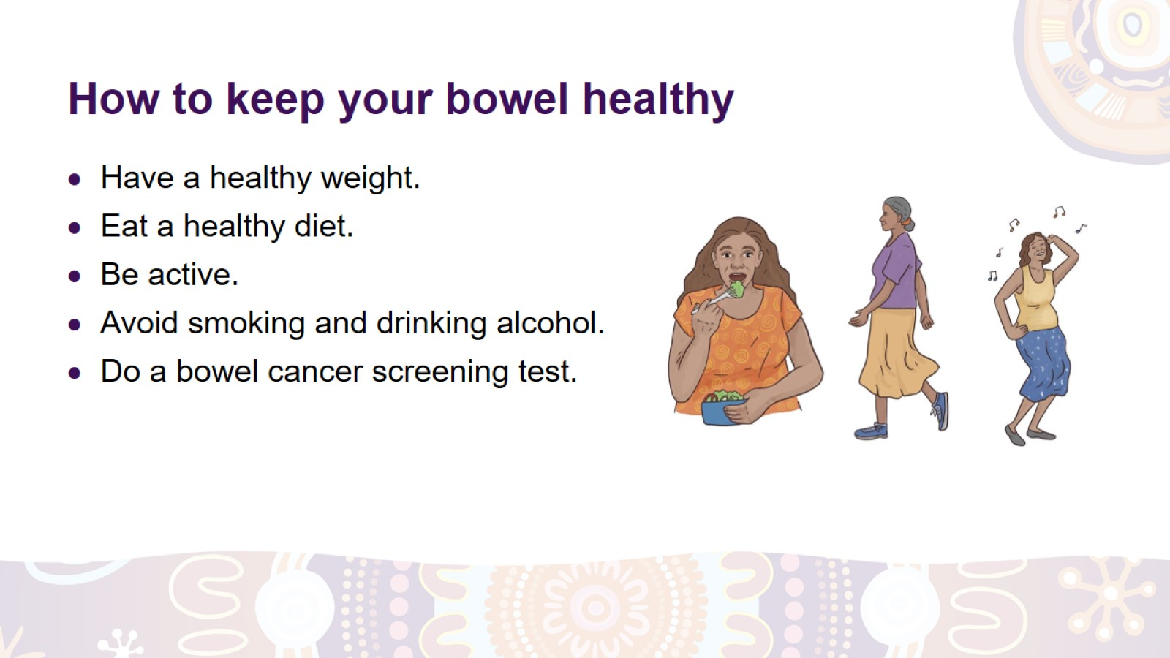
How to keep your bowel healthy
Notes:
How to keep your bowel healthy.
Have a healthy weight.
Eat a healthy diet (like bush tucker) – more vegetables, fruit and wholegrains, less red meat and processed foods – and avoid sugary drinks.
Drink plenty of water.
Be physically active – move, walk, dance.
Avoid smoking and drinking alcohol ­– a health carer can tell you how to quit smoking and drink less alcohol.
Do a bowel cancer screening test.

Slide 30
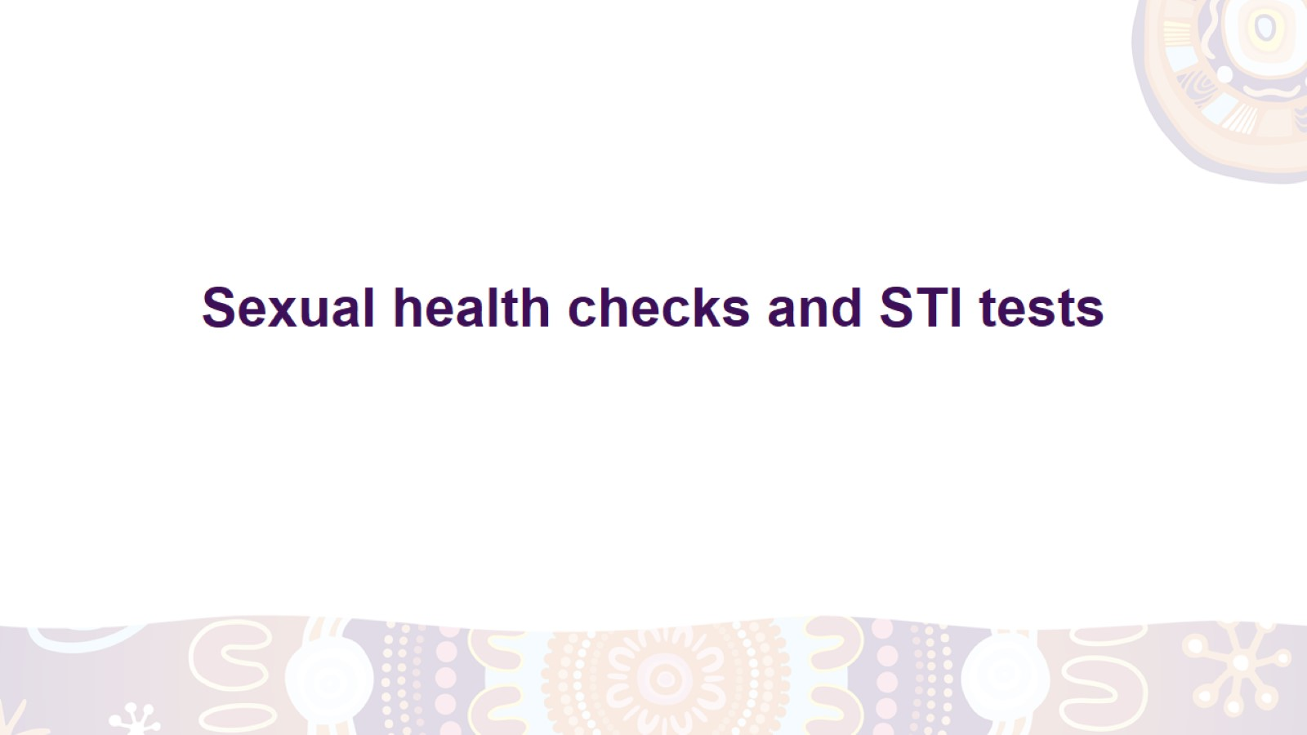
Sexual health checks and STI tests

Slide 31
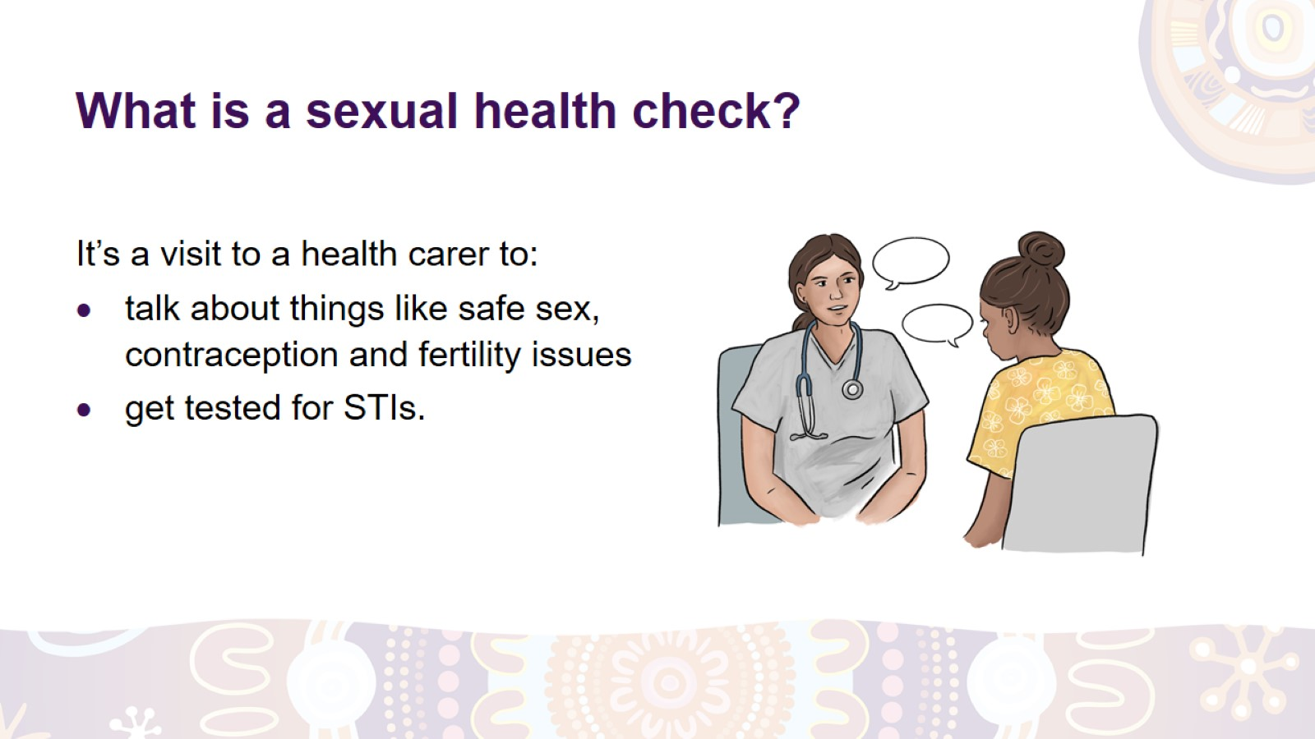
What is a sexual health check?
Notes:
What is a sexual health check?
A sexual health check is a visit to a health carer to:
talk about safe sex – how to protect yourself against sexually transmitted infections (STIs)
talk about contraception and your right to decide if you do or don’t want to get pregnant
talk about your rights when you’re in a relationship with someone
talk about fertility
get a cervical screening test if you’re due for one
have a test for STIs.

Slide 32
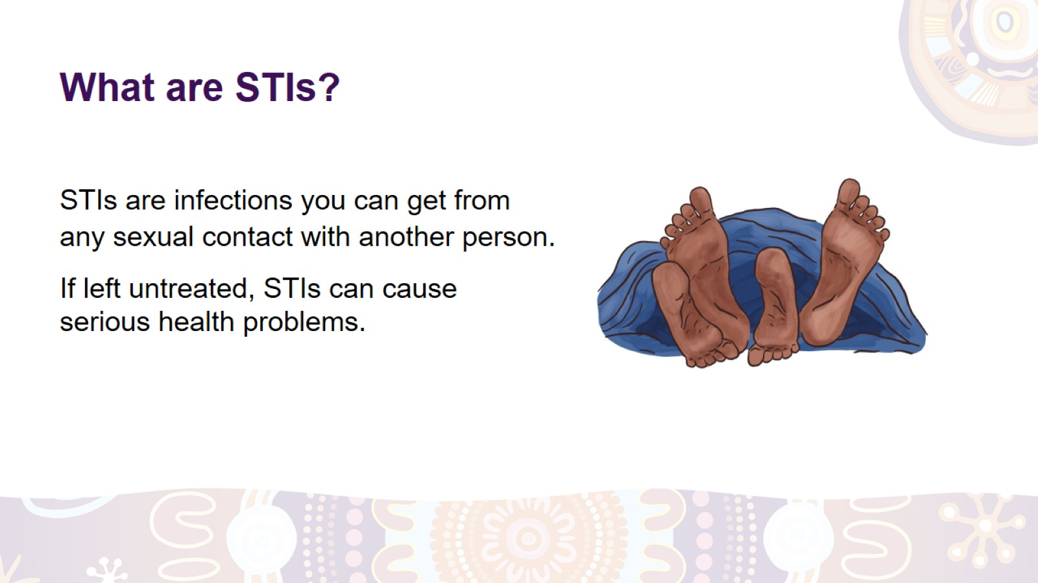
What are STIs?
Notes:
What are STIs?
STIs means ‘sexually transmitted infections’. They are infections that you can get if you:
have vaginal, oral or anal sex with someone
share needles that have someone’s blood on them (e.g. when using drugs or getting tattoos or piercings).
STIs are common all around the world. There are many different STIs, such as:
genital herpes
chlamydia
gonorrhoea
syphilis
hepatitis B and C
HIV.
If STIs are not treated, they can cause:
irritation and pain
problems with pregnancy or getting pregnant
serious health problems.

Slide 33
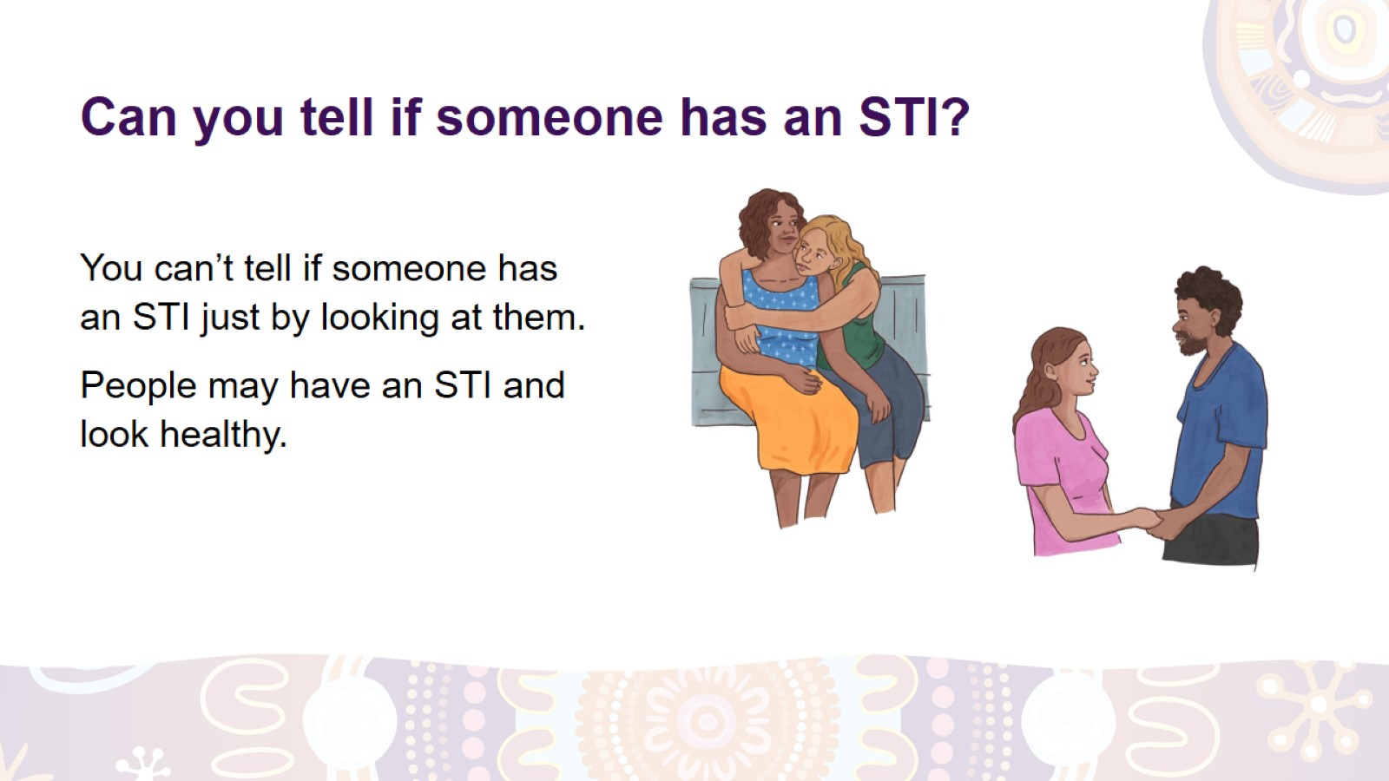
Can you tell if someone has an STI?
Notes:
Can you tell if someone has an STI?
Sometimes, STIs don’t cause visible symptoms, so you can’t tell just by looking at a person if they have an STI.
Even if a person looks strong and healthy, they can still have an STI and pass it on to another person.
It’s also possible to have an STI and not even know about it.
Some possible symptoms of STIs are:
sores, blisters, or broken skin on vulva, penis, anus or mouth
unusual liquid coming out of vagina, penis or anus
vulva or vagina looks red, hurts, is itchy or smells bad
lumps and bumps on penis, vulva, vagina or anus
pain or bleeding during sex
pain when weeing.

Slide 34
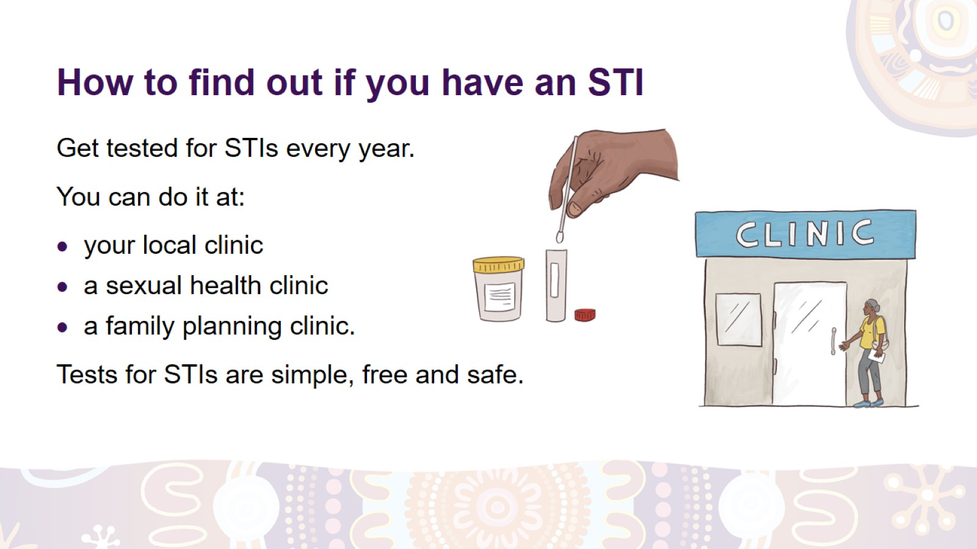
How to find out if you have an STI
Notes:
How to find out if you have an STI.
The only way to find out if you have an STI is to get tested.
Tests for STIs are simple, free and safe. You might need to give a wee sample or have a vaginal examination. Sometimes, you may need to have a throat swab, anal swab or blood test.
If the test shows you have an infection, you can start treatment straight away. This will help you get better sooner and stop you from giving the infection to someone else.
When do you need to have an STI test?
If you’re having sex, have an STI test every year. You’ll also need a test if:
you or your recent sexual partners have symptoms
you are starting a new sexual relationship
you had sex without a condom (e.g. a condom broke or fell off during sex)
you or your partner have sex with other people
you share needles with other people.
Where do you go for an STI test?*
You can have an STI test at:
your local clinic
a sexual health clinic
a family planning clinic.
What if you feel shame?
If you feel shame about having an STI test, remember that health carers:
won’t judge you
do the tests every day and it’s their job to look after you
won’t share your information with anyone.
If you are worried about your privacy, you can go to a different clinic (if possible).
*Note to the facilitator: Indicate where sexual health checks are available locally.

Slide 35
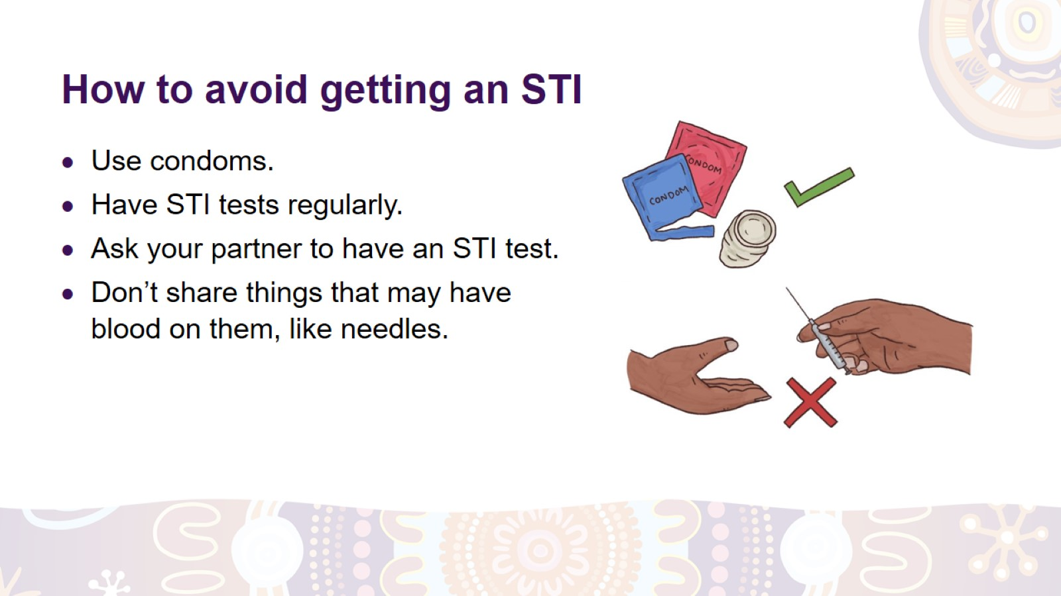
How to avoid getting an STI
Notes:
How to avoid getting an STI
Use condoms every time you have sex, even if you have your period (menstruation).
Get tested for STIs regularly.
Before you have sex with someone new, have an STI test and ask them to have one too.
Don’t share needles, tattoo equipment, razors, or other things that may have someone’s blood on them.

Slide 36
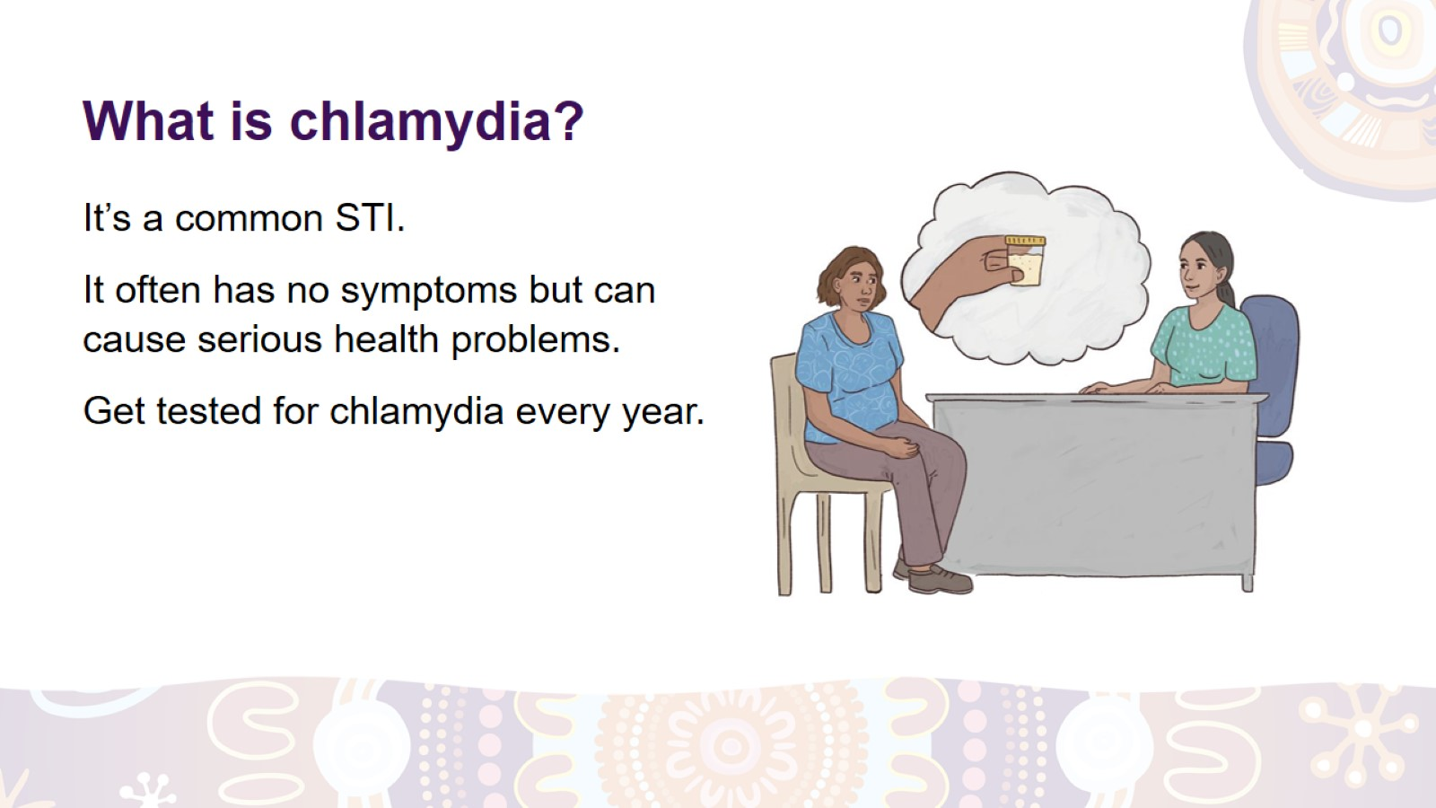
What is chlamydia?
Notes:
What is chlamydia?*
It’s a very common STI. Most women who have chlamydia have no symptoms, so they don’t know they have it.
Possible symptoms are:
a change in vaginal discharge
pain during sex
bleeding between periods or after sex
burning feeling when weeing
pain, discharge or bleeding from anus.
Symptoms that men might have are:
discharge from penis
pain or swelling of testicles.
Chlamydia can cause serious health problems if left untreated, such as:
chronic pelvic pain
problems with pregnancy
miscarriage
premature birth
infertility
passing chlamydia on to a newborn baby.
Chlamydia is easy to treat with antibiotics. Get your wee tested for chlamydia every year, especially if you’re 30 or younger.
*Note to the facilitator: This slide might not be relevant to all audiences.

Slide 37
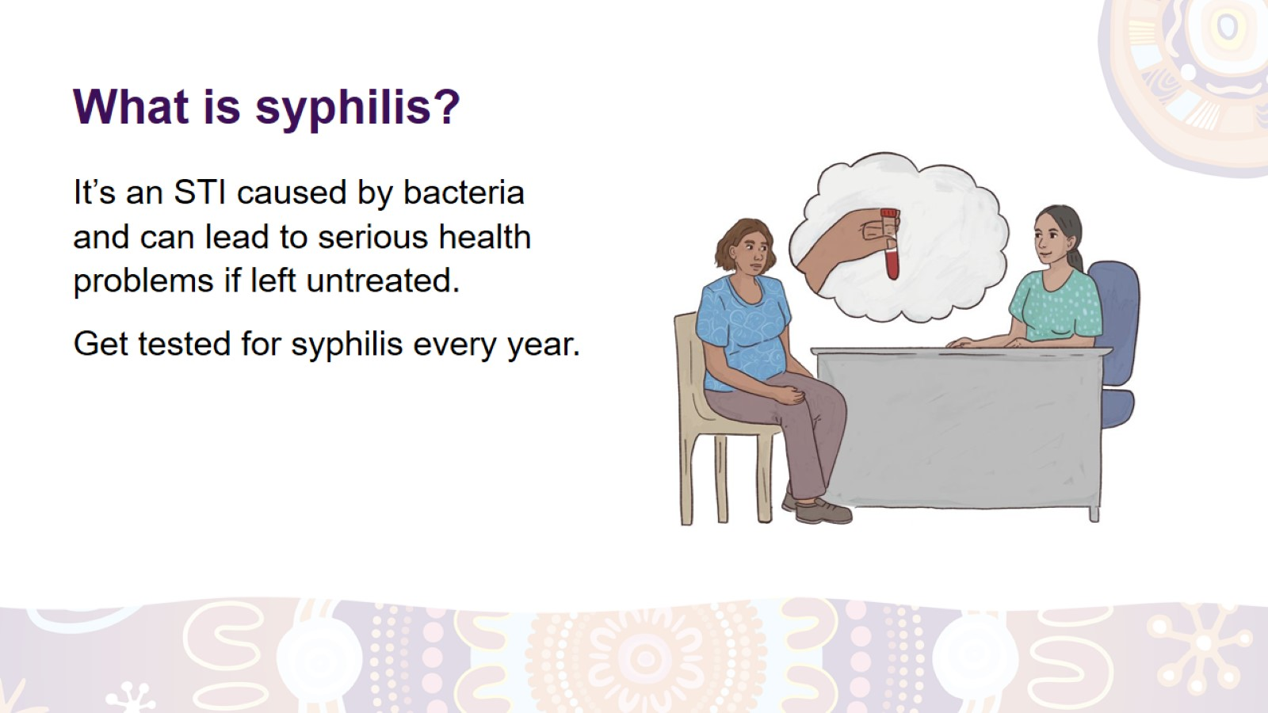
What is syphilis?
Notes:
What is syphilis?*
It’s an STI that’s increasing in Australia. Syphilis is caused by bacteria and can lead to serious health problems if left untreated. It’s easy to cure if found early.
The symptoms of syphilis depend on the stage of disease. In the early stages, there might be painless sores on the penis, vagina, anus, mouth or throat. Later, the symptoms may include:
a red rash on the palms, soles, chest or back
sore throat, headaches, pain in the bones, muscles and joints
ulcers in the mouth, nose or on genitals
hair loss
weight loss.
Untreated syphilis can damage different body parts and cause serious health problems. Syphilis during pregnancy can cause miscarriage, premature birth or stillbirth, and it can be passed on to the baby.
Get your blood tested for syphilis every year. It is especially important if you’re pregnant.
Syphilis can be treated with penicillin.
*Note to the facilitator: This slide might not be relevant to all audiences.

Slide 38
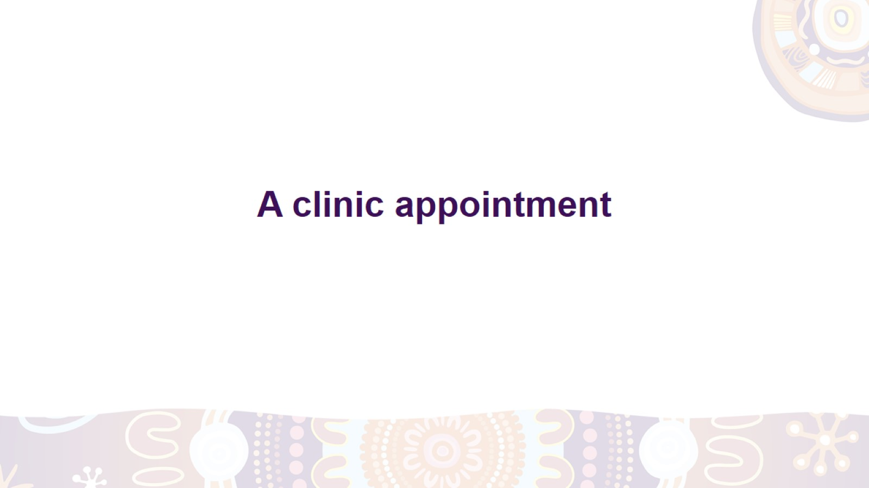
A clinic appointment

Slide 39
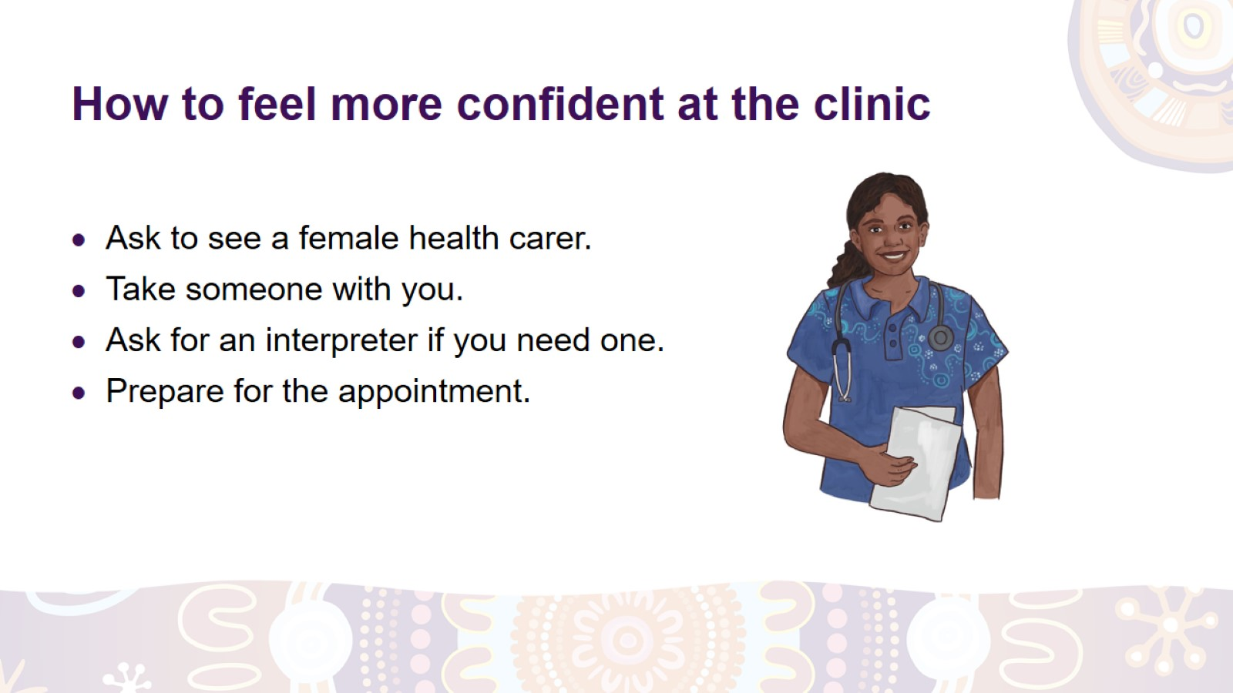
How to feel more confident at the clinic
Notes:
What if you don’t feel confident going to the clinic?
There are things you can do to make yourself feel more confident at your clinic appointment:
Ask to see a female health carer.
Take a family member or a friend with you.
Ask for an interpreter if you prefer to talk in your language.
Prepare for your appointment before you go.

Slide 40
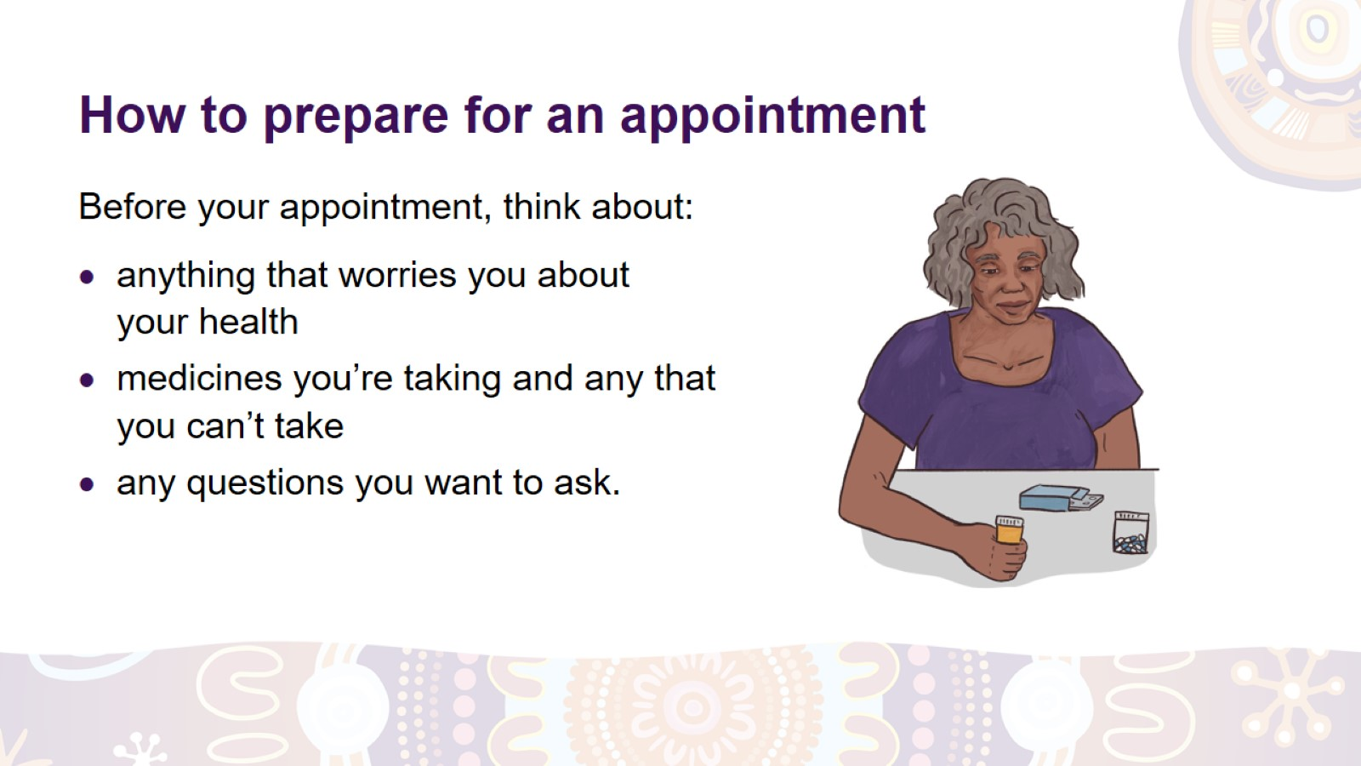
How to prepare for an appointment
Notes:
How to prepare for your appointment.
At the appointment, the health carer will ask you about:
anything that worries you about your health
all the medicines, vitamins and herbal remedies you’re taking
any medicines that you can’t take
any serious illnesses that you or other members of your close family have had
any questions you want to ask them
anything else you want to talk about.
It’s a good idea to think about these things before your appointment.

Slide 41
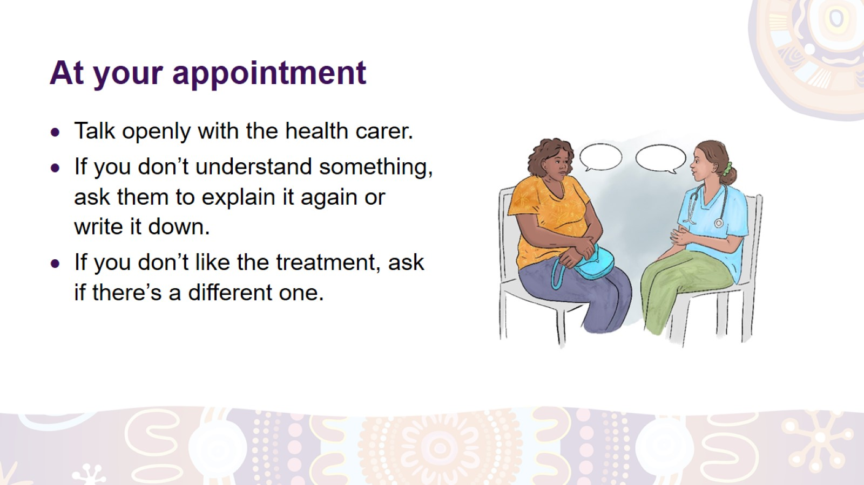
At your appointment
Notes:
At your appointment:
Talk to the health carer about anything that worries you and answer their questions truthfully. They will not judge or criticise you, or share your information without your permission.
If you don’t understand something, ask the health carer to explain it again or write it down for you.
If you’re not comfortable with the treatment the health carer gives you, ask if there are other treatments you could try.

Slide 42


